Slide 1
Positive Behavior Support in High School Settings
Hank Bohanon
hbohano@luc.edu
http://www.hankbohanon.net

Slide 2
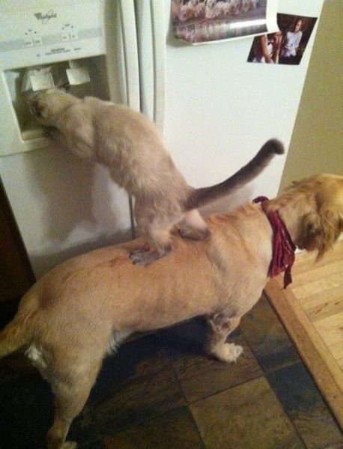
We All Need Support

Slide 3
Thank you
Andrew M. Greeley Center for Catholic Education and Staff
Verna Allworth, Regina Dominican

Slide 4
Powerpoints: Enduring Understandings
Prepare our staff for implementation
Help our teams work together
Be efficient and effective with our time
We need to use data to plan for interventions
Teams should able to identify the components of developing an effective school climate
Notes:
1 min

Slide 5
Essential Questions
How do you prepare systems to enhance the support in your environment
How do you organize personnel in ways to support to enhance the support in your environment
What are effective ways to encourage teams to work together efficiently and effectively?
Notes:
1 minute

Slide 6
Essential Questions
What are effective methods to consolidate actions and activities
How can teams convert data to a plan of action
What are the components of effective school environments? How do these components connect with an effective instructional model?
Notes:
1 minute

Slide 7
Outline
Enduring Understanding:
Prepare your staff
Develop teams
Prioritize efforts
Organize multiple data sources
Select effective instructional models

Slide 8
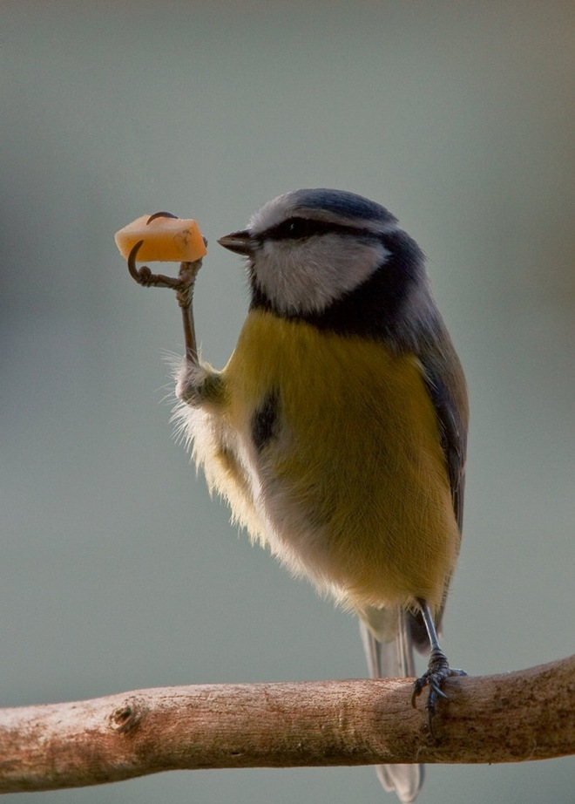
Finding what is important

Slide 9
Question
What are the underpinnings of your current approach to behavior and discipline?

Slide 10

Faith
Principles: Fathers, do not provoke your children to anger…(Ephesians 6:4; ESV)
Teaching: Train up a child in the way he should go; even when he is old he will not depart from it (Pr 22:6; ESV)
Graphic: http://holybible.ucoz.org/bible.jpg
Scripture: http://www.biblegateway.com

Slide 11
Faith
Encouragement: Therefore encourage one another and build one another up, just as you are doing (1 Thessalonians 5:11; ESV)
Redirection: Answer not a fool according to his folly, lest you be like him yourself. Answer a fool according to his folly, lest he be wise in his own eyes (Pr 26:4-5; ESV)
Graphic: http://holybible.ucoz.org/bible.jpg
Scripture: http://www.biblegateway.com

Slide 12
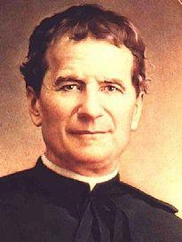
Foundations and Salesians
Stop cursing please…
“Boys should be guided and corrected, but not by aloof supervisors” (p. 32)
Abolish “hateful punishments”
Never correct in the presence of others…
“ Encourage them [youth] at all times, never humiliate them; praise them as often as you can and do not belittle them; only show your displeasure when you wish to punish them..” (p. 62)
St. John Bosco
1815 - 1888
Graphic: http://en.wikipedia.org/wiki/John_Bosco
Text: Morrison, 1997

Slide 13
MTSS: 4 Domains of School Climate
Safety
Behavioral Expectations
Teaching and Learning
Support for Learning
Social Skills Development
Interpersonal Relationships
Respect for Diversity
Social Supports for Students
Health & Wellness Expectations
Sense of Physical Security
Sense of Social-Emotional Security
Physical Environment
School Connectedness & Community Engagement
Physical Surrounding
Student Engagement & Self-Direction
Leadership
Professional Relationships
(Vermont Agency of Education, Accessed July 27, 2016)
Notes:
Make connections in handbook with VT
How familiar are you?

Slide 14
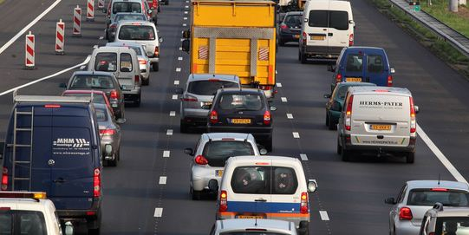
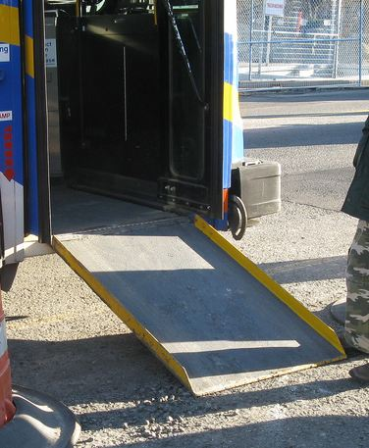
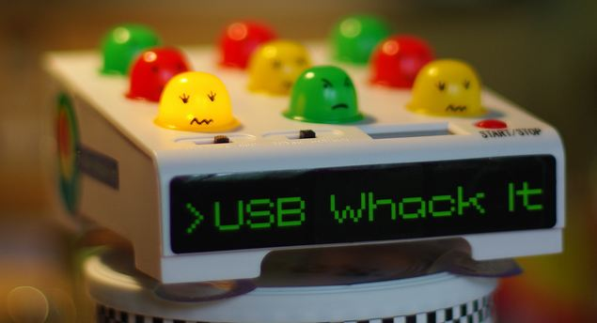

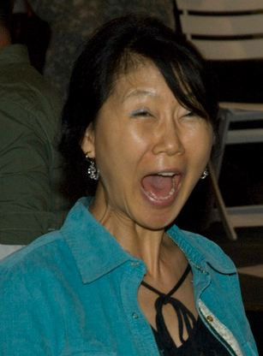
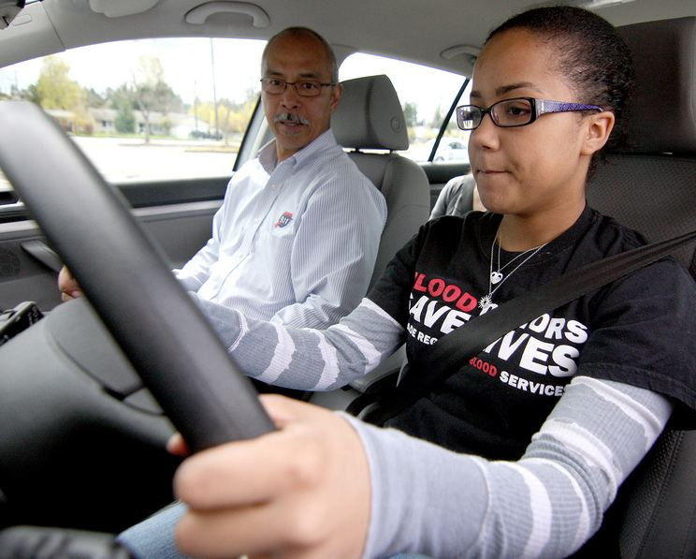
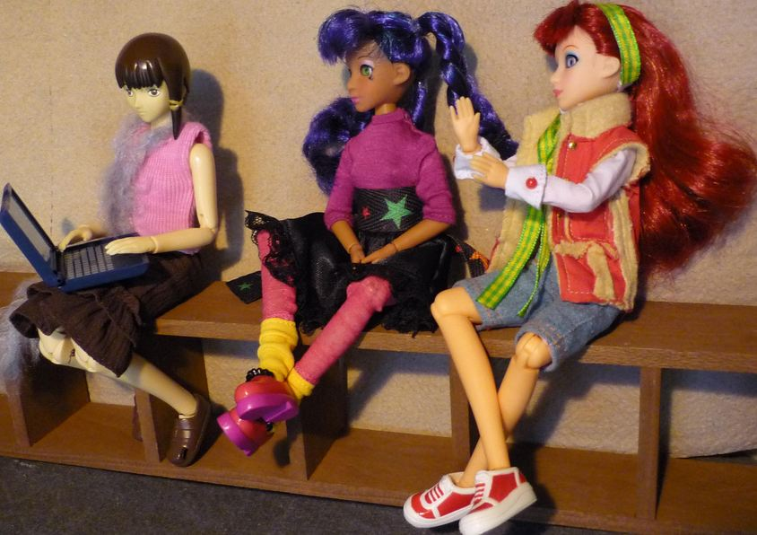
Key Principles
Incidental Benefit
Schoolwide
Schoolwide
Punishment
Reinforcement
Shaping
Reinforcement
Notes:
Whack a mole – don’t start individual
Highway - schoolwide
Ramp – incidental benefit
Yelling teacher – reinforcement
Student in the office - reinforcement
Stop sign – punishment
This works for teachers..teaching vs learning…
Learn to drive - shaping

Slide 15
Supporting Social Competence &
Academic Achievement
4 PBS Elements
OUTCOMES
Supporting
Decision
Making
Supporting
Staff Behavior
SYSTEMS
DATA
PRACTICES
Supporting
Student Behavior

Slide 16
Designing School-Wide Systems for Student Success
A Response to Intervention Model/MTSS
Questions
Answers
Tertiary Interventions/Tier 3:
Dig deeper – why?
Tertiary Intervention/Tier 3:
Ask questions,
Teach what works better *
Antibiotics
1-5%
1-5%
Secondary Interventions/Tier 2:
Can’t do/won’t do
5-10%
5-10%
Secondary Interventions/Tier 2:
Coke test analogy..
Aspirin, Soup*
Universal Intervention
Tier 1:
Were we clear? Does it work?
How do we respond?
80-90%
80-90%
Universal Intervention/Tier 1:
Be clear on expectations,
make sure they work, be humane
Rest, Vitamins*
*Scott, T. examples
Notes:
16
You may have a large copy of this in your handouts
tatoo..it is washable (just kidding)..
Example –
SW – Respect – Response Be kind – show poster ahead
Secondary – student could not write very well – even when given coke..skill deficit – then accommodate with writing prompt and remediate – teach skills
Tertiary – attention – personal greetings at the door and pre-correction was enough

Slide 17
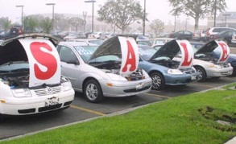
Buying a car
List out the steps you took last time you bought a car…
bestig.blogspot.com

Slide 18
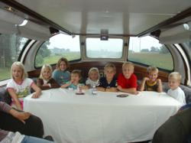



Steps
Consider Needs
Research
Not First!
Sample
Sign Up
Car http://www.prweb.com/releases/2012/8/prweb9815542.htm
Research http://www.uic.edu/uic/research/
Test drive http://www.familyhyundai.com/family-hyundai-customer-reviews/
Contract http://www.icts.uiowa.edu/content/contract-negotiation
Notes:
Place the steps for purchasing a car in the right order – at each step – what are people afraid of? Why did you not see the contact first? People are not the change – but the loss – you have to build the why before what and how. See Being Boss

Slide 19
Exploration Examples From 4 High Schools
  Communication - timeliness
  School climate
  Efficient meetings
  Integration of PD
  Work with PLCs
  Define academic and behavior expectations
  Use data for decisions
  Braid initiatives
  Align administrative supports with strategies
  Students within special support needs
  Need for increased school spirit
  Distribute roles
  Parental involvement
See example of questions: http://www.hankbohanon.net (Resources tab)
Notes:
Focus groups – across students, teachers, administrations
See Handbook – Niles West

Slide 20
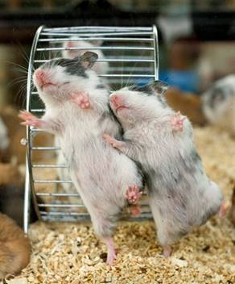
Effective teams in school settings
Duck video
Notes:
45 minutes for section
Duck Video

Slide 21
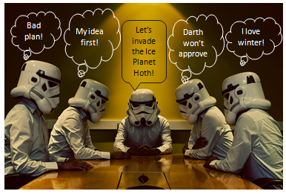

Slide 22
Effective Meetings
Scheduling and communication
Creation and use of an agenda
Meeting begins and ends on-time
Keeping the meeting on track
Action plan/delegating tasks
Meeting Participation
Dissemination of meeting notes
See examples: Herding Cats, Bad Meetings, Action Plans, Sample VT agenda
Rate yourself –
handbook
Notes:
Herding cats video
See Handbook

Slide 23
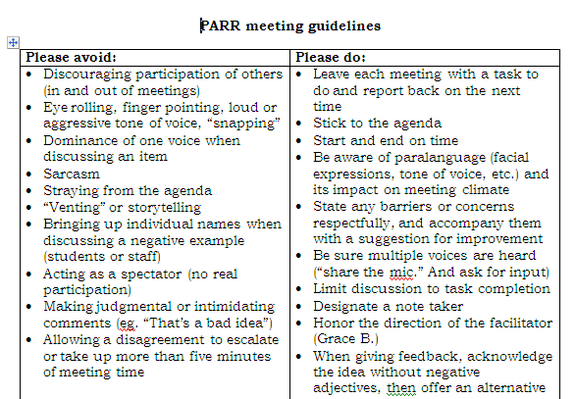
Notes:
23
Key things
Helped meetings become more efficient because
Helped keep everyone on task and respectful – depersonalized challenges
Everyone had to leave the meeting with a task – kept the spectators and ventors away
23

Slide 24
Reflection
Rate the health of their teams on each item
  (use Effective Meetings slide)
  5 positive things are going great
  1 not at all and we need to work on this

Slide 25
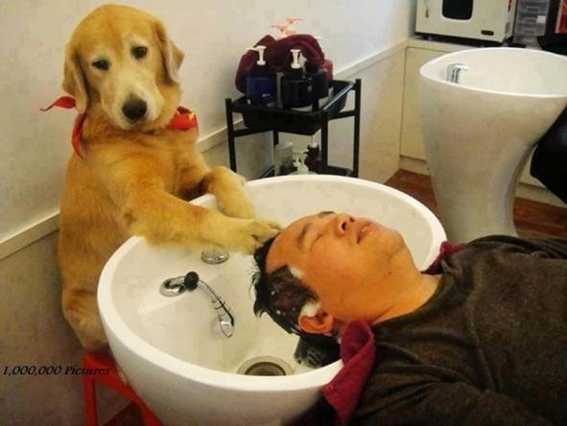
Work smarter and effective teams in school settings

Slide 26
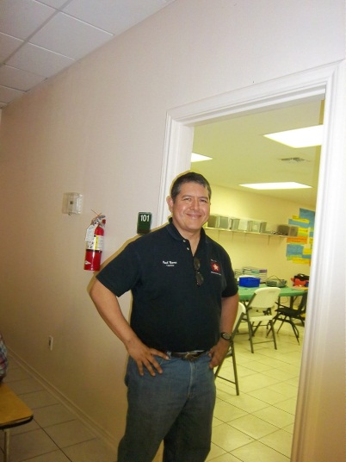
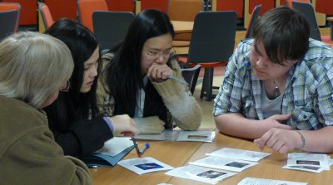
Alterable Variables
8th/9th attendance, 8th/9th GPA
predict graduation (Burke, 2015)
Reading assessment scores
predict college readiness
(Koon & Petscher, 2016)
Engagement
and failure rates
(Allen et al., 2013)
http://www.bristol.ac.uk/physics/

Slide 27
Designing School-Wide Systems for Student Success
A Response to Intervention Model
Academic Systems
Behavioral Systems
Tertiary Interventions/Tier 3:
*Young Leaders
*National Honor Society; Eyes on the World
Secondary/Tertiary-SLC teams
Tertiary Intervention/Tier 3:
- Assessment based…Wraparound,
1-5%
1-5%
Secondary Interventions/Tier 2:
Secondary/Tertiary-SLC teams
AVID; Mentor Moms
Credit Recovery
After School Matters
ELL
Summer School/(Freshman Connection)
Gear-Up
5-10%
5-10%
Secondary Interventions/Tier 2:
- AVID, After School Matters
- ELL;Gear-up;
Summer School(freshman Connection)
- In HouseTutoring- Mentor Moms
80-90%
80-90%
Universal Intervention
Tier 1:
In-House Tutoring; Summer
School (freshman Connection),ASPIRA;_
Service Learning;
Attendance andTardies_
SLC; PARR; Freshman Seminar
Universal Intervention/Tier 1:
-PARR
Attendance and Tardy
- Small Learning Communities (SLC)
Notes:
27

Slide 28
ACTIVITY
Designing School-Wide Systems for Student Success
A Response to Intervention Model
Academic Systems
Behavioral Systems
Tertiary Interventions/Tier 3:
_______________________
_______________________
_______________________
Tertiary Intervention/Tier 3:
______________________
______________________
______________________
1-5%
1-5%
Secondary Interventions/Tier 2:
________________________
________________________
________________________
5-10%
5-10%
Secondary Interventions/Tier 2:
________________________
________________________
________________________
80-90%
80-90%
Universal Intervention
Tier 1:
__________________
__________________
__________________
Universal Intervention/Tier 1:
______________________
______________________
______________________

Slide 29
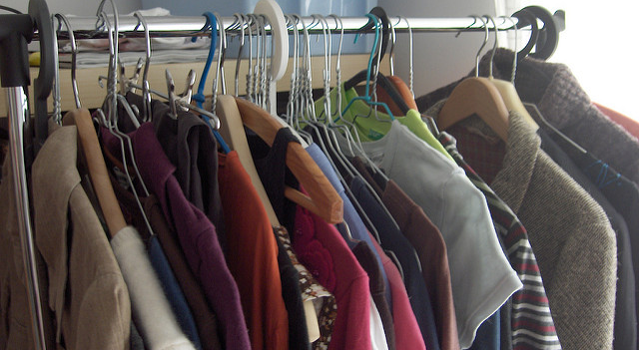
Describe Your Closet
https://flic.kr/p/aDLzzs
Rate it on a scale from 1-10 before you buy
Would you buy it again?
Have you used it one year? (McKeon, 2014)

Slide 30
Preparing Data for Decisions
Video – Sales are up

Slide 31
Question
If these were your data, how would you respond? (see workbook)

Slide 32
SET Data School 2 (year 1)

Slide 36
Priorities
Teaching, Acknowledging, Redirection training for teachers of first year high school students
Orientation for first year high school students
Circuit training for staff during opening of school
School store opens and training provided for staff
Notes:
Circuit training script part of your handout and on my website

Slide 37
Effective School Environments
Career Builder

Slide 38
Reflection
See Handout “Supportive Environments Quiz”
Take the quiz

Slide 39
Classroom
Walk around while the music plays. When music stops, tell someone about your favorite class and teacher

Slide 40
Components of Effective Classroom Settings
Maximized Structure
Post, teach, model reinforce expectations
Active engagement
Varity of ways to acknowledge
  Including success!
Continuum of ways to respond
(Simonsen, Fairbanks, Briesch, Myers, & Sugai, 2008)
See MO PBIS Great 8 training
http://pbismissouri.org/educators/effective-class-practice/

Slide 41
What’s in your syllabi?

Slide 42

Mark Shinn (http://markshinn.org)

Slide 43
The Syllabus
Goals
Contact information
Success Traits
Rules/expectations
Activities
Grades/Status
Procedures
Entering
Tardy/Absence
Materials
Assignments (returns)
Due dates
Late, missing work
Communication
Ending class
Consequences
Model projects
Checklists
Sprick (2006)/Shinn http://markshinn.org
See examples – http://www.hankbohanon.net (Resources page under “Teaching”
Sample first days of school for high school teacher)
Notes:
Show handout, look at student expectations

Slide 44
Planning
See example
What connections can you make for your staff?

Slide 45
Teaching Expectations
High School Football?

Slide 46
Teaching Expectations
Examples
Staff orientation meetings
Handbooks
Lesson plans
Syllabus
Posters
Booster sessions
Pre-correct/remind
Key Elements
Rationale
Negative examples
Positive examples
Practice/Feedback
Evaluate
See lesson- Blank!! Possible Example Teaching Story 1 or Pre-Teaching
Student example from football
Fruita Monument Example
Notes:
46
Say silk 3 times, then ask what do cows drink
Practice expectations with group

Slide 47
Aligned with Speaking and Listing Literacy National US Standards
CPS Matrix Aligned with Common Core Standards – See http://www.hankbohanon.net
Notes:
See standards lists or reference in handout

Slide 48
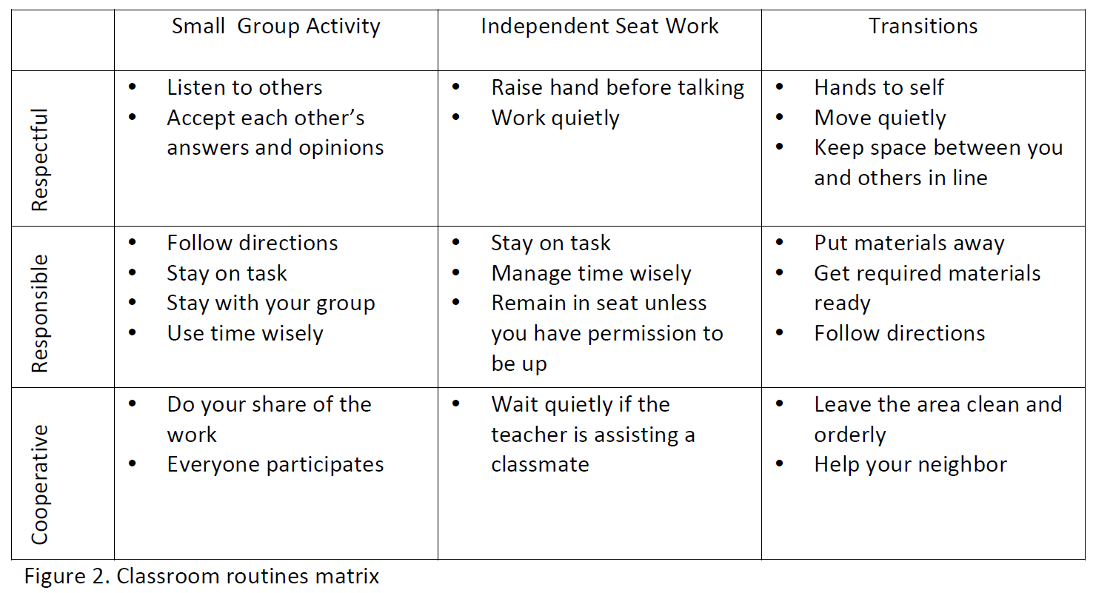
Sample Classroom Matrix
Newcomer (2009)
Which of these behaviors would you like to address?

Slide 49
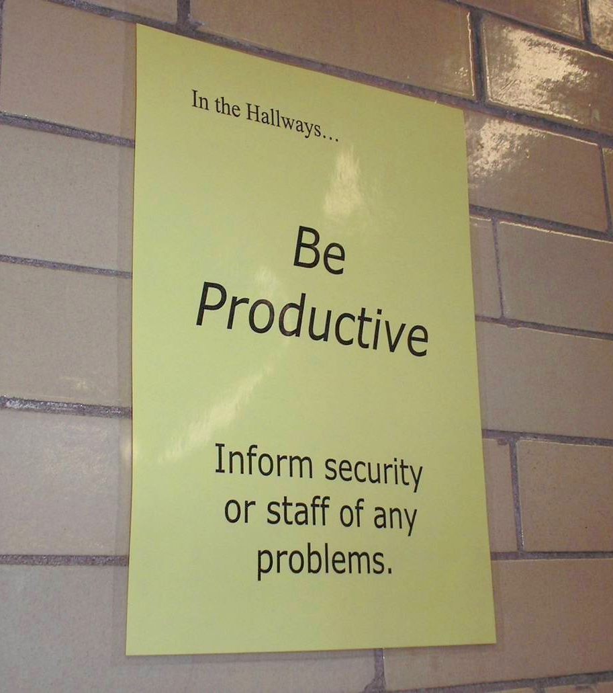
Notes:
49
Mr. Irvin
Defining expectations by location

Slide 50
Acknowledgement
Cheerleading Video?
Notes:
Cheerleading video

Slide 51
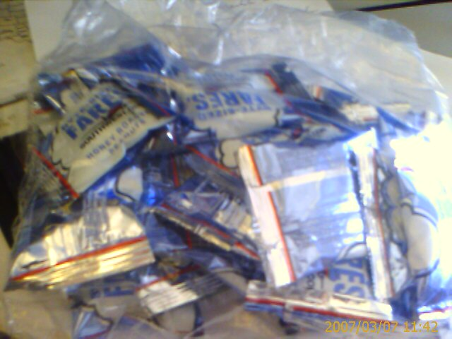
Earned this bag on SW…

Slide 52
Acknowledgement…
As part of schoolwide approach, can lead to improved performance
  Improved attendance (de Baca, Rinaldi, Billig, & Kinnison, 1991).
  Reductions in discipline problems (Bohanon et al., 2012)
Functional outcomes are important
  Relevant curriculum
  Social connection (Dunlap, Foster-Johnson, Clarke, Kern, & Childs, 1995).

Slide 53
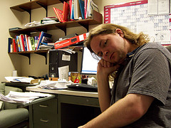
Other Advantages of Praise
Decreases in emotional
exhaustion
Higher efficacy
Reinke, W. M., Herman, K. C., & Stormont, M. (2013).
Photo by Josh Thompson

Slide 54
High Frequency

Slide 55
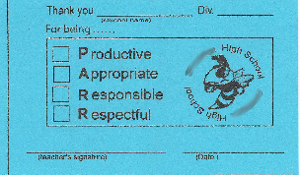
Buzzy Buck
Notes:
55
55
Brigit

Slide 56
Intermediate

Slide 57
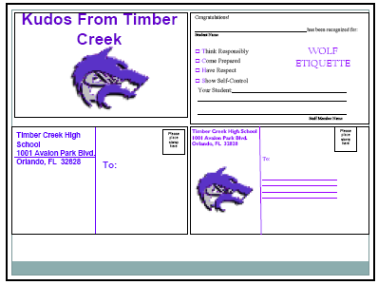
Timber Creek High School, FL, JOHN WRIGHT, PRINCIPAL

Slide 58
Large Scale

Slide 59
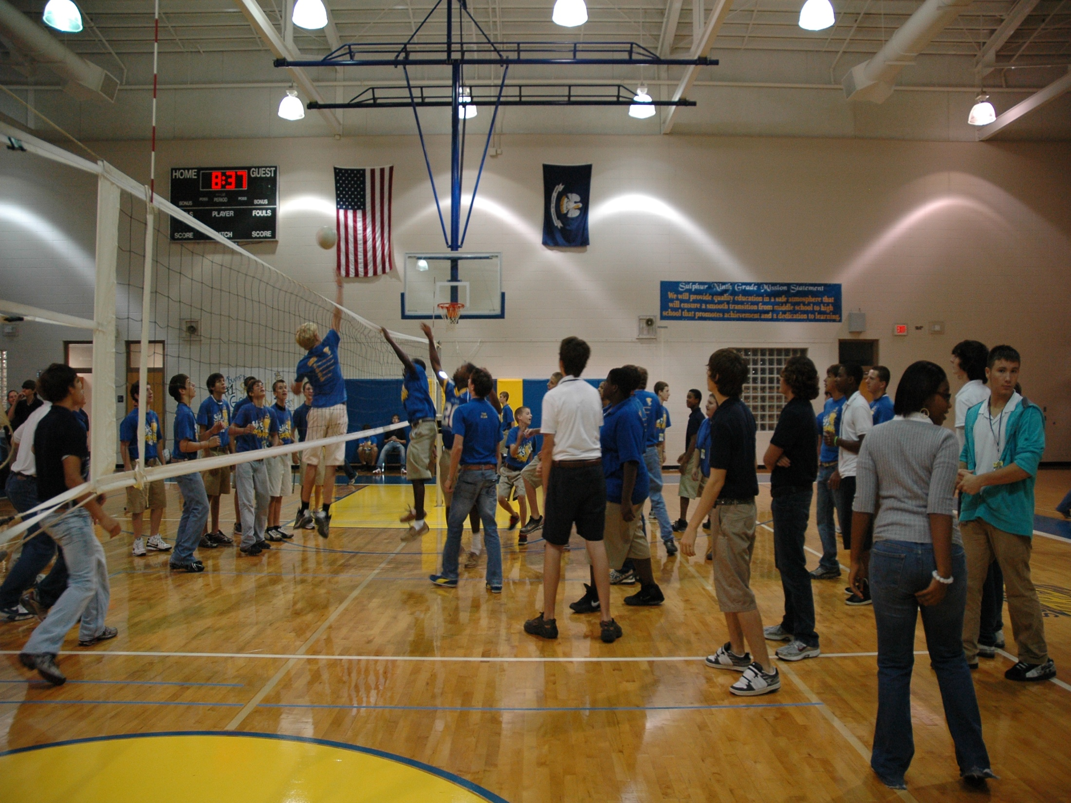
1st Six Weeks Party –
CHUCK HANSEN, Principal
AMY PALMER, Teacher
SULPHUR HIGH SCHOOL, LA

Slide 60
Engagement and Opportunities to Respond
Non-example – Ferris
Jeff Bliss Video Example
Notes:
Jeff Bliss Video Example

Slide 61

Quiz
What percentage of the American workers
consider themselves engaged at their jobs?
31.7 %
(Gallop, 2015) http://buff.ly/1Gna5NO
Photo from Flicker Creative Commons https://www.flickr.com/photos/pennwic/8142281815/in/photolist-dpvjHe-dpvjNz-dpvths-pQoPx7-aMi2SZ-8vEXtU-8vBWcM-5C6oVt-pEQiQm-97vCko-rKn1F-h7BuWg-h7ybkV-h7wXts-h7y2AF-h7y1NP-8vBVJ2-8vBW8g-8vBVL8-8vBVZr-8vEXGf-8vBWgB-8vBWdB-8vBVTe-8vBW8X-8vBW4Z-h7wVwR-h7x7bs-aMi6nD-5pYDTp-aMiarZ-aMi2xk-aMhLrn-aMhSLR-aMhUsa-aMhK7i-aMhJQz-aMhUbT-aMhJxr-aMhYfc-aMhURP-aMhTt2-aMhV48-aMhKk8-aMhKyV-aMhKRR-aMhLHT-aMhTFt-aMhTXz-aMhUEp

Slide 62
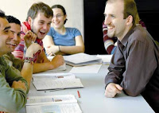
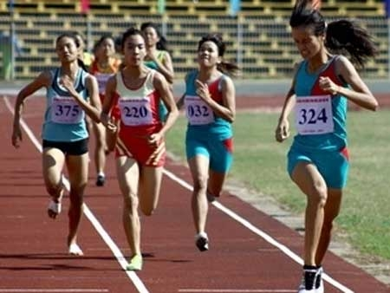

Instructional/Emotional Support
Failure rates
from 17% to 11%
  Choice of responding
  Laughing with students
  Out of desk greeting
Allen, Gregory, Mikami, Lun, Hamre, & Pinata (2013)
  Ask about events
  Ask “why”?
http://mzteachuh.blogspot.com/2012/05/that-kid-drives-me-nuts-tweets-of-day.html
http://ignitebrownsville.blogspot.com/p/picture-gallery.html
http://english.vietnamnet.vn/fms/sports/57762/hanoi-to-host-5th-asean-student-sports-games.html
http://www.phy.bris.ac.uk/news_archive1.html
http://www.hillel.org/jewish/ask-big-questions
Notes:
See Blog in handout and onwebsite

Slide 63
Redirection and Active Supervision
JcPenny’s does this very well
How some mom’s handle the pressure video – Whitney Young

Slide 64
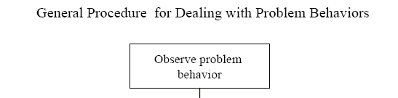
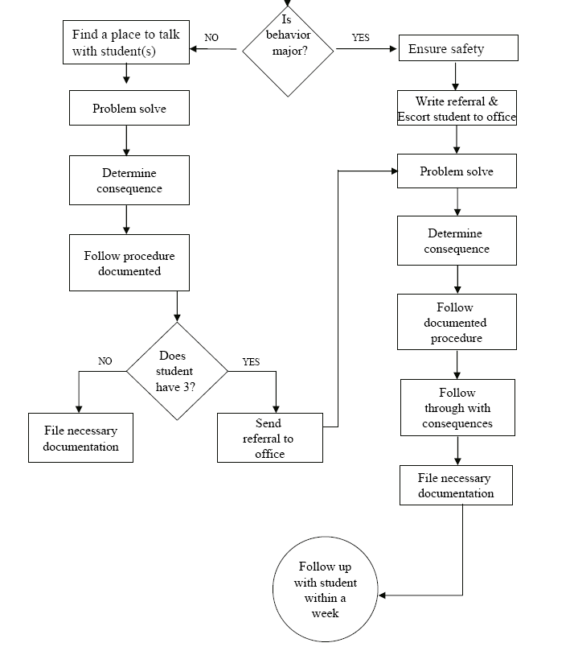
Is the behavior office- managed?

Slide 65
McClatchy Students Video, Dean?
Notes:
65
Alissa present (1 minute max)
65

Slide 66
Be at post
Escort students
Brief interactions
(Johnson-Gros et al., 2008)
See article about hallways @
http://hankbohanon.net
on publications page
Notes:
66
66
Mr. Irvin – tardy policy
being at post, escorting, and interacting with students

Slide 67
Support Staff: Preventing and Responding
Teach skills for prevention
  Good classroom instruction
  Non-classroom settings
Teach skills for redirection
  Classroom
  Non-classroom settings
See Handout “Professional Development on Redirection”

Slide 68
Videos
Michael Kennedy
http://vimeo.com/14818677
  See What does PBIS Look Like? – Opening, Redirection examples 6.12 mins
Other tools
Notes:
Tell story from NC when your said slurs about my family - how I handled – how I did not react…

Slide 69

Strategies
Mendler, A. N. & Mendler B. D. (2011) Power struggles: Successful techniques for teachers. Bloomington, IN: Solution Tree.

Slide 70

Classroom Management
Knoster, T. (2013). The Teacher’s pocket guide effective classroom management (2nd Ed.), Baltimore, MD: Paul H Brookes

Slide 71

Addressing Tardies
Start on Time!
Randy Sprick
http://www.safeandcivilschools.com/products/program_previews.php

Slide 72
Student Engagement
Webinar on using data to improve student engagement http://fb.me/4vHawmKtz
Webinar for increasing student engagement through real world projects http://bit.ly/1K5ZplN
Assessing school climate webinar http://bit.ly/1IRJgBH
Online survey: student hope, engagement, belonging, and classroom management.... http://fb.me/2bX9tbQh4
Teaching algebra in middle and high school http://buff.ly/1CqNf2c

Slide 73
Where are you?
Complete
  Classroom management self-assessment
  http://www.pbis.org/pbis_resource_detail_page.aspx?Type=4&PBIS_ResourceID=164
Free training on active supervision (limited time only)
  https://www.irised.com/freecourse&?utm_source=IRIS+Educational+Media+Mailing+List&utm_campaign=9d73acd430-FREEprog_SysSupEvElem_8_5_2014&utm_medium=email&utm_term=0_cb7ab95a8b-9d73acd430-291122974#.U-U6UPldWSq

Slide 74
Resources
http://www.hankbohanon.net/Resources_1.html

Slide 75
Videos
Michael Kennedy http://vimeo.com/channels/129830
  Fruita Monument
  Consistent
Scott’s Pride https://sites.google.com/a/ddouglas.k12.or.us/scotspride/

Slide 76
Finding more plans
Sample Lesson plans
  http://www.pbismaryland.org/
  http://www.hankbohanon.net
More Video Example
  http://vimeo.com/groups/pbisvideos

Slide 77
Other Supports
Defusing Disruptive Behavior in the Classroom
  Geoff Colvin http://www.lookiris.com/store/K-12_Professional_Development/Defusing_Disruptive_Behavior_in_the_Classroom/
Classroom management training
  http://pbismissouri.org/class.html
The FAST Method
  http://www.lookiris.com/store/K-12_Professional_Development/The_FAST_Method_ONLINE/
Notes:
See website

Slide 78
Other Supports
IRIS Online Modules
  http://iris.peabody.vanderbilt.edu/resources.html
Rti Action Network Article Behavior and Academics
  http://www.rtinetwork.org/Learn/Behavior/ar/Integrating-Behavior-and-Academic-Supports-Within-an-RtI-Framework-General-Overview
National Center on PBIS
  http://www.pbis.org
Association of Positive Behavior Support
  http://www.apbs.org
CASEL – SEL Center
  http://casel.org/
Direct behavior rating
  http://www.directbehaviorratings.com/cms/

