Slide 1
Using Schoolwide PBIS Approaches to Create Engaging Secondary Classroom Settings
Hank Bohanon
hbohano@luc.edu
http://www.hankbohanon.net
https://twitter.com/hbohano
https://www.facebook.com/hank.bohanon
Notes:
Who is here – you 15 minutes for set up - 5
Coaches – internal external
Middle schools/ High Schools
Parents
General education teachers
Special Education teachers
Counselors
School Psychologists
Social workers?
Administrators?
Academic focused schoolwide approach? Behavior? Social/emotional?
How many years?
5 or more
3 or more
1 or more
Fact finders?

Slide 2
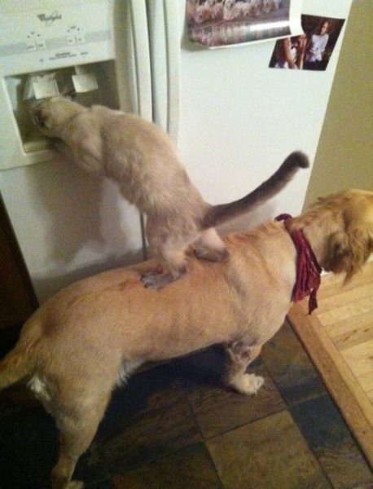
We All Need Support
Notes:
1 minute
Was teacher in DISD - better I got more students my way
KC- middle school PBS-
Chicago and other states around schoolwide behavior
Worked with other approaches academic- behavior – social/emotinal

Slide 3
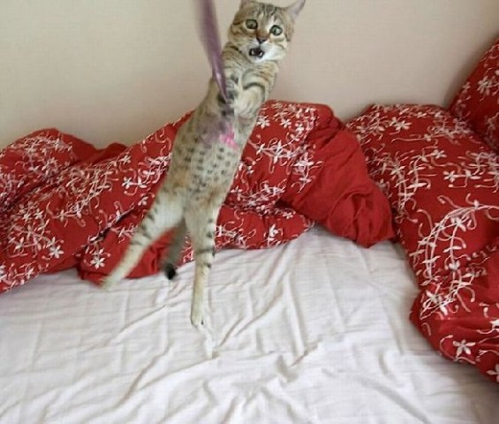
Hang in there!
Notes:
30 sec
From IKEA

Slide 4
Powerpoints: Enduring Understandings
We need each other to accomplish the goal of improving outcomes
We need to use data to plan for interventions
Teams should able to identify the components of developing an effective school climate
Notes:
1 min

Slide 5
Essential Questions
How do you organize systems to enhance the support in your environment (e.g., human, financial, structural)?
What are effective ways to encourage teams to work together efficiently and effectively?
What are the components of effective school environments? How do these components connect with an effective instructional model?
Notes:
1 minute

Slide 6
Thank you!
Arizona Department of Education
South West Junior High School, GESD32
Mesa Public Schools
Westwood High School
Mesa High
Red Mountain High School
Kino Junior High
Taylor Junior High
Fremont Junior High
Notes:
6
6
1 minute

Slide 7
Thank you!
“Systematic Analysis and Model Development for High School Positive Behavior Support” Institute for Education Science, U.S. Department of Education, Submitted with the University of Oregon. Awarded 2007.
(Q215S07001)
“Character Education: Application of Positive Behavior Supports” to U.S. Department of Education, Safe and Drug Free Schools. Awarded 2007. (R324A070157)
Notes:
7
7
30 sec

Slide 8
Key Principles
When did you get in trouble when you knew better?

Slide 9
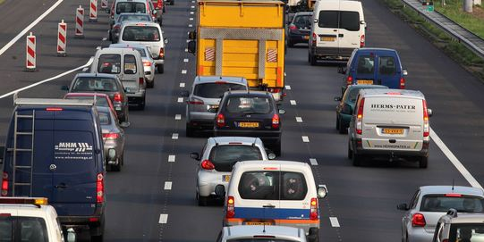
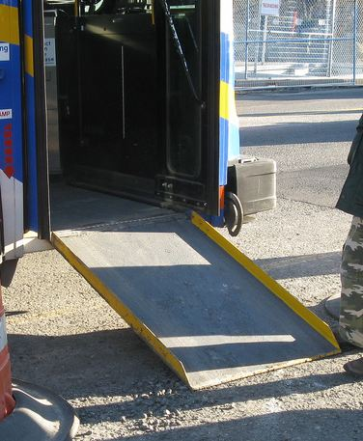
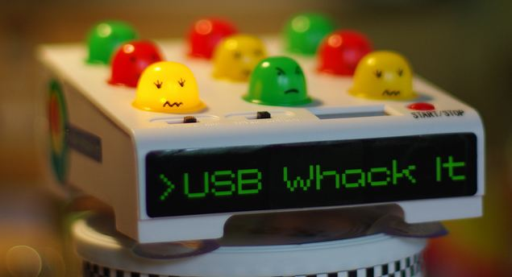

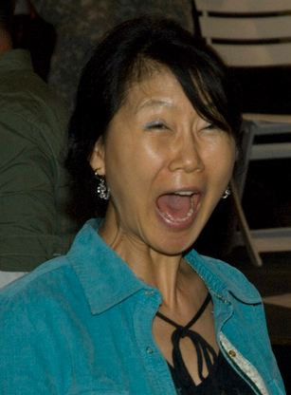
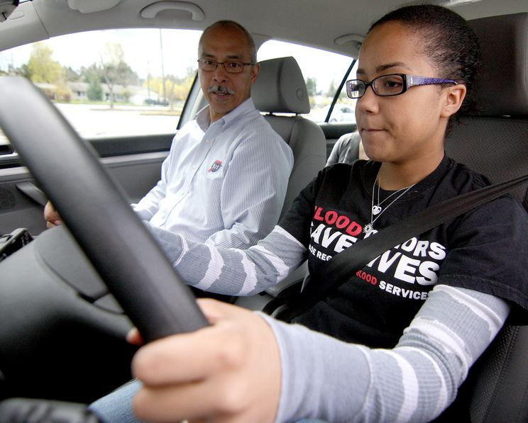
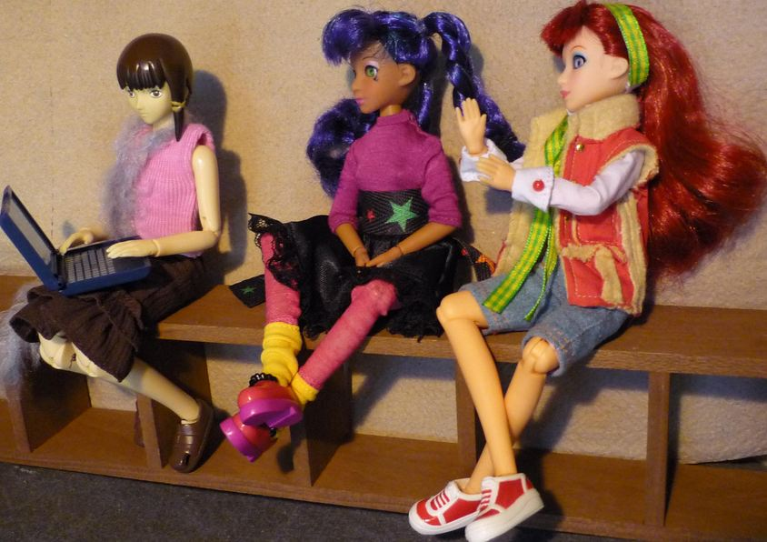
Key Principles
Incidental Benefit
Schoolwide
Schoolwide
Punishment
Reinforcement
Shaping
Reinforcement
Notes:
Whack a mole – don’t start individual
Highway - schoolwide
Ramp – incidental benefit
Yelling teacher – reinforcement
Student in the office - reinforcement
Stop sign – punishment
This works for teachers..teaching vs learning…
Learn to drive - shaping

Slide 10
Supporting Social Competence &
Academic Achievement
4 PBS Elements
OUTCOMES
Supporting
Decision
Making
Supporting
Staff Behavior
SYSTEMS
DATA
PRACTICES
Supporting
Student Behavior

Slide 11
Designing School-Wide Systems for Student Success
A Response to Intervention Model/MTSS
Questions
Answers
Tertiary Interventions/Tier 3:
Dig deeper – why?
Tertiary Intervention/Tier 3:
Ask questions,
Teach what works better *
Antibiotics
1-5%
1-5%
Secondary Interventions/Tier 2:
Can’t do/won’t do
5-10%
5-10%
Secondary Interventions/Tier 2:
Coke test analogy..
Aspirin, Soup*
Universal Intervention
Tier 1:
Were we clear? Does it work?
How do we respond?
80-90%
80-90%
Universal Intervention/Tier 1:
Be clear on expectations,
make sure they work, be humane
Rest, Vitamins*
*Scott, T. examples
Notes:
11
You may have a large copy of this in your handouts
tatoo..it is washable (just kidding)..
Example –
SW – Respect – Response Be kind – show poster ahead
Secondary – student could not write very well – even when given coke..skill deficit – then accommodate with writing prompt and remediate – teach skills
Tertiary – attention – personal greetings at the door and pre-correction was enough

Slide 12
Ask before you tell: Gathering Information
See Handout: Exploring Some Other Schools (academic/behavior support)
  What is working well?
  Next steps?
What connections do you make?
  Any suggestions for addressing “Next Steps”– write on poster – add your school name
Notes:
Teachers were able choose the steps they would take before referral
Some schools teaching – banners – posters – matrix
Check and connect in some schools.

Slide 13
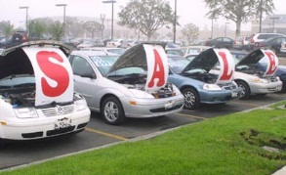
Buying a car
List out the steps you took last time you bought a car…
bestig.blogspot.com

Slide 14
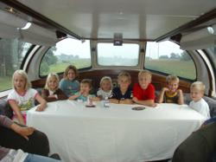



Steps
Consider Needs
Research
Not First!
Sample
Sign Up
Car http://www.prweb.com/releases/2012/8/prweb9815542.htm
Research http://www.uic.edu/uic/research/
Test drive http://www.familyhyundai.com/family-hyundai-customer-reviews/
Contract http://www.icts.uiowa.edu/content/contract-negotiation
Notes:
Place the steps for purchasing a car in the right order – at each step – what are people afraid of? Why did you not see the contact first? People are not the change – but the loss – you have to build the why before what and how. See Being Boss

Slide 15
What do we know about implementation
Successful systems change (Kotter, 1995)
  Created sense of urgency
  Core group of leaders
  Long-term vision for change
Implementation occurs in stages (Fixsen, et al., 2005)
  Exploration
  Installation
  Initial Implementation

Slide 16
Exploration Examples From 4 High Schools
  Communication - timeliness
  School climate
  Efficient meetings
  Integration of PD
  Work with PLCs
  Define academic and behavior expectations
  Use data for decisions
  Braid initiatives
  Align administrative supports with strategies
  Students within special support needs
  Need for increased school spirit
  Distribute roles
  Parental involvement
See example of questions: http://www.hankbohanon.net (Resources tab)
Notes:
Focus groups – across students, teachers, administrations
See Handbook – Niles West

Slide 17
Show Similar Example
Joe Zima, LMSW, Behavior Specialist St Clair County RESA

Slide 18
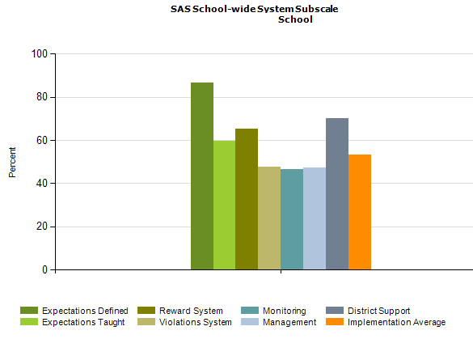
PBS Self-Assessment Survey – www.pbis.org
Notes:
See my website under resources – academic and behavior self- assessment from Niles West high school – based of Flordia’s RtI model

Slide 19
Designing School-Wide Systems for Student Success
A Response to Intervention Model
Academic Systems
Behavioral Systems
Tertiary Interventions/Tier 3:
*Young Leaders
*National Honor Society; Eyes on the World
Secondary/Tertiary-SLC teams
Tertiary Intervention/Tier 3:
- Assessment based…Wraparound,
1-5%
1-5%
Secondary Interventions/Tier 2:
Secondary/Tertiary-SLC teams
AVID; Mentor Moms
Credit Recovery
After School Matters
ELL
Summer School/(First Year Connection)
Gear-Up
5-10%
5-10%
Secondary Interventions/Tier 2:
- AVID, After School Matters
- ELL;Gear-up;
Summer School(First Year Connection)
- In HouseTutoring- Mentor Moms
80-90%
80-90%
Universal Intervention
Tier 1:
In-House Tutoring; Summer
School (First Year Connection),ASPIRA;_
Service Learning;
Attendance andTardies_
SLC; PARR; First Year Seminar
Universal Intervention/Tier 1:
-PARR
Attendance and Tardy
- Small Learning Communities (SLC)
Notes:
19
Shock and Awe

Slide 20
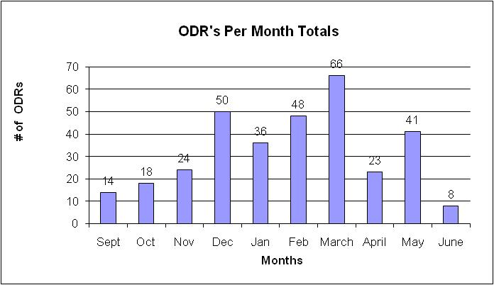
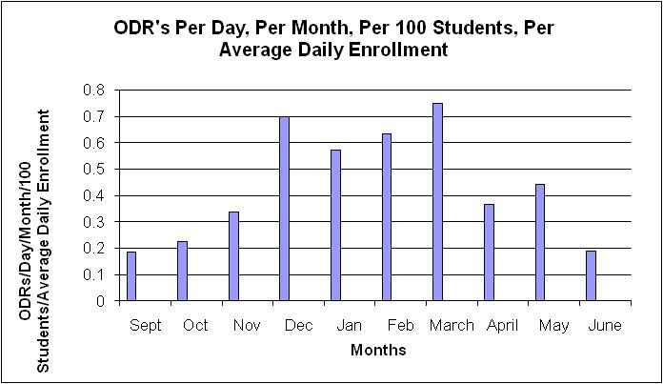
What are our priority months for support?

Slide 21
Build Case with Data:
Create Urgency (Kotter, 1995)
Writing a referral is not a bad thing, it is necessary!
We hope you have fewer reasons
Instructional time given to referrals
(20 Minutes per referral)
77,400 Minutes = 1,290 Instructional Hours

Slide 22
Question
Given these example, what are some ways you can “ask before you tell” to obtain, maintain, or increase buy-in from staff/schools?

Slide 23
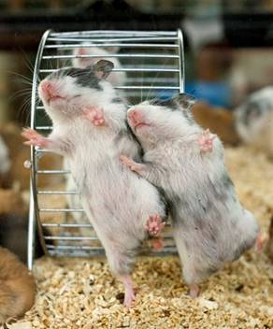
Effective teams in school settings
Duck video
Notes:
45 minutes for section
Duck Video

Slide 24
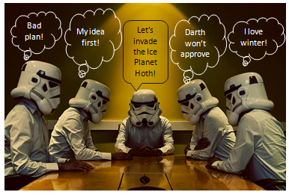

Slide 25
Effective Meetings
Scheduling and communication
Creation and use of an agenda
Meeting begins and ends on-time
Keeping the meeting on track
Action plan/delegating tasks
Meeting Participation
Dissemination of meeting notes
See examples: Herding Cats, Bad Meetings, Action Plans, Rate yourself –
handbook
Notes:
Herding cats video
See Handbook

Slide 26
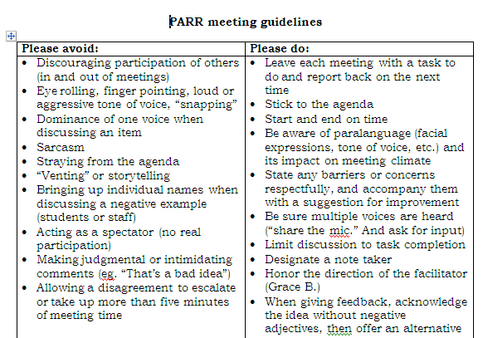
Notes:
26
Key things
Helped meetings become more efficient because
Helped keep everyone on task and respectful – depersonalized challenges
Everyone had to leave the meeting with a task – kept the spectators and ventors away
26

Slide 27
Reflection
Rate the health of their teams on each item
  (use Effective Meetings slide)
  5 positive things are going great
  1 not at all and we need to work on this
Choose one area to address
  See examples
  Meeting Facilitation Rubric for more detail
  Virginia MTSS Agenda Example

Slide 28
Installation and initial implementation
Using data
Preparing for your core
Career Builder
Notes:
Career Builder video

Slide 29
Question
If these were your data, how would you respond? (see workbook)

Slide 30
SET Data School 2 (year 1)

Slide 34
Priorities
Teaching, Acknowledging, Redirection training for teachers of first year high school students
Orientation for first year high school students
Circuit training for staff during opening of school
School store opens and training provided for staff
Notes:
Circuit training script part of your handout and on my website

Slide 35
Types of Existing Data
Office Discipline Referral Data
GPA (8th and 9th grade)
Credits toward graduation
Attendance
Failing grades
Statewide assessments
Existing screening data
(Burke, 2015; Heppen, O'Cummings, &
Therriault,2009; McIntosh, Flannery,
Sugai, Braun, & Cochrane, 2008; McIntosh et al., 2009)
Notes:
This study examined data from the 2007/08 grade 9 cohort in four Oregon districts to find early warning indicators of students who may drop out or fail to graduate from high school on time. The study identified four indicators that provided valuable early warning signals about students who did not graduate on time, particularly about students who dropped out of high school:
• Grade 8 attendance rate below 80 percent. • Grade 9 attendance rate below 80 percent. • Grade 8 grade point average (GPA) below 2.0. • Grade 9 GPA below 2.0.
When the influence of demographic, achievement, and behavioral characteristics and differences in the schools that students attended were considered at the same time, only gender, English learner student status, and attendance and GPA in grades 8 and 9 were associated with graduation outcomes. Burke, 2015
35

Slide 36
Effective School Environments
Career Builder

Slide 37
Reflection
See Handout “Supportive Environments Quiz”
Take the quiz

Slide 38



Answers
1-3
4-5
6
See short example video 0-1:36; 2:17-2:32
Notes:
Show Zappors video

Slide 39
Classroom
Tell me about your favorite class and teacher

Slide 40
Components of Effective Classroom Settings
Maximized Structure
Post, teach, model reinforce expectations
Active engagement
Varity of ways to acknowledge
  Including success!
Continuum of ways to respond
(Simonsen, Fairbanks, Briesch, Myers, & Sugai, 2008)

Slide 41
What do you include in your course syllabi?

Slide 42

Mark Shinn (http://markshinn.org)

Slide 43
The Syllabus
Goals
Contact information
Success Traits
Rules/expectations
Activities
Grades/Status
Procedures
Entering
Tardy/Absence
Materials
Assignments (returns)
Due dates
Late, missing work
Communication
Ending class
Consequences
Model projects
Checklists
Sprick (2006)/Shinn http://markshinn.org
See examples – http://www.hankbohanon.net (Resources page under “Teaching”
Sample first days of school for high school teacher)
Notes:
Show handout, look at student expectations

Slide 44
Planning
See example
What connections can you make for your staff?

Slide 45
Teaching Expectations
High School Football?

Slide 46
Teaching Expectations
Examples
Staff orientation meetings
Handbooks
Lesson plans
Syllabus
Posters
Booster sessions
Pre-correct/remind
Key Elements
Rationale
Negative examples
Positive examples
Practice/Feedback
Evaluate
See lesson- Blank!! Possible Example Teaching Story 1 or Pre-Teaching
Student example from football
Fruita Monument Example
Notes:
46
Say silk 3 times, then ask what do cows drink
Practice expectations with group

Slide 47
Alignment
Arizona College and Career Readiness Standards
  Language arts/English
      htthttp://www.azed.gov/standards-practices/englishlanguageartsstandards/
Social and Emotional Standards (SEL)
  Self-awareness and self-management skills
  Social-awareness and interpersonal skills
  Decision-making skills and responsible behaviors
    http://education.qld.gov.au/studentservices/protection/sel/
    http://www.isbe.net/ils/social_emotional/standards.htm
See examples from core?

Slide 48
Aligned with Speaking and Listing Literacy National US Standards
CPS Matrix Aligned with Common Core Standards – See http://www.hankbohanon.net
Notes:
See standards lists or reference in handout

Slide 49
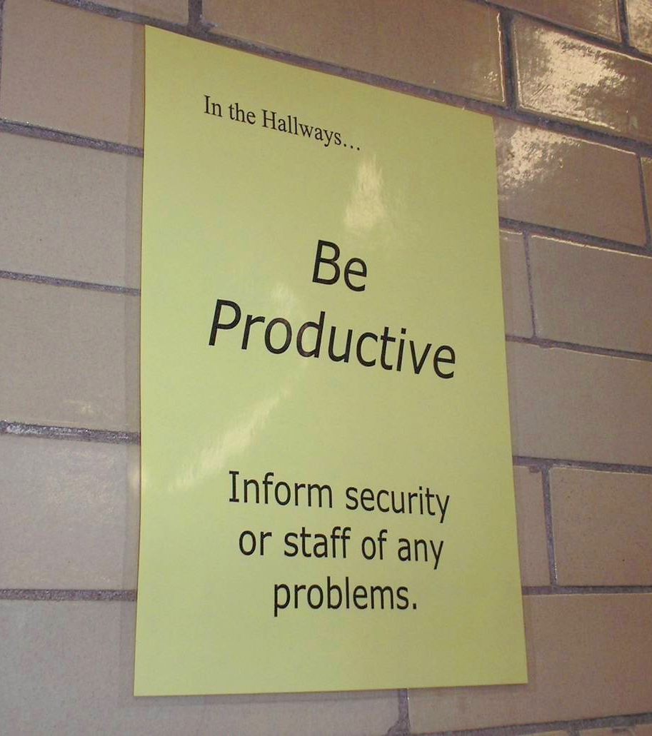
Notes:
49
Mr. Irvin
Defining expectations by location

Slide 50

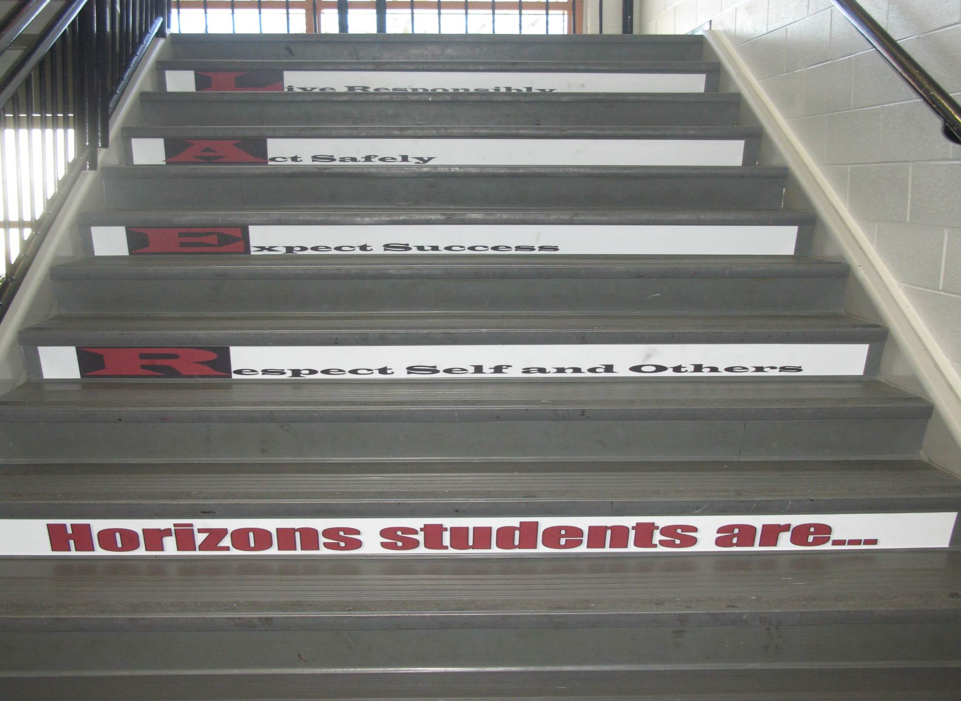
Shawnee Mission Schools, KS

Slide 51
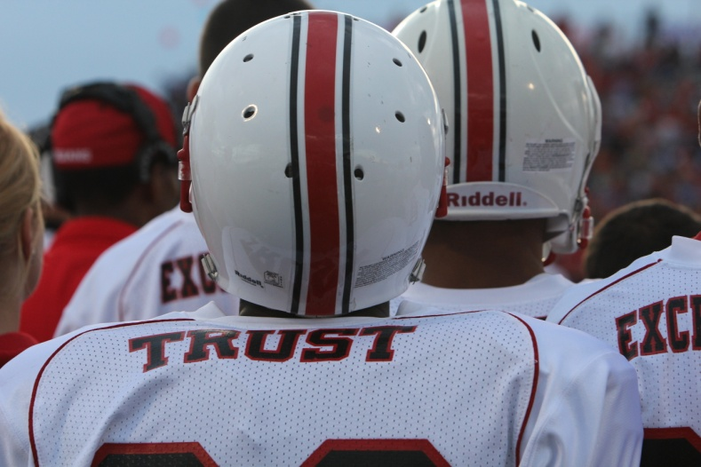
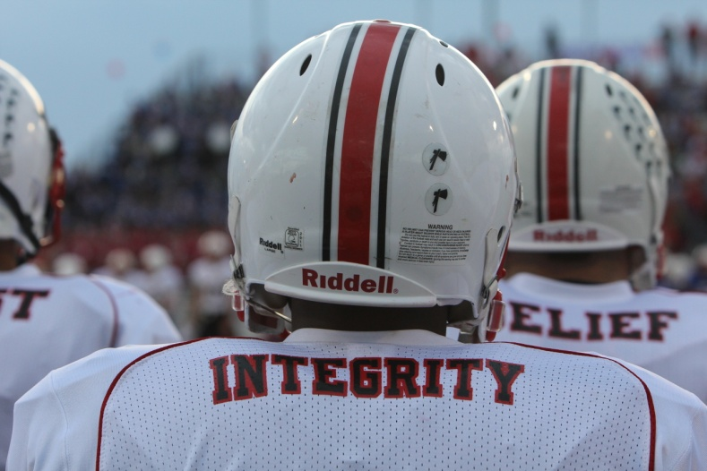
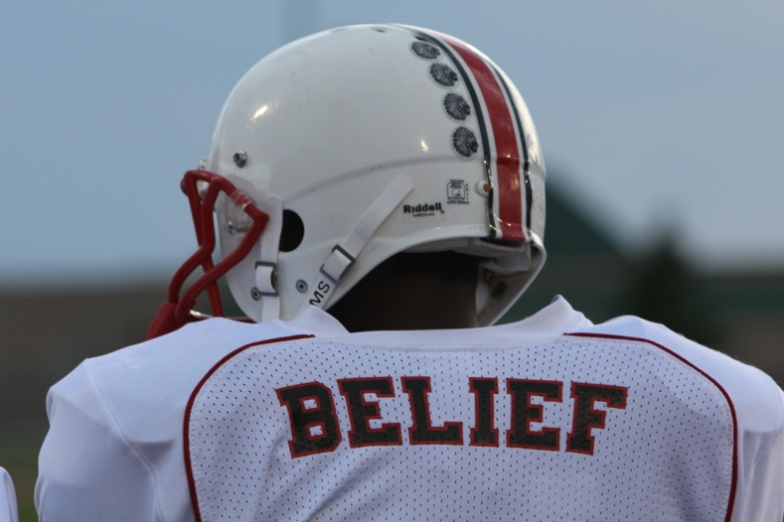
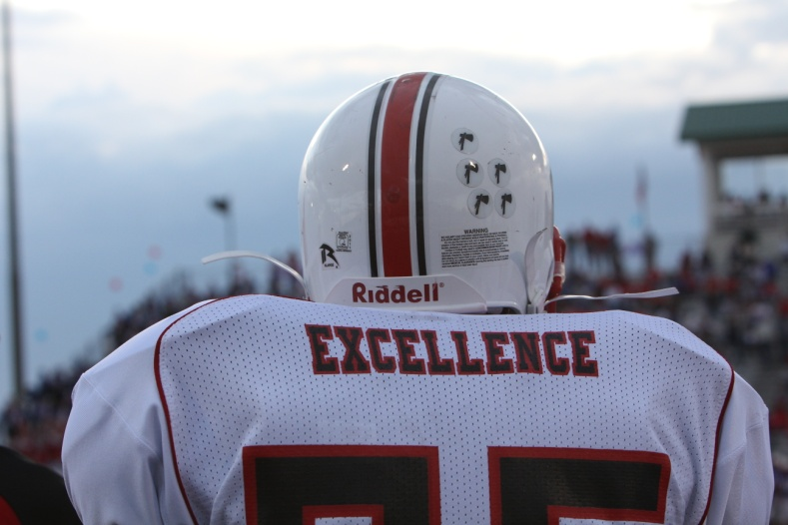
Shawnee Mission North
Football Jerseys
Notes:
Teaching expectations football?

Slide 52
Prepare your staff
http://vimeo.com/14818677 and Huntsville Cafeteria video
See check list in handbook, what did you see?
2 minutes..What does PBS look like…
How are you teaching expectations?

Slide 53
Change Point Analysis: 2005-2008
Possibly the booster for students and PD for staff in Jan/Feb 2007
Notes:
Hank present
(slide animation)
Explanation of possible factors contributing to decrease in Jan/Feb of 2007 will pop up
CLICK again …

Slide 54
Planning
See example lesson plans on website
How are you going to prepare your staff to teach expectations?
What types of behavior? What times of year to teach?
Notes:
See year at a glance

Slide 55
Acknowledgement
Cheerleading Video?
Notes:
Cheerleading video

Slide 56
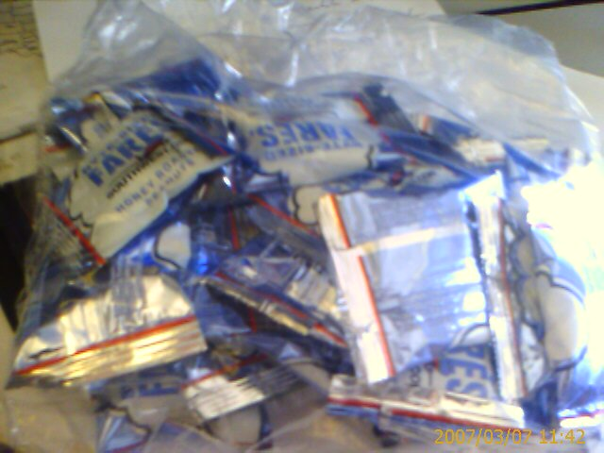
Earned this bag on SW…

Slide 57
Acknowledgement…
As part of schoolwide approach, can lead to improved performance
  Improved attendance (de Baca, Rinaldi, Billig, & Kinnison, 1991).
  Reductions in discipline problems (Bohanon et al., 2012)
Functional outcomes are important
  Relevant curriculum
  Social connection (Dunlap, Foster-Johnson, Clarke, Kern, & Childs, 1995).

Slide 58
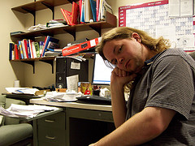
Other Advantages of Praise
Decreases in emotional
exhaustion
Higher efficacy
Reinke, W. M., Herman, K. C., & Stormont, M. (2013).
Photo by Josh Thompson

Slide 59
Video
See examples of why this is important
  One page document “Acknowledging Students for Good Behaviors”
  Cool tool
  What are your doing around acknowledgement?
  Zappos example? See short example video 0-1:36; 2:17-2:32
Notes:
Zappos video only if time
Tell them page number -

Slide 60
High Frequency

Slide 61
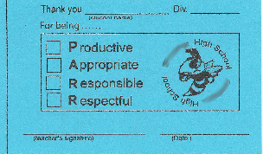
Buzzy Buck
Notes:
61
61
Brigit

Slide 62
Intermediate

Slide 63
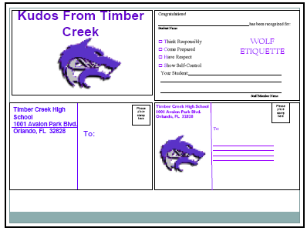
Timber Creek High School, FL, JOHN WRIGHT, PRINCIPAL

Slide 64
Large Scale

Slide 65
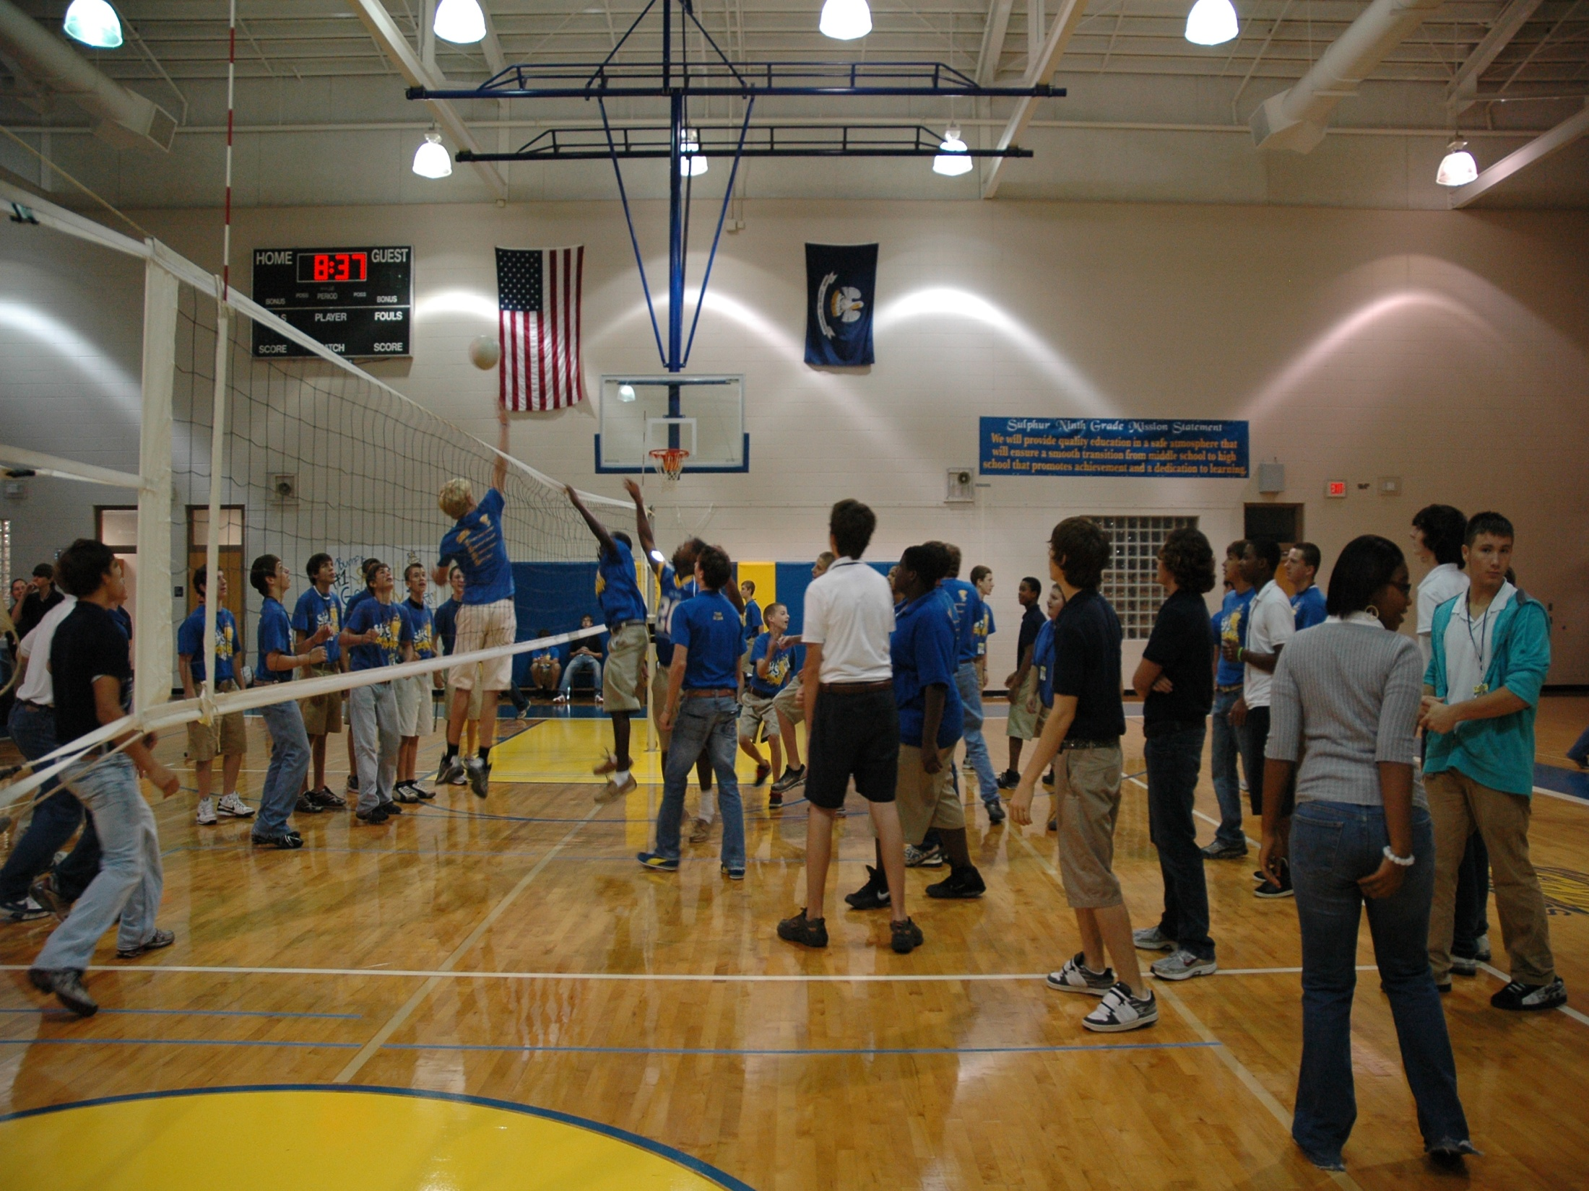
1st Six Weeks Party –
CHUCK HANSEN, Principal
AMY PALMER, Teacher
SULPHUR HIGH SCHOOL, LA

Slide 66
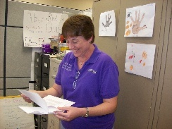
Teacher earns vacation
Timber Creek High School, FL, JOHN WRIGHT, PRINCIPAL

Slide 67
Matrix
See example
How will you prepare your staff?
Think through levels of acknowledgment for students and faculty.
Notes:
Tell page number

Slide 68
Engagement and Opportunities to Respond
Non-example – Ferris
Jeff Bliss Video Example
Notes:
Jeff Bliss Video Example

Slide 69

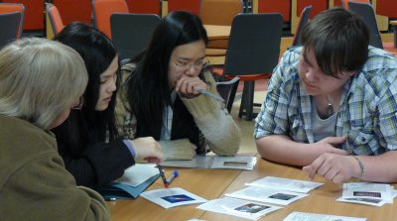
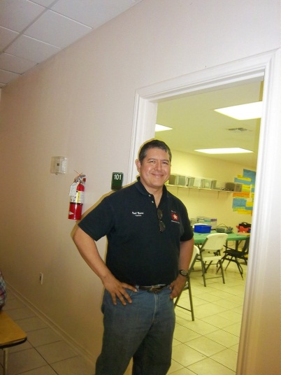
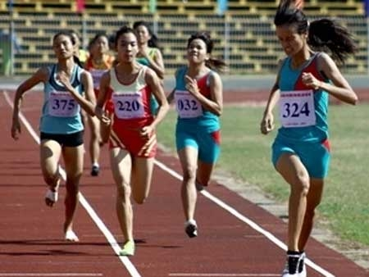

Instructional/Emotional Support
Failure rates
from 17% to 11%
  Choice of responding
  Laughing with students
  Out of desk greeting
Allen, Gregory, Mikami, Lun, Hamre, & Pinata (2013)
  Ask about events
  Ask “why”?
http://mzteachuh.blogspot.com/2012/05/that-kid-drives-me-nuts-tweets-of-day.html
http://ignitebrownsville.blogspot.com/p/picture-gallery.html
http://english.vietnamnet.vn/fms/sports/57762/hanoi-to-host-5th-asean-student-sports-games.html
http://www.phy.bris.ac.uk/news_archive1.html
http://www.hillel.org/jewish/ask-big-questions
Notes:
See Blog in handout and onwebsite

Slide 70
Redirection and Active Supervision
JcPenny’s does this very well
How some mom’s handle the pressure video – Whitney Young

Slide 71
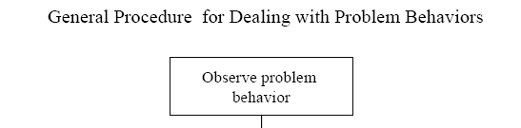
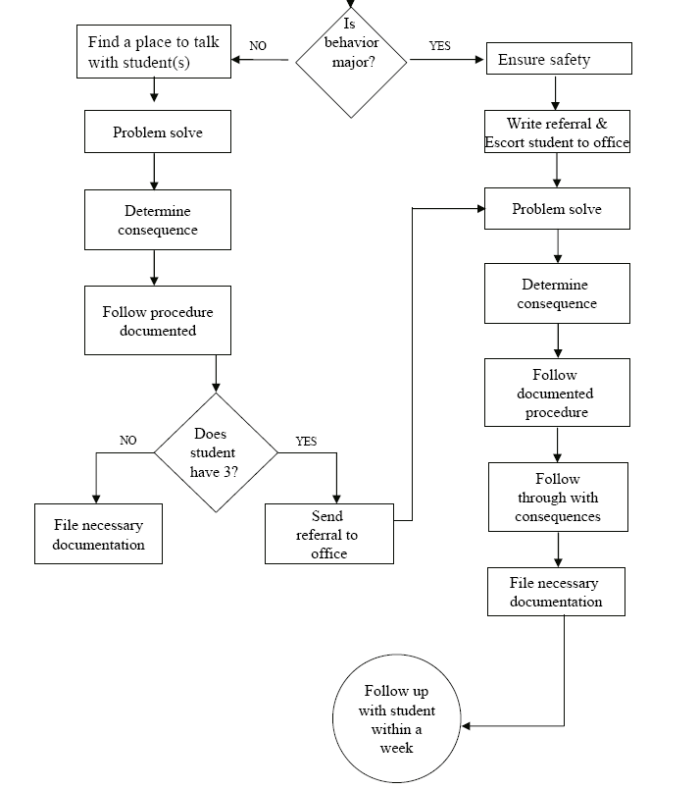
Is the behavior office- managed?

Slide 72
McClatchy Students Video, Dean?
Notes:
72
Alissa present (1 minute max)
72

Slide 73
Be at post
Escort students
Brief interactions
(Johnson-Gros et al., 2008)
See article about hallways @
http://hankbohanon.net
on publications page
Notes:
73
73
Mr. Irvin – tardy policy
being at post, escorting, and interacting with students

Slide 74
Support Staff: Preventing and Responding
Teach skills for prevention
  Good classroom instruction
  Non-classroom settings
Teach skills for redirection
  Classroom
  Non-classroom settings
See Handout “Professional Development on Redirection”

Slide 75
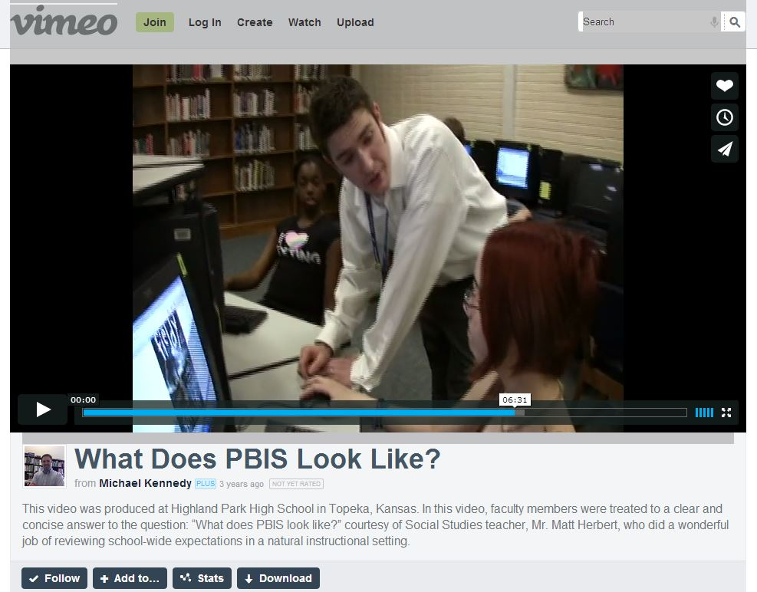
Videos
  What does PBIS Look Like? – Active Supervsion..opennnig
  Redirection examples 6.12 mins
  http://vimeo.com/14818677
Notes:
Tell story from NC when your said slurs about my family - how I handled – how I did not react…

Slide 76
Summary
What is one thing you can do, that would make everything else more effective for your school(s) related to the school environment?

Slide 77
Videos
Michael Kennedy
http://vimeo.com/14818677
  See What does PBIS Look Like? – Opening, Redirection examples 6.12 mins
Other tools
Notes:
Tell story from NC when your said slurs about my family - how I handled – how I did not react…

Slide 78
Resources
Year-at-a-glance
  http://www.hankbohanon.net/Resources_1.html
Training script for booster for staff
  http://www.hankbohanon.net/Resources_1.html

Slide 79

Strategies
Mendler, A. N. & Mendler B. D. (2011) Power struggles: Successful techniques for teachers. Bloomington, IN: Solution Tree.

Slide 80

Classroom Management
Knoster, T. (2013). The Teacher’s pocket guide effective classroom management (2nd Ed.), Baltimore, MD: Paul H Brookes

Slide 81

Addressing Tardies
Start on Time!
Randy Sprick
http://www.pacificnwpublish.com/home/pnp/page_38_14/start_on_time_safe_transitions_and_reduced_tardies.html

Slide 82
Data
Using data from the school's perspective http://buff.ly/1Fex5hb
Helping teachers collect data on their teaching to improve instruction buff.ly/1G0wwYY
Toolkit for data decision making fb.me/6z6iyxCU2
8th and 9th grade GPA and Attendance are predict drop out. http://fb.me/7sCfLI2QD
Data dashboard – webinar and examples http://bit.ly/1FFbzEm

Slide 83
Student Engagement
Webinar on using data to improve student engagement http://fb.me/4vHawmKtz
Webinar for increasing student engagement through real world projects http://bit.ly/1K5ZplN
Assessing school climate webinar http://bit.ly/1IRJgBH
Online survey: student hope, engagement, belonging, and classroom management.... http://fb.me/2bX9tbQh4
Teaching algebra in middle and high school http://buff.ly/1CqNf2c

Slide 84
Where are you?
Complete
  Classroom management self-assessment
  http://www.pbis.org/pbis_resource_detail_page.aspx?Type=4&PBIS_ResourceID=164
Free training on active supervision (limited time only)
  https://www.irised.com/freecourse&?utm_source=IRIS+Educational+Media+Mailing+List&utm_campaign=9d73acd430-FREEprog_SysSupEvElem_8_5_2014&utm_medium=email&utm_term=0_cb7ab95a8b-9d73acd430-291122974#.U-U6UPldWSq

Slide 85
Resources
State Implementation & Scaling-up of Evidence-based Practices Center
  http://sisep.fpg.unc.edu/
Kotter, J. (1995). Leading change: Why transformation efforts fail. Harvard Business Review, 73(2), 59–67. Retrieved from http://hbr.org/
http://www.hankbohanon.net/Resources_1.html

Slide 86
Videos
Michael Kennedy http://vimeo.com/channels/129830
  Fruita Monument
  Consistent
Scott’s Pride https://sites.google.com/a/ddouglas.k12.or.us/scotspride/

Slide 87
Finding more plans
Sample Lesson plans
  http://www.pbismaryland.org/
  http://www.hankbohanon.net
More Video Example
  http://vimeo.com/groups/pbisvideos

Slide 88
Other Supports
Defusing Disruptive Behavior in the Classroom
  Geoff Colvin http://www.lookiris.com/store/K-12_Professional_Development/Defusing_Disruptive_Behavior_in_the_Classroom/
Classroom management training
  http://pbismissouri.org/class.html
The FAST Method
  http://www.lookiris.com/store/K-12_Professional_Development/The_FAST_Method_ONLINE/
Notes:
See website

Slide 89
Other Supports
IRIS Online Modules
  http://iris.peabody.vanderbilt.edu/resources.html
Rti Action Network Article Behavior and Academics
  http://www.rtinetwork.org/Learn/Behavior/ar/Integrating-Behavior-and-Academic-Supports-Within-an-RtI-Framework-General-Overview
National Center on PBIS
  http://www.pbis.org
Association of Positive Behavior Support
  http://www.apbs.org
CASEL – SEL Center
  http://casel.org/
Direct behavior rating
  http://www.directbehaviorratings.com/cms/

Slide 90
References
Bohanon, H. (2015). Changes in adult behavior to decrease disruption from students in non-classroom settings. Intervention in School and Clinic, 15 (1), 12-18. http://ecommons.luc.edu/education_facpubs/39
Bohanon, H. & Wu, M. (2014). Developing buy-in for positive behavior support in secondary settings. Preventing School Failure, 58 (4), 1–7. doi: 10.1080/1045988X.2013.798774 http://ecommons.luc.edu/education_facpubs/17/
Bohanon, H., Castillo, J., & Afton, M. (2015). Embedding self-determination and futures planning within a schoolwide framework. Intervention in School and Clinic. 50 (4), 203-209. http://ecommons.luc.edu/education_facpubs/16/
Bohanon, H., Fenning, P., Hicks, K., Weber, S., Their, K., Akins. B., Morrissey, K., Briggs, A., Bartucci, G., Hoeper, L., Irvin, L., & McArdle, L. (2012). Case example of the implementation of schoolwide positive behavior support in a high school setting. Preventing School Failure, 56 (2), 92-103. http://ecommons.luc.edu/education_facpubs/7

Slide 91
More Resources
Brawley, S. (accessed March 22, 2011). PBS in the classroom. M.Ed. Heart of Missouri RPDC. http://www.cesa7.org/pbis/Classroom_Management.asp
Burke, A. (2015). Early Identification of High School Graduation Outcomes in Oregon Leadership Network Schools. REL 2015-079. Regional Educational Laboratory Northwest.
de Baca, M. R. C., Rinaldi, C., Billig, S., & Kinnison, B. M. (1991). Santo Domingo School: A rural schoolwide project success. Educational Evaluation and Policy Analysis, 13(4), 363-368. doi: 10.3102/01623737013004363
Flannery, B. K., Guest, E., & Horner, R. (2010). SWPBS: Schoolwide positive behavior supports. Principal Leadership, 11(1), 38-43. doi: 2123461661

Slide 92
More Resources
Johnson-Gros, K. N., Lyons, E. A., & Griffin, J. R. (2008). Active supervision: An intervention to reduce high school tardiness. Education & Treatment of Children, 31(1), 39-53.
McNeely, C. A., J. M. Nonnemaker, J.M., & Blum, R. W. (2002). Promoting School Connectedness: Evidence from the National Longitudinal Study of Adolescent Health. The Journal of School Health 72(4): 138-146.
McIntosh, K., Filter, K. J., Bennett, J. L., Ryan, C., & Sugai, G. (2009). Principles of sustainable prevention: Designing scale-up of School-wide Positive Behavior Support to promote durable systems. Psychology in the schools, 47(1), n-a-n/a. doi:10.1002/pits.20448
McIntosh, K., Flannery, K. B., Sugai, G., Braun, D., & Cochrane, K. L. (2008). Relationships between academics and problem behavior in the transition from middle school to high school. Journal of Positive Behavior Interventions, 10(4), 243–255. doi:10.1177/1098300708318961
Morrissey, K. L., Bohanon, H., & Fenning, P. (2010). Positive behavior support: Teaching and acknowledging behaviors in an urban high schools. Teaching Exceptional Children, 42(5), 26-35.

Slide 93
More Resources
National High School Center, National Center on Response to Intervention, and Center on Instruction. (2010). Tiered interventions in high schools: Using preliminary “lessons learned” to guide ongoing discussion. Washington, DC: American Institutes for Research.
Newcomer, L. (2009). Universal positive behavior support for the classroom. PBIS Newsletter, 4(4). Retrieved September 24, 2009 from http://www.pbis.org/pbis_newsletter/volume_4/issue4.aspx
Simonsen, B., Fairbanks, S., Briesch, A., Myers, D., & Sugai, G. (2008). Evidence-based Practices in Classroom Management: Considerations for Research to Practice1. Education & Treatment of Children, 31(3). Story from middle school high school http://www.wickedlocal.com/ashland/topstories/x1777802903/IN-THE-CLASSROOM- Rewarding-positive-behaviors#axzz1HLe0R2nk
Therriault, S. B., Heppen, J., O’Cummings, M., Fryer, L., & Johnson, A. (2010). Early warning system implementation guide. Retrieved from http://www.betterhighschools.org/documents/NHSCEWSImplementationGuide.pdf

