Slide 1
Schoolwide Positive Behavior Support and High Schools (SWPBIS): Perspectives Across Cultures
Hank Bohanon
hbohano@luc.edu
http://www.hankbohanon.net
https://twitter.com/hbohano
https://www.facebook.com/hank.bohanon
Notes:
Who is here – you 15 minutes for set up - 5
Coaches – internal external
Middle schools/ High Schools
Parents
General education teachers
Special Education teachers
Counselors
School Psychologists
Social workers?
Administrators?
Academic focused schoolwide approach? Behavior? Social/emotional?
How many years?
5 or more
3 or more
1 or more
Fact finders?

Slide 2
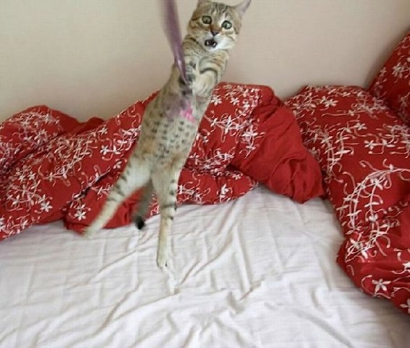
Decide if you want to try
Notes:
30 sec
From IKEA

Slide 3
PowerPoint's
Enduring Understanding:
Schoolwide positive behavior support (SWPBS) is evidence based in western cultures.
Research in Pan-Asia exists supporting individual students
Any practice must be considered in its context
You may be more convinced you do not need or want this

Slide 4
Essential Questions
What are key components of current western versions of SWPBS?
What are the connections between SWPBS and current practices in Pan-Asian settings?
What changes would need to be considered to apply SWPBS in Pan-Asian settings?
How can I make sure we don’t try this in our school?

Slide 5
Outline
Background
  Principles
  Systems
  Data
Practices
  Tiers 1-3
Discussion
  Gallery Walk

Slide 6
Thank you!
Association of Positive Behavior Support
National Taiwan Normal University
  Dr. Li-Yu Hung
Co-authors
  Michael Arthur-Kelly, The University of Newcastle, Australia
  Watinee Opartkiattikul, Chulalongkorn University, Thailand
Notes:
6
6

Slide 7
Thank you!
“Systematic Analysis and Model Development for High School Positive Behavior Support” Institute for Education Science, U.S. Department of Education, Submitted with the University of Oregon. Awarded 2007.
(Q215S07001)
“Character Education: Application of Positive Behavior Supports” to U.S. Department of Education, Safe and Drug Free Schools. Awarded 2007. (R324A070157)
Notes:
7
7

Slide 8
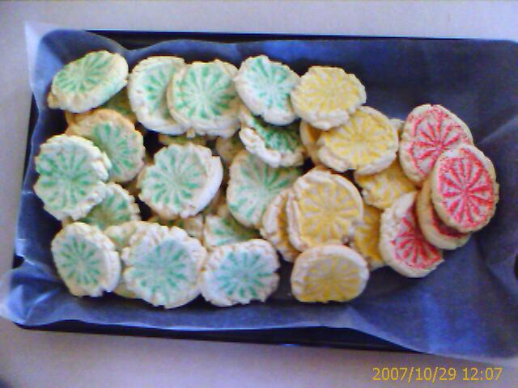

Slide 9
Key Principles
Self-Assessment: What staff need to know, particularly about student learning and behavior
When did you get in trouble when you knew better?

Slide 10
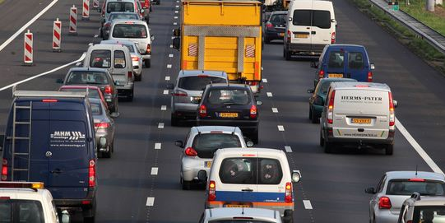
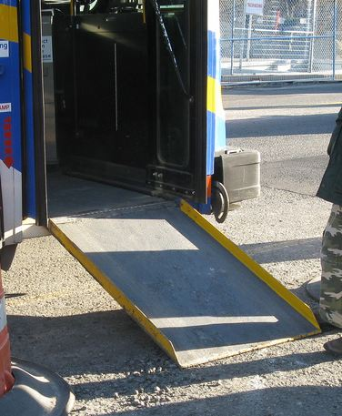
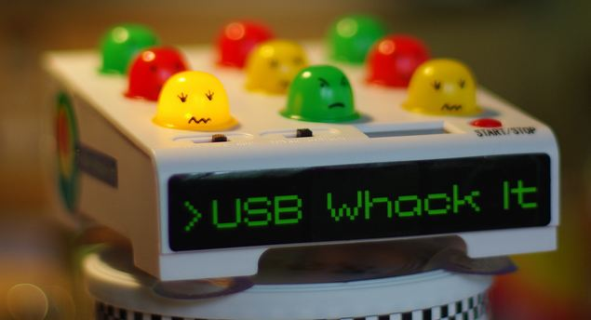


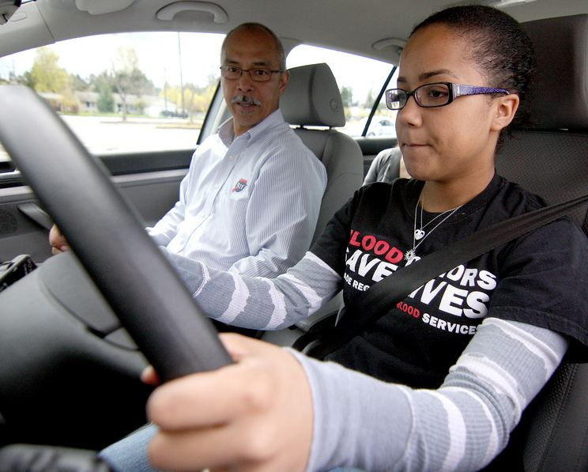
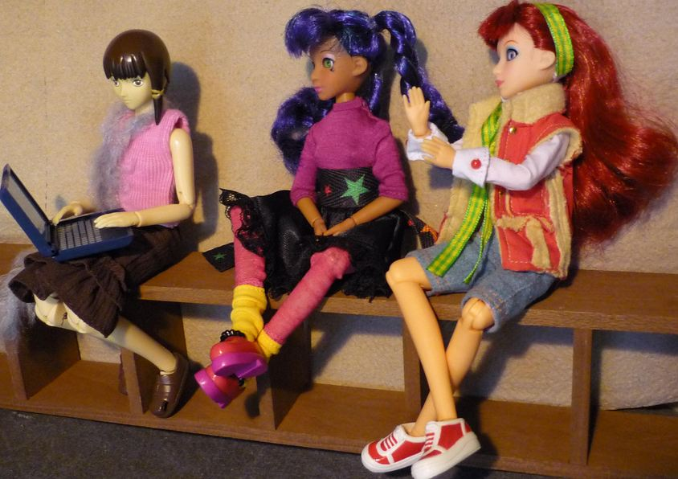
Key Principles
Incidental Benefit
Schoolwide
Schoolwide
Punishment
Reinforcement
Shaping
Reinforcement
Notes:
Whack a mole – don’t start individual
Highway - schoolwide
Ramp – incidental benefit
Yelling teacher – reinforcement
Student in the office - reinforcement
Stop sign – punishment
This works for teachers..teaching vs learning…
Learn to drive - shaping

Slide 11
Designing School-Wide Systems for Student Success
A Response to Intervention Model
Questions
Answers
Tertiary Interventions/Tier 3:
Dig deeper – why?
Tertiary Intervention/Tier 3:
Ask questions,
Teach what works better *
Qigong, Antibiotics
1-5%
1-5%
Secondary Interventions/Tier 2:
Can’t do/won’t do
5-10%
5-10%
Secondary Interventions/Tier 2:
Coke test analogy..
Chinese Medicine, Aspirin, Soup*
Universal Intervention
Tier 1:
Were we clear? Does it work?
How do we respond?
80-90%
80-90%
Universal Intervention/Tier 1:
Be clear on expectations,
make sure they work, be humane
Exercise, Rest, Vitamins*
*Scott, T. examples
Notes:
11
You should have a large copy of this in your handouts
Core NCATE assessment is tatoo..it is washable (just kidding)..
Example –
SW – Respect – Response Be kind – show poster ahead, parallel classes…instructional round
Secondary – student could not write very well – even when given coke..skill deficit – then accommodate with writing prompt and remediate – teach skills
Tertiary – attention – personal greetings at the door and pre-correction was enough

Slide 12
Designing School-Wide Systems for Student Success
A Response to Intervention Model
Academic Systems
Behavioral Systems
Tertiary Interventions/Tier 3:
*Young Leaders
*National Honor Society; Eyes on the World
Secondary/Tertiary-SLC teams
Tertiary Intervention/Tier 3:
- Functional Assessment based…Wraparound
1-5%
1-5%
Secondary Interventions/Tier 2:
Secondary/Tertiary-SLC teams
AVID; Mentor Moms
Credit Recovery
After School Matters
ELL
Summer School/(Freshman Connection)
Gear-Up
5-10%
5-10%
Secondary Interventions/Tier 2:
- AVID, After School Matters
- ELL;Gear-up;
Summer School(freshman Connection)
- In HouseTutoring- Mentor Moms
80-90%
80-90%
Universal Intervention/Tier 1:
-PARR
Attendance and Tardy
- Small Learning Communities (SLC)
Universal Intervention
Tier 1:
In-House Tutoring; Summer
School (freshman Connection),ASPIRA;_
Service Learning;
Attendance and Tardies_
SLC; PARR; Freshman Seminar
Notes:
12

Slide 13
Positive Outcomes SWPBS
21,000 US Schools, fewer high schools
Increases in student attendance
Decreases in behavior problems (Freeman et al., 2016)
Decreases in problems in non-classroom settings (Bohanon, 2015)

Slide 14
Study of FBA In School Implementation, Thailand Opartkiattikul, 2014
Time sampling outcomes for 5 target behaviours of the target students
Prior to PD
During PD
After PD

Slide 15
Napkin Test
You are at a function for your school. A colleague says they heard about this schoolwide PBIS approach. They asked you what it was about.
  On your napkin, draw or write out what you think schoolwide PBIS is
  Next, find a new friend and share your overview for two minutes

Slide 16
Preparing Systems and Data

Slide 17
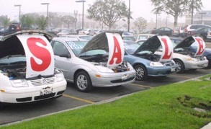
Making a Purchase
List out the steps you or family member took the last time you made a large purchase…
bestig.blogspot.com

Slide 18
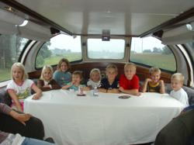



Steps
Consider Needs
Research
Not First!
Sample
Sign Up
Car http://www.prweb.com/releases/2012/8/prweb9815542.htm
Research http://www.uic.edu/uic/research/
Test drive http://www.familyhyundai.com/family-hyundai-customer-reviews/
Contract http://www.icts.uiowa.edu/content/contract-negotiation
Notes:
Place the steps for purchasing a car in the right order – at each step – what are people afraid of? Why did you not see the contact first? People are not the change – but the loss – you have to build the why before what and how. See Being Boss

Slide 19
What do we know about implementation
Successful systems change (Kotter, 1995)
  Created sense of urgency
  Core group of leaders
  Long-term vision for change
Implementation occurs in stages (Blasé, et a;. 2015)
  Exploration
  Installation
  Initial Implementation

Slide 20
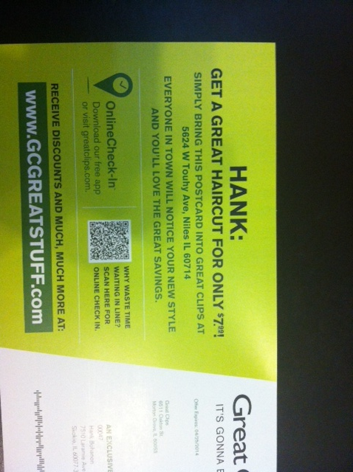

Slide 21
Exploration Examples From 4 High Schools
  Communication - timeliness
  School climate
  Efficient meetings
  Integration of PD
  Work with PLCs
  Define academic and behavior expectations
  Use data for decisions
  Braid initiatives
  Align administrative supports with strategies
  Students within special support needs
  Need for increased school spirit
  Distribute roles
  Parental involvement
See example of questions: http://www.hankbohanon.net (Suggested Resources tab)
Notes:
Focus groups – across students, teachers, administrations
See other examples from handout – niles and others

Slide 22
Show Similar Example
Joe Zima, LMSW, Behavior Specialist St Clair County RESA

Slide 23
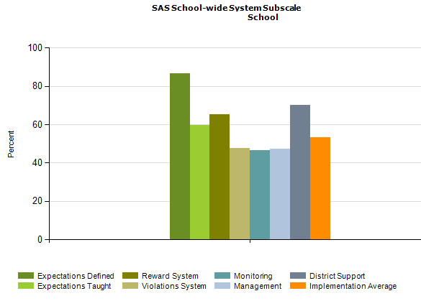
PBS Self-Assessment Survey – www.pbis.org
Notes:
See my website under resources – academic and behavior self- assessment from Niles West high school – based of Flordia’s RtI model

Slide 24
Designing School-Wide Systems for Student Success
A Response to Intervention Model
Academic Systems
Behavioral Systems
Tertiary Interventions/Tier 3:
*Young Leaders
*National Honor Society; Eyes on the World
Secondary/Tertiary-SLC teams
Tertiary Intervention/Tier 3:
- Functional Assessment based…Wraparound
1-5%
1-5%
Secondary Interventions/Tier 2:
Secondary/Tertiary-SLC teams
AVID; Mentor Moms
Credit Recovery
After School Matters
ELL
Summer School/(Freshman Connection)
Gear-Up
5-10%
5-10%
Secondary Interventions/Tier 2:
- AVID, After School Matters
- ELL;Gear-up;
Summer School(freshman Connection)
- In HouseTutoring- Mentor Moms
80-90%
80-90%
Universal Intervention/Tier 1:
-PARR
Attendance and Tardy
- Small Learning Communities (SLC)
Universal Intervention
Tier 1:
In-House Tutoring; Summer
School (freshman Connection),ASPIRA;_
Service Learning;
Attendance and Tardies_
SLC; PARR; Freshman Seminar
Notes:
24

Slide 25
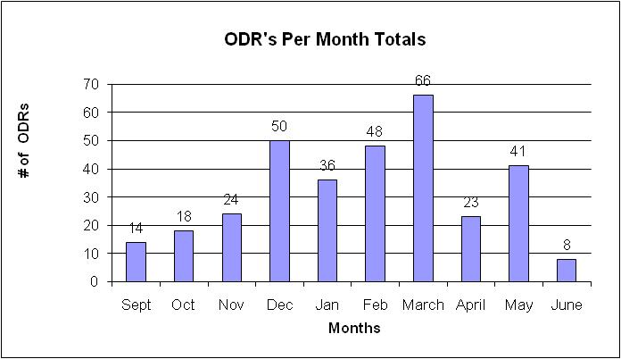
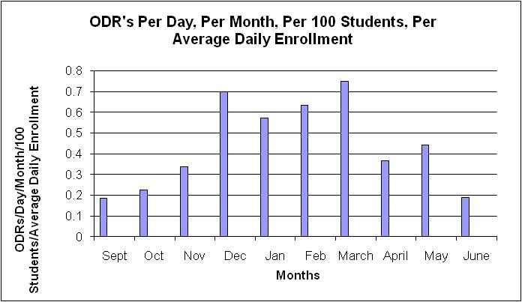
What are our priority months for support?

Slide 26
Build Case with Data:
Create Urgency (Kotter, 1995)
Writing a referral is not a bad thing, it is necessary!
We hope you have fewer reasons
Instructional time given to referrals
(20 Minutes per referral)
77,400 Minutes = 1,290 Instructional Hours

Slide 27
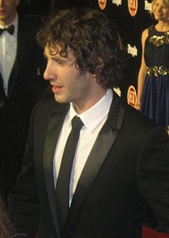


Key Elements
http://en.wikipedia.org/wiki/Josh_Groban
http://www.inmagine.com/searchterms/private_jet.html
Systems – Josh, flight, checklist
  Administrative Commitments, Coaching (external/internal), Representative Teams, Audit of practices, Priority
Practices
  Based on evidence
Data
  Process and impact – dropout
    What and with whom?
Notes:
27

Slide 28
Supporting Social Competence &
Academic Achievement
4 PBS Elements
OUTCOMES
Supporting
Decision
Making
Supporting
Staff Behavior
SYSTEMS
DATA
PRACTICES
Supporting
Student Behavior
Notes:
What are the big ideas of administrative involvement – systems and data?
Keys to implementations – systems, practices, and data
Spaulding high school –what kinds of systems do you have in place to support classrooms – teachers – literacy teams?

Slide 29
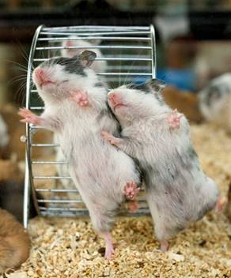
Healthy Team Functioning
Duck video
Notes:
45 minutes for section
Duck Video

Slide 30
Effective Meetings
Scheduling and communication
Creation and use of an agenda
Meeting begins and ends on-time
Keeping the meeting on track
Action plan/delegating tasks
Meeting Participation
Dissemination of meeting notes
See examples: Herding Cats, Bad Meetings, Action Plans, Rate yourself –
handbook
Notes:
Also vtss action plan for example – what I like – do you have what do you like?

Slide 31
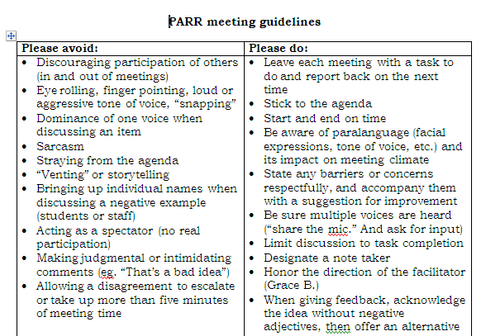
Notes:
31
If time rate your team
Key things
Helped meetings become more efficient because
Helped keep everyone on task and respectful – depersonalized challenges
Everyone had to leave the meeting with a task – kept the spectators and ventors away
31

Slide 32
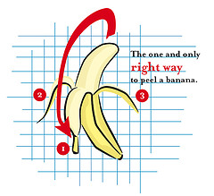
Evidence-Based Practices
See handout: Examples? Non-examples?
https://www.flickr.com/photos/asterasnowwhite/2132665143/in/photolist-4fst3F-5PU28T-5PUquM-kYruYN-fH3EBm-5PU3ac-9CqkVf-9CnqKD-9CnqGT-9CqkJj-2DouAJ-fH3ET1-fH3EFL-fH3EJY-fH3EPo------9RSbfP-bDN3fK-bwgacS-c8hitm-4x31qr-2gaeE-8PhzKc-8SgYFK-edUyPn-dUHRmn-5PYRCq-aBb3uH-6mrbyM-nkfVg-5PUxe4-2Dj47K-9oBXSD-9oF2CJ-9oEXoh-9oBUEz-9oEZwd-9oF1FG-9oBX2B-9oEZeQ-9oEY1N-9oBW9P-9oEXz9-9oF19N-9oBXzF-9oEXL5

Slide 33
Musical Chairs
When you hear the music, walk around
When the music stops, find the person closest to you, talk with your partner
Topic: Can you think of examples when these steps were applied with success? Or perhaps non-examples? (See handout)
  https://www.youtube.com/watch?v=fhnCiJQwcEk&feature=youtu.be (Start at 1:17)

Slide 34
Think about your favorite teacher
Why were they your favorite?

Slide 35
Components of Effective Classrooms
Maximized Structure
Post, teach, model reinforce expectations
Active engagement
Varity of ways to acknowledge
  Including success!
Continuum of ways to respond
(Simonsen, Fairbanks, Briesch, Myers, & Sugai, 2008)

Slide 36






Big Three
Teach expectations – early, often,
examples – non examples
Acknowledge/praise:
make deposits,
be specific
Redirect:
Private, eye contact,
proximity, humor
See http://www.hankbohanon.net see “Suggested Resources” tab
Notes:
SW - Teach example of respect
Acknowledge – Golf counter - teacher look if time you are making a deposit – corrections are withdrawals – turn to neighbor and say something nice, but do not tell them what it is..
Redirect- Anyone been to faculty meeting? Mrs. Jones we would not yell at teacher for not having lesson plans – why – sticky note and kissing example

Slide 37

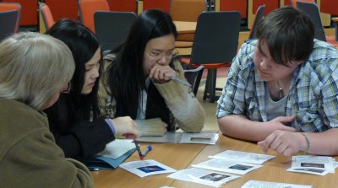
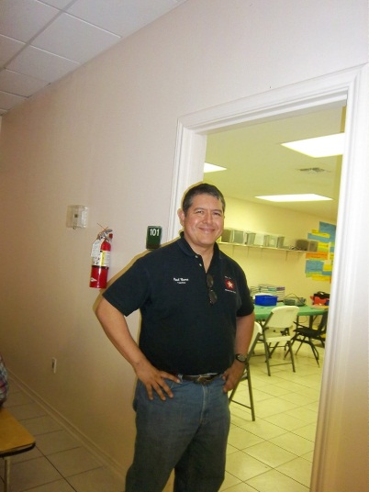
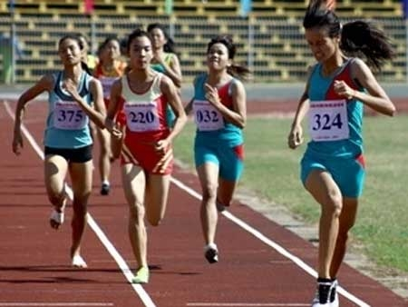

Instructional/Emotional Support
Failure rates
from 17% to 11%
  Choice of responding
  Laughing with students
  Out of desk greeting
Allen, Gregory, Mikami, Lun, Hamre, & Pinata (2013)
  Ask about events
  Ask “why”?
http://mzteachuh.blogspot.com/2012/05/that-kid-drives-me-nuts-tweets-of-day.html
http://ignitebrownsville.blogspot.com/p/picture-gallery.html
http://english.vietnamnet.vn/fms/sports/57762/hanoi-to-host-5th-asean-student-sports-games.html
http://www.phy.bris.ac.uk/news_archive1.html
http://www.hillel.org/jewish/ask-big-questions

Slide 38
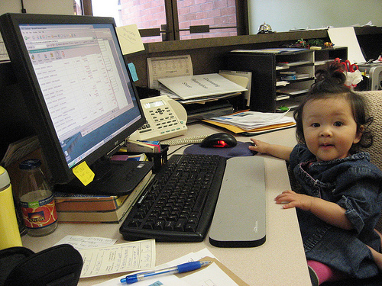
Yes, but once they get a job..nobody does this..
https://accounts-flickr.yahoo.com/photos/jenkim/2248275918/sizes/m/in/photolist-4qF16U-bUQXfn-edNnEu-3csa6n-5sgmyu-edGH9z-53piaq-mVMTRx-3XsPp-fWBZ75-7hkzE5-83prtu-4qruLT-81Yq7e-6RycDm-4j8ri-2shYkc-akHDaG-dNJpxB-4q9VJ4-KTPYW-4urrjg-bSv1hk-4FgyQG-4adsUK-cXd2yE-3gNij7-4RxFTH-9AwVns-4WRbFq-5xMwUJ-eNBioc-84xBVn-9sp4J-7JYZqT-5Zdkxt-dbAtWt-ckEAPd-5wvNsm-6MYR4A-dq71AH-5GbP34-bm5Qmj-jvsXuS-dbAvD1-7kS2Dv-5PVFe1-niJtLf-mBVEDF-2jPkVf-edNeH3/

Slide 39
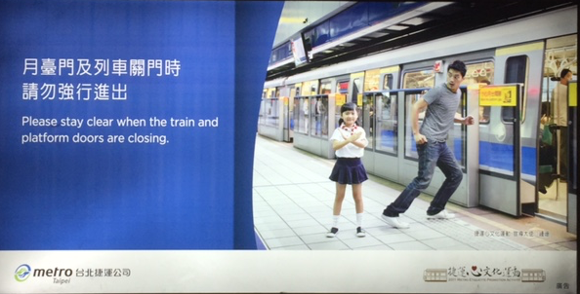
MRT – Be Safe

Slide 40

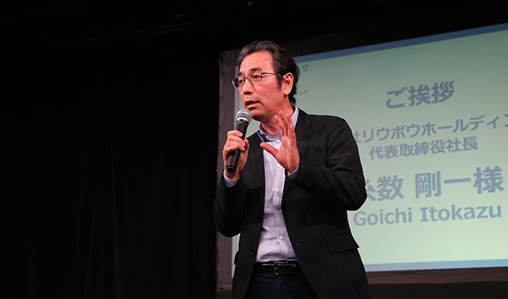
Acknowledgment/Reinforcement
Image from http://2015.oimf.jp/en/news/detail/104
Image from http://bit.ly/1ZIfcPF
Good merchandise alone will not appeal to the customer, it …[stores]…must attract the five senses (ANA Innovations)
  Goichi Itokazu, President of Ryubo Holdings, and former president of Family Mart
Notes:
Talk about unicycle

Slide 41

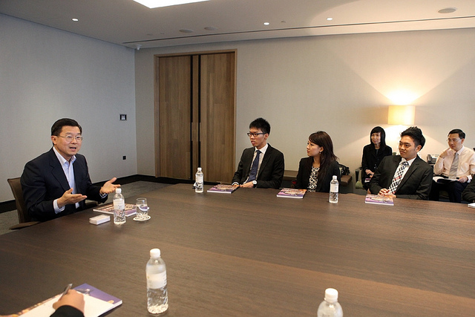
Redirection
Images from Flickr Creative Commons
If you need to correct someone, speak to the person personally – do not embarrass them in front of others. Treat the person with dignity (Ng & Foo, 2016)
  Stephen Raidy, president and CEO of the LIPPO Group
Notes:
(US $20 Billion Dollar Conglomerate and Executive Chairmen of OUE Singapore

Slide 42
What do people like about Starbucks? Is it just the coffee?

Slide 43


Redirection, Starbucks Style
Problem=
Listen
Acknowledge the problem
Take action
Thank the customer
Encourage their return
https://www.flickr.com/photos/jack79_mi/295241529/in/photolist-s6c2c-snPcA-cBe9L5-4MCv86-deQWpH-5Hrfq8-deQWmG-bs8WbE-8QwTKz-54v7jN-deQWkH-4LQZDz-pTk24-5Hrew-7zYn6p-jhtJ2-3PrS4-93M6u-5ZRgv-7iCBqP-7zXPki-cfkpQ1-cAWgMq-o3Essy-4bX7QK-jhB4Qw-oi8bk3-HPLbR-d11jb-cv4v-69dDt-5Zqe12-3KZ51j-7CSQRL-4BUac-deQWaJ-733Hyf-27bFgT-63CyTY-4JMpRY-4E56j9-dWAY9h-hHxqqw-bkD5C-5u4KaH-2ND7vr-dF4Szc-uigrX-5pETae-4V632M
https://www.flickr.com/photos/sfj/5460895004/in/photolist-9jyvQ9-4EDQCx-ciq9gq-acTCLV-or6MBF-opyZQr-7HD4bD-2VTQV-ecdhtd-oc3FqA-7uuFQf-2vECfM-5HQQga-EZgJA-7eVbg-a95T3-jGwNrD-atfY75-MaAHM-5T63vU-8Nx9W-c51DLd-4D98Gt-2WbnRa-cdr3WN-dvcKjv-7iGxjN-3jVKDf-dsbnCL-5iSejM-ci7Qe-cUGZfN-4pH6PT-8xfZ1S-9oTxv4-u8Rr6-5HXUFU-6jkHSR-cBaiHL-h6VisX-ctjB7u-dHpzzL-69sPWA-5nXi3n-s2Qe-478wUK-neMFoz-dGVCiR-jJgKTt-8MnN24

Slide 44
Figure 2: Three-Tier Model
ACADEMIC SYSTEMS
BEHAVIORAL SYSTEMS
Tier 3 Intensive, Individual Interventions
Individual Students
Assessment - based
High intensity
Of longer duration
Tier 3 Intensive, Individual Interventions
Individual Students
Assessment - based
Intense, durable procedures
5%
5%
15%
15%
Tier 2 Targeted Group Interventions
Some students (at-risk)
High efficiency
Rapid response
Tier 2 Targeted Group Interventions
Some students (at-risk)
High efficiency
Rapid response
Tier 1 Core Instructional Interventions
All students
Preventive, proactive
80%
80%
Tier 1 Core Universal Interventions
All settings, All students
Preventive, proactive
Batsche, G. M., Elliott, J., Graden, J., Grimes, J., Kovaleski, J. F., Prasse, D., et al. (2005). Response to intervention: Policy considerations and implementation. Alexandria, VA: National Association of State Directors of Special Education, Inc.
STUDENTS
Notes:
Pam

Slide 45
Missouri’s Tier 2 Model
Select Interventions Based on Function
Targeted Environmental Interventions (8 Classroom Factors)
Check In/Check Out
Small Group Social Skills
Mentoring
See: http://pbismissouri.org/teams/tier-2-workbook

Slide 46
Tier 3 Examples
Check In Check Out (see blog on resources http://bit.ly/1UJN0KH )
Mentoring
Credit recovery
Social skills
Homework lab
Home setting involvement
Counseling
Pass system
RENEW – See RENEW model - http://bit.ly/1kLVdAv
Student Leadership Referral.
APEX II: Somersworth HS & CTC, NH – See reference

Slide 47
Gallery Walk/Discussion
See handout with instructions

Slide 48
Data
Using data from the school's perspective http://buff.ly/1Fex5hb
Helping teachers collect data on their teaching to improve instruction buff.ly/1G0wwYY
Toolkit for data decision making fb.me/6z6iyxCU2
8th and 9th grade GPA and Attendance are predict drop out. http://fb.me/7sCfLI2QD
Data dashboard – webinar and examples http://bit.ly/1FFbzEm

Slide 49
Videos
Michael Kennedy http://vimeo.com/channels/129830
  Fruita Monument
  Consistent
Scott’s Pride https://sites.google.com/a/ddouglas.k12.or.us/scotspride/

Slide 50
References
Allen, J., Gregory, A., Mikami, A., Lun, J., Hamre, B., & Pianta, R. (2013). Observations of effective teacher–student interactions in secondary school classrooms: Predicting student achievement with the classroom assessment scoring system—secondary. School Psychology Review, 42(1), 76–98.
Blase, K. A., Fixsen, D.L., Sims, B.J., Ward, C.S. (2015). Implementation science – changing hearts, minds, behavior, and systems to improve educational outcomes. Paper presented at the Wing Institute’s Ninth Annual Summit on Evidence-Based Education, Berkeley, CA. http://nirn.fpg.unc.edu/resources/implementation-science-changing-hearts-minds-behavior-and-systems-to-improve
Bohanon, H. (2015). Changes in adult behavior to decrease disruption from students in non-classroom settings. Intervention in School and Clinic, 15 (1), 12-18. http://ecommons.luc.edu/education_facpubs/39
Bohanon, H., Castillo, J., & Afton, M. (2015). Embedding self-determination and futures planning within a schoolwide framework. Intervention in School and Clinic. 50 (4), 203-209. http://ecommons.luc.edu/education_facpubs/16/
Freeman, J., Simonsen, B., McCoach, D. B., Sugai, G., Lombardi, A., & Horner, R. (2016). Relationship Between School-Wide Positive Behavior Interventions and Supports and Academic, Attendance, and Behavior Outcomes in High Schools. Journal of Positive Behavior Interventions, 18(1), 41-51. doi:10.1177/1098300715580992
Kotter, J. (1995). Leading change: Why transformation efforts fail. Harvard Business Review, 73(2), 59–67.

Slide 51
References
Ng, J. & Foo, A. (2016). Heart to heart with Asian leaders: Exclusive interviews on crisis, comebacks, and character. Singapore: World Science Publishing.
Opartkiattikul, W., Arthur-Kelly, M., & Dempsey, I. (2016). Professional Development and Learning by General Teachers Implementing Functional Behavioural Assessment in Thai Inclusive Classrooms. International Journal of Disability, Development and Education, 1-20.
Opartkiattikul, W., Arthur-Kelly, M., & Dempsey, I. (2015). Implementing Functional Behavior Assessment in Thailand. Intervention in School and Clinic, 1053451215577471.
Opartkiattikul, W., Arthur-Kelly, M., & Dempsey, I. (2015). Implementing Functional Behavior Assessment in Thailand. Intervention in School and Clinic, 1053451215577471.
Simonsen, B., Fairbanks, S., Briesch, A., Myers, D., & Sugai, G. (2008). Evidence-based practices in classroom management: Considerations for research to practice. Education & Treatment of Children, 31(3), 351-380. doi:10.1353/etc.0.0007

