Slide 1
Embedding Reinforcement of Student Behavior within PBIS for Secondary Schools
2017 Kansas MTSS Symposium
Hank Bohanon
hbohano@luc.edu
http://www.hankbohanon.net
https://twitter.com/hbohano
https://www.facebook.com/hank.bohanon
Notes:
Who is here – you 15 minutes for set up - 5
Coaches – internal external
Middle schools/ High Schools
Parents
General education teachers
Special Education teachers
Counselors
School Psychologists
Social workers?
Administrators?
Academic focused schoolwide approach? Behavior? Social/emotional?
How many years?
5 or more
3 or more
1 or more
Fact finders?

Slide 2
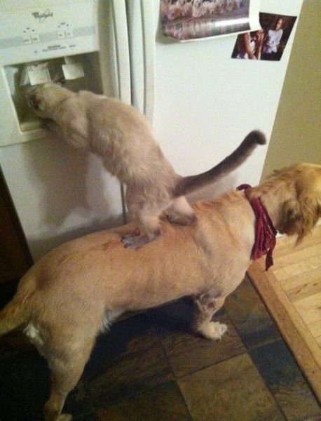
We All Need Support
Notes:
1 minute
Was teacher in DISD - better I got more students my way
KC- middle school PBS-
Chicago and other states around schoolwide behavior
Worked with other approaches academic- behavior – social/emotinal

Slide 3
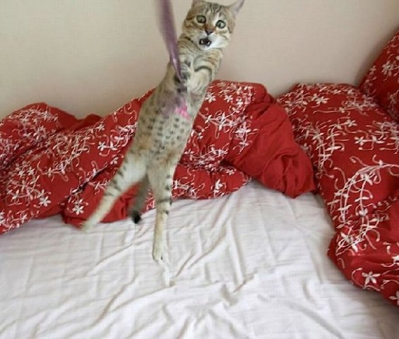
Hang in there!
Notes:
30 sec
From IKEA

Slide 4
Powerpoints: Enduring Understanding
Teams should able to identify the components of developing an effective school climate
Notes:
1 min

Slide 5
Essential Question
What are the components of effective school environments? How do these components connect with an effective instructional model?
Notes:
1 minute

Slide 6
Outline
Enduring Understanding:
Structure
Teaching
Acknowledging
Engagement
Policy/Redirection

Slide 7
Thank you!
Kansas Technical Assistance System Network (TASN)
Beth Clavenna-Deane
Brad Schwartz, TASN
Notes:
7
7
1 minute

Slide 8
Thank you!
“Systematic Analysis and Model Development for High School Positive Behavior Support” Institute for Education Science, U.S. Department of Education, Submitted with the University of Oregon. Awarded 2007.
(Q215S07001)
“Character Education: Application of Positive Behavior Supports” to U.S. Department of Education, Safe and Drug Free Schools. Awarded 2007. (R324A070157)
Notes:
8
8
30 sec

Slide 9
Effective School Environments
Career Builder

Slide 10
Reflection
See Handout “Supportive Environments Quiz”
Take the quiz

Slide 11



Answers
1-3
4-5
6
See short example video 0-1:36; 2:17-2:32
Notes:
Show Zappors video

Slide 12
Classroom
Tell me about your favorite class and teacher

Slide 13
Components of Effective Classroom Settings
Maximized Structure
Post, teach, model reinforce expectations
Active engagement
Varity of ways to acknowledge
  Including success!
Continuum of ways to respond
(Simonsen, Fairbanks, Briesch, Myers, & Sugai, 2008)
See MO PBIS Great 8 training
http://pbismissouri.org/educators/effective-class-practice/

Slide 14
Gallery Walk
See each poster, add what are you doing well in one or more area – school name..
  Structure to learning (e.g., syllabus, routines)
  Teaching expectations
  Engaging content – environment
  Acknowledging (students/staff)
  Policies and Redirection (e.g., tardy, train staff)

Slide 15
What’s in your syllabi?

Slide 16

Mark Shinn (http://markshinn.org)

Slide 17
The Syllabus
Goals
Contact information
Success Traits
Rules/expectations
Activities
Grades/Status
Procedures
Entering
Tardy/Absence
Materials
Assignments (returns)
Due dates
Late, missing work
Communication
Ending class
Consequences
Model projects
Checklists
Sprick (2006)/Shinn http://markshinn.org
See examples – http://www.hankbohanon.net (Resources page under “Teaching”
Sample first days of school for high school teacher)
Notes:
Show handout, look at student expectations

Slide 18
Planning
See example
What connections can you make for your staff?

Slide 19
Teaching Expectations
High School Football?

Slide 20
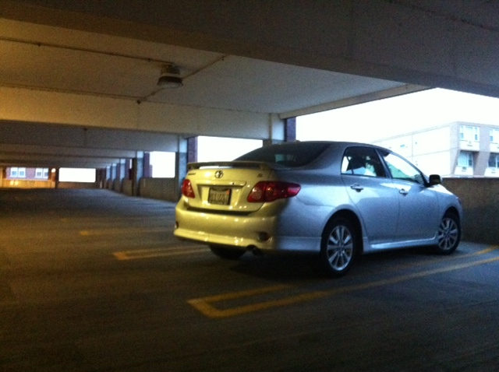
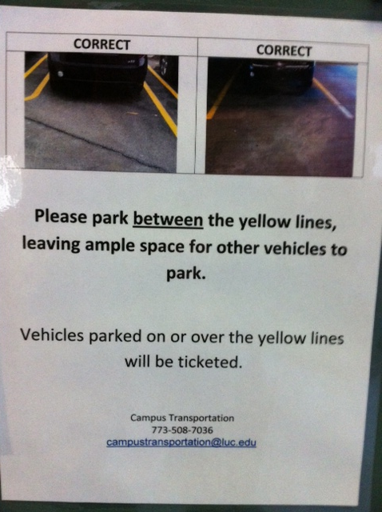
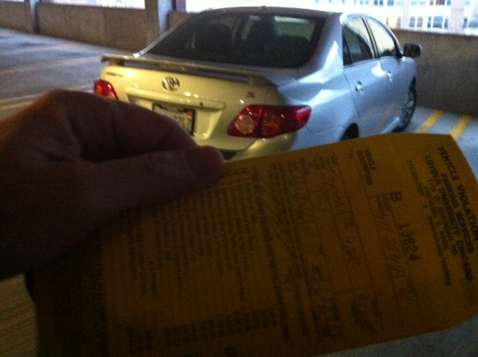
Learning through punishment
Notes:
Working on holiday break on university related tasks
Came up and apparently my car was parked over the line and clearly I was hindering the parking of others - $40 ticket..Are you kidding me? Complained – they said this time we will let you go, but next time it will be enforced..Then..the poster…many of our students learn the rules this way – at home, they say, pass the fn sugar – they are learning a new skill.. Do not assume.. Or you will get “are you kidding me?”

Slide 21
Teaching Expectations
Examples
Staff orientation meetings
Handbooks
Lesson plans
Syllabus
Posters
Booster sessions
Pre-correct/remind
Key Elements
Rationale
Negative examples
Positive examples
Practice/Feedback
Evaluate
See lesson- Blank!! Possible Example Teaching Story 1 or Pre-Teaching
Student example from football
Fruita Monument Example
Notes:
21
Say silk 3 times, then ask what do cows drink
Practice expectations with group

Slide 22
Alignment
College and Career Readiness Anchor Standards for Speaking and Listening 9th and 10th grade students (See handout)
Social and Emotional Standards (SEL)
  Self-awareness and self-management skills
  Social-awareness and interpersonal skills
  Decision-making skills and responsible behaviors
    http://education.qld.gov.au/studentservices/protection/sel/
    http://www.isbe.net/ils/social_emotional/standards.htm
See examples from core?

Slide 23
Aligned with Speaking and Listing Literacy National US Standards
CPS Matrix Aligned with Common Core Standards – See http://www.hankbohanon.net
Notes:
See standards lists or reference in handout

Slide 24
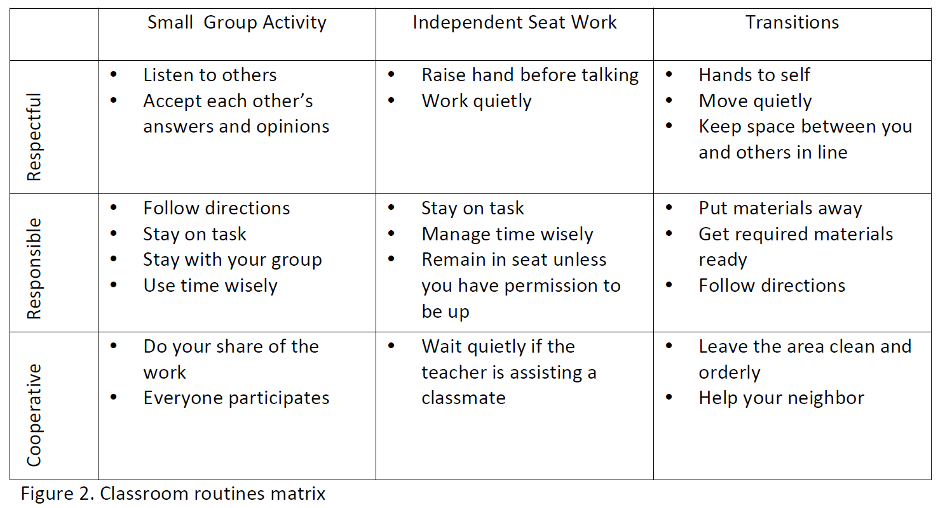
Sample Classroom Matrix
Newcomer (2009)
Which of these behaviors would you like to address?

Slide 25
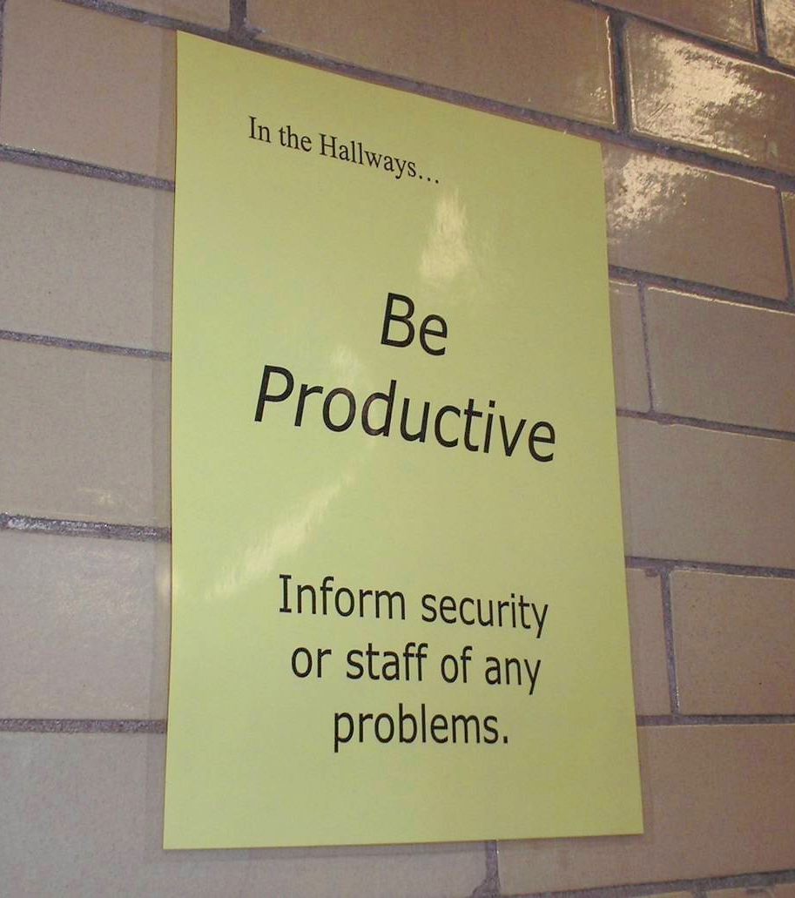
Notes:
25
Mr. Irvin
Defining expectations by location

Slide 26
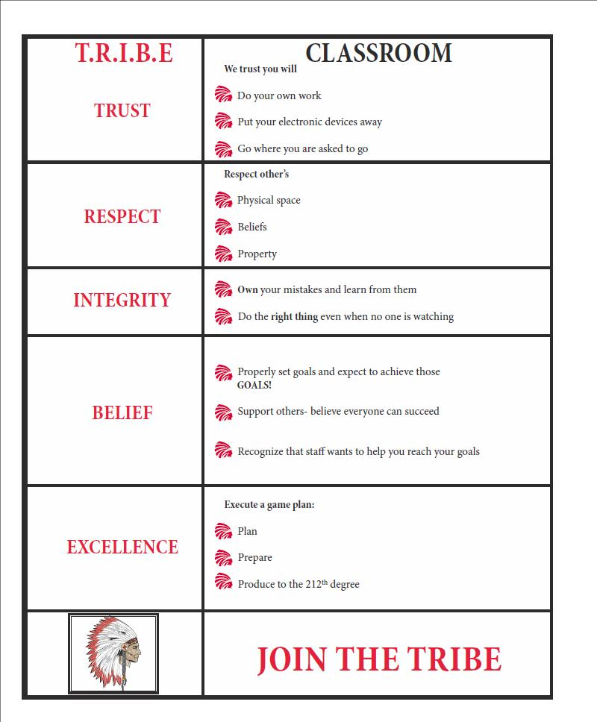
Shawnee Mission Schools, KS

Slide 27
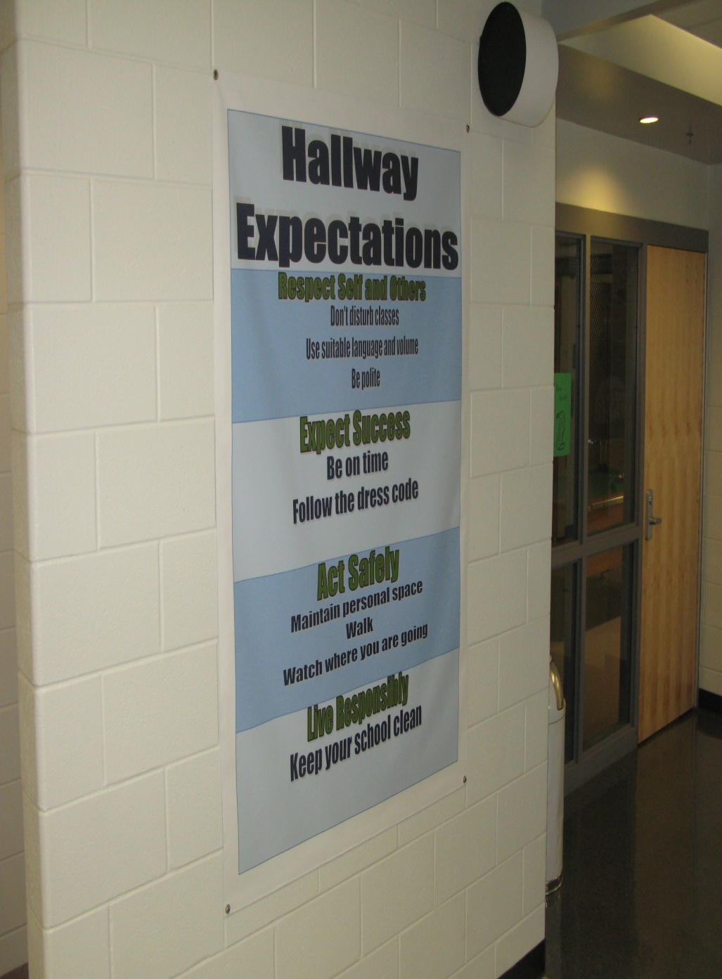
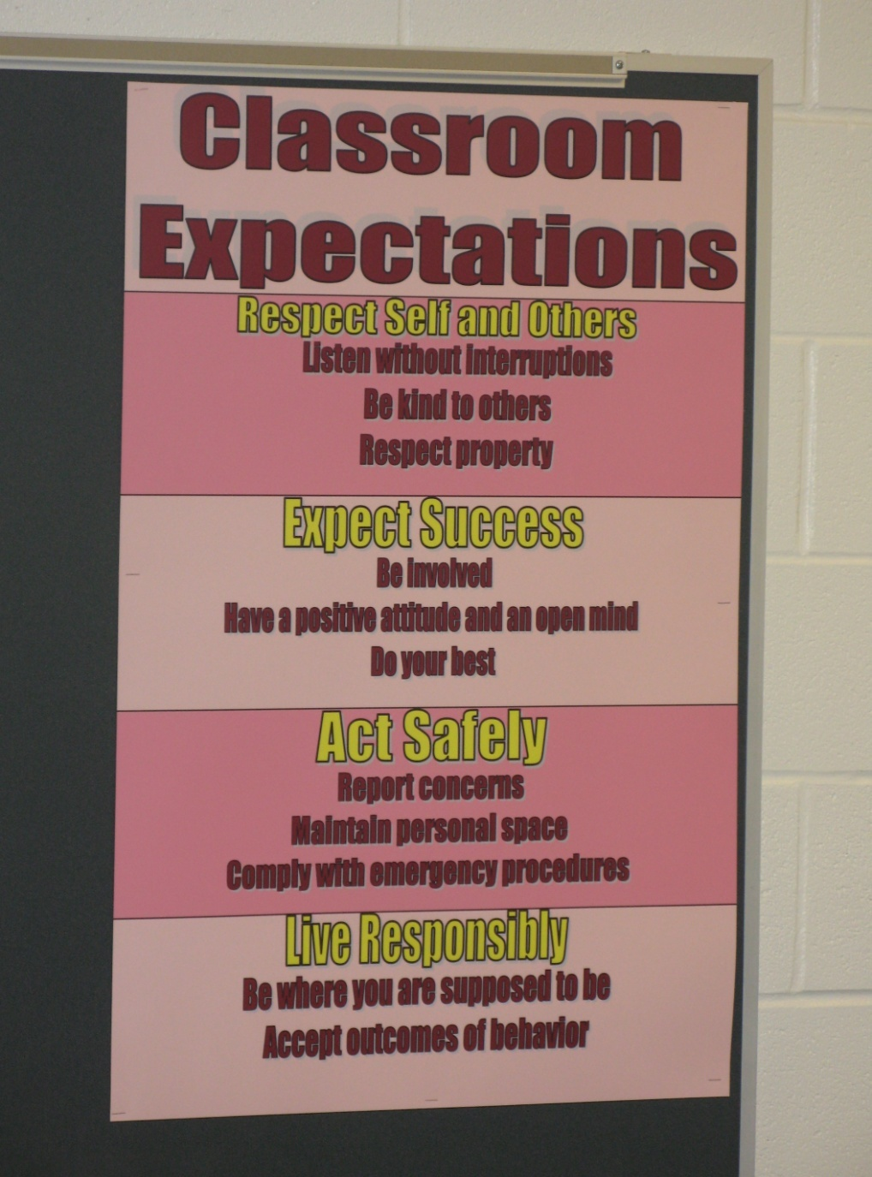
Shawnee Mission Schools, KS

Slide 28

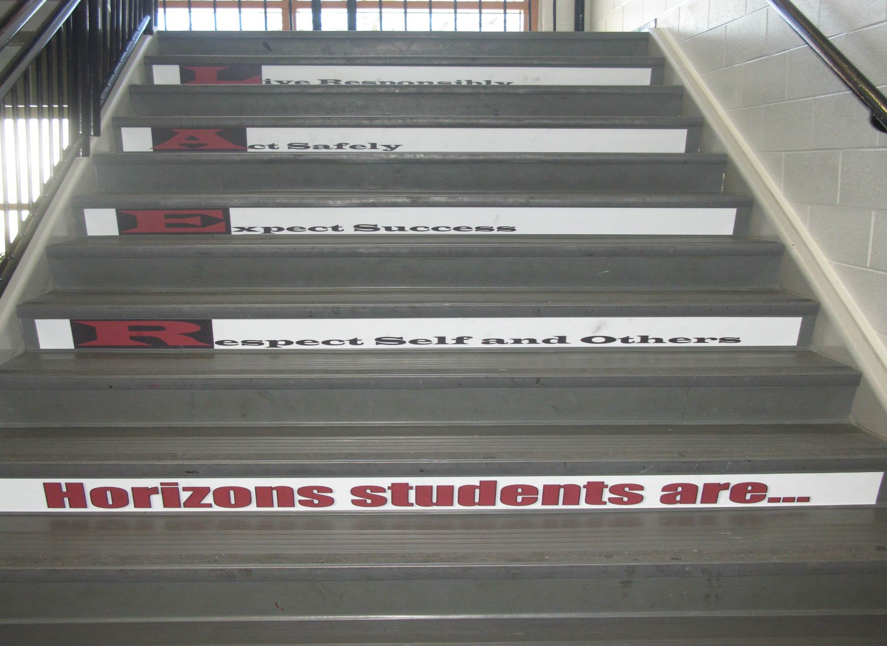
Shawnee Mission Schools, KS

Slide 29
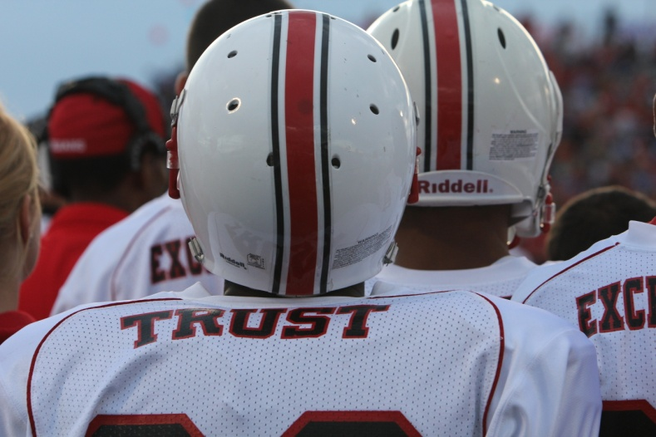
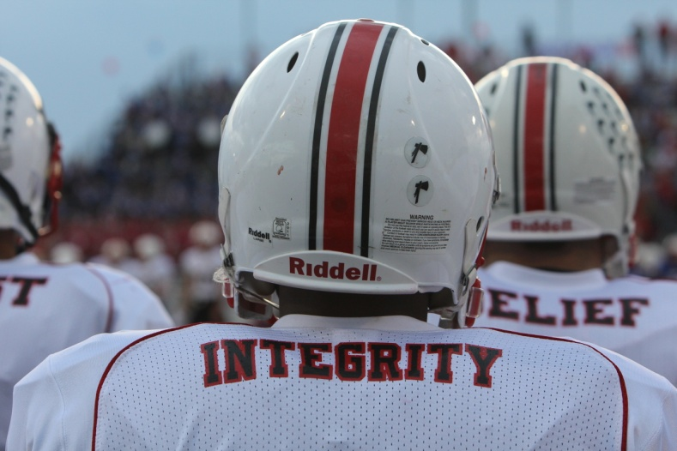
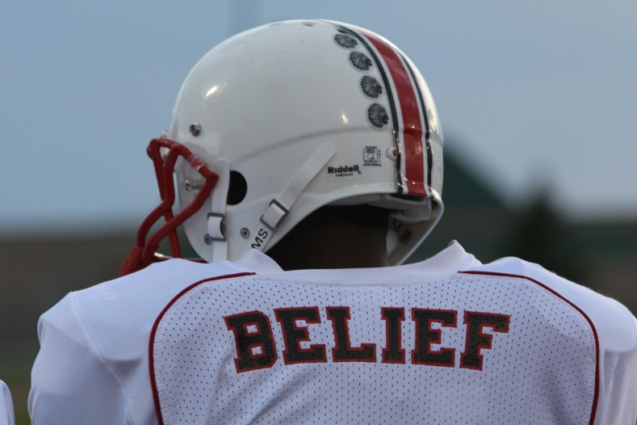
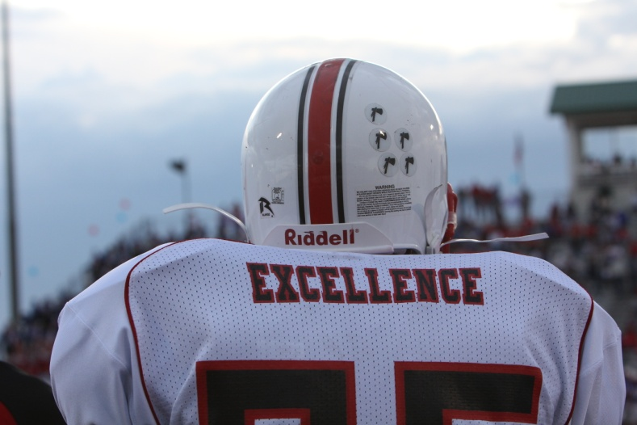
Shawnee Mission North
Football Jerseys
Notes:
Teaching expectations football?

Slide 30

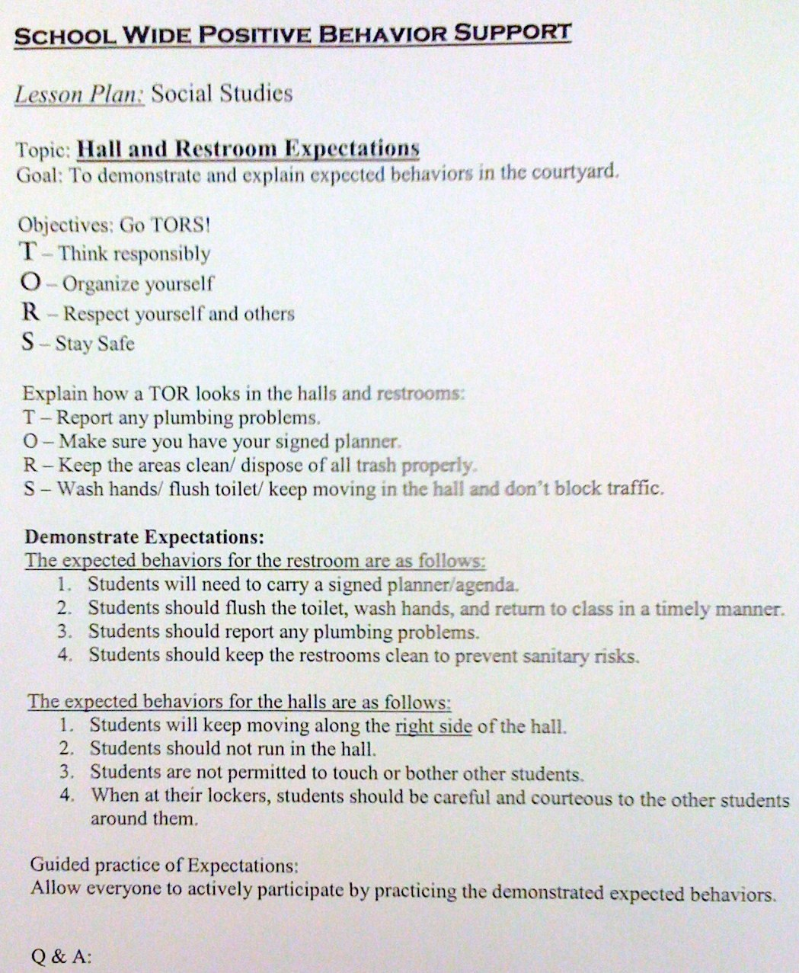
SULPHUR 9th GRADE - PBIS
Lesson Plan
CHUCK HANSEN, Principal
AMY PALMER, Teacher
SULPHUR HIGH SCHOOL, LA

Slide 31
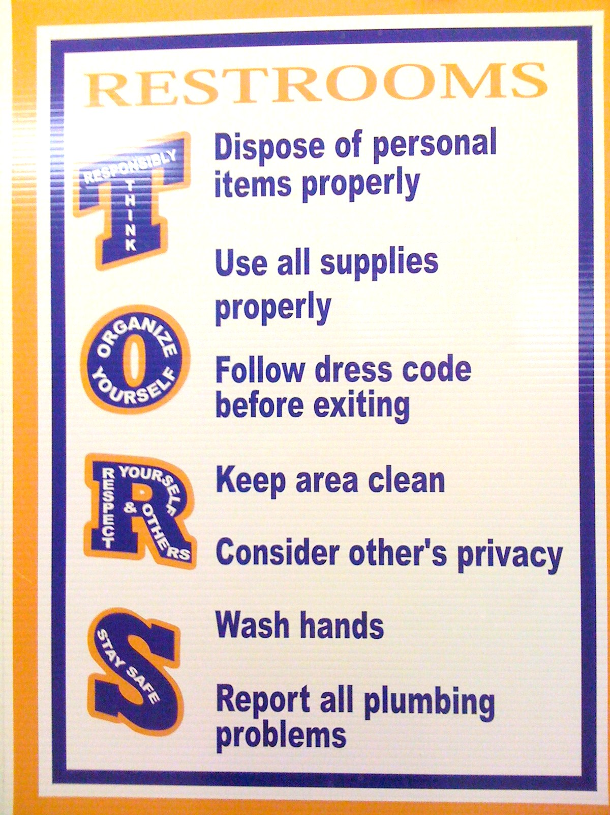
SULPHUR 9th GRADE - PBIS
Posters
CHUCK HANSEN, Principal
AMY PALMER, Teacher
SULPHUR HIGH SCHOOL, LA

Slide 32
See Handout: Matrix for Laptops and Desktops
Notes:
See website for active supervision
If elementary group present – share cafeteria video from Hunstsville

Slide 33
Prepare your staff
http://vimeo.com/14818677 and Huntsville Cafeteria video
See check list in handbook, what did you see?
2 minutes..What does PBS look like…
How are you teaching expectations?

Slide 34
Change Point Analysis: 2005-2008
Possibly the booster for students and PD for staff in Jan/Feb 2007
Notes:
Hank present
(slide animation)
Explanation of possible factors contributing to decrease in Jan/Feb of 2007 will pop up
CLICK again …

Slide 35
Planning
See example lesson plans on website
How are you going to prepare your staff to teach expectations?
What types of behavior? What times of year to teach?
Notes:
See year at a glance

Slide 36
Acknowledgement
Cheerleading Video?
Notes:
Cheerleading video

Slide 37
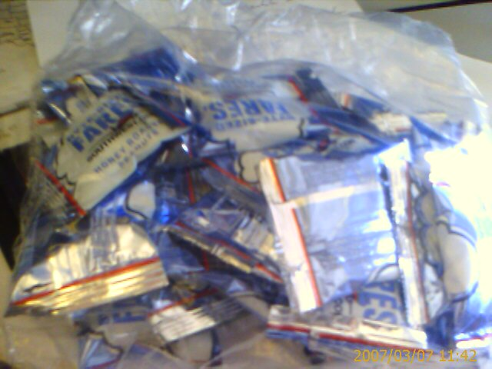
Earned this bag on SW…

Slide 38
Acknowledgement…
As part of schoolwide approach, can lead to improved performance
  Improved attendance (de Baca, Rinaldi, Billig, & Kinnison, 1991).
  Reductions in discipline problems (Bohanon et al., 2012)
Functional outcomes are important
  Relevant curriculum
  Social connection (Dunlap, Foster-Johnson, Clarke, Kern, & Childs, 1995).

Slide 39
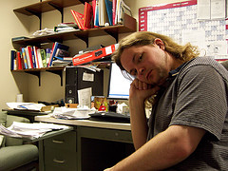
Other Advantages of Praise
Decreases in emotional
exhaustion
Higher efficacy
Reinke, W. M., Herman, K. C., & Stormont, M. (2013).
Photo by Josh Thompson

Slide 40
Video
See examples of why this is important
  One page document “Acknowledging Students for Good Behaviors”
  Cool tool
  What are your doing around acknowledgement?
  Zappos example? See short example video 0-1:36; 2:17-2:32
Notes:
Zappos video only if time
Tell them page number -

Slide 41
High Frequency

Slide 42
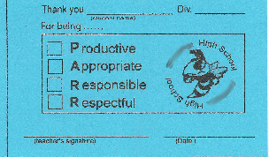
Buzzy Buck
Notes:
42
42
Brigit

Slide 43
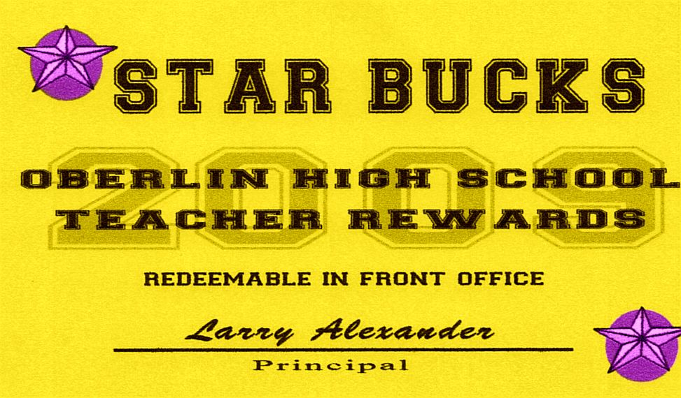
Teacher Rewards Program
2 – Soft Drink
3 – Candy Bar
5 – Preferred Parking
8 – Free Lunch
10 – No Bus Duty
15 – No Morning or
Lunch Duty
20 – Extra Planning
Period
Tonya Ryder, Assistant Principal
Selena Gomes, Graduation Coach / Teacher
Oberlin High School, LA

Slide 44
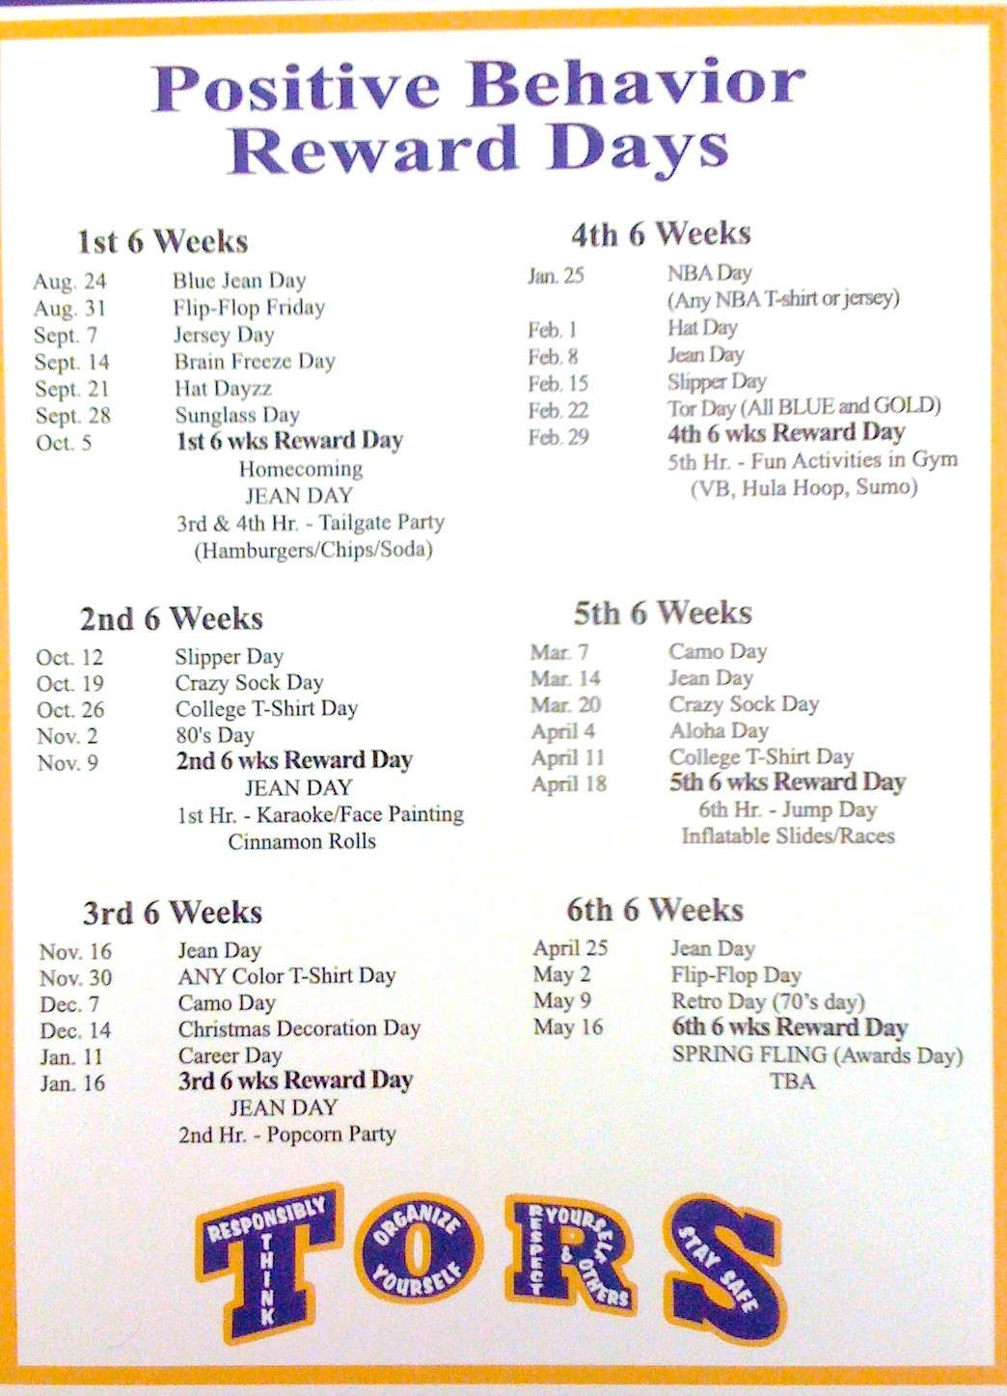
CHUCK HANSEN, Principal
AMY PALMER, Teacher
SULPHUR HIGH SCHOOL, LA

Slide 45
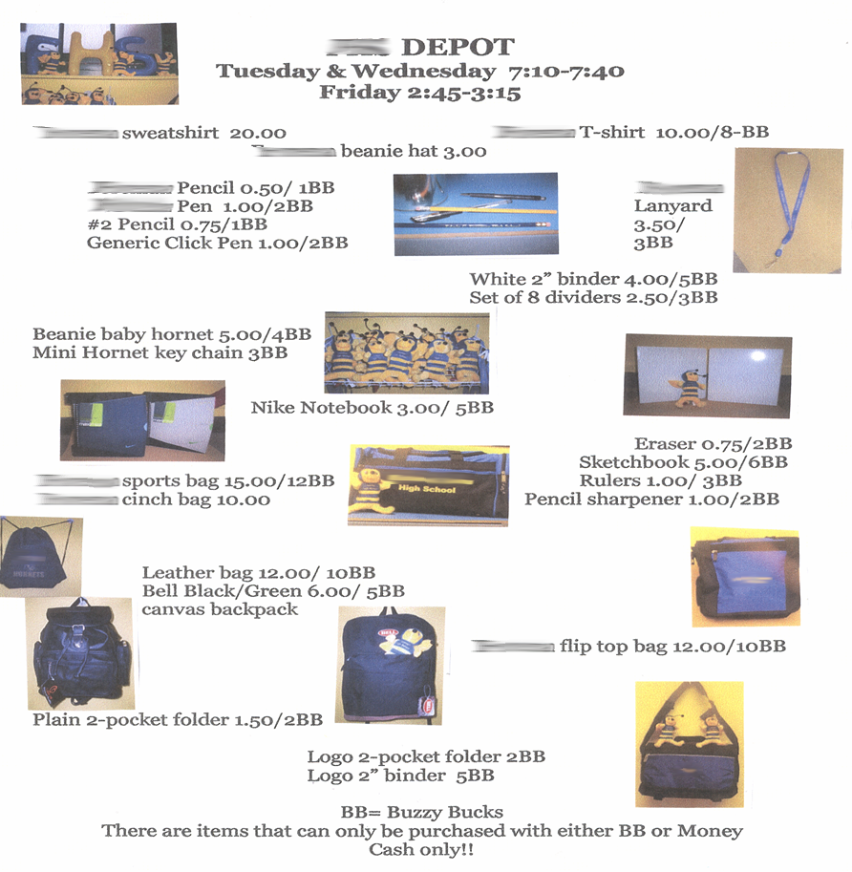
Notes:
45
45
Brigit

Slide 46
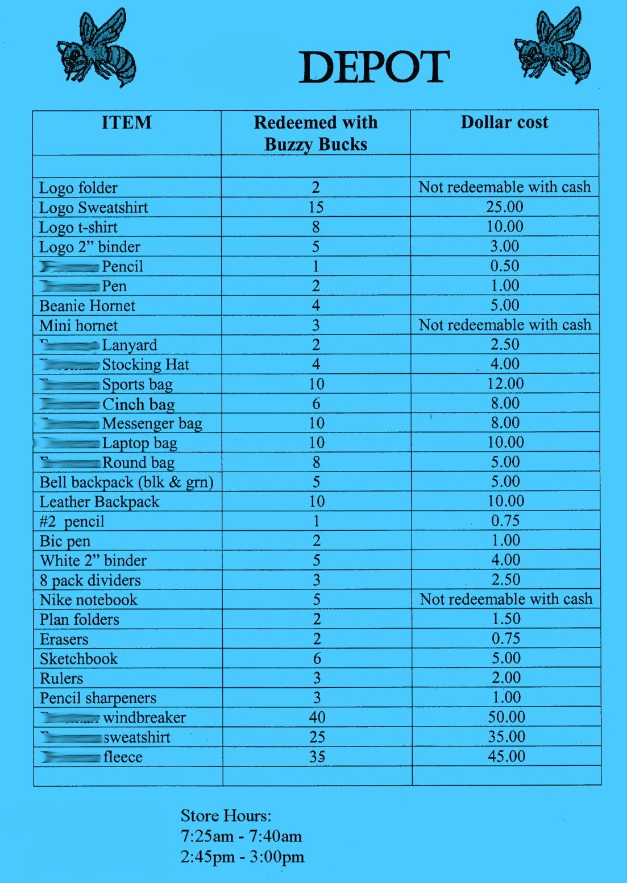
Notes:
46
46
Brigit

Slide 47
Intermediate

Slide 48
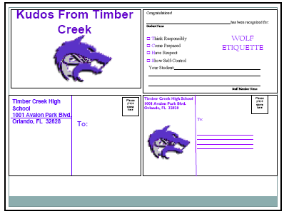
Timber Creek High School, FL, JOHN WRIGHT, PRINCIPAL

Slide 49
Notes:
49
49
Brigit

Slide 50
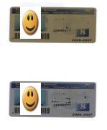
Gold and Silver ID Cards
Notes:
50
50
Brigit

Slide 51
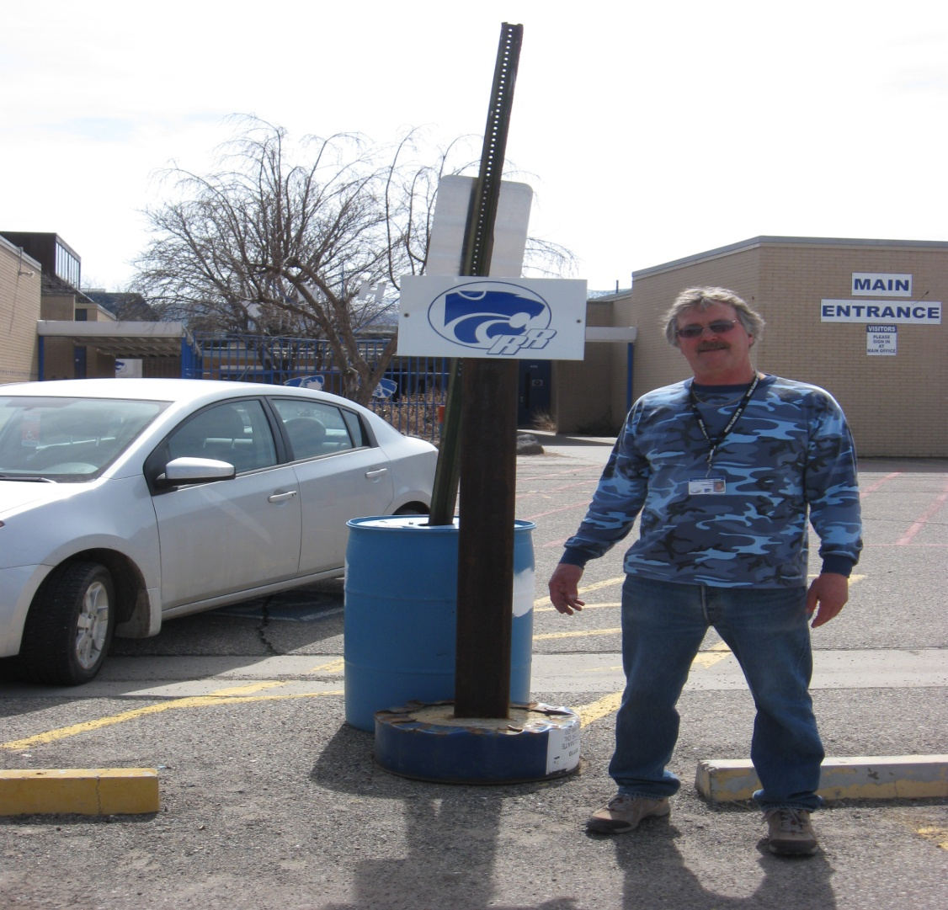
Ron our Liaison
Jody Mimmack, PhD Fruita Monument High School, CO

Slide 52
Large Scale

Slide 53
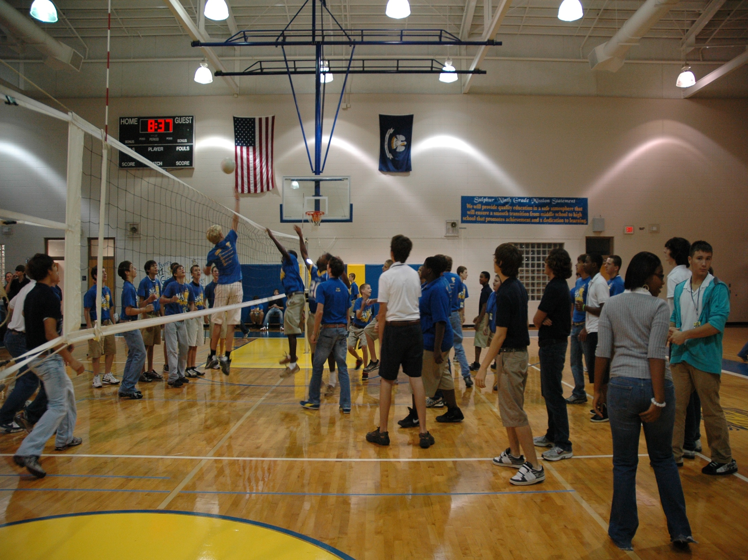
1st Six Weeks Party –
CHUCK HANSEN, Principal
AMY PALMER, Teacher
SULPHUR HIGH SCHOOL, LA

Slide 54
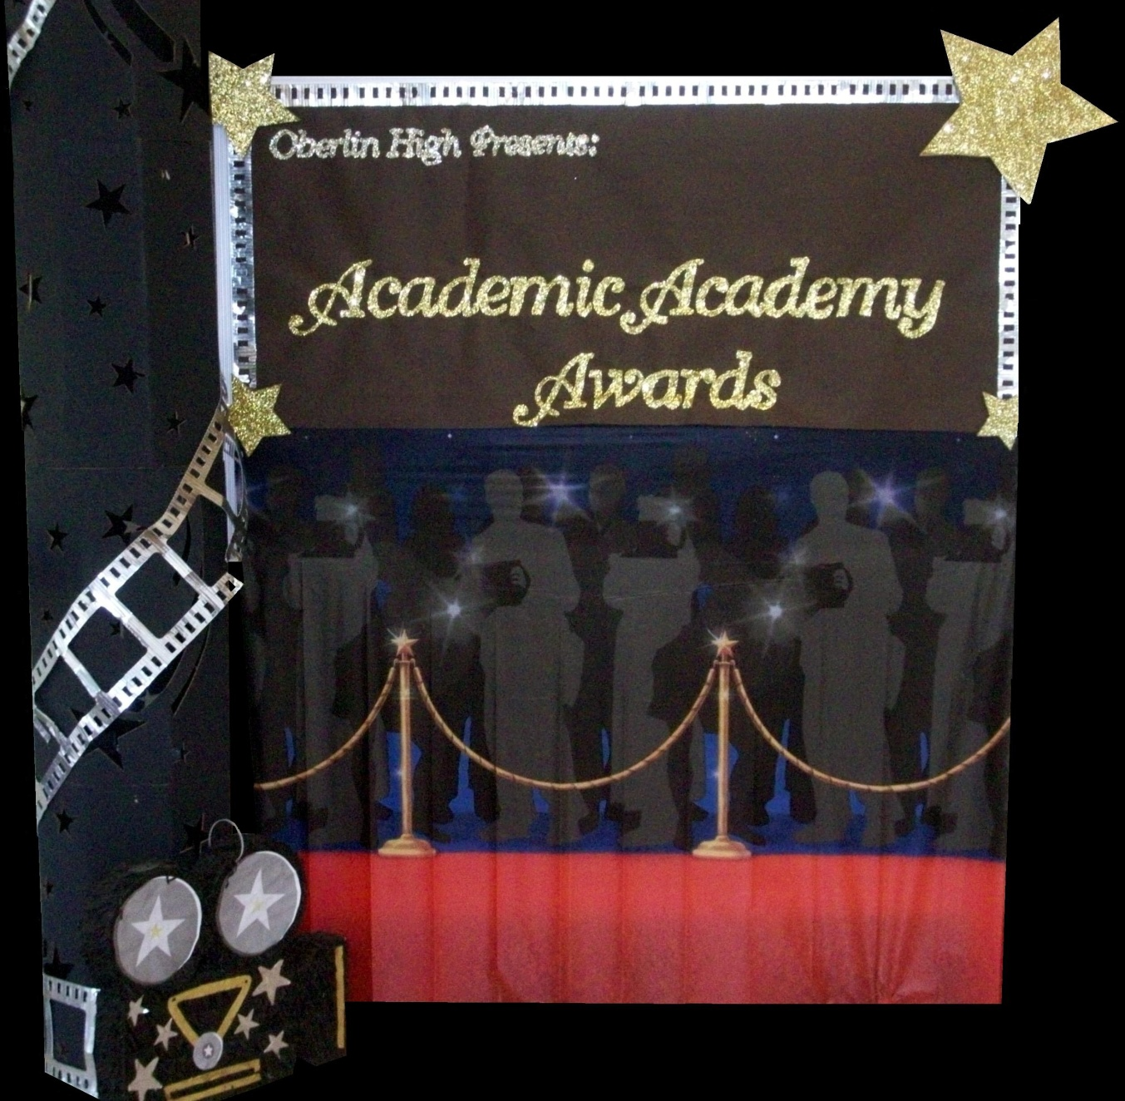
A Night in Paradise…
Tonya Ryder, Assistant Principal
Selena Gomes, Graduation Coach / Teacher
Oberlin High School, LA
Notes:
With these procedures in place, it became important to recognize our students’ social, academic and behavioral successes. We no longer have a traditional academic awards presentation, but instead have a school-wide academic pep rally that recognizes all of our students’ successes in various areas. This year’s theme will be “Academic Academy Awards…A Night in Paradise.”

Slide 55
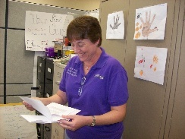
Teacher earns vacation
Timber Creek High School, FL, JOHN WRIGHT, PRINCIPAL

Slide 56
Freebies
http://www.kipbs.org/new_kipbs/familyInfo/freebies/

Slide 57

Certificate of Appreciation
Teaching Spartan of the Month
In recognition of excellence in teaching, __________ is awarded this certificate for devotion to the students, commitment to learning, and dedication to the core values of R High School.
Date
R324A070157
, Principal

Slide 58
Reflective Question
How are you/can you encourage staff to implement student/staff behavior recognition?
Think through levels of acknowledgment for students and faculty.

Slide 59
Engagement and Opportunities to Respond
Non-example – Ferris
Jeff Bliss Video Example
Notes:
Jeff Bliss Video Example

Slide 60

Quiz
What percentage of the American workers
consider themselves engaged at their jobs?
31.7 %
(Gallop, 2015) http://buff.ly/1Gna5NO
Photo from Flicker Creative Commons https://www.flickr.com/photos/pennwic/8142281815/in/photolist-dpvjHe-dpvjNz-dpvths-pQoPx7-aMi2SZ-8vEXtU-8vBWcM-5C6oVt-pEQiQm-97vCko-rKn1F-h7BuWg-h7ybkV-h7wXts-h7y2AF-h7y1NP-8vBVJ2-8vBW8g-8vBVL8-8vBVZr-8vEXGf-8vBWgB-8vBWdB-8vBVTe-8vBW8X-8vBW4Z-h7wVwR-h7x7bs-aMi6nD-5pYDTp-aMiarZ-aMi2xk-aMhLrn-aMhSLR-aMhUsa-aMhK7i-aMhJQz-aMhUbT-aMhJxr-aMhYfc-aMhURP-aMhTt2-aMhV48-aMhKk8-aMhKyV-aMhKRR-aMhLHT-aMhTFt-aMhTXz-aMhUEp

Slide 61

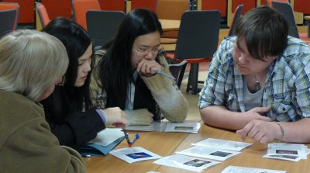
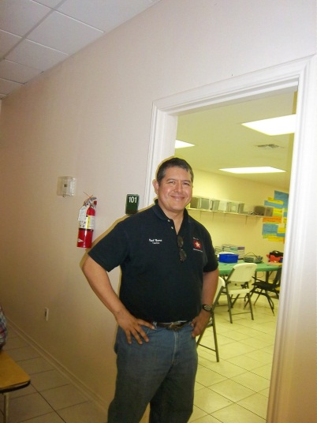
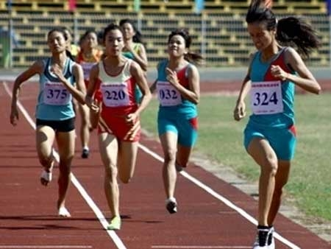

Instructional/Emotional Support
Failure rates
from 17% to 11%
  Choice of responding
  Laughing with students
  Out of desk greeting
Allen, Gregory, Mikami, Lun, Hamre, & Pinata (2013)
  Ask about events
  Ask “why”?
http://mzteachuh.blogspot.com/2012/05/that-kid-drives-me-nuts-tweets-of-day.html
http://ignitebrownsville.blogspot.com/p/picture-gallery.html
http://english.vietnamnet.vn/fms/sports/57762/hanoi-to-host-5th-asean-student-sports-games.html
http://www.phy.bris.ac.uk/news_archive1.html
http://www.hillel.org/jewish/ask-big-questions
Notes:
See Blog in handout and onwebsite

Slide 62
Student Engagement
Webinar on using data to improve student engagement http://fb.me/4vHawmKtz
Webinar for increasing student engagement through real world projects http://bit.ly/1K5ZplN
Assessing school climate webinar http://bit.ly/1IRJgBH
Online survey: student hope, engagement, belonging, and classroom management.... http://fb.me/2bX9tbQh4
Teaching algebra in middle and high school http://buff.ly/1CqNf2c

Slide 63
Example
What connections do you make with behavior and your instructional model?
Schoolwide examples https://www.youtube.com/watch?v=y0H5XsZ1gzA
See example, how is this teacher preventing problem behavior through engagement?
  See steps in handout (see video up to 2:43)
  https://www.youtube.com/watch?v=zxTuPVtayOI

Slide 64
Redirection and Active Supervision
JcPenny’s does this very well
How some mom’s handle the pressure video – Whitney Young

Slide 65
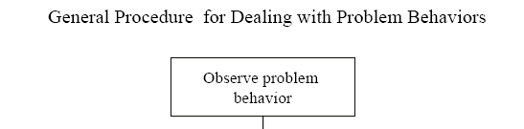
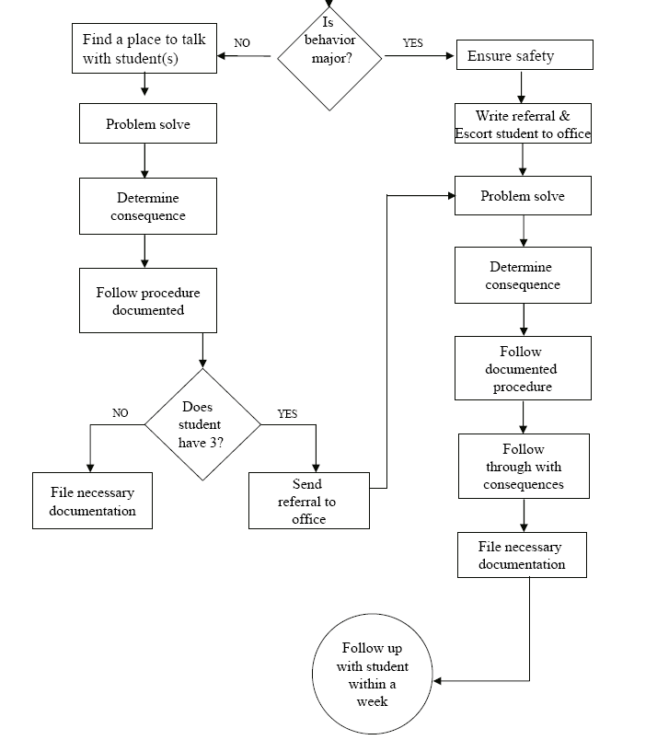
Is the behavior office- managed?

Slide 66
McClatchy Students Video, Dean?
Notes:
66
Alissa present (1 minute max)
66

Slide 67
Be at post
Escort students
Brief interactions
(Johnson-Gros et al., 2008)
See article about hallways @
http://hankbohanon.net
on publications page
Notes:
67
67
Mr. Irvin – tardy policy
being at post, escorting, and interacting with students

Slide 68
Support Staff: Preventing and Responding
Teach skills for prevention
  Good classroom instruction
  Non-classroom settings
Teach skills for redirection
  Classroom
  Non-classroom settings
See Handout “Professional Development on Redirection”

Slide 69
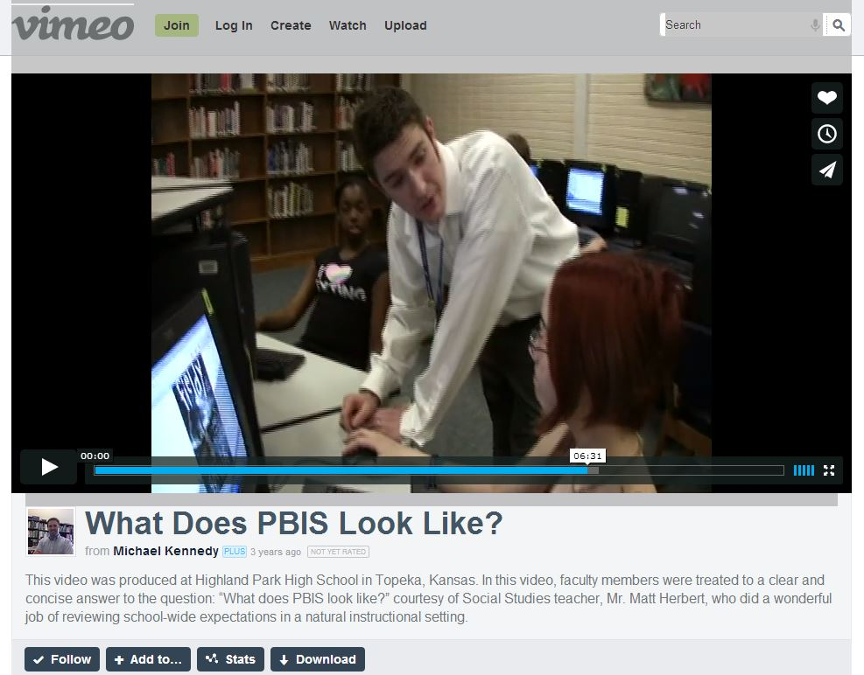
Videos
  What does PBIS Look Like? – Active Supervsion..opennnig
  Redirection examples 6.12 mins
  http://vimeo.com/14818677
Notes:
Tell story from NC when your said slurs about my family - how I handled – how I did not react…

Slide 70
Videos
Michael Kennedy
http://vimeo.com/14818677
  See What does PBIS Look Like? – Opening, Redirection examples 6.12 mins
Other tools
Notes:
Tell story from NC when your said slurs about my family - how I handled – how I did not react…

Slide 71
Resources
Year-at-a-glance
  http://www.hankbohanon.net/Resources_1.html
Training script for booster for staff
  http://www.hankbohanon.net/Resources_1.html

Slide 72

Strategies
Mendler, A. N. & Mendler B. D. (2011) Power struggles: Successful techniques for teachers. Bloomington, IN: Solution Tree.

Slide 73

Classroom Management
Knoster, T. (2013). The Teacher’s pocket guide effective classroom management (2nd Ed.), Baltimore, MD: Paul H Brookes

Slide 74

Addressing Tardies
Start on Time!
Randy Sprick
http://www.safeandcivilschools.com/products/program_previews.php

Slide 75
Student Engagement
Webinar on using data to improve student engagement http://fb.me/4vHawmKtz
Webinar for increasing student engagement through real world projects http://bit.ly/1K5ZplN
Assessing school climate webinar http://bit.ly/1IRJgBH
Online survey: student hope, engagement, belonging, and classroom management.... http://fb.me/2bX9tbQh4
Teaching algebra in middle and high school http://buff.ly/1CqNf2c

Slide 76
Preparing Your Teams
How will you prepare your staff?
See examples and action plan
Notes:
Tell page number

Slide 77
Where are you?
Complete
  Classroom management self-assessment
  http://www.pbis.org/pbis_resource_detail_page.aspx?Type=4&PBIS_ResourceID=164
Free training on active supervision (limited time only)
  https://www.irised.com/freecourse&?utm_source=IRIS+Educational+Media+Mailing+List&utm_campaign=9d73acd430-FREEprog_SysSupEvElem_8_5_2014&utm_medium=email&utm_term=0_cb7ab95a8b-9d73acd430-291122974#.U-U6UPldWSq

Slide 78
Videos
Michael Kennedy http://vimeo.com/channels/129830
  Fruita Monument
  Consistent
Scott’s Pride https://sites.google.com/a/ddouglas.k12.or.us/scotspride/

Slide 79
Finding more plans
Sample Lesson plans
  http://www.pbismaryland.org/
  http://www.hankbohanon.net
More Video Example
  http://vimeo.com/groups/pbisvideos

Slide 80
Other Supports
Defusing Disruptive Behavior in the Classroom
  Geoff Colvin http://www.lookiris.com/store/K-12_Professional_Development/Defusing_Disruptive_Behavior_in_the_Classroom/
Classroom management training
  http://pbismissouri.org/class.html
The FAST Method
  http://www.lookiris.com/store/K-12_Professional_Development/The_FAST_Method_ONLINE/
Notes:
See website

Slide 81
Other Supports
IRIS Online Modules
  http://iris.peabody.vanderbilt.edu/resources.html
Rti Action Network Article Behavior and Academics
  http://www.rtinetwork.org/Learn/Behavior/ar/Integrating-Behavior-and-Academic-Supports-Within-an-RtI-Framework-General-Overview
National Center on PBIS
  http://www.pbis.org
Association of Positive Behavior Support
  http://www.apbs.org
CASEL – SEL Center
  http://casel.org/
Direct behavior rating
  http://www.directbehaviorratings.com/cms/

Slide 82
Summary
What is one thing you can do, that would make everything else more effective for your school(s) related to the school environment?

Slide 83
References
Allen, J., Gregory, A., Mikami, A., Lun, J., Hamre, B., & Pianta, R. (2013). Observations of effective teacher– student interactions in secondary school classrooms: Predicting student achievement with the classroom assessment scoring system—secondary. School Psychology Review, 42(1), 76–98.
Benbenishty, R., Astor, R. A., Roziner, I., & Wrabel, S. L. (2016). Testing the Causal Links Between School Climate, School Violence, and School Academic Performance: A Cross-Lagged Panel Autoregressive Model. Educational Researcher, 45(3), 197-206. doi: 10.3102/0013189X16644603
Bohanon, H. (2015). Changes in adult behavior to decrease disruption from students in non-classroom settings. Intervention in School and Clinic, 15 (1), 12-18. http://ecommons.luc.edu/education_facpubs/39
Bohanon, H. & Wu, M. (2014). Developing buy-in for positive behavior support in secondary settings. Preventing School Failure, 58 (4), 1–7. doi: 10.1080/1045988X.2013.798774 http://ecommons.luc.edu/education_facpubs/17/
Bohanon, H., Castillo, J., & Afton, M. (2015). Embedding self-determination and futures planning within a schoolwide framework. Intervention in School and Clinic. 50 (4), 203-209. http://ecommons.luc.edu/education_facpubs/16/
Bohanon, H., Fenning, P., Hicks, K., Weber, S., Their, K., Akins. B., Morrissey, K., Briggs, A., Bartucci, G., Hoeper, L., Irvin, L., & McArdle, L. (2012). Case example of the implementation of schoolwide positive behavior support in a high school setting. Preventing School Failure, 56 (2), 92-103. http://ecommons.luc.edu/education_facpubs/7

Slide 84
References
Bohanon, H., Gilman, C., Parker, B., Amell, C., & Sortino, G. (2016 online first). Using school improvement and implementation science to integrate multi-tiered systems of support in secondary schools. Australasia Journal of Special Education. pp. 1–18. DOE: 10.1017/jse.2016.8. http://ecommons.luc.edu/ education_facpubs/80/
Blase, K. A., Fixsen, D.L., Sims, B.J., Ward, C.S. (2015). Implementation science – changing hearts, minds, behavior, and systems to improve educational outcomes. Paper presented at the Wing Institute’s Ninth Annual Summit on Evidence-Based Education, Berkeley, CA. http:// nirn.fpg.unc.edu/resources/ implementation-science-changing-hearts-minds-behavior-and-systems-to-improve
Brawley, S. (accessed March 22, 2011). PBS in the classroom. M.Ed. Heart of Missouri RPDC. http://www.cesa7.org/pbis/Classroom_Management.asp
Burke, A. (2015). Early Identification of High School Graduation Outcomes in Oregon Leadership Network Schools. REL 2015-079. Regional Educational Laboratory Northwest.
de Baca, M. R. C., Rinaldi, C., Billig, S., & Kinnison, B. M. (1991). Santo Domingo School: A rural schoolwide project success. Educational Evaluation and Policy Analysis, 13(4), 363-368. doi: 10.3102/01623737013004363
Flannery, B. K., Guest, E., & Horner, R. (2010). SWPBS: Schoolwide positive behavior supports. Principal Leadership, 11(1), 38-43. doi: 2123461661

Slide 85
References
Johnson-Gros, K. N., Lyons, E. A., & Griffin, J. R. (2008). Active supervision: An intervention to reduce high school tardiness. Education & Treatment of Children, 31(1), 39-53.
Koon, S., & Petscher, Y. (2016). Can scores on an interim high school reading assessment accurately predict low performance on college readiness exams? (REL 2016–124). Washington, DC: U.S. Department of Education, Institute of Education Sciences, National Center for Education Evaluation and Regional Assistance, Regional Educational Laboratory Southeast. Retrieved from http://ies.ed.gov/ncee/edlabs.
Kotter, J. (1995). Leading change: Why transformation efforts fail. Harvard Business Review, 73(2), 59–67.
McKeon, G. (2014). Essentialism: The disciplined pursuit of less. Crown Business
McNeely, C. A., J. M. Nonnemaker, J.M., & Blum, R. W. (2002). Promoting School Connectedness: Evidence from the National Longitudinal Study of Adolescent Health. The Journal of School Health 72(4): 138-146.
McIntosh, K., Filter, K. J., Bennett, J. L., Ryan, C., & Sugai, G. (2009). Principles of sustainable prevention: Designing scale-up of School-wide Positive Behavior Support to promote durable systems. Psychology in the schools, 47(1), n-a-n/a. doi:10.1002/pits.20448
McIntosh, K., Flannery, K. B., Sugai, G., Braun, D., & Cochrane, K. L. (2008). Relationships between academics and problem behavior in the transition from middle school to high school. Journal of Positive Behavior Interventions, 10(4), 243–255. doi:10.1177/1098300708318961
Morrissey, K. L., Bohanon, H., & Fenning, P. (2010). Positive behavior support: Teaching and acknowledging behaviors in an urban high schools. Teaching Exceptional Children, 42(5), 26-35.

Slide 86
References
National High School Center, National Center on Response to Intervention, and Center on Instruction. (2010). Tiered interventions in high schools: Using preliminary “lessons learned” to guide ongoing discussion. Washington, DC: American Institutes for Research. http://bit.ly/2r0SaeE
Newcomer, L. (2009). Universal positive behavior support for the classroom. PBIS Newsletter, 4(4). Retrieved September 24, 2009 from http://www.pbis.org/pbis_newsletter/volume_4/issue4.aspx
Rowan, B., Correnti, R., Miller, R. J., & Camburn, E. M. (2009). School improvement by design: Lessons from a study of comprehensive school reform programs. Consortium for Policy Research in Education. Retrieved from http://www.cpre.org/school-improvement-design-lessons-study-comprehensive-school-reform-programs
Sherif, M., Harvey, O. J., White, B. J., Hood, W. R., & Sherif, C. W. (1961). Intergroup conflict and cooperation: The Robbers Cave experiment (Vol. 10): University Book Exchange Norman, OK.
Simonsen, B., Fairbanks, S., Briesch, A., Myers, D., & Sugai, G. (2008). Evidence-based practices in classroom management: Considerations for research to practice. Education & Treatment of Children, 31(3), 351-380. doi:10.1353/etc.0.0007
Therriault, S. B., Heppen, J., O’Cummings, M., Fryer, L., & Johnson, A. (2010). Early warning system implementation guide. Retrieved from http://www.betterhighschools.org/documents/NHSCEWSImplementationGuide.pdf
Vermont Agency of Education (Accessed July 28, 2016). The 13 dimensions of school climate. Vermont Agency of Education, Retrieved from: http://education.vermont.gov/documents/edu-school- climate-13%20Dimensions.pdf

