Slide 1
Preparing for Acknowledgement Systems for PBIS in Secondary Schools
2017 Kansas MTSS Symposium
Hank Bohanon
hbohano@luc.edu
http://www.hankbohanon.net
https://twitter.com/hbohano
https://www.facebook.com/hank.bohanon
Notes:
Who is here – you 15 minutes for set up - 5
Coaches – internal external
Middle schools/ High Schools
Parents
General education teachers
Special Education teachers
Counselors
School Psychologists
Social workers?
Administrators?
Academic focused schoolwide approach? Behavior? Social/emotional?
How many years?
5 or more
3 or more
1 or more
Fact finders?

Slide 2
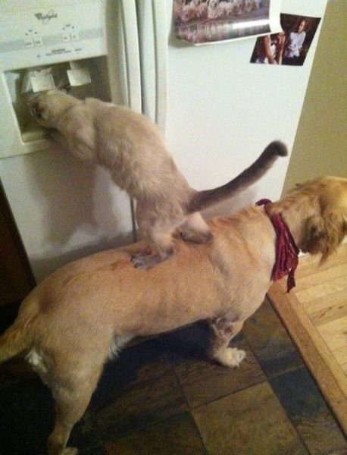
We All Need Support
Notes:
1 minute
Was teacher in DISD - better I got more students my way
KC- middle school PBS-
Chicago and other states around schoolwide behavior
Worked with other approaches academic- behavior – social/emotinal

Slide 3
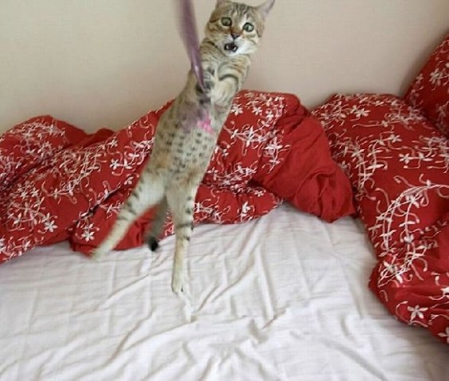
Hang in there!
Notes:
30 sec
From IKEA

Slide 4
Powerpoints: Enduring Understandings
Prepare our staff for implementation
Help our teams work together
Be efficient and effective with our time
We need to use data to plan for interventions
Notes:
1 min

Slide 5
Essential Questions
How do you prepare systems to enhance the support in your environment
How do you organize personnel in ways to support to enhance the support in your environment
What are effective ways to encourage teams to work together efficiently and effectively?
Notes:
1 minute

Slide 6
Essential Questions
What are effective methods to consolidate actions and activities
How can teams convert data to a plan of action
Notes:
1 minute

Slide 7
Outline
Enduring Understanding:
Prepare your staff
Develop teams
Prioritize efforts
Organize multiple data sources

Slide 8
Thank you!
Kansas Technical Assistance System Network (TASN)
Beth Clavenna-Deane
Brad Schwartz, TASN
Notes:
8
8
1 minute

Slide 9
Thank you!
“Systematic Analysis and Model Development for High School Positive Behavior Support” Institute for Education Science, U.S. Department of Education, Submitted with the University of Oregon. Awarded 2007.
(Q215S07001)
“Character Education: Application of Positive Behavior Supports” to U.S. Department of Education, Safe and Drug Free Schools. Awarded 2007. (R324A070157)
Notes:
9
9
30 sec

Slide 10
Key Principles
When did you get in trouble when you knew better?

Slide 11
MTSS: 4 Domains of School Climate
Safety
Behavioral Expectations
Teaching and Learning
Support for Learning
Social Skills Development
Interpersonal Relationships
Respect for Diversity
Social Supports for Students
Health & Wellness Expectations
Sense of Physical Security
Sense of Social-Emotional Security
Physical Environment
School Connectedness & Community Engagement
Physical Surrounding
Student Engagement & Self-Direction
Leadership
Professional Relationships
(Vermont Agency of Education, Accessed July 27, 2016)
Notes:
Make connections in handbook with VT
How familiar are you?

Slide 12
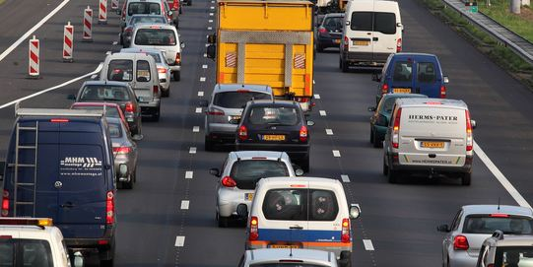
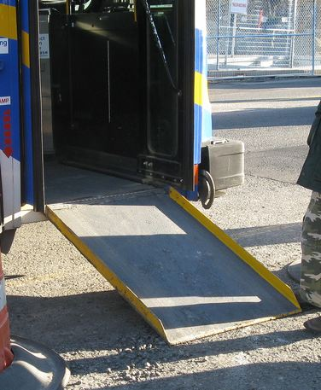
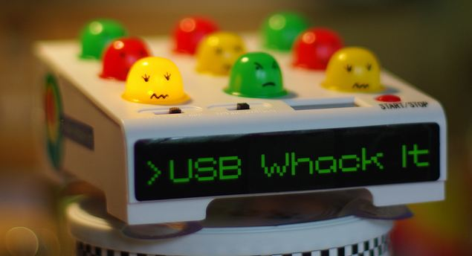


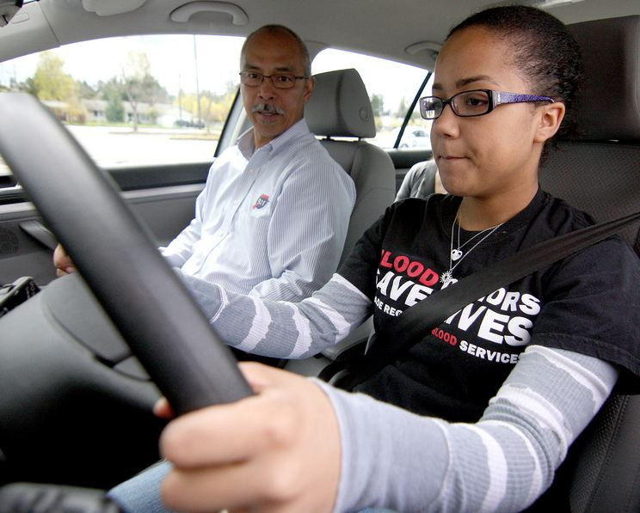
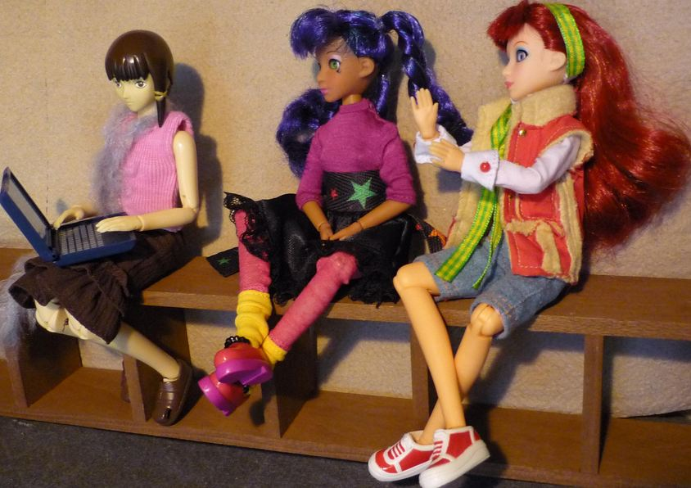
Key Principles
Incidental Benefit
Schoolwide
Schoolwide
Punishment
Reinforcement
Shaping
Reinforcement
Notes:
Whack a mole – don’t start individual
Highway - schoolwide
Ramp – incidental benefit
Yelling teacher – reinforcement
Student in the office - reinforcement
Stop sign – punishment
This works for teachers..teaching vs learning…
Learn to drive - shaping

Slide 13
Activity
While music plays, walk around
When music stops, find partner
Discussion
  When did you see examples or non-examples of implementation practices? (P. 9 of Handbook)

Slide 14
Supporting Social Competence &
Academic Achievement
4 PBS Elements
OUTCOMES
Supporting
Decision
Making
Supporting
Staff Behavior
SYSTEMS
DATA
PRACTICES
Supporting
Student Behavior

Slide 15
Designing School-Wide Systems for Student Success
A Response to Intervention Model/MTSS
Questions
Answers
Tertiary Interventions/Tier 3:
Dig deeper – why?
Tertiary Intervention/Tier 3:
Ask questions,
Teach what works better *
Antibiotics
1-5%
1-5%
Secondary Interventions/Tier 2:
Can’t do/won’t do
5-10%
5-10%
Secondary Interventions/Tier 2:
Coke test analogy..
Aspirin, Soup*
Universal Intervention
Tier 1:
Were we clear? Does it work?
How do we respond?
80-90%
80-90%
Universal Intervention/Tier 1:
Be clear on expectations,
make sure they work, be humane
Rest, Vitamins*
*Scott, T. examples
Notes:
15
You may have a large copy of this in your handouts
tatoo..it is washable (just kidding)..
Example –
SW – Respect – Response Be kind – show poster ahead
Secondary – student could not write very well – even when given coke..skill deficit – then accommodate with writing prompt and remediate – teach skills
Tertiary – attention – personal greetings at the door and pre-correction was enough

Slide 16
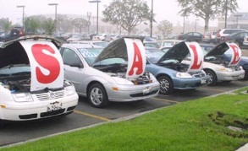
Buying a car
List out the steps you took last time you bought a car…
bestig.blogspot.com

Slide 17
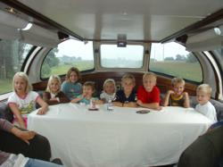



Steps
Consider Needs
Research
Not First!
Sample
Sign Up
Car http://www.prweb.com/releases/2012/8/prweb9815542.htm
Research http://www.uic.edu/uic/research/
Test drive http://www.familyhyundai.com/family-hyundai-customer-reviews/
Contract http://www.icts.uiowa.edu/content/contract-negotiation
Notes:
Place the steps for purchasing a car in the right order – at each step – what are people afraid of? Why did you not see the contact first? People are not the change – but the loss – you have to build the why before what and how. See Being Boss

Slide 18
Implementation
Exploration and adoption – buy in, urgency
Program installation – team, roles
Initial implementation – piloting, examples
Full operation – changing staff roles (some/all)
Innovation – use credibility, codifying roles
Sustainability – new leaders, share with all
(Kotter, 1995; Blasé, Fixsen, Sims, & Ward, 2015)
Notes:
1 introduction and universals 2 setting up your team, 3 is data, 4th is best practices (MT Approach)

Slide 19
Exploration Examples From 4 High Schools
  Communication - timeliness
  School climate
  Efficient meetings
  Integration of PD
  Work with PLCs
  Define academic and behavior expectations
  Use data for decisions
  Braid initiatives
  Align administrative supports with strategies
  Students within special support needs
  Need for increased school spirit
  Distribute roles
  Parental involvement
See example of questions: http://www.hankbohanon.net (Resources tab)
Notes:
Focus groups – across students, teachers, administrations
See Handbook – Niles West

Slide 20
Show Similar Example
Joe Zima, LMSW, Behavior Specialist St Clair County RESA

Slide 21
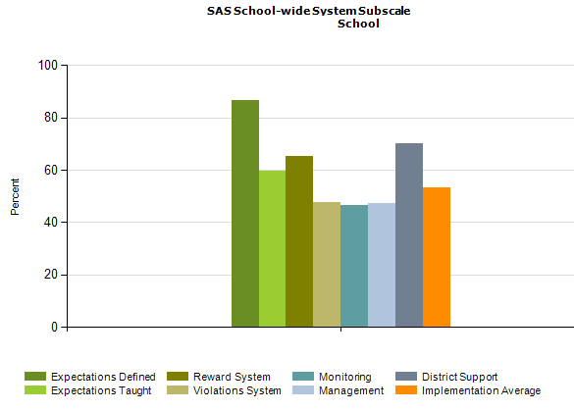
PBS Self-Assessment Survey – www.pbis.org
Notes:
See my website under resources – academic and behavior self- assessment from Niles West high school – based of Flordia’s RtI model

Slide 22
Designing School-Wide Systems for Student Success
A Response to Intervention Model
Academic Systems
Behavioral Systems
Tertiary Interventions/Tier 3:
*Young Leaders
*National Honor Society; Eyes on the World
Secondary/Tertiary-SLC teams
Tertiary Intervention/Tier 3:
- Assessment based…Wraparound,
1-5%
1-5%
Secondary Interventions/Tier 2:
Secondary/Tertiary-SLC teams
AVID; Mentor Moms
Credit Recovery
After School Matters
ELL
Summer School/(First Year Connection)
Gear-Up
5-10%
5-10%
Secondary Interventions/Tier 2:
- AVID, After School Matters
- ELL;Gear-up;
Summer School(First Year Connection)
- In HouseTutoring- Mentor Moms
80-90%
80-90%
Universal Intervention
Tier 1:
In-House Tutoring; Summer
School (First Year Connection),ASPIRA;_
Service Learning;
Attendance andTardies_
SLC; PARR; First Year Seminar
Universal Intervention/Tier 1:
-PARR
Attendance and Tardy
- Small Learning Communities (SLC)
Notes:
22
Shock and Awe

Slide 23
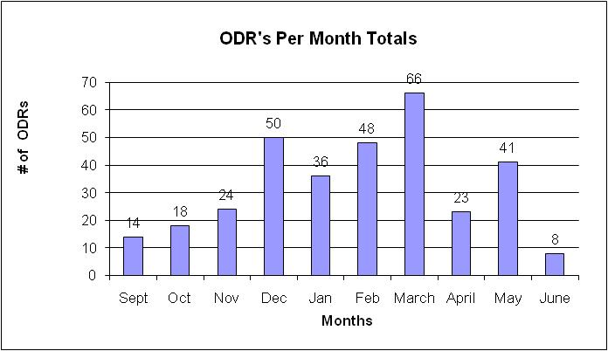
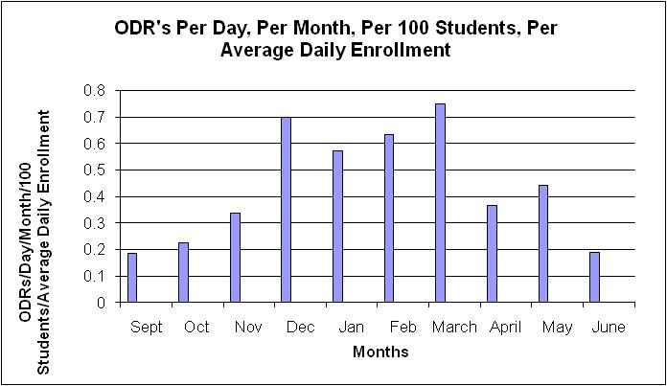
What are our priority months for support?

Slide 24
Build Case with Data:
Create Urgency (Kotter, 1995)
Writing a referral is not a bad thing, it is necessary!
We hope you have fewer reasons
Instructional time given to referrals
(20 Minutes per referral)
77,400 Minutes = 1,290 Instructional Hours

Slide 25
(Bohanon & Wu, 2014)

Slide 26
Question
Given these example, what are some ways you can “ask before you tell” to obtain, maintain, or increase buy-in from staff/schools?
See page 24 of Handbook, steps 1-4

Slide 27
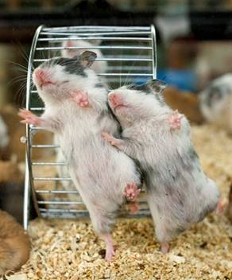
Effective teams in school settings
Duck video
Notes:
45 minutes for section
Duck Video

Slide 28
Possible Structures for MTSS

Slide 29
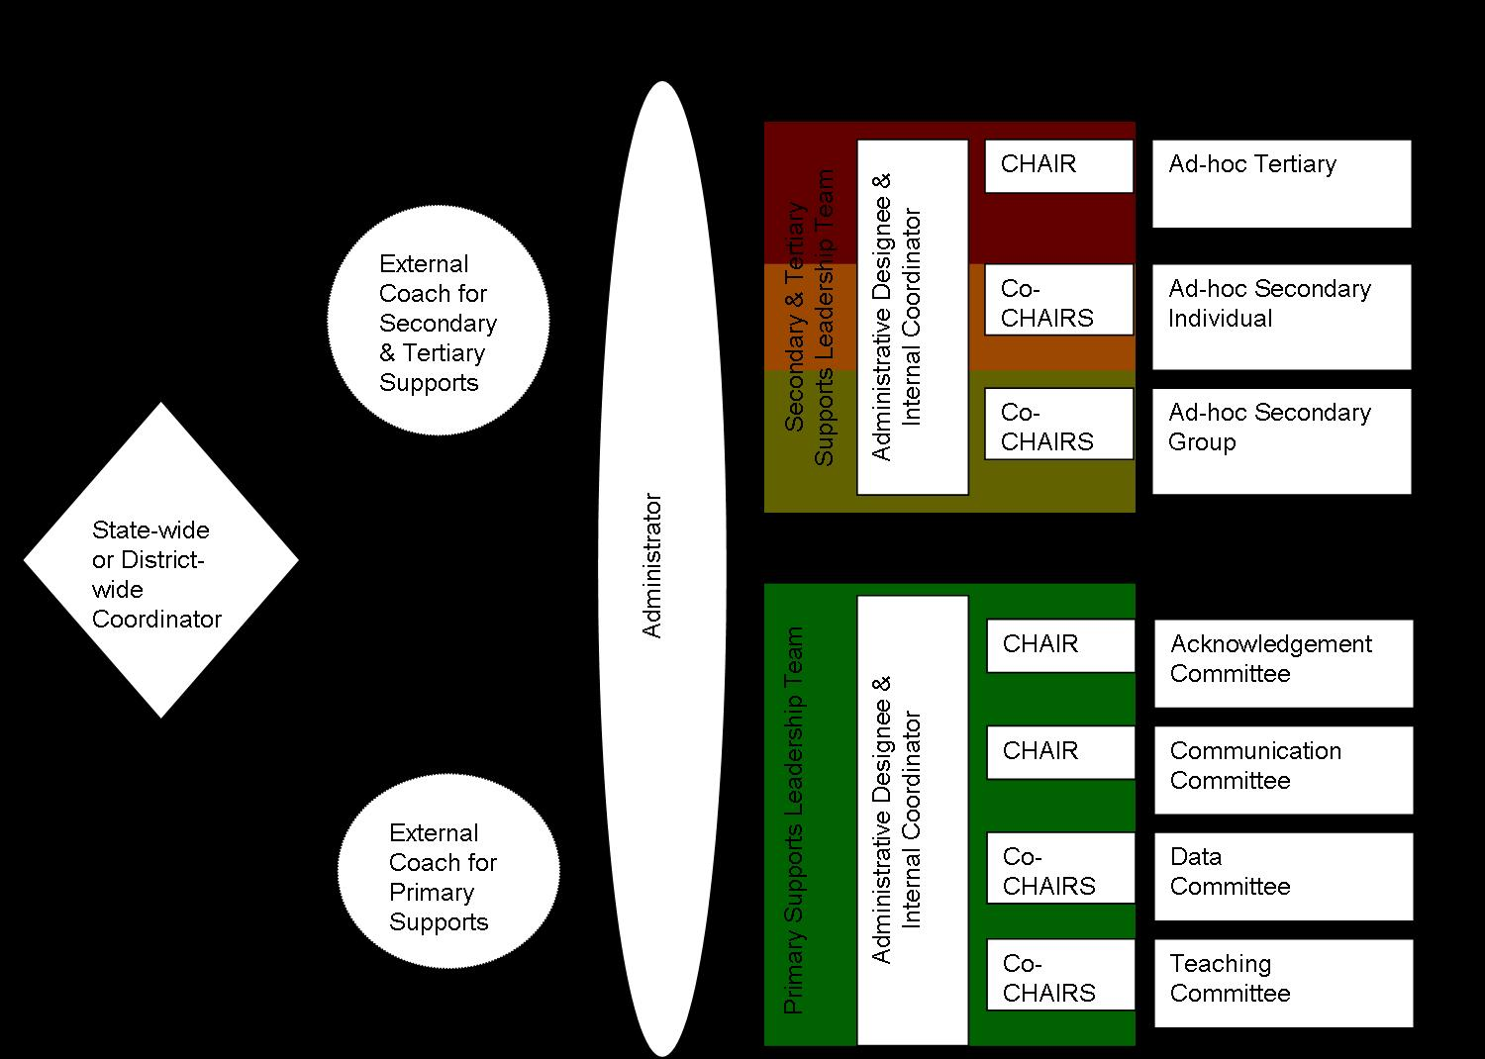
ICEPS Project, 2008
http://www.luc.edu/cseit

Slide 31
Designing School-Wide Systems for Student Success
A Response to Intervention Model
MTSS/SIP Teams
Examples
Few: Leadership Team
From problem-solving room
coordinator to data
chair. Department reps
1-5%
1-5%
5-10%
5-10%
Some: Subcommittees.
Prepare for leadership team
Clusters/divisions,
grade levels
review data.
Shadow chairs
80-90%
80-90%
All: Responsible for
MTSS/SIP
All staff teach
expectations
Job descriptions
reflect MTSS/SIP
Notes:
31

Slide 32
Model Positions Document
Building Based Staff
School Liaison | Administrator who oversees functioning and makes administrative decision for all tiers of MTSS within the building (e.g. attends meetings, allocates resources) | 10 hours a month | Sara,
Internal Coordinator (Primary Support Leader Team) | Internal staff who can lead staff, with support from the External Coach, in implementing MTSS schoolwide academics and behavior practices, run meetings and oversee sub-committees | 10 hours a month | Sara
Acknowledgement CHAIR | Lead the acknowledgement of student and staff behavior for schoolwide efforts, sub-committee in planning for celebrations and reinforcement systems within the school, meet with internal coordinator 2 times a month | 8 hours a month | Terry
Acknowledgement Sub-committee | Facilitate schoolwide acknowledgment activities, including design and implementation. | 4 hours a month | Janet

Slide 33
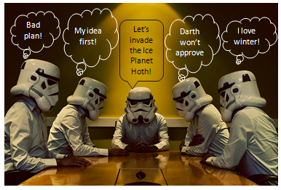

Slide 34
Effective Meetings
Scheduling and communication
Creation and use of an agenda
Meeting begins and ends on-time
Keeping the meeting on track
Action plan/delegating tasks
Meeting Participation
Dissemination of meeting notes
See examples: Herding Cats, Bad Meetings, Action Plans, Sample VT agenda
Rate yourself –
handbook
Notes:
Herding cats video
See Handbook

Slide 35
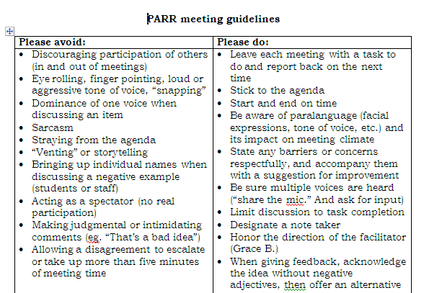
Notes:
35
Key things
Helped meetings become more efficient because
Helped keep everyone on task and respectful – depersonalized challenges
Everyone had to leave the meeting with a task – kept the spectators and ventors away
35

Slide 36
Possible Structures for MTSS
Who is/could be on your core universal team?
How do you assign roles?
How are responsibilities distributed?
Notes:
Example from Spaulding? Distributive leadership

Slide 37
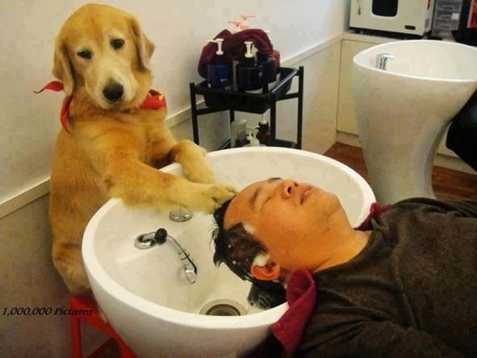
Work smarter and effective teams in school settings

Slide 38
Designing School-Wide Systems for Student Success
A Response to Intervention Model
Academic Systems
Behavioral Systems
Tertiary Interventions/Tier 3:
*Young Leaders
*National Honor Society; Eyes on the World
Secondary/Tertiary-SLC teams
Tertiary Intervention/Tier 3:
- Assessment based…Wraparound,
1-5%
1-5%
Secondary Interventions/Tier 2:
Secondary/Tertiary-SLC teams
AVID; Mentor Moms
Credit Recovery
After School Matters
ELL
Summer School/(Freshman Connection)
Gear-Up
5-10%
5-10%
Secondary Interventions/Tier 2:
- AVID, After School Matters
- ELL;Gear-up;
Summer School(freshman Connection)
- In HouseTutoring- Mentor Moms
80-90%
80-90%
Universal Intervention
Tier 1:
In-House Tutoring; Summer
School (freshman Connection),ASPIRA;_
Service Learning;
Attendance andTardies_
SLC; PARR; Freshman Seminar
Universal Intervention/Tier 1:
-PARR
Attendance and Tardy
- Small Learning Communities (SLC)
Notes:
38

Slide 39
ACTIVITY
Designing School-Wide Systems for Student Success
A Response to Intervention Model
Academic Systems
Behavioral Systems
Tertiary Interventions/Tier 3:
_______________________
_______________________
_______________________
Tertiary Intervention/Tier 3:
______________________
______________________
______________________
1-5%
1-5%
Secondary Interventions/Tier 2:
________________________
________________________
________________________
5-10%
5-10%
Secondary Interventions/Tier 2:
________________________
________________________
________________________
80-90%
80-90%
Universal Intervention
Tier 1:
__________________
__________________
__________________
Universal Intervention/Tier 1:
______________________
______________________
______________________

Slide 40
See example
Working Smarter (Sugai, 2008)
Initiative, Project, Committee | Purpose | Outcome | Target Group | Staff Involved | SIP/SID/etc
Attendance Committee
Character Education
Safety Committee
School Spirit Committee
Discipline Committee
DARE Committee
EBS Work Group
Notes:
40
5 minutes to review – home work – ask before you tell – do not train what you cannot support
Buy –in , Mission, role assignment, meeting healthy teams, working smarter

Slide 41
Working Smarter
Complete one triangle for universal support
If time, complete one row of the working smarter table

Slide 42
Preparing Data for Decisions
Video – Sales are up

Slide 43
Data
See Handout – Key ideas for schoolwide data – where are you?

Slide 44
Question
If these were your data, how would you respond? (see workbook)

Slide 45
SET Data School 2 (year 1)

Slide 49
Priorities
Teaching, Acknowledging, Redirection training for teachers of first year high school students
Orientation for first year high school students
Circuit training for staff during opening of school
School store opens and training provided for staff
Notes:
Circuit training script part of your handout and on my website

Slide 50
Factors
Graduation
  Passing Year 9 English, Algebra 1
  8th-9th grade GPA and attendance > 80%
    (Burke, 2015; Link: fb.me/7sCfLI2QD)
  School Connectedness – lack of leads to
    use substances
    engage in violence
    initiate sexual activity at an early age
National High School Center, National Center on Response to Intervention, and Center on Instruction (2010)
McNeely, Nonnemaker, & Blum (2002)

Slide 51
Deciding the Level of Intervention

Slide 52
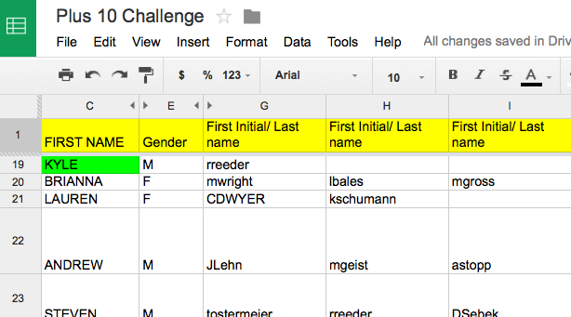
Staff Google Document
Keri Applebee, Associate Principal, Lincoln Southwest High School, NE
Notes:
Plus 10 challenge
Google docs- First initial, Last name- emphasize that it is ok if teachers could not put name by students – due to types of classes taught- important so we can see if students have academic/athletic connections
Criteria:
Do you know something about them outside of the classroom.
(Post -secondary plans, family structure, challenges)
Have you had a conversation with this student outside of normal class time?
Have you congratulated this student on an accomplishment or activity?
Has this student sought you out to share information with you about their life?

Slide 53
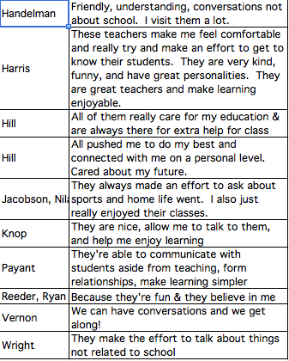
Results of student survey
Keri Applebee, Associate Principal, Lincoln Southwest High School, NE

Slide 54
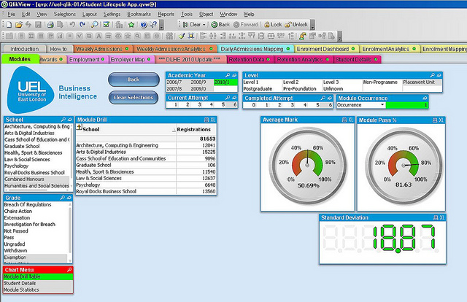
See Sample Dashboard

Slide 55
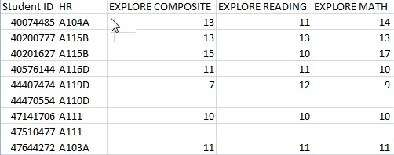
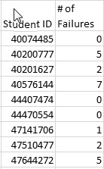
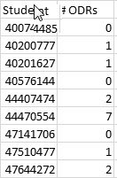
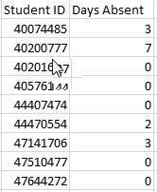
Separate Data Sets

Slide 56
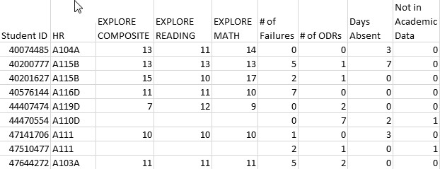
Combined Data Using VLookup
See YouTube examples: http://www.youtube.com/watch?v=3tk_Mif7040

Slide 57
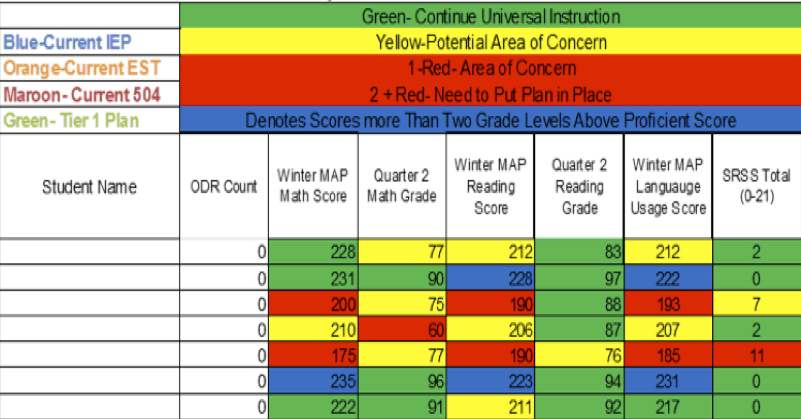
Integration of datasets
Northfield Middle School and High School, VT

Slide 58
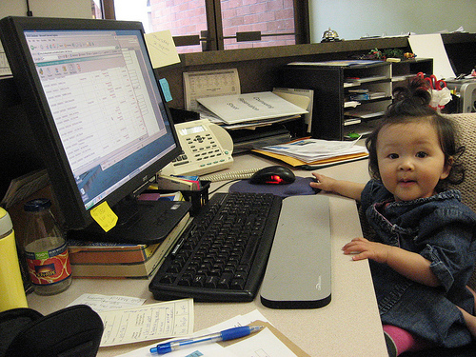
Northfield Middle/High School, VT
Revised master schedule
All students could participate in Study Island Program
https://accounts-flickr.yahoo.com/photos/jenkim/2248275918/sizes/m/in/photolist-4qF16U-bUQXfn-edNnEu-3csa6n-5sgmyu-edGH9z-53piaq-mVMTRx-3XsPp-fWBZ75-7hkzE5-83prtu-4qruLT-81Yq7e-6RycDm-4j8ri-2shYkc-akHDaG-dNJpxB-4q9VJ4-KTPYW-4urrjg-bSv1hk-4FgyQG-4adsUK-cXd2yE-3gNij7-4RxFTH-9AwVns-4WRbFq-5xMwUJ-eNBioc-84xBVn-9sp4J-7JYZqT-5Zdkxt-dbAtWt-ckEAPd-5wvNsm-6MYR4A-dq71AH-5GbP34-bm5Qmj-jvsXuS-dbAvD1-7kS2Dv-5PVFe1-niJtLf-mBVEDF-2jPkVf-edNeH3/
(Bohanon, Gilman, Parker, Amell, & Sortino, 2016)

Slide 59
Data
Using data from the school's perspective http://buff.ly/1Fex5hb
Helping teachers collect data on their teaching to improve instruction buff.ly/1G0wwYY
Toolkit for data decision making fb.me/6z6iyxCU2
8th and 9th grade GPA and Attendance are predict drop out. http://fb.me/7sCfLI2QD
Data dashboard – webinar and examples http://bit.ly/2qSfzie
Videos about using data http://bit.ly/2aAo1MO

Slide 60
Reflection Activity
How are your going to prepare to use data next year? (see other resources in handbook)

Slide 61
Resources
State Implementation & Scaling-up of Evidence-based Practices Center
  http://sisep.fpg.unc.edu/
Kotter, J. (1995). Leading change: Why transformation efforts fail. Harvard Business Review, 73(2), 59–67. Retrieved from http://hbr.org/
http://www.hankbohanon.net/Resources_1.html

Slide 62
Finding more plans
Sample Lesson plans
  http://www.pbismaryland.org/
  http://www.hankbohanon.net
More Video Example
  http://vimeo.com/groups/pbisvideos

Slide 63
Other Supports
Defusing Disruptive Behavior in the Classroom
  Geoff Colvin http://www.lookiris.com/store/K-12_Professional_Development/Defusing_Disruptive_Behavior_in_the_Classroom/
Classroom management training
  http://pbismissouri.org/class.html
The FAST Method
  http://www.lookiris.com/store/K-12_Professional_Development/The_FAST_Method_ONLINE/
Notes:
See website

Slide 64
Other Supports
IRIS Online Modules
  http://iris.peabody.vanderbilt.edu/resources.html
Rti Action Network Article Behavior and Academics
  http://www.rtinetwork.org/Learn/Behavior/ar/Integrating-Behavior-and-Academic-Supports-Within-an-RtI-Framework-General-Overview
National Center on PBIS
  http://www.pbis.org
Association of Positive Behavior Support
  http://www.apbs.org
CASEL – SEL Center
  http://casel.org/
Direct behavior rating
  http://www.directbehaviorratings.com/cms/

Slide 65
Summary
Ask before you tell
Do not train what you cannot support

Slide 66
References
Bohanon, H., Hall, N., & Goodman, S. (2016). Behavioral support: Research-based program reduces discipline problems. American School Board Journal Online. Retrieved from https://www.nsba.org/newsroom/american-school-board-journal/behavioral-support
Bohanon, H. & Wu, M. (2014). Developing buy-in for positive behavior support in secondary settings. Preventing School Failure, 58 (4), 1–7. doi: 10.1080/1045988X.2013.798774 http://ecommons.luc.edu/education_facpubs/17/
Bohanon, H., Castillo, J., & Afton, M. (2015). Embedding self-determination and futures planning within a schoolwide framework. Intervention in School and Clinic. 50 (4), 203-209. http://ecommons.luc.edu/education_facpubs/16/
Bohanon, H., Fenning, P., Hicks, K., Weber, S., Their, K., Akins. B., Morrissey, K., Briggs, A., Bartucci, G., Hoeper, L., Irvin, L., & McArdle, L. (2012). Case example of the implementation of schoolwide positive behavior support in a high school setting. Preventing School Failure, 56 (2), 92-103. http://ecommons.luc.edu/education_facpubs/7
Bohanon, H., Gilman, C., Parker, B., Amell, C., & Sortino, G. (2016 online first). Using school improvement and implementation science to integrate multi-tiered systems of support in secondary schools. Australasia Journal of Special Education. pp. 1–18. DOE: 10.1017/jse.2016.8. http://ecommons.luc.edu/ education_facpubs/80/
Blase, K. A., Fixsen, D.L., Sims, B.J., Ward, C.S. (2015). Implementation science – changing hearts, minds, behavior, and systems to improve educational outcomes. Paper presented at the Wing Institute’s Ninth Annual Summit on Evidence-Based Education, Berkeley, CA. http:// nirn.fpg.unc.edu/resources/ implementation-science-changing-hearts-minds-behavior-and-systems-to-improve

Slide 67
References
Burke, A. (2015). Early Identification of High School Graduation Outcomes in Oregon Leadership Network Schools. REL 2015-079. Regional Educational Laboratory Northwest.
Kotter, J. (1995). Leading change: Why transformation efforts fail. Harvard Business Review, 73(2), 59–67.
McNeely, C. A., J. M. Nonnemaker, J.M., & Blum, R. W. (2002). Promoting School Connectedness: Evidence from the National Longitudinal Study of Adolescent Health. The Journal of School Health 72(4): 138-146.
National High School Center, National Center on Response to Intervention, and Center on Instruction. (2010). Tiered interventions in high schools: Using preliminary “lessons learned” to guide ongoing discussion. Washington, DC: American Institutes for Research. http://bit.ly/2r0SaeE
Therriault, S. B., Heppen, J., O’Cummings, M., Fryer, L., & Johnson, A. (2010). Early warning system implementation guide. Retrieved from http://www.betterhighschools.org/documents/NHSCEWSImplementationGuide.pdf
Vermont Agency of Education (Accessed July 28, 2016). The 13 dimensions of school climate. Vermont Agency of Education, Retrieved from: http://education.vermont.gov/documents/edu-school- climate-13%20Dimensions.pdf

