Slide 1
National PBIS Leadership Community of Practice for Secondary Schools
APBS High School Network
Deep Dive:
High School PBIS Implementation at All 3 Tiers
JoAnne Malloy
Kathryn Francoeur
Hank Bohanon
September 6, 2018, Webinar

Slide 2
How to use the Zoom platform

Slide 3
Agenda
The National CoP in Secondary Leadership: Mission, Norms and Communities of Practice (15 minutes)
High School Case Study
  Dropout Prevention project
  Description of School
  Tier 1
  Tier 2
  Tier 3
  Discussion
Next Secondary Leadership Academy call- Agenda
Notes:
JoAnne

Slide 4
Acknowledgements
Susan Barrett, Sheppard Pratt Health Systems and the National PBIS Center
Jennifer Freeman, Center for Behavioral Education & Research at the University of Connecticut
Brigid Flannery, College of Education at the University of Oregon
Steve Goodman, Michigan's Integrated Behavior and Learning Support Initiative (MIBLSI)
Patti Hershfeldt, Sheppard Pratt Health Systems and National PBIS Center
JoAnne Malloy & Kathy Francoeur, University of New Hampshire
Kent McIntosh, College of Education at the University of Oregon
Jessica Swain-Bradway, Midwest PBIS Network
Hank Bohanon, Loyola University of Chicago
Notes:
JoAnne

Slide 5
Introduction: Community of Practice
www.ideapartnership.org

Slide 6

‘Communities of practice are groups of people who share information, insight, experience and tools about an area of common interest.’
Etienne Wenger
Notes:
Etienne Wenger is the acknowledged leader in CoP

Slide 7
Why establish a CoP?
A mechanism to promote rapid sharing of knowledge and expertise across diverse interest groups
Provides a forum to explore and test ideas
Opportunity to generate new knowledge and practice
Is responsive to emerging issues, complex problems, and opportunities
*(Cashman, Linehan, Purcell, Rosser, Schultz, & Skalski, 2014)
Notes:
Linking people who may not have day to day contact
Developing a trust between members
Practical aspects of practice, the day to day issues
Developing new knowledge
Learning from ‘what works’ and ‘what doesn’t’

Slide 8
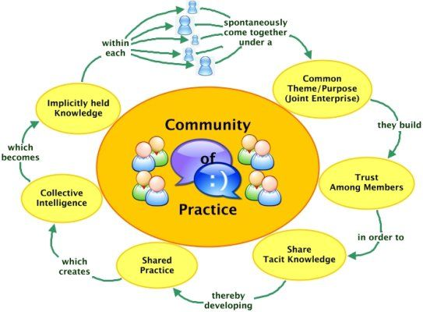
What is at the heart of it all?
Notes:
a group of ‘people’ who share a
Common interest
Common practice
Will to improve that practice

Slide 9
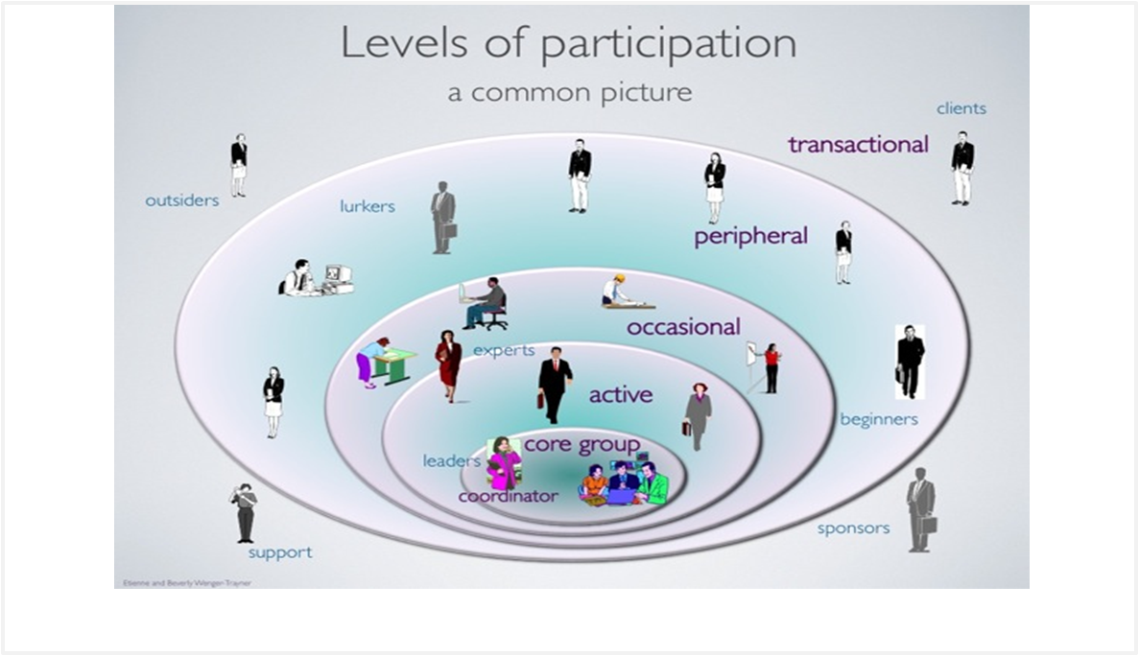
Participation

Slide 10
Objectives of Our Secondary Leadership Academy
Create a forum to discuss critical issues related to implementation of PBIS in the unique contexts of middle and high schools,
Share best practices and implementation examples with respect to:
  Addressing discipline disproportionality,
  The integration of mental health and substance abuse supports in schools,
  College and career readiness, and
  Youth leadership
  Professional development models
  Team structure and facilitation
  Data collection and use
Develop tools and information that will promote best practice in PBIS leadership.
http://apbs.org/hs-academy-meeting-info.html

Slide 11
Major Themes of Our CoP
How to gain buy-in
How to align all of our initiatives
How to align PBIS implementation with CCR and competency-base instruction
What does implementation look like? What are the skills needed to implement effectively?
OTHER IDEAS????

Slide 12
High School Case Study
JoAnne M. Malloy, Hank Bohanon & Kathryn Francoeur (2018): Positive Behavioral Interventions and Supports in High Schools: A Case Study From New Hampshire. Journal of Educational and Psychological Consultation,
DOI: 10.1080/10474412.2017.1385398
To link to this article: https://doi.org/10.1080/10474412.2017.1385398
Context: Dropout prevention
Notes:
JoAnne

Slide 13
Small NH High School
2006 and 2012 during implementation of a series of
federally and state-funded dropout prevention initiatives led by the New Hampshire Department of Education called Achievement in Dropout Prevention and Excellence (APEX).
PBIS was the dropout prevention strategy:
  Using data to screen and identify students who are off track for graduation
  Working in Tier 1, 2 and 3 teams
  Implementing research-based practices
  Progress monitoring
  External training and coaching (UNH)
Used RENEW for the highest need youth (a NH created Tier 3 model)
Notes:
JoAnne

Slide 14
APEX Project Model
Notes:
JoAnne

Slide 15
Research Questions
(RQ1)What was the fidelity of implementation of PBIS at tier 1, tier 2, and tier 3?
(RQ2)What were the pre- and post implementation outcomes at tier 1 as measured by student office discipline referrals (ODRs), annual event dropout rate, out-of school suspension rates, and in-school suspension rates?
(RQ3) What were the student outcomes pre- and post intervention for students who received tier 2 interventions as measured by ODRs, suspensions, and unexcused absences?
(RQ4) What were the student outcomes pre- and post intervention for students who received tier 3 interventions as measured by ODRs, suspensions, unexcused absences, credit hours earned, grade point average (GPA), and dropout?
Notes:
JoAnne

Slide 16
Discussion
What do you think the relationship is between PBIS implementation and student engagement?
Notes:
JoAnne

Slide 17
The Case Study School
Enrollment 570 and 610
In 2006, the student population was 2.8% African American, 2.9% Hispanic, 2.6% Asian American, 0% American Indian/Alaskan, and 91% White (New Hampshire Department of Education, 2013).
Median income in the city was 20% lower than the New Hampshire average
The school’s special education rate was nearly 20%, far higher than the state average
The high school was failing the state’s benchmarks for adequate yearly progress (AYP) for dropout rates during the baseline year (New Hampshire Department of Education, 2006)
Notes:
JoAnne

Slide 18
Implementation (Tiers 1, 2 and 3)
Tier 1
  Fall 2006 overview with high school examples
  Vote on adoption
  Spring 2017
    Establish team with clear roles and responsibilities
    Established behavioral expectations
    Training for staff
    Created behavior response guidelines
    Implemented SWIS
  Spring 2008 first targeted schoolwide intervention
Notes:
Hank

Slide 19
Implementation Data
YEAR | 2006-07 | 2007-08 Baseline Year | 2008-09 | 2009-2010 | 2010-11 | 2011-12 | Change Baseline to 2012
SET Scores (Overall/Expectations Taught) | 36/0 | 83/70 | 91/80 | 89/90 | 86/70 | 93/75 | +10/5
Number of major ODRS/100 Students | 101 | 260 | 198 | 152 | 117 | 146 | -114
Number of In-School Suspensions/100 Students | N/A | 29.89 | 59.00 | 49.83 | 36.86 | 50.86 | +20.97
Number of Out-of-School Suspensions/100 Students | N/A | 46.63 | 34.00 | 31.50 | 31.39 | 24.57 | -22.06
Annual Event Dropout Rate- Case School | 3.7 | 2.8 | 2.1 | 1.39 | .88 | .88 | -1.92
Annual Event Dropout Rate- State | 3.2 | 2.5 | 1.7 | .97 | 1.19 | 1.26 | -1.24
Notes:
Hank

Slide 20
Schoolwide Outcomes: ODRS
Office discipline referral per 100 students per month.
Note. ODR = office discipline referral. Bimonthly ODR rates over time, showing significant
reductions beginning in December 2008 (*z = 32.678, p .0003).
Notes:
Hank

Slide 21
Tier 2 Outcomes: BSP
Outcomes of Students with Behavior Support Plans Over Four Semesters (n=18)
Outcome Variables | Baseline | Time 1 | Time 2 | Time 3
Credits Earned | 2.64 | 2.64 | 1.67 | 2.43
ODRs | 3.83 | 2.11 | 0.67** | 0.56**
Unexcused Absences | 2.47 | 2.60 | 2.73 | 2.31
ISS | 1.39 | 0.72 | 0.22** | 0.11**
OSS | 0.67 | 0.28 | 0.12 | 0.06
**Significant change in means from baseline: p< .01
Notes:
Kathy

Slide 22
Tier 2 Outcomes: Check In Check Out (CICO)
c
Outcomes of Students in Check In/Check Out Over Four Semesters (n=13)
Outcome Variables | Baseline | Time 1 | Time 2 | Time 3
Credits Earned | 2.08 | 2.44 | 2.71 | 3
ODRs | 2.23 | 1 | 2.09 | 1.45
Unexcused Absences | 8.46 | 3.85* | 3.91* | 2.45*
ISS | 1.38 | .38 | 1.2 | 0.4
OSS | .69 | .31 | 0.6 | 0.3
*Significant change in means from baseline: p< .05
Notes:
Kathy

Slide 23
Tier 3 Outcomes: RENEW
Outcomes of Students in RENEW (n=25)
Outcome Variable | Baseline | Time 1 | Time 2
ODRs/Semester | 5.64 | 5.52 | 4.04
ISS/Semester | .88 | 1.36 | 1.08
OSS/Semester | 1.32 | 1.16 | .64
Credits Earned/Semester | 2.27 | 1.85 | 2.54
All Absences/Semester | 20.20 | 20.38 | 15.04
Unexcused Absences/Semester | 15.44 | 15.52 | 11.42
Annual GPA | .84 | 1.14* | N/A
*Significant difference in means from baseline: p<.05
Notes:
Kathy

Slide 24
Summary and Discussion- from the chat
Notes:
Hank

Slide 25
PBIS National TA Center High School Workgroup
Jessica Swain-Bradway
Brigid Flannery
Jennifer Freeman
Stephanie Martinez- USF
Patti Hershfeldt
Notes:
JoAnne

Slide 26
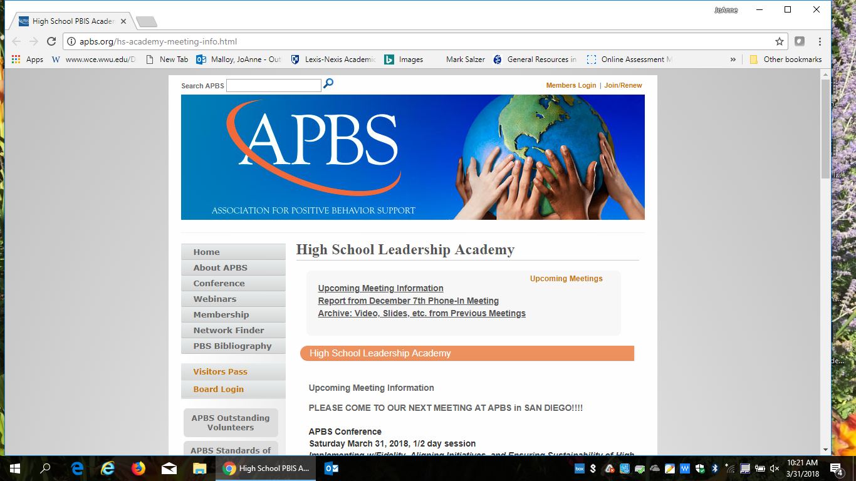
Notes:
JoAnne

Slide 27
Future Calls & Meetings
December 6, 2018
APBS in Washington DC February 23, 2019
Notes:
JoAnne

Slide 28
Agenda Items for Next Meeting
College and Career Readiness skills and aligning with schoolwide PBIS
More family involvement at the secondary level –
Alignment and initiative fatigue---
Blending or aligning SEL and PBIS
MTSS academic and behavior
Large high schools
Notes:
JoAnne

Slide 29
Questions?
Thank you!
Evaluate our CoP meeting
Next CoP call is December, 6, 2018
12 noon- 1:30 pm est.
Contact us:
  Joanne.malloy@unh.edu
  Kathryn.Francoeur@unh.edu
  Hbohano@luc.edu
Notes:
JoAnne

