Slide 1
Multi-Tiered Systems of Supports (MTSS) and Improvement Efforts in Secondary School Settings
Hank Bohanon
Loyola University of Chicago
hbohano@luc.edu
http://www.hankbohanon.net
Steve Goodman
Michigan’s Integrated Behavior and Learning Initiative
https://miblsi.org/
sgoodman@miblsimtss.org

Slide 2
In General - Professions and MTSS
School Psychology
Special Education
Psychology, Social Work
Psychiatry, Social Work
RtI
PBIS
SEL
SBMH

Slide 3
You have a vision

Slide 4
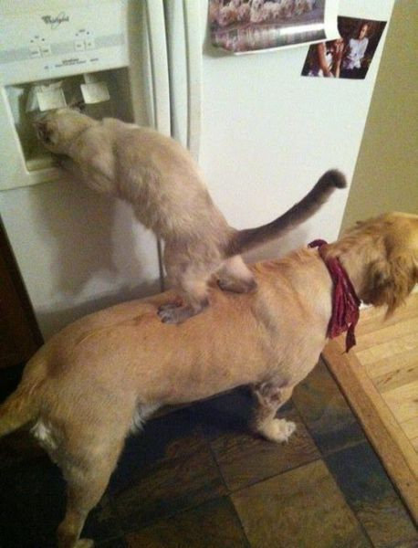
There are ways to support districts and schools

Slide 5
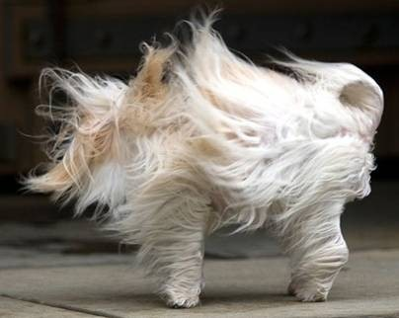
Leadership is important, people can still feel overwhelmed

Slide 6
We understand

Slide 7
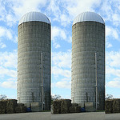
Integration of Efforts MTSS and Improvement Silos are OK, let’s make some bread
https://www.flickr.com/photos/docsearls/5500118475/in/photolist-cXMNUQ-bC1HTo-9o2xAT-9o5AEY-69MYfV-bubVYL-fu5X2f-E9aS-8DnR9y-bxgyP7-5qSgwP-dSA9Bi-5shMyD-8usn4k-5kZNd-89XiCo-2BGoqb-79hKaP-6wBTN-d7tNeN-7Sp5BB-9gfYVD-bA5evD-7i8Yvi-7WuQSP-4pTi29-cFS2Bs-9bk1ib-vxLgw-CJ6Cg-8GYAwP-5y9gAy-9PykmB-s4Zdf-gtS4jP-5gF5YM-6wBUr-57aEQb-6ALHfs-auR8jn-h8TtVm-3FHzm8-nTvUk-xKH84-4Vc2E6-3pSKw-5W5NMW-ma4TR-29BGFW-7Sp6Wg

Slide 8
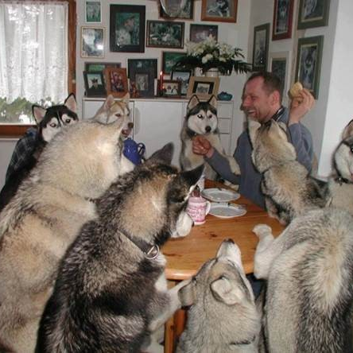
Some Elements
Administrative support
Team
Images from https://flic.kr/p/naAdyP, https://flic.kr/p/53Gxci
Mission and Vision

Slide 9
CSR’s & School Improvement By Design: What does improvement mean in your state?
Mission and Vision
Include SEL?
Control Procedures
Professional Control
Everyone teaches expectations? Prepare, time?
PD Needed? Calendar changed?
Rowan, Correnti, Miller, & Camburn, 2009

Slide 10
Designing School-Wide Systems for Student Success A Response to Intervention Model/MTSS
Questions
Answers
Tertiary Interventions/Tier 3:
Dig deeper – why?
Tertiary Intervention/Tier 3:
Ask questions,
Teach what works better
Cholesterol drugs
1-5%
1-5%
Secondary Interventions/Tier 2:
Can’t do/won’t do
5-10%
5-10%
Secondary Interventions/Tier 2:
Coke test analogy..
Over 50 Daily Aspirin
Universal Intervention
Tier 1:
Were we clear? Does it work?
How do we respond?
80-90%
80-90%
Universal Intervention/Tier 1:
Be clear on expectations,
make sure they work, be humane
Banging smoking in
public places*
*Greenburg & Abenavoli, 2017
Notes:
10
You may have a large copy of this in your handouts
tatoo..it is washable (just kidding)..
Example –
SW – Respect – Response Be kind – show poster ahead
Secondary – student could not write very well – even when given coke..skill deficit – then accommodate with writing prompt and remediate – teach skills
Tertiary – attention – personal greetings at the door and pre-correction was enough

Slide 11
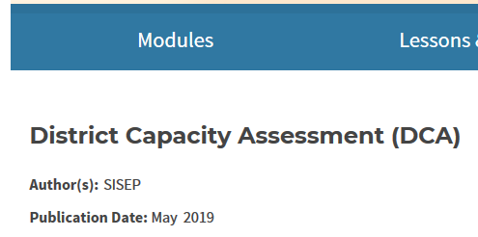
Call to Action
What are your districts’/schools’ improvement goals
Can you connect?
Look at capacity
See: https://nirn.fpg.unc.edu/resources/district-capacity-assessment-dca

Slide 12
Find out more
Goodman, S. & Bohanon, H. (2018). A Framework for Supporting All Students: One-Size-Fits-All No Longer Works in Schools. American School Board Journal, February, 1-4, 2018. https://ecommons.luc.edu/education_facpubs/116/

Slide 13
What You Doing Already?
School
Improvement
Systems
Data
Practices
MTSS
(Tiers)

Slide 14
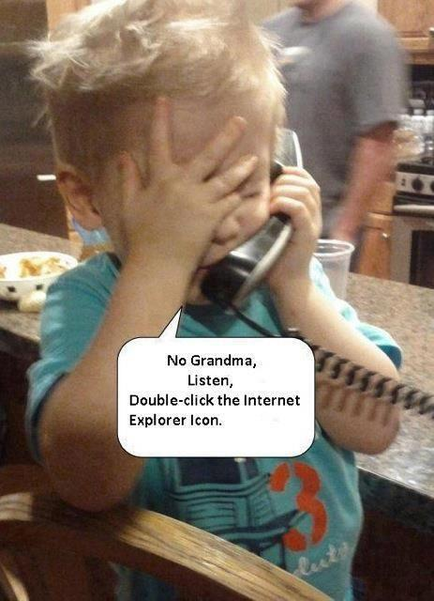
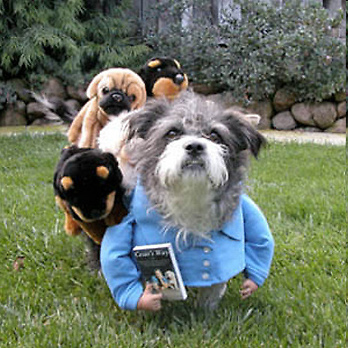
Transformation – From one more thing - to MTSS and improvement

