Slide 1
Preventing Miscommunication with CAIRO
Hank Bohanon
hbohano@luc.edu
Loyola University of Chicago

Slide 2
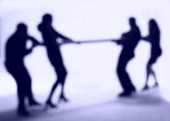
Reflective Question
When was the last time someone you knew was upset because they were not informed about a next step?
Was this the outcome (example)?
This Photo by Unknown Author is licensed under CC BY-SA
Notes:
Fighting Kangaroo movie

Slide 3
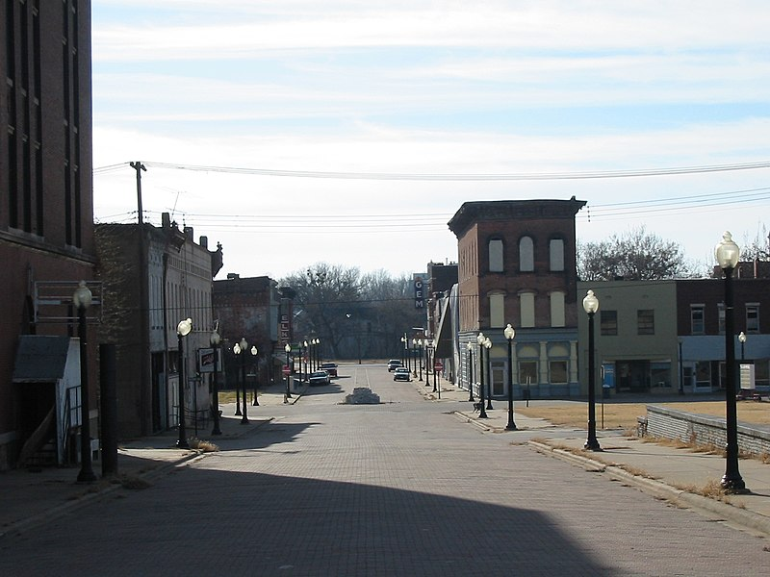
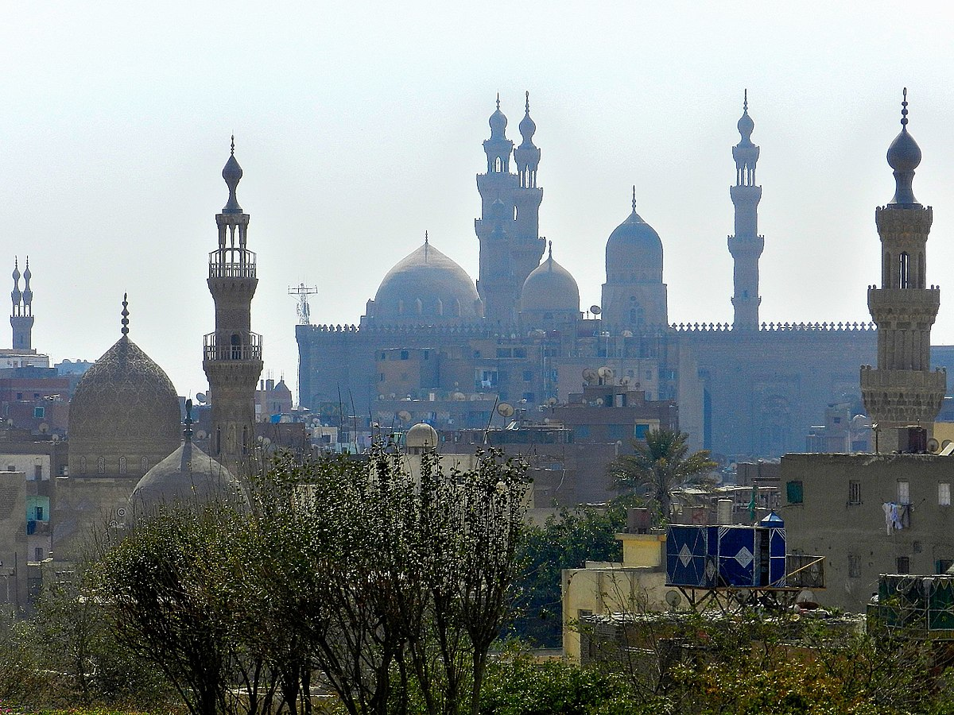
CAIRO: A way to access linkages
Consulted
Approval
Informed
Responsible
Out of Decision Loop
Image of Cairo, IL (link)
This Photo by Unknown Author is licensed under CC BY-SA

Slide 4
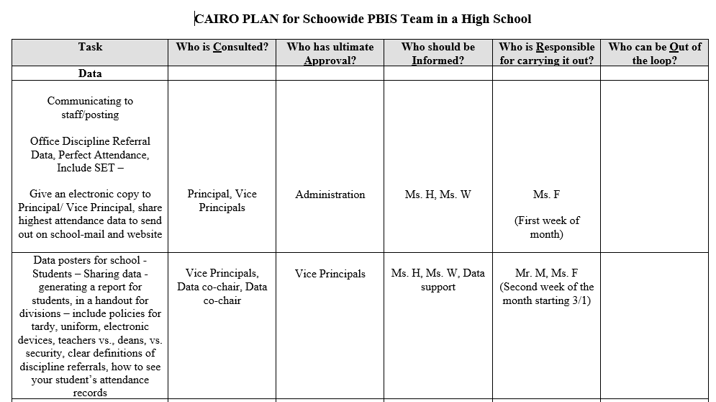
Sample CAIRO Plan

Slide 5
CAIRO
See Example, and Blank Version
Pick three next actionable steps
List out tasks
Complete CAIRO with team
Report out
This Photo by Unknown Author is licensed under CC BY-NC-ND
Notes:
Or one if time – do together if needed – tell Kelly – department chair and vp had not spoken – caused problem

Slide 6
For More Information
Implementing Systematic Interventions (link)
Reframing the Path to School Leadership (link)

