Slide 1
Engage Your Students, Save the Cat
Hank Bohanon
hbohano@luc.edu
Loyola University of Chicago

Slide 2
Reflective Question
Why do you think movies include scenes early on where the hero does something to help someone, or another act of kindness?
Watch Moana save a turtle link
Notes:
Fighting Kangaroo movie

Slide 3
Engagement Strategies
Laughing with students (not at students)
Giving students choice (e.g., topic, partners)
Out of desk greeting (or personal welcome)
Asking about events like sports
Asking students why (e.g., why did you say..)
Delivering specific praise/approval
Provide positive non-verbal gestures
(Allen et al., 2013; Cook et al.. 2017)

Slide 4
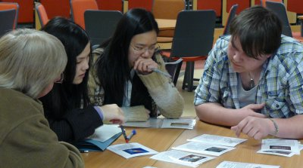
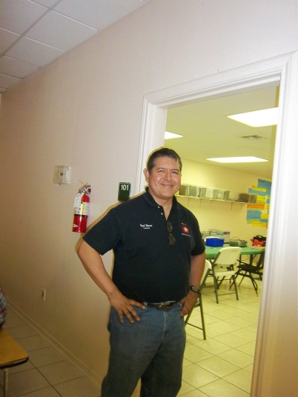
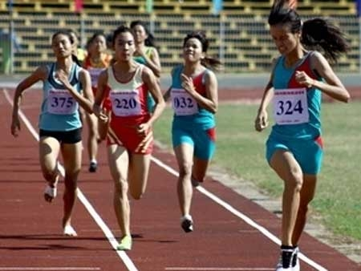
Instructional/Emotional Support
Failure rates
from 17% to 11%
Choice of responding
Laughing with students
Out of desk greeting
Ask about events
Ask “why”?
http://mzteachuh.blogspot.com/2012/05/that-kid-drives-me-nuts-tweets-of-day.html
http://ignitebrownsville.blogspot.com/p/picture-gallery.html
http://english.vietnamnet.vn/fms/sports/57762/hanoi-to-host-5th-asean-student-sports-games.html
http://www.phy.bris.ac.uk/news_archive1.html
http://www.hillel.org/jewish/ask-big-questions
(Allen et al., 2013)

Slide 5
Practice
See other examples (list)
See NCII module on Antecedent and Instructional Strategies (link)
Rank order the strategies in order of comfort
Or identify one of your own
Pilot one strategy this week
Watch a movie
Report out
Notes:
Or one if time – do together if needed – tell Kelly – department chair and vp had not spoken – caused problem

Slide 6
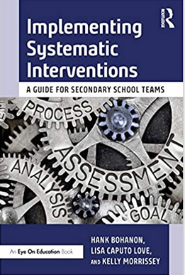
For More Information
Implementing Systematic Interventions (link)
Save the Cat (link)

Slide 7
References
Allen, J., Gregory, A., Mikami, A., Lun, J., Hamre, B., & Pianta, R. (2013). Observations of effective teacher – student interactions in secondary school classrooms: Predicting student achievement with the classroom assessment scoring system—secondary. School Psychology Review, 42(1), 76–98.
Cook, C. R., Grady, E. A., Long, A. C., Renshaw, T., Codding, R. S., Fiat, A., & Larson, M. (2017). Evaluating the impact of increasing general education teachers’ ratio of positive-to-negative interactions on students’ classroom behavior. Journal of Positive Behavior Interventions, 19(2), 67–77. doi:10.1177/1098300716679137

