Slide 1
Adapting PBL for High School Success
PBL Conference 2022
Hank Bohanon
Loyola University of Chicago
hbohano@luc.edu
http://www.hankbohanon.net

Slide 2
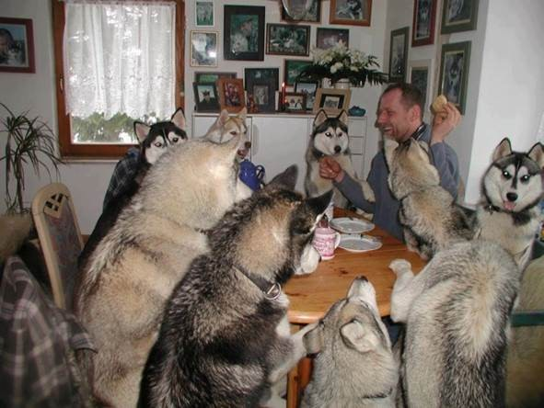
Everyone working together

Slide 3
PowerPoint's
Enduring Understanding:
PBL supports school improvement and effective secondary schools
Using data to determine needs can enhance your implementation efforts
PBL can improve classroom and non-classroom settings

Slide 4
Essential Questions
What are the connections between the specific components of PBL related to school improvement and effective secondary schools?
How can staff use data to identify strategies to improve instructional and behavioural support for all students?

Slide 5
Essential Questions
How can teams embed PBL strategies into related multi-tiered systems of supports and school improvement in secondary settings, including classroom/non-classroom settings?

Slide 6
Thank you!
Lorna Hepburn
PBL Behaviour Team, State Schools – Operations
Queensland Department of Education
Notes:
6
6

Slide 7

To Learn More (link)
Amazon Link

Slide 8
Chapter 1: What Makes for an Effective Secondary School?
Questions About Implementation

Slide 9
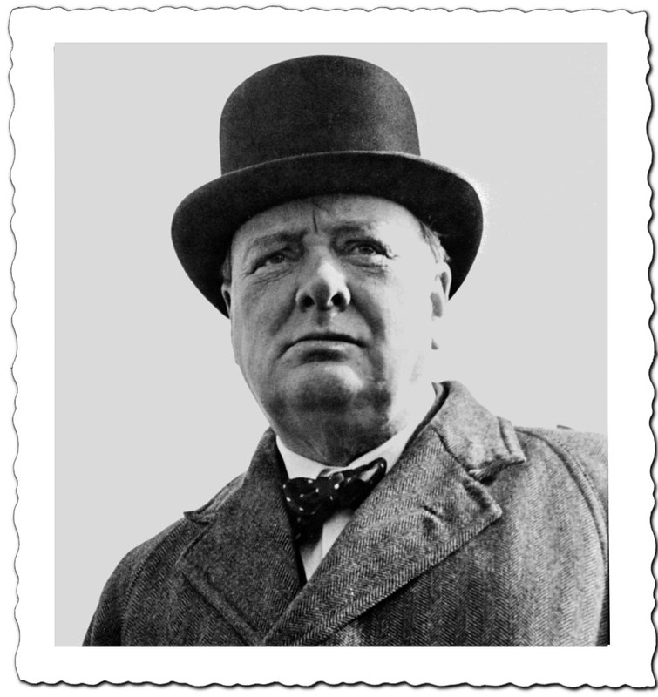
Meet Winston Churchill
Leader of Britain during World War II
Person of courage
Brave
“Never give up”
Image from https://flic.kr/p/rtbVoU

Slide 10
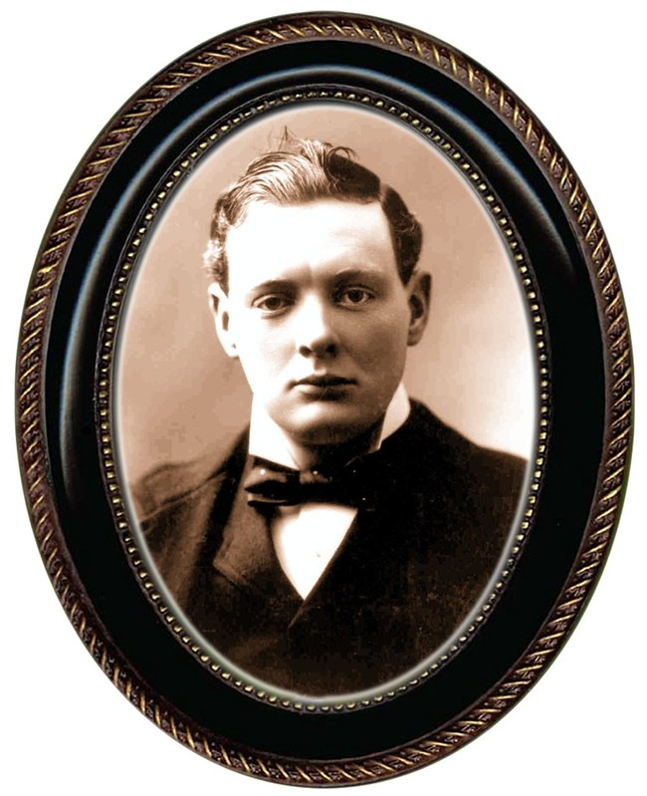
Winston Churchill – Early Life
When it came time for school “ I took to the woods”
Punished for lack of performance
Wished school could have engaged him in something meaningful
Image from https://flic.kr/p/rthwtX

Slide 11

What Connections Can You Make?
See p. 2 of the handout
Based on conversations with Australian PBL Leaders
Do you have anything in common?

Slide 12

Prevention – A Simple Bar of Soap
1.4 million children die each year due to preventable infectious diseases (e.g., diarrhea, pneumonia)
Equal to AIDS, malaria, measles, meningitis, and tetanus combined
https://usa.soapaid.org/
Image from https://usa.soapaid.org/wp-content/uploads/2018/09/boys-washing-hands-1024x594.jpg

Slide 13
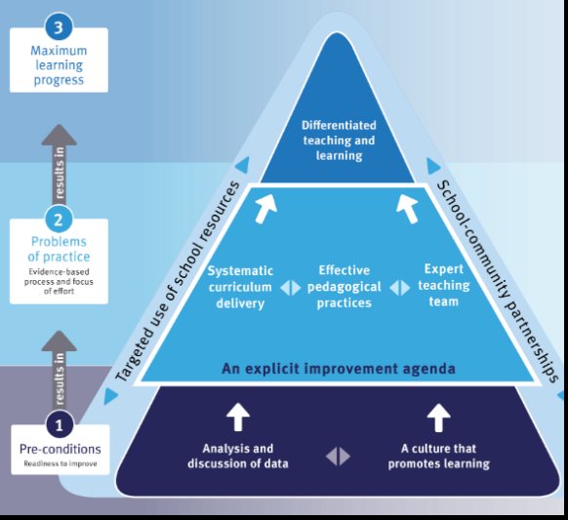
School Improvement, Every 4 Years
p. 3 and Handout
Notes:
You also have to annual reports
Report –School Annual Report annually (link)
Must report social climate
Attendance rates
Managing non-attendance
National Assessment Program data
Retention rates
Staff attendance rates
Post-secondary outcomes

Slide 14

Napkin Test
Read Table 1.2, P. 4
On a napkin – write how PBL could support your school improvement efforts
Share with someone, not at your table

Slide 15
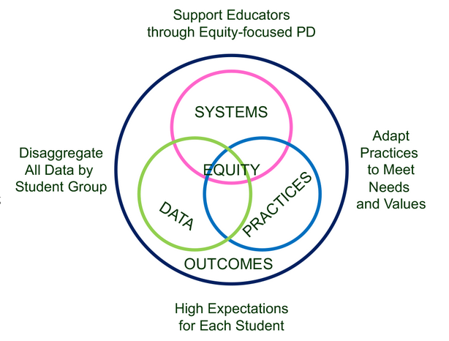
Supporting Social Competence &
Academic Achievement
4 PBL Elements
From https://www.pbis.org/topics/equity

Slide 16
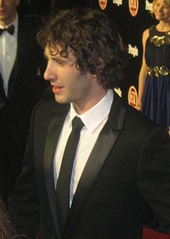


Key Elements
Systems – Josh, flight, checklist
  Administrative Commitments, Coaching (external/internal), Representative Teams, Audit of practices, Priority
Practices
  Based on evidence
Data
  Process and impact – dropout
    What and with whom?
http://en.wikipedia.org/wiki/Josh_Groban
http://www.inmagine.com/searchterms/private_jet.html
Notes:
16

Slide 17

Problem Solving – Where do you already use these steps?
Identify
Analyze
Plan
Implement/
Evaluate
Harms, Nantais, Tuomikoski, & Weaver, S. (2019)
From Flickr creative commons https://flic.kr/p/24UJUYy
Notes:
Einstein – if I had 25 minutes to save the world, I would spend 55 minutes identifying the problem

Slide 18
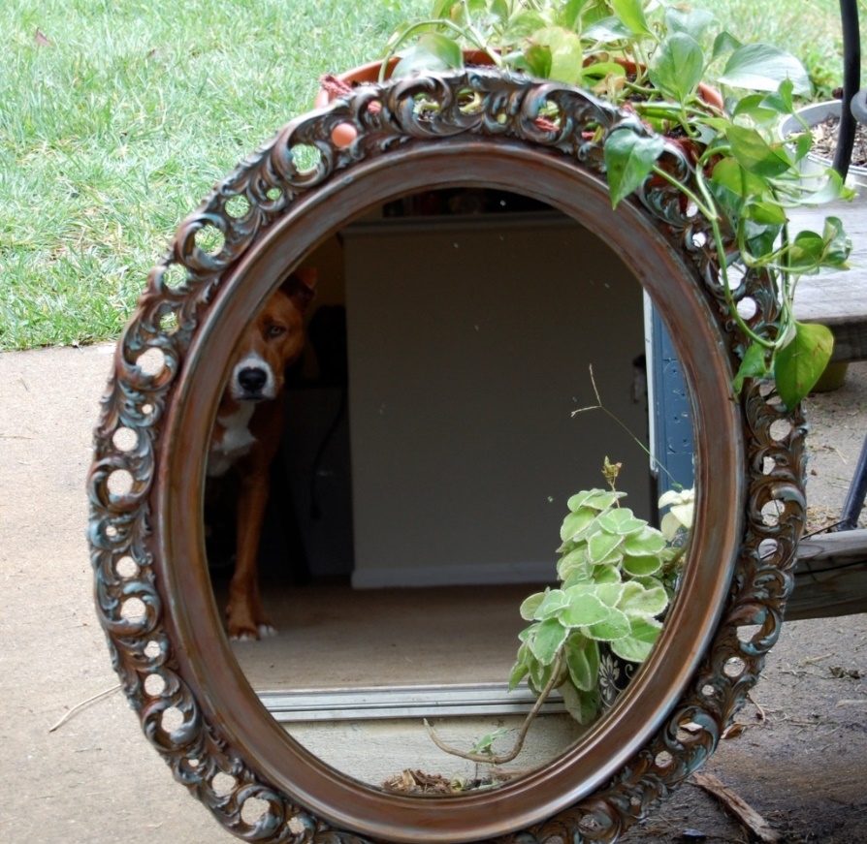
Reflection on PBL Systems, Practices, and Data
Walk around the room until the music stops
Where have you seen interventions work/not work based on Table 1.2?
Now, back at your table – what is one area of strength and area for improvement for your systems, practices, and data related to PBL? P. 5
This Photo by Unknown Author is licensed under CC BY-SA-NC

Slide 19
Designing School-Wide Systems for Student Success
A Response to Intervention Model/MTSS
Questions
Answers
Tertiary Interventions/Tier 3:
Dig deeper – why?
Tertiary Intervention/Tier 3:
Ask questions,
Teach what works better
Cholesterol drugs
1-5%
1-5%
Secondary Interventions/Tier 2:
Can’t do/won’t do
5-10%
5-10%
Secondary Interventions/Tier 2:
Coke test analogy..
Over 50 Daily Aspirin
Universal Intervention
Tier 1:
Were we clear? Does it work?
How do we respond?
80-90%
80-90%
Universal Intervention/Tier 1:
Be clear on expectations,
make sure they work, be humane
Banning smoking in
public places*
*Greenburg & Abenavoli, 2017
Notes:
19
You may have a large copy of this in your handouts
tatoo..it is washable (just kidding)..
Example –
SW – Respect – Response Be kind – show poster ahead
Secondary – student could not write very well – even when given coke..skill deficit – then accommodate with writing prompt and remediate – teach skills
Tertiary – attention – personal greetings at the door and pre-correction was enough

Slide 20
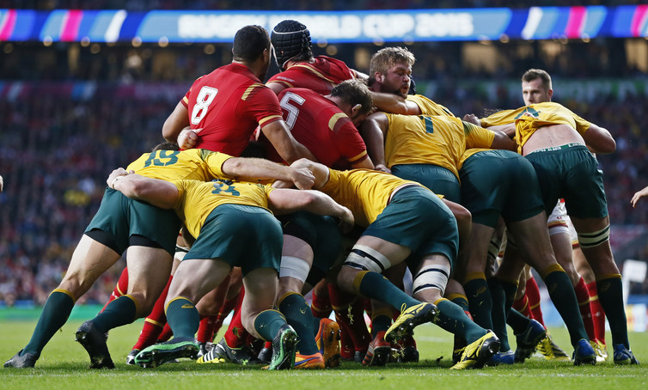
How Do You Learn
Think about a sport, music, or hobby you have learned. How did your coach, teacher, or mentor support you in your new skill?
This Photo by Unknown Author is licensed under CC BY-ND

Slide 21
Tier One
Focuses on Explicit Instruction
Breakdown skill
Provide rationale for skill
Model the skill
Guided practice (with the instructor or peers)
Independent practice
Provide Feedback

Slide 22
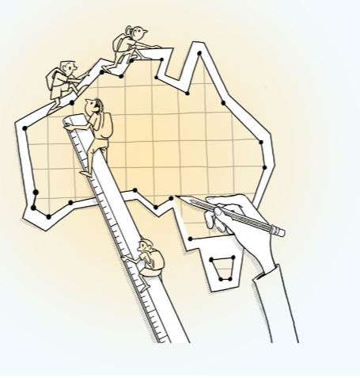
Tier One – Standards Aligned Core Curriculum
Australian Curriculum 9.0 (p. 21-22)
Grade 9 Literacy Standards
  Understand that roles and relationships are developed and challenged through language and interpersonal skills (ACELA1551 - Scootle)
Grade 10 Language Standards
  Understand how language use can have inclusive and exclusive social effects, and can empower or disempower people (ACELA1564 – Scootle)
Year 10 Achievement Standards
  Productive modes (speaking, writing and creating)
  Make presentations and contribute actively to class and group discussions, building on others' ideas, solving problems, justifying opinions, and developing and expanding arguments.

Slide 23
Tier One – Common Practices
Instructional Routines
  Scaffolding instruction
  Graphic organizers for writing and note-taking
  Reading for Meaning (link)
Common lesson plan formats
Evidenced-based instructional strategies
  High Leverage Practices (Opportunities to respond)
    Opportunities to respond
  Core Six

Slide 24
Instructional routines reduce cognitive load and allow students to be more independent learners
Examples
Reading for Meaning graphic organizer (Silver) - example below
Cornell style notes (Pauk)
Collaborative Strategic Reading (Klingner and Vaughn)
Claim-Evidence-Reasoning writing graphic organizer (many to choose from)
Evidence to prove | Claim | Evidence to refute
Table 1 shows that people with PhDs make an average income of $80,000 versus those with BAs make an average of $40,000 | People with more advanced degrees make more money
 | Most people work in the field the study for in college | Paragraph 5 stated that "75% of college graduates work in a different field than their BA was geared toward"
https://www.flickr.com/photos/docsearls/5500118475/in/photolist-cXMNUQ-bC1HTo-9o2xAT-9o5AEY-69MYfV-bubVYL-fu5X2f-E9aS-8DnR9y-bxgyP7-5qSgwP-dSA9Bi-5shMyD-8usn4k-5kZNd-89XiCo-2BGoqb-79hKaP-6wBTN-d7tNeN-7Sp5BB-9gfYVD-bA5evD-7i8Yvi-7WuQSP-4pTi29-cFS2Bs-9bk1ib-vxLgw-CJ6Cg-8GYAwP-5y9gAy-9PykmB-s4Zdf-gtS4jP-5gF5YM-6wBUr-57aEQb-6ALHfs-auR8jn-h8TtVm-3FHzm8-nTvUk-xKH84-4Vc2E6-3pSKw-5W5NMW-ma4TR-29BGFW-7Sp6Wg

Slide 25

Music Walk
What tier-one evidence-based practices do you have in your schools?
How do you prepare all staff to use these strategies?
What evidence do you have that they are implemented consistently across classrooms?

Slide 26
Tiers Two and Three
Increase intensity
  Staff
  Time
  Ratio of students-to-staff
Systematic
  Criteria for entry/exit
Quick response times
Does not require diagnosis (e.g., disability)

Slide 27
Tiers Two and Three Examples
Academic
Additional course or flexible time
  Implemented within the master schedule
  Evidence-based reading programs
    Tier two: REWARDS
    Tier three: Wilson Reading System
Behavioral/Social and Emotional
Check in/Check out system
Behavior Education Program
Social Skills Curriculum
Class-Wide Function-related Intervention Teams
  Taiwan Example
Functional Behavior Assessment/Positive Behavior Intervention
  Taiwan Example
Person centered/wrap around transition support

Slide 28
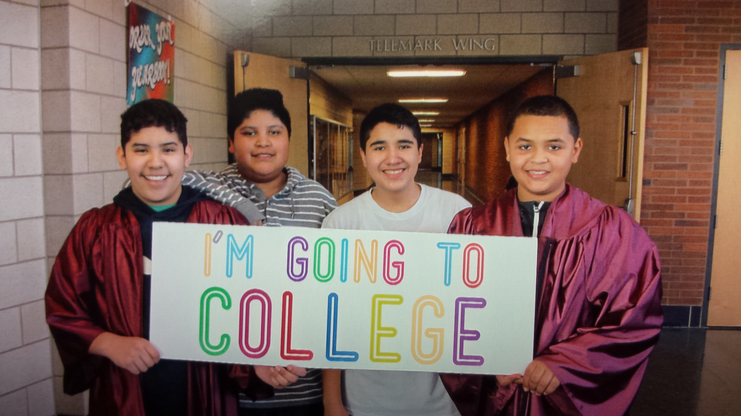
Northfield Middle/High School
Tier 1 to 2 – See P. 6-8

Slide 29

Matt and MTSS – See P. 9
Universal
  Retaught expectations
Targeted
  Check In/Check Out
  Math remediation
Individual
  FBA/BIP
  Project RENEW – Mentor/Plan
Image from https://flic.kr/p/EyKKf

Slide 30
Chapter 11: Using Data to Monitor Systems and Target Interventions
Career Builder video 1

Slide 31

Using Data At the YMCA
Notes:
YMCA Australia – looked at data – people cared more about connections and being connected with others (staff, other patrons) – enrolment went up (See Charles Duhigg = Power of Habit)

Slide 32
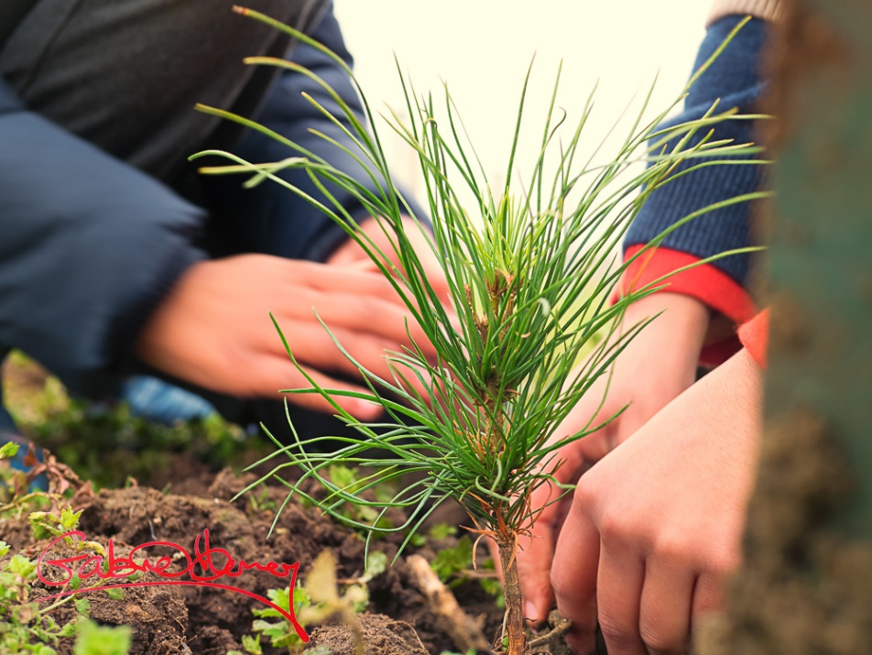
Plant the Tree Today
Organize what you have that aligns with school goals (e.g., grades, attendance, discipline referrals)
Start asking questions about the data
You will see what new data you need
This Photo by Unknown Author is licensed under CC BY-NC-ND
Notes:
Chinese proverb – the best time to have planet a tree was 20 years ago, next best time is today

Slide 33

Types of Data
Perception data
Existing Data
School Climate Surveys
Social and Emotional Screening
Attendance
GPA 8th-9th grade
Standardized test scores
Discipline infractions
Demographics
Screening data
Image from Flickr Creative Commons https://flic.kr/p/dZ8UiN
Notes:
Australia collects - School Opinion Survey.

Slide 34
Types of Existing Data
Office Discipline Referral Data
GPA (8th and 9th grade)
Credits toward graduation
Attendance (80> or more unexcused)
Failing grades (Algebra I, English I)
Statewide assessments
Existing screening data
(Burke, 2015; Heppen, O'Cummings, &
Therriault,2009; Henderson, Cassandra & Fantuzzo, 2022; McIntosh, Flannery,
Sugai, Braun, & Cochrane, 2008; McIntosh et al., 2009)
Notes:
This study examined data from the 2007/08 grade 9 cohort in four Oregon districts to find early warning indicators of students who may drop out or fail to graduate from high school on time. The study identified four indicators that provided valuable early warning signals about students who did not graduate on time, particularly about students who dropped out of high school:
• Grade 8 attendance rate below 80 percent. • Grade 9 attendance rate below 80 percent. • Grade 8 grade point average (GPA) below 2.0. • Grade 9 GPA below 2.0.
When the influence of demographic, achievement, and behavioral characteristics and differences in the schools that students attended were considered at the same time, only gender, English learner student status, and attendance and GPA in grades 8 and 9 were associated with graduation outcomes. Burke, 2015
34

Slide 35
Perception data
Social and Emotional Screening (includes free tools)
School Climate Surveys
Pediatric Symptoms
Signs of Suicide
Notes:
35

Slide 36
Deciding the Level of Intervention

Slide 37
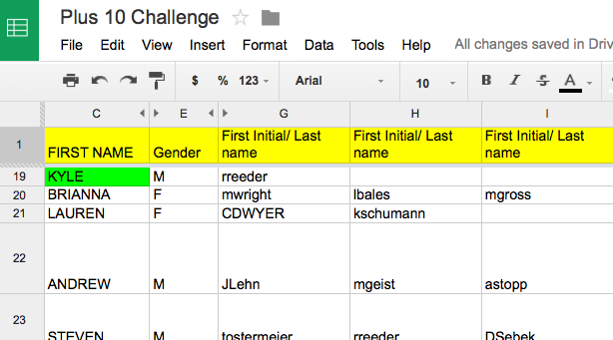
Staff Google Document
Keri Applebee, Associate Principal, Lincoln Southwest High School, NE
Notes:
Plus 10 challenge
Google docs- First initial, Last name- emphasize that it is ok if teachers could not put name by students – due to types of classes taught- important so we can see if students have academic/athletic connections
Criteria:
Do you know something about them outside of the classroom.
(Post -secondary plans, family structure, challenges)
Have you had a conversation with this student outside of normal class time?
Have you congratulated this student on an accomplishment or activity?
Has this student sought you out to share information with you about their life?

Slide 38
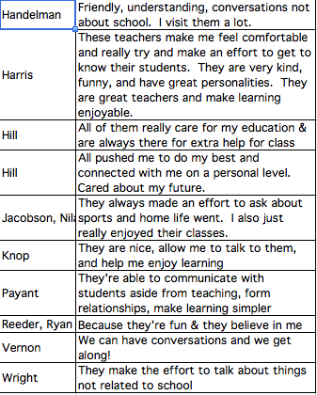
Results of student survey
Keri Applebee, Associate Principal, Lincoln Southwest High School, NE

Slide 39
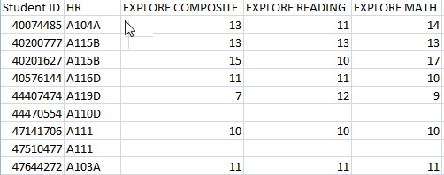
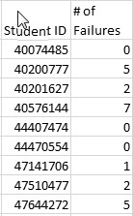
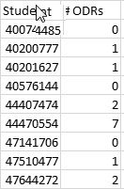
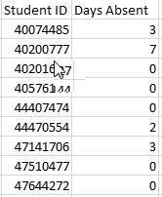
Separate Data Sets

Slide 40
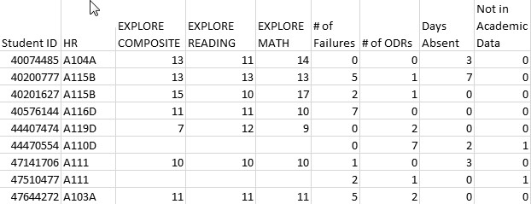
Combined Data Using VLookup
See YouTube examples: http://www.youtube.com/watch?v=3tk_Mif7040

Slide 41
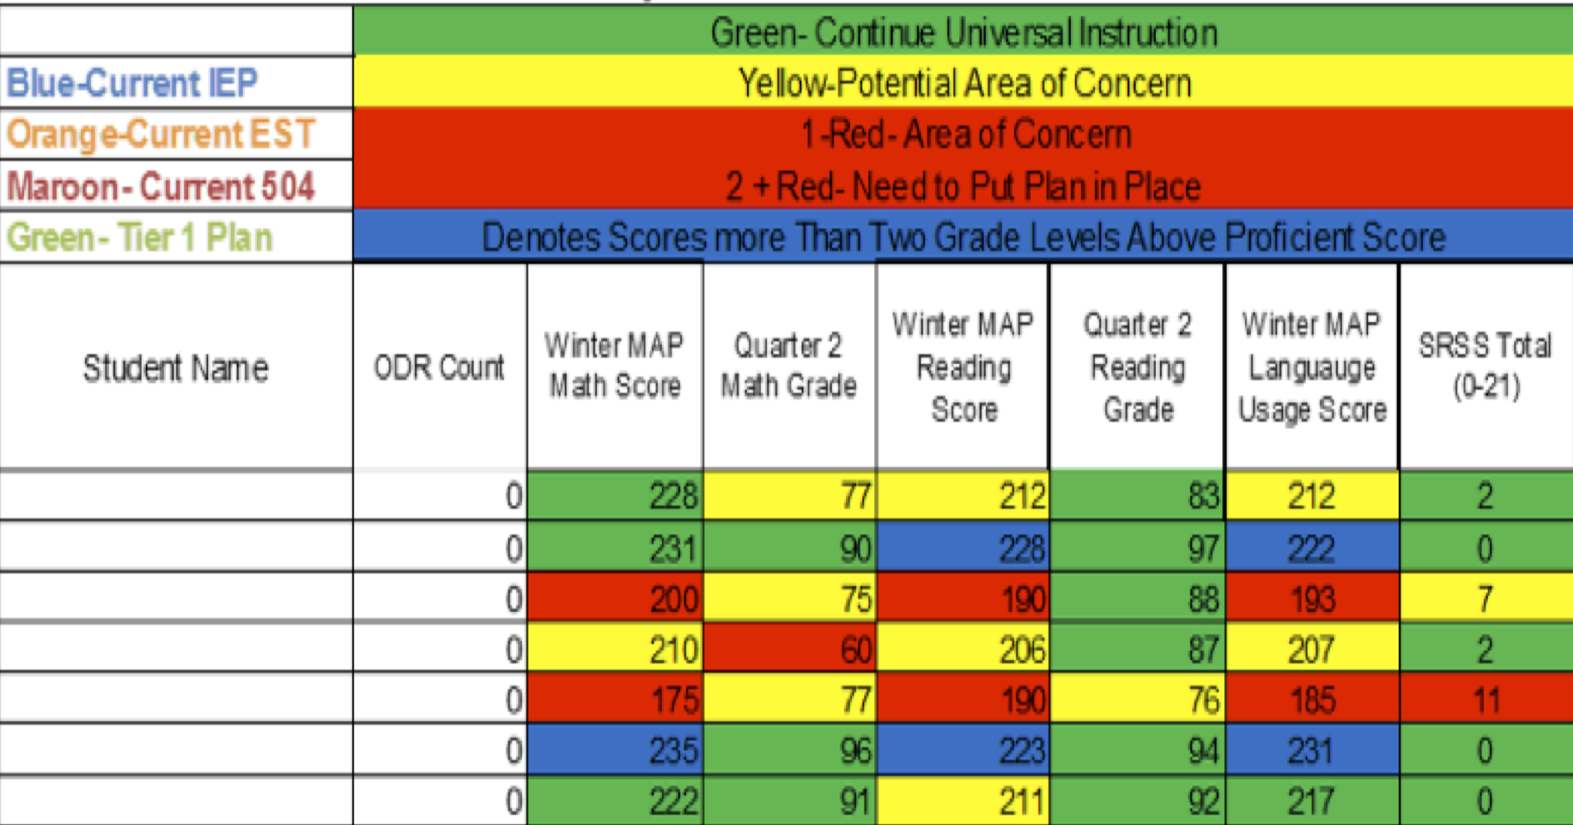
Integration of datasets
Northfield Middle School and High School, VT

Slide 42

Data Next Steps
See Table 5.6 on p. 10
  Brainstorm as many data sources as you can think of related to your school or class goals
See “Data Next Steps” on p. 11 – using the CAIRO method

Slide 43
Chapter 12: Providing Structure for Learning

Slide 44

Attendance Reflection
Think of a time when you missed an outing with friends and family – how did you feel?

Slide 45
Attendanceworks.org
Tier three – specialized support – 20% < days
Tier two – early intervention 10 – 20% of school days (2-3 per month)
Tier one – > 10% of school days (about 1 per month)
What are you doing for each level?

Slide 46

Responses
Engage students and parents
Recognize good and improved attendance
Provide personalized early outreach
Monitor data
Nudge Intervention – Sending a postcard to parents to encourage students’ attendance (Rogers et al., 2017)
https://provingground.cepr.harvard.edu/files/provingground/files/proving_ground_postcard_guide_march2020.pd f

Slide 47
Sample Response Tables
See Tables 12.3 and 12.4 to help you plan your responses – p. 12
How useful might these tools be to your class or school?

Slide 48
Be at post
Escort students
Brief interactions
(Johnson-Gros et al., 2008)
See article about hallways @
http://hankbohanon.net
on publications page
Tardy Policy Office
Notes:
48
48
Mr. Irvin – tardy policy
being at post, escorting, and interacting with students

Slide 49

Tardy Data
Who is tardy? – time of day, locations, grade levels
ODR data for hallways – non-classroom
Mall Walking– count how many students are in the fall after passing – 10 minutes in 20/20 box
This Photo by Unknown Author is licensed under CC BY

Slide 50
Preventing Tardies
Staff posted at doors
Brief interactions with students during passing
Staff in the hallway to encourage being on time
See example (link)
(Kristian Johnson-Gros et al., 2008)

Slide 51
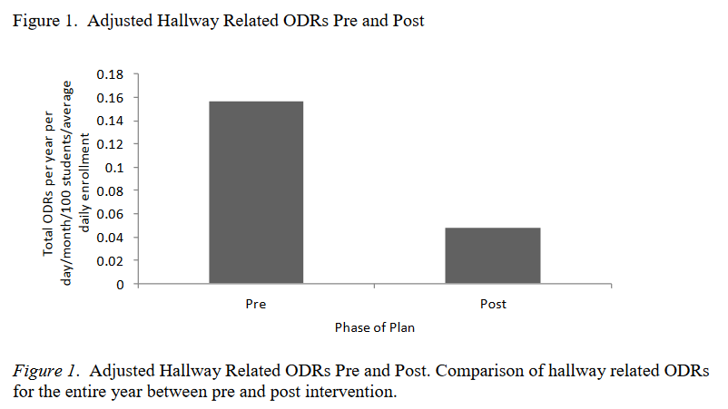
High School Example
(Bohanon, 2015)

Slide 52

Addressing Tardies
Start on Time!
Randy Sprick
http://www.safeandcivilschools.com/products/program_previews.php

Slide 53
Reflection
What data do you have, can you use these to address tardies to class?
What approaches are you taking now to tardies, how might these suggestions help you work?

Slide 54
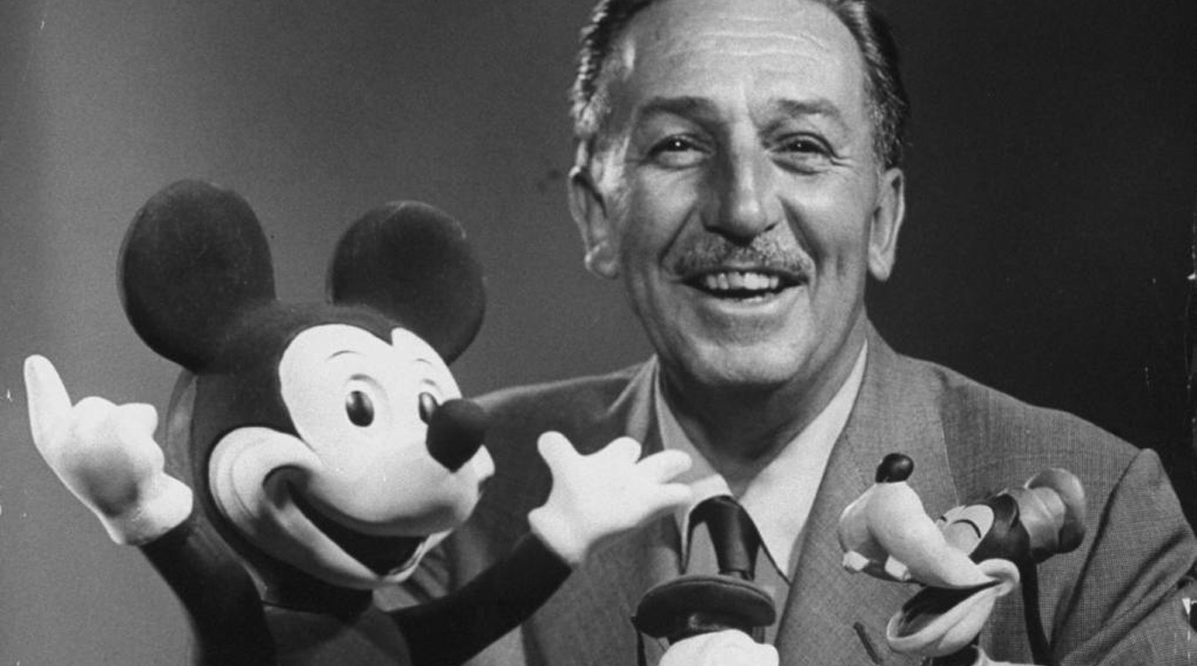
Preparing Your Syllabus
Walt Disney – “unarticulated expectations are premeditated disappointments”
This Photo by Unknown Author is licensed under CC BY-NC-ND

Slide 55
The Syllabus
Goals
Contact information
Success Traits
Rules/expectations
Activities
Grades/Status
Procedures
Entering
Tardy/Absence
Materials
Assignments (returns)
Due dates
Late, missing work
Communication
Ending class
Consequences
Model projects
Checklists
Sprick (2006)/Shinn http://markshinn.org
See examples – http://www.hankbohanon.net (Resources page under “Teaching”
Sample first days of school for high school teacher)
Notes:
Show handout, look at student expectations

Slide 56
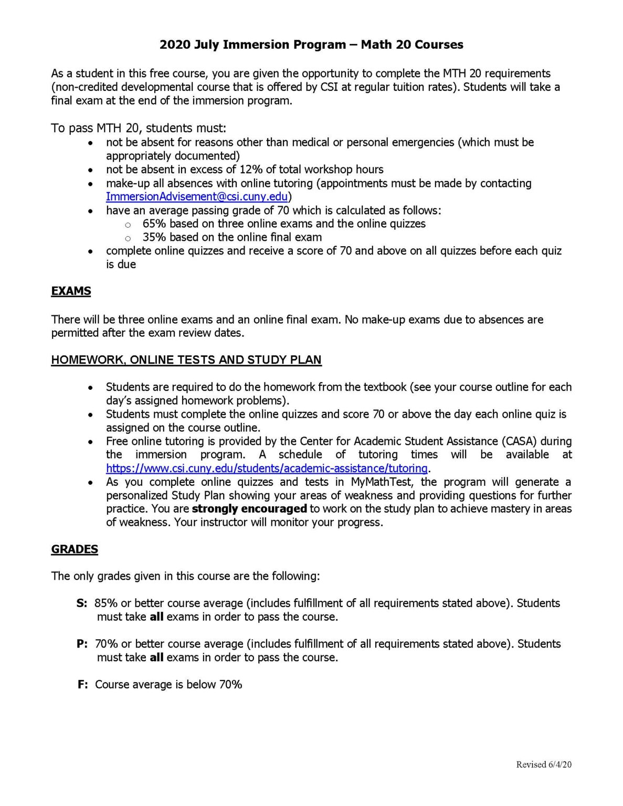
Reflection on Syllabus
What are the kinds of things you, or your teachers, repeat every day for students?
See Table 12.5 and example, p. 13– how much agreement does your school have on these key ideas?
This Photo by Unknown Author is licensed under CC BY-SA-NC

Slide 57
Chapter 13: Defining Norms to Build Community

Slide 58
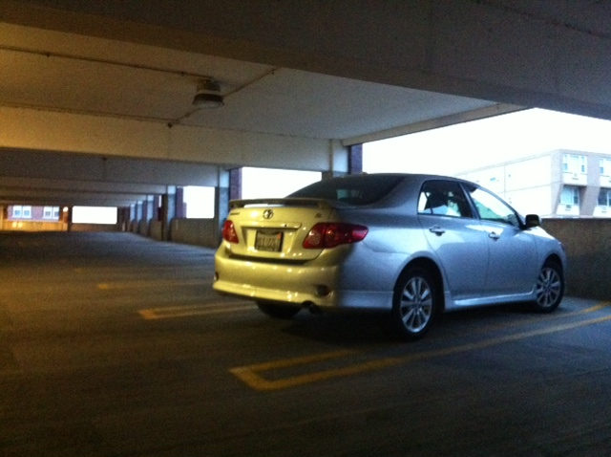
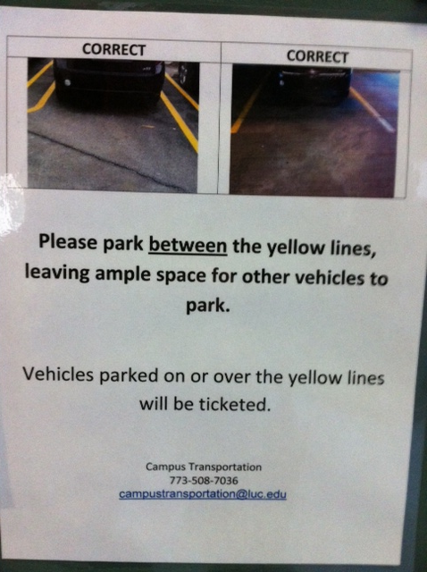
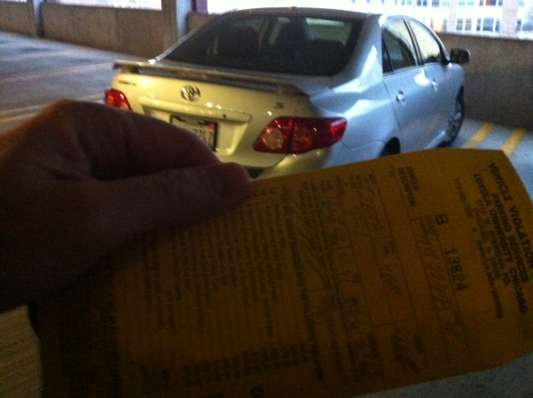
Learning through punishment - Zappos
Notes:
Working on holiday break on university related tasks
Came up and apparently my car was parked over the line and clearly I was hindering the parking of others - $40 ticket..Are you kidding me? Complained – they said this time we will let you go, but next time it will be enforced..Then..the poster…many of our students learn the rules this way – at home, they say, pass the fn sugar – they are learning a new skill.. Do not assume.. Or you will get “are you kidding me?”

Slide 59

Benefits of Teaching Expectations
Includes behavioral, social, academic skills
Fewer defiance and drug-related discipline problems (Molloy et al., 2013)
Improved development and course grades (Farrington et al., 2012)
This Photo by Unknown Author is licensed under CC BY-NC-ND
Notes:
Can include non-academic skills such as mindsets, metacognition, and self-regulation – helps with development and course grades – see Farrington p. 184
Belonging to the community
Effort
Success is possible
Finding value in my work
Social and emotional skills – self-awareness, self-management, social awareness, relationship skills, and responsible decision making – CASEL
Self-determined – self-evaluation, set goals, problem-solve, express wants and needs – Wehmeyer p. 184

Slide 60
Teaching Expectations
Examples
Staff orientation meetings
Handbooks
Lesson plans
Videos
Examples
Syllabus
Posters
Booster sessions
Pre-correct/remind
See lesson- Blank!! Possible Example Teaching Story 1 or Pre-Teaching
Student example from football
Fruita Monument Example
Notes:
60
Say silk 3 times, then ask what do cows drink
Practice expectations with group

Slide 61

Developing Expectations
3-5
General
Positively stated
Use an acronym if possible
  Respectful, Appropriate, Determined (RAD)
Connect to school mascot if possible
Academic and social and emotional standards
Align with mission and vision

Slide 62

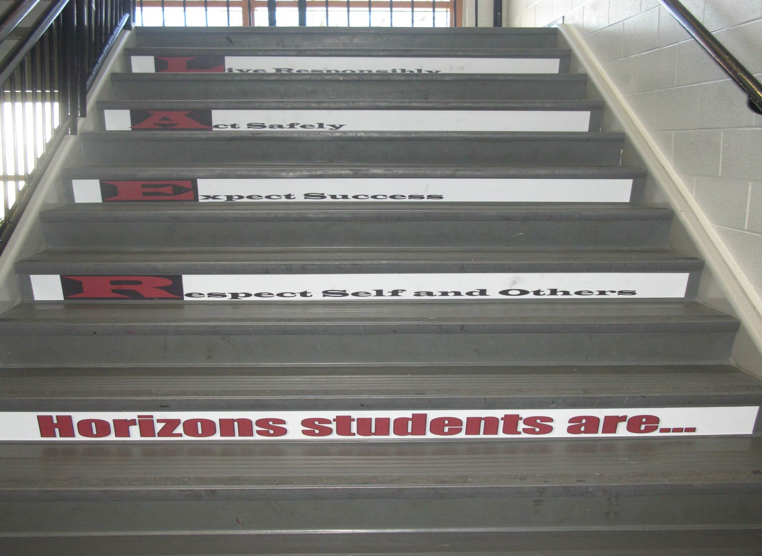
Shawnee Mission Schools, KS

Slide 63

Developing Expectations
Include your whole community
Schoolwide Expectations Survey for Specific Settings https://ci3t.org/pdf/SESSS.pdf
60% = respect, responsibility, and safety (Lynass, et al., 2012)
See the example from p. 16-18, why were these included?
This Photo by Unknown Author is licensed under CC BY-SA

Slide 64
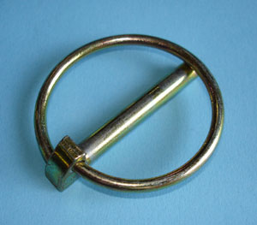
Standards and Lynchpin Skills – See P. 21-22
Skills
Australian Standards ·Grade 10 Literacy Standards
How to work cooperatively with peers
How to be respectful of people from other cultural backgrounds
Using effective strategies for dialogue and discussion in a range of formal and informal contexts, including speaking clearly and coherently
Link to Oklahoma State Learning Standards: https://sde.ok.gov/sites/ok.gov.sde/files/documents/files/OAS-ELA-Final%20Version_0.pdf
Image from: https://commons.wikimedia.org/wiki/File:Lynch-pin.jpg
Notes:
If students engage in these skills, they are more likely to be successful in other areas

Slide 65
p. 24
How could you align your standards?
CPS Matrix Aligned with Common Core Standards – See http://www.hankbohanon.net
Notes:
See standards lists or reference in handout
Use your data
Select an evidence-based program – See CASEL
Develop an expectations matrix
What is the problem, what you do want to see instead
Remember academic and non-academic skills (e.g., mindsets)
See PBIS.org schoolwide matrix p. 188
Align with standards – see my example – how could you align with Australian standards

Slide 66
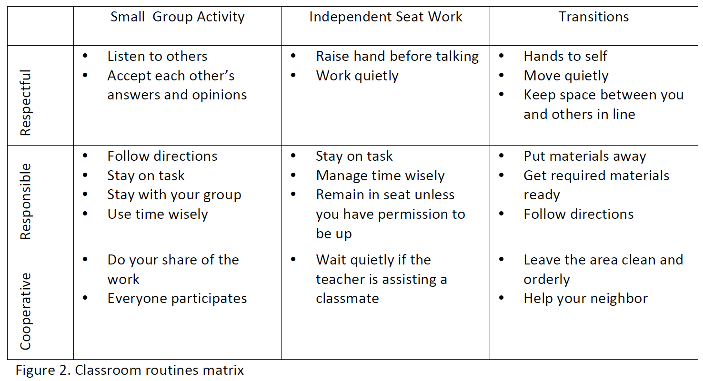
Sample Classroom Matrix
Newcomer (2009)
Which of these behaviors would you like to address?

Slide 67
Identifying Your Expectations
See Table 13.2, p. 23 to help you prepare or improve your expectations
This Photo by Unknown Author is licensed under CC BY-SA

Slide 68
Alignment
See the example Matrix on p. 24
Using the Australian Curriculum, align one cell of the matrix with a standard see p. 21-22

Slide 69

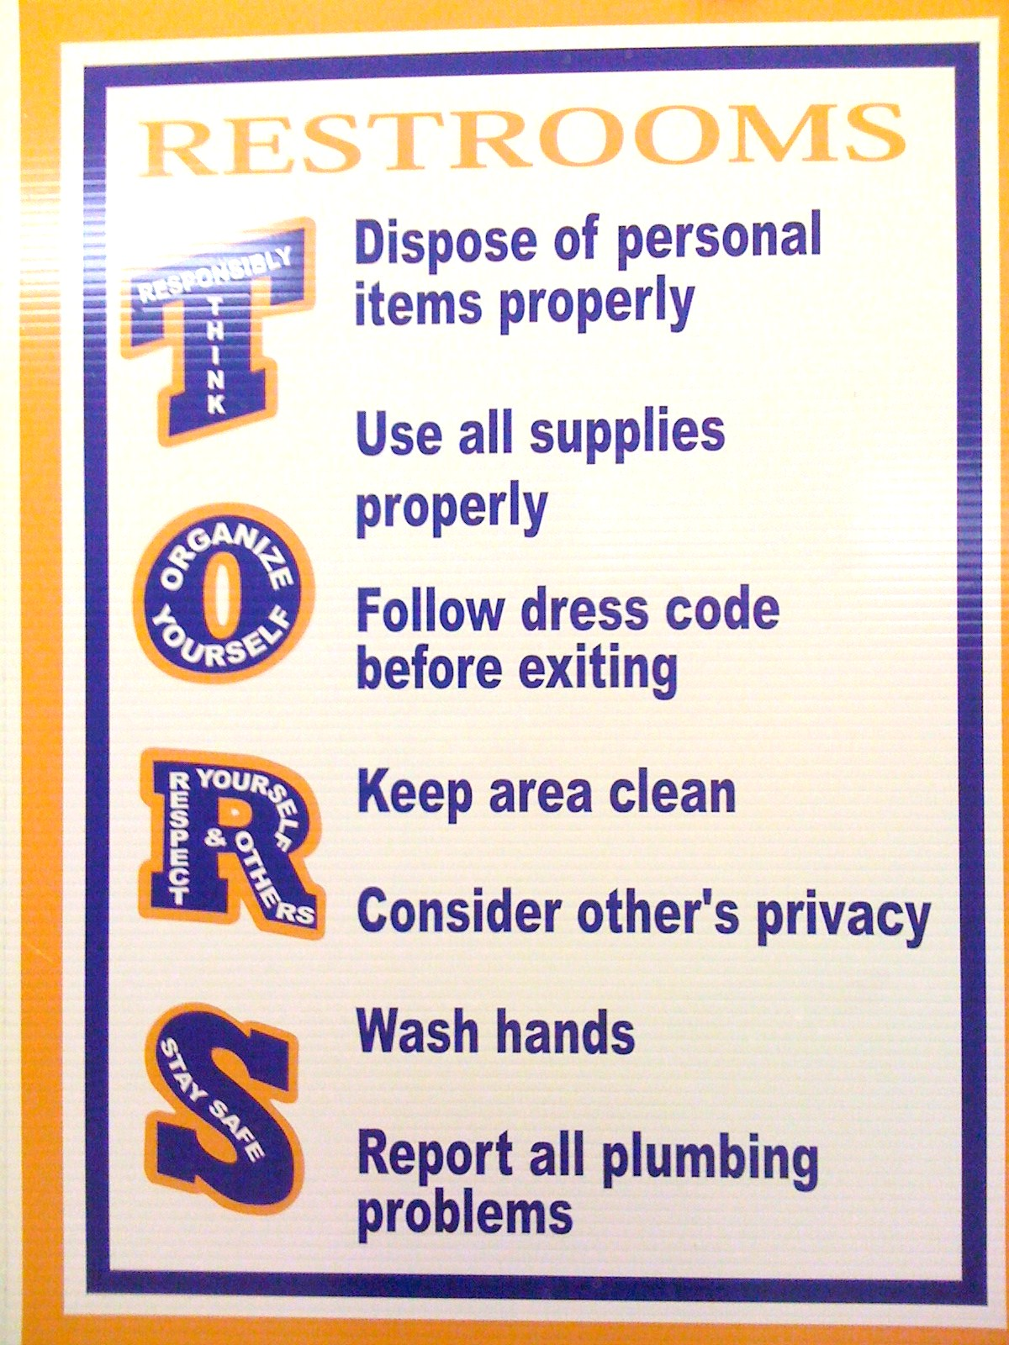
SULPHUR 9th GRADE - PBIS
Posting
CHUCK HANSEN, Principal
AMY PALMER, Teacher
SULPHUR HIGH SCHOOL, LA
Notes:
Ideas
Large font
Focus on behaviour you want to see think “Employees must wash hands”
Keep the verbiage to a minimum
Consider height
Images and language culturally relevant
Content needs to be taught

Slide 70
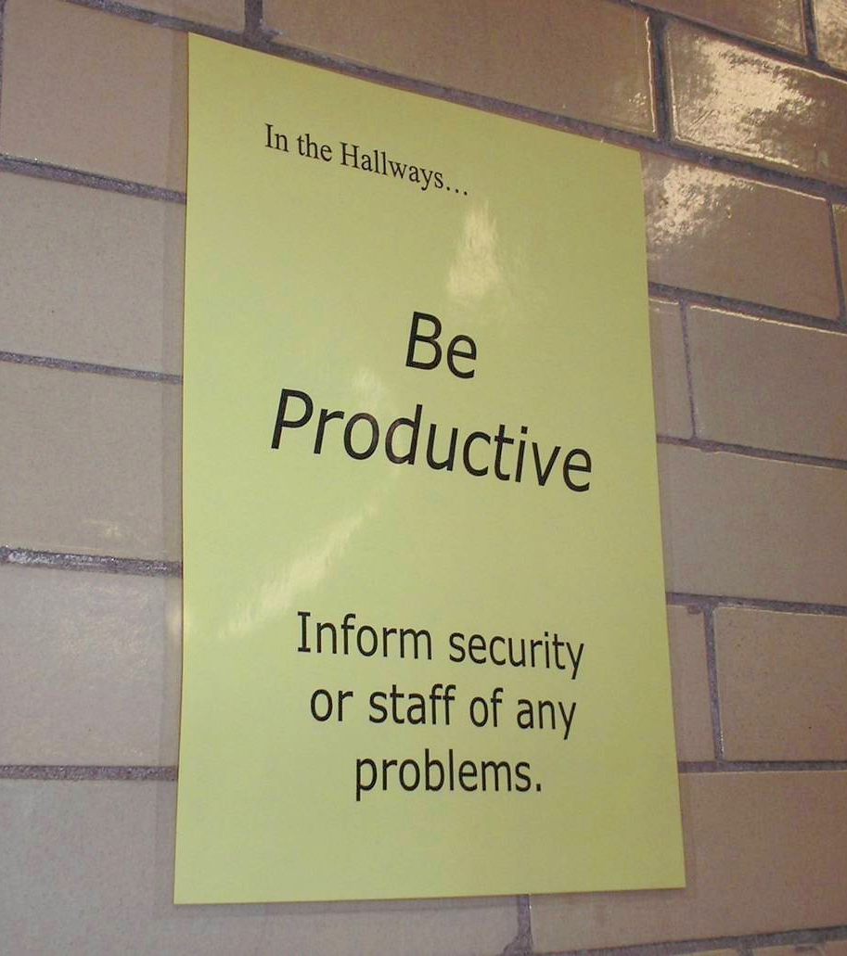
Notes:
70
Mr. Irvin
Defining expectations by location

Slide 71
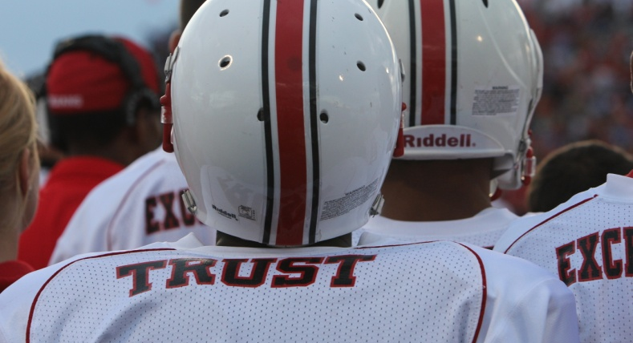
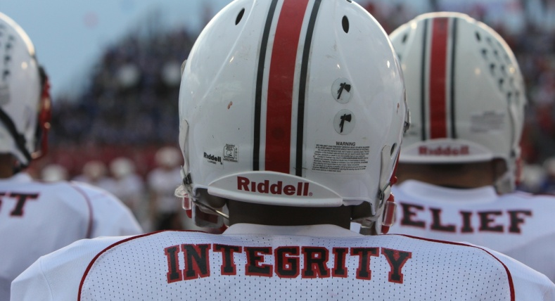
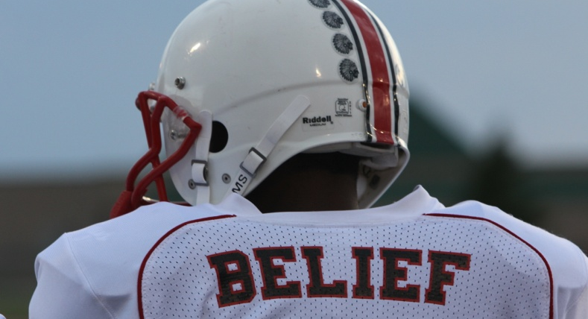
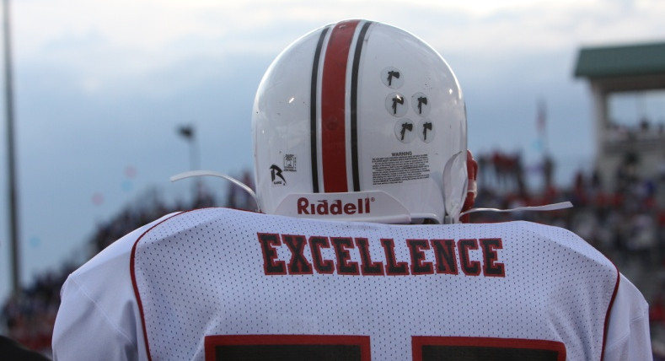
Shawnee Mission North
Football Jerseys
Notes:
Teaching expectations football?

Slide 72
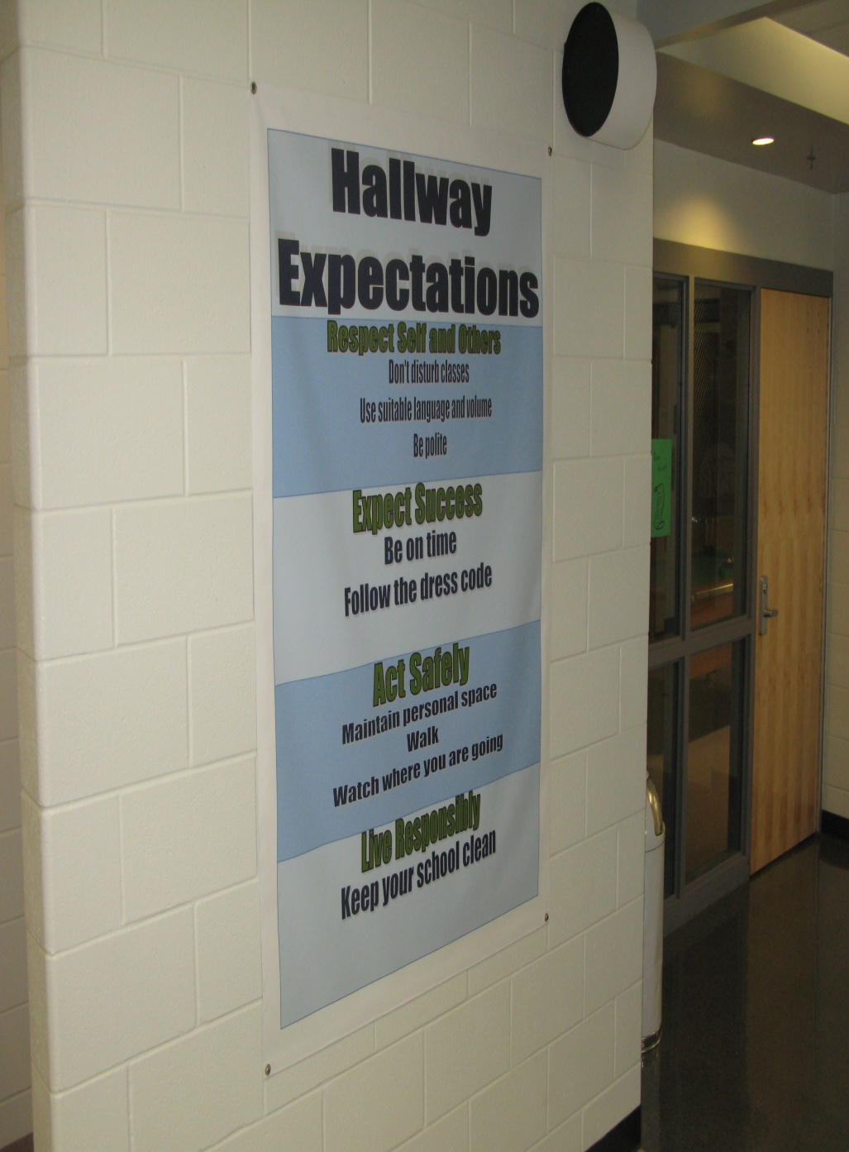
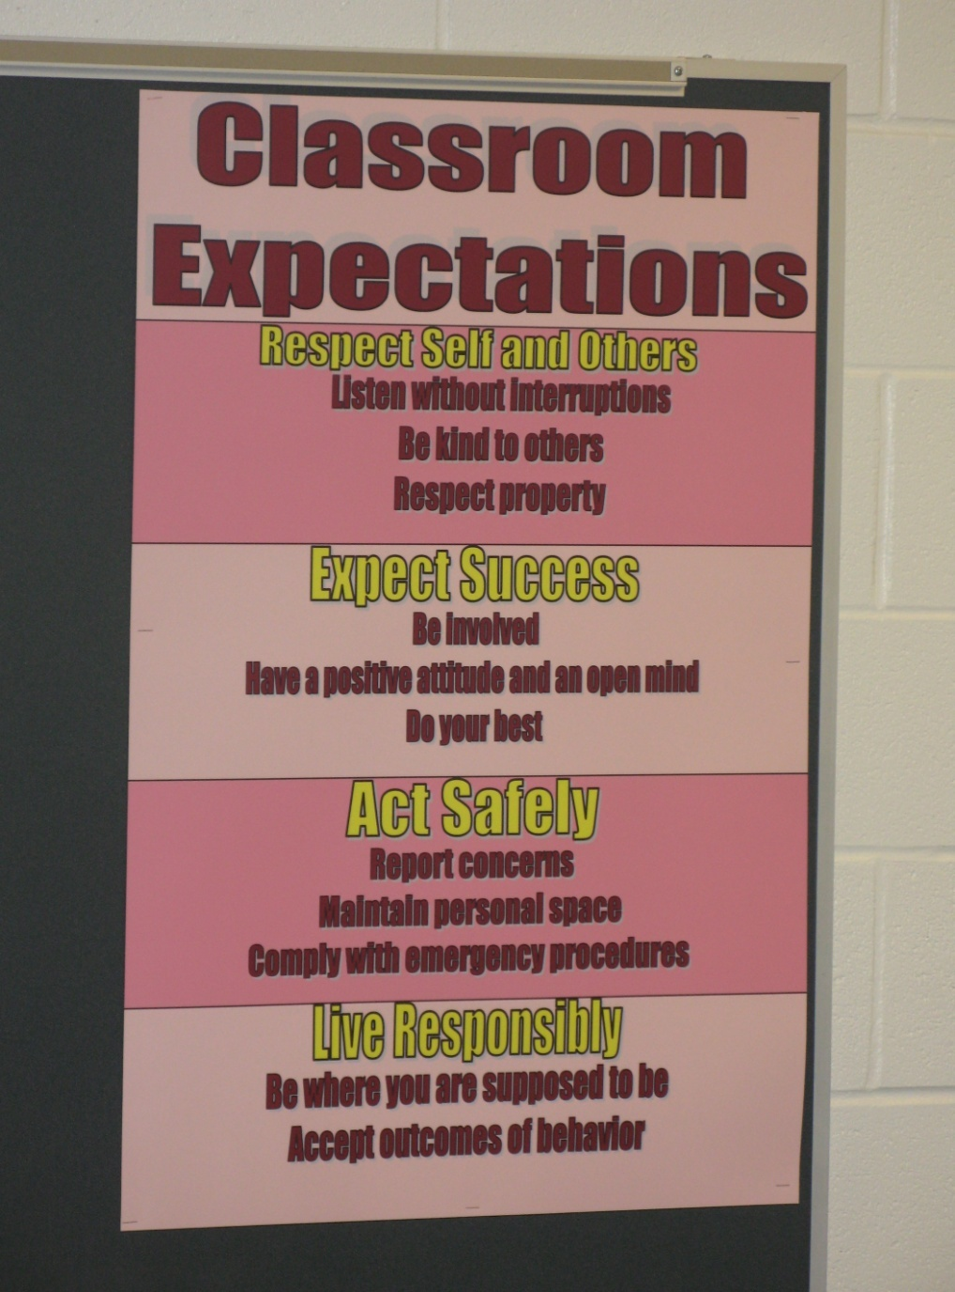
Shawnee Mission Schools, KS

Slide 73
Posting Reflection Question
What expectations do you consistently need to prompt?
How could/do visual examples help?

Slide 74

Teaching Expectations
Key Elements
Rationale
Negative examples
Positive examples
Practice/Feedback
Evaluate
This Photo by Unknown Author is licensed under CC BY

Slide 75

Prepare your staff
See the example lesson plan p. 26
High School example (at two minutes)
Elementary Example
What elements of teaching did you see?
How long does it take to teach an expectation?

Slide 76

Finding more plans
Sample Lesson plans
  http://www.pbismaryland.org/
  http://www.hankbohanon.net
More Video Examples
  http://vimeo.com/groups/pbisvideos

Slide 77
Acknowledgement
Cheerleading Video
Notes:
Cheerleading video

Slide 78
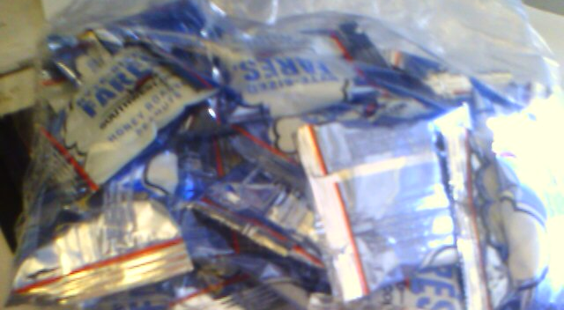
Earned this bag on SW…

Slide 79
Acknowledgement…
As part of schoolwide approach, can lead to improved performance
  Improved attendance (de Baca, Rinaldi, Billig, & Kinnison, 1991).
  Reductions in discipline problems (Bohanon et al., 2012)
Functional outcomes are important
  Relevant curriculum
  Social connection (Dunlap, Foster-Johnson, Clarke, Kern, & Childs, 1995).

Slide 80
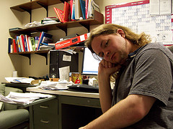
Other Advantages of Specific Praise
Decreases in emotional
exhaustion
Higher efficacy
Reinke, W. M., Herman, K. C., & Stormont, M. (2013).
Photo by Josh Thompson

Slide 81
Video
See examples of why this is important
  One page document “Acknowledging Students for Good Behaviors” p. 29
  Cool tool
  What are you doing around acknowledgment?
  Zappos example? See short example video 0-1:36; 2:17-2:32
Notes:
Zappos video only if time
Tell them page number -

Slide 82
High Frequency

Slide 83
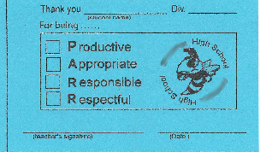
Buzzy Buck
Notes:
83
83
Brigit

Slide 84
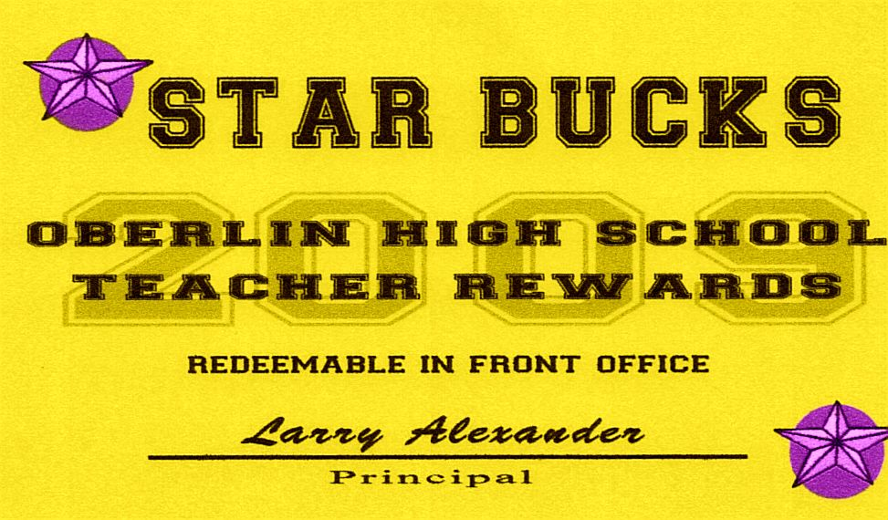
Teacher Rewards Program
2 – Soft Drink
3 – Candy Bar
5 – Preferred Parking
8 – Free Lunch
10 – No Bus Duty
15 – No Morning or
Lunch Duty
20 – Extra Planning
Period
Tonya Ryder, Assistant Principal
Selena Gomes, Graduation Coach / Teacher
Oberlin High School, LA

Slide 85
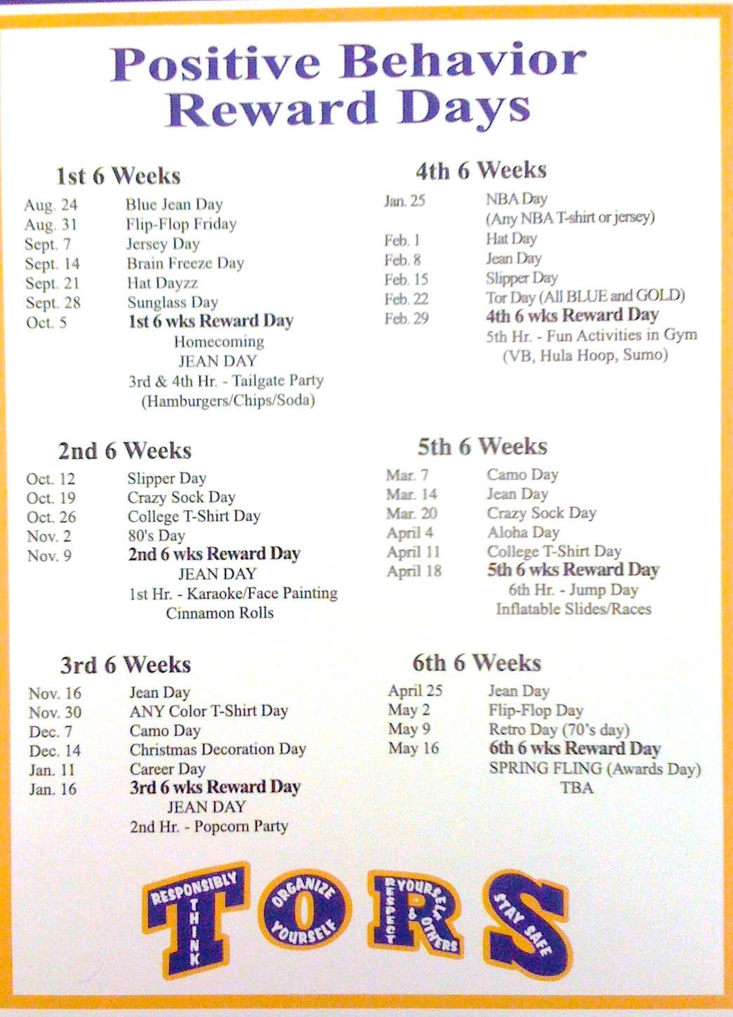
CHUCK HANSEN, Principal
AMY PALMER, Teacher
SULPHUR HIGH SCHOOL, LA

Slide 86
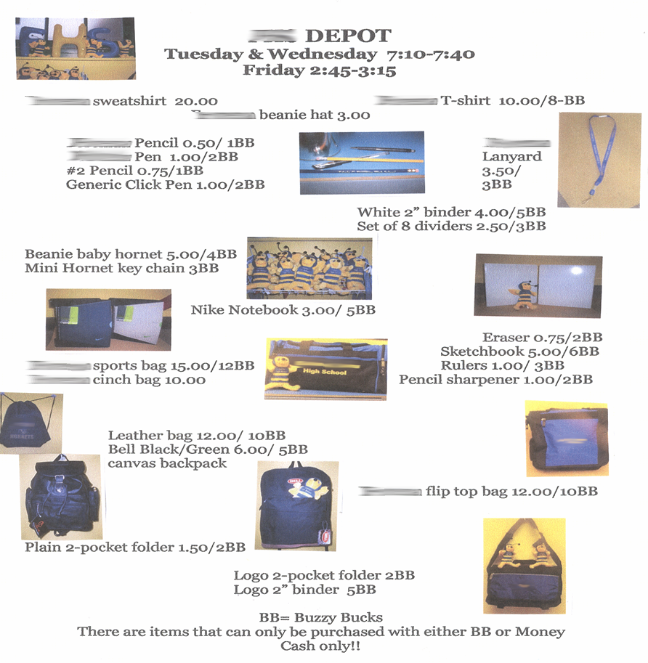
Notes:
86
86
Brigit

Slide 87
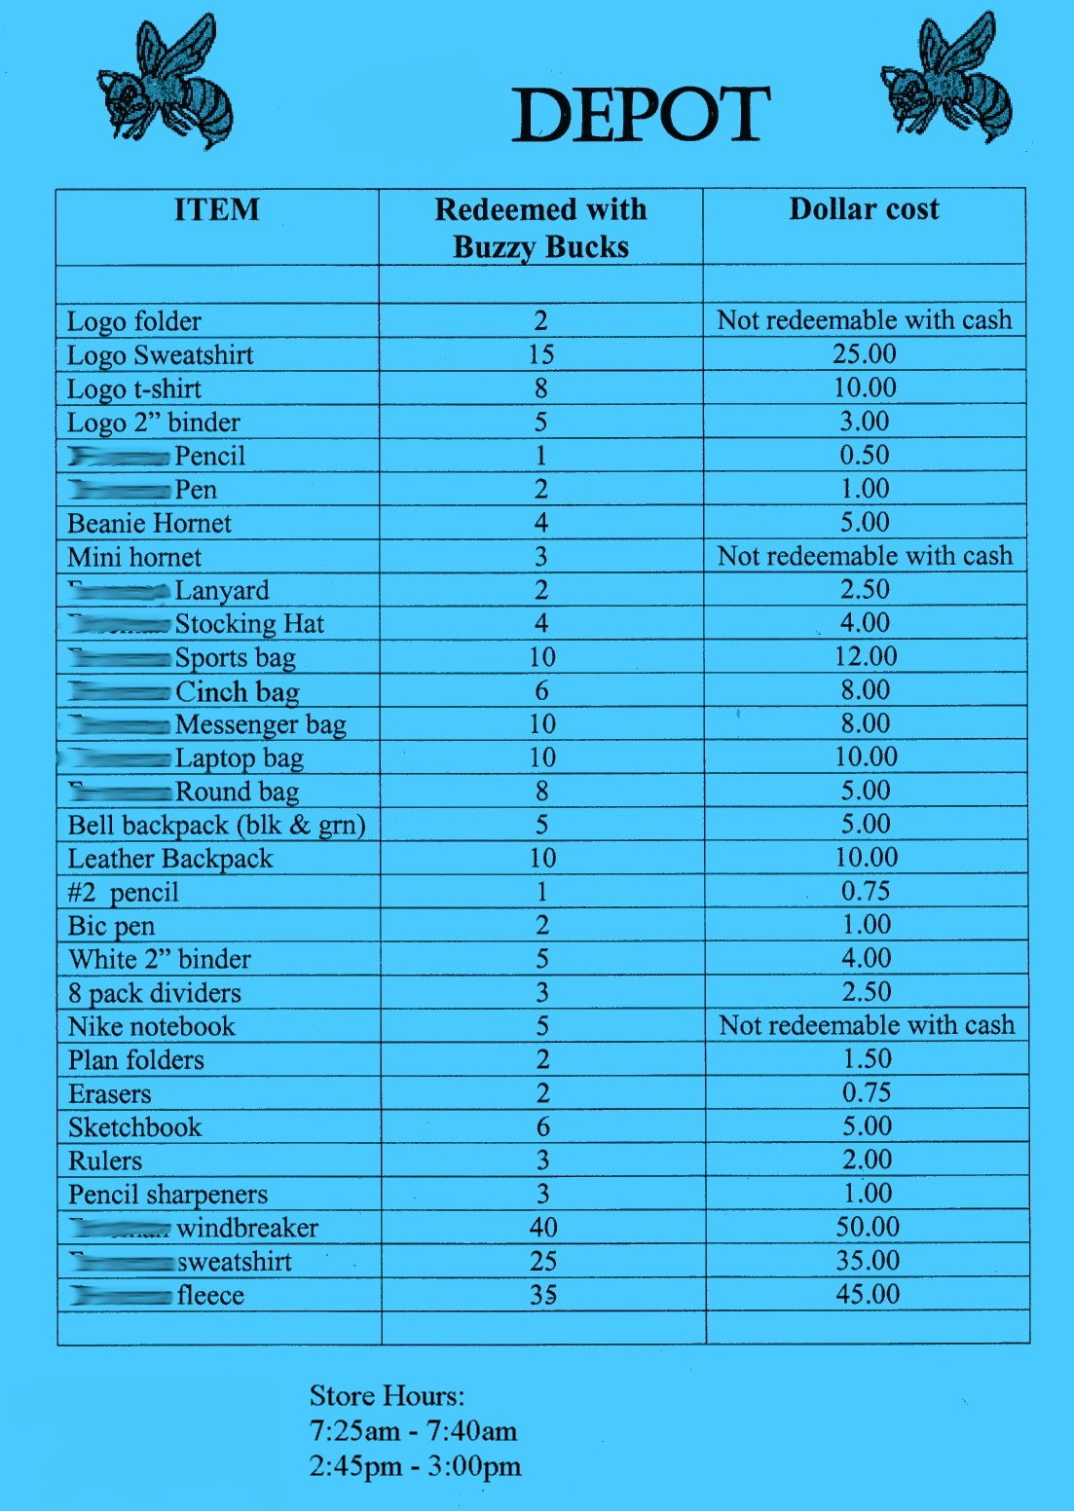
Notes:
87
87
Brigit

Slide 88
Intermediate

Slide 89
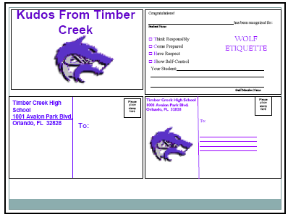
Woodridge Example (link)
Timber Creek High School, FL, JOHN WRIGHT, PRINCIPAL

Slide 90
Notes:
90
90
Brigit

Slide 91
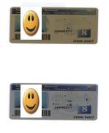
Gold and Silver ID Cards
Notes:
91
91
Brigit

Slide 92
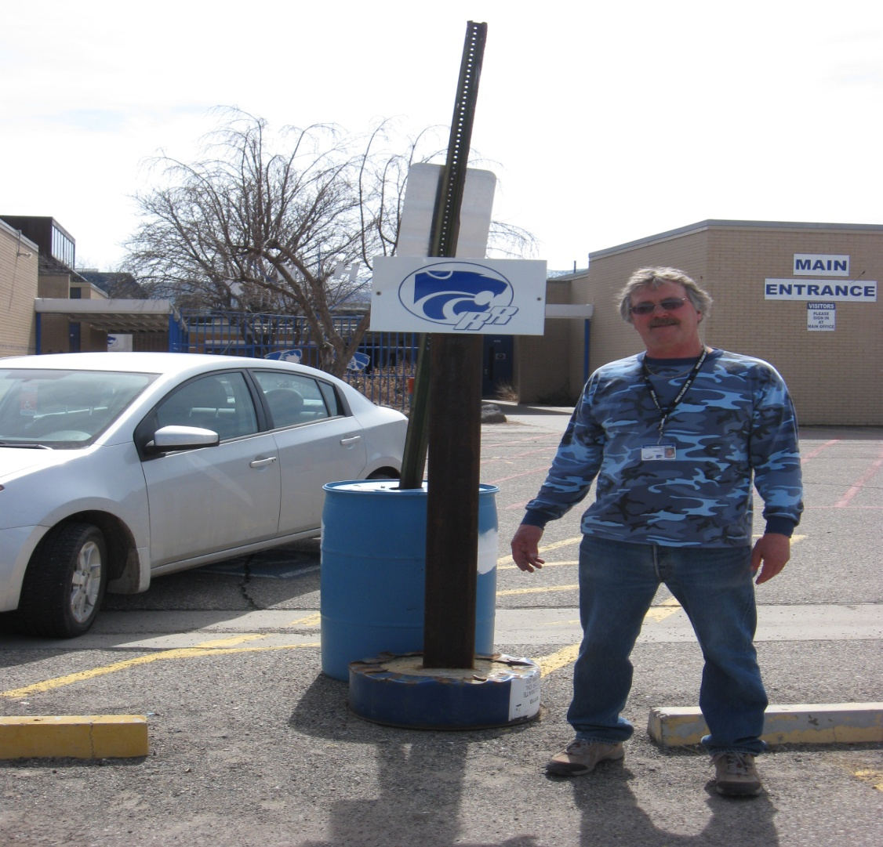
Ron our Liaison
Jody Mimmack, PhD Fruita Monument High School, CO

Slide 93
Large Scale

Slide 94
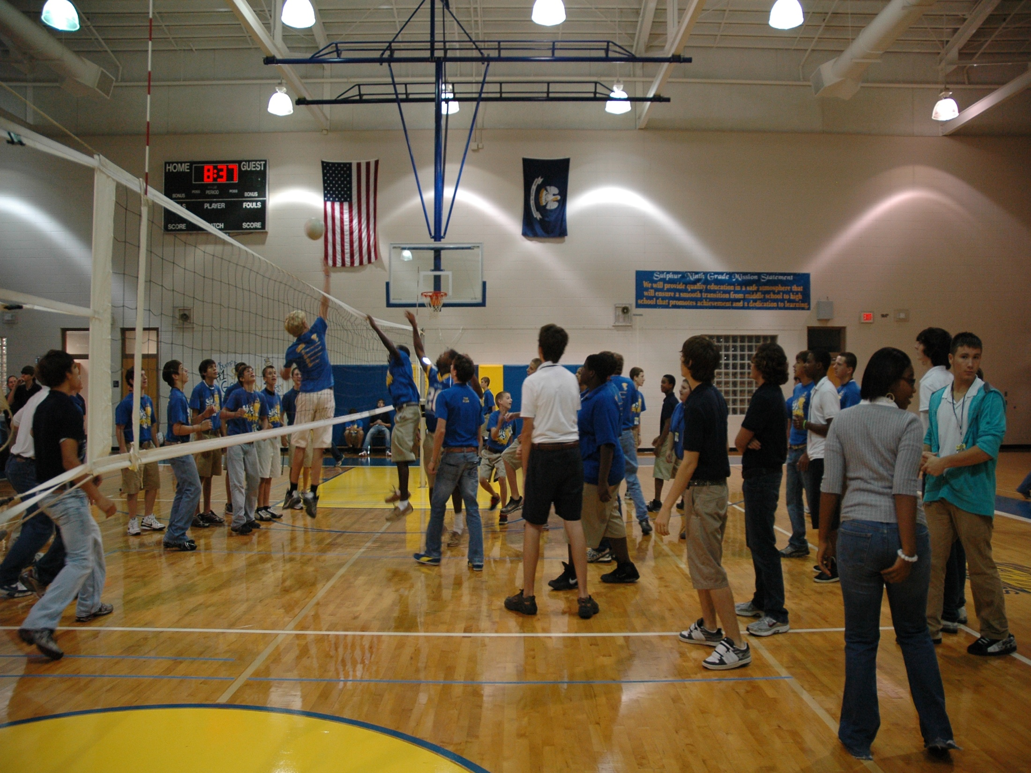
1st Six Weeks Party –
CHUCK HANSEN, Principal
AMY PALMER, Teacher
SULPHUR HIGH SCHOOL, LA

Slide 95
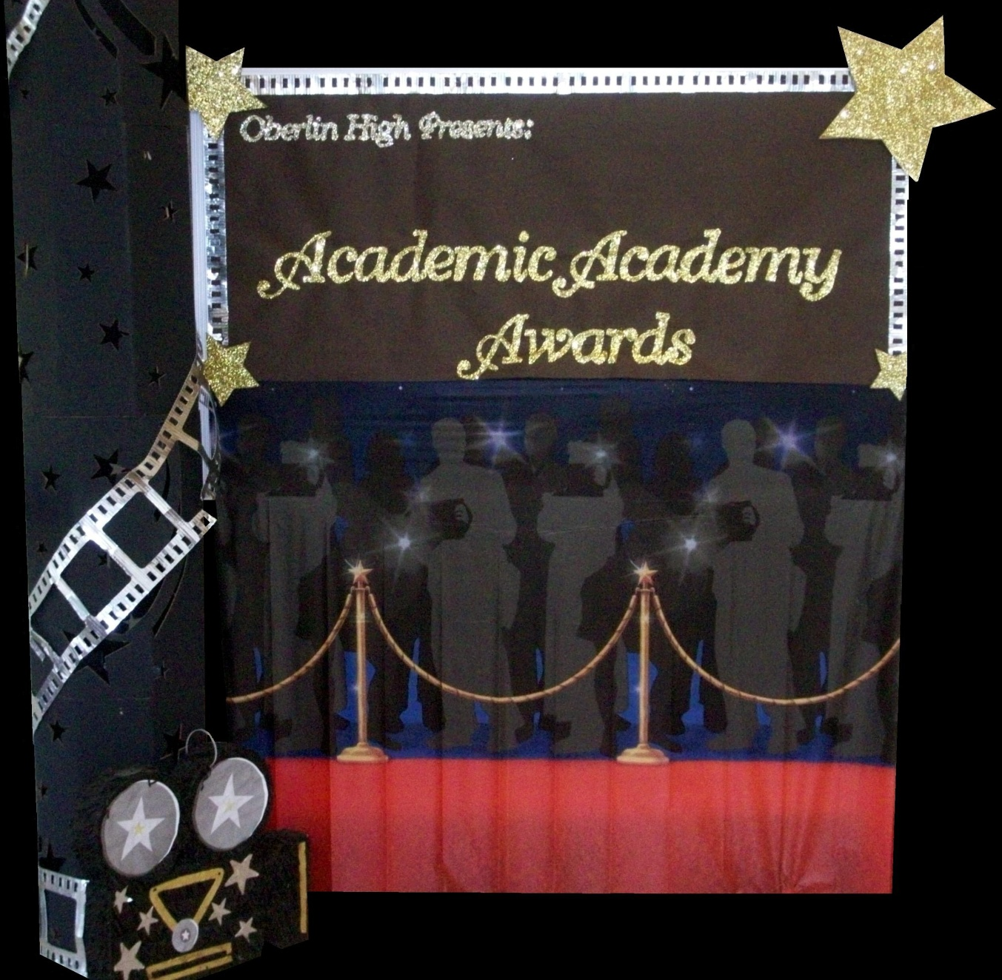
A Night in Paradise…
Tonya Ryder, Assistant Principal
Selena Gomes, Graduation Coach / Teacher
Oberlin High School, LA
Notes:
With these procedures in place, it became important to recognize our students’ social, academic and behavioral successes. We no longer have a traditional academic awards presentation, but instead have a school-wide academic pep rally that recognizes all of our students’ successes in various areas. This year’s theme will be “Academic Academy Awards…A Night in Paradise.”

Slide 96
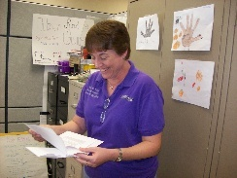
Teacher earns vacation
Timber Creek High School, FL, JOHN WRIGHT, PRINCIPAL

Slide 97
Freebies
http://www.kipbs.org/new_kipbs/familyInfo/freebies/

Slide 98

Certificate of Appreciation
Teaching Spartan of the Month
In recognition of excellence in teaching, __________ is awarded this certificate for devotion to the students, commitment to learning, and dedication to the core values of R High School.
Date
R324A070157
, Principal

Slide 99
Reflective Question
See sample and blank reinforcement matrix, p. 30
What is one high-frequency acknowledgment that might work for your students or teachers?
What is one unpredictable/intermittent “BOOSTERS” acknowledgment that might work for your students or teachers?
What is Attention-Grabbing “Celebrations” acknowledgment that might work for your students or teachers? See matrix

Slide 100
Engagement and Opportunities to Respond
Non-example – Ferris
Jeff Bliss Video Example
Notes:
Jeff Bliss Video Example

Slide 101

Quiz
What percentage of workers worldwide
consider themselves engaged at their jobs?
15 %
https://haiilo.com/blog/employee-engagement-8-statistics-you-need-to-know/
Photo from Flicker Creative Commons https://www.flickr.com/photos/pennwic/8142281815/in/photolist-dpvjHe-dpvjNz-dpvths-pQoPx7-aMi2SZ-8vEXtU-8vBWcM-5C6oVt-pEQiQm-97vCko-rKn1F-h7BuWg-h7ybkV-h7wXts-h7y2AF-h7y1NP-8vBVJ2-8vBW8g-8vBVL8-8vBVZr-8vEXGf-8vBWgB-8vBWdB-8vBVTe-8vBW8X-8vBW4Z-h7wVwR-h7x7bs-aMi6nD-5pYDTp-aMiarZ-aMi2xk-aMhLrn-aMhSLR-aMhUsa-aMhK7i-aMhJQz-aMhUbT-aMhJxr-aMhYfc-aMhURP-aMhTt2-aMhV48-aMhKk8-aMhKyV-aMhKRR-aMhLHT-aMhTFt-aMhTXz-aMhUEp

Slide 102


To Engage Students, Save the Cat
Why is this scene in Moana (link)?

Slide 103
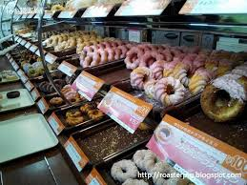

Engagement
Image from http://2015.oimf.jp/en/news/detail/104
Image from http://bit.ly/1ZIfcPF
Good merchandise alone will not appeal to the customer, it …[stores]…must attract the five senses (ANA Innovations)
  Goichi Itokazu, President of Ryubo Holdings, and former president of Family Mart
Notes:
Talk about unicycle

Slide 104





Instructional/Emotional Support
Failure rates
from 17% to 11%
  Choice of responding
  Laughing with students
  Out of desk greeting
Allen, Gregory, Mikami, Lun, Hamre, & Pinata (2013)
  Ask about events
  Ask “why”?
http://mzteachuh.blogspot.com/2012/05/that-kid-drives-me-nuts-tweets-of-day.html
http://ignitebrownsville.blogspot.com/p/picture-gallery.html
http://english.vietnamnet.vn/fms/sports/57762/hanoi-to-host-5th-asean-student-sports-games.html
http://www.phy.bris.ac.uk/news_archive1.html
http://www.hillel.org/jewish/ask-big-questions
Notes:
See Blog in handout and onwebsite

Slide 105

Reflection on Universal Design for Learning – Providing Flexible Means of Engagement
Think about the worst class you ever attended, why was it so bad/frustrating?
This Photo by Unknown Author is licensed under CC BY-NC

Slide 106

Universal Design Slide
Get from old UDL presentation
This Photo by Unknown Author is licensed under CC BY-NC

Slide 107

Flexible Means of Engagement
Explicit teaching, modeling, guided practice
  www.cast.org
Make choices
  Content
  Who to work with
  Where to work
Explore content of interest
Using technology (e.g., Kahoot)
Instructional Routines (The Core Six )
Notes:
Instructional routine – using EBP classroom strategy, as designed, frequently and regularly until students become familiar enough with the strategy that it becomes a habit
Reduce cognitive load for students with emotional or executive functioning challenges
The Core Six – Harey Silver’s book
Include writing processes, graphic organizers, academic vocabulary instruction, problem-solving steps, and self-monitoring

Slide 108
Instructional routines reduce cognitive load and allow students to be more independent learners
Examples
Reading for Meaning graphic organizer (Silver) - example below
Cornell style notes (Pauk)
Collaborative Strategic Reading (Klingner and Vaughn)
Claim-Evidence-Reasoning writing graphic organizer (many to choose from)
Evidence to prove | Claim | Evidence to refute
Table 1 shows that people with PhDs make an average income of $80,000 versus those with BAs make an average of $40,000 | People with more advanced degrees make more money
 | Most people work in the field the study for in college | Paragraph 5 stated that "75% of college graduates work in a different field than their BA was geared toward"
https://www.flickr.com/photos/docsearls/5500118475/in/photolist-cXMNUQ-bC1HTo-9o2xAT-9o5AEY-69MYfV-bubVYL-fu5X2f-E9aS-8DnR9y-bxgyP7-5qSgwP-dSA9Bi-5shMyD-8usn4k-5kZNd-89XiCo-2BGoqb-79hKaP-6wBTN-d7tNeN-7Sp5BB-9gfYVD-bA5evD-7i8Yvi-7WuQSP-4pTi29-cFS2Bs-9bk1ib-vxLgw-CJ6Cg-8GYAwP-5y9gAy-9PykmB-s4Zdf-gtS4jP-5gF5YM-6wBUr-57aEQb-6ALHfs-auR8jn-h8TtVm-3FHzm8-nTvUk-xKH84-4Vc2E6-3pSKw-5W5NMW-ma4TR-29BGFW-7Sp6Wg

Slide 109
Example for Reading for Meaning
See p. 19 for practice example
Evidence to prove | Claim | Evidence to refute
Table 1 shows that people with PhDs make an average income of $80,000 versus those with BAs make an average of $40,000 | People with more advanced degrees make more money
 | Most people work in the field the study for in college | Paragraph 5 stated that "75% of college graduates work in a different field than their BA was geared toward"

Slide 110

Reflective Question
See Table 14.2, Rank order the strategies by personal preference, p. 14.2

Slide 111
Student Engagement
Webinar on using data to improve student engagement http://fb.me/4vHawmKtz
Webinar for increasing student engagement through real world projects http://bit.ly/1K5ZplN
Assessing school climate webinar http://bit.ly/1IRJgBH
Online survey: student hope, engagement, belonging, and classroom management.... http://fb.me/2bX9tbQh4
Teaching algebra in middle and high school http://buff.ly/1CqNf2c

Slide 112
Example
What connections do you make with behavior and your instructional model?
Schoolwide examples https://www.youtube.com/watch?v=y0H5XsZ1gzA
See example, how is this teacher preventing problem behavior through engagement?
  See steps in handout (see video up to 2:43)
  https://www.youtube.com/watch?v=zxTuPVtayOI

Slide 113
Redirection and Active Supervision
JC Penny’s does this very well
How some mom’s handle the pressure video – Whitney Young

Slide 114


Redirection
Images from Flickr Creative Commons
If you need to correct someone, speak to the person personally – do not embarrass them in front of others. Treat the person with dignity (Ng & Foo, 2016)
  Stephen Raidy, president and CEO of the LIPPO Group
Notes:
(US $20 Billion Dollar Conglomerate and Executive Chairmen of OUE Singapore

Slide 115
What do people like about Starbucks? Is it just the coffee?

Slide 116


Redirection, Starbucks Style
Problem=
Listen
Acknowledge the problem
Take action
Thank the customer
Encourage their return
https://www.flickr.com/photos/jack79_mi/295241529/in/photolist-s6c2c-snPcA-cBe9L5-4MCv86-deQWpH-5Hrfq8-deQWmG-bs8WbE-8QwTKz-54v7jN-deQWkH-4LQZDz-pTk24-5Hrew-7zYn6p-jhtJ2-3PrS4-93M6u-5ZRgv-7iCBqP-7zXPki-cfkpQ1-cAWgMq-o3Essy-4bX7QK-jhB4Qw-oi8bk3-HPLbR-d11jb-cv4v-69dDt-5Zqe12-3KZ51j-7CSQRL-4BUac-deQWaJ-733Hyf-27bFgT-63CyTY-4JMpRY-4E56j9-dWAY9h-hHxqqw-bkD5C-5u4KaH-2ND7vr-dF4Szc-uigrX-5pETae-4V632M
https://www.flickr.com/photos/sfj/5460895004/in/photolist-9jyvQ9-4EDQCx-ciq9gq-acTCLV-or6MBF-opyZQr-7HD4bD-2VTQV-ecdhtd-oc3FqA-7uuFQf-2vECfM-5HQQga-EZgJA-7eVbg-a95T3-jGwNrD-atfY75-MaAHM-5T63vU-8Nx9W-c51DLd-4D98Gt-2WbnRa-cdr3WN-dvcKjv-7iGxjN-3jVKDf-dsbnCL-5iSejM-ci7Qe-cUGZfN-4pH6PT-8xfZ1S-9oTxv4-u8Rr6-5HXUFU-6jkHSR-cBaiHL-h6VisX-ctjB7u-dHpzzL-69sPWA-5nXi3n-s2Qe-478wUK-neMFoz-dGVCiR-jJgKTt-8MnN24

Slide 117


Is the behavior office- managed?

Slide 118
McClatchy Students Video, Dean?
Notes:
118
Alissa present (1 minute max)
118

Slide 119

Support Staff: Preventing and Responding
Teach skills for prevention
  Good classroom instruction
  Non-classroom settings
Teach skills for redirection
  Classroom
  Non-classroom settings
See Handout “Professional Development on Redirection” p. 34
This Photo by Unknown Author is licensed under CC BY-NC

Slide 120

Videos
  What does PBIS Look Like? – Active Supervision and
  Redirection examples 6.12 mins
  http://vimeo.com/14818677
Notes:
Tell story from NC when your said slurs about my family - how I handled – how I did not react…

Slide 121
Reflective Question
Create a T-Chart of expectations for handling problem behavior
Identify who handles behaviors in your school
List out behaviors that should be handled by each on each side. P. 35

Slide 122

See Woodridge High School Prezi (link)

Slide 123
Resources
Year-at-a-glance
  http://www.hankbohanon.net/Resources_1.html
Training script for booster for staff
  http://www.hankbohanon.net/Resources_1.html

Slide 124

Strategies
Mendler, A. N. & Mendler B. D. (2011) Power struggles: Successful techniques for teachers. Bloomington, IN: Solution Tree.

Slide 125

Classroom Management
Knoster, T. (2013). The Teacher’s pocket guide effective classroom management (2nd Ed.), Baltimore, MD: Paul H Brookes

Slide 126
Student Engagement
Webinar on using data to improve student engagement http://fb.me/4vHawmKtz
Webinar for increasing student engagement through real world projects http://bit.ly/1K5ZplN
Assessing school climate webinar http://bit.ly/1IRJgBH
Online survey: student hope, engagement, belonging, and classroom management.... http://fb.me/2bX9tbQh4
Teaching algebra in middle and high school http://buff.ly/1CqNf2c

Slide 127
Preparing Your Teams
How will you prepare your staff?
See examples and action plan
Notes:
Tell page number

Slide 128
Where are you?
Complete
  Classroom management self-assessment
  http://www.pbis.org/pbis_resource_detail_page.aspx?Type=4&PBIS_ResourceID=164
Free training on active supervision (limited time only)
  https://www.irised.com/freecourse&?utm_source=IRIS+Educational+Media+Mailing+List&utm_campaign=9d73acd430-FREEprog_SysSupEvElem_8_5_2014&utm_medium=email&utm_term=0_cb7ab95a8b-9d73acd430-291122974#.U-U6UPldWSq

Slide 129
Resources
State Implementation & Scaling-up of Evidence-based Practices Center
  http://sisep.fpg.unc.edu/
Kotter, J. (1995). Leading change: Why transformation efforts fail. Harvard Business Review, 73(2), 59–67. Retrieved from http://hbr.org/
http://www.hankbohanon.net/Resources_1.html

Slide 130
Videos
Michael Kennedy http://vimeo.com/channels/129830
  Fruita Monument
  Consistent
Scott’s Pride https://sites.google.com/a/ddouglas.k12.or.us/scotspride/

Slide 131
Other Supports
Defusing Disruptive Behavior in the Classroom
  Geoff Colvin http://www.lookiris.com/store/K-12_Professional_Development/Defusing_Disruptive_Behavior_in_the_Classroom/
Classroom management training
  http://pbismissouri.org/class.html
The FAST Method
  http://www.lookiris.com/store/K-12_Professional_Development/The_FAST_Method_ONLINE/
Notes:
See website

Slide 132
Other Supports
IRIS Online Modules
  http://iris.peabody.vanderbilt.edu/resources.html
Rti Action Network Article Behavior and Academics
  http://www.rtinetwork.org/Learn/Behavior/ar/Integrating-Behavior-and-Academic-Supports-Within-an-RtI-Framework-General-Overview
National Center on PBIS
  http://www.pbis.org
Association of Positive Behavior Support
  http://www.apbs.org
CASEL – SEL Center
  http://casel.org/
Direct behavior rating
  http://www.directbehaviorratings.com/cms/

Slide 133
Summary
Ask before you tell
Do not implement what you cannot support
Remember your humanity and that of the people you serve

Slide 134
References
Allen, J., Gregory, A., Mikami, A., Lun, J., Hamre, B., & Pianta, R. (2013). Observations of effective teacher–student interactions in secondary school classrooms: Predicting student achievement with the classroom assessment scoring system—secondary. School Psychology Review, 42(1), 76–98.
Benbenishty, R., Astor, R. A., Roziner, I., & Wrabel, S. L. (2016). Testing the Causal Links Between School Climate, School Violence, and School Academic Performance: A Cross-Lagged Panel Autoregressive Model. Educational Researcher, 45(3), 197-206. doi:10.3102/0013189X16644603
Bohanon, H. (2015). Changes in adult behavior to decrease disruption from students in non-classroom settings. Intervention in School and Clinic, 15 (1), 12-18. http://ecommons.luc.edu/education_facpubs/39
Bohanon, H. & Wu, M. (2014). Developing buy-in for positive behavior support in secondary settings. Preventing School Failure, 58 (4), 1–7. doi: 10.1080/1045988X.2013.798774 http://ecommons.luc.edu/education_facpubs/17/
Bohanon, H., Castillo, J., & Afton, M. (2015). Embedding self-determination and futures planning within a schoolwide framework. Intervention in School and Clinic. 50 (4), 203-209. http://ecommons.luc.edu/education_facpubs/16/
Bohanon, H. (2015). Changes in adult behavior to decrease disruption from students in non-classroom settings. Intervention in School and Clinic, 15 (1), 12-18. http://ecommons.luc.edu/education_facpubs/39
Bohanon, H., Fenning, P., Hicks, K., Weber, S., Their, K., Akins. B., Morrissey, K., Briggs, A., Bartucci, G., Hoeper, L., Irvin, L., & McArdle, L. (2012). Case example of the implementation of schoolwide positive behavior support in a high school setting. Preventing School Failure, 56 (2), 92-103. http://ecommons.luc.edu/education_facpubs/7

Slide 135
References
Bohanon, H., Gilman, C., Parker, B., Amell, C., & Sortino, G. (2016 online first). Using school improvement and implementation science to integrate multi-tiered systems of support in secondary schools. Australasia Journal of Special Education. pp. 1–18. DOE: 10.1017/jse.2016.8. http://ecommons.luc.edu/ education_facpubs/80/
Blase, K. A., Fixsen, D.L., Sims, B.J., Ward, C.S. (2015). Implementation science – changing hearts, minds, behavior, and systems to improve educational outcomes. Paper presented at the Wing Institute’s Ninth Annual Summit on Evidence-Based Education, Berkeley, CA. http:// nirn.fpg.unc.edu/resources/implementation-science-changing-hearts-minds-behavior-and-systems-to-improve
Brawley, S. (accessed March 22, 2011). PBS in the classroom. M.Ed. Heart of Missouri RPDC. http://www.cesa7.org/pbis/Classroom_Management.asp
Burke, A. (2015). Early Identification of High School Graduation Outcomes in Oregon Leadership Network Schools. REL 2015-079. Regional Educational Laboratory Northwest.
de Baca, M. R. C., Rinaldi, C., Billig, S., & Kinnison, B. M. (1991). Santo Domingo School: A rural schoolwide project success. Educational Evaluation and Policy Analysis, 13(4), 363-368. doi: 10.3102/01623737013004363
Eber, L., Phillips, D., Upreti, G., Hyde, K., Lewandowski, H., & Rose, J. (2009). Illinois positive behavioral interventions & supports (PBIS) network 2008-09 progress report (pp. 245). La Grange Park, IL.
Flannery, B. K., Guest, E., & Horner, R. (2010). SWPBS: Schoolwide positive behavior supports. Principal Leadership, 11(1), 38-43. doi: 2123461661
Illinois Positive Behavior Intervention and Support Network (2011). FY11 end of the year summary report. La Grange, IL: Illinois Positive Behavior Intervention Network.

Slide 136
References
Johnson-Gros, K. N., Lyons, E. A., & Griffin, J. R. (2008). Active supervision: An intervention to reduce high school tardiness. Education & Treatment of Children, 31(1), 39-53.
Koon, S., & Petscher, Y. (2016). Can scores on an interim high school reading assessment accurately predict low performance on college readiness exams? (REL 2016–124). Washington, DC: U.S. Department of Education, Institute of Education Sciences, National Center for Education Evaluation and Regional Assistance, Regional Educational Laboratory Southeast. Retrieved from http://ies.ed.gov/ncee/edlabs.
Kotter, J. (1995). Leading change: Why transformation efforts fail. Harvard Business Review, 73(2), 59–67.
Lynass, L., Tsai, S.-F., Richman, T. D., & Cheney, D. (2012). Social Expectations and Behavioral Indicators in School-Wide Positive Behavior Supports. Journal of Positive Behavior Interventions, 14(3), 153-161. doi:10.1177/1098300711412076
McKeon, G. (2014). Essentialism: The disciplined pursuit of less. Crown Business
McNeely, C. A., J. M. Nonnemaker, J.M., & Blum, R. W. (2002). Promoting School Connectedness: Evidence from the National Longitudinal Study of Adolescent Health. The Journal of School Health 72(4): 138-146.
McIntosh, K., Filter, K. J., Bennett, J. L., Ryan, C., & Sugai, G. (2009). Principles of sustainable prevention: Designing scale-up of School-wide Positive Behavior Support to promote durable systems. Psychology in the schools, 47(1), n-a-n/a. doi:10.1002/pits.20448
McIntosh, K., Flannery, K. B., Sugai, G., Braun, D., & Cochrane, K. L. (2008). Relationships between academics and problem behavior in the transition from middle school to high school. Journal of Positive Behavior Interventions, 10(4), 243–255. doi:10.1177/1098300708318961
Morrissey, K. L., Bohanon, H., & Fenning, P. (2010). Positive behavior support: Teaching and acknowledging behaviors in an urban high schools. Teaching Exceptional Children, 42(5), 26-35.

Slide 137
References
National High School Center, National Center on Response to Intervention, and Center on Instruction. (2010). Tiered interventions in high schools: Using preliminary “lessons learned” to guide ongoing discussion. Washington, DC: American Institutes for Research. http://bit.ly/2r0SaeE
Newcomer, L. (2009). Universal positive behavior support for the classroom. PBIS Newsletter, 4(4). Retrieved September 24, 2009 from http://www.pbis.org/pbis_newsletter/volume_4/issue4.aspx
Ng, J. & Foo, A. (2016). Heart to heart with Asian leaders: Exclusive interviews on crisis, comebacks, and character. Singapore: World Science Publishing.
Rogers, T., Duncan, T., Wolford, T., Ternovski, J., Subramanyam, S., & Reitano, A. (2017). A randomized experiment using absenteeism information to "nudge" attendance (REL 2017– 252). Retrieved from Washington, DC: https://ies.ed.gov/ncee/edlabs/regions/midatlantic/pdf/REL_2017252.pdf
Rowan, B., Correnti, R., Miller, R. J., & Camburn, E. M. (2009). School improvement by design: Lessons from a study of comprehensive school reform programs. Consortium for Policy Research in Education. Retrieved from http://www.cpre.org/school-improvement-design-lessons-study-comprehensive-school-reform-programs
Sherif, M., Harvey, O. J., White, B. J., Hood, W. R., & Sherif, C. W. (1961). Intergroup conflict and cooperation: The Robbers Cave experiment (Vol. 10): University Book Exchange Norman, OK.
Simonsen, B., Fairbanks, S., Briesch, A., Myers, D., & Sugai, G. (2008). Evidence-based practices in classroom management: Considerations for research to practice. Education & Treatment of Children, 31(3), 351-380. doi:10.1353/etc.0.0007
Therriault, S. B., Heppen, J., O’Cummings, M., Fryer, L., & Johnson, A. (2010). Early warning system implementation guide. Retrieved from http://www.betterhighschools.org/documents/NHSCEWSImplementationGuide.pdf
Vermont Agency of Education (Accessed July 28, 2016). The 13 dimensions of school climate. Vermont Agency of Education, Retrieved from: http://education.vermont.gov/documents/edu-school- climate-13%20Dimensions.pdf

