Slide 1
Embedding UDL into Multi-Tiered Systems of Supports
Hank Bohanon
Loyola University of Chicago
hbohano@luc.edu
http://www.hankbohanon.net
https://twitter.com/hbohano

Slide 2
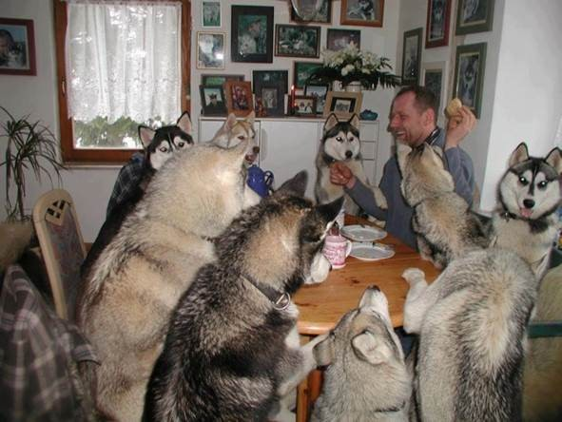
Everyone working together

Slide 3

Thank you!
Andrew M. Greeley Center for Catholic Education
Notes:
3
3

Slide 4

To Learn More (link)
Amazon Link

Slide 5
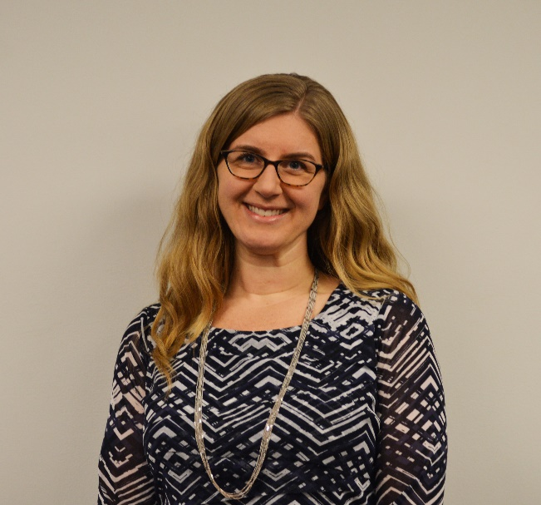

Co-Authors and Content
Lisa Caputo Love
Kelly Morrissey

Slide 6

Goal
Help participants learn strategies for embedding UDL into related multi-tiered systems of support (MTSS) and school improvement in PK-12 school settings

Slide 7
Objectives
Identify areas of strength and need for improvement related to your Universal Design For Learning Strategies (UDL) related to systems, practices, and data
Identify your current schoolwide strategies related to UDL and one strategy that all teachers might be able to implement efficiently and effectively
Questions and Answers

Slide 8

UDL and MTSS
Role Water Fall
Type your role in the chat (wait)
When I say go..hit enter

Slide 9

Prevention – A Simple Bar of Soap
1.4 million children die each year due to preventable infectious diseases (e.g., diarrhea, pneumonia)
Equal to AIDS, malaria, measles, meningitis, and tetanus combined
https://usa.soapaid.org/
Image from https://usa.soapaid.org/wp-content/uploads/2018/09/boys-washing-hands-1024x594.jpg

Slide 10
Designing School-Wide Systems for Student Success
A Response to Intervention Model/MTSS
Questions
Answers
Tertiary Interventions/Tier 3:
Dig deeper – why?
Tertiary Intervention/Tier 3:
Ask questions,
Teach what works better
Cholesterol drugs
1-5%
1-5%
Secondary Interventions/Tier 2:
Can’t do/won’t do
5-10%
5-10%
Secondary Interventions/Tier 2:
Coke test analogy..
Over 50 Daily Aspirin
Universal Intervention
Tier 1:
Were we clear? Does it work?
How do we respond? Did we use
multiple means for instruction?
80-90%
80-90%
Universal Intervention/Tier 1:
Be clear on expectations,
make sure they work, be humane
Banning smoking in
public places*
*Greenburg & Abenavoli, 2017
Notes:
10
You may have a large copy of this in your handouts
tatoo..it is washable (just kidding)..
Example –
SW – Respect – Response Be kind – show poster ahead
Secondary – student could not write very well – even when given coke..skill deficit – then accommodate with writing prompt and remediate – teach skills
Tertiary – attention – personal greetings at the door and pre-correction was enough

Slide 11

Reflective Question
Why do you think some interventions are not successful in school settings? Why do you think some interventions, in your experience, have been successful?

Slide 12
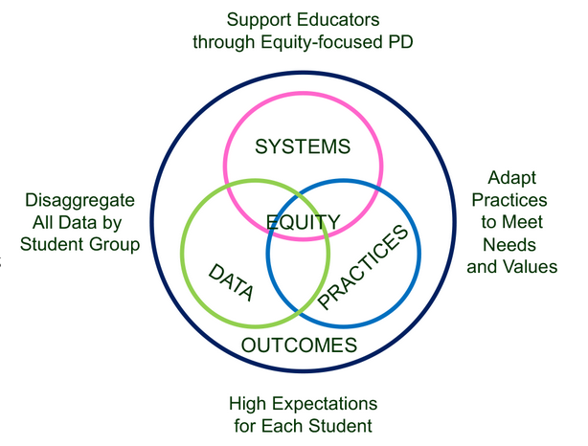
Supporting Social Competence &
Academic Achievement
4 MTSS/PBIS Elements
From https://www.pbis.org/topics/equity

Slide 13
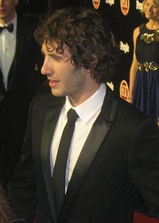


Key Elements of Systems
Systems – Josh, flight, checklist
  Administrative Commitments, Coaching (external/internal), Representative Teams, Audit of Practices, Priority
Practices
  Based on evidence
Data
  Process and impact – dropout
    What and with whom?
http://en.wikipedia.org/wiki/Josh_Groban
http://www.inmagine.com/searchterms/private_jet.html
Notes:
13

Slide 14

Problem Solving – Where do you already use these steps?
Identify
Analyze
Plan
Implement/
Evaluate
Harms, Nantais, Tuomikoski, & Weaver, S. (2019)
From Flickr creative commons https://flic.kr/p/24UJUYy
Notes:
Einstein – if I had 25 minutes to save the world, I would spend 55 minutes identifying the problem

Slide 15

Reflection on Universal Design for Learning – Providing Flexible Means of Engagement
Think about the worst class you ever attended, why was it so bad/frustrating?
This Photo by Unknown Author is licensed under CC BY-NC

Slide 16
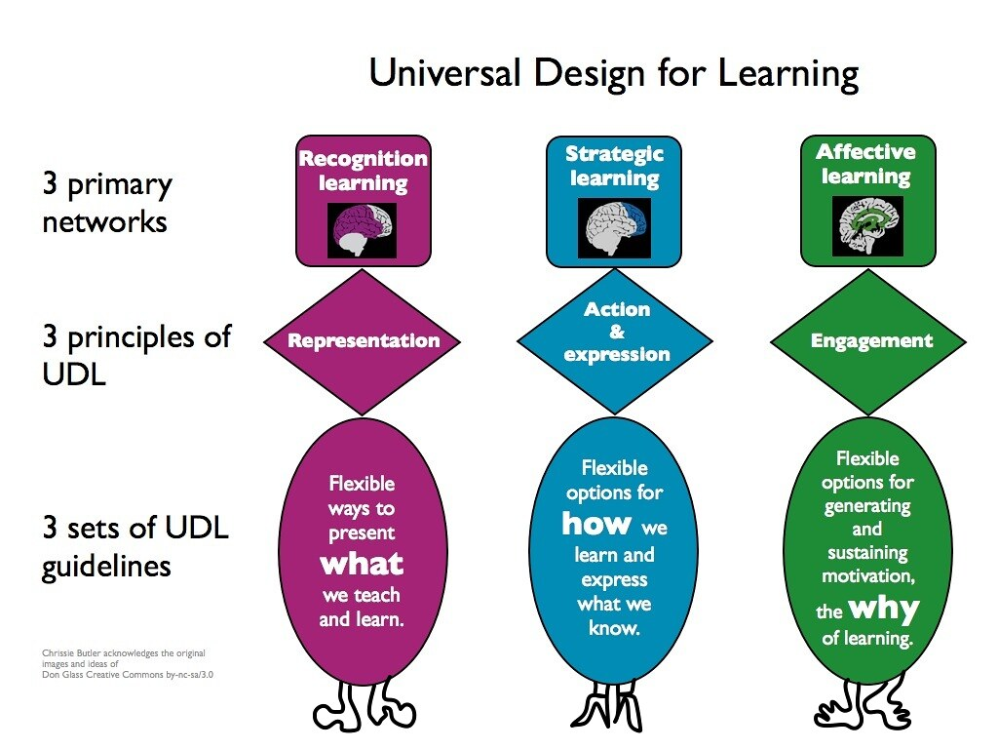
Universal Design Slide
Get from old UDL presentation
This Photo by Unknown Author is licensed under CC BY-NC

Slide 17
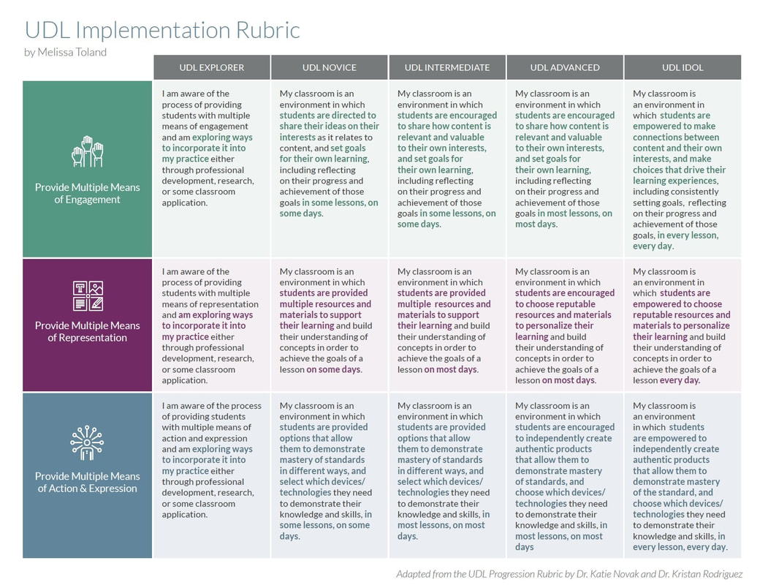
https://www.theudlproject.com/udl-tools---all-grades.html

Slide 18

UDL and Tier 1: A Perfect Union!
Component | UDL | MTSS Tier 1
Proactive (planned in advance) | Yes | Yes
Supports all learners in achieving common standards for success | Yes | Yes
Fosters independence in learners | Yes | Yes
Flexible enough to meet wide variety of needs | Yes | Yes
UDL and MTSS are not the same thing, but many elements overlap and they work well together – MTSS can systematize elements of UDL

Slide 19

Activity Slide
Where have you seen an intervention not work because one of these system/data components was not in place? It may or may not be related to UDL
See Slide 13
This Photo by Unknown Author is licensed under CC BY

Slide 20
Embedding UDL Into MTSS

Slide 21
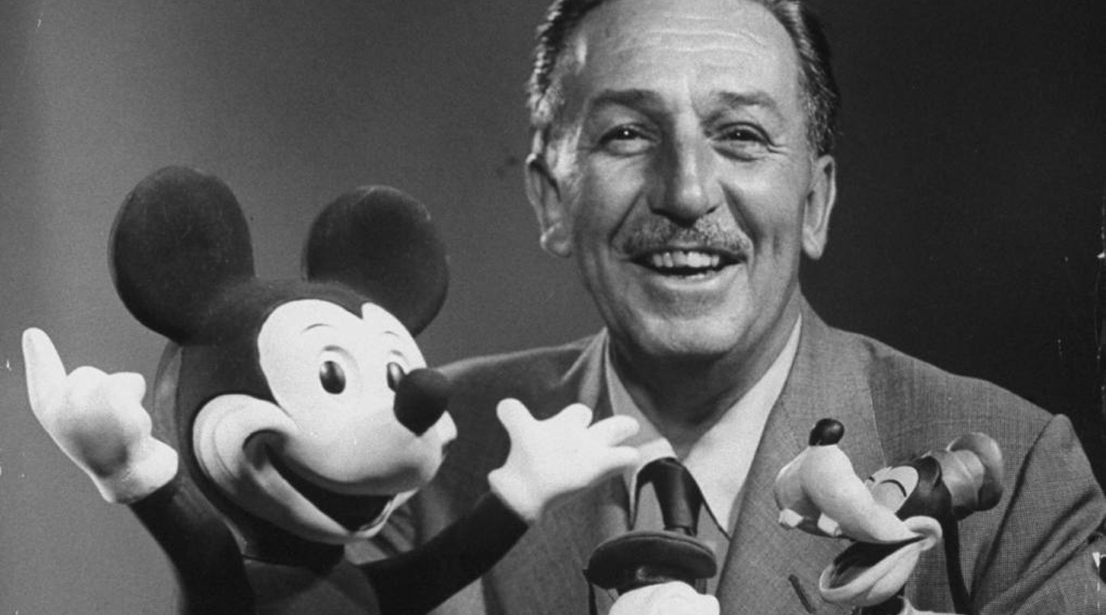
Clear Expectations
Walt Disney – “unarticulated expectations are premeditated disappointments”
This Photo by Unknown Author is licensed under CC BY-NC-ND

Slide 22
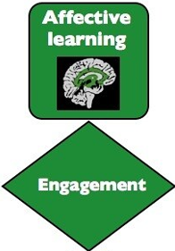
Example: Flexible Engagement elements with connections to Tier 1 strategies
Creating clear expectations for different spaces and activities with explicit lesson plans to help students develop the social emotional learning skills needed to meet the expectations can help recruit interest by minimizing threats (CAST, 2018) by making the space more predictable
  Collaborating with students to develop the expectations also optimizes relevance, value, and authenticity (CAST, 2018)

Slide 23

Developing Expectations
3-5
General
Positively stated
Use an acronym if possible
  Respectful, Appropriate, Determined (RAD)
Connect to school mascot if possible
Academic and social and emotional standards
Align with mission and vision

Slide 24
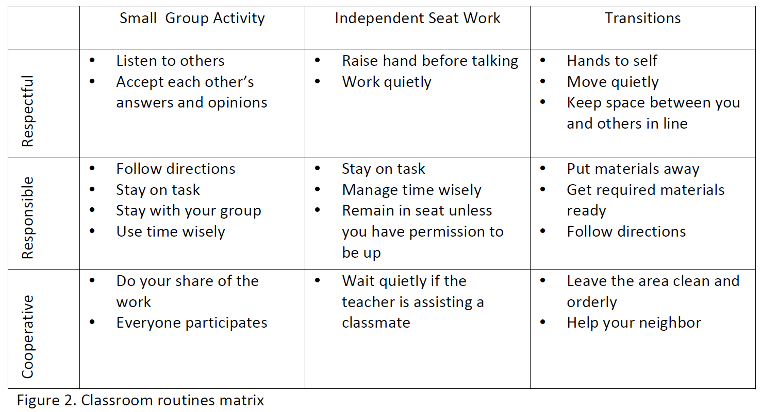
Sample Classroom Matrix
Newcomer (2009)
Which of these behaviors would you like to address?

Slide 25
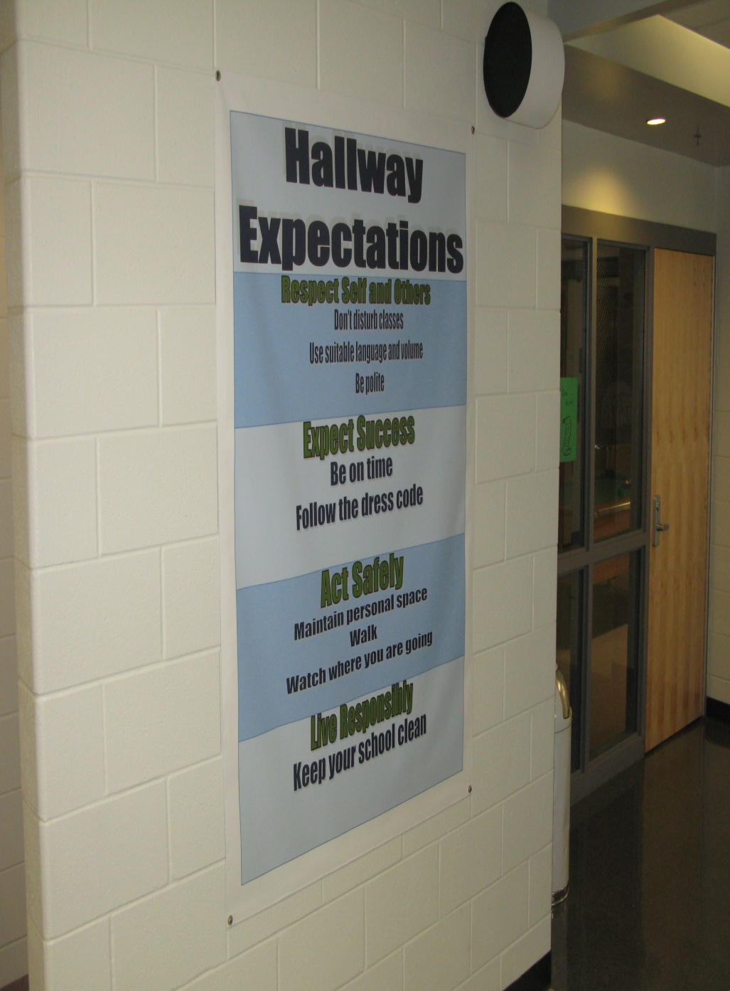
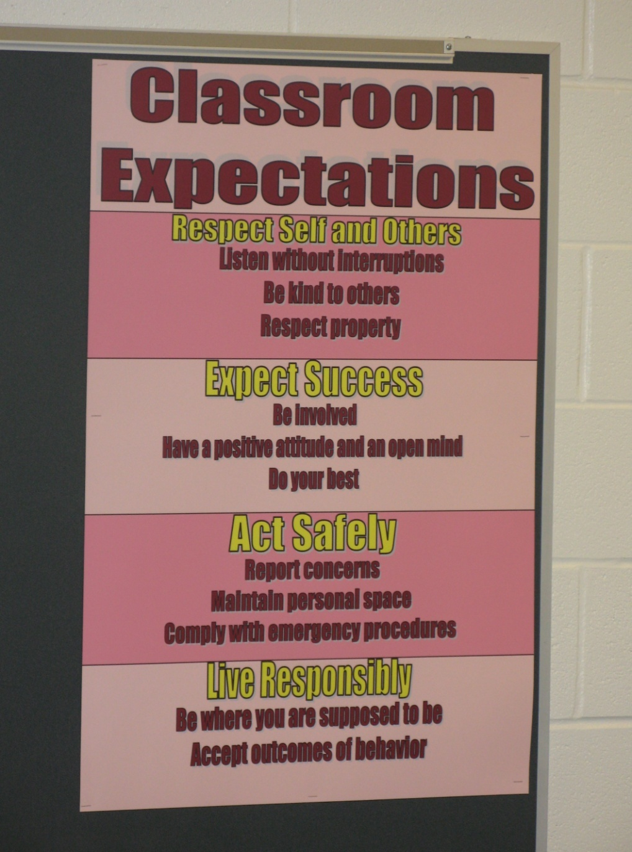
Shawnee Mission Schools, KS

Slide 26

Developing Expectations
Include your whole community
Schoolwide Expectations Survey for Specific Settings https://ci3t.org/pdf/SESSS.pdf
60% = respect, responsibility, and safety (Lynass, et al., 2012)
See this example, why were the teacher expectations included?
This Photo by Unknown Author is licensed under CC BY-SA

Slide 27
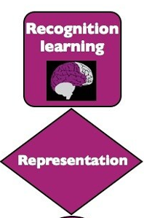
Example: Flexible Representation elements with connections to Tier 1 strategies
Using an instructional routine such as the Reading for Meaning process with graphic organizer (Silver, Dewing, Perini, 2012) helps to provide options for comprehension through highlighting critical features and big ideas, as well as guiding information processing and visualizing (CAST, 2018)

Slide 28
Let's talk through an example...
Reading for Meaning Example (Silver, Dewing, Perini, 2012)
Evidence to prove | Claim | Evidence to refute
Table 1 shows that people with PhDs make an average income of $80,000 versus those with BAs make an average of $40,000 | People with more advanced degrees make more money
 | Most people work in the field they study for in college | Paragraph 5 stated that "75% of college graduates work in a different field than their BA was geared toward"

Slide 29
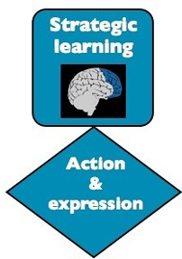
Example: Flexible Expression elements with connections to Tier 1 strategies
Using a common checklist to self monitor problem-solving steps in math helps to provide options for executive function by supporting planning and strategy development (CAST, 2018)

Slide 30
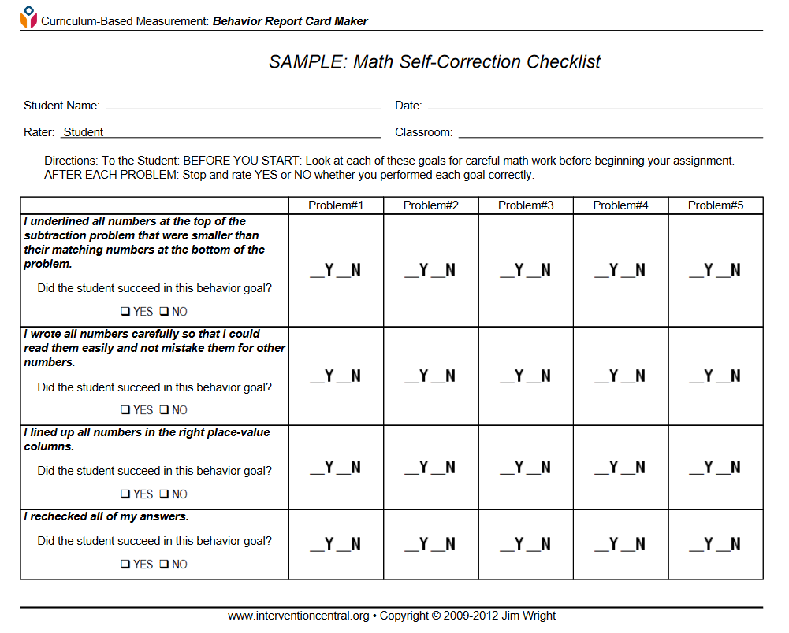
Reading for Meaning continued
Flex it up!
  Allow students to choose from articles at different Lexile levels on the same topic, or different claims with vary levels of "difficulty" to prove or disprove
  Use images, songs, websites, directions, etc. As texts to "read"
  Once comfortable with the routine, students can create their own and challenge each other

Slide 31
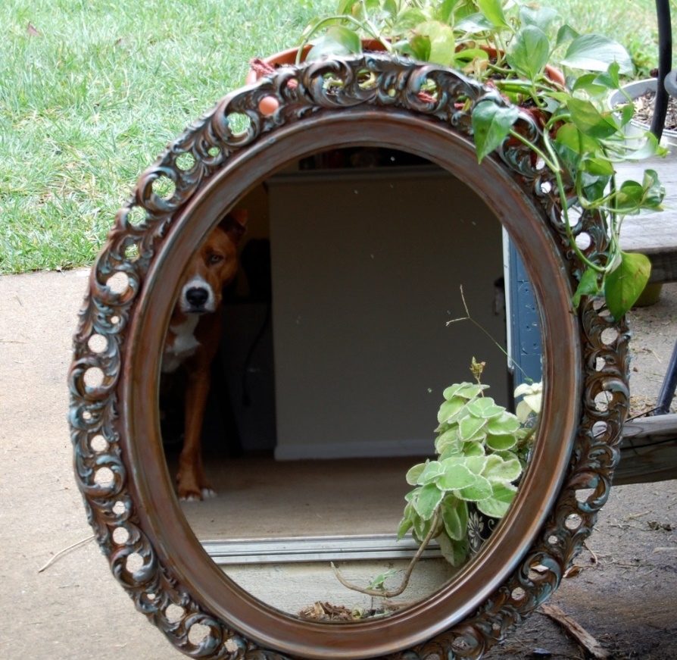
Reflection on UDL and Core MTSS/Tier One Strategies
Identify at least one core UDL-related strategy that might all teachers (at least 80%) might consider implementing that might be efficient for all staff.
Representation
Engage
Expression
See the UDL Guidelines
This Photo by Unknown Author is licensed under CC BY-SA-NC

Slide 32
Dialog
What questions do you have related to MTSS and UDL?
What additional strategies or ideas do you have related to MTSS and UDL?

Slide 33
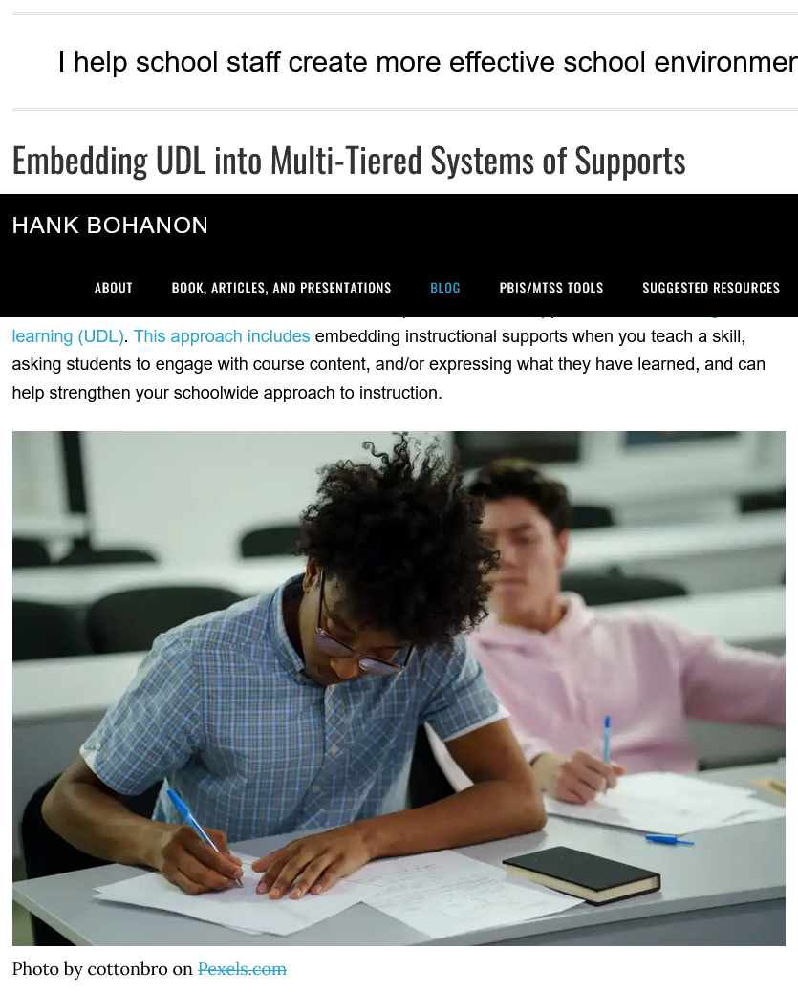
For More Information

Slide 34
Resources
CAST (2018). Universal Design for Learning Guidelines version 2.2. Retrieved from http://udlguidelines.cast.org
Harms, A., Nantais, M., Tuomikoski, K., & Weaver, S. (2019). Designing educational data systems to support continuous improvement. Association for Positive Behavior Support Newsletter, 17(1), 2-3.
UDL in 15 Minutes https://udlin15minutes.podbean.com/

Slide 35
Resources
Iris Center Modul on UDL retrieved from https://iris.peabody.vanderbilt.edu/module/udl/cresource/q1/p01/#content
The UDL Approach (great books and podcast)
Silver, H. F., Dewing, R. T., & Perini, M. J. (2012). The Core Six: Essential Strategies for Achieving Excellence with the Common Core. Association for Supervision and Curriculum Development.

