Slide 1
Together to Tomorrow: Creating Supportive Learning Environments for All
Hank Bohanon
Loyola University of Chicago
hbohano@luc.edu
http://www.hankbohanon.net

Slide 2
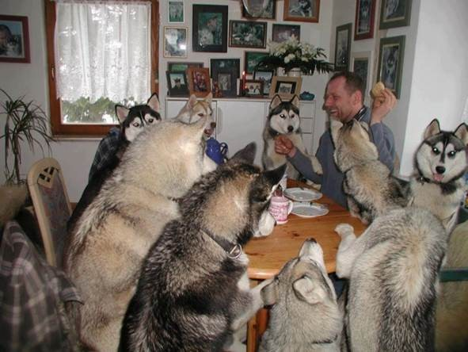
Everyone working together

Slide 3
Thank you!
Conference Team
Nancy Marks
Deb Reed
Montana Office of Public Instruction
Keith Hoyer
Tammy Lysons
Laura Riffel (The Behavior Doctor)
Heather Robbins
Notes:
3
3

Slide 4

Session Topics
Leadership
Instructional Strategies
Transition
Early Childhood
Supporting Students with Disabilities
Special education processes
Behavior support
MTSS

Slide 5
Enduring Understandings (PowerPoints):
Students had significant levels of trauma
Staff also experienced stress
Scaling intervention without systems is problematic

Slide 6


Essential Questions
How can staff support students’ whole child needs if they are not therapists?
What are strategies staff can implement to support their well-being?

Slide 7

Essential Questions
What are examples of systems school teams can use to implement effective interventions?

Slide 8

One Word
What is one word you would like students, staff, and parents to use to describe you?
Go to www.menti.com
Use Code:

Slide 9
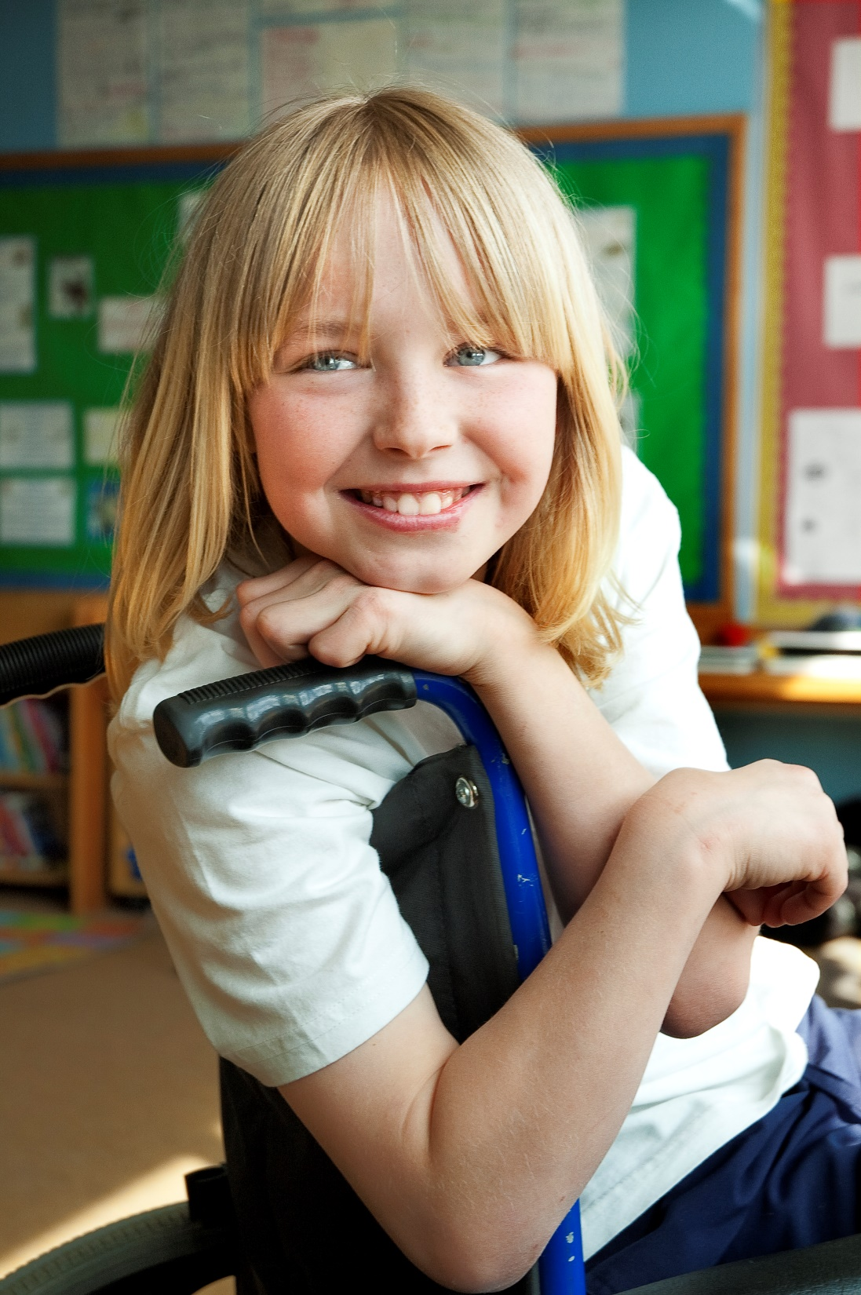
Student Well-Being

Slide 10
Conditions for Students
During Pandemic – 1 in 3 experienced poor mental health
1/2 felt persistently sad/hopeless
Economic hardships, hunger, and abuse (CDC, 2022)
Mental health leading cause of disability and poor life outcomes (Perou et al., 2013)
25% experienced depression
20% experienced anxiety (Racine et al., 2021)
Notes:
Students are struggling to connect with their schools and are dealing with emotional due to stress related to their personal experiences, and are having even more difficulty learning than before the pandemic – reconnecting
Staff feel overwhelmed personally and professionally there are efficient ways to help teachers address the needs of their students, and for them to take better care of themselves in the process
My own experiences – teaching with my boys – hair pre and post
Anxiety and depression symptoms doubled

Slide 11
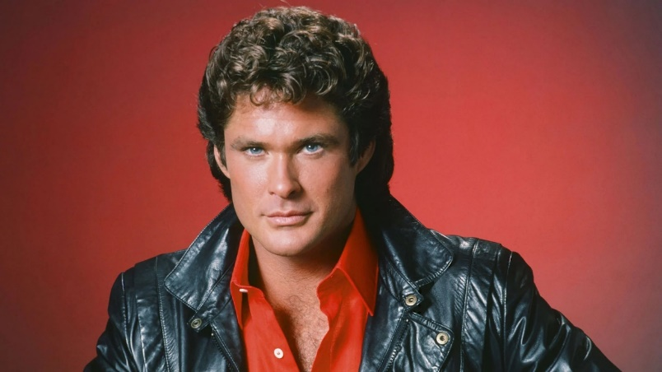

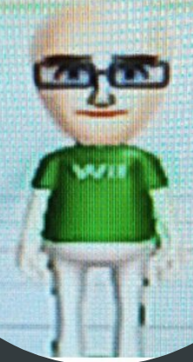
The Impact of the Pandemic on One University Faculty Member (Bohanon et al., 2023)
Baseline – Pre-Pandemic
Phase I
Phase II
Image from: https://www.mensjournal.com/health-fitness/photo-tribute-david-hasselhoff-paragon-manliness/

Slide 12

Student Connections
Students who felt more connected to people at school had better mental health (CDC, 2022)

Slide 13
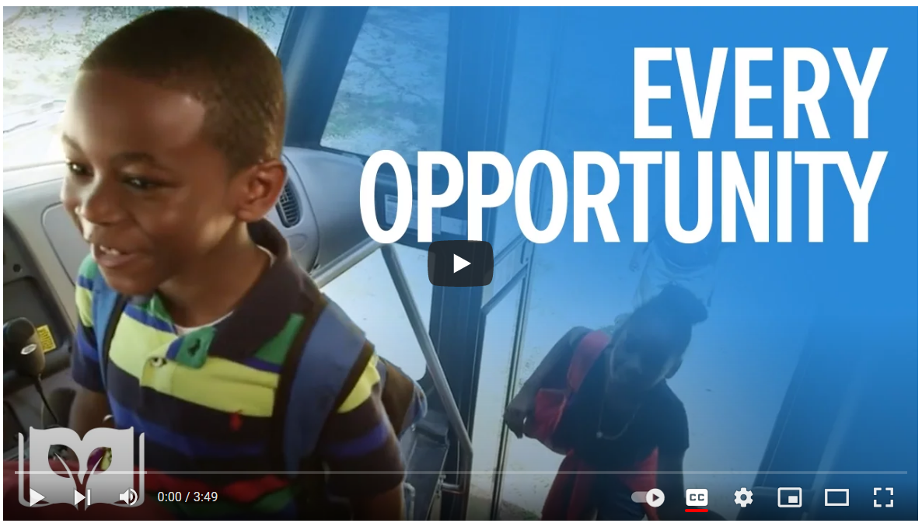
Student Well-Being (link)
Notes:
Tell

Slide 14

Engaging and Connecting
Positive Door Greetings
Behavioral Momentum: High-Probability Requests
Instructional Choice
Opportunities to Respond
Behavior-Specific Praise Collins & Landrum, 2022

Slide 15

What are your first interactions each day?
Do:
Ask how the day is going
Ask if students need help and give feedback
Don’t:
Ask detailed questions
Hand out work without explicit instruction
(McHugh et al., 2013)
Notes:
Teachers are just interested in your learning . . . if you’re just sitting
there not doing nothing. Some teachers will just call to you and tell you,
“Hey, do your work.” But they’ll never ask you, “Oh, what’s wrong?
Are you feeling all right? Do you need something?”
it’s hard to notice from someone like me
because I don’t really like to talk about it . . . She didn’t know what
was going on . . . She thought I was just a good student in school and
not worrying about anything at home and stuff. When I told her my
problems, I felt like she knew me, because she told me . . . “It’s going
to be okay.”

Slide 16
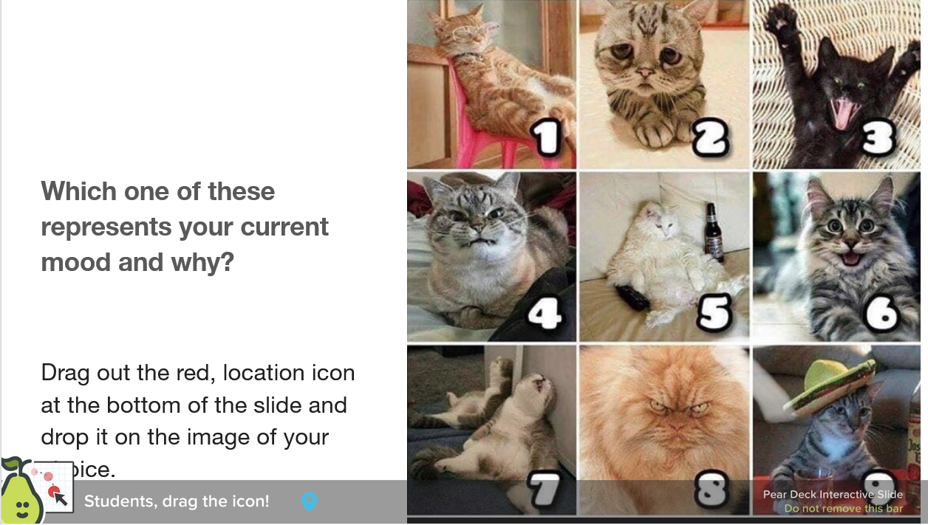

Try Pair Deck (link)

Slide 17

Make a Connection
Find someone with the same color shoe
Talk about your favorite strategy to address students’ whole child well-being

Slide 18

Staff Quality of Life

Slide 19
Do you think educators are more/less burned out than people in other fields?
Field | % Always/Often
K-12 education | 44
College or university | 35
Professional services | 33
Government or public policy | 33
Retail | 32
Healthcare | 31
U.S. Workers' Burnout Rates by Industry, 2022 - Gallup

Slide 20
Connections with Quality of Life
Teacher’s life satisfaction linked to students’ subjective physical/mental health (Maricuțoiu et al., 2022)
Teachers’ negative affect correlated with
Low student achievement (Prewett & Whitney, 2021)
Poor vocabulary development and school adjustment, higher levels of externalizing problems (Koenen et al., 2017)

Slide 21
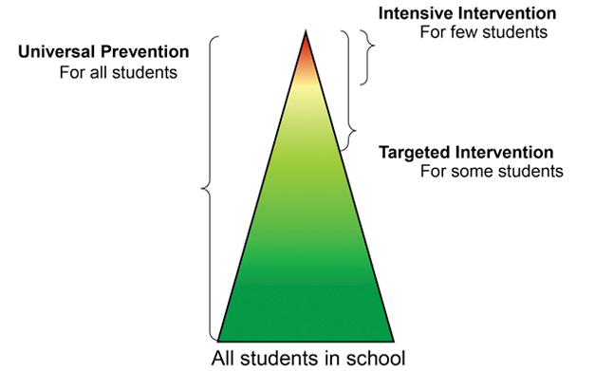
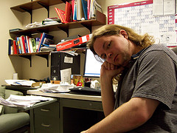
What Helps
Wellbeing in settings with schoolwide MTSS for behavior (Ross et al., 2012)
Specific praise – 5/1
  Decreased emotional exhaustion
  Higher efficacy (Reinke et al., 2013)
Image from MI MTSS
Photo by Josh Thompson

Slide 22
Self-Care – Teaching Exceptional Children
School Confidant
Pet Therapy
Stress Management Plan
Instructional Improvement
Celebrate Accomplishments
Gratitude Journal
Reflection Time
Exercise
Proper Diet
Family Time
Lesh, J. J. (2020)

Slide 23
Quality of Life Matrix Activity
Physical Exercise Diet Rest | Personal Hobbies Finance Well-being
Intellectual Learn a new skill Develop a skill Self-improvement | Social Family Friends Community

Slide 24
Make a Plan – See Handout
Review the matrix and write one area of strength and one area for improvement
Write the next actionable step
Text your next step to someone who can help with accountability

Slide 25

Great Book (link)

Slide 26

Systems Well-Being

Slide 27
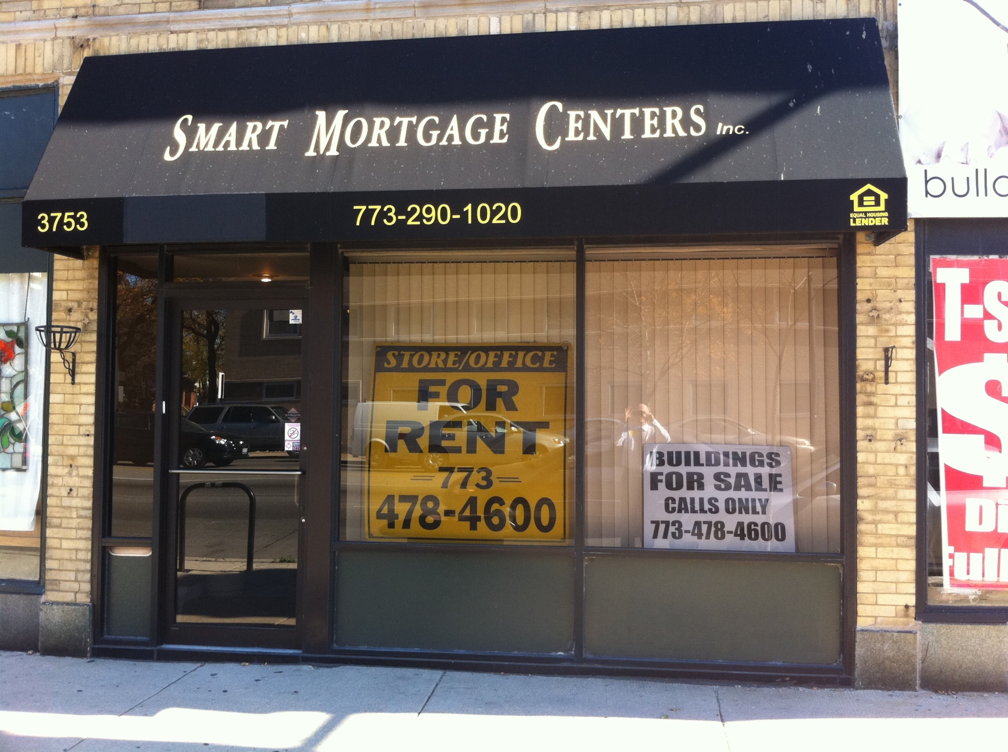
Good idea – poor implementation

Slide 28
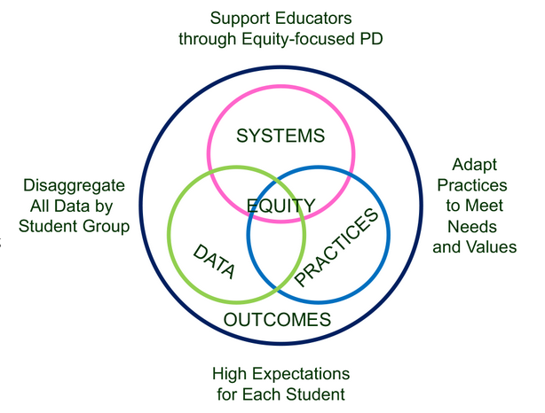
Supporting Social Competence &
Academic Achievement
4 SWPBIS
MTSS-B
Elements
From https://www.pbis.org/topics/equity

Slide 29
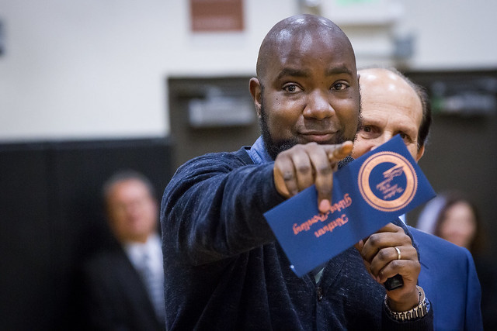

Three Elements
Administrative support
Team
Images from https://flic.kr/p/naAdyP, https://flic.kr/p/53Gxci
Mission and Vision

Slide 30
Connection to the Mission/Vision
Is your project connected to a top three school goal?
  See what works https://www.youtube.com/watch?v=LJhG3HZ7b4o
Notes:
Play video on missions that don’t suck

Slide 31
Administrative Support
Images from https://flic.kr/p/naAdyP
Vote with their feet
Do you have to wait for retirement?

Slide 32

Leadership Team: The Hero’s Journey
External Coach
Internal Coach
Leadership Team
Image from https://images.app.goo.gl/QByrfE6TvKd2SmNm9

Slide 33
(Bohanon & Wu, 2014)

Slide 34

Activity
When did an intervention succeed or fail due to:
  Connection with the school’s mission/vision (priorities)
  Administrative support
  Team-based leadership

Slide 35


To Learn More (link)
Subscribe
htttp://www.hankbohanon.net
Amazon Link

Slide 36

Summary
Connect with your students
Connect with yourself
Connect with your systems

Slide 37
References
CDC. (2022). Adolescent Behaviors and Experiences Survey (ABES). Retrieved from https://www.cdc.gov/healthyyouth/data/abes.htm
Collins, L. W., & Landrum, T. J. (2022). Using Behavioral Interventions to Build Relationships With Students With Challenging Behavior. TEACHING Exceptional Children, 0(0). https://doi.org/10.1177/00400599221085727
Koenen, A. K., Vervoort, E., Kelchtermans, G., Verschueren, K., & Spilt, J. L. (2017). Teachers’ daily negative emotions in interactions with individual students in special education. Journal of Emotional and Behavioral Disorders, 27(1), 37–51. https://doi.org/10.1177/1063426617739579
Lesh, J. J. (2020). Don’t Forget About Yourself: Words of Wisdom on Special Education Teacher Self-Care. TEACHING Exceptional Children, 52(6), 367–369. https://doi.org/10.1177/0040059920936158
McHugh, R. M., Horner, C. G., Colditz, J. B., & Wallace, T. L. (2013). Bridges and barriers: Adolescent perceptions of student–teacher relationships. Urban Education, 48(1), 9-43.

Slide 38
References
Maricuțoiu, L. P., Pap, Z., Ștefancu, E., Mladenovici, V., Valache, D. G., Popescu, B. D., ... & Vîrgă, D. (2023). Is Teachers’ Well-Being Associated with Students’ School Experience? A Meta-analysis of Cross-Sectional Evidence. Educational Psychology Review, 35(1), 1.
Perou et al., (2013). Mental health surveillance among children--United States, 2005-2011. MMWR. Morbidity and Mortality Weekly Report Supplements, 62(2), 1–35.Prewett, S. L., & Whitney, S. D. (2021). The relationship between teachers’ teaching self-efficacy and negative affect on eighth grade U.S. students’ reading and math achievement. Teacher Development, 25(1), 1–17.
Prewett, S. L., & Whitney, S. D. (2021). The relationship between teachers’ teaching self-efficacy and negative affect on eighth grade U.S. students’ reading and math achievement. Teacher Development, 25(1), 1–17. https://doi.org/10.1080/13664530.2020.1850514
Racine, N., McArthur, B. A., Cooke, J. E., Eirich, R., Zhu, J., & Madigan, S. (2021). Global Prevalence of Depressive and Anxiety Symptoms in Children and Adolescents During COVID-19: A Meta-analysis. JAMA Pediatrics, 175(11), 1142–1150.
Reinke, W. M., Herman, K. C., & Stormont, M. (2013). Classroom-level positive behavior supports in schools implementing SW-PBIS: Identifying areas for enhancement. Journal of Positive Behavior Interventions, 15(1), 39-50.
Ross, S. W., Romer, N., & Horner, R. H. (2012). Teacher Well-Being and the Implementation of School-Wide Positive Behavior Interventions and Supports. Journal of Positive Behavior Interventions, 14(2), 118–128. https://doi.org/10.1177/1098300711413820

