Slide 1
Establishing Buy-in for Schoolwide Interventions in Secondary Schools
MT CEC/CASE Conference
Hank Bohanon
hbohano@luc.edu
http://www.hankbohanon.net
https://twitter.com/hbohano
https://www.facebook.com/hank.bohanon
Notes:
Welcome
Had some bad experiences, hope to prevent
Updates on website on social media – promise not to update about lunch

Slide 2
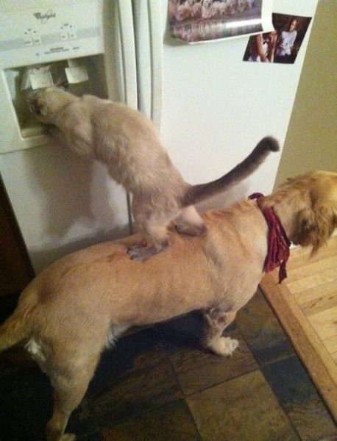
We All Need Support
Notes:
1 minute
Was teacher in DISD - better I got more students my way
KC- middle school PBS-
Chicago and other states around schoolwide behavior
Worked with other approaches academic- behavior – social/emotional

Slide 3
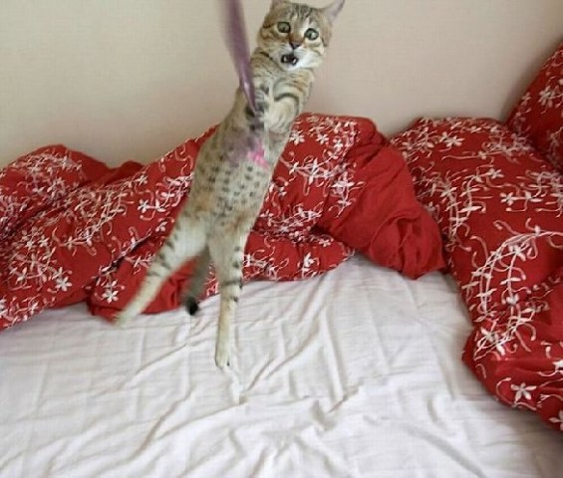
Hang in there!
Notes:
I know you had a long day! Hang in there! I hope this webinar might make life a little easier for you
From IKEA

Slide 4
Thank you!
Conference Team
Nancy Marks
Deb Reed
Montana Office of Public Instruction
Keith Hoyer
Tammy Lysons
Laura Riffel (The Behavior Doctor)
Heather Robbins
Notes:
4
4

Slide 5
PowerPoints: Enduring Understandings
• Understanding and addressing staff mindsets towards prevention and intervention may prevent missteps in the early stages of implementing MTSS
• There are specific strategies that can support the development of buy-in for MTSS approaches in secondary school settings
• Having a plan for establishing buy-in can help leadership teams systematically prepare their community for the implementation of MTSS
Notes:
1 min
Required by law to have a point when using PowerPoint.
Use understanding by design as a planning format
Support schools to implement effective core practices, to improve outcomes for all students.

Slide 6
Essential Question
What are effective strategies for addressing staff’s misconceptions of MTSS and engaging in practices to address mindsets related to prevention and intervention?
What are effective strategies for developing buy-in for MTSS through stages of implementation?
How can teams develop specific approaches for their school to obtain buy-in from faculty and staff?
Notes:
I hope by the end that you will be able to answer this question
How do you support buy-in for core behavioral practices for schools and students?

Slide 7

To Learn More (link)
Amazon Link

Slide 8
Chapter 2: Understanding Principles of Prevention and Support
Questions for the Community
Sometimes it feels like we are building the plane while flying it

Slide 9
MTSS: 4 Dimensions of School Climate
Safety
Behavioral Expectations
Teaching and Learning
Support for Learning
Social Skills Development
Interpersonal Relationships
Respect for Diversity
Social Supports for Students
Health & Wellness Expectations
Sense of Physical Security
Sense of Social-Emotional Security
Physical Environment
School Connectedness & Community Engagement
Physical Surrounding
Student Engagement & Self-Direction
Leadership
Professional Relationships
(Vermont Agency of Education, Accessed July 27, 2016, based
the work of the National Center of School Climate)
Notes:
Make connections in handbook with VT
How familiar are you?

Slide 10
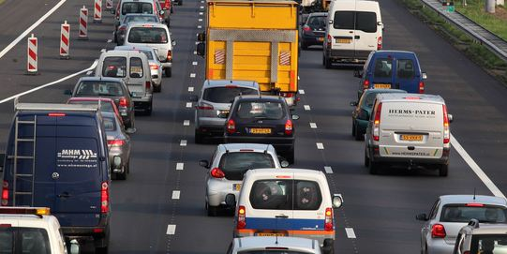
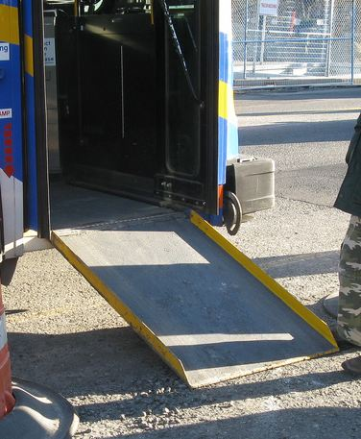
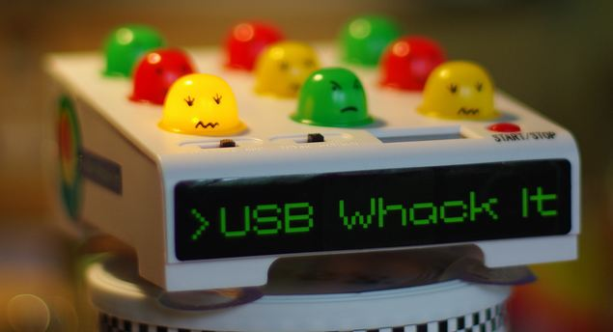

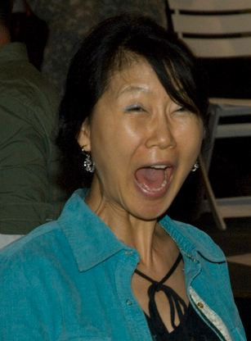
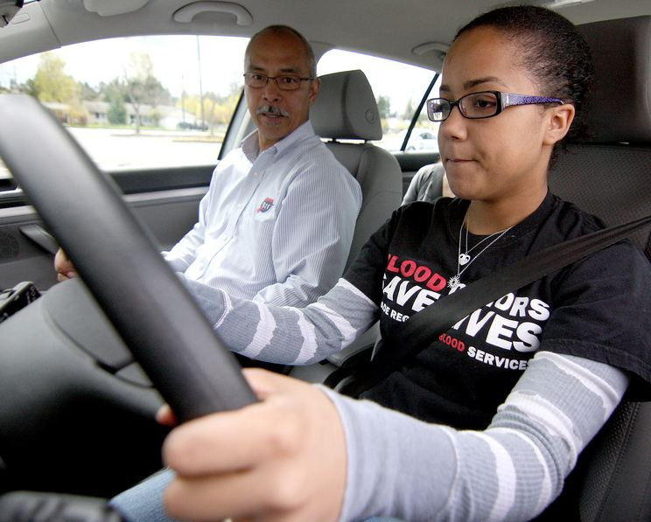
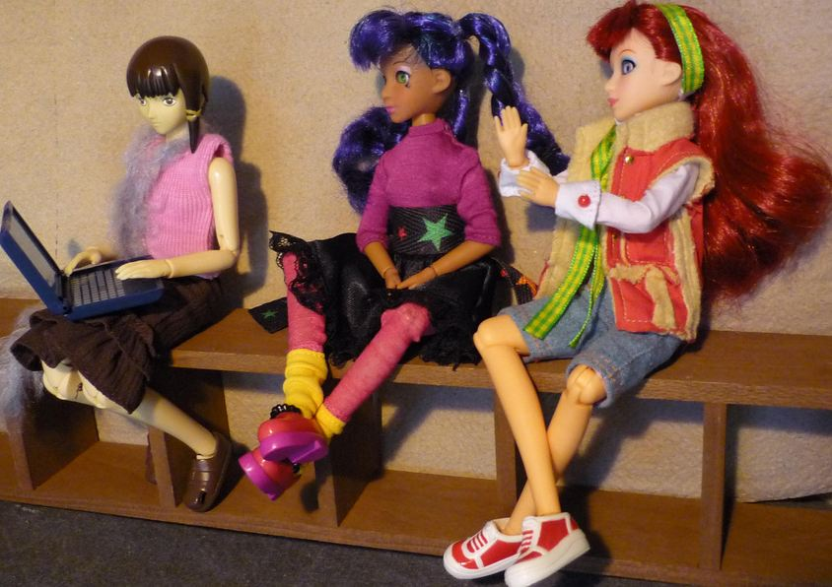
Key Principles
Incidental Benefit
Schoolwide
Schoolwide
Punishment
Reinforcement
Shaping
Reinforcement
Notes:
Whack a mole – don’t start individual
Highway - schoolwide
Ramp – incidental benefit
Yelling teacher – reinforcement
Student in the office - reinforcement
Stop sign – punishment
This works for teachers..teaching vs learning…
Learn to drive - shaping
55 MPH = 88 KPH

Slide 11

Throwing Hank Out of The Room
Are there:
Short-term skills you could teach to help me handle my frustration?
Accommodations you could provide to help me be successful?
Long-term solutions that might help my reading level and need for attention?

Slide 12
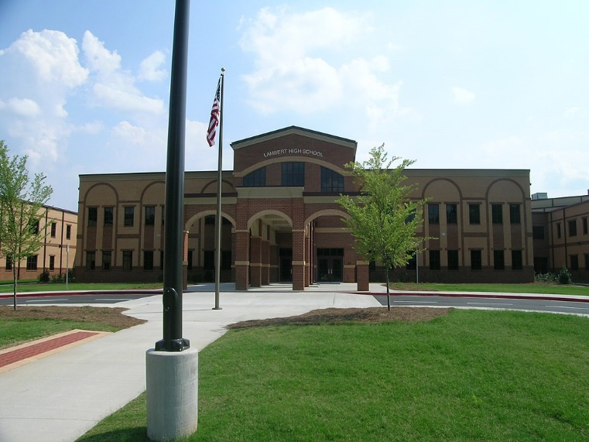
One High School
Taught expectations to all students
Identified students failing standardized assessment reading
Created an academic reading intervention class master schedule for all students (Study Island)
Screened for students with more intense whole child needs
This Photo by Unknown Author is licensed under CC BY-SA
http://ecommons.luc.edu/education_facpubs/80/

Slide 13
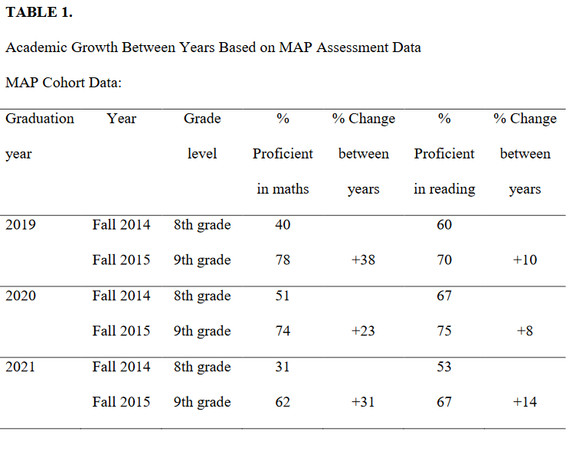
(Bohanon et al., 2016)

Slide 14

Reflection Questions
If you could choose one of your favorite strategies that you wish all teachers would implement, what would it be?
What do you think would be the impact on the students?

Slide 15
Chapter 3: Stages of Implementation
Chapter 4: Effective Systems

Slide 16
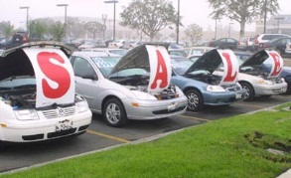
Buying a car
List out the steps you take when you buy a car…
bestig.blogspot.com
Notes:
We do talk about buy in when it comes to practices, so let’s reflect on that for a minute.
In the chat box, type out a few steps you go through when you purchase a car.
We will give you about 1 minute here

Slide 17
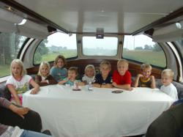



Steps
Consider Needs
Research
Not First!
Sample
Sign Up
Car http://www.prweb.com/releases/2012/8/prweb9815542.htm
Research http://www.uic.edu/uic/research/
Test drive http://www.familyhyundai.com/family-hyundai-customer-reviews/
Contract http://www.icts.uiowa.edu/content/contract-negotiation
Notes:
Place the steps for purchasing a car in the right order – at each step – what are people afraid of? Why did you not see the contact first? People are not the change – but the loss – you have to build the why before what and how.

Slide 18
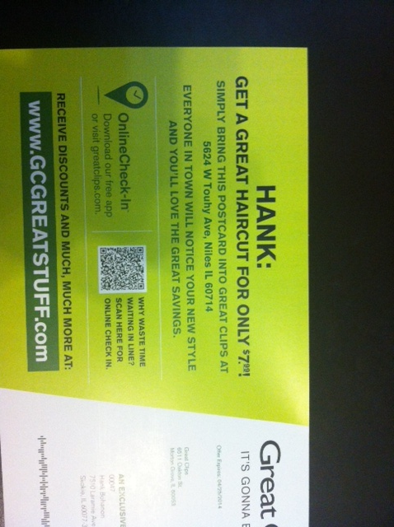
Notes:
Our solution must solve a problem the school has..

Slide 19

Barriers you face
Not familiar/trained
Not my job
Doing too much now
Told but not asked
Agree/disagree/other
Core practices will improve problems staff
are already trying to address
Image from Flickr Creative Commons https://flic.kr/p/92ME2
Notes:
Before we begin, we would love to hear about some of the issues you face when trying to support secondary schools to change their core practices. We are focusing on behavior today, but other ideas are welcome!
For me, some of the issues that I come across include
Not familiar/trained
Not my job
Doing too much now
Told but not asked
In the chat box, could you type if you agree these are barriers in secondary schools, disagree, or have other barriers you have come across. We will give you about 2 minutes.

Slide 20
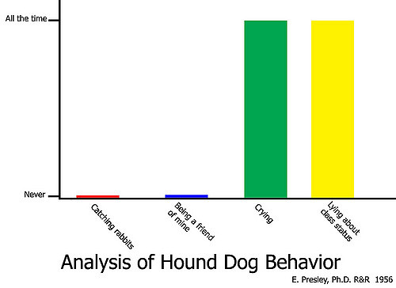
My First Presentation
No air
One day before school
All data
Sr+ & Sr-
Have you been there?
  Y/N
Images from Flickr Creative Commons https://flic.kr/p/4uQR54
Notes:
Let me tell you a little bit about my first experience
It was about 1998. I was part of a research project that was implementing schoolwide PBIS in the first middle school. All examples of schoolwide PBIS at this point were elementary
No air
One day before school
All data
Sr+ & Sr-
Have you every been on the kicking or receiving team for a presentation like this? Just type yes or no in the chat box.

Slide 21

There had to be a better way
Image from https://flic.kr/p/6okjAW
Notes:
They told us, they were ready for us..They had ways of making things not work.
There had to be a better way, which is our purpose today

Slide 22

Activity
While music plays, walk around
When music stops, find a partner
Discussion
  When did you see examples or non-examples of implementation practices? (P. 3 of Handbook)
Now, score yourself on each area with MTSS in mind

Slide 23
Implementation
Exploration and adoption – buy in, urgency
Program installation – team, roles
Initial implementation – piloting, examples
Full operation – changing staff roles (some/all)
Innovation – use credibility, codifying roles
Sustainability – new leaders, share with all
(Kotter, 1995; Blasé, Fixsen, Sims, & Ward, 2015)
Notes:
1 introduction and universals 2 setting up your team, 3 is data, 4th is best practices (MT Approach)

Slide 24

Reviewing Your Stages
Based on the “Implementation Stages Planning Tool” (link)
What stage(s) are you in with your MTSS work?
You may be in different stages for different components (e.g., behavior, academics)

Slide 25
Chapter 5: Exploration, Readiness, and Buy-in: Asking Before You Tell

Slide 26
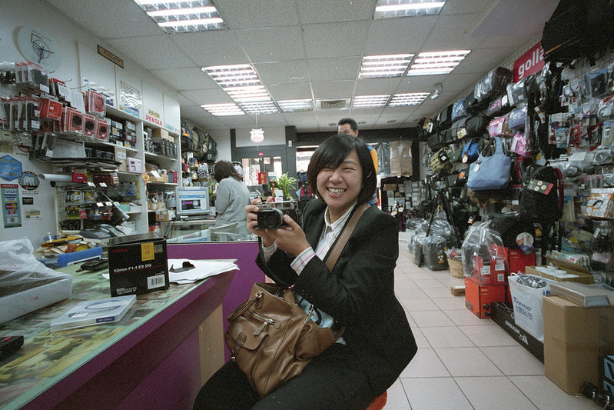
Step 1 in Sales – Qualify the Customer
Buy-in implies selling
Believe in your product/approach
Questions to ask
  Can they benefit?
  Can they commit?
Image from https://flic.kr/p/7YKQEH

Slide 27
(Bohanon & Wu, 2014)

Slide 28
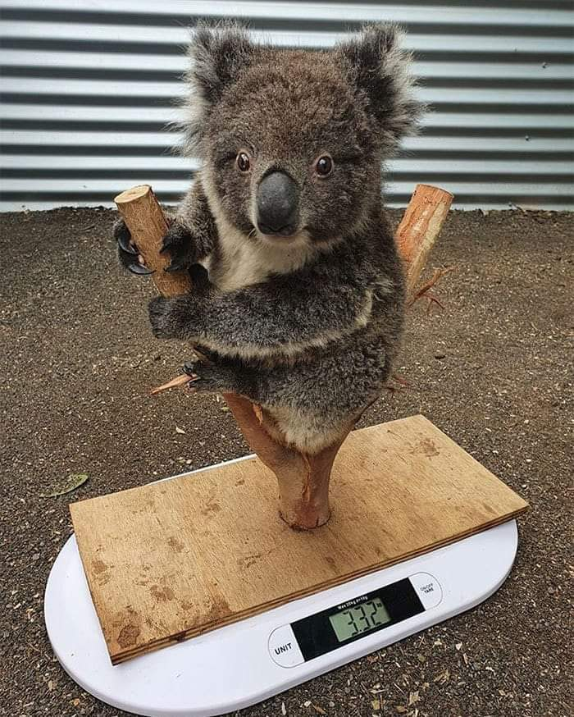
Assessing Needs
Tools
  Interviews
  Observations
  Surveys
  Focus Group
  Existing documents and data (e.g., school plans, reports)
Goals
  Identify Strengths
  Identify Needs

Slide 29
Interviews and Surveys

Slide 30

What Are Current Needs?
Communication
High staff turnover
Inconsistent practices, polices, and procedures
Negative perception of school
School climate
Lack of data-based decision making
Lack of buy-in to address concerns
Image from https://flic.kr/p/25UMFK4
Notes:
Stake holders need to see a need – look at existing practices p. 51
I (Hank) was working with four high schools as a part of a project to implement
schoolwide academic and behavior support within their settings. We
had conducted a needs assessment. We identified several themes that we
could perhaps address. These included:
•• The need for effective communication with staff
•• High staff turnover
•• Inconsistency in defined practices, polices, and procedures
•• Negative outside community perception of school
•• School climate concerns
•• Lack of use of data for decision making
•• Lack of buy-in for staff to address concerns

Slide 31
Connection to Needs
Priorities/Next Steps | Connections with Schoolwide Initiative
Improve communication | Develop a leadership team that can effectively communicate with the school community
Define responses for students who struggle academically and behaviorally | Develop a continuum of supports for all students
Improve school climate | Develop, teach, acknowledge and redirect students to expected behaviors
Use data for decision making | Identify problems and needed data sets for decision making using MTSS framework
Notes:
Example from one school – p. 51 – see table 5.1

Slide 32
See Sample Tools for Interview
Needs Assessments – p. 4-6
Summary Table – p. 7
Summary from MT MTSS coaches as an example p. 8
Do any of these needs/strengths connect with your school(s)?
Have you used any other approaches (PLC’s)?

Slide 33
Identify Current MTSS Related Strategies
Academic Systems
Behavioral Systems
Tertiary Interventions/Tier 3:
*Young Leaders
*National Honor Society; Eyes on the World
Secondary/Tertiary-SLC teams
Tertiary Intervention/Tier 3:
- Assessment based…Wraparound,
1-5%
1-5%
Secondary Interventions/Tier 2:
Secondary/Tertiary-SLC teams
AVID; Mentor Moms
Credit Recovery
After School Matters
ELL
Summer School/(First Year Connection)
Gear-Up
5-10%
5-10%
Secondary Interventions/Tier 2:
- AVID, After School Matters
- ELL;Gear-up;
Summer School(First Year Connection)
- In HouseTutoring- Mentor Moms
80-90%
80-90%
Universal Intervention
Tier 1:
In-House Tutoring; Summer
School (First Year Connection), ASPIRA;_
Service Learning;
Attendance and Tardies_
SLC; PARR; First-Year Seminar
Universal Intervention/Tier 1:
-PARR
Attendance and Tardy
- Small Learning Communities (SLC)
Notes:
33
Shock and Awe

Slide 34
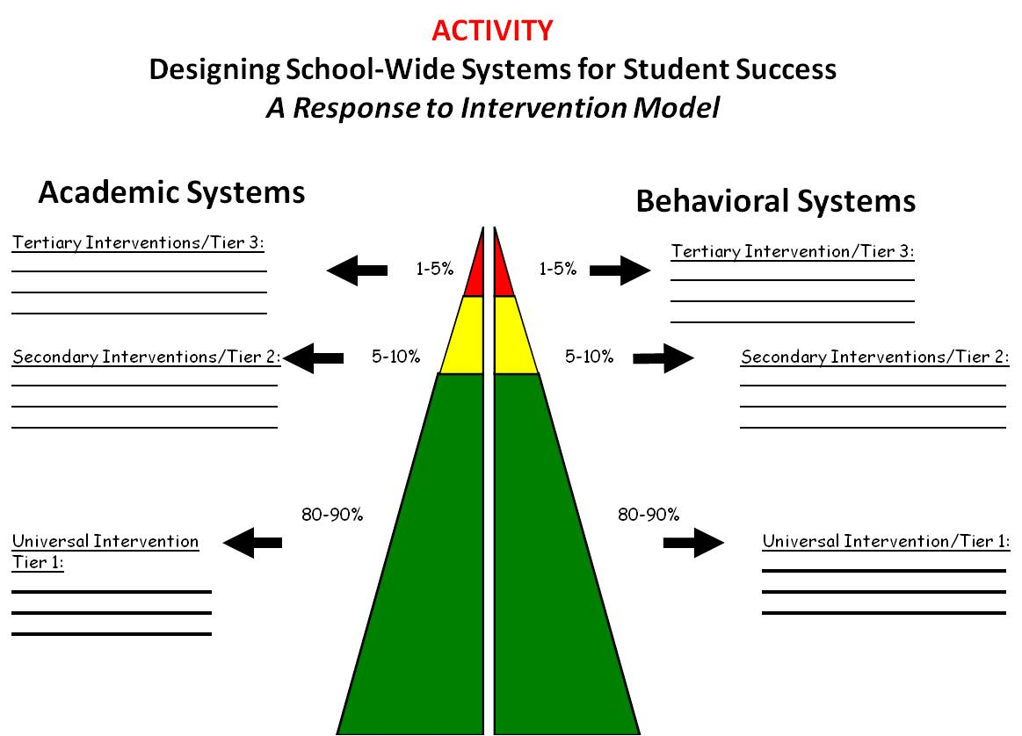
Example:
Quality Learning and Teaching

Slide 35
Activity
Take a moment to identify at least one intervention your school is implementing across the tiers. See p. 7
Consider “Love It or List It” process

Slide 36
Self-Assessment

Slide 37

Self-Assessment
Purpose
Identify priorities based on a model
Develop action plans
Make decision based on evidence
Methods
Team completes
Proportion of school
Random sample

Slide 38
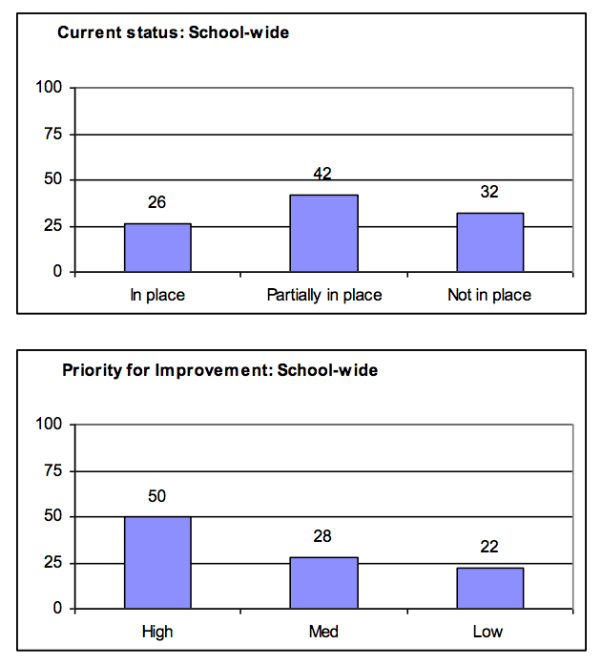
p. 10
PBS Self-Assessment Survey – www.pbis.org online at https://www.pbisapps.org
Notes:
Once a have a qualitative idea of the needs, I then ask for feedback from the staff on specific priorities..
There are two wonderful tools that can help with this..
The Effective Behavior Support Self Assessment is a great tool the entire staff can complete online in PBIS apps. It summarize what is in place and the priorities of the staff. I really like this tool in the early stages of implementation. It does not need to replace the TFI…you typically want about 30-40% of the staff to respond. See the handout
See my website under resources – academic and behavior self- assessment from Niles West high school – based of Flordia’s RtI model

Slide 39
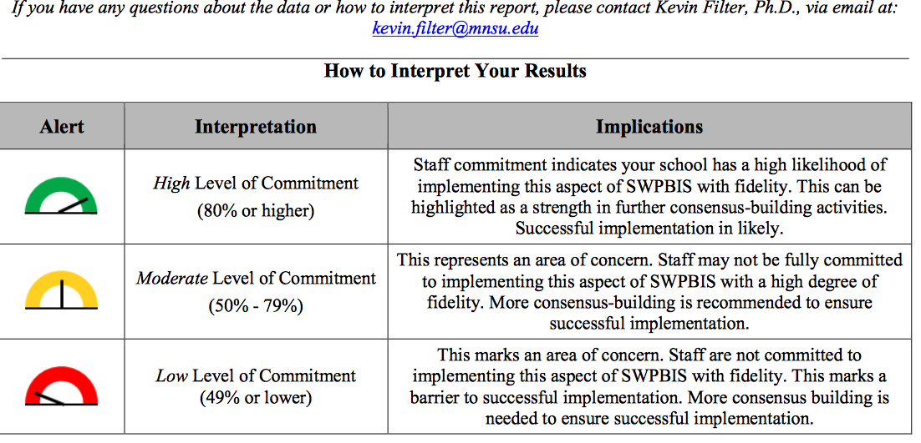
How much buy-in do you have?
p. 11
PBIS Action and Commitment Tool (PBIS-ACT) by Kevin Filter
See this link for more information http://sbs.mnsu.edu/psych/psyd/people/filter/
Notes:
I also like this tool that is specific to buy in from Kevin Filter at the University of Minnesota Mankato..
It can give you a useful temperature read on the current level of buy-in for your staff. It too can be completed online..see the example of the survey in the handout

Slide 40
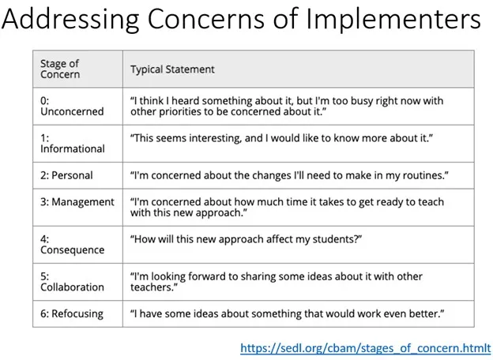
Seven Stages of Concern – See MT Readiness Worksheet

Slide 41

Activity
See master list, on p. 12-13
Which of these tools might best align with your work?
What self-assessment tools are you already using? – See MT Tools

Slide 42
Organizing Existing Data

Slide 43

Finding Patterns
Reviewed standardized math test
High achieving students
Wanted more growth
Tracked missed problems
Found patterns
Addressed gaps
Image from Flickr Creative Commons https://flic.kr/p/3a6jio
Notes:
Lisa’s story – page 57

Slide 44

Types of Existing Data
Office Discipline Referral Data
GPA (8th and 9th grade)
Credits toward graduation
Attendance (80> or less unexcused)
Failing grades (Algebra I, English I)
Standardized assessments
Existing screening data
School Climate
(Burke, 2015; Heppen, O'Cummings, &
Therriault,2009; Henderson, Cassandra & Fantuzzo, 2022; McIntosh, Flannery,
Sugai, Braun, & Cochrane, 2008; McIntosh et al., 2009)
Notes:
This study examined data from the 2007/08 grade 9 cohort in four Oregon districts to find early warning indicators of students who may drop out or fail to graduate from high school on time. The study identified four indicators that provided valuable early warning signals about students who did not graduate on time, particularly about students who dropped out of high school:
• Grade 8 attendance rate below 80 percent. • Grade 9 attendance rate below 80 percent. • Grade 8 grade point average (GPA) below 2.0. • Grade 9 GPA below 2.0.
When the influence of demographic, achievement, and behavioral characteristics and differences in the schools that students attended were considered at the same time, only gender, English learner student status, and attendance and GPA in grades 8 and 9 were associated with graduation outcomes. Burke, 2015
Australia collects - School Opinion Survey.
44

Slide 45
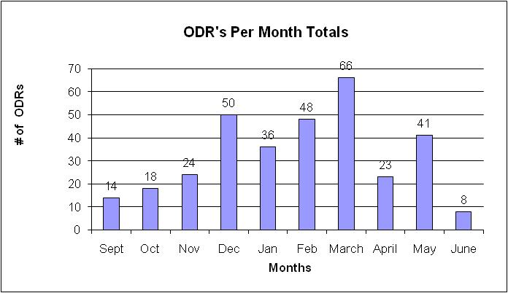
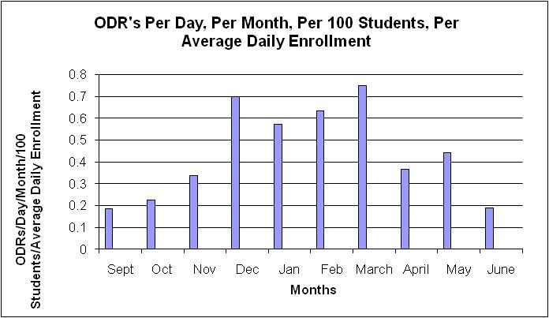
What are our priority months for support?

Slide 46
Build Case with Data:
Create Urgency (Kotter, 1995)
Writing a referral is not a bad thing, it is necessary!
Use Circuit Training
We hope you have fewer reasons
20 Minutes per referral – Teachers
77,400 Minutes = 1,290 Instructional Hours
40 minutes per referral – Administrators
114,800 Minutes = 2,870 Administrative Hours
Scott, T. M., & Barrett, S. B. (2004).
Notes:
Present graphically – avoid data snow blindness

Slide 47
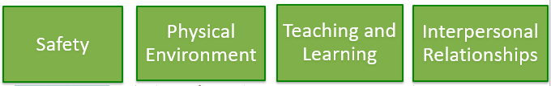
Activity
What data do you have across the four domains of school climate? Use Table 5.6 on p. 14

Slide 48
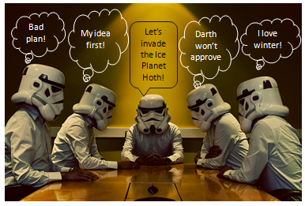
Avoid false starts
Sabotage
Notes:
And move away from..false starts and sabotage..
Love this team meeting..

Slide 49

Prepare for Resistance
Think of possible questions people will ask prior to the meeting
Prepare a response
Always be respectful
See p. 15 for practice
For more information (link)

Slide 50
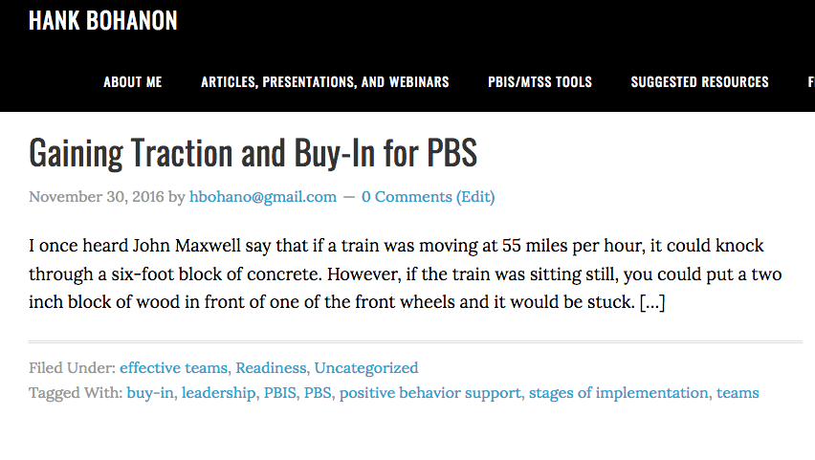
Additional Tools
Link to tools for buy-in http://www.hankbohanon.net/tag/buy-in/
Notes:
We provided some additional tools for you that specific to buy in secondary school. Just click on the link in the slide

Slide 51
Additional Reading
Developing Buy-in for Positive Behavior Support in Secondary Settings (See Example p. 17)
Case example of the implementation of schoolwide positive behavior support in a high school setting

Slide 52
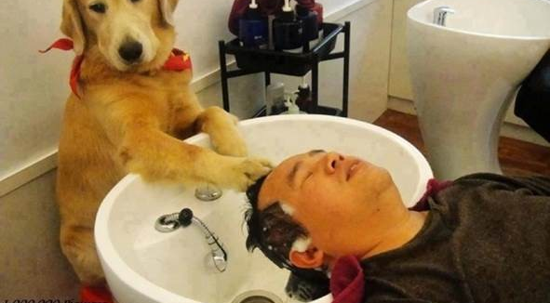
Have you tried these? What does/does not work for buy-in?
Notes:
We would love to hear if you have tried any of these approaches.
What has worked, or not worked? What other ideas do you have about obtaining buy from secondary schools?

Slide 53
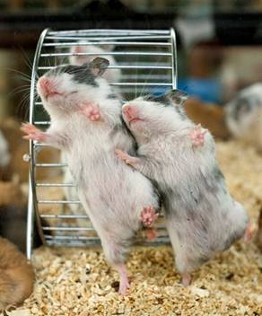
Ask Before You Tell
Less frustration
More consistency
Better use of time
Notes:
By asking before your tell..we hope you will have
Less frustration
More consistency
Better use of time
(No animals were hurt in the making of these slides)

Slide 54

Stop convincing, try solving someone’s problem

Slide 55
House Keeping
Rate the Session on Edu-Plus App (or use hard copy)
If needed – pick up label for Credit Accumulation Card

Slide 56
References
Bohanon, H., Gilman, C., Parker, B., Amell, C., & Sortino, G. (2016). Using School Improvement and Implementation Science to Integrate Multi-Tiered Systems of Support in Secondary Schools. Australasian Journal of Special Education, 40(2), 99-116. doi:10.1017/jse.2016.8 http://ecommons.luc.edu/education_facpubs/80/
Bohanon, H., Fenning, P., Carney, K., Minnis, M., Anderson-Harris, S., Moroz, K., Kasper, B., Hicks, K., Culos, C., & Sailor, W. (2006). School-wide application of urban high school positive behavior support: A case study. Journal of Positive Behavior Interventions and Supports. 8 (3), 131-145. Link: https://bit.ly/2GZR24s
Bohanon, H. & Wu, M. (2014). Developing buy-in for positive behavior support in secondary settings. Preventing School Failure, 58 (4), 1–7. doi: 10.1080/1045988X.2013.798774 http://ecommons.luc.edu/education_facpubs/17/
Bohanon, H., Fenning, P., Hicks, K., Weber, S., Their, K., Akins. B., Morrissey, K., Briggs, A., Bartucci, G., Hoeper, L., Irvin, L., & McArdle, L. (2012). Case example of the implementation of schoolwide positive behavior support in a high school setting. Preventing School Failure, 56 (2), 92-103. http://ecommons.luc.edu/education_facpubs/7
Bohanon, H., Gilman, C., Parker, B., Amell, C., & Sortino, G. (2016 online first). Using school improvement and implementation science to integrate multi-tiered systems of support in secondary schools. Australasia Journal of Special Education. pp. 1–18. DOE: 10.1017/jse.2016.8. http://ecommons.luc.edu/ education_facpubs/80/
Blase, K. A., Fixsen, D.L., Sims, B.J., Ward, C.S. (2015). Implementation science – changing hearts, minds, behavior, and systems to improve educational outcomes. Paper presented at the Wing Institute’s Ninth Annual Summit on Evidence-Based Education, Berkeley, CA. http:// nirn.fpg.unc.edu/resources/ implementation-science-changing-hearts-minds-behavior-and-systems-to-improve
Brawley, S. (accessed March 22, 2011). PBS in the classroom. M.Ed. Heart of Missouri RPDC. http://www.cesa7.org/pbis/Classroom_Management.asp
Eber, L., Phillips, D., Upreti, G., Hyde, K., Lewandowski, H., & Rose, J. (2009). Illinois positive behavioral interventions & supports (PBIS) network 2008-09 progress report (pp. 245). La Grange Park, IL.
Illinois Positive Behavior Intervention and Support Network (2011). FY11 end of the year summary report. La Grange, IL: Illinois Positive Behavior Intervention Network.

Slide 57
References
Kotter, J. (1995). Leading change: Why transformation efforts fail. Harvard Business Review, 73(2), 59–67.
McIntosh, K., Flannery, K. B., Sugai, G., Braun, D., & Cochrane, K. L. (2008). Relationships between academics and problem behavior in the transition from middle school to high school. Journal of Positive Behavior Interventions, 10(4), 243–255. doi:10.1177/1098300708318961
Morrissey, K. L., Bohanon, H., & Fenning, P. (2010). Positive behavior support: Teaching and acknowledging behaviors in an urban high schools. Teaching Exceptional Children, 42(5), 26-35.
Scott, T. M., & Barrett, S. B. (2004). Using staff and student time engaged in disciplinary procedures to evaluate the impact of school-wide PBS. Journal of Positive Behavior Interventions, 6(1), 21-27. doi:10.1177/10983007040060010401
Vermont Agency of Education (Accessed July 28, 2016). The 13 dimensions of school climate. Vermont Agency of Education, Retrieved from: http://education.vermont.gov/documents/edu-school- climate-13%20Dimensions.pdf

