Slide 1
Keeping Silos but Baking Better Bread: Integrating MTSS Efforts to Transform Practices
Nebraska MTSS Summit
Hank Bohanon
Loyola University of Chicago
hbohano@luc.edu
http://www.hankbohanon.net
Notes:
Who is here – you 15 minutes for set up - 5
Coaches – internal external
Middle schools/ High Schools
Parents
General education teachers
Special Education teachers
Counselors
School Psychologists
Social workers?
Administrators?
Academic focused schoolwide approach? Behavior? Social/emotional?
How many years?
5 or more
3 or more
1 or more
Fact finders?

Slide 2
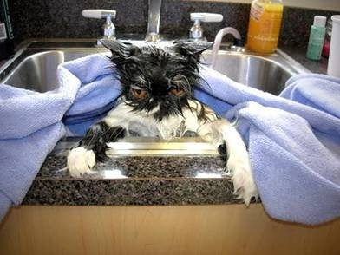
Keep going!

Slide 3
Thank you!
Nebraska Department of Education
NeMTSS
Maureen Halpenny
Scott Eckman
Jason Evans
NeMTSS Team Members
Notes:
3
3

Slide 4
PowerPoint's
Enduring Understanding:
Effective Schools Have Common Traits
MTSS and School Improvement Are Connected
Both Aid Effective Schoolwide Implementation

Slide 5
Essential Questions
What are your strengths and areas of improvement related to effective schools for students and staff?
How can you integrate your school improvement and MTSS to develop student support?

Slide 6
Essential Questions
What are some of the key components of implementing school improvement and MTSS in your school setting?

Slide 7
Thank you!
“Systematic Analysis and Model Development for High School Positive Behavior Support” Institute for Education Science, U.S. Department of Education, Submitted with the University of Oregon. Awarded 2007.
(Q215S07001)
“Character Education: Application of Positive Behavior Supports” to U.S. Department of Education, Safe and Drug Free Schools. Awarded 2007. (R324A070157)
Notes:
7
7

Slide 8
Effective Schools

Slide 9
In General - Professions and MTSS
School Psychology
Special Education
Psychology, Social Work
Psychiatry, Social Work
RtI
PBIS
SEL
SBMH

Slide 10
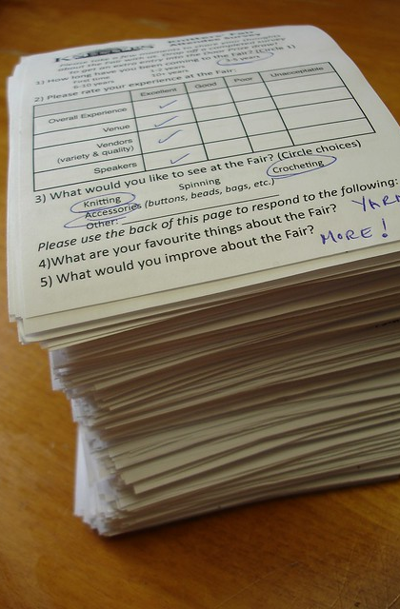
Death by Survey
From Flickr creative commons https://flic.kr/p/8AhUx4
From Flickr creative commons https://flic.kr/p/DvDzv

Slide 11
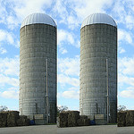
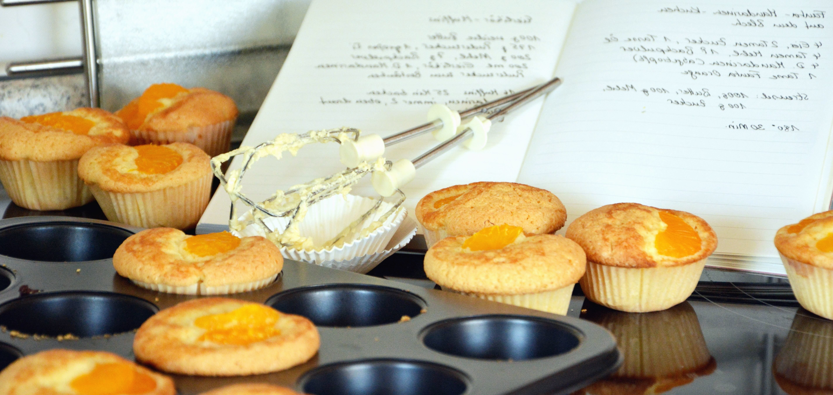
Integration of Efforts
Silos are OK, let’s bake bread
https://www.flickr.com/photos/docsearls/5500118475/in/photolist-cXMNUQ-bC1HTo-9o2xAT-9o5AEY-69MYfV-bubVYL-fu5X2f-E9aS-8DnR9y-bxgyP7-5qSgwP-dSA9Bi-5shMyD-8usn4k-5kZNd-89XiCo-2BGoqb-79hKaP-6wBTN-d7tNeN-7Sp5BB-9gfYVD-bA5evD-7i8Yvi-7WuQSP-4pTi29-cFS2Bs-9bk1ib-vxLgw-CJ6Cg-8GYAwP-5y9gAy-9PykmB-s4Zdf-gtS4jP-5gF5YM-6wBUr-57aEQb-6ALHfs-auR8jn-h8TtVm-3FHzm8-nTvUk-xKH84-4Vc2E6-3pSKw-5W5NMW-ma4TR-29BGFW-7Sp6Wg

Slide 12
MTSS: 4 Dimensions of School Climate
Safety
Behavioral Expectations
Teaching and Learning
Support for Learning
Social Skills Development
Interpersonal Relationships
Respect for Diversity
Social Supports for Students
Health & Wellness Expectations
Sense of Physical Security
Sense of Social-Emotional Security
Physical Environment
School Connectedness & Community Engagement
Physical Surrounding
Student Engagement & Self-Direction
Leadership
Professional Relationships
(Vermont Agency of Education, Accessed July 27, 2016, based
the work of the National Center of School Climate)
Notes:
Make connections in handbook with VT
How familiar are you?

Slide 13

Are your Ready for Change?
From Flickr creative commons https://flic.kr/p/VCb92K

Slide 14
Activity – P. 3
While music plays, walk around
When music stops, find partner
Discussion
  When did you see examples or non-examples of effective implementation practices?

Slide 15
Activity – P. 2
While music plays, walk around
When the music stops, find a partner
Based on Elements of Effective Schools
  What are your areas of strength?
  What are areas for improvement?

Slide 16
Activity – Handout
Complete checklist of domains for effective schools (p. 3)
  Rate your current level from 1-5
  What are your current strengths?
  What are your areas for improvement?

Slide 17
Connections Between School Improvement and MTSS

Slide 18
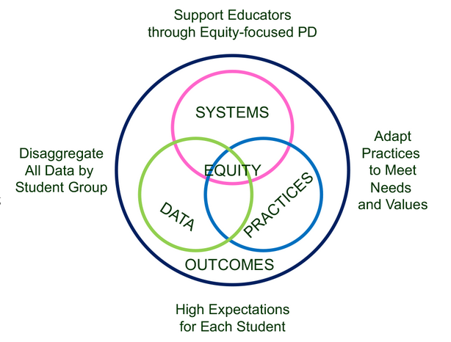
Supporting Social Competence &
Academic Achievement
4 SWPBIS
MTSS-B
Elements
From https://www.pbis.org/topics/equity

Slide 19
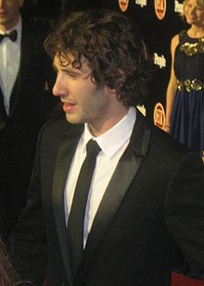


Key Elements
Systems – Josh, flight, checklist
  Administrative Commitments, Coaching (external/internal), Representative Teams, Audit of practices, Priority
Practices
  Based on evidence
Data
  Process and impact – dropout
    What and with whom?
http://en.wikipedia.org/wiki/Josh_Groban
http://www.inmagine.com/searchterms/private_jet.html
Notes:
19

Slide 20

Problem Solving
Identify
Analyze
Plan
Implement/
Evaluate
Harms, Nantais, Tuomikoski, & Weaver, S. (2019)
From Flickr creative commons https://flic.kr/p/24UJUYy
Notes:
Einstein – if I had 25 minutes to save the world, I would spend 55 minutes identifying the problem

Slide 21
Designing School-Wide Systems for Student Success
A Response to Intervention Model/MTSS
Questions
Answers
Tertiary Interventions/Tier 3:
Dig deeper – why?
Tertiary Intervention/Tier 3:
Ask questions,
Teach what works better
Cholesterol drugs
1-5%
1-5%
Secondary Interventions/Tier 2:
Can’t do/won’t do
5-10%
5-10%
Secondary Interventions/Tier 2:
Coke test analogy..
Over 50 Daily Aspirin
Universal Intervention
Tier 1:
Were we clear? Does it work?
How do we respond?
80-90%
80-90%
Universal Intervention/Tier 1:
Be clear on expectations,
make sure they work, be humane
Banging smoking in
public places*
*Greenburg & Abenavoli, 2017
Notes:
21
You may have a large copy of this in your handouts
tatoo..it is washable (just kidding)..
Example –
SW – Respect – Response Be kind – show poster ahead
Secondary – student could not write very well – even when given coke..skill deficit – then accommodate with writing prompt and remediate – teach skills
Tertiary – attention – personal greetings at the door and pre-correction was enough

Slide 22
Based on purpose of
behavior, person-centered,
behavior support,
academic remediation
Connections with the core
curriculum
P. 4
Intensive supports
Group interventions:
Based on cannot do
or will not do
Explicitly teaching
effective self-
expression, self-
evaluation, problem
solving, goal setting,
within academic and
behavior core:
Common Core, College
and Career Readiness
Embedding student
choice into the academic,
behavior, social core curriculum:
universal design
Teaching specific
social expectations
Universal Supports

Slide 23


How do you protect your home?
Similar to MTSS
Prevent
Detect
Recover
Image from Flickr Creative Commons https://flic.kr/p/92ME2, https://flic.kr/p/bvNkLa,
https://flic.kr/p/ed3LV3 - Example by Christopher Porter

Slide 24
CSR’s & Continuous Improvement By Design
Mission and Vision
Include SEL?
Procedures
Workflow
Everyone teaches expectations? Prepare, time?
PD Needed? Calendar changed?
Rowan, Correnti, Miller, & Camburn, 2009

Slide 25
What You Doing Already? (P. 6)
School
Improvement
Systems
Data
Practices
MTSS
(Tiers)

Slide 26
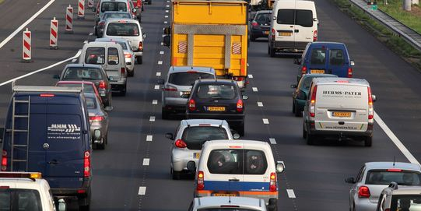
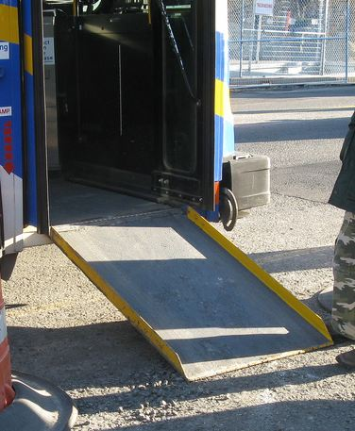
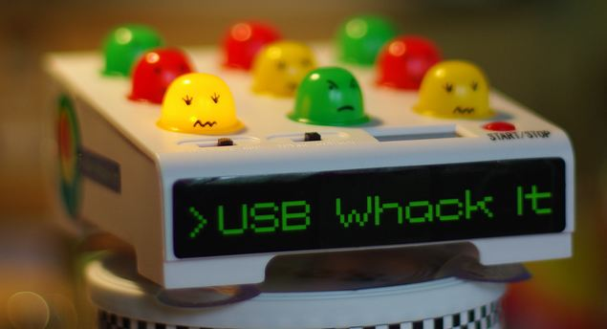


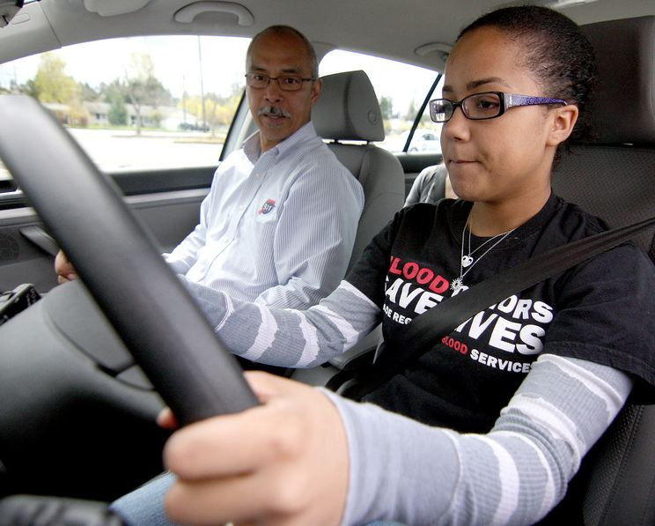
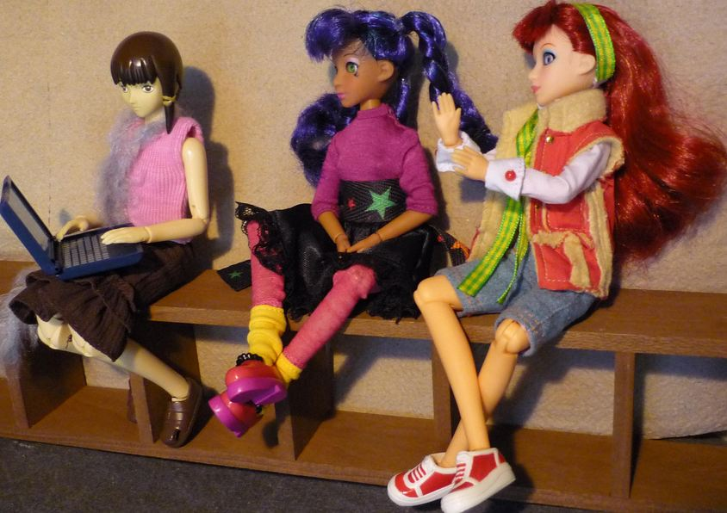
Key Principles
Incidental Benefit
Schoolwide
Schoolwide
Punishment
Reinforcement
Shaping
Reinforcement
Notes:
Whack a mole – don’t start individual
Highway - schoolwide
Ramp – incidental benefit
Yelling teacher – reinforcement
Student in the office - reinforcement
Stop sign – punishment
This works for teachers..teaching vs learning…
Learn to drive - shaping

Slide 27
Question Receipt Reinforcement
What is a way someone has accidently reinforced a student’s undesired behavior in the past? Did this person add something preferred or remove something aversive?

Slide 28

Ways to give feedback
Written
Verbal
Visual
Humorous
Private
Public
Direct
From Flickr creative commons https://flic.kr/p/8VBCoV

Slide 29
Shaping and New Years Resolutions
Tell your neighbor about a New Year’s resolution that did or did not stick
From Flickr creative commons https://flic.kr/p/7s2fTe

Slide 30

Making Connections with Universal Supports – P. 9
From Flickr creative commons https://flic.kr/p/2FNUzm

Slide 31
Targeted Supports - Have a Coke!
Can’t Do (Skill Deficit)
  Responses
  Teach skill
  Priming
  Intersperse
  Teach escape
Won’t Do (Acquisition)
  Responses
  Prompt
  2-10
  Personal greeting
  Choice/preference
See CAST: http://www.cast.org/ and SIM http://www.kucrl.org/sim/
Notes:
Make Less aversive – student with down syndrome – liked stories about dogs and bones, would read.

Slide 32

Why Did You Speed?
Image from https://images.app.goo.gl/csjQfX8sVBwFZozj7

Slide 33
Samples of Functions of Behavior (link)
Escape something negative
Avoid something negative
You got something (object)
Attention (good, bad, or ugly)
You were over/under stimulated
Setting events (what happened way in advance?)

Slide 34

Saving Time and Discipline Referrals
20 Minutes per referral – Scott & Barrett, 2004
77,400 Minutes = 1,290 Instructional Hours
Image from https://flic.kr/p/5Yiw1f

Slide 35

How does School Improvement and MTSS Add Value to Each Other In Your School?
See the activity on page 6

Slide 36
Key Components for Implementation

Slide 37

Good idea – poor implementation

Slide 38
Implementation
Exploration and adoption – buy in, urgency
Program installation – team, roles
Initial implementation – piloting, examples
Full operation – changing staff roles (some/all)
Innovation – use credibility, codifying roles
Sustainability – new leaders, share with all
(Kotter, 1995; Blasé, Fixsen, Sims, & Ward, 2015)
Notes:
1 introduction and universals 2 setting up your team, 3 is data, 4th is best practices (MT Approach)

Slide 39
(Bohanon & Wu, 2014)

Slide 40

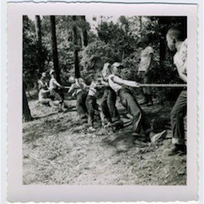
Find the Common Problem
Image from http://bit.ly/2aqNnKF
Image from http://bit.ly/2aMJY8n
(Sherif, M., Harvey, O. J., White, B. J., Hood, W. R., & Sherif, C. W.,1961)
Notes:
Contact along did not cause cooperation, When groups in a state of friction are brought into contact under conditions embodying superordinate goals the attainment of which is compelling but which cannot be achieved by the efforts of one group alone, they cooperate toward the common goal.
Boulders in front of water tank only together could they move them – they were happy and rejoiced
More intergroup choices of friends after problems..

Slide 41

Northfield Middle/High School, VT
Revised master schedule
All students could participate in Study Island Program
https://accounts-flickr.yahoo.com/photos/jenkim/2248275918/sizes/m/in/photolist-4qF16U-bUQXfn-edNnEu-3csa6n-5sgmyu-edGH9z-53piaq-mVMTRx-3XsPp-fWBZ75-7hkzE5-83prtu-4qruLT-81Yq7e-6RycDm-4j8ri-2shYkc-akHDaG-dNJpxB-4q9VJ4-KTPYW-4urrjg-bSv1hk-4FgyQG-4adsUK-cXd2yE-3gNij7-4RxFTH-9AwVns-4WRbFq-5xMwUJ-eNBioc-84xBVn-9sp4J-7JYZqT-5Zdkxt-dbAtWt-ckEAPd-5wvNsm-6MYR4A-dq71AH-5GbP34-bm5Qmj-jvsXuS-dbAvD1-7kS2Dv-5PVFe1-niJtLf-mBVEDF-2jPkVf-edNeH3/

Slide 42
Northfield Middle/High School, VT
(Bohanon et al., 2016)

Slide 43
School Improvement, MTSS, and SIP Outcomes
 | Average % Total TIERS Score 2017 | Average % Total BoQ Score 2015 | Average % Total TFI Tier One Ratio Score 2016 | Average % School Improvement Points Earned 2016
Above the Median n = 2 | 61 | 36 | 70 | 81
Below the Median n = 2 | 54 | 29 | 42 | 79
Note. TIERS stands for the Tiered Inventory of Effective Resources in Schools. BoQ stands for the Benchmarks of Quality. TFI stands for the Tiered Fidelity Inventory. Data are presented based on the schools above and below the median score on the TIERS (N=5 schools).
(Bohanon et al., In Press)

Slide 44
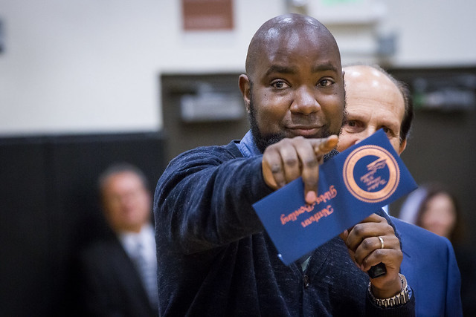

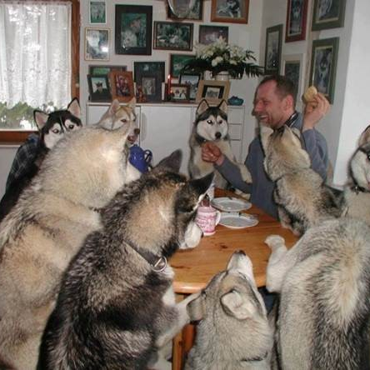

Three Elements
Administrative support
Team
Images from https://flic.kr/p/naAdyP, https://flic.kr/p/53Gxci
Mission and Vision

Slide 45
Defining yourself
How does your MTSS team connect with the school’s improvement goals, mission, or vision?
  See what works https://www.youtube.com/watch?v=LJhG3HZ7b4o
  See Handout P. 10
Notes:
Play video on missions that don’t suck

Slide 46
Administrative Support (link) Theme Song
Images from https://flic.kr/p/naAdyP
Where have you seen these factors
help or hinder any interventions in
your school? P. 12

Slide 47

Three Types of Team Members
External Coach
Internal Coach
Leadership Team
Image from https://images.app.goo.gl/QByrfE6TvKd2SmNm9

Slide 48
Activity
See the sorting activity on page 13
Sort the approaches into one of two categories
  Traditional implementation
  MTSS/Improvement implementation

Slide 49

To Learn More (link)
Amazon Link

Slide 50
PowerPoint's
Enduring Understanding:
Effective Schools Have Common Traits
MTSS and School Improvement Are Connected
Both Aid Effective Schoolwide Implementation

Slide 51
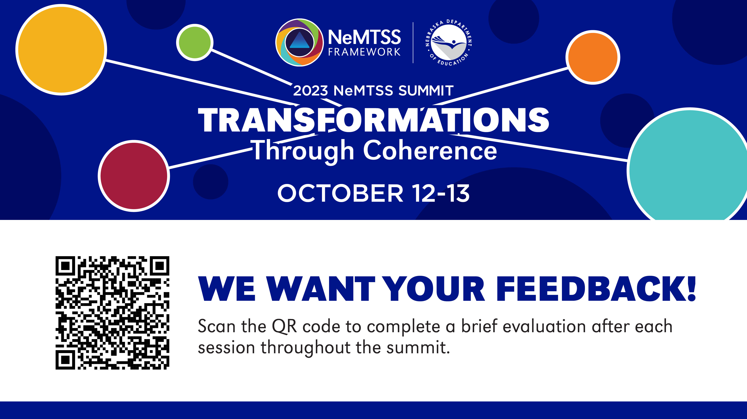

Slide 52
References
Allen, J., Gregory, A., Mikami, A., Lun, J., Hamre, B., & Pianta, R. (2013). Observations of effective teacher–student interactions in secondary school classrooms: Predicting student achievement with the classroom assessment scoring system—secondary. School Psychology Review, 42(1), 76– 98.
Blase, K. A., Fixsen, D.L., Sims, B.J., Ward, C.S. (2015). Implementation science – changing hearts, minds, behavior, and systems to improve educational outcomes. Paper presented at the Wing Institute’s Ninth Annual Summit on Evidence-Based Education, Berkeley, CA. http://nirn.fpg.unc.edu/resources/implementation-science-changing-hearts- minds-behavior-and-systems-to-improve
Bohanon, H., Wu, M., Kushki, A., & LeVesseur, C., (Accepted). Connecting School Improvement and MTSS with Student Outcomes. Australasian Journal of Special Education
Bohanon, H., Gilman, C., Parker, B., Amell, C., & Sortino, G. (2016). Using School Improvement and Implementation Science to Integrate Multi-Tiered Systems of Support in Secondary Schools. Australasian Journal of Special Education, 40(2), 99-116. doi:10.1017/jse.2016.8 http://ecommons.luc.edu/education_facpubs/80/

Slide 53
References
Harms, A., Nantais, M., Tuomikoski, K., & Weaver, S. (2019). Designing educational data systems to support continuous improvement. Association for Positive Behavior Support Newsletter, (17) 1 ,p. 2-3.
Greenberg, M. T., & Abenavoli, R. (2017). Universal interventions: Fully exploring their impacts and potential to produce population-level impacts. Journal of Research on Educational Effectiveness, 10(1), 40-67.
McIntosh, K., Kelm, J. L., & Canizal Delabra, A. (2016). In search of how principals change: A qualitative study of events that help and hinder administrator support for school-wide PBIS. Journal of Positive Behavior Interventions, 18(2), 100-110. doi:10.1177/1098300715599960
Scott, T. M., & Barrett, S. B. (2004). Using staff and student time engaged in disciplinary procedures to evaluate the impact of school-wide PBS. Journal of Positive Behavior Interventions, 6(1), 21-27. doi:10.1177/10983007040060010401

