Slide 2
Embedding Targeted Interventions into Daily Teaching
Hank Bohanon
Loyola University of Chicago
hbohano@luc.edu
http://www.hankbohanon.net
Notes:
If it did not happen in high schools it did not happen, or one like ours

Slide 3
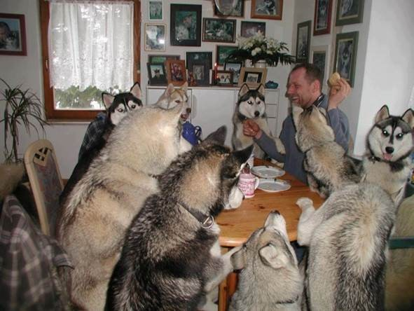
Everyone working together

Slide 4
Thank you!
Joshua Reed
Leadership Team
Valier School District
Montana MTSS
Notes:
4
4

Slide 5
PowerPoint's
Enduring Understanding:
Students typically struggle in three areas of learning
Strategies can prevent some problems related to student learning
These strategies can be embedded within the classroom setting

Slide 6
Essential Questions
What are the typical learning stages where students struggle?
What tier-one strategies can prevent problem behaviors for students in the classroom?
How can teachers embed at least one routine into their current classroom setting?

Slide 7
Where Do Students and Staff Currently Struggle?

Slide 8

What Connections Can You Make?
See p. 2-4 of the handout
Based on conversations with Montana MTSS educators
Do you have anything in common?

Slide 9

Reflection on Universal Design for Learning – Providing Flexible Means of Engagement
Think about the worst class you ever attended, why was it so bad/frustrating?
This Photo by Unknown Author is licensed under CC BY-NC

Slide 10
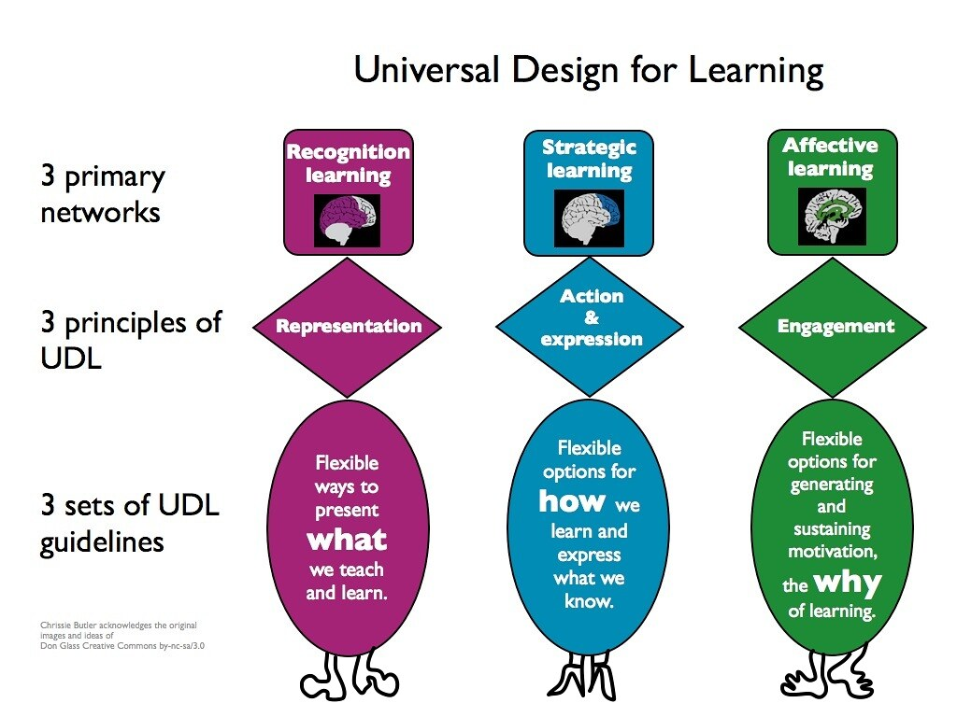
Universal Design Slide
Get from old UDL presentation
This Photo by Unknown Author is licensed under CC BY-NC

Slide 11
What Tier-One Strategies Can Support your Students?

Slide 12

Why Did Someone Drive Too Fast?
Image from https://images.app.goo.gl/csjQfX8sVBwFZozj7

Slide 13
Samples of Functions of Behavior (link)
Escape something negative
Avoid something negative
You got something (object)
Attention (good, bad, or ugly)
You were over/under stimulated
Setting events (what happened way in advance?)

Slide 14
Designing School-Wide Systems for Student Success
A Response to Intervention Model/MTSS
Questions
Answers
Tertiary Interventions/Tier 3:
Dig deeper – why?
Tertiary Intervention/Tier 3:
Ask questions,
Teach what works better
Cholesterol drugs
1-5%
1-5%
Secondary Interventions/Tier 2:
Can’t do/won’t do
5-10%
5-10%
Secondary Interventions/Tier 2:
Coke test analogy..
Over 50 Daily Aspirin
Universal Intervention
Tier 1:
Were we clear? Does it work?
How do we respond?
80-90%
80-90%
Universal Intervention/Tier 1:
Be clear on expectations,
make sure they work, be humane
Banning smoking in
public places*
*Greenburg & Abenavoli, 2017
Notes:
14
You may have a large copy of this in your handouts
tatoo..it is washable (just kidding)..
Example –
SW – Respect – Response Be kind – show poster ahead
Secondary – student could not write very well – even when given coke..skill deficit – then accommodate with writing prompt and remediate – teach skills
Tertiary – attention – personal greetings at the door and pre-correction was enough

Slide 15
Targeted Supports - Have a Coke!
Can’t Do (Skill Deficit)
  Responses
  Teach skill
  Priming
  Intersperse
  Teach escape
Won’t Do (Acquisition)
  Responses
  Prompt
  2-10
  Personal greeting
  Choice/preference
See CAST: http://www.cast.org/ and SIM http://www.kucrl.org/sim/
Notes:
Make Less aversive – student with down syndrome – liked stories about dogs and bones, would read.

Slide 16
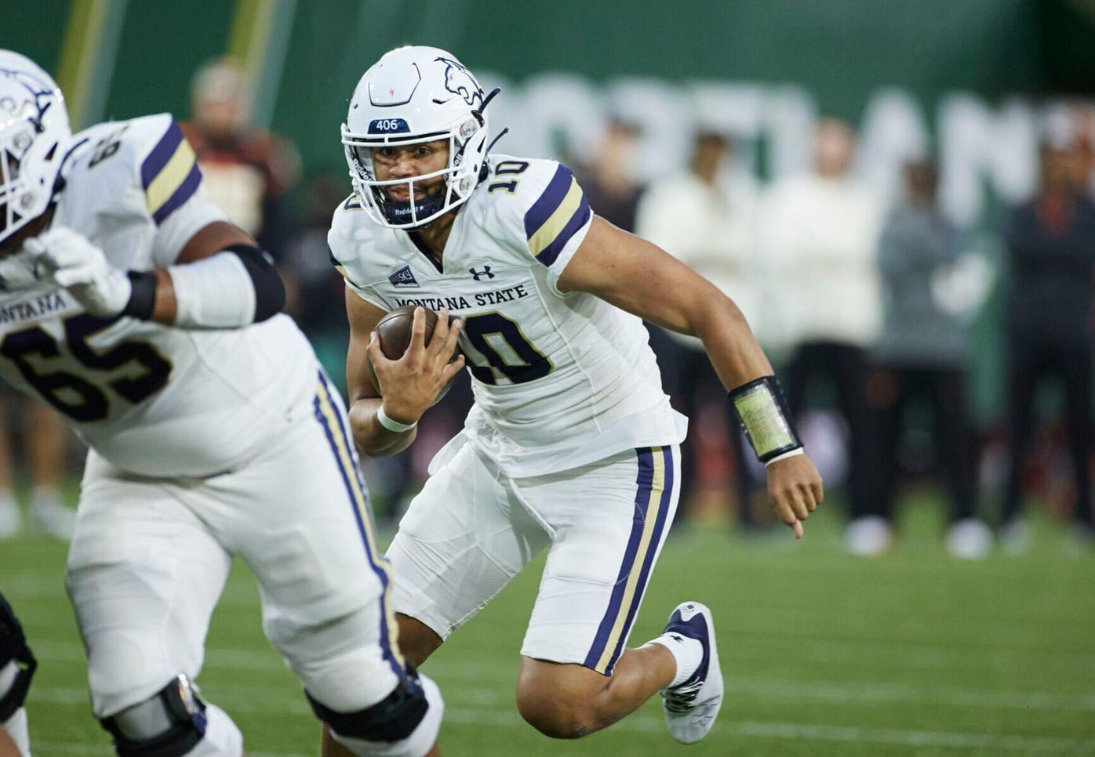
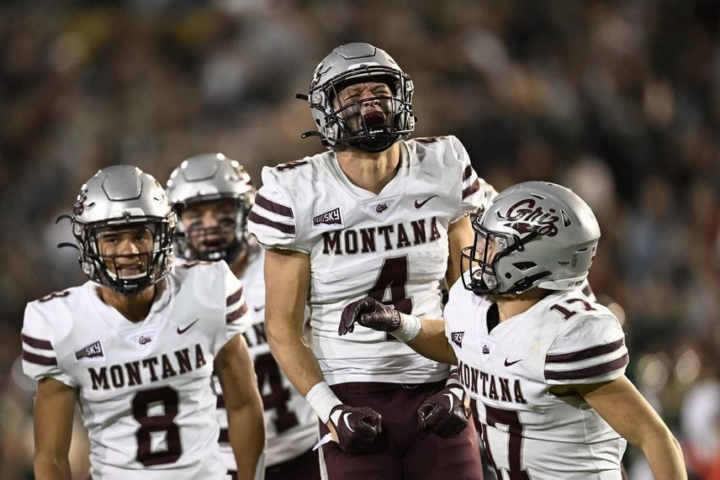
How Do You Learn - How Do You Learn – Listen to Music (link)
Think about a sport, music, or hobby you have learned. How did your coach, teacher, or mentor support you in developing your new skill?
Images from https://townsquare.media/site/117/files/2022/10/attachment-Griz-vs-Wildcats.jpg, and https://www.bozemandailychronicle.com/townnews/sport/montana-state-finding-creative-ways-to-generate-rushing-offense/article_588b6b70-dc48-5ff0-963a-af95457382db.html

Slide 17
Tier One
Focuses on Explicit Instruction
Breakdown skill
Provide rationale for skill
Model the skill
Guided practice (with the instructor or peers)
Independent practice
Provide Feedback

Slide 18

Tier One – Standards-Aligned Core Curriculum - See p. 27
  ELA Speaking and Listening: Comprehension and Collaboration: Standard
  Comprehension and Collaboration | Communicate effectively and appropriately in collaborative activities for a variety of tasks, purposes, and audiences to express ideas, share knowledge, and generate new understandings. LA.12.SL.1

Slide 19
Tier One – Common Practices
Instructional Routines
  Scaffolding instruction
  Graphic organizers for writing and note-taking
  Reading for Meaning (link)
Common lesson plan formats
Evidenced-based instructional strategies
  Teaching schoolwide expectations
  High Leverage Practices
    Opportunities to respond
  Core Six

Slide 20
Instructional routines reduce cognitive load and allow students to be more independent learners
Examples
Reading for Meaning graphic organizer (Silver) - example below
Cornell style notes (Pauk)
Collaborative Strategic Reading (Klingner and Vaughn)
Claim-Evidence-Reasoning writing graphic organizer (many to choose from)
Evidence to prove | Claim | Evidence to refute
Table 1 shows that people with PhDs make an average income of $80,000 versus those with BAs make an average of $40,000 | People with more advanced degrees make more money
 | Most people work in the field the study for in college | Paragraph 5 stated that "75% of college graduates work in a different field than their BA was geared toward"
https://www.flickr.com/photos/docsearls/5500118475/in/photolist-cXMNUQ-bC1HTo-9o2xAT-9o5AEY-69MYfV-bubVYL-fu5X2f-E9aS-8DnR9y-bxgyP7-5qSgwP-dSA9Bi-5shMyD-8usn4k-5kZNd-89XiCo-2BGoqb-79hKaP-6wBTN-d7tNeN-7Sp5BB-9gfYVD-bA5evD-7i8Yvi-7WuQSP-4pTi29-cFS2Bs-9bk1ib-vxLgw-CJ6Cg-8GYAwP-5y9gAy-9PykmB-s4Zdf-gtS4jP-5gF5YM-6wBUr-57aEQb-6ALHfs-auR8jn-h8TtVm-3FHzm8-nTvUk-xKH84-4Vc2E6-3pSKw-5W5NMW-ma4TR-29BGFW-7Sp6Wg

Slide 21
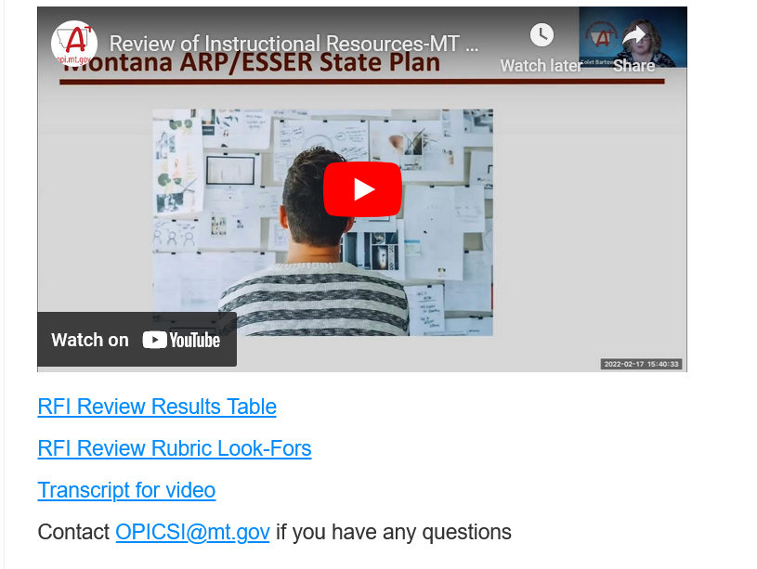
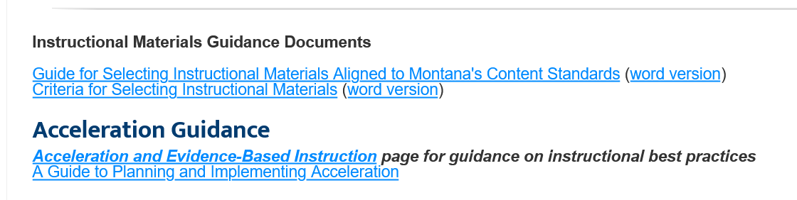
Montana – Evidence-Based Practices Selection (link)

Slide 22

Connections – Interventions
Review Interventions, p. 8
What connections do you make with your school(s)
Link

Slide 23

Find Someone with Same Color Shoes
What tier-one evidence-based practices do you have in your schools?
How do you prepare all staff to use these strategies?
What evidence do you have that they are implemented consistently across classrooms?

Slide 24
Chapter 12: Providing Structure for Learning

Slide 25

Attendance Reflection
Think of a time when you missed an outing with friends and family – how did you feel?

Slide 26
Attendanceworks.org
Tier three – specialized support – 20% < days
Tier two – early intervention 10 – 20% of school days (2-3 per month)
Tier one – > 10% of school days (about 1 per month)
What are you doing for each level?

Slide 27

Responses
Engage students and parents
Recognize good and improved attendance
Provide personalized early outreach
Monitor data
Nudge Intervention – Sending a postcard to parents to encourage students’ attendance (Rogers et al., 2017)
https://provingground.cepr.harvard.edu/files/provingground/files/proving_ground_postcard_guide_march2020.pd f

Slide 28
Sample Response Tables
See Tables 12.3 and 12.4 to help you plan your responses – p. 19
How useful might these tools be to your class or school?

Slide 29
Be at post
Escort students
Brief interactions
(Johnson-Gros et al., 2008)
See article about hallways @
http://hankbohanon.net
on publications page
Tardy Policy Office
Notes:
29
29
Mr. Irvin – tardy policy
being at post, escorting, and interacting with students

Slide 30

Tardy Data
Who is tardy? – time of day, locations, grade levels
ODR data for hallways – non-classroom
Mall Walking– count how many students are in the fall after passing – 10 minutes in 20/20 box
This Photo by Unknown Author is licensed under CC BY

Slide 31
Preventing Tardies
Staff posted at doors
Brief interactions with students during passing
Staff in the hallway to encourage being on time
See example (link)
(Kristian Johnson-Gros et al., 2008)

Slide 32
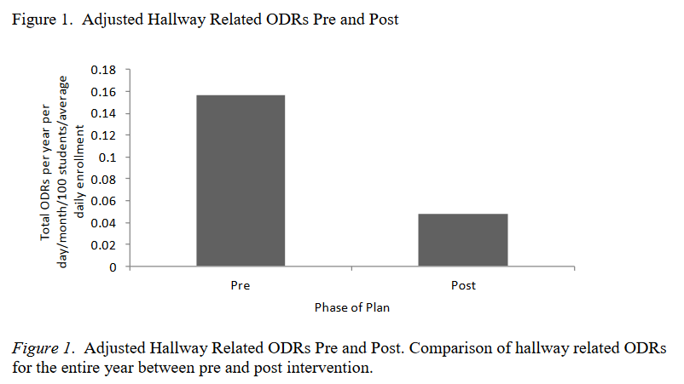
High School Example
(Bohanon, 2015)

Slide 33

Addressing Tardies
Start on Time!
Randy Sprick
http://www.safeandcivilschools.com/products/program_previews.php

Slide 34
Reflection
What data do you have, can you use these to address tardies to class?
What approaches are you taking now to tardies, how might these suggestions help you work?

Slide 35
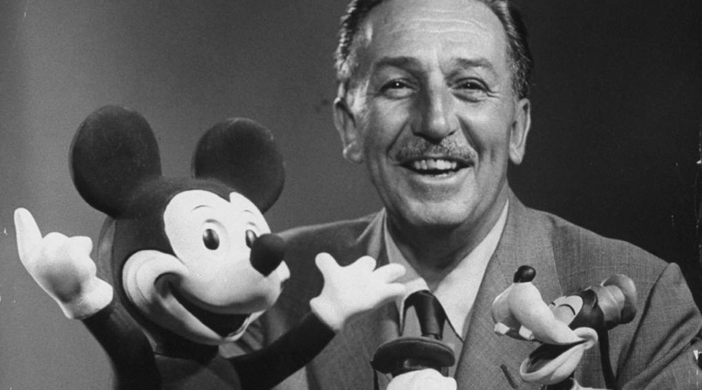
Preparing Your Syllabus
Walt Disney – “unarticulated expectations are premeditated disappointments”
This Photo by Unknown Author is licensed under CC BY-NC-ND

Slide 36
The Syllabus
Goals
Contact information
Success Traits
Rules/expectations
Activities
Grades/Status
Procedures
Entering
Tardy/Absence
Materials
Assignments (returns)
Due dates
Late, missing work
Communication
Ending class
Consequences
Model projects
Checklists
Sprick (2006)/Shinn http://markshinn.org
See examples – http://www.hankbohanon.net (Resources page under “Teaching”
Sample first days of school for high school teacher)
Notes:
Show handout, look at student expectations

Slide 37
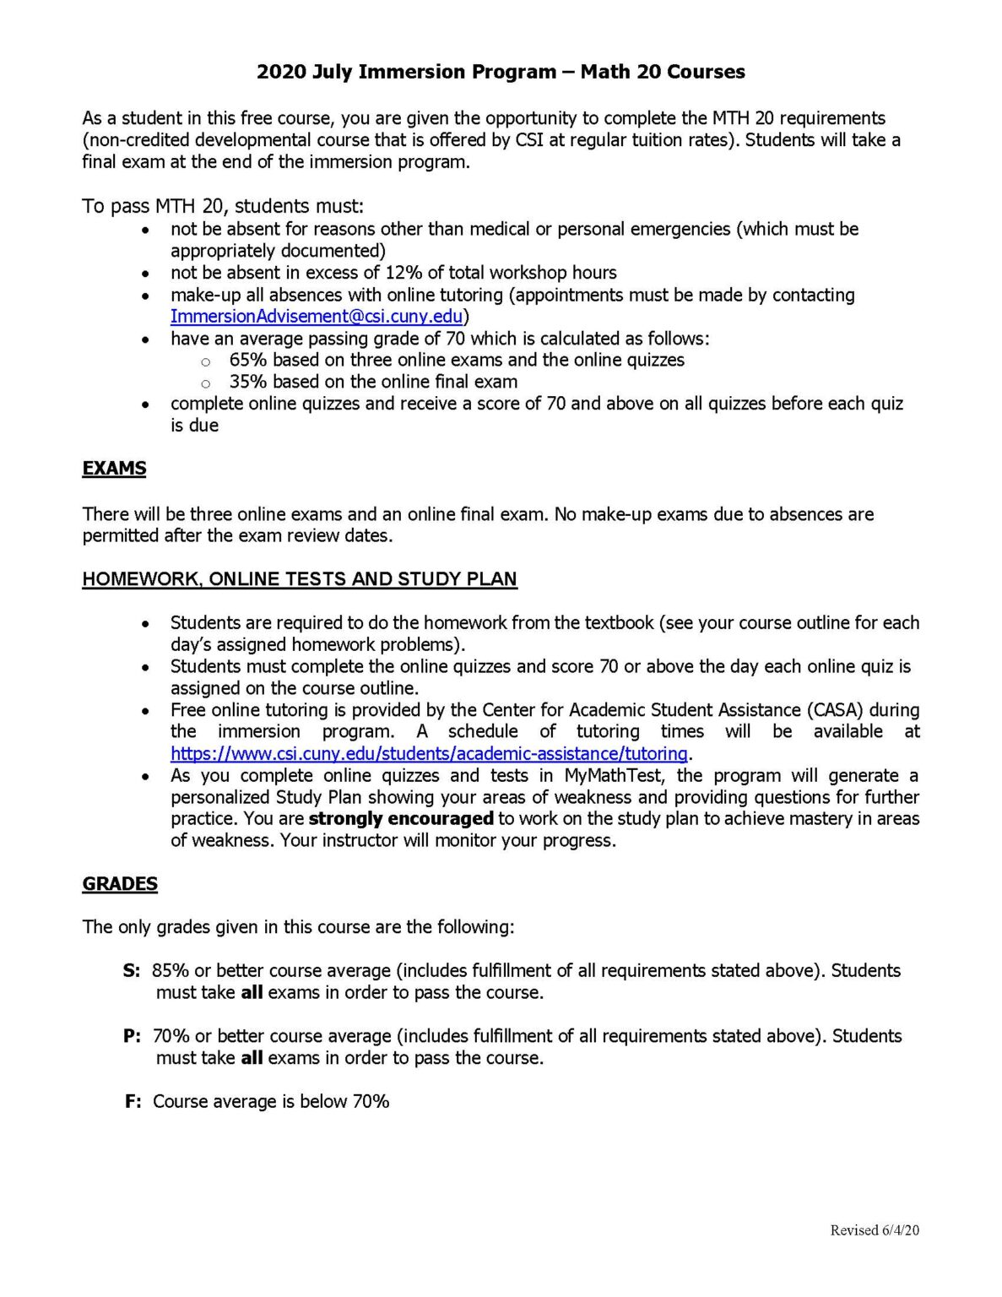
Reflection on Syllabus
What are the things you, or your teachers, repeat daily for students?
See Table 12.5 and example, p. 20 – how much agreement does your school have on these key ideas?
This Photo by Unknown Author is licensed under CC BY-SA-NC

Slide 38
Chapter 13: Defining Norms to Build Community

Slide 39
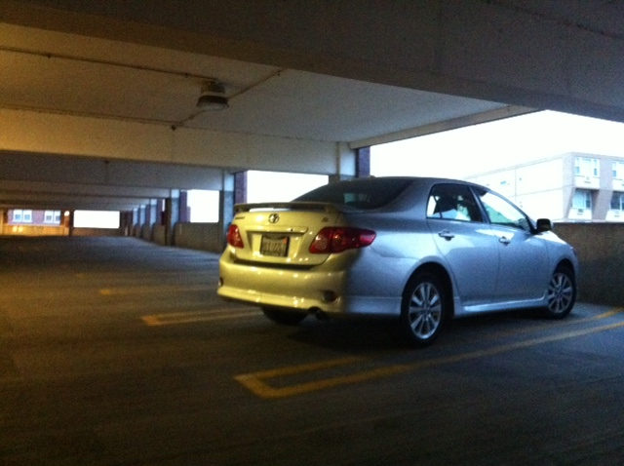
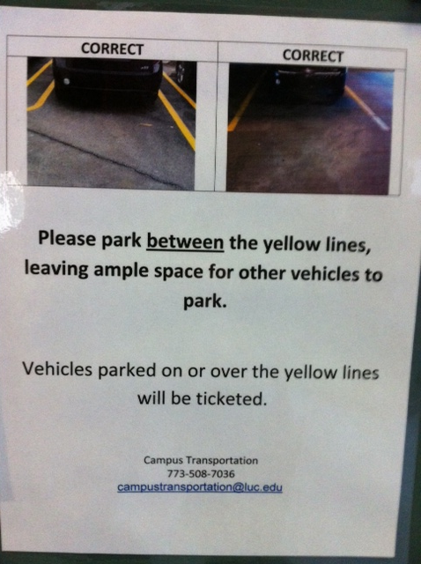
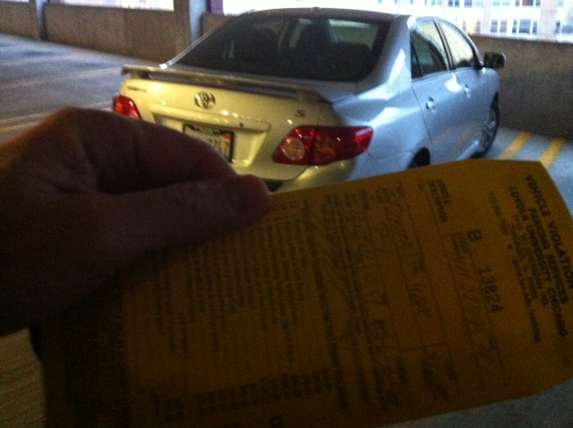
Learning through punishment - Zappos
Notes:
Working on holiday break on university related tasks
Came up and apparently my car was parked over the line and clearly I was hindering the parking of others - $40 ticket..Are you kidding me? Complained – they said this time we will let you go, but next time it will be enforced..Then..the poster…many of our students learn the rules this way – at home, they say, pass the fn sugar – they are learning a new skill.. Do not assume.. Or you will get “are you kidding me?”

Slide 40

Benefits of Teaching Expectations
Includes behavioral, social, academic skills
Fewer defiance and drug-related discipline problems (Molloy et al., 2013)
Improved development and course grades (Farrington et al., 2012)
This Photo by Unknown Author is licensed under CC BY-NC-ND
Notes:
Can include non-academic skills such as mindsets, metacognition, and self-regulation – helps with development and course grades – see Farrington p. 184
Belonging to the community
Effort
Success is possible
Finding value in my work
Social and emotional skills – self-awareness, self-management, social awareness, relationship skills, and responsible decision making – CASEL
Self-determined – self-evaluation, set goals, problem-solve, express wants and needs – Wehmeyer p. 184

Slide 41
Teaching Expectations
Examples
Staff orientation meetings
Handbooks
Lesson plans
Videos
Examples
Syllabus
Posters
Booster sessions
Pre-correct/remind
See lesson- Blank!! Possible Example Teaching Story 1 or Pre-Teaching
Student example from football
Fruita Monument Example
Notes:
41
Say silk 3 times, then ask what do cows drink
Practice expectations with group

Slide 42

Developing Expectations
3-5
General
Positively stated
Use an acronym if possible
  Respectful, Appropriate, Determined (RAD)
Connect to school mascot if possible
Academic and whole child standards
Align with school mission and vision

Slide 43

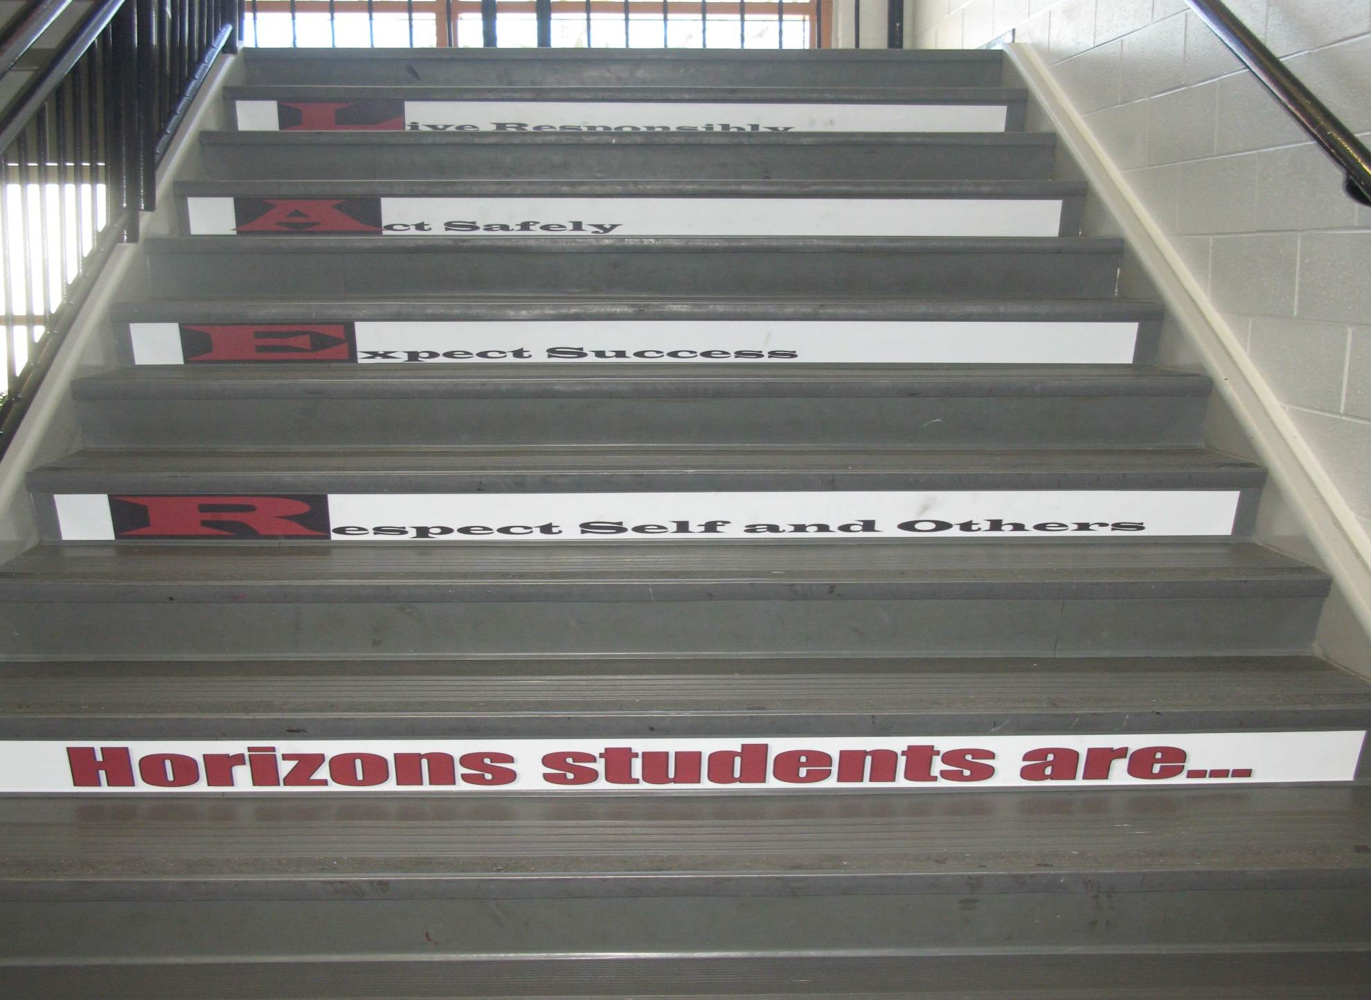
Shawnee Mission Schools, KS

Slide 44

Developing Expectations
Include your whole community
Schoolwide Expectations Survey for Specific Settings https://ci3t.org/pdf/SESSS.pdf
60% = respect, responsibility, and safety (Lynass, et al., 2012)
See the example from p. 23-25, why were these included?
This Photo by Unknown Author is licensed under CC BY-SA

Slide 45
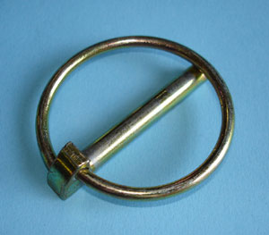
Standards and Lynchpin Skills – See P. 28
Skills
NE ELA: Comprehension and Collaboration (link)
How to work cooperatively with peers
How to be respectful of people from various backgrounds
LA.12.SL.1 Communicate effectively and appropriately in collaborative activities for a variety of tasks, purposes, and audiences to express ideas, share knowledge, and generate new understandings.
Link to Oklahoma State Learning Standards: https://sde.ok.gov/sites/ok.gov.sde/files/documents/files/OAS-ELA-Final%20Version_0.pdf
Image from: https://commons.wikimedia.org/wiki/File:Lynch-pin.jpg
Notes:
If students engage in these skills, they are more likely to be successful in other areas

Slide 46
p. 30
How could you align your standards?
CPS Matrix Aligned with Common Core Standards – See http://www.hankbohanon.net
Notes:
See standards lists or reference in handout
Use your data
Select an evidence-based program – See CASEL
Develop an expectations matrix
What is the problem, what you do want to see instead
Remember academic and non-academic skills (e.g., mindsets)
See PBIS.org schoolwide matrix p. 188
Align with standards – see my example – how could you align with Australian standards

Slide 47
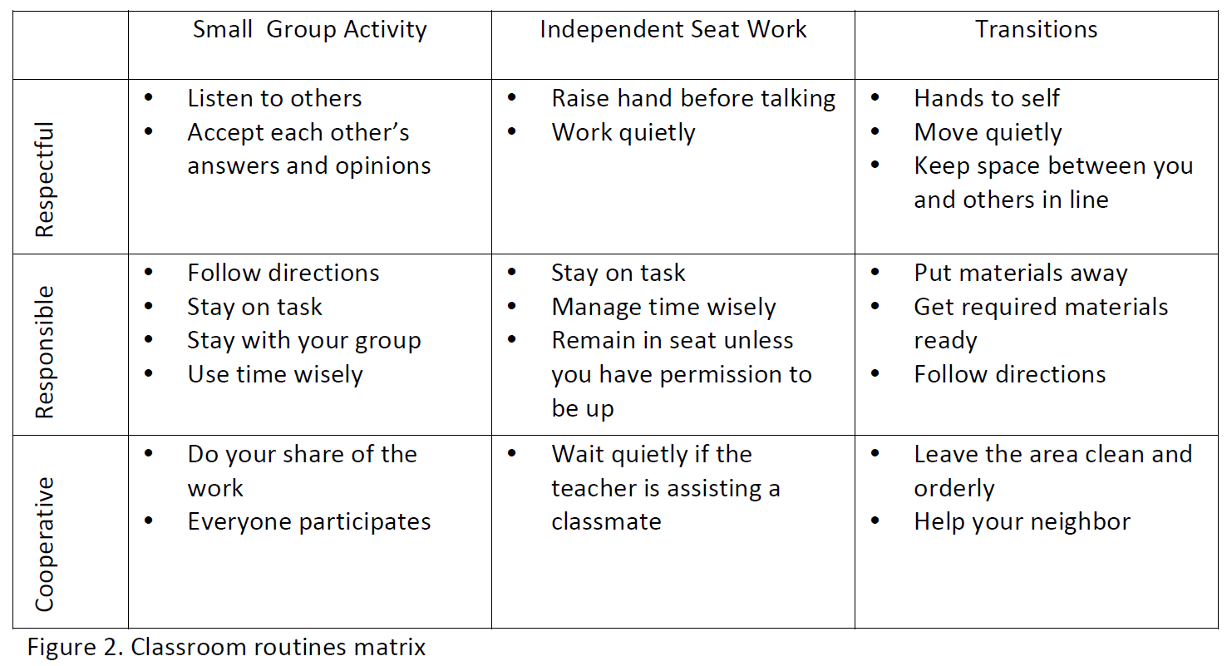
Sample Classroom Matrix
Newcomer (2009)
Which of these behaviors would you like to address?

Slide 48
Developing Expectations
Schoolwide Expectations Survey for Specific Settings (link)
60% = respect, responsibility, and safety (Lynass, et al., 2012)
Share expectations (link) or complete Table 13.2 in Handbook, P. 29
Add next steps to action plan
This Photo by Unknown Author is licensed under CC BY-SA

Slide 49
Alignment
See the example Matrix on p. 30
Using the MT ELA Standards, align one cell of the matrix with a standard see p. 28

Slide 50
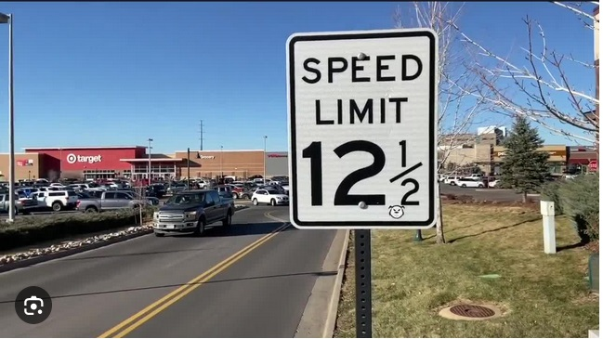
Posting Expectations
From https://www.denver7.com/traffic/driving-you-crazy/whats-driving-you-crazy-speed-limit-signs-with-fractions-really

Slide 51
Posting Big Ideas
Large font
Focus on behaviors you want to see
  "Employees must wash hands“
Keep the verbiage to a minimum
Consider height
Images and language culturally relevant
Must be taught

Slide 52

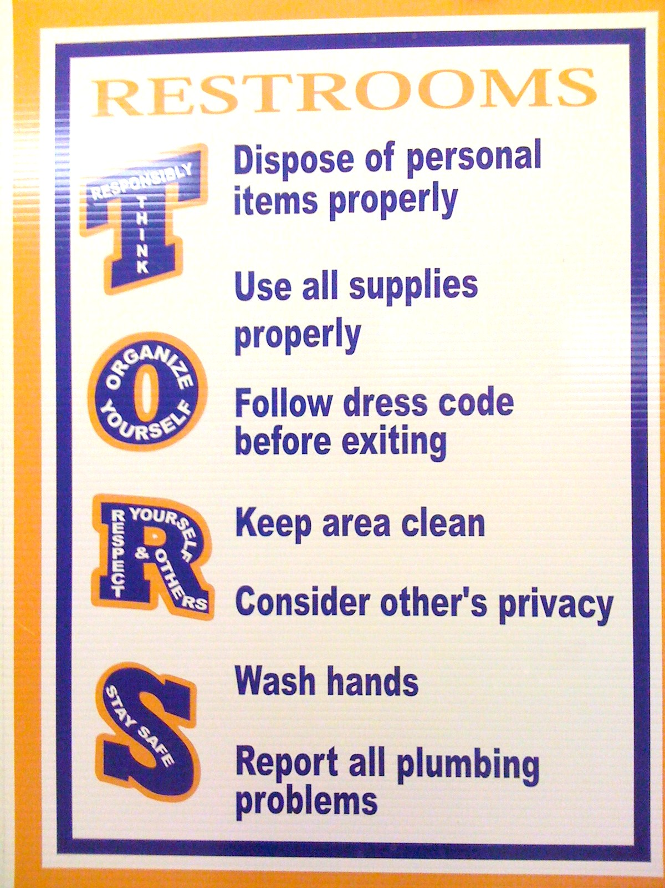
SULPHUR 9th GRADE - PBIS
Posting
CHUCK HANSEN, Principal
AMY PALMER, Teacher
SULPHUR HIGH SCHOOL, LA
Notes:
Ideas
Large font
Focus on behavior you want to see think “Employees must wash hands”
Keep the verbiage to a minimum
Consider height
Images and language culturally relevant
Content needs to be taught

Slide 53
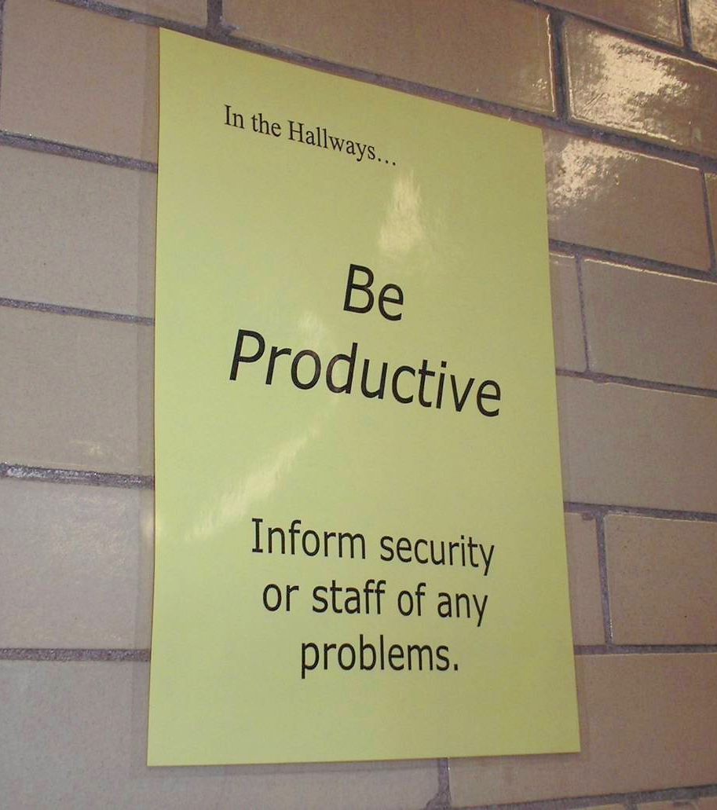
Notes:
53
Mr. Irvin
Defining expectations by location

Slide 54
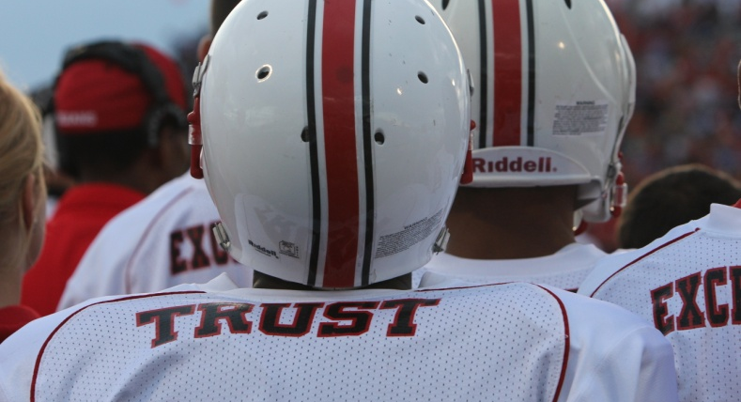
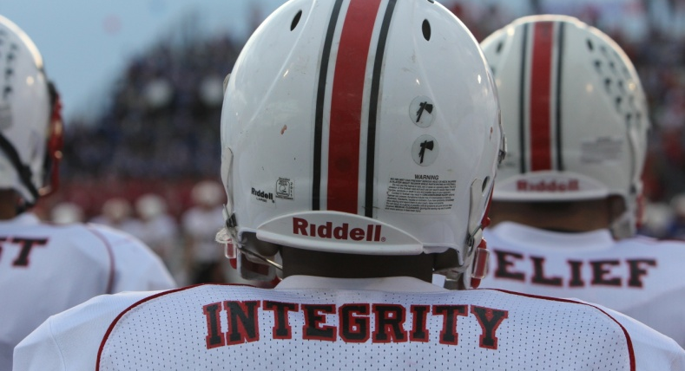
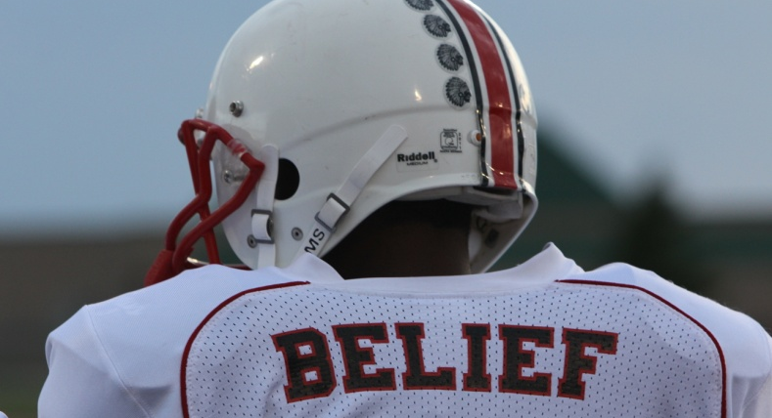
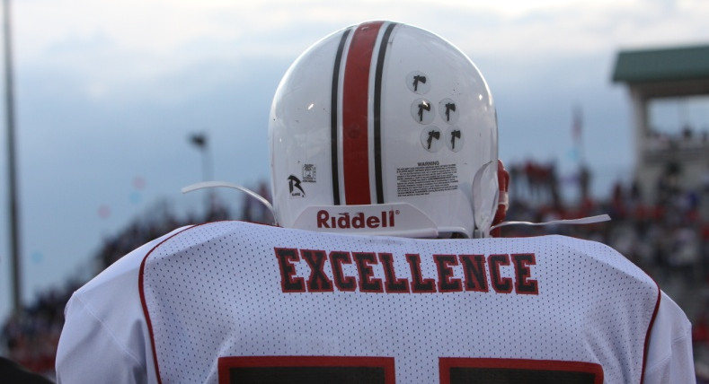
Shawnee Mission North
Football Jerseys
Notes:
Teaching expectations football?

Slide 55
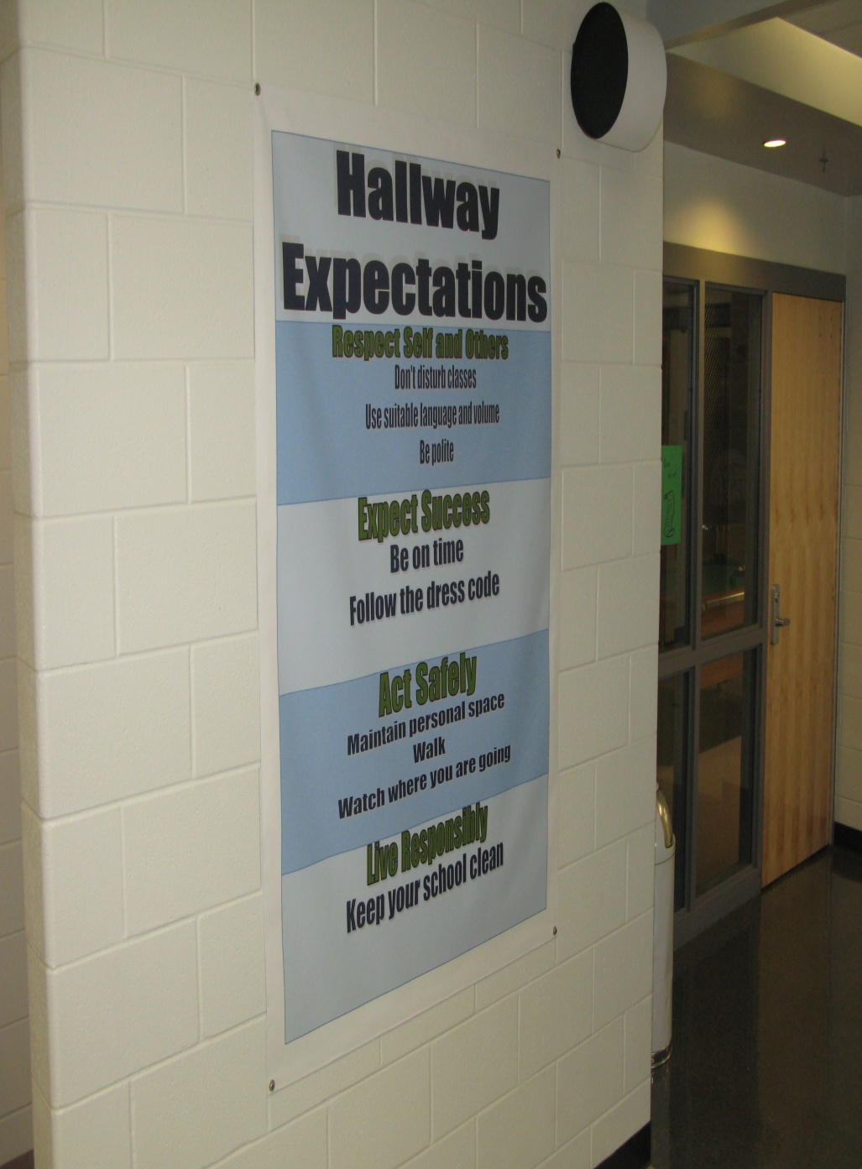
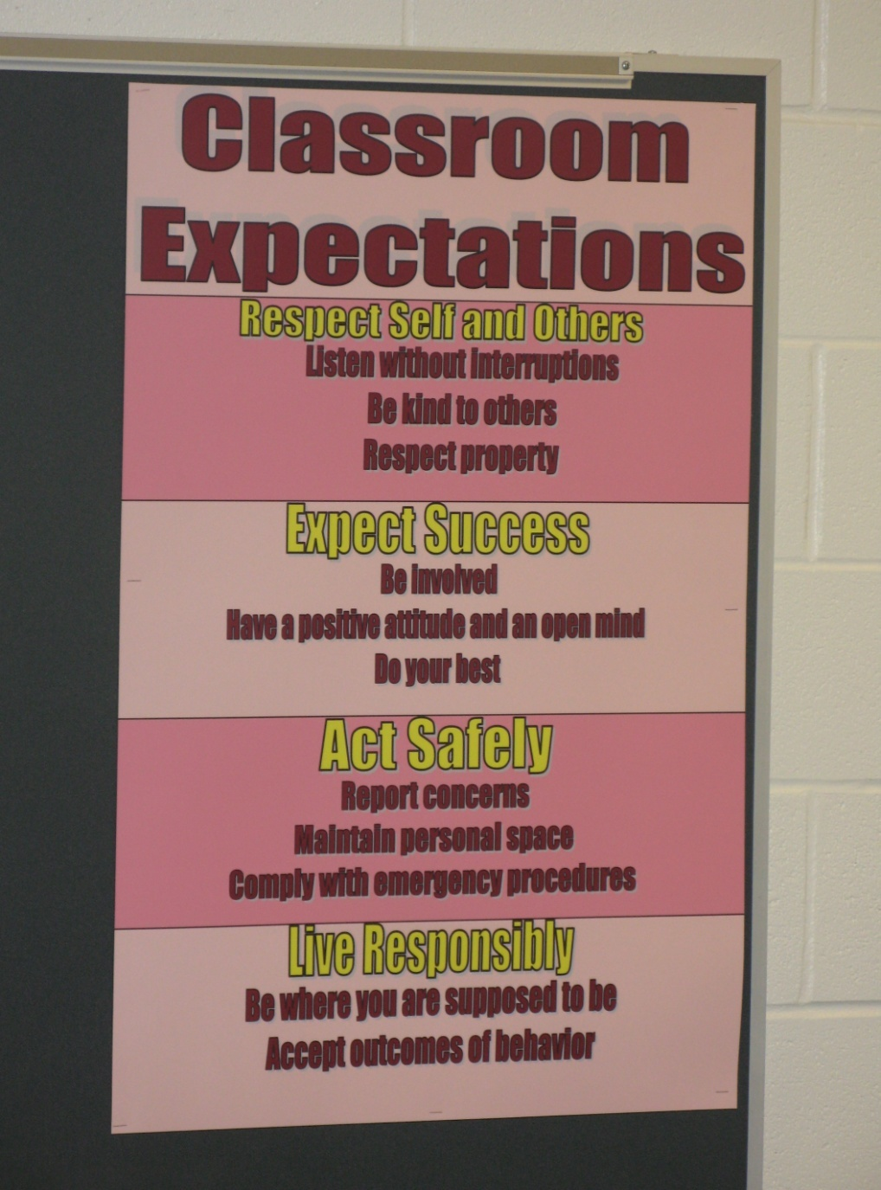
Shawnee Mission Schools, KS

Slide 56
Posting Reflection Question
What expectations do you consistently need to prompt?
How could/do visual examples help?

Slide 57

Teaching Expectations
Key Elements
Rationale
Negative examples
Positive examples
Practice/Feedback
Evaluate
This Photo by Unknown Author is licensed under CC BY

Slide 58

Prepare your staff
See the example lesson plan p. 31
High School example (at two minutes)
Elementary Example
What elements of teaching did you see?
How long does it take to teach an expectation?

Slide 59

Finding more plans
Sample Lesson plans
  http://www.hankbohanon.net
More Video Examples
  http://vimeo.com/groups/pbisvideos

Slide 60
Acknowledgement
Cheerleading Video
Notes:
Cheerleading video

Slide 61
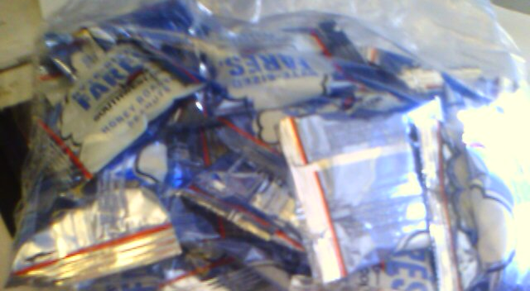
Earned this bag on SW…

Slide 62
Acknowledgement…
As part of schoolwide approach, can lead to improved performance
  Improved attendance (de Baca, Rinaldi, Billig, & Kinnison, 1991).
  Reductions in discipline problems (Bohanon et al., 2012)
Functional outcomes are important
  Relevant curriculum
  Social connection (Dunlap, Foster-Johnson, Clarke, Kern, & Childs, 1995).

Slide 63
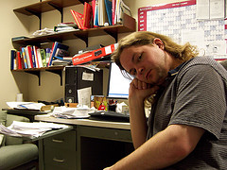
Other Advantages of Specific Praise
Decreases in emotional
exhaustion
Higher efficacy
Reinke, W. M., Herman, K. C., & Stormont, M. (2013).
Photo by Josh Thompson

Slide 64
Video
See examples of why this is important
  One-page document “Acknowledging Students for Good Behaviors” p. 34
  Page 35 – How could the principles from Japanese businesses apply to your school? (link)
Notes:
Zappos video only if time
Tell them page number -

Slide 65
High Frequency

Slide 66
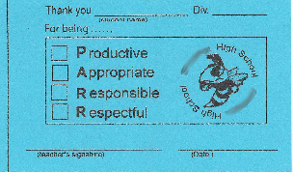
Buzzy Buck
Notes:
66
66
Brigit

Slide 67

Teacher Rewards Program
2 – Soft Drink
3 – Candy Bar
5 – Preferred Parking
8 – Free Lunch
10 – No Bus Duty
15 – No Morning or
Lunch Duty
20 – Extra Planning
Period
Tonya Ryder, Assistant Principal
Selena Gomes, Graduation Coach / Teacher
Oberlin High School, LA

Slide 68
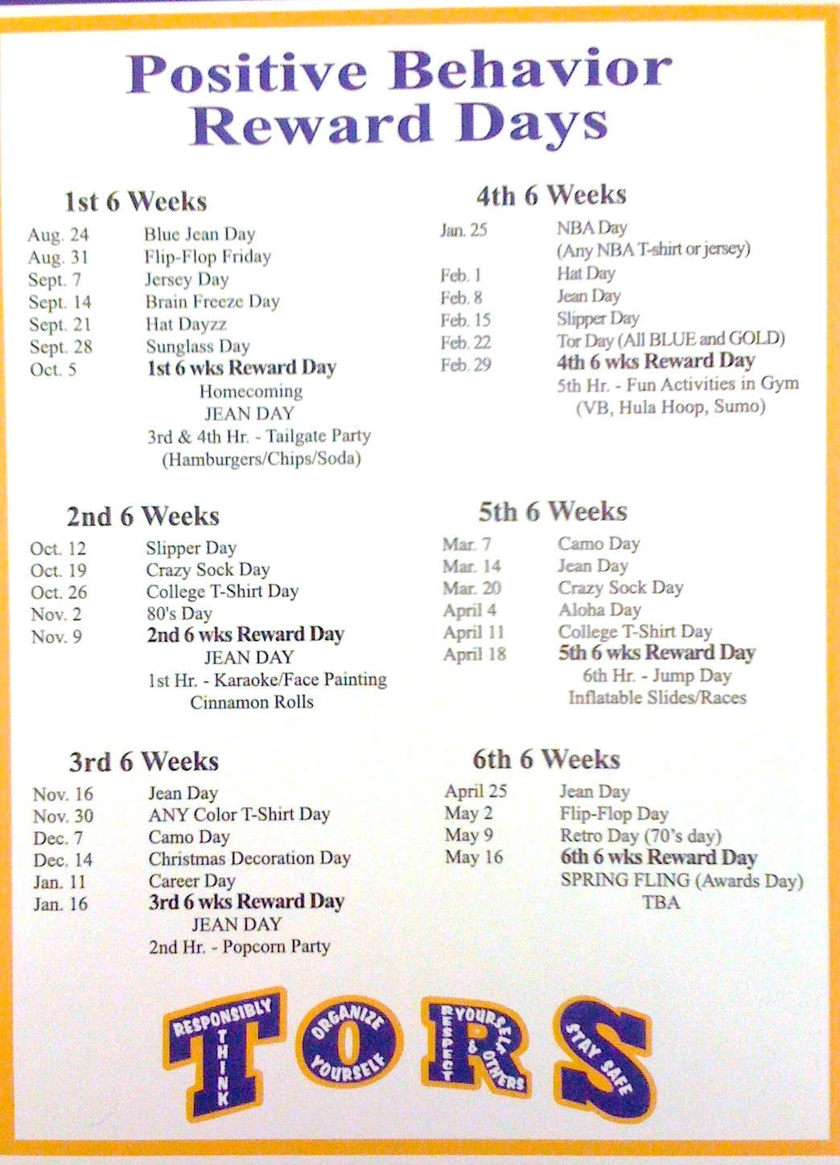
CHUCK HANSEN, Principal
AMY PALMER, Teacher
SULPHUR HIGH SCHOOL, LA

Slide 69
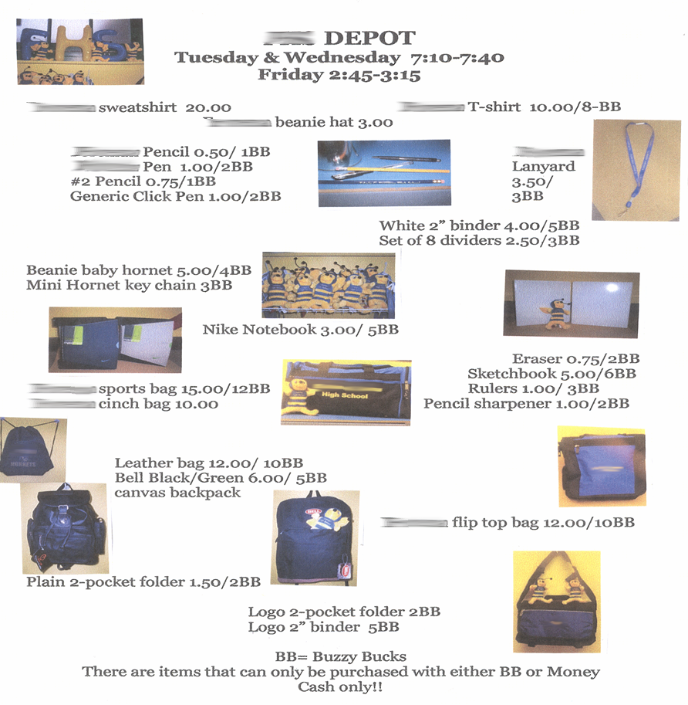
Notes:
69
69
Brigit

Slide 70
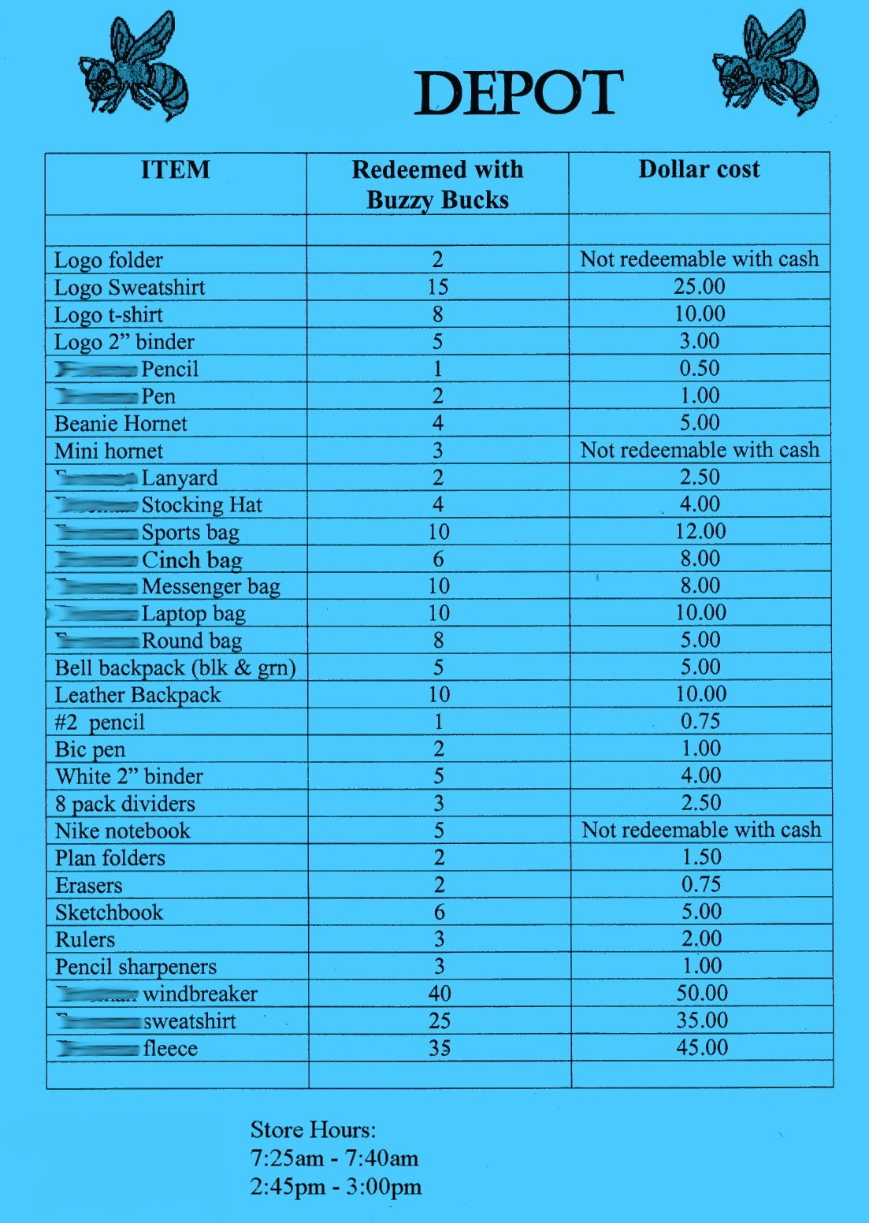
Notes:
70
70
Brigit

Slide 71
Intermediate

Slide 72
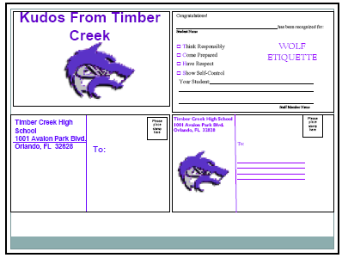
Woodridge Example (link)
Timber Creek High School, FL, JOHN WRIGHT, PRINCIPAL

Slide 73
Notes:
73
73
Brigit

Slide 74

Gold and Silver ID Cards
Notes:
74
74
Brigit

Slide 75
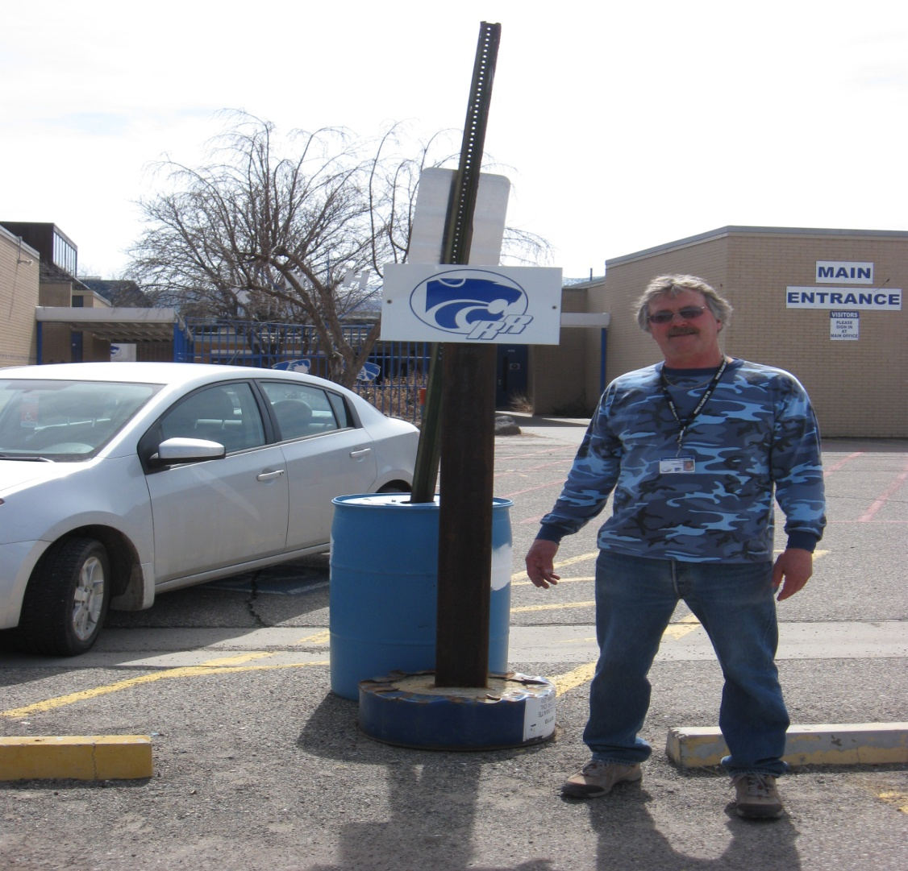
Ron our Liaison
Jody Mimmack, PhD Fruita Monument High School, CO

Slide 76
Large Scale

Slide 77
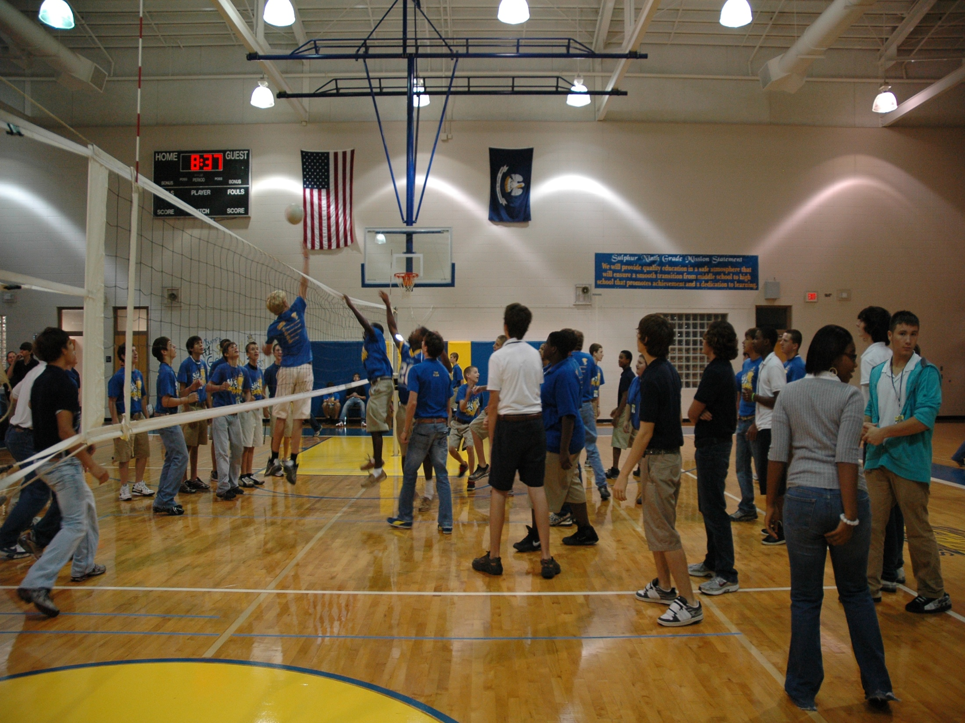
1st Six Weeks Party –
CHUCK HANSEN, Principal
AMY PALMER, Teacher
SULPHUR HIGH SCHOOL, LA

Slide 78

A Night in Paradise…
Tonya Ryder, Assistant Principal
Selena Gomes, Graduation Coach / Teacher
Oberlin High School, LA
Notes:
With these procedures in place, it became important to recognize our students’ social, academic and behavioral successes. We no longer have a traditional academic awards presentation, but instead have a school-wide academic pep rally that recognizes all of our students’ successes in various areas. This year’s theme will be “Academic Academy Awards…A Night in Paradise.”

Slide 79
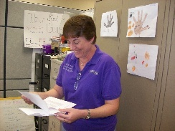
Teacher earns vacation
Timber Creek High School, FL, JOHN WRIGHT, PRINCIPAL

Slide 80
Freebies
http://www.kipbs.org/new_kipbs/familyInfo/freebies/

Slide 81

Certificate of Appreciation
Teaching Spartan of the Month
In recognition of excellence in teaching, __________ is awarded this certificate for devotion to the students, commitment to learning, and dedication to the core values of R High School.
Date
R324A070157
, Principal

Slide 82
Reflective Question
See sample and blank reinforcement matrix, p. 34
What is one high-frequency acknowledgment that might work for your students or teachers?
What is one unpredictable/intermittent “BOOSTERS” acknowledgment that might work for your students or teachers?
What is Attention-Grabbing “Celebrations” acknowledgment that might work for your students or teachers? See matrix

Slide 83
Engagement and Opportunities to Respond
Non-example – Ferris
Jeff Bliss Video Example
Notes:
Jeff Bliss Video Example

Slide 84

Quiz
What percentage of workers worldwide
consider themselves engaged at their jobs?
23 %
https://www.gallup.com/394373/indicator-employee-engagement.aspx
Photo from Flicker Creative Commons https://www.flickr.com/photos/pennwic/8142281815/in/photolist-dpvjHe-dpvjNz-dpvths-pQoPx7-aMi2SZ-8vEXtU-8vBWcM-5C6oVt-pEQiQm-97vCko-rKn1F-h7BuWg-h7ybkV-h7wXts-h7y2AF-h7y1NP-8vBVJ2-8vBW8g-8vBVL8-8vBVZr-8vEXGf-8vBWgB-8vBWdB-8vBVTe-8vBW8X-8vBW4Z-h7wVwR-h7x7bs-aMi6nD-5pYDTp-aMiarZ-aMi2xk-aMhLrn-aMhSLR-aMhUsa-aMhK7i-aMhJQz-aMhUbT-aMhJxr-aMhYfc-aMhURP-aMhTt2-aMhV48-aMhKk8-aMhKyV-aMhKRR-aMhLHT-aMhTFt-aMhTXz-aMhUEp

Slide 85


To Engage Students, Save the Cat
Why is this scene in Moana (link)?

Slide 86
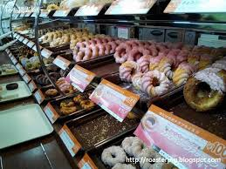
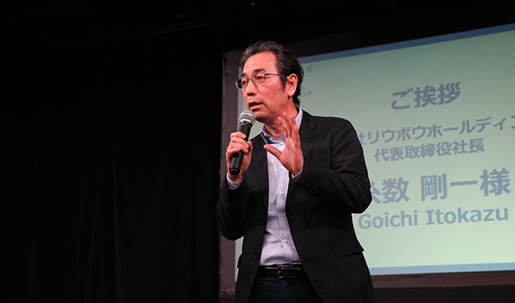
Engagement
Image from http://2015.oimf.jp/en/news/detail/104
Image from http://bit.ly/1ZIfcPF
Good merchandise alone will not appeal to the customer, it …[stores]…must attract the five senses (ANA Innovations)
  Goichi Itokazu, President of Ryubo Holdings, and former president of Family Mart
Notes:
Talk about unicycle

Slide 87


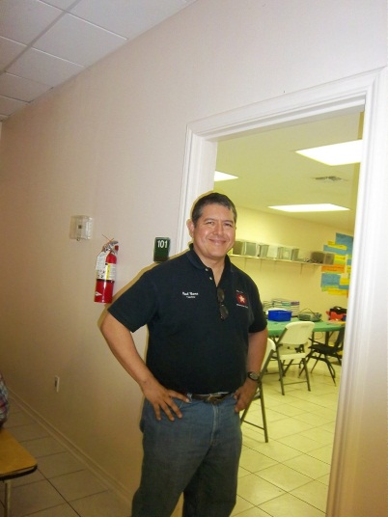
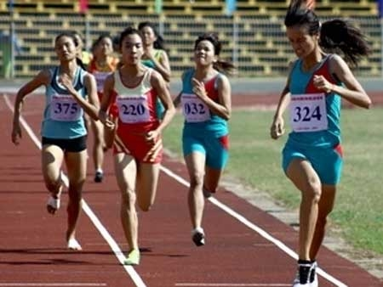

Instructional/Emotional Support
Failure rates
from 17% to 11%
  Choice of responding
  Laughing with students
  Out of desk greeting
Allen, Gregory, Mikami, Lun, Hamre, & Pinata (2013)
  Ask about events
  Ask “why”?
http://mzteachuh.blogspot.com/2012/05/that-kid-drives-me-nuts-tweets-of-day.html
http://ignitebrownsville.blogspot.com/p/picture-gallery.html
http://english.vietnamnet.vn/fms/sports/57762/hanoi-to-host-5th-asean-student-sports-games.html
http://www.phy.bris.ac.uk/news_archive1.html
http://www.hillel.org/jewish/ask-big-questions
Notes:
See Blog in handout and onwebsite

Slide 88
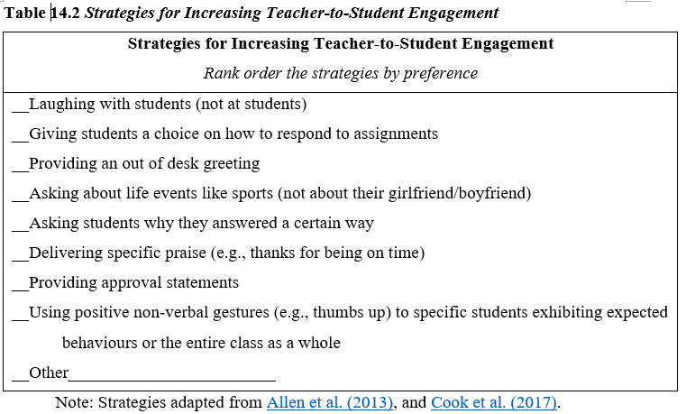
Reflective Question
See Table 14.2, Rank order the strategies by personal preference, p. 38

Slide 89
Reflection on Universal Design for Learning – Providing Flexible Means of Engagement
Think about the worst class you ever attended, why was it so bad/frustrating?
This Photo by Unknown Author is licensed under CC BY-NC

Slide 90
Universal Design Slide
Get from old UDL presentation
This Photo by Unknown Author is licensed under CC BY-NC

Slide 91

Flexible Means of Engagement
Explicit teaching, modeling, guided practice
  link
Make choices
  Content
  Who to work with
  Where to work
Explore content of interest
Using technology (e.g., Kahoot)
  See examples in Handbook page 39
Instructional Routines (The Core Six )
Notes:
Instructional routine – using EBP classroom strategy, as designed, frequently and regularly until students become familiar enough with the strategy that it becomes a habit
Reduce cognitive load for students with emotional or executive functioning challenges
The Core Six – Harey Silver’s book
Include writing processes, graphic organizers, academic vocabulary instruction, problem-solving steps, and self-monitoring

Slide 92
Instructional routines reduce cognitive load and allow students to be more independent learners
Examples
Reading for Meaning graphic organizer (Silver) - example below
Cornell style notes (Pauk)
Collaborative Strategic Reading (Klingner and Vaughn)
Claim-Evidence-Reasoning writing graphic organizer (many to choose from)
Evidence to prove | Claim | Evidence to refute
Table 1 shows that people with PhDs make an average income of $80,000 versus those with BAs make an average of $40,000 | People with more advanced degrees make more money
 | Most people work in the field the study for in college | Paragraph 5 stated that "75% of college graduates work in a different field than their BA was geared toward"
https://www.flickr.com/photos/docsearls/5500118475/in/photolist-cXMNUQ-bC1HTo-9o2xAT-9o5AEY-69MYfV-bubVYL-fu5X2f-E9aS-8DnR9y-bxgyP7-5qSgwP-dSA9Bi-5shMyD-8usn4k-5kZNd-89XiCo-2BGoqb-79hKaP-6wBTN-d7tNeN-7Sp5BB-9gfYVD-bA5evD-7i8Yvi-7WuQSP-4pTi29-cFS2Bs-9bk1ib-vxLgw-CJ6Cg-8GYAwP-5y9gAy-9PykmB-s4Zdf-gtS4jP-5gF5YM-6wBUr-57aEQb-6ALHfs-auR8jn-h8TtVm-3FHzm8-nTvUk-xKH84-4Vc2E6-3pSKw-5W5NMW-ma4TR-29BGFW-7Sp6Wg

Slide 93
Example for Reading for Meaning
See p. 26-27 for practice example – Also Try – “Do you need an advanced degree in ag?” (link)
Evidence to prove | Claim | Evidence to refute
Table 1 shows that people with PhDs make an average income of $80,000 versus those with BAs make an average of $40,000 | People with more advanced degrees make more money
 | Most people work in the field the study for in college | Paragraph 5 stated that "75% of college graduates work in a different field than their BA was geared toward"

Slide 94

Opportunities to Respond (OTRs)
Asking questions at a high rate
Using rapid prompting strategies (e.g., text-based, gestures, verbal)
Providing immediate feedback
Teacher-related prompts (e.g., choral responses)
Peer-related prompts (e.g., peer tutoring, pair-share)
Technology-related prompts (e.g., gamifying responses)
(Common et al., 2020

Slide 95
Student Engagement
Webinar on using data to improve student engagement http://fb.me/4vHawmKtz
Webinar for increasing student engagement through real world projects http://bit.ly/1K5ZplN
Assessing school climate webinar http://bit.ly/1IRJgBH
Online survey: student hope, engagement, belonging, and classroom management.... http://fb.me/2bX9tbQh4
Teaching algebra in middle and high school http://buff.ly/1CqNf2c

Slide 96
Example
What connections do you make with behavior and your instructional model?
Schoolwide examples https://www.youtube.com/watch?v=y0H5XsZ1gzA
See example, how is this teacher preventing problem behavior through engagement?
  See steps in handout (see video up to 2:43)
  https://www.youtube.com/watch?v=zxTuPVtayOI

Slide 97
Redirection and Active Supervision
JC Penny’s does this very well
How some moms handle the pressure video – Whitney Young

Slide 98

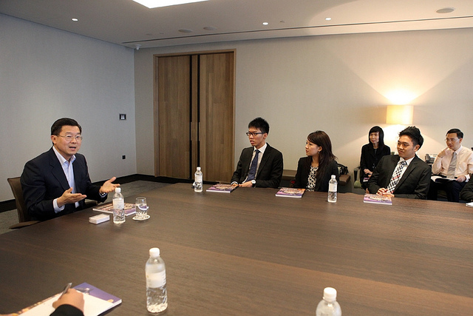
Redirection
Images from Flickr Creative Commons
If you need to correct someone, speak to the person personally – do not embarrass them in front of others. Treat the person with dignity (Ng & Foo, 2016)
  Stephen Raidy, president and CEO of the LIPPO Group
Notes:
(US $20 Billion Dollar Conglomerate and Executive Chairmen of OUE Singapore

Slide 99
What do people like about Starbucks? Is it just the coffee?

Slide 100


Redirection, Starbucks Style
Problem=
Listen
Acknowledge the problem
Take action
Thank the customer
Encourage their return
https://www.flickr.com/photos/jack79_mi/295241529/in/photolist-s6c2c-snPcA-cBe9L5-4MCv86-deQWpH-5Hrfq8-deQWmG-bs8WbE-8QwTKz-54v7jN-deQWkH-4LQZDz-pTk24-5Hrew-7zYn6p-jhtJ2-3PrS4-93M6u-5ZRgv-7iCBqP-7zXPki-cfkpQ1-cAWgMq-o3Essy-4bX7QK-jhB4Qw-oi8bk3-HPLbR-d11jb-cv4v-69dDt-5Zqe12-3KZ51j-7CSQRL-4BUac-deQWaJ-733Hyf-27bFgT-63CyTY-4JMpRY-4E56j9-dWAY9h-hHxqqw-bkD5C-5u4KaH-2ND7vr-dF4Szc-uigrX-5pETae-4V632M
https://www.flickr.com/photos/sfj/5460895004/in/photolist-9jyvQ9-4EDQCx-ciq9gq-acTCLV-or6MBF-opyZQr-7HD4bD-2VTQV-ecdhtd-oc3FqA-7uuFQf-2vECfM-5HQQga-EZgJA-7eVbg-a95T3-jGwNrD-atfY75-MaAHM-5T63vU-8Nx9W-c51DLd-4D98Gt-2WbnRa-cdr3WN-dvcKjv-7iGxjN-3jVKDf-dsbnCL-5iSejM-ci7Qe-cUGZfN-4pH6PT-8xfZ1S-9oTxv4-u8Rr6-5HXUFU-6jkHSR-cBaiHL-h6VisX-ctjB7u-dHpzzL-69sPWA-5nXi3n-s2Qe-478wUK-neMFoz-dGVCiR-jJgKTt-8MnN24

Slide 101
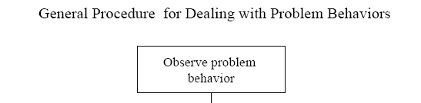
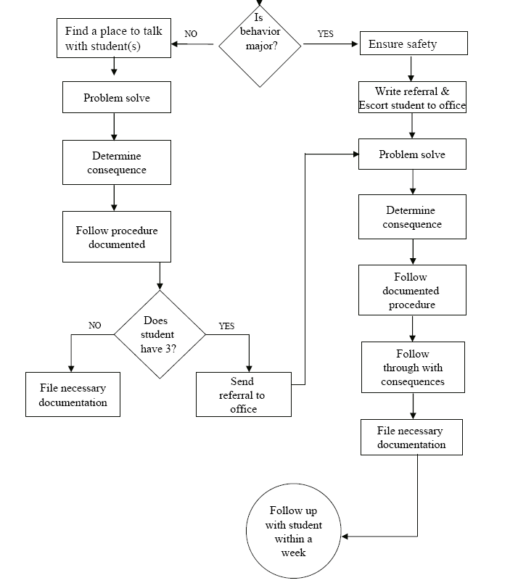
Is the behavior office- managed?

Slide 102
McClatchy Students Video, Dean?
Notes:
102
Alissa present (1 minute max)
102

Slide 103

Support Staff: Preventing and Responding
Teach skills for prevention
  Good classroom instruction
  Non-classroom settings
Teach skills for redirection
  Classroom
  Non-classroom settings
See Handout “Professional Development on Redirection” p. 40
This Photo by Unknown Author is licensed under CC BY-NC

Slide 104
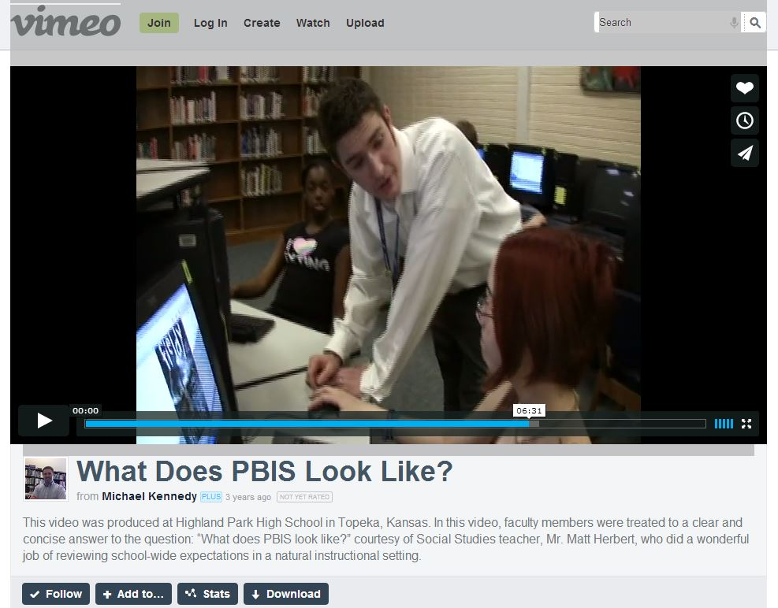
Videos
  What does PBIS Look Like? – Active Supervision and
  Redirection examples 6.12 mins
  http://vimeo.com/14818677 or (link)
Notes:
Tell story from NC when your said slurs about my family - how I handled – how I did not react…

Slide 105
Reflective Question
Create a T-Chart of expectations for handling problem behavior
Identify who handles behaviors in your school
List out behaviors that should be handled on each side. P. 41-42

Slide 106
What Tier-One Strategies Can Support your Students?

Slide 107
Making a Plan
See Handbook page 43
Review the tier-one checklist from MOPBIS (link)
Identify three areas of strength
Identify one area for improvement
Identify specific next steps to support your students.

Slide 108

To Learn More (link)
Amazon Link

Slide 109
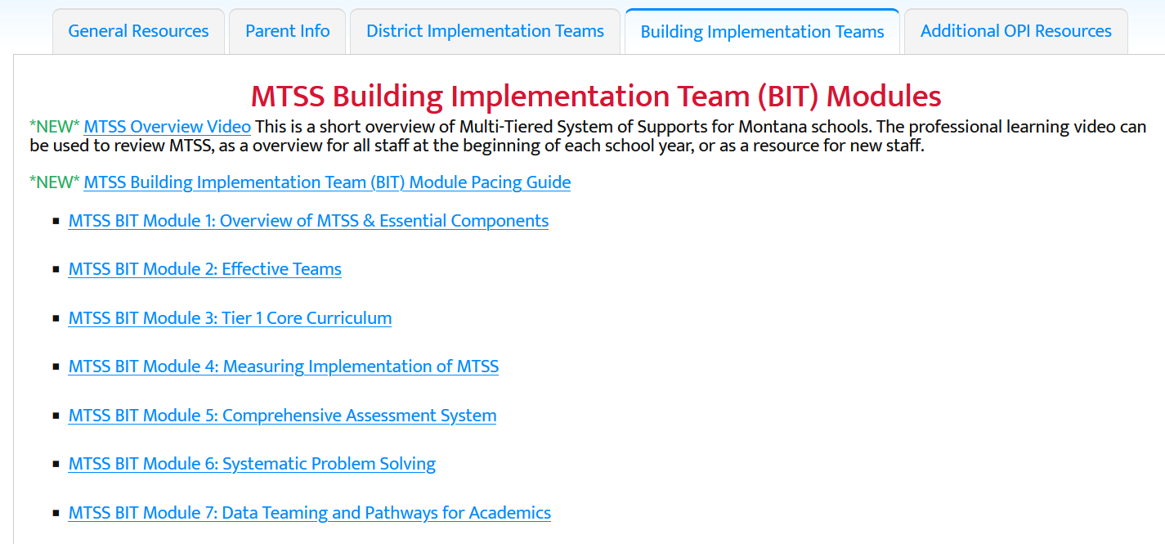
See Montana MTSS for More
Link

Slide 110

See Woodridge High School Prezi (link)

Slide 111
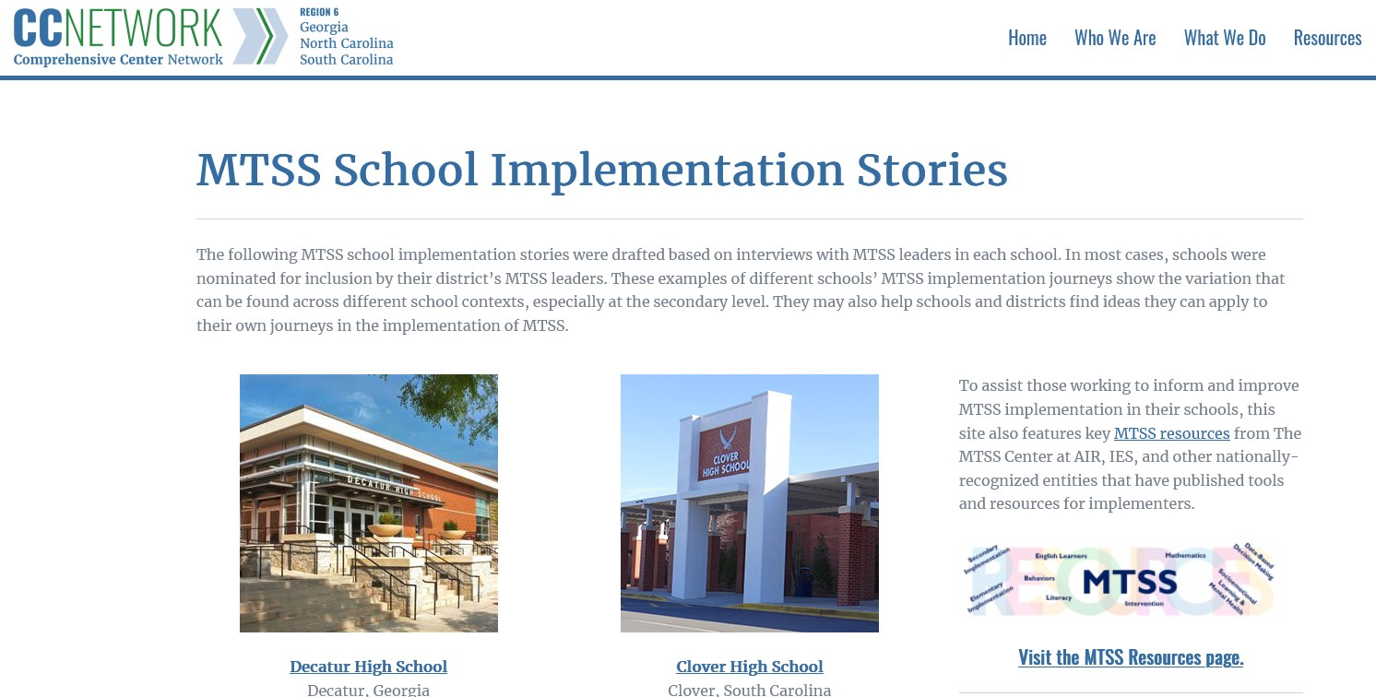
Case Stories (link)

Slide 112
Resources
Year-at-a-glance
  http://www.hankbohanon.net/Resources_1.html
Professional development outline, p 25 (link)
Training script for booster for staff
  http://www.hankbohanon.net/Resources_1.html

Slide 113

Strategies
Mendler, A. N. & Mendler B. D. (2011) Power struggles: Successful techniques for teachers. Bloomington, IN: Solution Tree.

Slide 114

Classroom Management
Knoster, T. (2013). The Teacher’s pocket guide effective classroom management (2nd Ed.), Baltimore, MD: Paul H Brookes

Slide 115
PowerPoint's
Enduring Understanding:
SWPBS/MTSS supports school improvement and effective schools
Using data to determine needs can enhance your SWPBS implementation efforts
SWPBS/MTSS can improve classroom and non-classroom settings

Slide 116
Student Engagement
Webinar on using data to improve student engagement http://fb.me/4vHawmKtz
Webinar for increasing student engagement through real world projects http://bit.ly/1K5ZplN
Assessing school climate webinar http://bit.ly/1IRJgBH
Online survey: student hope, engagement, belonging, and classroom management.... http://fb.me/2bX9tbQh4
Teaching algebra in middle and high school http://buff.ly/1CqNf2c

Slide 117
Preparing Your Teams
How will you prepare your staff?
See examples and action plan
Notes:
Tell page number

Slide 118
Where are you?
Complete
  Classroom management self-assessment
  http://www.pbis.org/pbis_resource_detail_page.aspx?Type=4&PBIS_ResourceID=164
Free training on active supervision (limited time only)
  https://www.irised.com/freecourse&?utm_source=IRIS+Educational+Media+Mailing+List&utm_campaign=9d73acd430-FREEprog_SysSupEvElem_8_5_2014&utm_medium=email&utm_term=0_cb7ab95a8b-9d73acd430-291122974#.U-U6UPldWSq

Slide 119
Resources
State Implementation & Scaling-up of Evidence-based Practices Center
  http://sisep.fpg.unc.edu/
Kotter, J. (1995). Leading change: Why transformation efforts fail. Harvard Business Review, 73(2), 59–67. Retrieved from http://hbr.org/
http://www.hankbohanon.net/Resources_1.html

Slide 120
Videos
Michael Kennedy http://vimeo.com/channels/129830
  Fruita Monument
  Consistent
Scott’s Pride https://sites.google.com/a/ddouglas.k12.or.us/scotspride/

Slide 121
Other Supports
Defusing Disruptive Behavior in the Classroom
  Geoff Colvin http://www.lookiris.com/store/K-12_Professional_Development/Defusing_Disruptive_Behavior_in_the_Classroom/
Classroom management training
  http://pbismissouri.org/class.html
The FAST Method
  http://www.lookiris.com/store/K-12_Professional_Development/The_FAST_Method_ONLINE/
Notes:
See website

Slide 122
Other Supports
IRIS Online Modules
  http://iris.peabody.vanderbilt.edu/resources.html
Rti Action Network Article Behavior and Academics
  http://www.rtinetwork.org/Learn/Behavior/ar/Integrating-Behavior-and-Academic-Supports-Within-an-RtI-Framework-General-Overview
National Center on PBIS
  http://www.pbis.org
Association of Positive Behavior Support
  http://www.apbs.org
Direct behavior rating
  http://www.directbehaviorratings.com/cms/

Slide 123
References
Allen, J., Gregory, A., Mikami, A., Lun, J., Hamre, B., & Pianta, R. (2013). Observations of effective teacher–student interactions in secondary school classrooms: Predicting student achievement with the classroom assessment scoring system—secondary. School Psychology Review, 42(1), 76–98.
Benbenishty, R., Astor, R. A., Roziner, I., & Wrabel, S. L. (2016). Testing the Causal Links Between School Climate, School Violence, and School Academic Performance: A Cross-Lagged Panel Autoregressive Model. Educational Researcher, 45(3), 197-206. doi:10.3102/0013189X16644603
Bohanon, H. (2015). Changes in adult behavior to decrease disruption from students in non-classroom settings. Intervention in School and Clinic, 15 (1), 12-18. http://ecommons.luc.edu/education_facpubs/39
Bohanon, H. & Wu, M. (2014). Developing buy-in for positive behavior support in secondary settings. Preventing School Failure, 58 (4), 1–7. doi: 10.1080/1045988X.2013.798774 http://ecommons.luc.edu/education_facpubs/17/
Bohanon, H., Castillo, J., & Afton, M. (2015). Embedding self-determination and futures planning within a schoolwide framework. Intervention in School and Clinic. 50 (4), 203-209. http://ecommons.luc.edu/education_facpubs/16/
Bohanon, H. (2015). Changes in adult behavior to decrease disruption from students in non-classroom settings. Intervention in School and Clinic, 15 (1), 12-18. http://ecommons.luc.edu/education_facpubs/39
Bohanon, H., Fenning, P., Hicks, K., Weber, S., Their, K., Akins. B., Morrissey, K., Briggs, A., Bartucci, G., Hoeper, L., Irvin, L., & McArdle, L. (2012). Case example of the implementation of schoolwide positive behavior support in a high school setting. Preventing School Failure, 56 (2), 92-103. http://ecommons.luc.edu/education_facpubs/7

Slide 124
References
Bohanon, H., Gilman, C., Parker, B., Amell, C., & Sortino, G. (2016 online first). Using school improvement and implementation science to integrate multi-tiered systems of support in secondary schools. Australasia Journal of Special Education. pp. 1–18. DOE: 10.1017/jse.2016.8. http://ecommons.luc.edu/ education_facpubs/80/
Blase, K. A., Fixsen, D.L., Sims, B.J., Ward, C.S. (2015). Implementation science – changing hearts, minds, behavior, and systems to improve educational outcomes. Paper presented at the Wing Institute’s Ninth Annual Summit on Evidence-Based Education, Berkeley, CA. http:// nirn.fpg.unc.edu/resources/implementation-science-changing-hearts-minds-behavior-and-systems-to-improve
Brawley, S. (accessed March 22, 2011). PBS in the classroom. M.Ed. Heart of Missouri RPDC. http://www.cesa7.org/pbis/Classroom_Management.asp
Common, E. A., Lane, K. L., Cantwell, E. D., Brunsting, N. C., Oakes, W. P., Germer, K. A., & Bross, L. A. (2020). Teacher-delivered strategies to increase students’ opportunities to respond: A systematic methodological review. Behavioral Disorders, 45(2), 67-84.
Burke, A. (2015). Early Identification of High School Graduation Outcomes in Oregon Leadership Network Schools. REL 2015-079. Regional Educational Laboratory Northwest.
de Baca, M. R. C., Rinaldi, C., Billig, S., & Kinnison, B. M. (1991). Santo Domingo School: A rural schoolwide project success. Educational Evaluation and Policy Analysis, 13(4), 363-368. doi: 10.3102/01623737013004363
Eber, L., Phillips, D., Upreti, G., Hyde, K., Lewandowski, H., & Rose, J. (2009). Illinois positive behavioral interventions & supports (PBIS) network 2008-09 progress report (pp. 245). La Grange Park, IL.
Flannery, B. K., Guest, E., & Horner, R. (2010). SWPBS: Schoolwide positive behavior supports. Principal Leadership, 11(1), 38-43. doi: 2123461661
Illinois Positive Behavior Intervention and Support Network (2011). FY11 end of the year summary report. La Grange, IL: Illinois Positive Behavior Intervention Network.

Slide 125
References
Johnson-Gros, K. N., Lyons, E. A., & Griffin, J. R. (2008). Active supervision: An intervention to reduce high school tardiness. Education & Treatment of Children, 31(1), 39-53.
Koon, S., & Petscher, Y. (2016). Can scores on an interim high school reading assessment accurately predict low performance on college readiness exams? (REL 2016–124). Washington, DC: U.S. Department of Education, Institute of Education Sciences, National Center for Education Evaluation and Regional Assistance, Regional Educational Laboratory Southeast. Retrieved from http://ies.ed.gov/ncee/edlabs.
Kotter, J. (1995). Leading change: Why transformation efforts fail. Harvard Business Review, 73(2), 59–67.
Lynass, L., Tsai, S.-F., Richman, T. D., & Cheney, D. (2012). Social Expectations and Behavioral Indicators in School-Wide Positive Behavior Supports. Journal of Positive Behavior Interventions, 14(3), 153-161. doi:10.1177/1098300711412076
Luh, H-J, Ni, H., Chen, C., & Feng, Y. (2024). SW-PBIS in China: A case study on implementation and cultural adaptations. Presentation at 2024 Association of Positive Behavior Support International Conference, Chicago, IL.
McKeon, G. (2014). Essentialism: The disciplined pursuit of less. Crown Business
McNeely, C. A., J. M. Nonnemaker, J.M., & Blum, R. W. (2002). Promoting School Connectedness: Evidence from the National Longitudinal Study of Adolescent Health. The Journal of School Health 72(4): 138-146.
McIntosh, K., Filter, K. J., Bennett, J. L., Ryan, C., & Sugai, G. (2009). Principles of sustainable prevention: Designing scale-up of School-wide Positive Behavior Support to promote durable systems. Psychology in the schools, 47(1), n-a-n/a. doi:10.1002/pits.20448
McIntosh, K., Flannery, K. B., Sugai, G., Braun, D., & Cochrane, K. L. (2008). Relationships between academics and problem behavior in the transition from middle school to high school. Journal of Positive Behavior Interventions, 10(4), 243–255. doi:10.1177/1098300708318961
Morrissey, K. L., Bohanon, H., & Fenning, P. (2010). Positive behavior support: Teaching and acknowledging behaviors in an urban high schools. Teaching Exceptional Children, 42(5), 26-35.

Slide 126
References
National High School Center, National Center on Response to Intervention, and Center on Instruction. (2010). Tiered interventions in high schools: Using preliminary “lessons learned” to guide ongoing discussion. Washington, DC: American Institutes for Research. http://bit.ly/2r0SaeE
Newcomer, L. (2009). Universal positive behavior support for the classroom. PBIS Newsletter, 4(4). Retrieved September 24, 2009 from http://www.pbis.org/pbis_newsletter/volume_4/issue4.aspx
Ng, J. & Foo, A. (2016). Heart to heart with Asian leaders: Exclusive interviews on crisis, comebacks, and character. Singapore: World Science Publishing.
Rogers, T., Duncan, T., Wolford, T., Ternovski, J., Subramanyam, S., & Reitano, A. (2017). A randomized experiment using absenteeism information to "nudge" attendance (REL 2017– 252). Retrieved from Washington, DC: https://ies.ed.gov/ncee/edlabs/regions/midatlantic/pdf/REL_2017252.pdf
Rowan, B., Correnti, R., Miller, R. J., & Camburn, E. M. (2009). School improvement by design: Lessons from a study of comprehensive school reform programs. Consortium for Policy Research in Education. Retrieved from http://www.cpre.org/school-improvement-design-lessons-study-comprehensive-school-reform-programs
Sherif, M., Harvey, O. J., White, B. J., Hood, W. R., & Sherif, C. W. (1961). Intergroup conflict and cooperation: The Robbers Cave experiment (Vol. 10): University Book Exchange Norman, OK.
Simonsen, B., Fairbanks, S., Briesch, A., Myers, D., & Sugai, G. (2008). Evidence-based practices in classroom management: Considerations for research to practice. Education & Treatment of Children, 31(3), 351-380. doi:10.1353/etc.0.0007
Therriault, S. B., Heppen, J., O’Cummings, M., Fryer, L., & Johnson, A. (2010). Early warning system implementation guide. Retrieved from http://www.betterhighschools.org/documents/NHSCEWSImplementationGuide.pdf
Vermont Agency of Education (Accessed July 28, 2016). The 13 dimensions of school climate. Vermont Agency of Education, Retrieved from: http://education.vermont.gov/documents/edu-school- climate-13%20Dimensions.pdf

