Slide 2
Embedding Tiered Supports Within the Master Schedule
Hank Bohanon
Loyola University of Chicago
hbohano@luc.edu
http://www.hankbohanon.net
Notes:
If it did not happen in high schools it did not happen, or one like ours

Slide 3
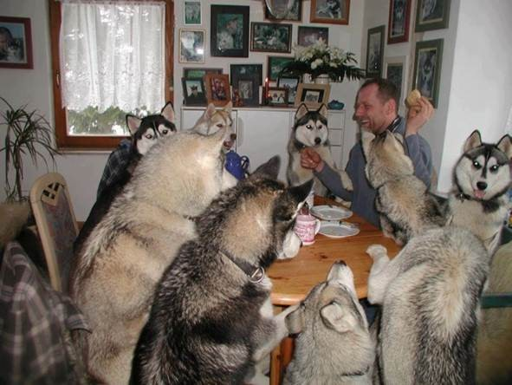
Everyone working together

Slide 4
Thank you!
Joshua Reed
Leadership Team
Valier School District
Montana MTSS
Notes:
4
4

Slide 5
PowerPoint's
Enduring Understanding:
Tier-two interventions include important components
The Valier team already has many tier-two components in place
There are specific actionable steps to enhance tiered supports for students

Slide 6
Essential Questions
What specific components of tiered supports (continuum of intervention) guide student and staff success?
What components of tier two support are staff already implementing to build upon for next year?

Slide 7
Essential Questions
What specific action steps will help staff implement tier-two supports?

Slide 8
Tier-Two Components

Slide 9
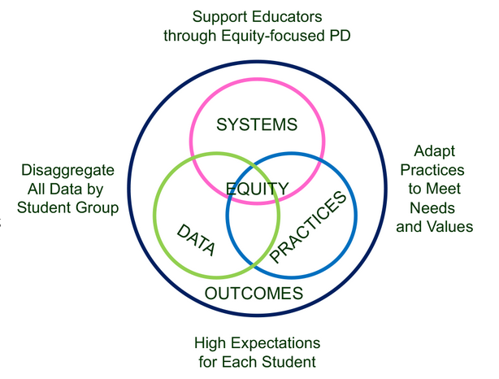
Supporting Social Competence &
Academic Achievement
4 SWPBIS
MTSS-B
Elements
From https://www.pbis.org/topics/equity

Slide 10



Key Elements
Systems – Josh, flight, checklist
  Administrative Commitments, Coaching (external/internal), Representative Teams, Audit of practices, Priority
Practices
  Based on evidence
Data
  Process and impact – dropout
    What and with whom?
http://en.wikipedia.org/wiki/Josh_Groban
http://www.inmagine.com/searchterms/private_jet.html
Notes:
10

Slide 11
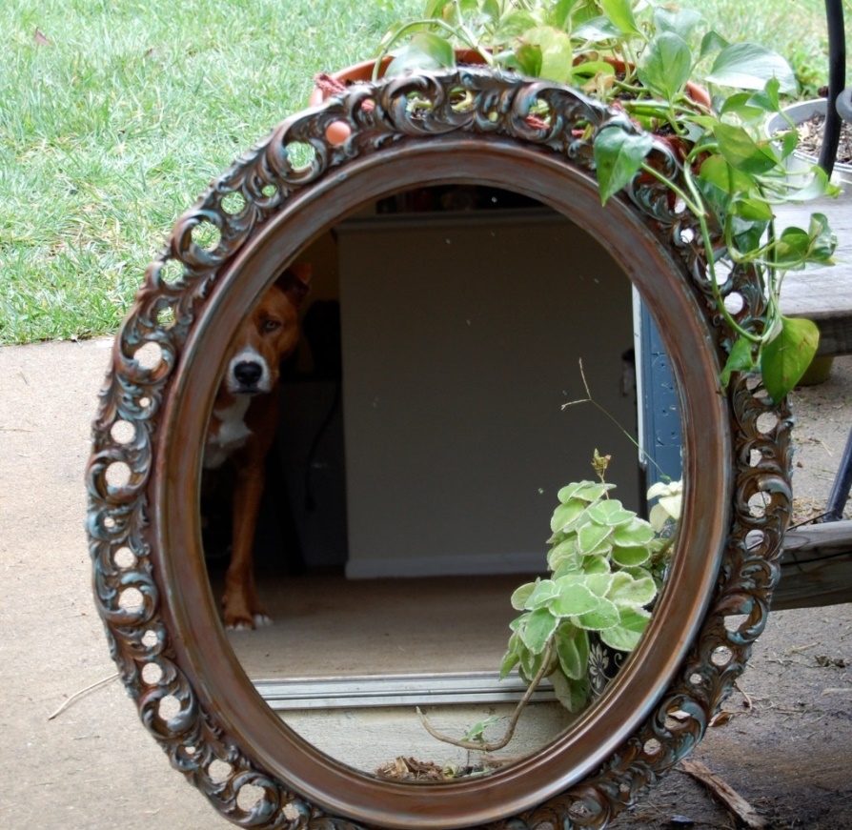
Reflection on SWPBIS/MTSS Systems, Practices, and Data
Walk around the room until the music stops
Where have you seen interventions work/not work based on Table 1.2 (p. 6)?
Now, back at your table – what is one area of strength and area for improvement for your systems, practices, and data related to SWPBIS/MTSS? (p. 7)
This Photo by Unknown Author is licensed under CC BY-SA-NC

Slide 12

Problem Solving – Where do you already use these steps?
Identify
Analyze
Plan
Implement/
Evaluate
Harms, Nantais, Tuomikoski, & Weaver, S. (2019)
From Flickr creative commons https://flic.kr/p/24UJUYy
Notes:
Einstein – if I had 25 minutes to save the world, I would spend 55 minutes identifying the problem

Slide 13

Implementation of Schoolwide
38% More Tier 2/3 Interventions
  (Eber, Phillips, Upreti, Hyde, Lewandowski, & Rose, 2009)
50% decrease in outside school placements
6% increase in students 80% or more in general education (compared to state 3%)
  (Illinois Positive Behavior Intervention and Support Network, 2011).
Image from https://flic.kr/p/25UMFK4

Slide 14

Why Did Someone Drive Too Fast?
Image from https://images.app.goo.gl/csjQfX8sVBwFZozj7

Slide 15
Samples of Functions of Behavior (link)
Escape something negative
Avoid something negative
You got something (object)
Attention (good, bad, or ugly)
You were over/under stimulated
Setting events (what happened way in advance?)

Slide 16
Designing School-Wide Systems for Student Success
A Response to Intervention Model/MTSS
Questions
Answers
Tertiary Interventions/Tier 3:
Dig deeper – why?
Tertiary Intervention/Tier 3:
Ask questions,
Teach what works better
Cholesterol drugs
1-5%
1-5%
Secondary Interventions/Tier 2:
Can’t do/won’t do
5-10%
5-10%
Secondary Interventions/Tier 2:
Coke test analogy..
Over 50 Daily Aspirin
Universal Intervention
Tier 1:
Were we clear? Does it work?
How do we respond?
80-90%
80-90%
Universal Intervention/Tier 1:
Be clear on expectations,
make sure they work, be humane
Banning smoking in
public places*
*Greenburg & Abenavoli, 2017
Notes:
16
You may have a large copy of this in your handouts
tatoo..it is washable (just kidding)..
Example –
SW – Respect – Response Be kind – show poster ahead
Secondary – student could not write very well – even when given coke..skill deficit – then accommodate with writing prompt and remediate – teach skills
Tertiary – attention – personal greetings at the door and pre-correction was enough

Slide 17
Tiers Two and Three
Increase intensity
  Staff
  Time
  Ratio of students-to-staff
Systematic
  Criteria for entry/exit
Quick response times
Does not require diagnosis (e.g., disability)

Slide 18
Targeted Supports - Have a Coke!
Can’t Do (Skill Deficit)
  Responses
  Teach skill
  Priming
  Intersperse
  Teach escape
Won’t Do (Acquisition)
  Responses
  Prompt
  2-10
  Personal greeting
  Choice/preference
See CAST: http://www.cast.org/ and SIM http://www.kucrl.org/sim/
Notes:
Make Less aversive – student with down syndrome – liked stories about dogs and bones, would read.

Slide 19
Key Tier Two Strategies
Universal strategies in place with high-fidelity
Commitment school administrators
Specialized support team
Early intervention process for student identification
Process for matching interventions with needs
Selection and use of research-based interventions
Regular monitoring of student progress
Coordinated decision-making for continuum of support
Mitchell et al., 2016; Hepburn, 2024

Slide 20
Tier-Two Barriers
Variability in implementation and monitoring
Using too broad a range of tier-two interventions
  (Start with one intervention when possible)
Limited research support for some interventions
Hepburn, 2024

Slide 21
Selecting Interventions
Explicit teaching
Structured prompts
Practice opportunities
Feedback
Classroom-based – see my list of choices.
Small group-based
(Anderson & Borgmeier. 2010; Hepburn, 2024)

Slide 22
Tiers Two and Three Examples
Academic
Additional course or flexible time
  Implemented within the master schedule
  Credit recovery
  IXL – Math/ELA
  Evidence-based reading programs
    Tier two: REWARDS
    Tier three: Wilson Reading System
Behavioral/Social and Emotional
Check in/Check out system
Behavior Education Program
Social Skills Curriculum
Class-Wide Function-related Intervention Teams
Functional Behavior Assessment/Positive Behavior Intervention
Person centered/wrap around transition support

Slide 23
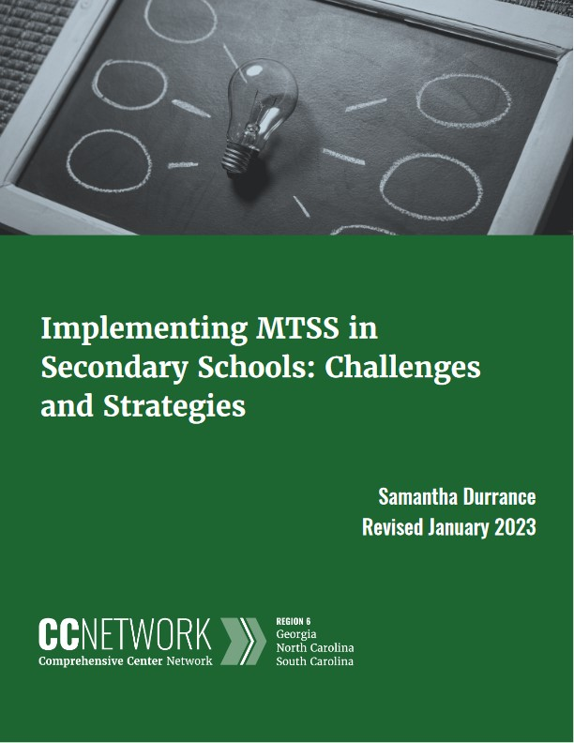
Connections – Interventions and Master Schedule
Pages 3-5 (Durrance) Master Schedule – Link
  Common planning
Review Interventions, Handbook p. 9
What connections do you make with your school(s)

Slide 24
Chapter 11: Using Data to Monitor Systems and Target Interventions
Career Builder video 1

Slide 25

Data Can Be Beautiful

Slide 26

Using Data At the YMCA
Notes:
YMCA Australia – looked at data – people cared more about connections and being connected with others (staff, other patrons) – enrolment went up (See Charles Duhigg = Power of Habit)

Slide 27
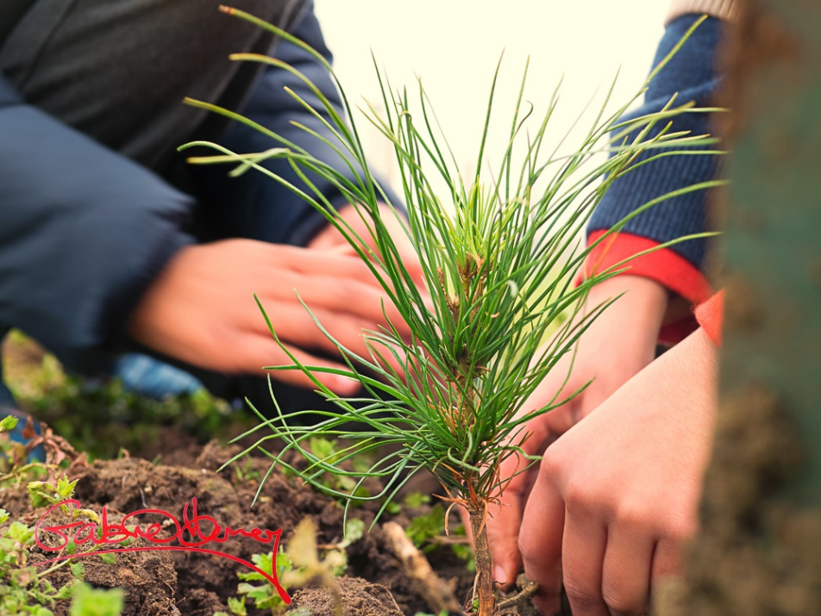
Plant the Tree Today
Organize what you have that aligns with school goals (e.g., grades, attendance, discipline referrals)
Start asking questions about the data
You will see what new data you need
This Photo by Unknown Author is licensed under CC BY-NC-ND
Notes:
Chinese proverb – the best time to have planet a tree was 20 years ago, next best time is today

Slide 28

Types of Data
Perception data
Existing Data
School Climate Surveys
Whole Child Related Screening
Attendance
GPA 8th-9th grade
Standardized test scores
Discipline infractions
Demographics
Screening data
Image from Flickr Creative Commons https://flic.kr/p/dZ8UiN
Notes:
Australia collects - School Opinion Survey.

Slide 29
Types of Existing Data
Office Discipline Referral Data
GPA (8th and 9th grade)
Credits toward graduation
Attendance (80 % or > unexcused)
Failing grades (Algebra I, English I)
Statewide assessments
Existing screening data
  MAP & IXL (link)
(Burke, 2015; Heppen, O'Cummings, &
Therriault,2009; Henderson, Cassandra & Fantuzzo, 2022; McIntosh, Flannery,
Sugai, Braun, & Cochrane, 2008; McIntosh et al., 2009)
Notes:
This study examined data from the 2007/08 grade 9 cohort in four Oregon districts to find early warning indicators of students who may drop out or fail to graduate from high school on time. The study identified four indicators that provided valuable early warning signals about students who did not graduate on time, particularly about students who dropped out of high school:
• Grade 8 attendance rate below 80 percent. • Grade 9 attendance rate below 80 percent. • Grade 8 grade point average (GPA) below 2.0. • Grade 9 GPA below 2.0.
When the influence of demographic, achievement, and behavioral characteristics and differences in the schools that students attended were considered at the same time, only gender, English learner student status, and attendance and GPA in grades 8 and 9 were associated with graduation outcomes. Burke, 2015
29

Slide 30

Montana’s Early Warning System (link)

Slide 31
Perception data
Whole Child Screening (includes free tools)
School Climate Surveys
Pediatric Symptoms
Signs of Suicide
Notes:
31

Slide 32
Deciding the Level of Intervention

Slide 33
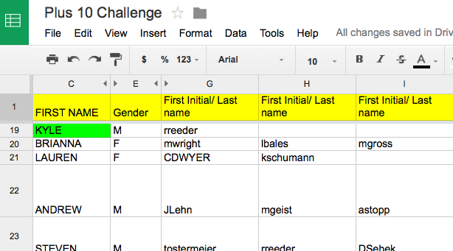
Staff Google Document
Keri Applebee, Associate Principal, Lincoln Southwest High School, NE
Notes:
Plus 10 challenge
Google docs- First initial, Last name- emphasize that it is ok if teachers could not put name by students – due to types of classes taught- important so we can see if students have academic/athletic connections
Criteria:
Do you know something about them outside of the classroom.
(Post -secondary plans, family structure, challenges)
Have you had a conversation with this student outside of normal class time?
Have you congratulated this student on an accomplishment or activity?
Has this student sought you out to share information with you about their life?

Slide 34
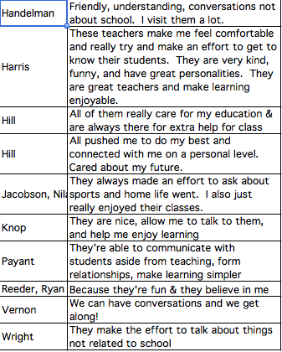
Results of student survey
Keri Applebee, Associate Principal, Lincoln Southwest High School, NE

Slide 35
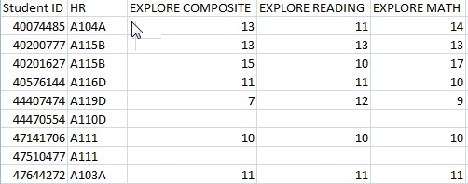
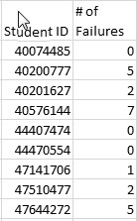
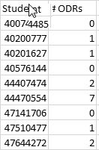
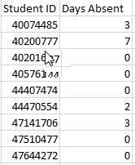
Separate Data Sets

Slide 36
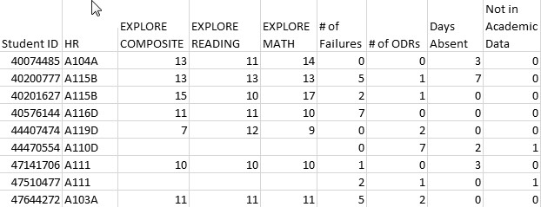
Combined Data Using VLookup
See YouTube examples: http://www.youtube.com/watch?v=3tk_Mif7040

Slide 37
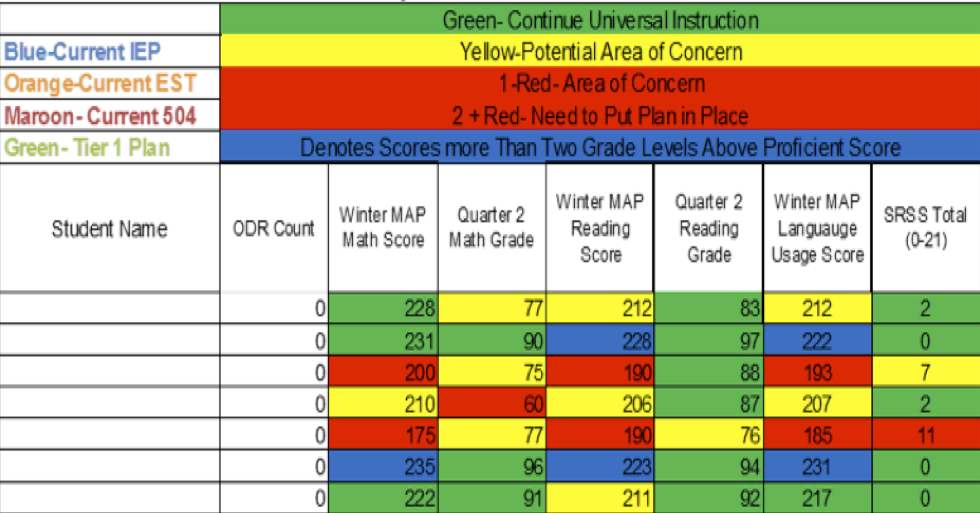
Integration of datasets
Northfield Middle School and High School, VT

Slide 38
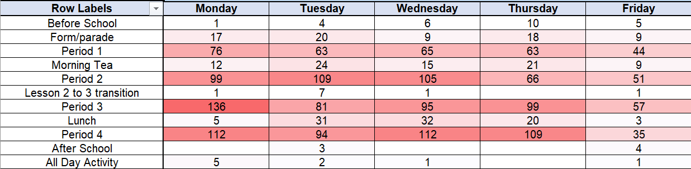
Discipline Heat Map – For Chairs/Deans
Developed by Todd Winton
and his colleagues at Beaudesert State High School in Australia

Slide 39
Activity
How would you recommend responding to the following data? P. 16

Slide 40
SET Data School 2 (year 1)

Slide 41
9th
10th
11th
12th

Slide 42
9th
10th
11th
12th

Slide 44
Priorities
Teaching, Acknowledging, and Redirection training for teachers of first year high school students
Orientation for first year high school students
Circuit training for staff during opening of the school
School store opens and training provided for staff
Notes:
Circuit training script part of your handout and on my website

Slide 45
Connections – Early Warning, Decision Rules
Review Early Warning Indicators and Decision Rules, p. 22-23
Review using benchmark data, p. 21
What connections do you make for your school(s)
Link

Slide 46

Data Next Steps
See Table 5.6 on p. 17
  Brainstorm as many data sources as you can think of related to your school or class goals

Slide 47
Matching Interventions
Description of the intervention
Entry criteria
Progress monitoring criteria
Exit criteria
Purpose of function if possible
See example –
  Moving from tiers 1 to 2, Handbook p. 10-14

Slide 48
Team Processes
Scheduling and communication
Creation and use of an agenda
Meeting begins and ends on-time
Keeping the meeting on track
Action plan/delegating tasks
Meeting Participation
Dissemination of meeting notes
See examples: Herding Cats, Bad Meetings, Action Plans, Sample VT agenda
Rate yourself –
handbook
Notes:
Herding cats video
See Handbook

Slide 49
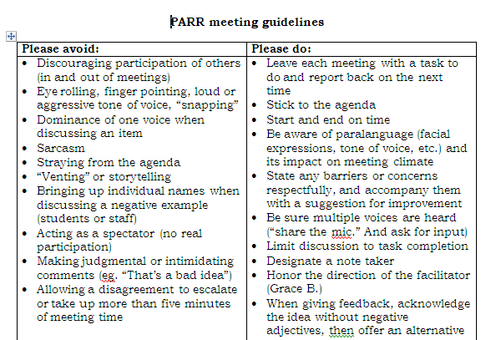
Notes:
49
Key things
Helped meetings become more efficient because
Helped keep everyone on task and respectful – depersonalized challenges
Everyone had to leave the meeting with a task – kept the spectators and ventors away
49

Slide 50
Reflection P. 19
Rate the health of their teams on each item
  (use Effective Meetings slide)
  5 positive things are going great
  1 not at all and we need to work on this
Choose one area to address
  See examples
  Meeting Facilitation Rubric for more detail

Slide 51
Fidelity of implementation
Overall process – Montana MTSS Essential Components (link)
Intervention implementation
  Was the intervention implemented as designed?
  Did students get the correct dosage?
    Two IXL skills per week – better ELA/Math MAP Scores
    Recommend 80% per skill (link)
    IXL Student Score Chart (link)

Slide 52
What components of tier two support are staff already implementing?

Slide 53
Review Components of Tier-Two Together – See Handbook P. 44
From https://www.pbis.org/topics/equity

Slide 54
What are some specific action steps to support the staff in implementing tier-two support? See Handbook Page 45

Slide 55
Key Point
Start with what you have
Identify a few useful general outcome measures
Determine if you need additional data
Use data to monitor student outcomes
Use data to adjust interventions
(Hepburn, 2024)

Slide 56
Activity
What are your current strengths for your grade-band team?
What are areas for improvement?
What is one key area for improvement
Add to the action plan on Handbook page 45

Slide 57
Resources
State Implementation & Scaling-up of Evidence-based Practices Center
  http://sisep.fpg.unc.edu/
Kotter, J. (1995). Leading change: Why transformation efforts fail. Harvard Business Review, 73(2), 59–67. Retrieved from http://hbr.org/
http://www.hankbohanon.net/Resources_1.html

Slide 58
Videos
Michael Kennedy http://vimeo.com/channels/129830
  Fruita Monument
  Consistent
Scott’s Pride https://sites.google.com/a/ddouglas.k12.or.us/scotspride/

Slide 59
Other Supports
Defusing Disruptive Behavior in the Classroom
  Geoff Colvin http://www.lookiris.com/store/K-12_Professional_Development/Defusing_Disruptive_Behavior_in_the_Classroom/
Classroom management training
  http://pbismissouri.org/class.html
The FAST Method
  http://www.lookiris.com/store/K-12_Professional_Development/The_FAST_Method_ONLINE/
Notes:
See website

Slide 60
Other Supports
IRIS Online Modules
  http://iris.peabody.vanderbilt.edu/resources.html
Rti Action Network Article Behavior and Academics
  http://www.rtinetwork.org/Learn/Behavior/ar/Integrating-Behavior-and-Academic-Supports-Within-an-RtI-Framework-General-Overview
National Center on PBIS
  http://www.pbis.org
Association of Positive Behavior Support
  http://www.apbs.org
Direct behavior rating
  http://www.directbehaviorratings.com/cms/

Slide 61
References
Allen, J., Gregory, A., Mikami, A., Lun, J., Hamre, B., & Pianta, R. (2013). Observations of effective teacher–student interactions in secondary school classrooms: Predicting student achievement with the classroom assessment scoring system—secondary. School Psychology Review, 42(1), 76–98.
Benbenishty, R., Astor, R. A., Roziner, I., & Wrabel, S. L. (2016). Testing the Causal Links Between School Climate, School Violence, and School Academic Performance: A Cross-Lagged Panel Autoregressive Model. Educational Researcher, 45(3), 197-206. doi:10.3102/0013189X16644603
Bohanon, H. (2015). Changes in adult behavior to decrease disruption from students in non-classroom settings. Intervention in School and Clinic, 15 (1), 12-18. http://ecommons.luc.edu/education_facpubs/39
Bohanon, H. & Wu, M. (2014). Developing buy-in for positive behavior support in secondary settings. Preventing School Failure, 58 (4), 1–7. doi: 10.1080/1045988X.2013.798774 http://ecommons.luc.edu/education_facpubs/17/
Bohanon, H., Castillo, J., & Afton, M. (2015). Embedding self-determination and futures planning within a schoolwide framework. Intervention in School and Clinic. 50 (4), 203-209. http://ecommons.luc.edu/education_facpubs/16/
Bohanon, H. (2015). Changes in adult behavior to decrease disruption from students in non-classroom settings. Intervention in School and Clinic, 15 (1), 12-18. http://ecommons.luc.edu/education_facpubs/39
Bohanon, H., Fenning, P., Hicks, K., Weber, S., Their, K., Akins. B., Morrissey, K., Briggs, A., Bartucci, G., Hoeper, L., Irvin, L., & McArdle, L. (2012). Case example of the implementation of schoolwide positive behavior support in a high school setting. Preventing School Failure, 56 (2), 92-103. http://ecommons.luc.edu/education_facpubs/7

Slide 62
References
Anderson, C. M., & Borgmeier, C. (2010). Tier II interventions within the framework of school-wide positive behaviorsupport: Essential features for design, implementation, and maintenance. Behavior Analysis in Practice,3(1), 33-45.
Bohanon, H., Gilman, C., Parker, B., Amell, C., & Sortino, G. (2016 online first). Using school improvement and implementation science to integrate multi-tiered systems of support in secondary schools. Australasia Journal of Special Education. pp. 1–18. DOE: 10.1017/jse.2016.8. http://ecommons.luc.edu/ education_facpubs/80/
Blase, K. A., Fixsen, D.L., Sims, B.J., Ward, C.S. (2015). Implementation science – changing hearts, minds, behavior, and systems to improve educational outcomes. Paper presented at the Wing Institute’s Ninth Annual Summit on Evidence-Based Education, Berkeley, CA. http:// nirn.fpg.unc.edu/resources/implementation-science-changing-hearts-minds-behavior-and-systems-to-improve
Brawley, S. (accessed March 22, 2011). PBS in the classroom. M.Ed. Heart of Missouri RPDC. http://www.cesa7.org/pbis/Classroom_Management.asp
Burke, A. (2015). Early Identification of High School Graduation Outcomes in Oregon Leadership Network Schools. REL 2015-079. Regional Educational Laboratory Northwest.
de Baca, M. R. C., Rinaldi, C., Billig, S., & Kinnison, B. M. (1991). Santo Domingo School: A rural schoolwide project success. Educational Evaluation and Policy Analysis, 13(4), 363-368. doi: 10.3102/01623737013004363
Eber, L., Phillips, D., Upreti, G., Hyde, K., Lewandowski, H., & Rose, J. (2009). Illinois positive behavioral interventions & supports (PBIS) network 2008-09 progress report (pp. 245). La Grange Park, IL.
Flannery, B. K., Guest, E., & Horner, R. (2010). SWPBS: Schoolwide positive behavior supports. Principal Leadership, 11(1), 38-43. doi: 2123461661
Illinois Positive Behavior Intervention and Support Network (2011). FY11 end of the year summary report. La Grange, IL: Illinois Positive Behavior Intervention Network.
Hepburn, L. (2024). Overcoming barriers to effective Tier 2 implementation. Presentation at the Association of Positive Behavior Support International Conference, Chicago, IL.

Slide 63
References
Johnson-Gros, K. N., Lyons, E. A., & Griffin, J. R. (2008). Active supervision: An intervention to reduce high school tardiness. Education & Treatment of Children, 31(1), 39-53.
Koon, S., & Petscher, Y. (2016). Can scores on an interim high school reading assessment accurately predict low performance on college readiness exams? (REL 2016–124). Washington, DC: U.S. Department of Education, Institute of Education Sciences, National Center for Education Evaluation and Regional Assistance, Regional Educational Laboratory Southeast. Retrieved from http://ies.ed.gov/ncee/edlabs.
Kotter, J. (1995). Leading change: Why transformation efforts fail. Harvard Business Review, 73(2), 59–67.
Lynass, L., Tsai, S.-F., Richman, T. D., & Cheney, D. (2012). Social Expectations and Behavioral Indicators in School-Wide Positive Behavior Supports. Journal of Positive Behavior Interventions, 14(3), 153-161. doi:10.1177/1098300711412076
Luh, H-J, Ni, H., Chen, C., & Feng, Y. (2024). SW-PBIS in China: A case study on implementation and cultural adaptations. Presentation at 2024 Association of Positive Behavior Support International Conference, Chicago, IL.
McKeon, G. (2014). Essentialism: The disciplined pursuit of less. Crown Business
McNeely, C. A., J. M. Nonnemaker, J.M., & Blum, R. W. (2002). Promoting School Connectedness: Evidence from the National Longitudinal Study of Adolescent Health. The Journal of School Health 72(4): 138-146.
McIntosh, K., Filter, K. J., Bennett, J. L., Ryan, C., & Sugai, G. (2009). Principles of sustainable prevention: Designing scale-up of School-wide Positive Behavior Support to promote durable systems. Psychology in the schools, 47(1), n-a-n/a. doi:10.1002/pits.20448
McIntosh, K., Flannery, K. B., Sugai, G., Braun, D., & Cochrane, K. L. (2008). Relationships between academics and problem behavior in the transition from middle school to high school. Journal of Positive Behavior Interventions, 10(4), 243–255. doi:10.1177/1098300708318961
Mitchell, B. S., Bruhn, A. L., & Lewis, T. J. (2016). Essential features of Tier 2 and 3 school-wide positive behavioral supports. In Handbook of response to intervention (pp. 539-562). Springer, Boston, MA.
Morrissey, K. L., Bohanon, H., & Fenning, P. (2010). Positive behavior support: Teaching and acknowledging behaviors in an urban high schools. Teaching Exceptional Children, 42(5), 26-35.

Slide 64
References
National High School Center, National Center on Response to Intervention, and Center on Instruction. (2010). Tiered interventions in high schools: Using preliminary “lessons learned” to guide ongoing discussion. Washington, DC: American Institutes for Research. http://bit.ly/2r0SaeE
Newcomer, L. (2009). Universal positive behavior support for the classroom. PBIS Newsletter, 4(4). Retrieved September 24, 2009 from http://www.pbis.org/pbis_newsletter/volume_4/issue4.aspx
Ng, J. & Foo, A. (2016). Heart to heart with Asian leaders: Exclusive interviews on crisis, comebacks, and character. Singapore: World Science Publishing.
Rogers, T., Duncan, T., Wolford, T., Ternovski, J., Subramanyam, S., & Reitano, A. (2017). A randomized experiment using absenteeism information to "nudge" attendance (REL 2017– 252). Retrieved from Washington, DC: https://ies.ed.gov/ncee/edlabs/regions/midatlantic/pdf/REL_2017252.pdf
Rowan, B., Correnti, R., Miller, R. J., & Camburn, E. M. (2009). School improvement by design: Lessons from a study of comprehensive school reform programs. Consortium for Policy Research in Education. Retrieved from http://www.cpre.org/school-improvement-design-lessons-study-comprehensive-school-reform-programs
Sherif, M., Harvey, O. J., White, B. J., Hood, W. R., & Sherif, C. W. (1961). Intergroup conflict and cooperation: The Robbers Cave experiment (Vol. 10): University Book Exchange Norman, OK.
Simonsen, B., Fairbanks, S., Briesch, A., Myers, D., & Sugai, G. (2008). Evidence-based practices in classroom management: Considerations for research to practice. Education & Treatment of Children, 31(3), 351-380. doi:10.1353/etc.0.0007
Therriault, S. B., Heppen, J., O’Cummings, M., Fryer, L., & Johnson, A. (2010). Early warning system implementation guide. Retrieved from http://www.betterhighschools.org/documents/NHSCEWSImplementationGuide.pdf
Vermont Agency of Education (Accessed July 28, 2016). The 13 dimensions of school climate. Vermont Agency of Education, Retrieved from: http://education.vermont.gov/documents/edu-school- climate-13%20Dimensions.pdf

