Slide 1
Providing Student Supports in Secondary Classrooms: Connecting Interventions Across Tiers
NSSEO
Hank Bohanon
Loyola University of Chicago
hbohano@luc.edu
http://www.hankbohanon.net
https://twitter.com/hbohano
https://www.facebook.com/hank.bohanon
Notes:
Welcome
Had some bad experiences, hope to prevent
Updates on website on social media – promise not to update about lunch

Slide 2
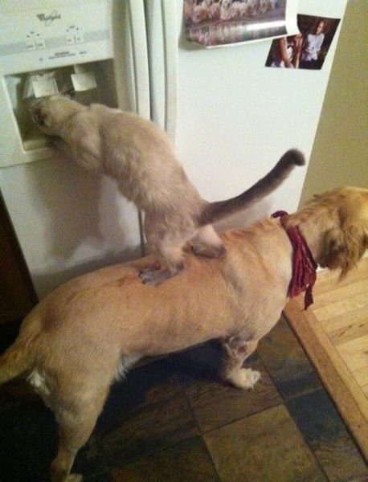
We All Need Support
Notes:
1 minute
Was teacher in DISD - better I got more students my way
KC- middle school PBS-
Chicago and other states around schoolwide behavior
Worked with other approaches academic- behavior – social/emotional

Slide 3
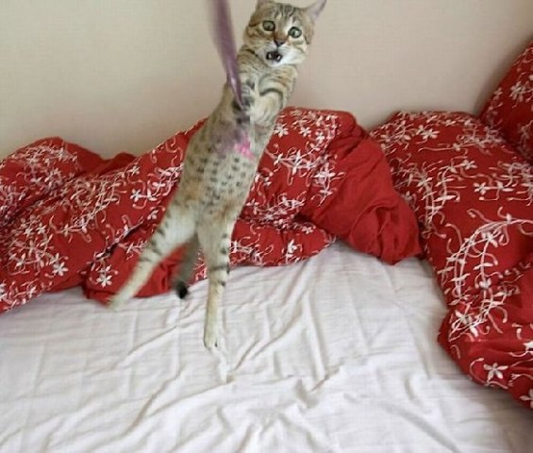
Hang in there!
Notes:
I know you had a long day! Hang in there! I hope this webinar might make life a little easier for you
From IKEA

Slide 4
Thank you!
NSSEO
Beth Mand
Katie Krafton
NSSEO Partners
Meghan Muldoon Brown
Andrea Mugler
Karina Rodriguez
Notes:
4
4

Slide 5
Wifi
Network: NSSEO-GUEST
Password: nsseo##805

Slide 6
PowerPoints: Enduring Understandings
  There are principles, processes, and procedures that make for more effective behavior support for students
  There are effective procedures for developing functional behavioral assessments
  There are effective procedures for developing behavior intervention plans
Notes:
1 min
Required by law to have a point when using PowerPoint.
Use understanding by design as a planning format
Support schools to implement effective core practices, to improve outcomes for all students.

Slide 7
Essential Question
What are the principles, processes, and procedures for more effective behavior support for students
What are effective procedures for developing functional behavioral assessments
What are the procedures for developing behavior intervention plans
Notes:
I hope by the end that you will be able to answer this question
How do you support buy-in for core behavioral practices for schools and students?

Slide 8

To Learn More (link)
Amazon Link

Slide 9
Principles, Processes, and Procedures

Slide 10

Where are you in your journey of student supports?

Slide 11

What Connections Can You Make?
See “Implementing_MTSS Brief Needs Assessment”
Based on conversations with NSSEO team members
Do you have anything in common?

Slide 12
See Carr, 2007
Why bother?
Team time: How do you know it is time to intervene?
What makes a problem a problem?
What two types of problems are there?

Slide 13
Why bother?
Team time: How do you know it is time to intervene?
  Intensity, impact, frequency
What makes a problem a problem?
  Age (developmental and chronological), impact on self and others,
What two types of problems are there?
  Internalized and externalized

Slide 14
Definitions of PBS
Positive behavior support (PBS) is a broad range of systemic and individualized strategies for achieving important social and learning outcomes while preventing problem behavior.
Turnbull, A., Edmonson, H., Griggs, P., Wickham, D., Sailor, W., Beech, S., Freeman, R., Guess, D., Lassen, S., McCart, A., Park, J., D., Turnbull, R., & Warren, J. (2002). A Blueprint for schoolwide positive behavior support: Full implementation of three components, Exceptional Children, 68 (3), pgs. 337-402.

Slide 15
History
Other punitive approaches were used
  See Guess et al.
    Electric Shock
    Spraying water in face
    Spraying ammonia in face
    Isolation
  Self-Injurious behavior (SIB)
  Self-stimulatory behavior
See Horner Discussion

Slide 16
Component of the ideal plan
What would you say would be the components of an ideal treatment plan for a student whose behavior impedes their learning of the learning of others?

Slide 17
PBS Beginnings
Lifestyle change
Function focused
Multi-component intervention
Ecological and setting events
Teaching new behaviors
Build environments
Reduce punishers
Differentiate between reaction and proactive
Social validity
Horner, R. H. & Carr, E. G. (1997).

Slide 18
What IDEA says about PBS
In the case of a child with a disability whose behavior impedes his or her learning or the learning of others, IDEA required the IEP team to “consider, if appropriate, strategies, including positive behavioral interventions, strategies, and supports to address that behavior.”
  20 U.S.C. § 1414(d) (3) (B) (I); C.F.R. § 300.346

Slide 19
General Ed Participates
Sec. 1414 (a)(5)(d)(3)(C)
The regular education teacher of the child, as a member of the IEP Team, shall, to the extent appropriate, participate in the development of the IEP...including...positive behavioral interventions and strategies ...

Slide 20
Role of School Improvement
Sec. 1413 (g)
(1) In General - Each local agency may, in accordance with paragraph (2), use funds...to...design, implement, and evaluate a school-based improvement plan...designed to improve the educational setting...

Slide 21
Coordination of Efforts
Sec. 1400 (c)(5)(C)
[Educators can coordinate]...this Act with other local, educational service agency, State, and Federal school improvement efforts in order to ensure that...children benefit from such efforts and that special education can become a service for such children rather than a place where they are sent;

Slide 22
Supports Schoolwide Efforts
Sec. 1413 (a)(2)(D) ...a local education agency may use funds received under this part for any fiscal year to carry out a schoolwide program...

Slide 23
Incidental Benefits to General Education
Sec. 1413 (a)(4)(A)
[Supports and services can be provided in]...a regular class or other education-related setting to a child with a disability in accordance with the individualized education program of the child, even if one or more nondisabled children benefit from such services.

Slide 24
Designing School-Wide Systems for Student Success
A Response to Intervention Model/MTSS
Questions
Answers
Tertiary Interventions/Tier 3:
Dig deeper – why?
Tertiary Intervention/Tier 3:
Ask questions,
Teach what works better
Cholesterol drugs
1-5%
1-5%
Secondary Interventions/Tier 2:
Can’t do/won’t do
5-10%
5-10%
Secondary Interventions/Tier 2:
Coke test analogy..
Over 50 Daily Aspirin
Universal Intervention
Tier 1:
Were we clear? Does it work?
How do we respond?
80-90%
80-90%
Universal Intervention/Tier 1:
Be clear on expectations,
make sure they work, be humane
Banning smoking in
public places*
*Greenburg & Abenavoli, 2017
Notes:
24
You may have a large copy of this in your handouts
tatoo..it is washable (just kidding)..
Example –
SW – Respect – Response Be kind – show poster ahead
Secondary – student could not write very well – even when given coke..skill deficit – then accommodate with writing prompt and remediate – teach skills
Tertiary – attention – personal greetings at the door and pre-correction was enough

Slide 25

Implementation of Schoolwide
38% More Tier 2/3 Interventions
  (Eber, Phillips, Upreti, Hyde, Lewandowski, & Rose, 2009)
50% decrease in outside school placements
6% increase in students 80% or more in general education (compared to state 3%)
  (Illinois Positive Behavior Intervention and Support Network, 2011).
Image from https://flic.kr/p/25UMFK4

Slide 26
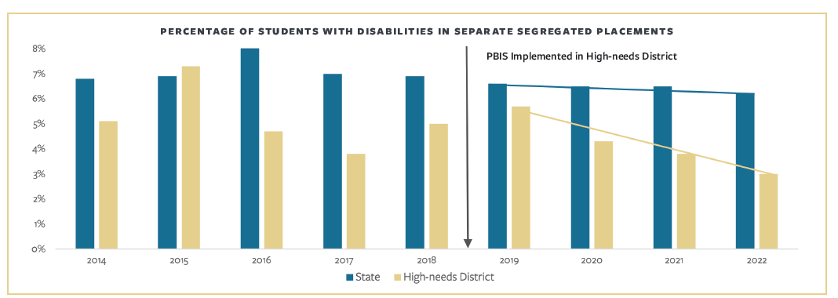
Cost Savings for PBS
Dropout Prevention
  $105 for every $1 on PBS
Out of District Placement (MA)
  $20 USD for every $1 on PBS
(May Institute, 2024)

Slide 27
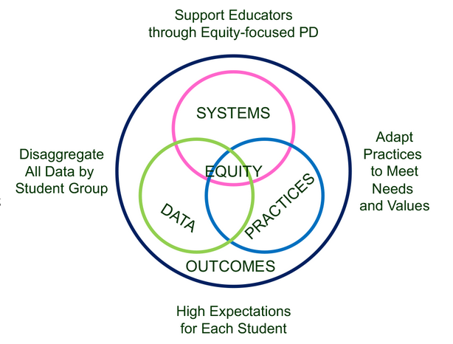
Supporting Social Competence &
Academic Achievement
4 SWPBIS
MTSS-B
Elements
From https://www.pbis.org/topics/equity

Slide 28
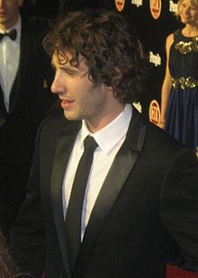


Key Elements
Systems – Josh, flight, checklist
  Administrative Commitments, Coaching (external/internal), Representative Teams, Audit of practices, Priority
Practices
  Based on evidence
Data
  Process and impact – dropout
    What and with whom?
http://en.wikipedia.org/wiki/Josh_Groban
http://www.inmagine.com/searchterms/private_jet.html
Notes:
28

Slide 29
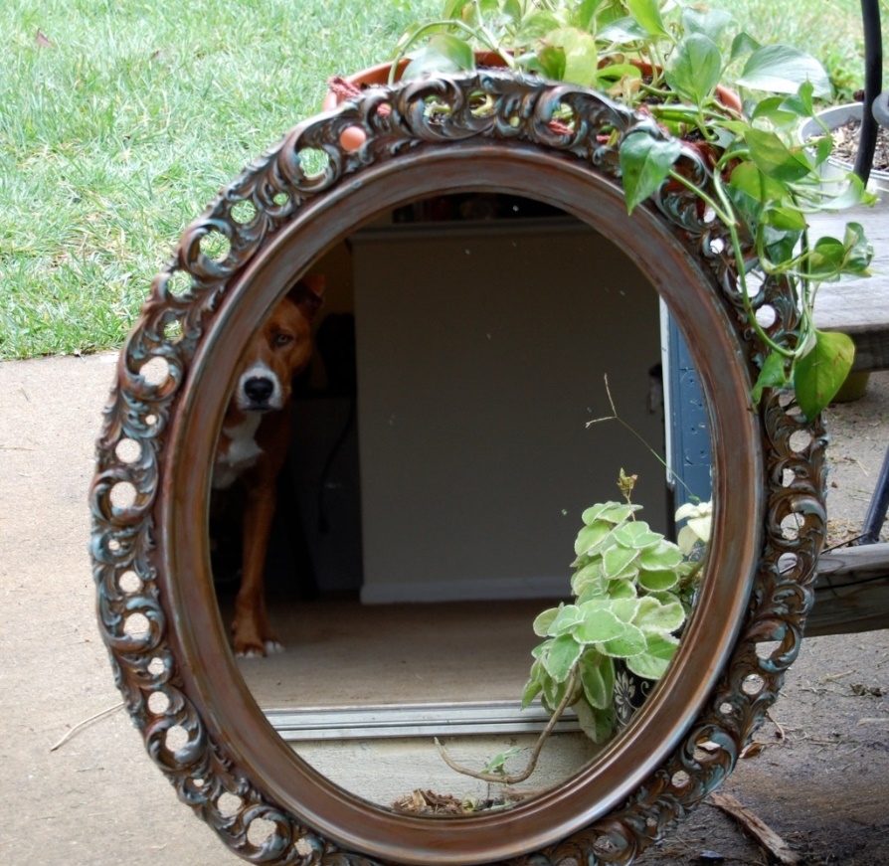
Reflection on SWPBIS/MTSS Systems, Practices, and Data
Walk around the room until the music stops
Where have you seen interventions work/not work based on the previous list?
Now, back at your table – what is one area of strength and area for improvement for your systems, practices, and data?
This Photo by Unknown Author is licensed under CC BY-SA-NC

Slide 30
What IDEA says about FBA
IDEA specifically mentions the use of Functional Behavior Assessment for students with impeding behaviors.
An FBA must be done when a change in placement is proposed as a discipline measure.
Generally on the 11th day of removal from school an FBA must be conducted

Slide 31
What is FBA
FBA is…
  a process designed to improve our understanding of impeding behavior to develop more effective, efficient, and relevant behavior support plans.
FBA is not used to:
  directly diagnose disability, establish eligibility, determine placement, determine whether a problem is caused by the disability (manifestation determination)

Slide 32
FBA Should Include
Definition of behavior (measurable and observable)
When and when not
Consequences that maintain
Hunch about behavior
Direct observation-based data
  (O’Neil, Horner, Albin, Sprague, Storey, Newton, 1997)

Slide 33
What is a BIP?
The Behavior Intervention Plan is derived from the FBA (intervention probes are OK)
A written plan for manipulating variables that predict or maintain problem behaviors
It is evaluated and revised on a frequent basis
The BIP is an appendix of the IEP
The BIP may contain a crisis plan
OK to pilot-test drive interventions

Slide 34
Additional Considerations
Disability and discipline now means
  Parent expressed concern in writing to an administrator or a teacher;
  Parent of the child has requested an evaluation of the child pursuant to Section 614(a)(1)(B); or
  Teacher or other school or LEA personnel expressed specific concerns about a pattern of behavior demonstrated to an administrator 615(k)(5)
Stay put rules are different
Evaluation must me expedited

Slide 35

MTSS (B, A, SEL) Big Ideas
Consensus & Commitment
Team-Based Leadership
Comprehensive Screening & Assessment System
Tiered Delivery System
Selection and Implementation of Evidence-Based Instruction, Interventions and Supports
Data-Based Decision Making
Collaborative Teams
From OPI Essential Elements (link)

Slide 36
Deciding the Level of Intervention

Slide 37
Tiers Two and Three
Increase intensity
  Staff
  Time
  Ratio of students-to-staff
Systematic
  Criteria for entry/exit
Quick response times
Does not require diagnosis (e.g., disability)

Slide 38
Tier-Three Process
Multi-disciplinary Team (leader, coach)
  Student focused
  Systems focused – review of process
Behavior Support Expertise
Formal Fidelity and Outcome Data Collection
Function-based Assessments
Behavior Intervention Plans
Person Center-Planning
https://www.pbis.org/pbis/tier-3

Slide 39
Functional Behavioral Assessments

Slide 40
Individual Positive Behavior Support
Remember your goals: Teach new skills,
improve quality of life, systems change,
altering the environment
Identify Behaviors
(positive and negative)
Observe Behaviors
Ask questions about the
conditions for both problem
behaviors and strengthens:
Who, What, Where,
When, Why
(Just like writing a good
paragraph!)
Gather Information/
Identify Support Team
Develop and test your
“educated guess” about
Why behaviors occur
Similar to the scientific method!
Develop Behavior
Intervention Plan
Document Review
Evaluate Plan
Continue with plan
Hank Bohanon @ Loyola University of Chicago

Slide 41
Functional Assessment
Target
Behavior
Functional assessment:
a process for gathering
information to understand
the function
(purpose/non-purposive) of
behavior in order to enable
and teach more effective
behavior alternatives
Interviews
Observations
Hypothesis

Slide 42

Why Did You Speed?
Image from https://images.app.goo.gl/csjQfX8sVBwFZozj7

Slide 43
Samples of Functions of Behavior (link)
Escape something negative
Avoid something negative
You got something (object)
Attention (good, bad, or ugly)
You were over/under stimulated
Setting events (what happened way in advance?)

Slide 44
What are you looking for?
Setting events
  Alter how a student responds to antecedents and consequences (usually a time delay)
Antecedents
  Stimuli that set the occasion for behavior and affect the probability of occurrence (e.g., trigger)
Behaviors
  Clear and measurable responses
Consequence
  The outcome the behavior produces

Slide 45
Setting Events Cont….
Medications Diagnosis
Sleep
Chronic illness
Nutrition
Arousal
Sensory Sensitivity
Personal
Factors

Slide 46
Setting Events Cont….
Preferred activities
Length of task
Modality
Choice making
Skill level
Level of activity
Behavioral
Learning
Preferences

Slide 47
Setting Events
Neighborhood
Quality of Life
Interactions/Reactions
Home Environment
Level of Curriculum
Instructional arrangements
History
Environmental
Factors

Slide 48
Is There A Classwide Need?
Brief: Classroom Management Self-Assessment (link)
More Comprehensive: Positive Behavior Support Planning Checklist And Teacher Self-Assessment (link)

Slide 49
Record Review
diagnostic & medical records
psychological information
educational assessments
social histories
developmental profiles
previous behavior programs
individual education plans
anecdotal records/incident reports/discipline summaries
Use Cumulative Folder Review

Slide 50

Types of Existing Data
Office Discipline Referral Data
GPA (8th and 9th grade)
Credits toward graduation
Attendance (80 % or > unexcused)
Failing grades (Algebra I, English I)
Statewide assessments
Existing screening data
(Burke, 2015; Heppen, O'Cummings, &
Therriault,2009; Henderson, Cassandra & Fantuzzo, 2022; McIntosh, Flannery,
Sugai, Braun, & Cochrane, 2008; McIntosh et al., 2009)
Notes:
This study examined data from the 2007/08 grade 9 cohort in four Oregon districts to find early warning indicators of students who may drop out or fail to graduate from high school on time. The study identified four indicators that provided valuable early warning signals about students who did not graduate on time, particularly about students who dropped out of high school:
• Grade 8 attendance rate below 80 percent. • Grade 9 attendance rate below 80 percent. • Grade 8 grade point average (GPA) below 2.0. • Grade 9 GPA below 2.0.
When the influence of demographic, achievement, and behavioral characteristics and differences in the schools that students attended were considered at the same time, only gender, English learner student status, and attendance and GPA in grades 8 and 9 were associated with graduation outcomes. Burke, 2015
50

Slide 51
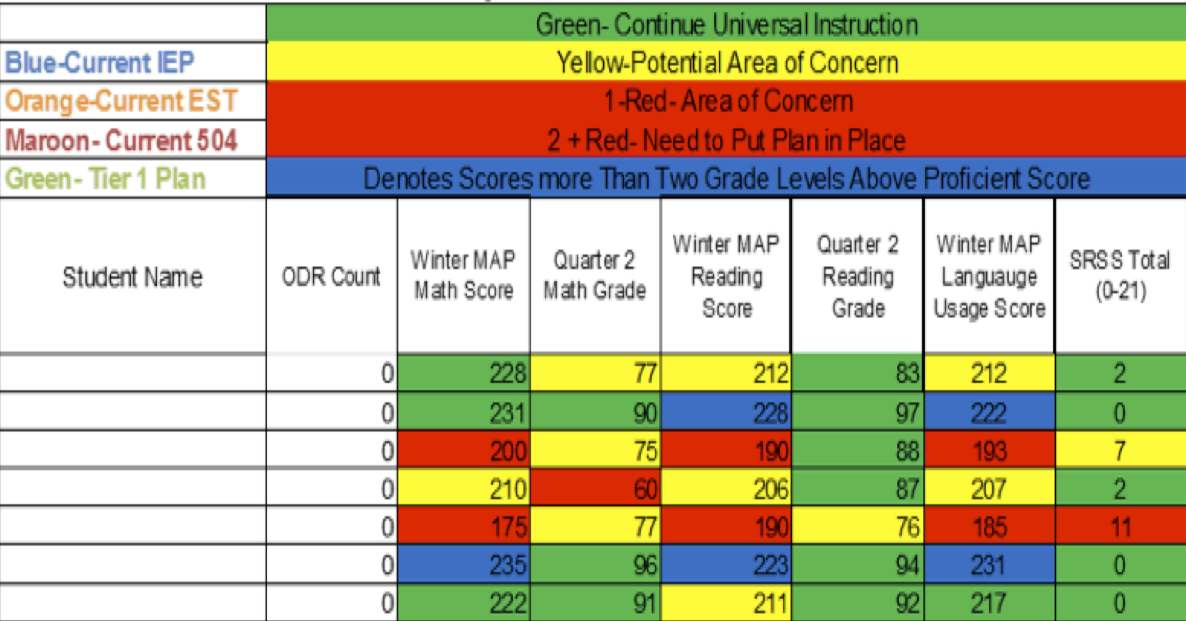
Integration of datasets
Northfield Middle School and High School, VT

Slide 52
Attendanceworks.org
Tier three – specialized support – 20% < days
Tier two – early intervention 10 – 20% of school days (2-3 per month)
Tier one – > 10% of school days (about 1 per month)
What are you doing for each level?

Slide 53

Responses
Engage students and parents
Recognize good and improved attendance
Provide personalized early outreach
Monitor data
Nudge Intervention – Sending a postcard to parents to encourage students’ attendance (Rogers et al., 2017)
https://provingground.cepr.harvard.edu/files/provingground/files/proving_ground_postcard_guide_march2020.pd f

Slide 54
Individual PBS Assessment
Interviews are key to the process
Description of environment
Student’s strengths
Description of problem behavior(s)
Assessments
Personal conditions
Problems occur when…
Problems do not occur when…
Notes:
Denise will talk about how to select a team leader and build.
If you bear with the presenter, I will first describe components three and four. I first talk about what they are, then I will talk about the process of both of them together. To separate them does not make sense, because you do them both together.
How does understanding the function of behavior help support that student?
How foreign this to general education (what are the concerns of gen. ed)

Slide 55
Checklist for Team/Teachers PTR
Functional Behavioral Assessment Checklist (See handout) – Prevent, Teach, Reinforce (link)
Functional Assessment Checklist for Teachers (FACTS) (link)
Student-Assisted Functional Assessment Interview (link)

Slide 56
Interviews
Conducted as a team, start with strengths
Who has valuable information? Who is interested in the future of this child? Use someone with a good rapport
Students may need examples or just the "big ideas"
Define "what gets you in to trouble and what does not”

Slide 57
Selecting a Target Behavior
Impact
Importance
Intensity
Individualization (e.g., age-appropriate) See slide 13 - (link) for specific rules
Concrete and measurable
Notes:
Break into groups
Watch 30 seconds of this clip (link) - what are your thoughts based on a possible target behavior?

Slide 58
PTR Summary/Goal Setting Forms
Not just stopping behavior but replacing
Identify broad goals for the students
Develop short-term goals
Increase and decrease
Identify and operationalize target behaviors
Behaviorally, Socially, Academically
As a group, develop board and specific goals based on the video (link)

Slide 59
Direct Observation
Antecedent – Behavior – Consequence
Frequency
Rate
Duration
Latency
Intensity
Permanent Products
Direct Behavior Rating Scales
See examples https://iris.peabody.vanderbilt.edu/module/fba/cresource/q2/p07/#content

Slide 60
Time Sampling
Watch this short example of time sampling using partial interval recording (link)
Practice partial interval recording for three minutes using the student from our video clip (link), using this data collection form (link). Calculate % of intervals using the form provided.

Slide 61
Behavior Rating Scales
Are perception based – measures intensity – not actual behavior
Can underestimate appropriate behavior
Can overestimate inappropriate behavior
Can be efficient for classroom teachers
Problems for high or low frequency behaviors
Efficient and effective for teachers
  Perception is important

Slide 62
Direct Behavior Rating Scales
Direct Behavior Rating (DBR) (link)
  Baseline
  Progress monitoring
  Self-monitoring
Three key behaviors
Self-selected target behaviors
Visual and written versions
Video overview (link)

Slide 63
Behavior Rating Scale PTR (see handout)
Baseline and progress monitor
Visual representation
Define target behavior
    specific, objective, descriptive
Measurement
  frequency, time (e.g., duration, latency), intensity
Develop anchor points both + and –

Slide 65
Developing Hypothesis PTR
Includes functions (i.e., escape/avoid, get/obtain, sensory)
Includes setting events, antecedents, behavior, consequence
When = Setting Events and Antecedents (e.g., trigger, presented with non-preferred task
Then = Behavior (be specific, measurable)
As a Result = Consequence

Slide 66
Example
Behavior | When | Then | As a Result
Problem Behavior – Shouting Out | When Emma is required to complete independent math seat work | Shout out things not related to math | As a result, she can delay the task and also get teacher attention
Pro-social behavior –Asking for help | When Emma is in a preferred class (e.g., app development) | Then she will ask for help appropriately (raise hand, ask politely, on task request), volume level is appropriate | Receives positive teacher attention, and the support she needs for class

Slide 67
Questions About the Hypothesis
Practice with student in video using the PTR hypothesis form (link)
Questions:
  Is the team clear on the typical setting events, antecedents, and consequences of behavior?
  Does there appear to be a well hypothesis of the behavior?
  Does the team need more information, or can they move forward towards interventions?
Notes:
(Appendix 4.2 P. 62 – examples on PTR pages 50 & 52)

Slide 68
Behavior Intervention Plans

Slide 69
Assess What You Already Have In Place
Academic Systems
Behavioral Systems
Tertiary Interventions/Tier 3:
*Young Leaders
*National Honor Society; Eyes on the World
Secondary/Tertiary-SLC teams
Tertiary Intervention/Tier 3:
- Assessment based…Wraparound,
1-5%
1-5%
Secondary Interventions/Tier 2:
Secondary/Tertiary-SLC teams
AVID; Mentor Moms
Credit Recovery
After School Matters
ELL
Summer School/(Freshman Connection)
Gear-Up
5-10%
5-10%
Secondary Interventions/Tier 2:
- AVID, After School Matters
- ELL;Gear-up;
Summer School(freshman Connection)
- In HouseTutoring- Mentor Moms
80-90%
80-90%
Universal Intervention
Tier 1:
In-House Tutoring; Summer
School (freshman Connection),ASPIRA;_
Service Learning;
Attendance andTardies_
SLC; PARR; Freshman Seminar
Universal Intervention/Tier 1:
-PARR
Attendance and Tardy
- Small Learning Communities (SLC)
Notes:
69

Slide 70
ACTIVITY
Designing School-Wide Systems for Student Success
A Response to Intervention Model
Academic Systems
Behavioral Systems
Tertiary Interventions/Tier 3:
_______________________
_______________________
_______________________
Tertiary Intervention/Tier 3:
______________________
______________________
______________________
1-5%
1-5%
Secondary Interventions/Tier 2:
________________________
________________________
________________________
5-10%
5-10%
Secondary Interventions/Tier 2:
________________________
________________________
________________________
80-90%
80-90%
Universal Intervention
Tier 1:
__________________
__________________
__________________
Universal Intervention/Tier 1:
______________________
______________________
______________________

Slide 71
Selecting Interventions
Generalization
  when you learned to drive, why do you drive across multiple types of roads?
Maintenance
  why are you still able to say hello?

Slide 72
Interventions
Educational – teaching mediation strategies (raising hand – acceptable)
Normative - natural , classwide when possible (group stretch – example, ask friend for help)
Acceptable (asking for help, asking for a break)
Efficient – functional (taking a break – example)
Incompatible with challenging behaviors (spitting and saying no are incompatible, they cannot happen at the same time)
(Chandler & Dahlquist, 2014)

Slide 73
Use the PTR Hypothesis Table
Prevent Interventions – When data
What triggers appropriate behavior (e.g., structure)
What triggers problem behavior (e.g., identify capital letters)
Teach Interventions – Then data (see page Hypo table)
Functional equivalent – PRT (e.g., ask for break – same response class as problem)
Physically Incompatible PTR (e.g., remaining in seat with praise)
Reinforce As a result data (see page Hypo table)
What follows appropriate behavior (e.g., specific praise – Increase ratio of + to 5/1)
What follows inappropriate behavior (e.g., redirection, Discontinue Reinforcement of Problem behavior)
Notes:
See Rachel page 66 PTR

Slide 74
PTR Intervention Checklist/Action Plan
Rank the top 2-4 Interventions
Can complete as team, individual
Good way to build buy-in/social validity
Complete action plan
  at least 1 from each category

Slide 75
PTR Fidelity of Implementation
    What parts of the plan were you/the teacher able/not able to implement?
    What changes (if any) need to be made to the plan to make it work better for the student/teacher?
Adherence – what are the minimum requirements of the intervention?
Quality – how well is it being implemented?

Slide 76
Tiers Two and Three Examples
Academic
Additional course or flexible time
  Implemented within the master schedule
  Credit recovery
  IXL – Math/ELA
  Evidence-based reading programs
    Tier two: REWARDS
    Tier three: Wilson Reading System
  MTSS in Secondary Schools
Behavioral/Social and Emotional
Check in/Check out system
Behavior Education Program
Social Skills Curriculum
Class-Wide Function-related Intervention Teams
Functional Behavior Assessment/Positive Behavior Intervention
Class Pass
Breaks are Better
Person centered - RENEW

Slide 77
Implementing a Continuum

Slide 78

Reflection on Universal Design for Learning – Providing Flexible Means of Engagement
Think about the worst class you ever attended, why was it so bad/frustrating?
This Photo by Unknown Author is licensed under CC BY-NC

Slide 79
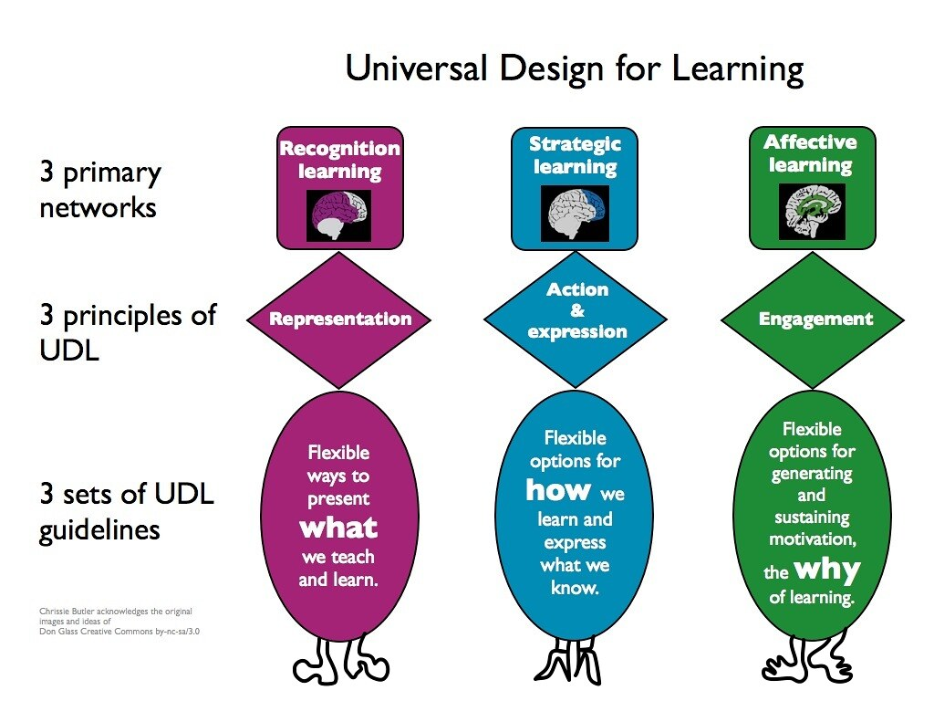
Universal Design Slide
Get from old UDL presentation
This Photo by Unknown Author is licensed under CC BY-NC

Slide 80
Why Did Someone Drive Too Fast?
Image from https://images.app.goo.gl/csjQfX8sVBwFZozj7

Slide 81
Samples of Functions of Behavior (link)
Escape something negative
Avoid something negative
You got something (object)
Attention (good, bad, or ugly)
You were over/under stimulated
Setting events (what happened way in advance?)

Slide 82
Designing School-Wide Systems for Student Success
A Response to Intervention Model/MTSS
Questions
Answers
Tertiary Interventions/Tier 3:
Dig deeper – why?
Tertiary Intervention/Tier 3:
Ask questions,
Teach what works better
Cholesterol drugs
1-5%
1-5%
Secondary Interventions/Tier 2:
Can’t do/won’t do
5-10%
5-10%
Secondary Interventions/Tier 2:
Coke test analogy..
Over 50 Daily Aspirin
Universal Intervention
Tier 1:
Were we clear? Does it work?
How do we respond?
80-90%
80-90%
Universal Intervention/Tier 1:
Be clear on expectations,
make sure they work, be humane
Banning smoking in
public places*
*Greenburg & Abenavoli, 2017
Notes:
82
You may have a large copy of this in your handouts
tatoo..it is washable (just kidding)..
Example –
SW – Respect – Response Be kind – show poster ahead
Secondary – student could not write very well – even when given coke..skill deficit – then accommodate with writing prompt and remediate – teach skills
Tertiary – attention – personal greetings at the door and pre-correction was enough

Slide 83
Targeted Supports - Have a Coke!
Can’t Do (Skill Deficit)
  Responses
  Teach skill
  Priming
  Intersperse
  Teach escape
Won’t Do (Acquisition)
  Responses
  Prompt
  2-10
  Personal greeting
  Choice/preference
See CAST: http://www.cast.org/ and SIM http://www.kucrl.org/sim/
Notes:
Make Less aversive – student with down syndrome – liked stories about dogs and bones, would read.

Slide 84
Chapter 12: Providing Structure for Learning
Tell me about your favorite class and teacher

Slide 85
Components of Effective Classroom Settings
Maximized Structure
Post, teach, model reinforce expectations
Active engagement
Varity of ways to acknowledge
  Including success!
Continuum of ways to respond
(Simonsen, Fairbanks, Briesch, Myers, & Sugai, 2008)
See MO PBIS Great 8 training
http://pbismissouri.org/educators/effective-class-practice/

Slide 86

Attendance Reflection
Think of a time when you missed an outing with friends and family – how did you feel?

Slide 87
Attendanceworks.org
Tier three – specialized support – 20% < days
Tier two – early intervention 10 – 20% of school days (2-3 per month)
Tier one – > 10% of school days (about 1 per month)
What are you doing for each level?

Slide 88
Responses
Engage students and parents
Recognize good and improved attendance
Provide personalized early outreach
Monitor data
Nudge Intervention – Sending a postcard to parents to encourage students’ attendance (Rogers et al., 2017)
https://provingground.cepr.harvard.edu/files/provingground/files/proving_ground_postcard_guide_march2020.pd f

Slide 89
Sample Response Tables
See Tables 12.3 and 12.4 to help you plan your responses – p. 23
How useful might these tools be to your class or school?

Slide 90
Be at post
Escort students
Brief interactions
(Johnson-Gros et al., 2008)
See article about hallways @
http://hankbohanon.net
on publications page
Tardy Policy Office
Notes:
90
90
Mr. Irvin – tardy policy
being at post, escorting, and interacting with students

Slide 91

Tardy Data
Who is tardy? – time of day, locations, grade levels
ODR data for hallways – non-classroom
Mall Walking– count how many students are in the fall after passing – 10 minutes in 20/20 box
This Photo by Unknown Author is licensed under CC BY

Slide 92
Preventing Tardies
Staff posted at doors
Brief interactions with students during passing
Staff in the hallway to encourage being on time
See example (link)
(Kristian Johnson-Gros et al., 2008)

Slide 93
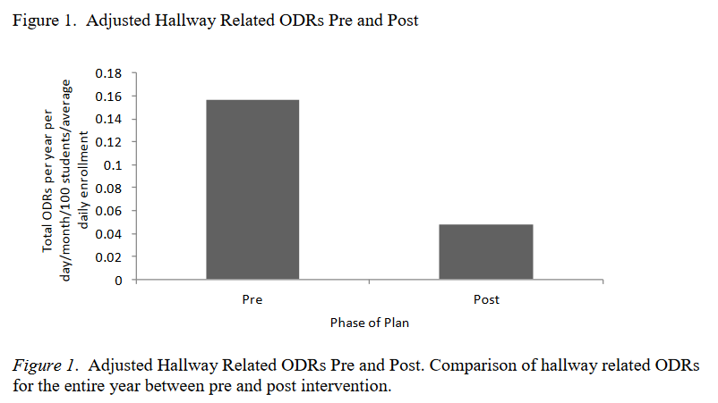
High School Example
(Bohanon, 2015)

Slide 94

Addressing Tardies
Start on Time!
Randy Sprick
http://www.safeandcivilschools.com/products/program_previews.php

Slide 95
Reflection
What data do you have, can you use these to address tardies to class?
What approaches are you taking now to tardies, how might these suggestions help you work?

Slide 96
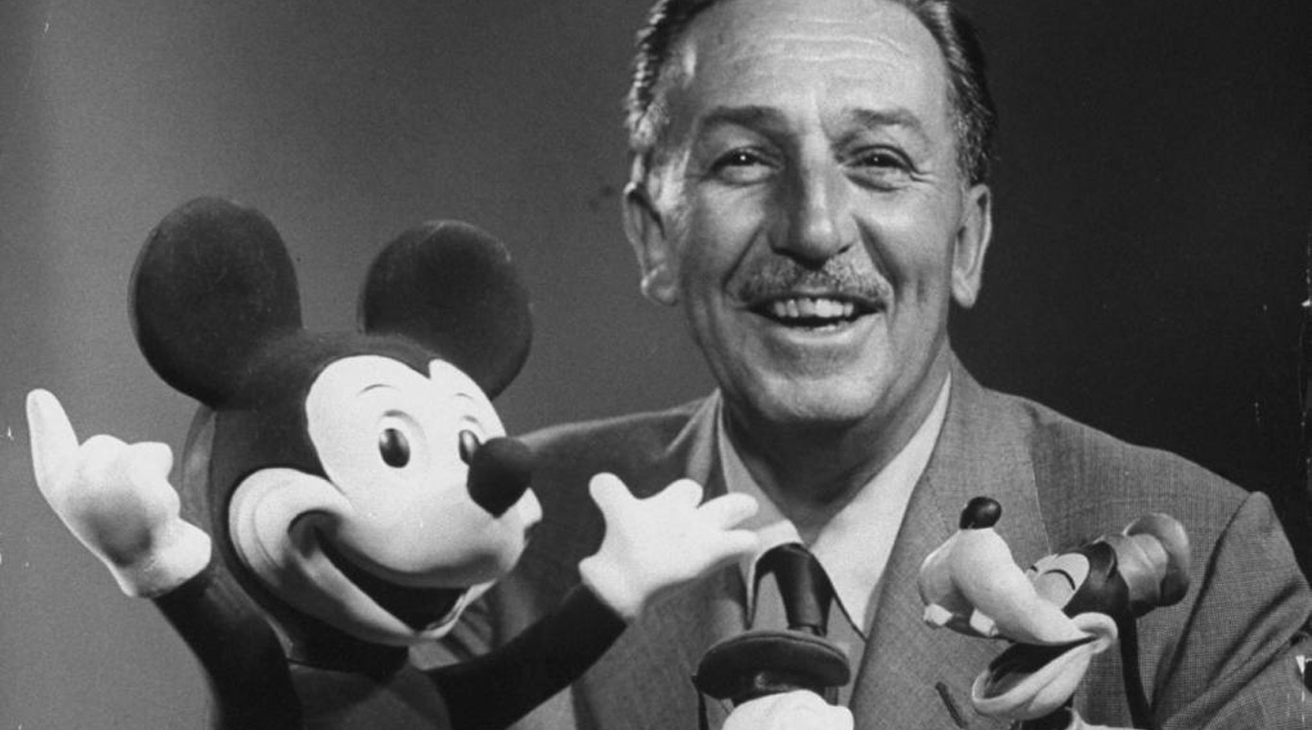
Preparing Your Syllabus
Walt Disney – “unarticulated expectations are premeditated disappointments”
This Photo by Unknown Author is licensed under CC BY-NC-ND

Slide 97
The Syllabus
Goals
Contact information
Success Traits
Rules/expectations
Activities
Grades/Status
Procedures
Entering
Tardy/Absence
Materials
Assignments (returns)
Due dates
Late, missing work
Communication
Ending class
Consequences
Model projects
Checklists
Sprick (2006)/Shinn http://markshinn.org
See examples – http://www.hankbohanon.net (Resources page under “Teaching”
Sample first days of school for high school teacher)
Notes:
Show handout, look at student expectations

Slide 98
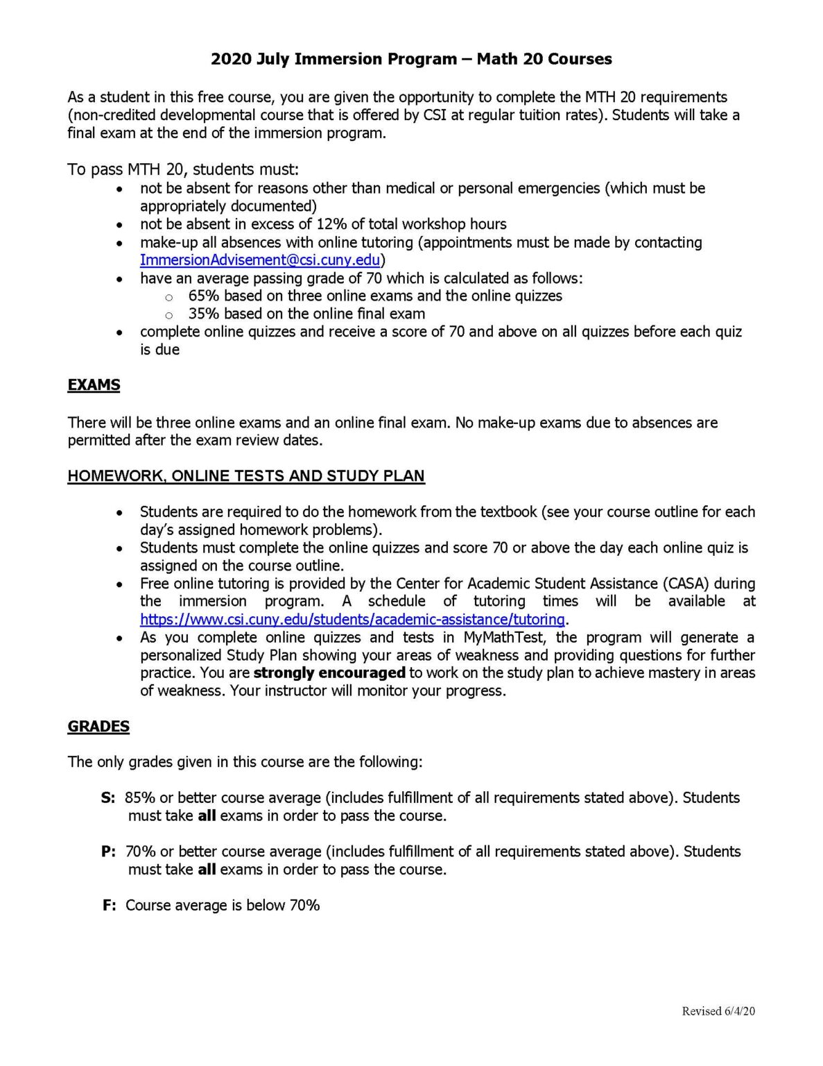
Reflection on Syllabus
What are the things you, or your teachers, repeat daily for students?
See Table 12.5 and example, p. 24 – how much agreement does your school have on these key ideas?
This Photo by Unknown Author is licensed under CC BY-SA-NC

Slide 99
Chapter 13: Defining Norms to Build Community

Slide 100
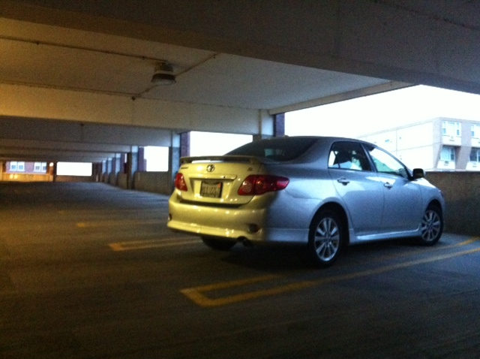
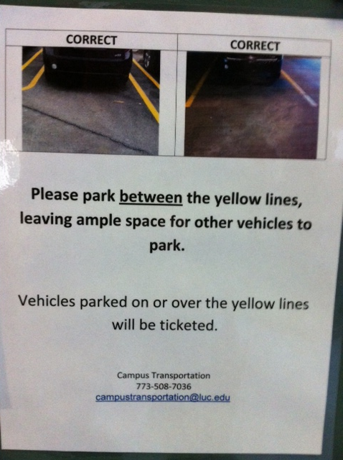
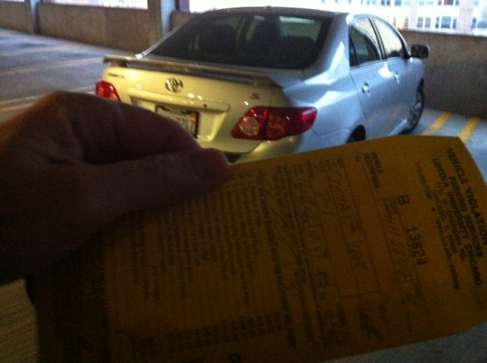
Learning through punishment - Zappos
Notes:
Working on holiday break on university related tasks
Came up and apparently my car was parked over the line and clearly I was hindering the parking of others - $40 ticket..Are you kidding me? Complained – they said this time we will let you go, but next time it will be enforced..Then..the poster…many of our students learn the rules this way – at home, they say, pass the fn sugar – they are learning a new skill.. Do not assume.. Or you will get “are you kidding me?”

Slide 101

Benefits of Teaching Expectations
Includes behavioral, social, academic skills
Fewer defiance and drug-related discipline problems (Molloy et al., 2013)
Improved development and course grades (Farrington et al.,
2012)
This Photo by Unknown Author is licensed under CC BY-NC-ND
Notes:
Can include non-academic skills such as mindsets, metacognition, and self-regulation – helps with development and course grades – see Farrington p. 184
Belonging to the community
Effort
Success is possible
Finding value in my work
Social and emotional skills – self-awareness, self-management, social awareness, relationship skills, and responsible decision making – CASEL
Self-determined – self-evaluation, set goals, problem-solve, express wants and needs – Wehmeyer p. 184

Slide 102
Teaching Expectations
Examples
Staff orientation meetings
Handbooks
Lesson plans
Videos
Examples
Syllabus
Posters
Booster sessions
Pre-correct/remind
See lesson- Blank!! Possible Example Teaching Story 1 or Pre-Teaching
Student example from football
Fruita Monument Example
Notes:
102
Say silk 3 times, then ask what do cows drink
Practice expectations with group

Slide 103

Developing Expectations
3-5
General
Positively stated
Use an acronym if possible
  Respectful, Appropriate, Determined (RAD)
Connect to school mascot if possible
Academic and whole child standards
Align with school mission and vision

Slide 104

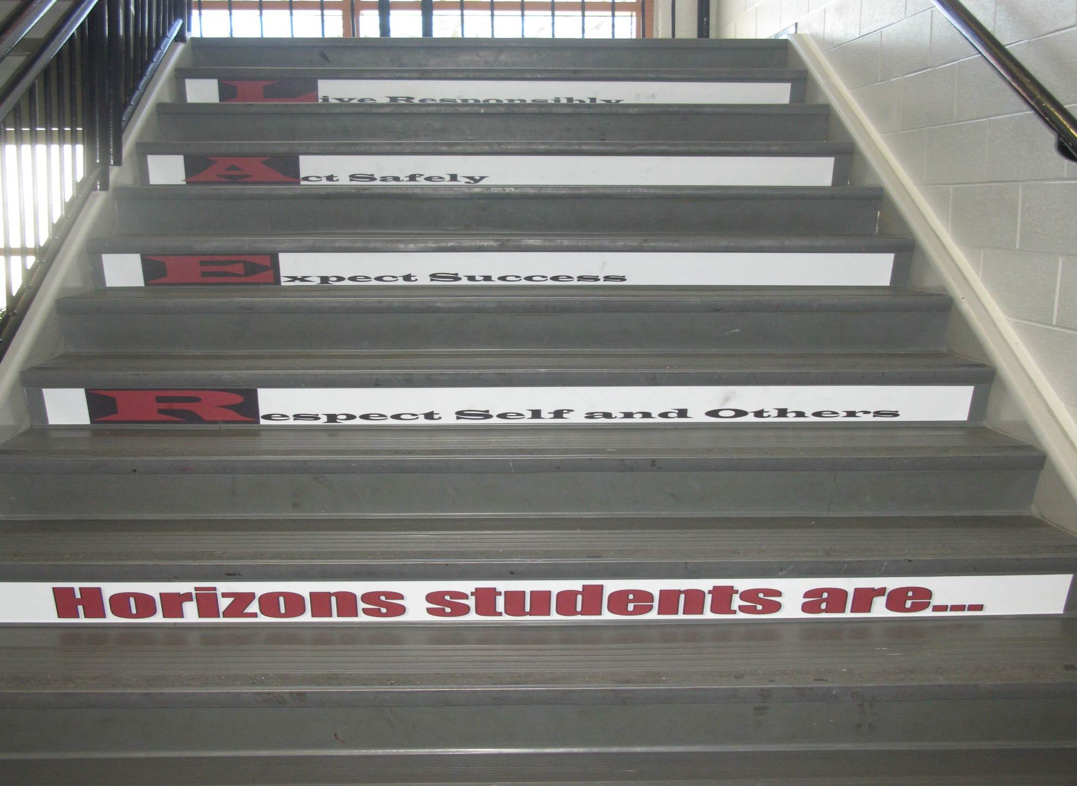
Shawnee Mission Schools, KS

Slide 105

Developing Expectations
Schoolwide Expectations Survey for Specific Settings (link)
60% = respect, responsibility, and safety (Lynass, et al., 2012)
Share expectations (link) or complete Table 13.2 in Handbook p. 33
Add next steps to action plan
This Photo by Unknown Author is licensed under CC BY-SA

Slide 106
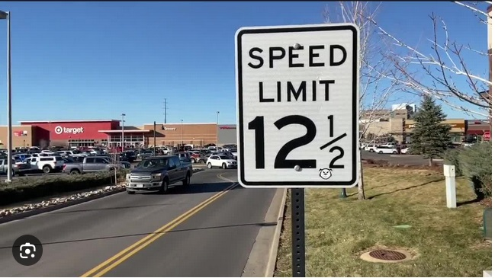
Posting Expectations
From https://www.denver7.com/traffic/driving-you-crazy/whats-driving-you-crazy-speed-limit-signs-with-fractions-really

Slide 107
Posting Big Ideas
Large font
Focus on behaviors you want to see
  "Employees must wash hands“
Keep the verbiage to a minimum
Consider height
Images and language culturally relevant
Must be taught
Add next steps to action plan

Slide 108

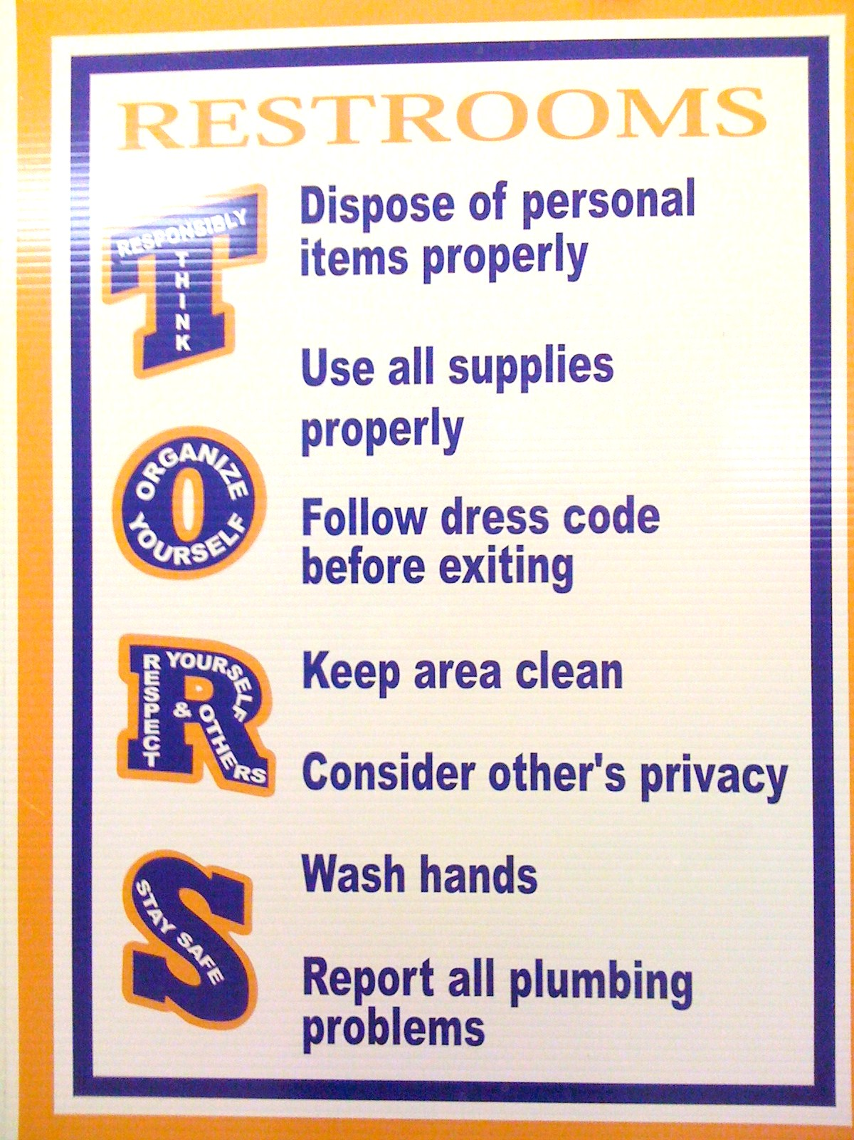
SULPHUR 9th GRADE - PBIS
Posting
CHUCK HANSEN, Principal
AMY PALMER, Teacher
SULPHUR HIGH SCHOOL, LA
Notes:
Ideas
Large font
Focus on behavior you want to see think “Employees must wash hands”
Keep the verbiage to a minimum
Consider height
Images and language culturally relevant
Content needs to be taught

Slide 109
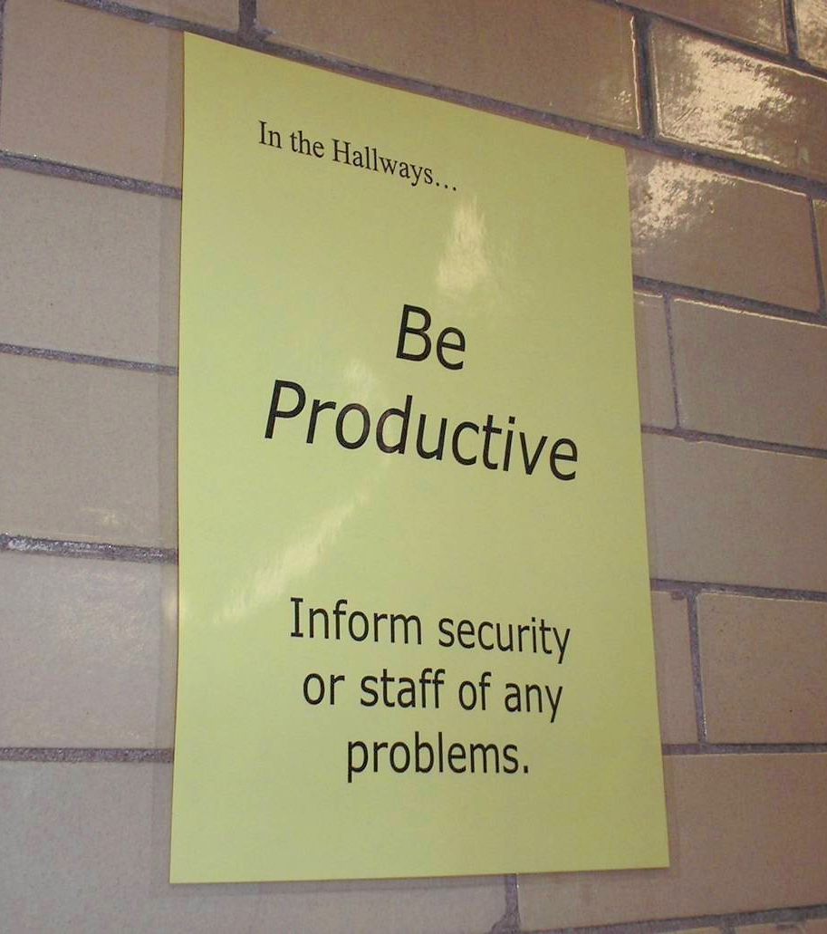
Notes:
109
Mr. Irvin
Defining expectations by location

Slide 110
Deciding What to Teach
Use your data
Select an evidence-based program
Develop an expectations matrix
  What is the problem, what you do want to see instead
Remember academic and non-academic skills (e.g., mindsets)
Align with standards

Slide 111
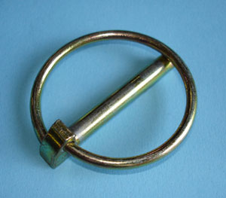
Standards and Lynchpin Skills – See P. 32
Skills
MT ELA: Comprehension and Collaboration 1.b.
How to work cooperatively with peers
How to be respectful of people from various backgrounds
Respond thoughtfully to diverse perspectives; synthesize comments, claims, and evidence made on all sides of an issue
Link to Oklahoma State Learning Standards: https://sde.ok.gov/sites/ok.gov.sde/files/documents/files/OAS-ELA-Final%20Version_0.pdf
Image from: https://commons.wikimedia.org/wiki/File:Lynch-pin.jpg
Notes:
If students engage in these skills, they are more likely to be successful in other areas

Slide 112
p. 29
How could you align your standards?
CPS Matrix Aligned with Common Core Standards – See http://www.hankbohanon.net
Notes:
See standards lists or reference in handout
Use your data
Select an evidence-based program – See CASEL
Develop an expectations matrix
What is the problem, what you do want to see instead
Remember academic and non-academic skills (e.g., mindsets)
See PBIS.org schoolwide matrix p. 188
Align with standards – see my example – how could you align with Australian standards

Slide 113
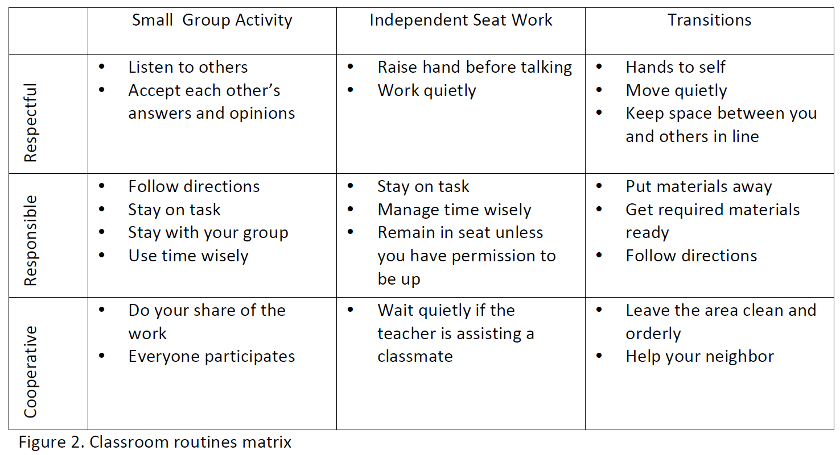
Sample Classroom Matrix
Newcomer (2009)
Which of these behaviors would you like to address?

Slide 114
Developing Expectations
Schoolwide Expectations Survey for Specific Settings (link)
60% = respect, responsibility, and safety (Lynass, et al., 2012)
Share expectations (link) or complete Table 13.2 in Handbook, P. 29
Add next steps to action plan
This Photo by Unknown Author is licensed under CC BY-SA

Slide 115
Alignment
See the example Matrix on p. 34
Using the MT ELA Standards, align one cell of the matrix with a standard see p. 32

Slide 116
Teaching Matrix
Start a draft matrix (blank)
Review/refine your current matrix
Align your matrix with Montana ELA Comprehension and Collaboration standards
  Sample (link)
  Standards (link)
See example in handbook
Add next steps to action plan

Slide 117
Posting Expectations
From https://www.denver7.com/traffic/driving-you-crazy/whats-driving-you-crazy-speed-limit-signs-with-fractions-really

Slide 118
Posting Big Ideas
Large font
Focus on behaviors you want to see
  "Employees must wash hands“
Keep the verbiage to a minimum
Consider height
Images and language culturally relevant
Must be taught

Slide 119
SULPHUR 9th GRADE - PBIS
Posting
CHUCK HANSEN, Principal
AMY PALMER, Teacher
SULPHUR HIGH SCHOOL, LA
Notes:
Ideas
Large font
Focus on behavior you want to see think “Employees must wash hands”
Keep the verbiage to a minimum
Consider height
Images and language culturally relevant
Content needs to be taught

Slide 120
Notes:
120
Mr. Irvin
Defining expectations by location

Slide 121
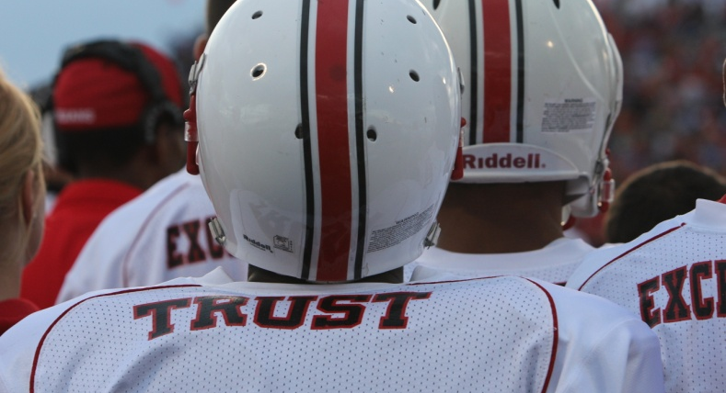
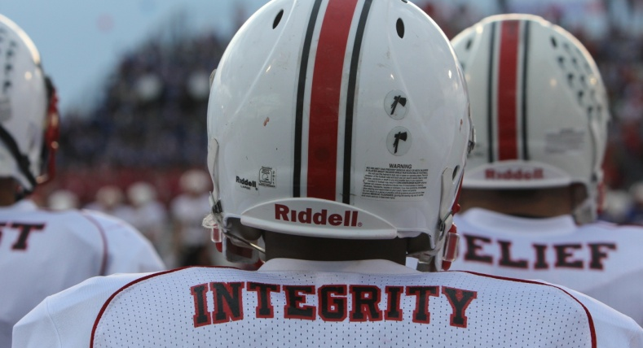
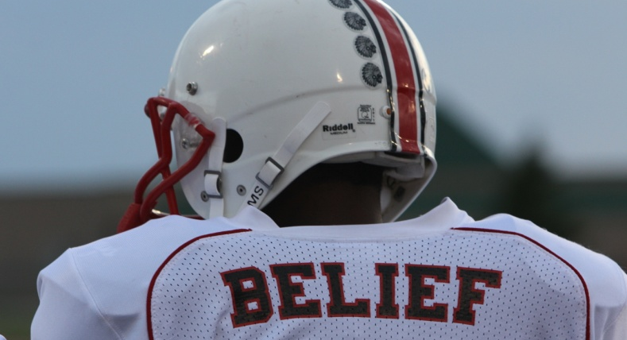
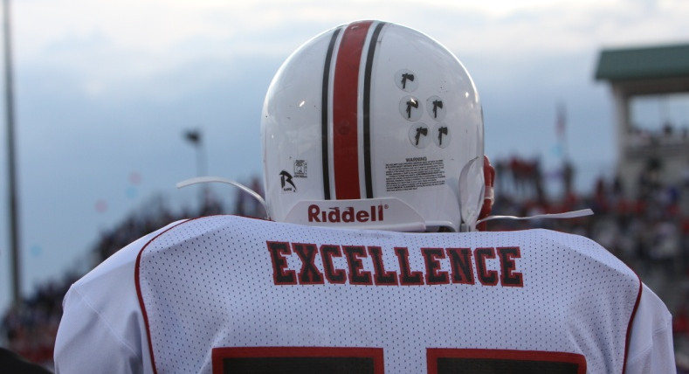
Shawnee Mission North
Football Jerseys
Notes:
Teaching expectations football?

Slide 122
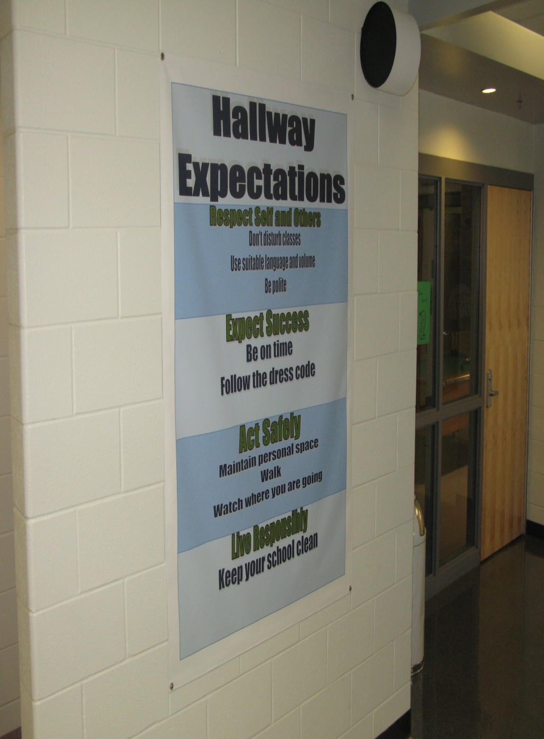
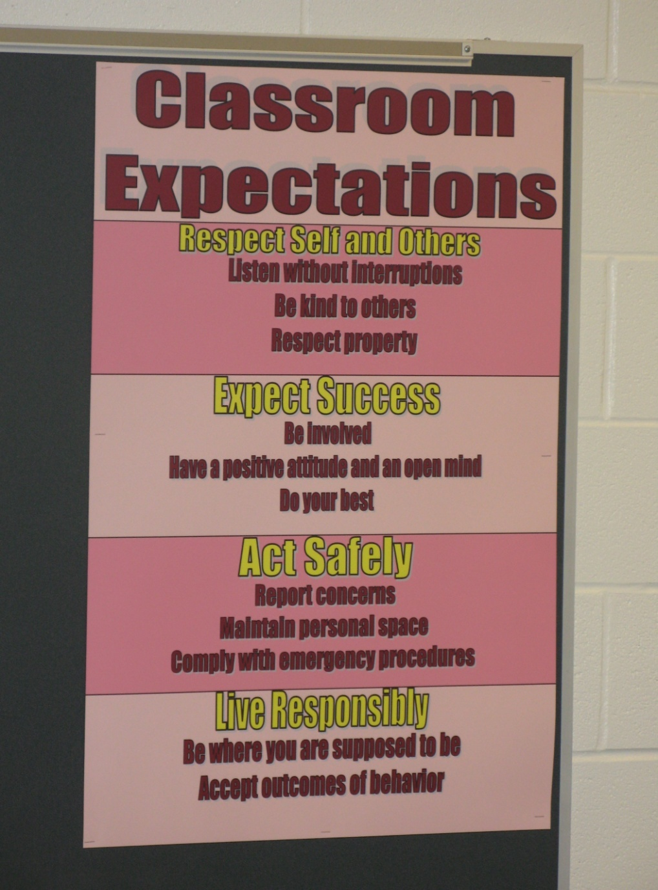
Shawnee Mission Schools, KS

Slide 123
Posting Reflection Question
What expectations do you consistently need to prompt?
How could/do visual examples help?

Slide 124

Teaching Expectations
Key Elements
Rationale
Negative examples
Positive examples
Practice/Feedback
Evaluate
This Photo by Unknown Author is licensed under CC BY

Slide 125

Prepare your staff
See the example lesson plan p. 35
High School example (at two minutes)
Elementary Example
What elements of teaching did you see?
How long does it take to teach an expectation?

Slide 126

Finding more plans
Sample Lesson plans
  https://www.pbis.org/resource/lesson-plan-to-address-behavior
  http://www.hankbohanon.net
More Video Examples
  http://vimeo.com/groups/pbisvideos

Slide 127
Develop Lesson Plan
Select one behavior from the matrix (what is bleeding the most) and draft out a plan (adapt based on data)
Choose one behavior from matrix to pilot with staff
Allow staff to choose one behavior
See my template (link) or this template (link)
Share a link to examples if possible (link)
Add next steps to action plan

Slide 128
Rhythm of Teaching
Were you ever in a class where you were only taught the skill once before the test?
Use your data
Major transitions - breaks, settings
Work completion (e.g., using a planner, study plans, prioritizing), moving towards graduation (e.g., reading transcripts, on-track), connecting to school (e.g., productive coping, getting involved, teacher allies) (Kato et al., 2018)
Year at-a-glance (link)
Add next steps to action plan

Slide 129
Acknowledgement
Cheerleading Video
Notes:
Cheerleading video

Slide 130
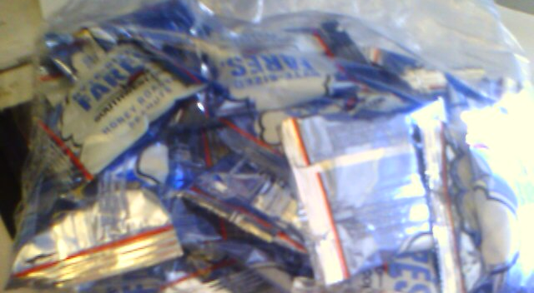
Earned this bag on SW…

Slide 131
Feedback and Acknowledgement
Daniel Wilson, Ladder of Feedback
  Clarify - ask questions to understand
  Value - what stood out as strong
  Raise Questions & Concerns - not judgments
  Suggest - build upon existing ideas
  Thank - share what you learned
Where did this go off the rails? (link)

Slide 132
Video
See examples of why this is important
  One page document “Acknowledging Students for Good Behaviors” p. 38
  Cool tool
  What are you doing around acknowledgment?
  Zappos example? See short example video 0-1:36; 2:17-2:32
Notes:
Zappos video only if time
Tell them page number -

Slide 133
High Frequency

Slide 134
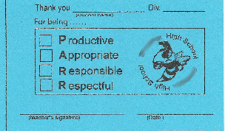
Buzzy Buck
Notes:
134
134
Brigit

Slide 135

Teacher Rewards Program
2 – Soft Drink
3 – Candy Bar
5 – Preferred Parking
8 – Free Lunch
10 – No Bus Duty
15 – No Morning or
Lunch Duty
20 – Extra Planning
Period
Tonya Ryder, Assistant Principal
Selena Gomes, Graduation Coach / Teacher
Oberlin High School, LA

Slide 136
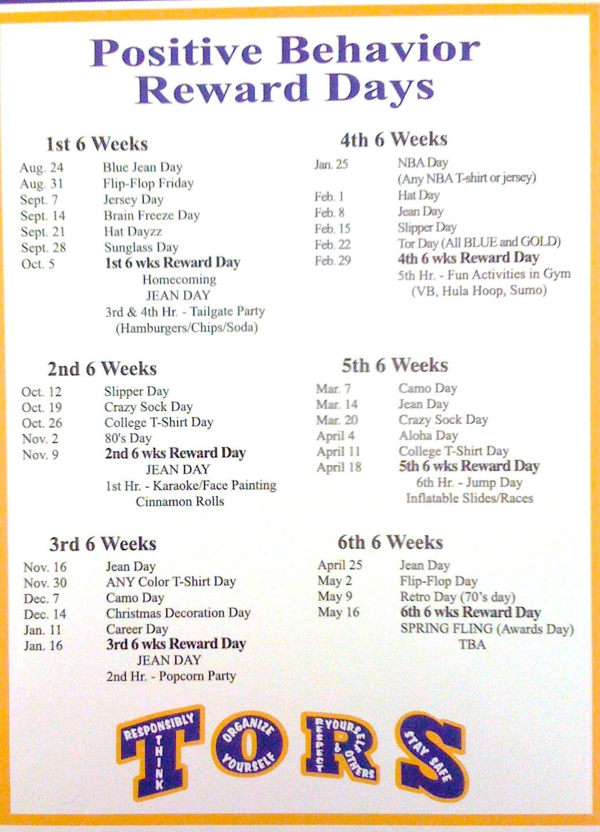
CHUCK HANSEN, Principal
AMY PALMER, Teacher
SULPHUR HIGH SCHOOL, LA

Slide 137
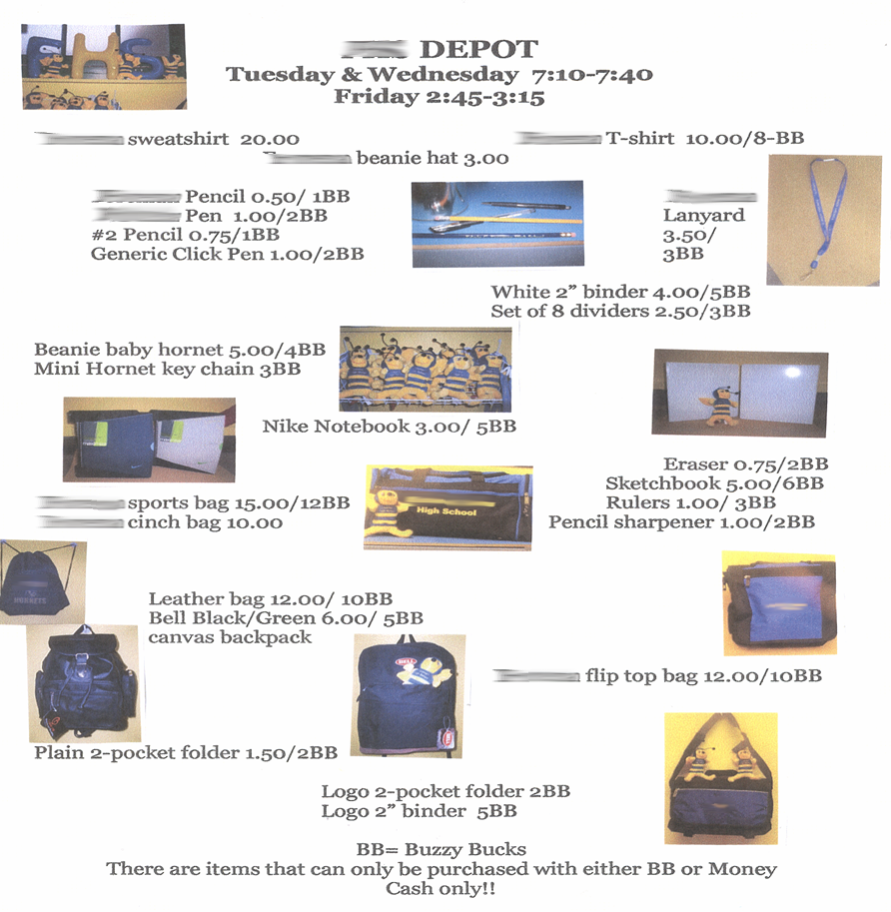
Notes:
137
137
Brigit

Slide 138
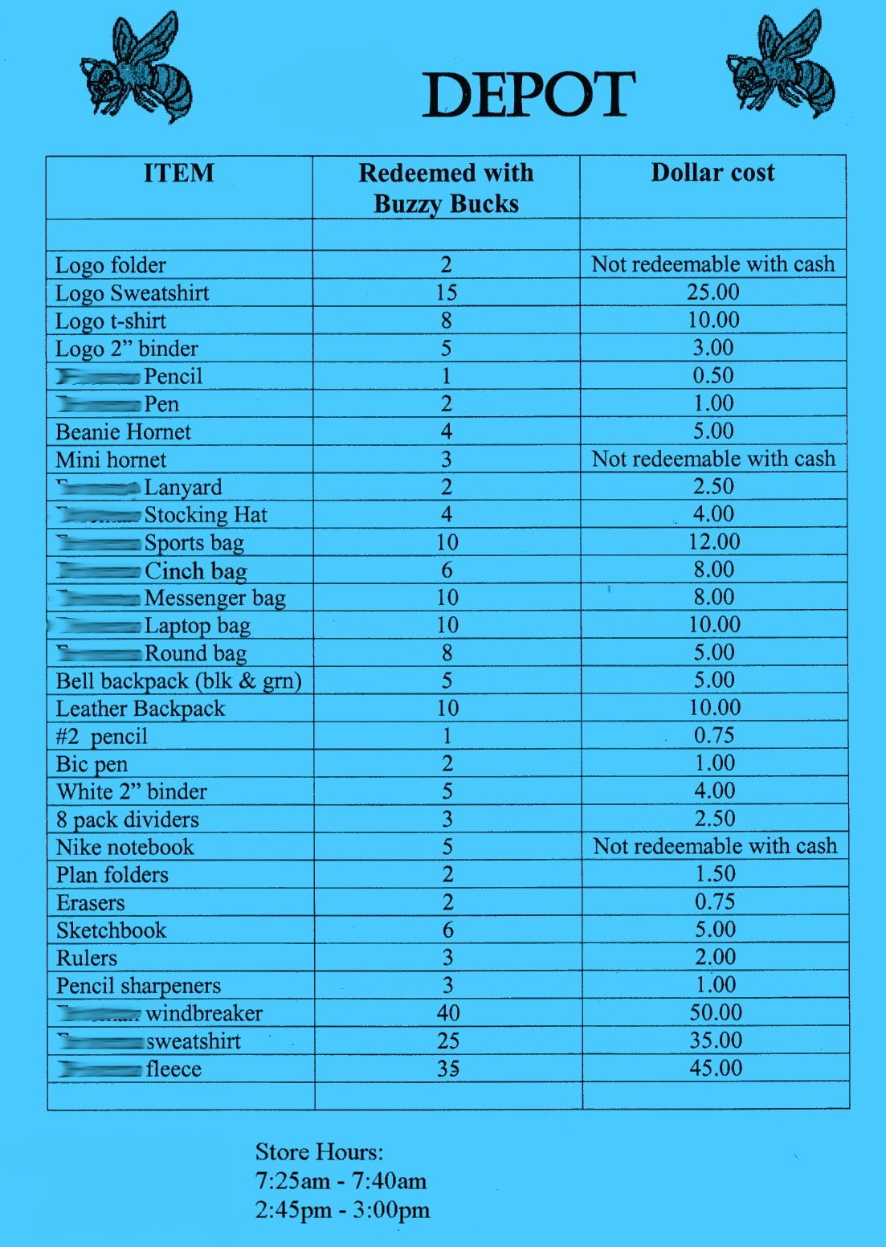
Notes:
138
138
Brigit

Slide 139
Intermediate

Slide 140
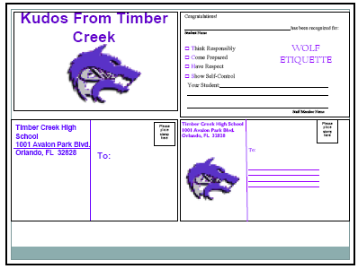
Woodridge Example (link)
Timber Creek High School, FL, JOHN WRIGHT, PRINCIPAL

Slide 141
Notes:
141
141
Brigit

Slide 142
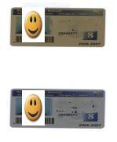
Gold and Silver ID Cards
Notes:
142
142
Brigit

Slide 143
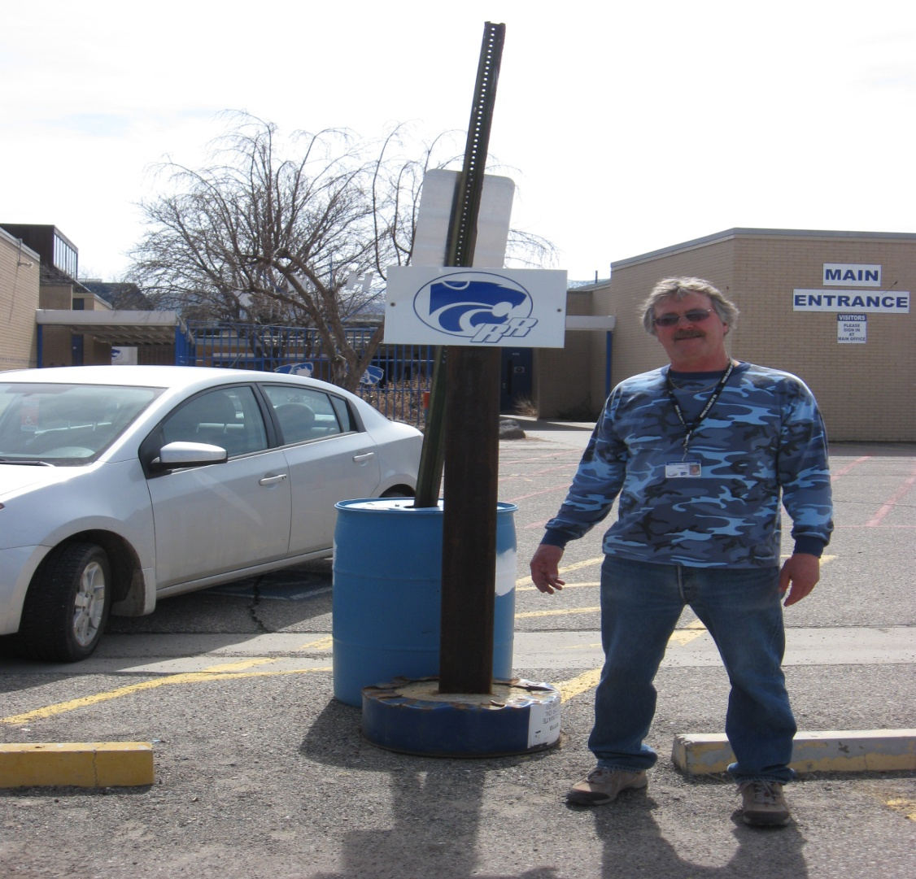
Ron our Liaison
Jody Mimmack, PhD Fruita Monument High School, CO

Slide 144
Large Scale

Slide 145
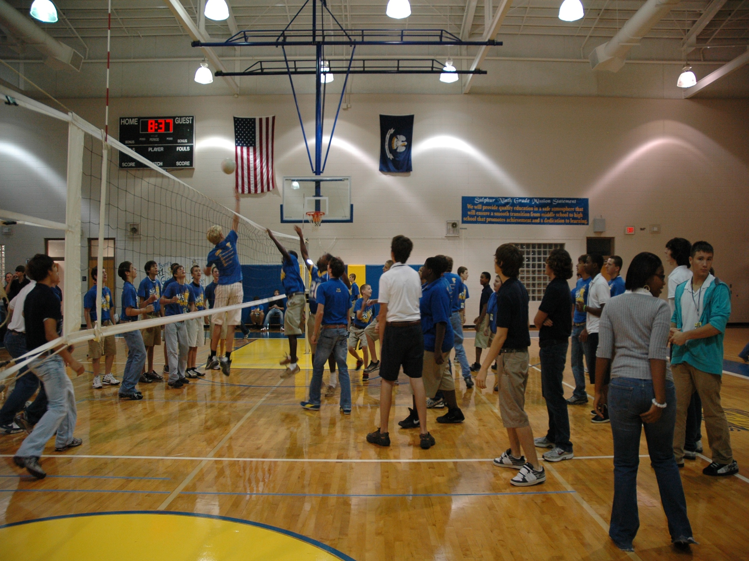
1st Six Weeks Party –
CHUCK HANSEN, Principal
AMY PALMER, Teacher
SULPHUR HIGH SCHOOL, LA

Slide 146

A Night in Paradise…
Tonya Ryder, Assistant Principal
Selena Gomes, Graduation Coach / Teacher
Oberlin High School, LA
Notes:
With these procedures in place, it became important to recognize our students’ social, academic and behavioral successes. We no longer have a traditional academic awards presentation, but instead have a school-wide academic pep rally that recognizes all of our students’ successes in various areas. This year’s theme will be “Academic Academy Awards…A Night in Paradise.”

Slide 147
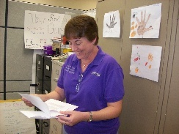
Teacher earns vacation
Timber Creek High School, FL, JOHN WRIGHT, PRINCIPAL

Slide 148
Freebies
http://www.kipbs.org/new_kipbs/familyInfo/freebies/
http://behaviordoctor.org/wp-content/uploads/2019/10/fy20freelowcostreinforcers.pdf

Slide 149

Certificate of Appreciation
Teaching Spartan of the Month
In recognition of excellence in teaching, __________ is awarded this certificate for devotion to the students, commitment to learning, and dedication to the core values of R High School.
Date
R324A070157
, Principal

Slide 150
Develop an acknowledgement plan
See sample and blank reinforcement matrix
What is one high-frequency acknowledgment that might work for you or your students or teachers?
What is one unpredictable/intermittent “BOOSTERS” acknowledgment that might work for your students or teachers?
What is an Attention-Grabbing “Celebration” acknowledgment that might work for your students or teachers? See matrix
Share examples if possible (link)
Add next steps to action plan

Slide 151
Engagement and Opportunities to Respond
Non-example – Ferris
Jeff Bliss Video Example
Notes:
Jeff Bliss Video Example

Slide 152

Quiz
What percentage of workers worldwide
consider themselves engaged at their jobs?
23 %
https://www.gallup.com/394373/indicator-employee-engagement.aspx
Photo from Flicker Creative Commons https://www.flickr.com/photos/pennwic/8142281815/in/photolist-dpvjHe-dpvjNz-dpvths-pQoPx7-aMi2SZ-8vEXtU-8vBWcM-5C6oVt-pEQiQm-97vCko-rKn1F-h7BuWg-h7ybkV-h7wXts-h7y2AF-h7y1NP-8vBVJ2-8vBW8g-8vBVL8-8vBVZr-8vEXGf-8vBWgB-8vBWdB-8vBVTe-8vBW8X-8vBW4Z-h7wVwR-h7x7bs-aMi6nD-5pYDTp-aMiarZ-aMi2xk-aMhLrn-aMhSLR-aMhUsa-aMhK7i-aMhJQz-aMhUbT-aMhJxr-aMhYfc-aMhURP-aMhTt2-aMhV48-aMhKk8-aMhKyV-aMhKRR-aMhLHT-aMhTFt-aMhTXz-aMhUEp

Slide 153


To Engage Students, Save the Cat
Why is this scene in Moana (link)?

Slide 154
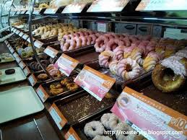
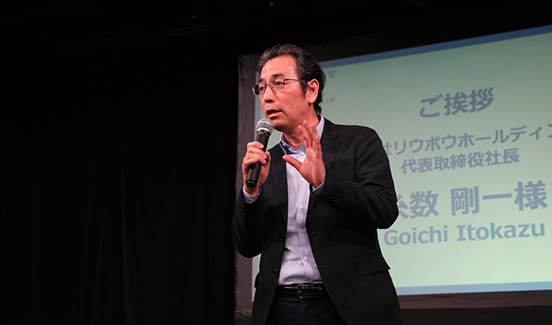
Engagement
Image from http://2015.oimf.jp/en/news/detail/104
Image from http://bit.ly/1ZIfcPF
Good merchandise alone will not appeal to the customer, it …[stores]…must attract the five senses (ANA Innovations)
  Goichi Itokazu, President of Ryubo Holdings, and former president of Family Mart
Notes:
Talk about unicycle

Slide 155


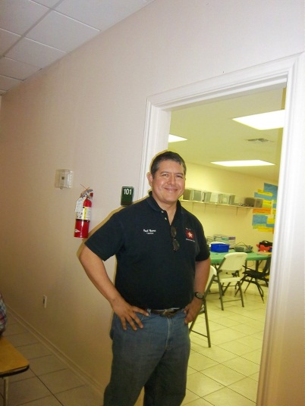
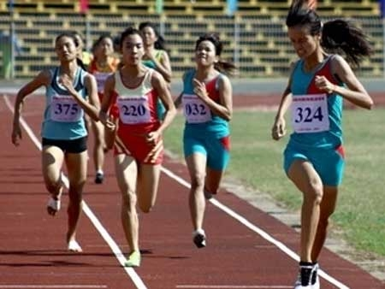

Instructional/Emotional Support
Failure rates
from 17% to 11%
  Choice of responding
  Laughing with students
  Out of desk greeting
Allen, Gregory, Mikami, Lun, Hamre, & Pinata (2013)
  Ask about events
  Ask “why”?
http://mzteachuh.blogspot.com/2012/05/that-kid-drives-me-nuts-tweets-of-day.html
http://ignitebrownsville.blogspot.com/p/picture-gallery.html
http://english.vietnamnet.vn/fms/sports/57762/hanoi-to-host-5th-asean-student-sports-games.html
http://www.phy.bris.ac.uk/news_archive1.html
http://www.hillel.org/jewish/ask-big-questions
Notes:
See Blog in handout and onwebsite

Slide 156
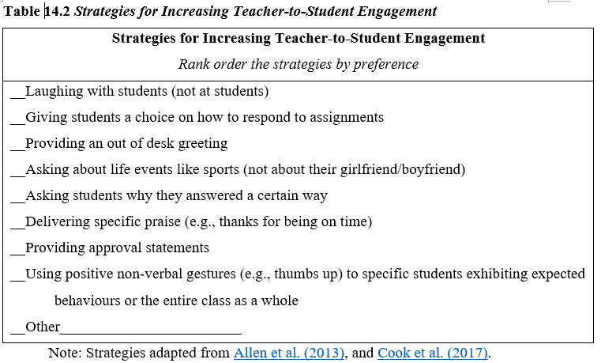
Reflective Question
See Table 14.2, Rank order the strategies by personal preference, p. 42

Slide 157
Reflection on Universal Design for Learning – Providing Flexible Means of Engagement
Think about the worst class you ever attended, why was it so bad/frustrating?
This Photo by Unknown Author is licensed under CC BY-NC

Slide 158
Universal Design Slide
Get from old UDL presentation
This Photo by Unknown Author is licensed under CC BY-NC

Slide 159
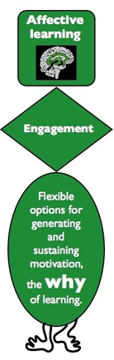
Flexible Means of Engagement
Explicit teaching, modeling, guided practice
  link
Make choices
  Content
  Who to work with
  Where to work
Explore content of interest
Using technology (e.g., Kahoot)
  See examples in Handbook page 43
Instructional Routines (The Core Six )
Notes:
Instructional routine – using EBP classroom strategy, as designed, frequently and regularly until students become familiar enough with the strategy that it becomes a habit
Reduce cognitive load for students with emotional or executive functioning challenges
The Core Six – Harey Silver’s book
Include writing processes, graphic organizers, academic vocabulary instruction, problem-solving steps, and self-monitoring

Slide 160
Instructional routines reduce cognitive load and allow students to be more independent learners
Examples
Reading for Meaning graphic organizer (Silver) - example below
Cornell style notes (Pauk)
Collaborative Strategic Reading (Klingner and Vaughn)
Claim-Evidence-Reasoning writing graphic organizer (many to choose from)
Evidence to prove | Claim | Evidence to refute
Table 1 shows that people with PhDs make an average income of $80,000 versus those with BAs make an average of $40,000 | People with more advanced degrees make more money
 | Most people work in the field the study for in college | Paragraph 5 stated that "75% of college graduates work in a different field than their BA was geared toward"
https://www.flickr.com/photos/docsearls/5500118475/in/photolist-cXMNUQ-bC1HTo-9o2xAT-9o5AEY-69MYfV-bubVYL-fu5X2f-E9aS-8DnR9y-bxgyP7-5qSgwP-dSA9Bi-5shMyD-8usn4k-5kZNd-89XiCo-2BGoqb-79hKaP-6wBTN-d7tNeN-7Sp5BB-9gfYVD-bA5evD-7i8Yvi-7WuQSP-4pTi29-cFS2Bs-9bk1ib-vxLgw-CJ6Cg-8GYAwP-5y9gAy-9PykmB-s4Zdf-gtS4jP-5gF5YM-6wBUr-57aEQb-6ALHfs-auR8jn-h8TtVm-3FHzm8-nTvUk-xKH84-4Vc2E6-3pSKw-5W5NMW-ma4TR-29BGFW-7Sp6Wg

Slide 161
Example for Reading for Meaning
See p. 30-31 for practice example – Also Try – “Do you need an advanced degree in ag?” (link)
Evidence to prove | Claim | Evidence to refute
Table 1 shows that people with PhDs make an average income of $80,000 versus those with BAs make an average of $40,000 | People with more advanced degrees make more money
 | Most people work in the field the study for in college | Paragraph 5 stated that "75% of college graduates work in a different field than their BA was geared toward"

Slide 162

Opportunities to Respond (OTRs)
Asking questions at a high rate
Using rapid prompting strategies (e.g., text-based, gestures, verbal)
Providing immediate feedback
Teacher-related prompts (e.g., choral responses)
Peer-related prompts (e.g., peer tutoring, pair-share)
Technology-related prompts (e.g., gamifying responses)
(Common et al., 2020

Slide 163
Student Engagement
Webinar on using data to improve student engagement http://fb.me/4vHawmKtz
Webinar for increasing student engagement through real world projects http://bit.ly/1K5ZplN
Assessing school climate webinar http://bit.ly/1IRJgBH
Online survey: student hope, engagement, belonging, and classroom management.... http://fb.me/2bX9tbQh4
Teaching algebra in middle and high school http://buff.ly/1CqNf2c

Slide 164
Example
What connections do you make with behavior and your instructional model?
Schoolwide examples https://www.youtube.com/watch?v=y0H5XsZ1gzA
See example, how is this teacher preventing problem behavior through engagement?
  See steps in handout (see video up to 2:43)
  https://www.youtube.com/watch?v=zxTuPVtayOI

Slide 165
Redirection and Active Supervision
JC Penny’s does this very well
How some moms handle the pressure video – Whitney Young

Slide 166

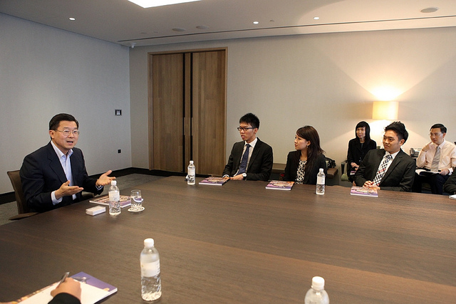
Redirection
Images from Flickr Creative Commons
If you need to correct someone, speak to the person personally – do not embarrass them in front of others. Treat the person with dignity (Ng & Foo, 2016)
  Stephen Raidy, president and CEO of the LIPPO Group
Notes:
(US $20 Billion Dollar Conglomerate and Executive Chairmen of OUE Singapore

Slide 167
Redirection and Active Supervision
JC Penny’s does this very well
How some mom’s handle the pressure video – Whitney Young

Slide 168
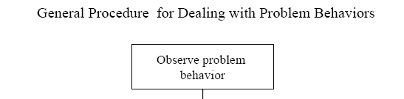
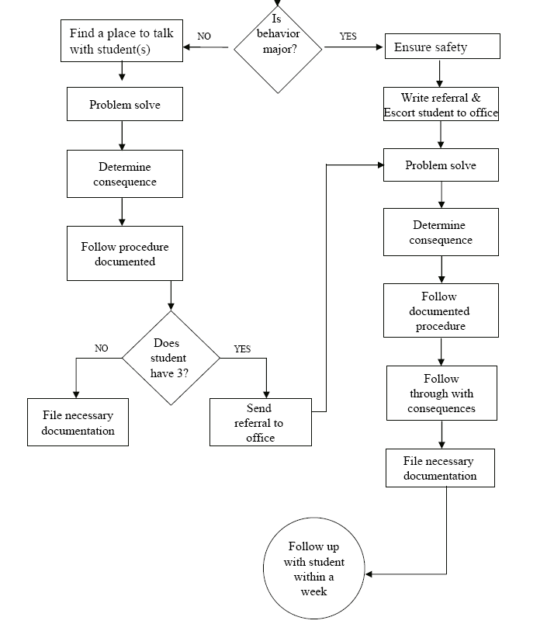
Is the behavior office- managed?

Slide 169
McClatchy Students Video, Dean?
Notes:
169
Alissa present (1 minute max)
169

Slide 170

Support Staff: Preventing and Responding
Teach skills for prevention
  Good classroom instruction
  Non-classroom settings
Teach skills for redirection
  Classroom
  Non-classroom settings
See Handout “Professional Development on Redirection” P. 44
This Photo by Unknown Author is licensed under CC BY-NC

Slide 171
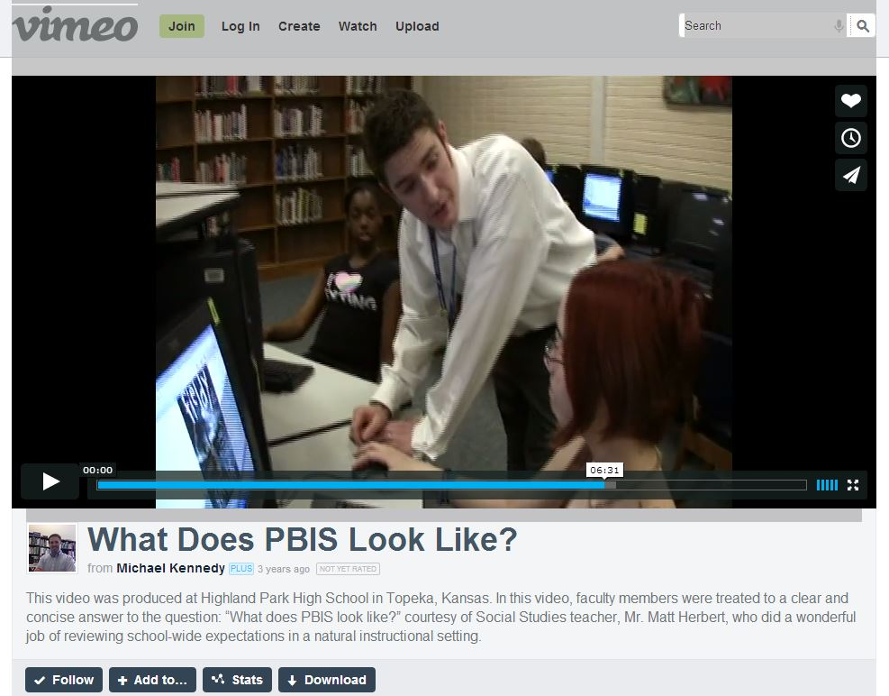
Videos
  What does PBIS Look Like? – Active Supervision and
  Redirection examples 6.12 mins
  http://vimeo.com/14818677
Notes:
Tell story from NC when your said slurs about my family - how I handled – how I did not react…

Slide 172
Reflective Question
Create a T-Chart of expectations for handling problem behavior (link) P. 46
Identify who handles behaviors in your school
List out behaviors that should be handled on each side
Review flow chart for behavior (link)
Add next steps to action plan

Slide 173
Training for Staff
Think Circuit Training (link)
How might you plan for training your staff?

Slide 174
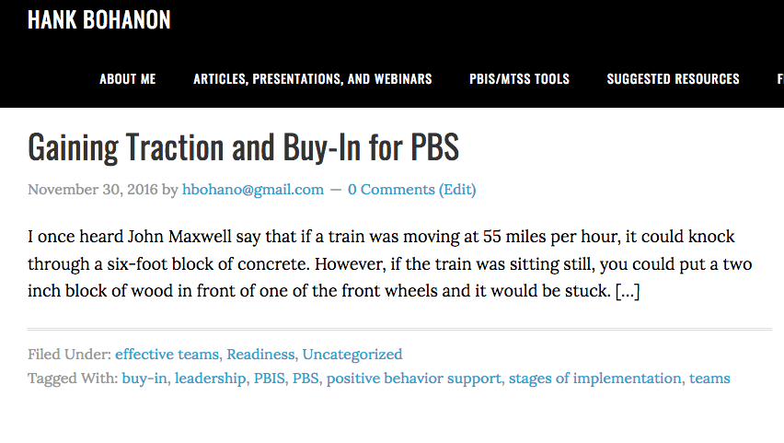
Additional Tools
Link to tools for buy-in http://www.hankbohanon.net/tag/buy-in/
Notes:
We provided some additional tools for you that specific to buy in secondary school. Just click on the link in the slide

Slide 175
Additional Reading
Developing Buy-in for Positive Behavior Support in Secondary Settings (See Example p. 21)
Case example of the implementation of schoolwide positive behavior support in a high school setting

Slide 176
What Tier-One Strategies Can Support your Students?

Slide 177
Making a Plan
See Handbook page 47
Review the tier-one checklist from MOPBIS (link)
Identify three areas of strength
Identify one area for improvement
Identify specific next steps to support your students.

Slide 178
To Learn More (link)
Amazon Link

Slide 179

Strategies
Mendler, A. N. & Mendler B. D. (2011) Power struggles: Successful techniques for teachers. Bloomington, IN: Solution Tree.

Slide 180

Classroom Management
Knoster, T. (2013). The Teacher’s pocket guide effective classroom management (2nd Ed.), Baltimore, MD: Paul H Brookes

Slide 181
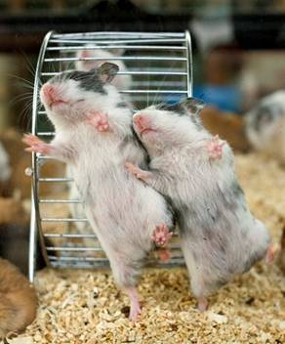
Ask Before You Tell
Less frustration
More consistency
Better use of time
Notes:
By asking before your tell..we hope you will have
Less frustration
More consistency
Better use of time
(No animals were hurt in the making of these slides)

Slide 182
References
Bohanon, H., Gilman, C., Parker, B., Amell, C., & Sortino, G. (2016). Using School Improvement and Implementation Science to Integrate Multi-Tiered Systems of Support in Secondary Schools. Australasian Journal of Special Education, 40(2), 99-116. doi:10.1017/jse.2016.8 http://ecommons.luc.edu/education_facpubs/80/
Bohanon, H., Fenning, P., Carney, K., Minnis, M., Anderson-Harris, S., Moroz, K., Kasper, B., Hicks, K., Culos, C., & Sailor, W. (2006). School-wide application of urban high school positive behavior support: A case study. Journal of Positive Behavior Interventions and Supports. 8 (3), 131-145. Link: https://bit.ly/2GZR24s
Bohanon, H. & Wu, M. (2014). Developing buy-in for positive behavior support in secondary settings. Preventing School Failure, 58 (4), 1–7. doi: 10.1080/1045988X.2013.798774 http://ecommons.luc.edu/education_facpubs/17/
Bohanon, H., Fenning, P., Hicks, K., Weber, S., Their, K., Akins. B., Morrissey, K., Briggs, A., Bartucci, G., Hoeper, L., Irvin, L., & McArdle, L. (2012). Case example of the implementation of schoolwide positive behavior support in a high school setting. Preventing School Failure, 56 (2), 92-103. http://ecommons.luc.edu/education_facpubs/7
Bohanon, H., Gilman, C., Parker, B., Amell, C., & Sortino, G. (2016 online first). Using school improvement and implementation science to integrate multi-tiered systems of support in secondary schools. Australasia Journal of Special Education. pp. 1–18. DOE: 10.1017/jse.2016.8. http://ecommons.luc.edu/ education_facpubs/80/
Blase, K. A., Fixsen, D.L., Sims, B.J., Ward, C.S. (2015). Implementation science – changing hearts, minds, behavior, and systems to improve educational outcomes. Paper presented at the Wing Institute’s Ninth Annual Summit on Evidence-Based Education, Berkeley, CA. http:// nirn.fpg.unc.edu/resources/ implementation-science-changing-hearts-minds-behavior-and-systems-to-improve
Brawley, S. (accessed March 22, 2011). PBS in the classroom. M.Ed. Heart of Missouri RPDC. http://www.cesa7.org/pbis/Classroom_Management.asp
Eber, L., Phillips, D., Upreti, G., Hyde, K., Lewandowski, H., & Rose, J. (2009). Illinois positive behavioral interventions & supports (PBIS) network 2008-09 progress report (pp. 245). La Grange Park, IL.
Illinois Positive Behavior Intervention and Support Network (2011). FY11 end of the year summary report. La Grange, IL: Illinois Positive Behavior Intervention Network.

Slide 183
References
Kotter, J. (1995). Leading change: Why transformation efforts fail. Harvard Business Review, 73(2), 59–67.
McGrath Kato, M., Flannery, B., Triplett, D., & Saeturn, S. (2018). Investing in Freshmen: Providing Preventive Support to 9th Graders. Grantee Submission
McIntosh, K., Flannery, K. B., Sugai, G., Braun, D., & Cochrane, K. L. (2008). Relationships between academics and problem behavior in the transition from middle school to high school. Journal of Positive Behavior Interventions, 10(4), 243–255. doi:10.1177/1098300708318961
Morrissey, K. L., Bohanon, H., & Fenning, P. (2010). Positive behavior support: Teaching and acknowledging behaviors in an urban high schools. Teaching Exceptional Children, 42(5), 26-35.
Scott, T. M., & Barrett, S. B. (2004). Using staff and student time engaged in disciplinary procedures to evaluate the impact of school-wide PBS. Journal of Positive Behavior Interventions, 6(1), 21-27. doi:10.1177/10983007040060010401
Vermont Agency of Education (Accessed July 28, 2016). The 13 dimensions of school climate. Vermont Agency of Education, Retrieved from: http://education.vermont.gov/documents/edu-school- climate-13%20Dimensions.pdf

Slide 184
Other Supports
IRIS Online Modules
  http://iris.peabody.vanderbilt.edu/resources.html
Rti Action Network Article Behavior and Academics
  http://www.rtinetwork.org/Learn/Behavior/ar/Integrating-Behavior-and-Academic-Supports-Within-an-RtI-Framework-General-Overview
National Center on PBIS
  http://www.pbis.org
Association of Positive Behavior Support
  http://www.apbs.org
Direct behavior rating
  http://www.directbehaviorratings.com/cms/

Slide 185
References
Chandler, L. K., & Dahlquist, C. M. (2014). Functional assessment: Strategies to prevent and remediate challenging behavior in school settings. Pearson Higher Ed.
Johnson-Gros, K. N., Lyons, E. A., & Griffin, J. R. (2008). Active supervision: An intervention to reduce high school tardiness. Education & Treatment of Children, 31(1), 39-53.
Koon, S., & Petscher, Y. (2016). Can scores on an interim high school reading assessment accurately predict low performance on college readiness exams? (REL 2016–124). Washington, DC: U.S. Department of Education, Institute of Education Sciences, National Center for Education Evaluation and Regional Assistance, Regional Educational Laboratory Southeast. Retrieved from http://ies.ed.gov/ncee/edlabs.
Kotter, J. (1995). Leading change: Why transformation efforts fail. Harvard Business Review, 73(2), 59–67.
Lynass, L., Tsai, S.-F., Richman, T. D., & Cheney, D. (2012). Social Expectations and Behavioral Indicators in School-Wide Positive Behavior Supports. Journal of Positive Behavior Interventions, 14(3), 153-161. doi:10.1177/1098300711412076
Luh, H-J, Ni, H., Chen, C., & Feng, Y. (2024). SW-PBIS in China: A case study on implementation and cultural adaptations. Presentation at 2024 Association of Positive Behavior Support International Conference, Chicago, IL.
McKeon, G. (2014). Essentialism: The disciplined pursuit of less. Crown Business
McNeely, C. A., J. M. Nonnemaker, J.M., & Blum, R. W. (2002). Promoting School Connectedness: Evidence from the National Longitudinal Study of Adolescent Health. The Journal of School Health 72(4): 138-146.
McIntosh, K., Filter, K. J., Bennett, J. L., Ryan, C., & Sugai, G. (2009). Principles of sustainable prevention: Designing scale-up of School-wide Positive Behavior Support to promote durable systems. Psychology in the schools, 47(1), n-a-n/a. doi:10.1002/pits.20448
McIntosh, K., Flannery, K. B., Sugai, G., Braun, D., & Cochrane, K. L. (2008). Relationships between academics and problem behavior in the transition from middle school to high school. Journal of Positive Behavior Interventions, 10(4), 243–255. doi:10.1177/1098300708318961
Morrissey, K. L., Bohanon, H., & Fenning, P. (2010). Positive behavior support: Teaching and acknowledging behaviors in an urban high schools. Teaching Exceptional Children, 42(5), 26-35.

Slide 186
References
National High School Center, National Center on Response to Intervention, and Center on Instruction. (2010). Tiered interventions in high schools: Using preliminary “lessons learned” to guide ongoing discussion. Washington, DC: American Institutes for Research. http://bit.ly/2r0SaeE
Newcomer, L. (2009). Universal positive behavior support for the classroom. PBIS Newsletter, 4(4). Retrieved September 24, 2009 from http://www.pbis.org/pbis_newsletter/volume_4/issue4.aspx
Ng, J. & Foo, A. (2016). Heart to heart with Asian leaders: Exclusive interviews on crisis, comebacks, and character. Singapore: World Science Publishing.
Rogers, T., Duncan, T., Wolford, T., Ternovski, J., Subramanyam, S., & Reitano, A. (2017). A randomized experiment using absenteeism information to "nudge" attendance (REL 2017– 252). Retrieved from Washington, DC: https://ies.ed.gov/ncee/edlabs/regions/midatlantic/pdf/REL_2017252.pdf
Rowan, B., Correnti, R., Miller, R. J., & Camburn, E. M. (2009). School improvement by design: Lessons from a study of comprehensive school reform programs. Consortium for Policy Research in Education. Retrieved from http://www.cpre.org/school-improvement-design-lessons-study-comprehensive-school-reform-programs
Sherif, M., Harvey, O. J., White, B. J., Hood, W. R., & Sherif, C. W. (1961). Intergroup conflict and cooperation: The Robbers Cave experiment (Vol. 10): University Book Exchange Norman, OK.
Simonsen, B., Fairbanks, S., Briesch, A., Myers, D., & Sugai, G. (2008). Evidence-based practices in classroom management: Considerations for research to practice. Education & Treatment of Children, 31(3), 351-380. doi:10.1353/etc.0.0007
Therriault, S. B., Heppen, J., O’Cummings, M., Fryer, L., & Johnson, A. (2010). Early warning system implementation guide. Retrieved from http://www.betterhighschools.org/documents/NHSCEWSImplementationGuide.pdf
Vermont Agency of Education (Accessed July 28, 2016). The 13 dimensions of school climate. Vermont Agency of Education, Retrieved from: http://education.vermont.gov/documents/edu-school- climate-13%20Dimensions.pdf

