Slide 1
Establishing Schoolwide Positive Behavior Supports in Taiwan Secondary Schools 臺灣中等學校建立全校性正向行為支持
Hank Bohanon
Loyola University of Chicago
美國羅耀拉大學芝加哥分校
hbohano@luc.edu
http://www.hankbohanon.net
Notes:
If it did not happen in high schools it did not happen, or one like ours

Slide 2
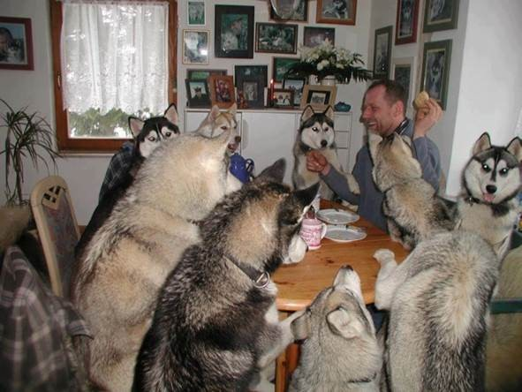
Everyone working together 大家一起合作

Slide 3
Thank you! 感謝
Taiwan K-12 Administration, Ministry of Education
臺灣教育部國教署
Taiwan Association of Positive Behavior Support
臺灣正向行為支持學會
Technology Team
資訊科技團隊
Dr. Li-Yu Hung
洪儷瑜博士
Dr. PeiFang Wu
吳佩芳博士
Dr. Pei-Yu Chen (translation)
陳佩玉博士
Dr. Chi-ching Chuang
(translation)
莊季靜博士
Translation Team
翻譯團隊
Graduate team
研究生團隊
Notes:
3
3

Slide 4
PowerPoint's
Enduring Understanding 簡報重點幫助大家了解:
Tier 1 MTSS/PBIS includes key components to guide implementation
多層級系統支持／正向行為介入與支持實施指導的要素
Taiwan secondary schools already implement strategies related to MTSS/PBIS
臺灣中學已經開始實施有關MTSS/PBIS
Taiwan schools implement MTSS/PBIS through implementation science and creating local implementation pilots
臺灣學校透過執行科學和創造在地實施前導行動實施MTSS/PBIS
翻譯加註：另一工作手冊檔

Slide 5
Essential Questions 基本問題
What are the key components of MTSS/PBIS Tier 1 in secondary schools?
MTSS/PBIS 在中學第一層級的要素有哪些？
What are strategies that secondary schools can align with MTSS/PBIS practices?
中學有哪些跟MTSS/PBIS有關的策略

Slide 6
Essential Questions 重要問題
How can Taiwan secondary schools begin to create momentum for implementing MTSS/PBIS in settings?
臺灣的中學如何在地開始或創造動能實施MTSS/PBIS

Slide 7
Introduce yourself to a colleague you don’t know. 請向一位您不認識的同事自我介紹。
Name
School or professional role
Goals for today
姓名
學校或專業角色
今天的目標

Slide 8
Who is in the room? 請問今天與會者有哪些角色？
Administrators – 行政人員
General education teachers – 普通教育老師
Special education teachers – 特殊教育老師
Psychologists – 心理師
Counselors – 輔導老師／諮商師
University – 大學代表
Regional center – 區域中心代表
Family members – 家庭成員
Other – 其他

Slide 9
Agenda
9:00–9:30 Check-in（報到）
9:30–12:00 Session 1 (Understanding MTSS/PBIS Tier 1)（第一節課程：了解多層次支持系統PBIS 第一層級）
10:15–10:30 Break（休息）
12:00–13:00 Lunch（午餐）
13:00–16:00 Session 2 (Connecting with existing school practices of Tier 1 in secondary schools)
（第二節課程：連結中學現有的第一層級實務）
14:30–14:45 Break（休息）
15:50 Check-out（簽退／結束）

Slide 10
Tier 1 MTSS/PBIS Key Components
層級一( 普及) MTSS/PBIS 關鍵要素

Slide 11

What Connections Can You Make? 你可以建立什麼關聯性?
See p. 2-5 of the handout 看講義2-5頁
Based on conversations with Taiwan and US educators 依據台灣與美國教師的對話
Do you have anything in common? 你有任何共同處?

Slide 12
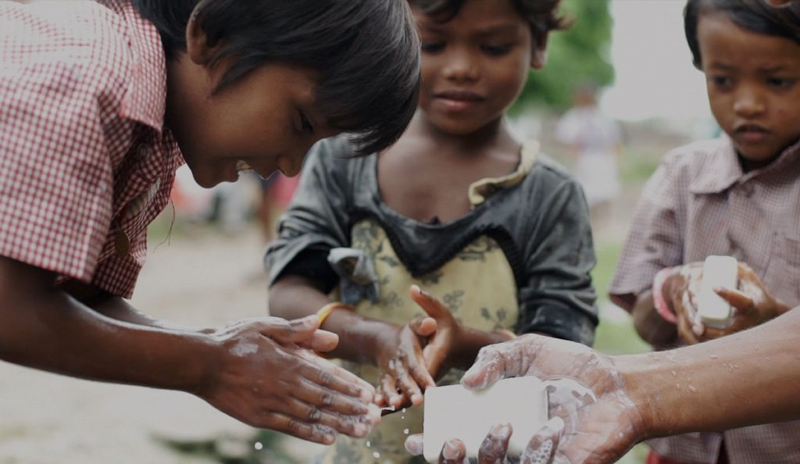
Prevention – A Simple Bar of Soap 預防—簡單的一塊肥皂
1.4 million children die each year due to preventable infectious diseases (e.g., diarrhea, pneumonia)
每年有140萬名孩童死於可預防的感染性疾病(如:腹瀉、肺炎)
Equal to AIDS, malaria, measles, meningitis, and tetanus combined
數量等同於感染愛滋病、瘧疾、麻疹、腦膜炎及破傷風的合計病例
https://usa.soapaid.org/
Image from https://usa.soapaid.org/wp-content/uploads/2018/09/boys-washing-hands-1024x594.jpg

Slide 13

MTSS Big Ideas MTSS 的主要觀點
Consensus & Commitment 共識和使命
Team-Based Leadership
Comprehensive Screening & Assessment System
Tiered Delivery System
Selection and Implementation of Evidence-Based Instruction, Interventions and Supports
Data-Based Decision Making
Collaborative Teams
團隊為本的領導
選擇與實施實證本位的教學、介入與支持
完整篩選和評估系統
資料本位的決策
層級實施計系統
協作的團隊
From OPI Essential Elements (link)

Slide 14
MTSS: 4 Dimensions of School Climate
多層級支持系統: 學校氛圍的四個面向
Safety
安全
Behavioral Expectations 行為期待
Teaching and Learning
教學與學習
Support for Learning 學習支持
Interpersonal Relationships
人際關係
Respect for Diversity 尊重多樣性
Sense of Physical Security 人身安全感
Physical Environment
物理環境
School Connectedness & Community Engagement 學校連結與社區參與
Physical Surrounding 物理環境
Student Engagement & Self-Direction 學生參與和自我導向
Social Supports for Students 學生的社會支持
Leadership 領導能力
Professional Relationships 專業關係
Sense of Social-Emotional Security 社會情緒的安全感
Health & Wellness Expectations 身心健康的期待
Social Skills Development 社會技巧建立
(Vermont Agency of Education, Accessed July 27, 2016, based
the work of the National Center of School Climate) 佛蒙特教育局,
參考自國家學校氛圍中心
Notes:
Make connections in handbook with VT
How familiar are you?

Slide 15
Activity – Handout 活動—講義
Complete checklist of domains for effective schools (p. 3)
完成第三頁—學校效能領域檢核表
Rate your current level from 1-5
將現況由1-5進行評分
What are your current strengths?
你的學校現在的優勢為何?
What are your areas for improvement?
哪些領域是需要改善的?

Slide 16
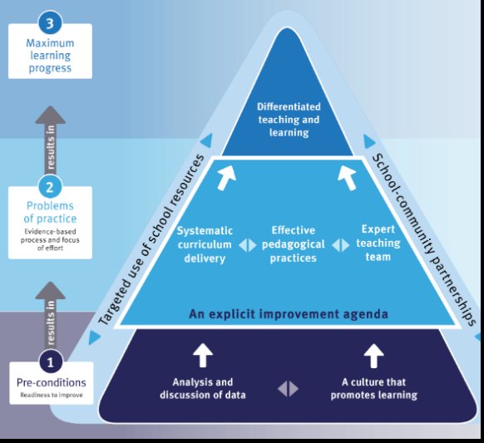
School Improvement Cycle 學校精進循環
實施進步最大化
差異化教導和學習
準備實施
系統化課程實施
有效的教學實施
專家教學團隊
實施前
分析和討論資料
促進學習的文化
p. 3 and Handout
Notes:
You also have to annual reports
Report –School Annual Report annually (link)
Must report social climate
Attendance rates
Managing non-attendance
National Assessment Program data
Retention rates
Staff attendance rates
Post-secondary outcomes

Slide 17

Napkin Test 餐巾紙的測試
Read Table 1.2, P. 8
On a napkin – write how MTSS could support your school improvement efforts
Share with someone, not at your table

Slide 18
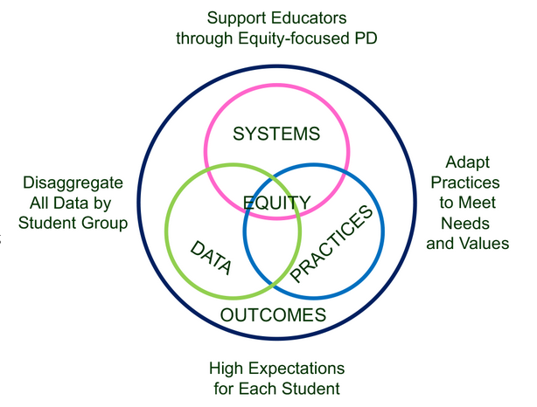
4 SWPBIS
MTSS-B
Elements
全校性正向行為支持多層級支持系統的四個要素
Supporting Social Competence &
Academic Achievement 支持社會能力與
學業成就
透過公平為中心的專業發展支持教師
系統
公平
根據不同學生團體分解所有數據
數據
實務
調整實務以符合需求與價值觀
From https://www.pbis.org/topics/equity
對每位學生設定高期待

Slide 19
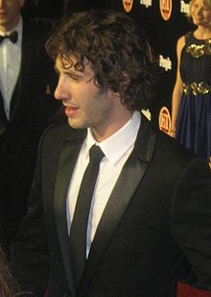


Key Elements 關鍵要素
Systems 系統 – Josh約書亞, flight 班機, checklist 檢核表
Administrative Commitments 行政承諾, Coaching培訓 (external內部/internal外部), Representative Teams代表團, Audit of practices 實務審查, Priority 優先事項, Action Plan
Practices 實務
Based on evidence 根據實證
Data 數據
Process and impact 過程與影響
– dropout 輟學
What and with whom? 是什麼以及和誰?
http://en.wikipedia.org/wiki/Josh_Groban
http://www.inmagine.com/searchterms/private_jet.html
Notes:
19

Slide 20
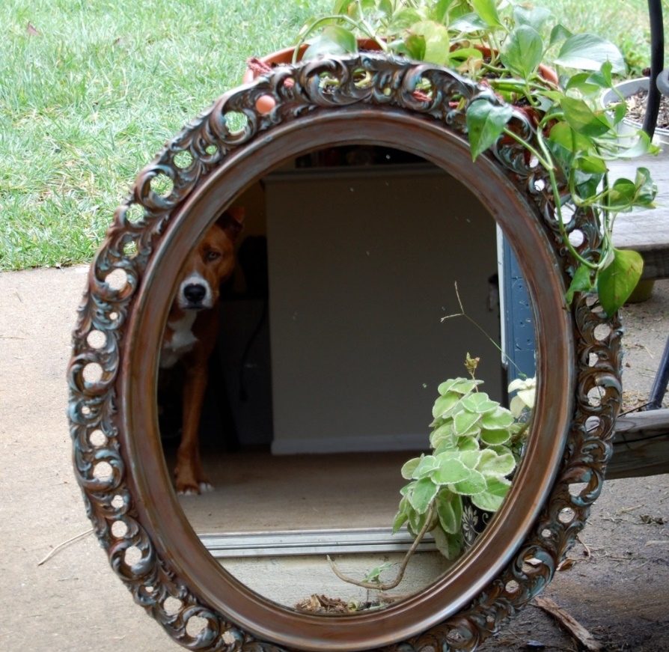
Reflection on MTSS Systems, Practices, and Data 對多層級支持系統、實務和數據的反思
Walk around the room until the music stops 在會議室裡走動直到音樂停止
Where have you seen interventions work/not work based on Table 1.2 (p. 5)?根據表 1.2，您在哪裡看到介入有效/無效?
Now, back at your table – what is one area of strength and area for improvement for your systems, practices, and data related to MTSS? (p. 6)現在，回到您的桌面上 - 與 MTSS 相關的系統、實務和數據的優勢和須改進的方向是什麼?
This Photo by Unknown Author is licensed under CC BY-SA-NC

Slide 21

Problem Solving – Where do you already use these steps?問題解決 – 您已經在哪裡使用這些步驟?
Identify 辨別
Analyze分析
Plan計畫
Implement實施/
Evaluate評估
Harms, Nantais, Tuomikoski, & Weaver, S. (2019)
From Flickr creative commons https://flic.kr/p/24UJUYy
Notes:
Einstein – if I had 25 minutes to save the world, I would spend 55 minutes identifying the problem

Slide 22
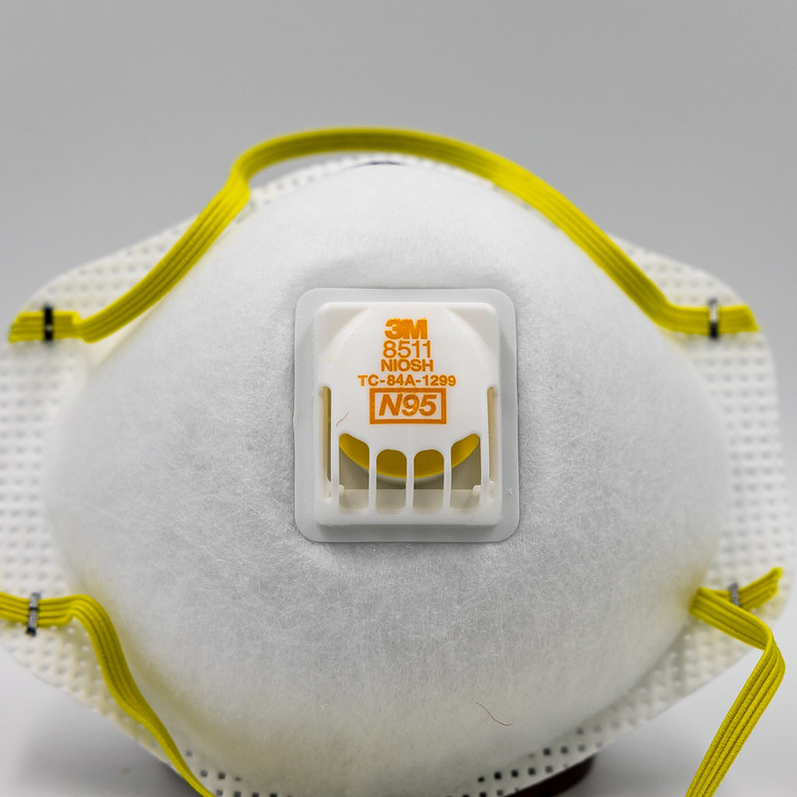
For Example舉例 – The N95 Mask N95口罩
Invented by Professor Peter Tsai from Taiwan由臺灣的Peter Tsai教授發明
Problem Solving – spread of drug resistant tuberculosis問題解決 – 耐葯結核病的傳播
Developed virus resistant mask開發抗病毒口罩
Image from https://flic.kr/p/2ijbc7P

Slide 23
Designing School-Wide Systems for Student Success 營造有助學生成功的全校性系統 A Response to Intervention Model/MTSS 介入反應模式/MTSS
Questions 問題
Answers 回答
Tertiary Interventions/Tier 3:
Dig deeper – why? 個別性第三層級預防
深入了解為什麼?
Tertiary Intervention/Tier 3個別性
第三層級預防
Ask questions, 提問
Teach what works better 教什麼較好
Cholesterol drugs 膽固醇藥物
1-5%
1-5%
Secondary Interventions/Tier 2:
Can’t do/won’t do 第二層級預防
不能做/不會做
5-10%
5-10%
Secondary Interventions/Tier 2:
Coke test analogy..第二層級預防:
用可樂測試比喻
Over 50 Daily Aspirin
每天服用超過 50 片阿斯匹靈
Universal Intervention
Tier 1: 第一層級初級預防
Teach Expectations, Encourage
Performance, Redirect with Dignity
80-90%
80-90%
Universal Intervention/Tier 1:
第一層級初級預防
Be clear on expectations, 設定
明確期待
make sure they work, be humane
確保它們有效,人性化
Banning smoking in
public places* 禁止在公共
場所吸菸
*Greenburg & Abenavoli, 2017
Notes:
23
You may have a large copy of this in your handouts
tatoo..it is washable (just kidding)..
Example –
SW – Respect – Response Be kind – show poster ahead
Secondary – student could not write very well – even when given coke..skill deficit – then accommodate with writing prompt and remediate – teach skills
Tertiary – attention – personal greetings at the door and pre-correction was enough

Slide 24
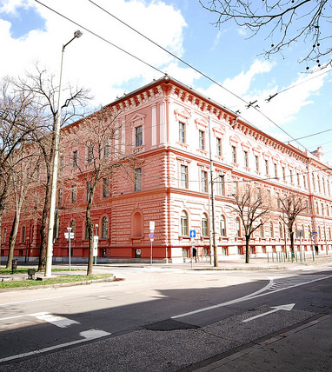
Implementation of Schoolwide 全校性實施
38% More Tier 2/3 Interventions 第2/3層級介入增加38%
(Eber, Phillips, Upreti, Hyde, Lewandowski, & Rose, 2009)
50% decrease in outside school placements校外安置減少 50%
6% increase in students 80% or more in general education (compared to state 3%)普通教育學生增加 6%, 比例上佔 80% 或更多（與州 3% 相比）
(Illinois Positive Behavior Intervention and Support Network, 2011).
Image from https://flic.kr/p/25UMFK4

Slide 25
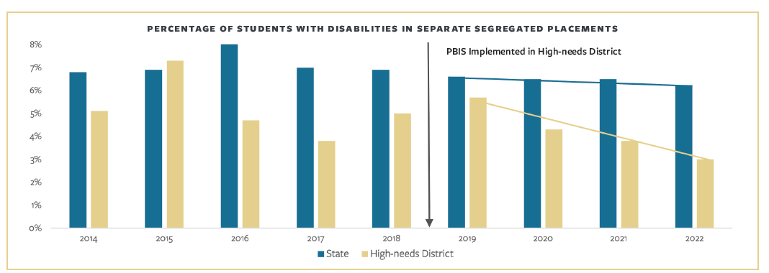
Cost Savings 節省成本
Dropout Prevention 輟學預防
$105 USD ($3394.81 TWD) for every $1 on PBIS 花在PBIS上每 1 美元 會節省105 美元（3394.81 新臺幣）
Out of District Placement (MA) 學區外安置
$20 USD ($646.63 TWD) for every $1 on PBIS 花在PBIS上每1美元節省20美元(646.63新台幣)
身心障礙學生安置於隔離環境百分比
在高需求學區實施PBIS
(May Institute, 2024)

Slide 26

Why Did Someone Drive Too Fast? 為什麼有人開得太快？
Image from https://images.app.goo.gl/csjQfX8sVBwFZozj7

Slide 27
Samples of Functions of Behavior 行為功能範例 (link連結)
Escape something negative 逃避嫌惡刺激
Avoid something negative 避免嫌惡刺激
You got something (object) 獲得物品
Attention (good, bad, or ugly) 獲得注意(好的, 壞的或醜的)
You were over/under stimulated 獲得過度/不足的刺激
Setting events (what happened way in advance?) 背景事件(事前發生了什麼?)

Slide 28


How Do You Learn – Find someone with same shoe color 你如何學習 – 找一個鞋色相同的人
Think about a sport, music, or hobby you have learned. How did your coach, teacher, or mentor support you in developing your new skill?想想你學到的運動、音樂或愛好。您的教練、老師或導師如何支持您發展新技能？
https://www.flickr.com/photos/vista/20869340/in/photolist-2QXJd-sSNdvz-qHSMQ-q7irg9-sSB3cw-GZqfj-HaZmk-GZpRw-9brTdB-58zaPt-hfzo4g-52hTeH-eKuTR-5TCiEu-ebgWqa-GT3iDk-qfDDxJ-25niJco-9QQvRe-58zcKF-xw1rp2-r148Jg-5ASAGt-58zbKB-bYG711-jcj5PP-prRUXL-tUPYs3-5ZXt9V-tEzfvd-tXaitD-eizYrm-tEFPDz-fwgTNY-tExR45-tExRrQ-bQhKm-tWMwBU-7wULm-tXaqRV-2bnvad-fD5wEL-t1hXLV-2ffsUP-eiudVT-tExeyL-tExN59-5nFeku-iGMghm-GZqCS

Slide 29
Tier One 第一層級
Focuses on Explicit Instruction 強調明確教學
Breakdown skill 分解技能
Provide rationale for skill 提供教導技能的理由
Model the skill 示範技能
Guided practice (with the instructor or peers) 引導練習(與老師或同儕)
Independent practice 獨立練習
Provide Feedback 提供回饋

Slide 30

Tier One第一層級 – Standards-Aligned Core Curriculum符合 標準的核心課程 - See p. 26
ELA Speaking and Listening: Comprehension and Collaboration: Standard
ELA 口語和聽力：理解和合作：標準
Comprehension and Collaboration | Communicate effectively and appropriately in collaborative activities for a variety of tasks, purposes, and audiences to express ideas, share knowledge, and generate new understandings. LA.12.SL.1理解與合作 |在各種任務、目的和觀眾的合作活動中有效且適當地溝通，以表達想法、分享知識並產生新的想法。LA.12.SL.1

Slide 31
Tier One第一層級 – Common Practices 常見作法
Instructional Routines 教學流程
Scaffolding instruction 鷹架式教學
Graphic organizers for writing and note-taking 組織圖用來進行寫作與筆記
Reading for Meaning 有意義的閱讀(link)
Common lesson plan formats 常用教案格式
Evidenced-based instructional strategies 實證本位的教學策略
Teaching schoolwide expectations 教導全校性期待
High Leverage Practices 高槓桿比率的實務(Opportunities to respond) 反應機會
Opportunities to respond 反應機會
Core Six

Slide 32
Instructional routines reduce cognitive load and allow students to be more independent learners
Examples
Reading for Meaning graphic organizer (Silver) - example below
Cornell style notes (Pauk)
Collaborative Strategic Reading (Klingner and Vaughn)
Claim-Evidence-Reasoning writing graphic organizer (many to choose from)
Evidence to prove | Claim | Evidence to refute
Table 1 shows that people with PhDs make an average income of $80,000 versus those with BAs make an average of $40,000 | People with more advanced degrees make more money
 | Most people work in the field the study for in college | Paragraph 5 stated that "75% of college graduates work in a different field than their BA was geared toward"
https://www.flickr.com/photos/docsearls/5500118475/in/photolist-cXMNUQ-bC1HTo-9o2xAT-9o5AEY-69MYfV-bubVYL-fu5X2f-E9aS-8DnR9y-bxgyP7-5qSgwP-dSA9Bi-5shMyD-8usn4k-5kZNd-89XiCo-2BGoqb-79hKaP-6wBTN-d7tNeN-7Sp5BB-9gfYVD-bA5evD-7i8Yvi-7WuQSP-4pTi29-cFS2Bs-9bk1ib-vxLgw-CJ6Cg-8GYAwP-5y9gAy-9PykmB-s4Zdf-gtS4jP-5gF5YM-6wBUr-57aEQb-6ALHfs-auR8jn-h8TtVm-3FHzm8-nTvUk-xKH84-4Vc2E6-3pSKw-5W5NMW-ma4TR-29BGFW-7Sp6Wg

Slide 33
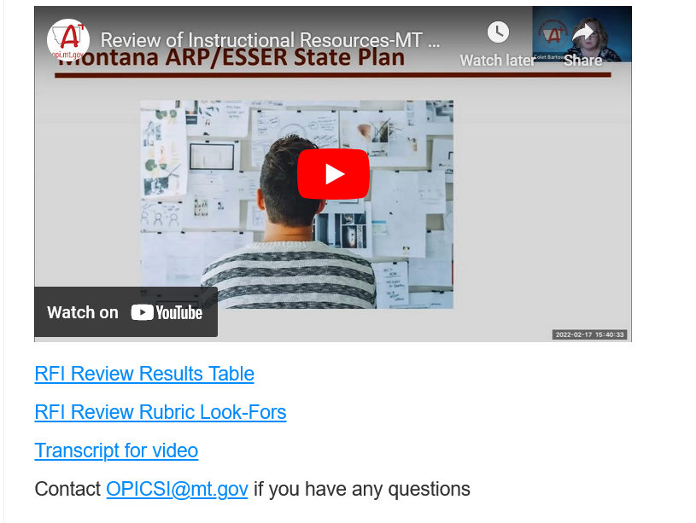
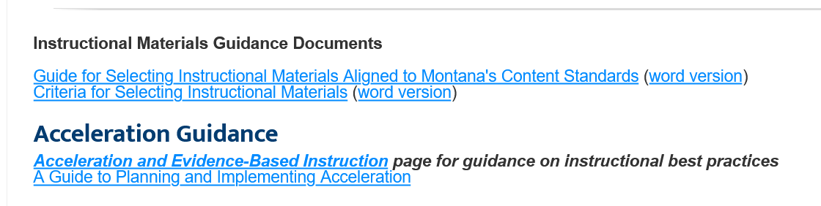
Montana – Evidence-Based Practices Selection (link)
蒙他拿州--選擇實證本位的實施

Slide 34

Connections 連結 – Interventions 介入
Review Interventions, p. 7 回顧介入
What connections do you make with your school(s) 如何連結到你的學校
Link

Slide 35

Find Someone with Same Color Shoes 找出穿同色鞋的人
What tier-one evidence-based practices do you have in your schools?你的學校有哪些第一層級實證本位的做法?
How do you prepare all staff to use these strategies? 你如何讓所有教職員為使用這些策略做好準備?
What evidence do you have that they are implemented consistently across classrooms? 你有什麼證據證明這些策略在課堂上有一致地實施?

Slide 36
Tiers Two and Three 第二與第三層級
Increase intensity 增加強度
Staff 教職員
Time時間
Ratio of students-to-staff 師生比
Systematic 系統性
Criteria for entry/exit 進出標準
Quick response times 快速反應時間
Does not require diagnosis (e.g., disability) 無須診斷(如:身心障礙)

Slide 37
Targeted Supports 有目標的支持 - Have a Coke! 喝杯可樂
Can’t Do 不能做(Skill Deficit技能缺陷)
Responses 反應
Teach skill 教導技能
Priming 促發
Intersperse 穿插
Teach escape 教導逃避
Won’t Do不會做 (Acquisition精熟)
Responses 反應
Prompt 提示
2-10
Personal greeting 個人問候
Choice/preference 選擇/偏好
See CAST: http://www.cast.org/ and SIM http://www.kucrl.org/sim/
Notes:
Make Less aversive – student with down syndrome – liked stories about dogs and bones, would read.

Slide 38
Tiers Two and Three Examples 第二和三層級範例
Academic 學業
Additional course or flexible time 額外課程或彈性時間
Implemented within the master schedule 在主要時間表內實施
Credit recovery 信用恢復
Evidence-based reading programs 實證本位的閱讀方案
Tier two第二層級: REWARDS
Tier three第三層級: Wilson Reading System
Behavioral/Social and Emotional 行為/社會情緒
Check in/Check out system 簽到簽退制
Taiwan Example 台灣範例
Behavior Education Program 行為教育方案
Social Skills Curriculum 社會技巧課程
Class-Wide Function-related Intervention Teams 教室本位的功能性介入團隊
Taiwan Example 台灣範例
Functional Behavior Assessment/Positive Behavior Intervention 功能行為評量/正向行為介入
Taiwan Example 台灣範例
Person centered/wrap around transition support 個人中心/轉銜支持

Slide 39
Connections 連結 – Interventions介入
Review Interventions 回顧介入, p. 8
Moving from tiers 1 to 2 從第一到第二層級, p. 9-13
What connections do you make with your school(s) 如何連結到你的學校?
Link

Slide 40
Secondary Schools and MTSS/PBIS
Department structure
Content experts
Complex systems
School size
Teachers’ beliefs about behavior
Time required for implementation
Student involvement
科系組織
學科專家
複雜的系統
學校大小
教師對行為的信念
中學和多層級系統的支持或正向行為介入與支持
實施需要的時間
學生參與
Citation Link

Slide 41
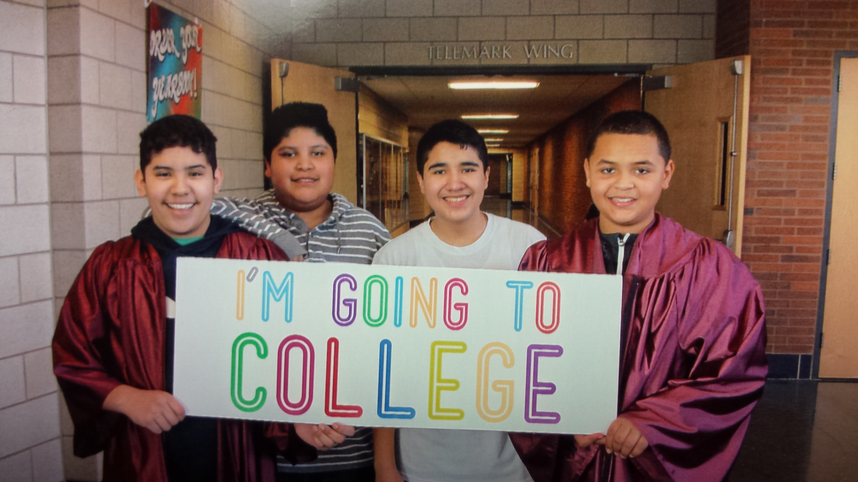
Northfield Middle/High School 中學 Tier 1 to 2 第一到第二層級 – See P. 10-14

Slide 42

Matt and MTSS – See P. 13
Universal 第一層級
Retaught expectations 重新教導期待
Targeted 第二層級
Check In/Check Out 簽到簽退
Math remediation 數學補救
Individual 第三層級
FBA/BIP 功能評量/行為介入方案
Project RENEW – Mentor/Plan 導師/計畫
Image from https://flic.kr/p/EyKKf

Slide 43
Taiwan MTSS/PBIS Connections
臺灣 MTSS/PBIS 的連結
Career Builder video 1

Slide 44
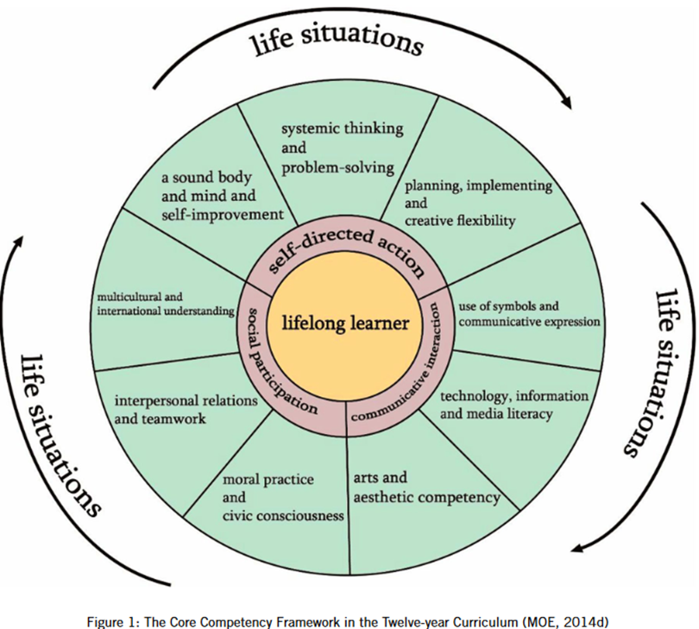
Taiwan’s Core Competencies
(Link)
生活現況
系統思考與問題解決
健全身心與自我提升
計畫,實施與創意靈活性
自我導向行動
使用符號與溝通表達
終生學習者
多元文化與國際理解
社會參與
科技, 資訊與媒體素養
溝通互動
人際互動與團隊合作
道德實務與公民意識
藝術與審美能力

Slide 45
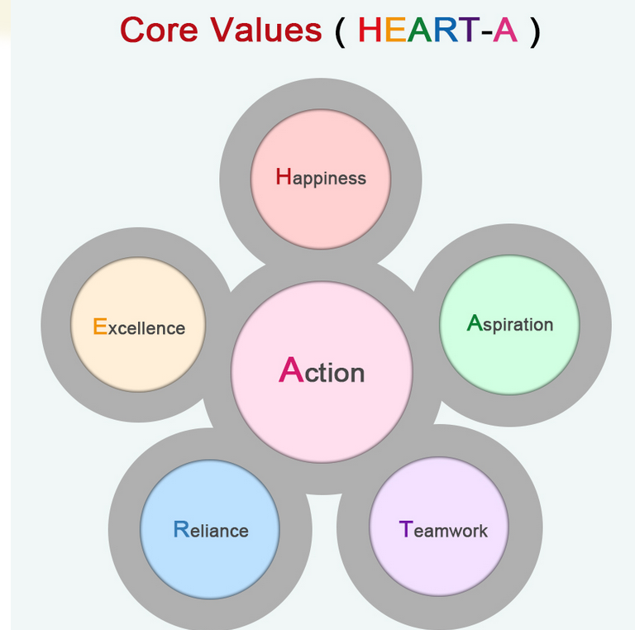
Ministry of Education Core Values 教育部的核心價值 (中文見下頁)
Happiness: Creating a happy environment.
Excellence: Nurturing excellent human resources.
Aspiration: Arousing aspiration for education.
Reliance: Earning the trust of parents, teachers and students.
Teamwork: Building a strong, solid team.
Action: Taking action with great vigor.
Taiwan K-12 Education Administration (Link)

Slide 46
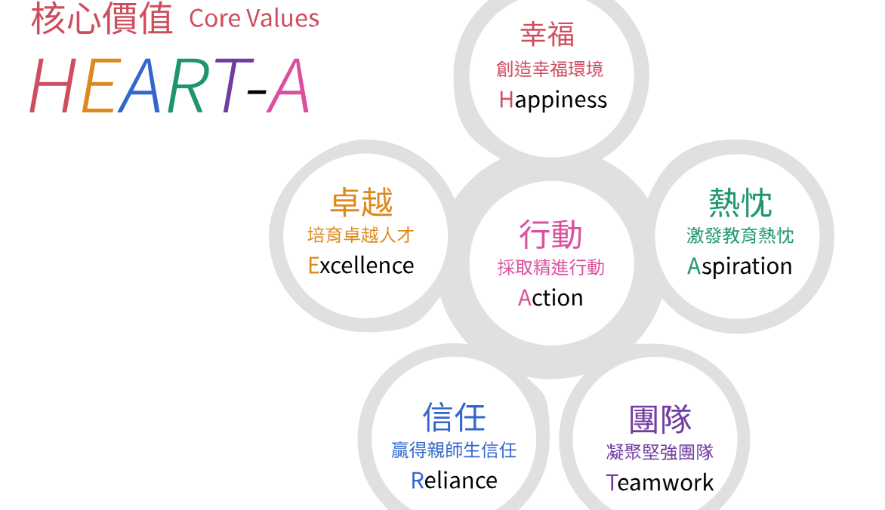
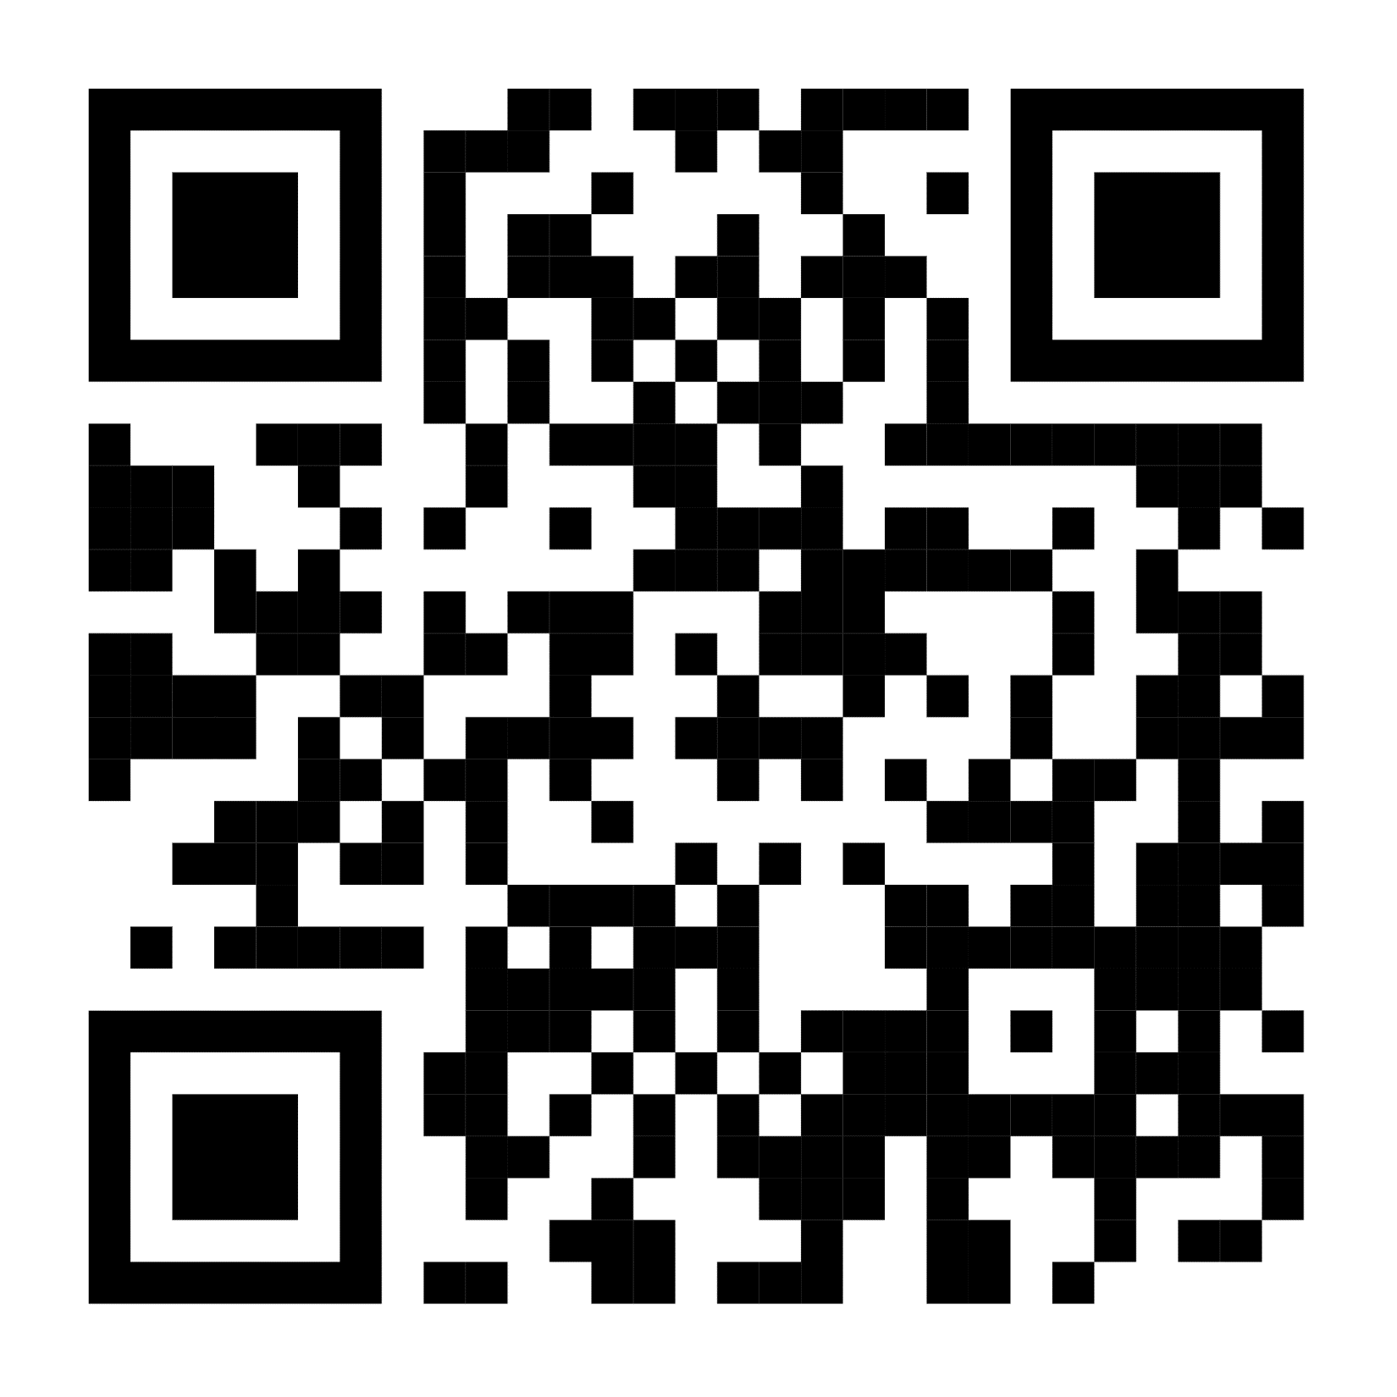
國教署提出的核心價值

Slide 47
Activity – Page 2
Happiness: Creating a happy environment.
Excellence: Nurturing excellent human resources.
Aspiration: Arousing aspiration for education.
Reliance: Earning the trust of parents, teachers and students.
Teamwork: Building a strong, solid team.
Action: Taking action with great vigor.
Rank each point on a scale from 1-5 (1 lowest, 5 highest)
Identify one area of strength, one area for improvement
Taiwan K-12 Education Administration (Link)

Slide 48
Taiwan Character and Moral Education 臺灣的品格與道德教育
Respect for Life
Filial Piety
Fraternal Duty
Benevolence and Love
Honesty and Credibility
Self-Discipline and Responsibility
Humility and Tolerance
Appreciation and Gratitude
Caring and Beneficence
Fairness and Justice
Uprightness and Self-restraint
Article 2 of the Educational Fundamental Act (link)

Slide 49
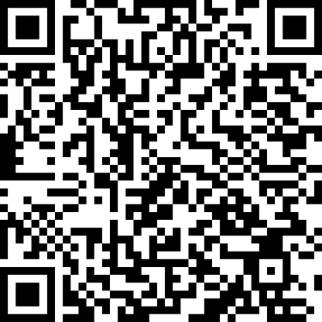
教育部品德教育促進方案
尊重生命
孝悌仁愛
誠實信用
自 律負責
謙遜包容
欣賞感恩
行善關懷
公平正義
廉潔自持

Slide 50
How Are You Teaching, Encouraging, and Providing Feedback for These Traits? Page 3 你如何教導、鼓勵和提供這些特質回饋。
Respect for Life
Filial Piety
Fraternal Duty
Benevolence and Love
Honesty and Credibility
Self-Discipline and Responsibility
Humility and Tolerance
Appreciation and Gratitude
Caring and Beneficence
Fairness and Justice
Uprightness and Self-restraint
Article 2 of the Educational Fundamental Act (link)

Slide 51
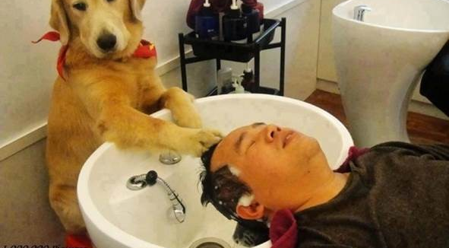
Work smarter and effective teams in school settings
聰明的工作和學校情境有效的團隊
Chapters 6 and 8

Slide 52
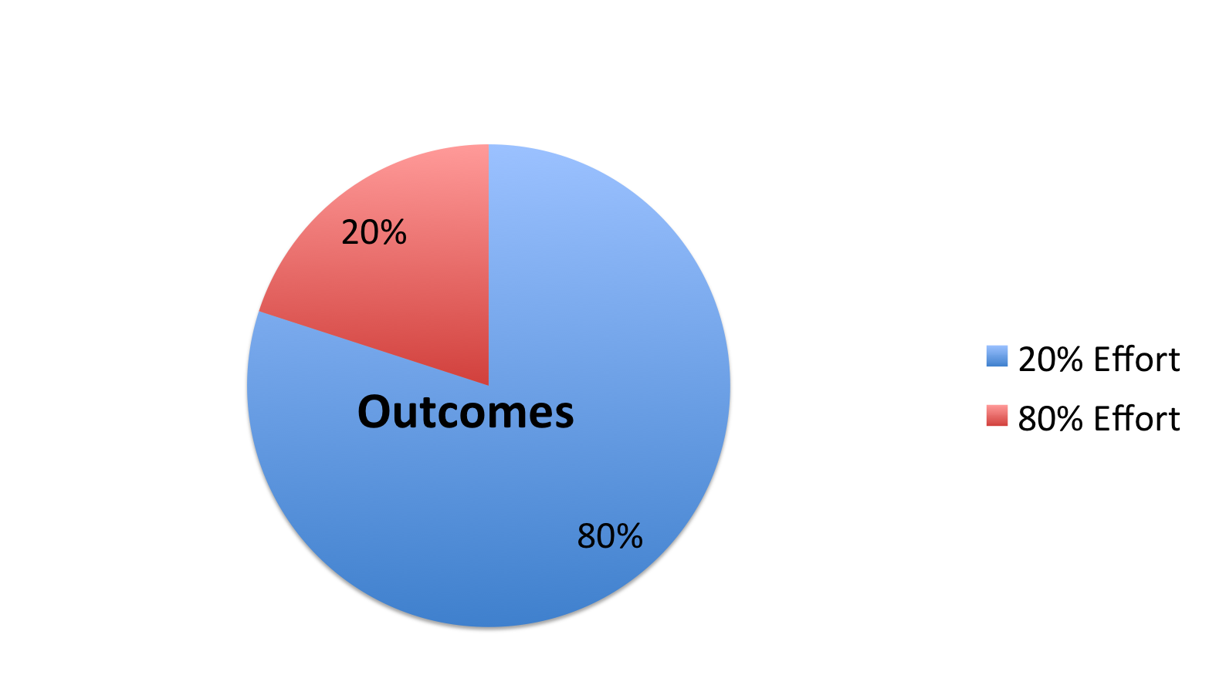
Pareto’s 80/20 Rule
McKeon, 2014
Notes:
Mention Steve Jobs

Slide 53
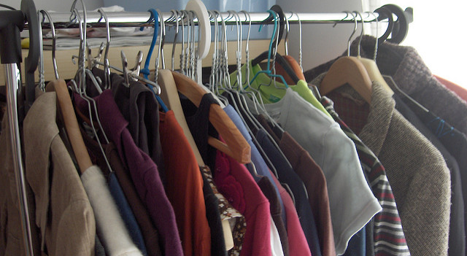
Describe Your Closet
https://flic.kr/p/aDLzzs
Rate it on a scale from 1-10 before you buy
Would you buy it again?
Have you used it one year? (McKeon, 2014)

Slide 54
Designing School-Wide Systems for Student Success A Response to Intervention Model 為學生的成功設計全校性系統—一種對介入模式的反應
Academic Systems 學業
Behavioral Systems 行為
Tertiary Interventions/Tier 3:
*Young Leaders
*National Honor Society; Eyes on the World
Secondary/Tertiary-SLC teams
Tertiary Intervention/Tier 3:
- Assessment based…Wraparound,
1-5%
1-5%
Secondary Interventions/Tier 2:
Secondary/Tertiary-SLC teams
AVID; Mentor Moms
Credit Recovery
After School Matters
ELL
Summer School/(Freshman Connection)
Gear-Up
5-10%
5-10%
Secondary Interventions/Tier 2:
- AVID, After School Matters
- ELL;Gear-up;
Summer School(freshman Connection)
- In HouseTutoring- Mentor Moms
80-90%
80-90%
Universal Intervention
Tier 1:
In-House Tutoring; Summer
School (freshman Connection),ASPIRA;_
Service Learning;
Attendance andTardies_
SLC; PARR; Freshman Seminar
Universal Intervention/Tier 1:
-PARR
Attendance and Tardy
- Small Learning Communities (SLC)
Notes:
54

Slide 55
ACTIVITY Designing School-Wide Systems for Student Success A Response to Intervention Model 為學生的成功設計全校性系統—一種對介入模式的反應
Academic Systems
Behavioral Systems
Tertiary Interventions/Tier 3:
_______________________
_______________________
_______________________
Tertiary Intervention/Tier 3:
______________________
______________________
______________________
1-5%
1-5%
Secondary Interventions/Tier 2:
________________________
________________________
________________________
5-10%
5-10%
Secondary Interventions/Tier 2:
________________________
________________________
________________________
80-90%
80-90%
Universal Intervention
Tier 1:
__________________
__________________
__________________
Universal Intervention/Tier 1:
______________________
______________________
______________________

Slide 56
See example
Working Smarter 更聰明的工作(Sugai, 2008)
Initiative, Project 革新計劃 Committee 委員 | Purpose 目標 | Outcome 成果 | Target Group 目標團體 | Staff Involved 參與員工 | SIP/SID/etc
Attendance Committee 出席委員
Character Education 品格教育
Safety Committee 安全委員
School Spirit Committee
Discipline Committee
DARE Committee
EBS Work Group
Notes:
56
5 minutes to review – home work – ask before you tell – do not train what you cannot support
Buy –in , Mission, role assignment, meeting healthy teams, working smarter

Slide 57
Reflection Activity – Page 4
Start working smarter triangle (link), at least one tier for academics or behavior
Begin working smarter matrix for at least one intervention (sample) (blank)
Is there anything you could stop doing?
Add next steps to action plan

Slide 58
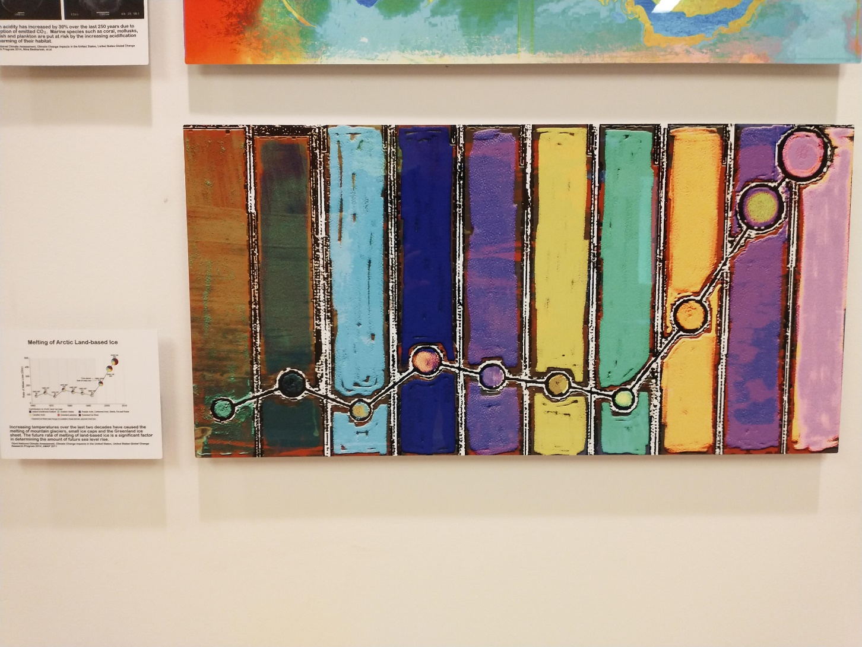
Data Can Be Beautiful 數據可以很漂亮

Slide 59

Using Data At the YMCA
Notes:
YMCA Australia – looked at data – people cared more about connections and being connected with others (staff, other patrons) – enrolment went up (See Charles Duhigg = Power of Habit)

Slide 60
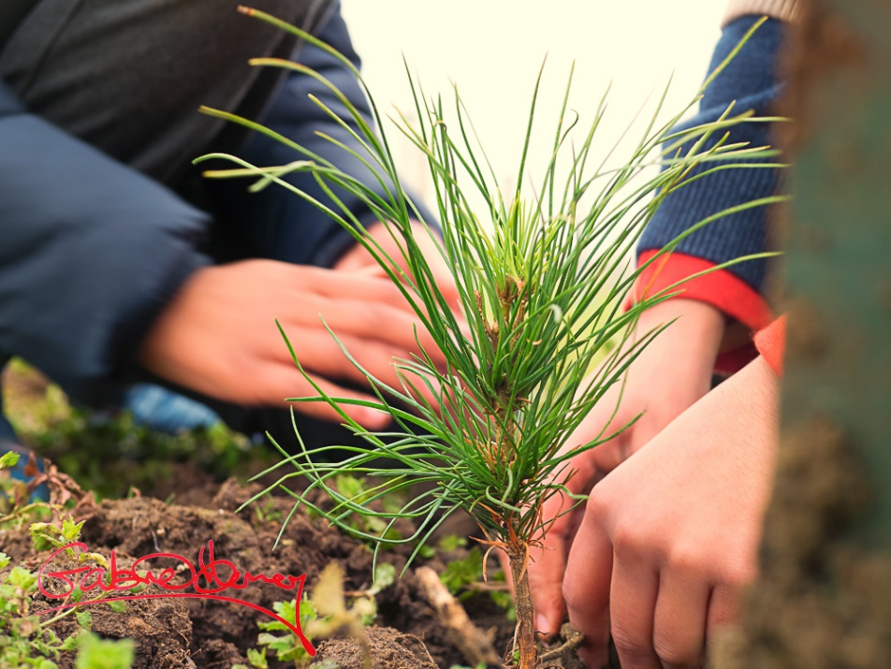
Plant the Tree Today 今天就種下樹
Organize what you have that aligns with school goals (e.g., grades, attendance, discipline referrals) 整理所有與學校目標相符的數據(如:成績、出缺席、獎懲紀錄)
Start asking questions about the data 開始詢問有關數據的問題
You will see what new data you need 你會知道還需要哪些新的數據
This Photo by Unknown Author is licensed under CC BY-NC-ND
Notes:
Chinese proverb – the best time to have planet a tree was 20 years ago, next best time is today

Slide 61

Types of Data
Perception data
Existing Data
School Climate Surveys
Whole Child Related Screening
Attendance
GPA 8th-9th grade
Standardized test scores
Discipline infractions
Demographics
Screening data
Image from Flickr Creative Commons https://flic.kr/p/dZ8UiN
Notes:
Australia collects - School Opinion Survey.

Slide 62
Types of Existing Data 現有數據的類型
Office Discipline Referral Data 獎懲紀錄數據
GPA (8th and 9th grade) 學業成績
Credits toward graduation 畢業學分數
Attendance (80 % or > unexcused) 出缺席 (80%或大於無故缺席)
Failing grades (Algebra I, English I)
不及格成績
Statewide assessments 全州評估
Existing screening data 現有篩檢
數據
(Burke, 2015; Heppen, O'Cummings, &
Therriault,2009; Henderson, Cassandra & Fantuzzo, 2022; McIntosh, Flannery,
Sugai, Braun, & Cochrane, 2008; McIntosh et al., 2009)
Notes:
This study examined data from the 2007/08 grade 9 cohort in four Oregon districts to find early warning indicators of students who may drop out or fail to graduate from high school on time. The study identified four indicators that provided valuable early warning signals about students who did not graduate on time, particularly about students who dropped out of high school:
• Grade 8 attendance rate below 80 percent. • Grade 9 attendance rate below 80 percent. • Grade 8 grade point average (GPA) below 2.0. • Grade 9 GPA below 2.0.
When the influence of demographic, achievement, and behavioral characteristics and differences in the schools that students attended were considered at the same time, only gender, English learner student status, and attendance and GPA in grades 8 and 9 were associated with graduation outcomes. Burke, 2015
62

Slide 63
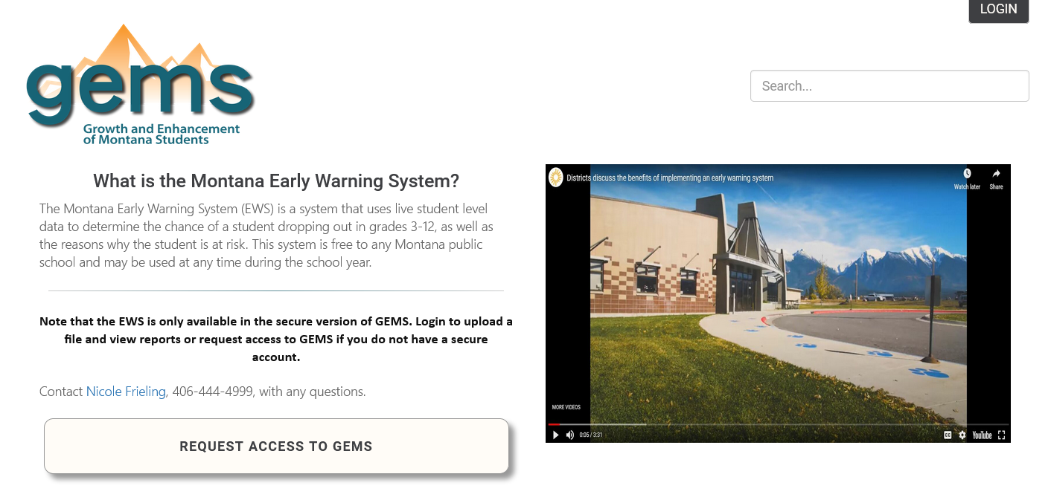
Montana’s Early Warning System (link)

Slide 64
Perception data
Whole Child Screening (includes free tools)
School Climate Surveys
Pediatric Symptoms
Signs of Suicide
Notes:
64

Slide 65
Deciding the Level of Intervention

Slide 66
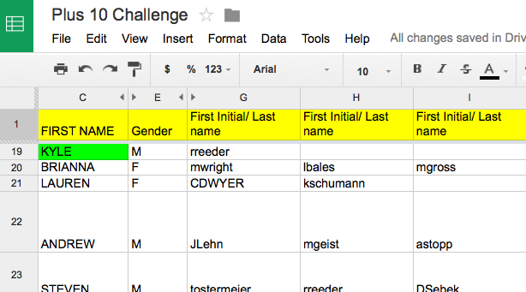
Staff Google Document
Keri Applebee, Associate Principal, Lincoln Southwest High School, NE
Notes:
Plus 10 challenge
Google docs- First initial, Last name- emphasize that it is ok if teachers could not put name by students – due to types of classes taught- important so we can see if students have academic/athletic connections
Criteria:
Do you know something about them outside of the classroom.
(Post -secondary plans, family structure, challenges)
Have you had a conversation with this student outside of normal class time?
Have you congratulated this student on an accomplishment or activity?
Has this student sought you out to share information with you about their life?

Slide 67
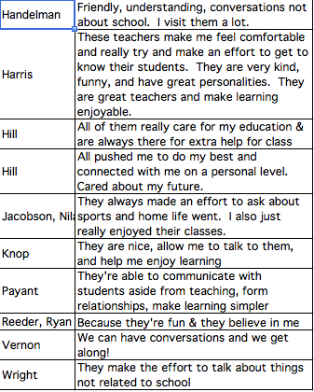
Results of student survey
Keri Applebee, Associate Principal, Lincoln Southwest High School, NE

Slide 68
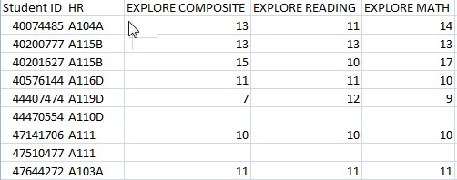
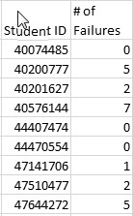
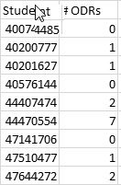
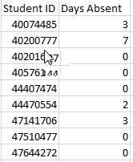
Separate Data Sets

Slide 69
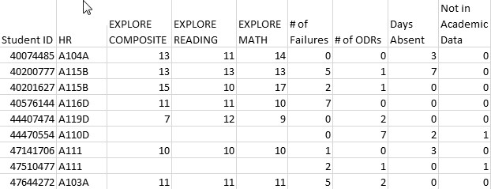
Combined Data Using Vlookup 使用 VLookup 合併數據
See YouTube examples: http://www.youtube.com/watch?v=3tk_Mif7040

Slide 70
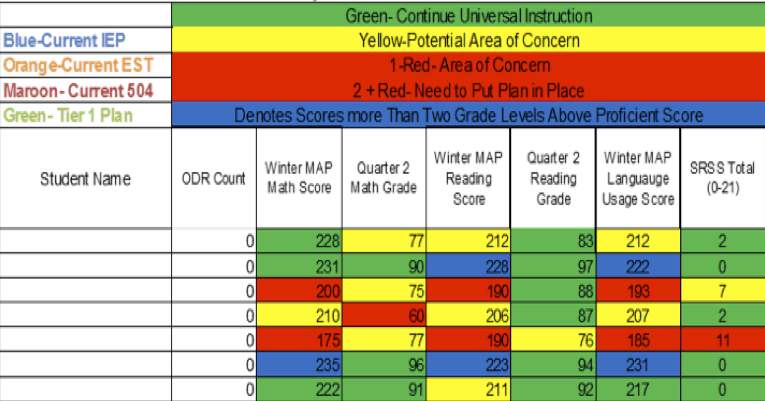
Integration of datasets 整合數據
Northfield Middle School and High School, VT

Slide 71
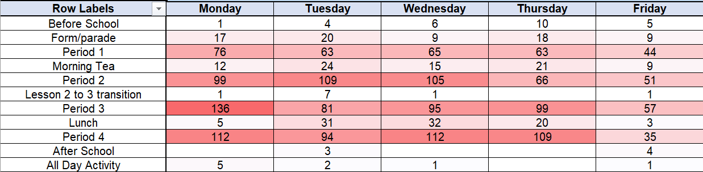
Discipline Heat Map 懲處熱圖– For Chairs/Deans 給主席/院長
Developed by Todd Winton
and his colleagues at Beaudesert State High School in Australia

Slide 72
Activity 活動
How would you recommend responding to the following data? P. 14 你建議如何回應以下數據?

Slide 73
SET Data School 2 (year 1第一年)

Slide 74
每100位學生輕度違規次數-以年級分
課堂干擾
服儀
遲到
9th
10th
11th
12th

Slide 75
每100位學生記違規的前三理由
罵髒話
不遵守規則
違抗權威
9th
10th
11th
12th

Slide 76
被記違規時間

Slide 77
Priorities 優先事項
Teaching, Acknowledging, and Redirection training for teachers of first year high school students 針對高一教師進行教學、認知與重新定向訓練
Orientation for first year high school students 高一學生的新生訓練
Circuit training for staff during opening of the school 開學期間對教職員進行回流訓練
School store opens and training provided for staff 學校開放並持續提供教職員訓練
Notes:
Circuit training script part of your handout and on my website

Slide 78
Connections – Early Warning, Decision Rules
Review Early Warning Indicators and Decision Rules, p. 22-23
Review using benchmark data, p. 24
What connections do you make for your school(s)
Link

Slide 79

Data Next Steps 數據的下一步
See Table 5.6 on p. 15 看p.15 表5.6
Brainstorm as many data sources as you can think of related to your school or class goals 盡可能想想看與你的學校或班級目標相關的數據來源

Slide 80
Creating Momentum for MTSS/PBIS

Slide 81

Moving from Model Demonstration to Standard Practice
Examine Feasibility/Efficacy of Practice Being Developed
Modifying System for Standard Practice
Embed within existing work: Provide access as current practice
Model Demonstration: Does it work in a specific setting with a specific population?
Replications:
Can it be reproduced in different settings with different populations?
Scale-Up:
Increase “reach” of practice to critical mass of implementation
Invest heavily in resources to produce results
Utilize typical/existing resources

Slide 82
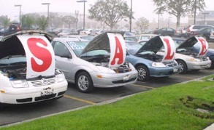
Buying a car
List out the steps you take when you buy a car or scooter…
bestig.blogspot.com
Notes:
We do talk about buy in when it comes to practices, so let’s reflect on that for a minute.
In the chat box, type out a few steps you go through when you purchase a car.
We will give you about 1 minute here

Slide 83
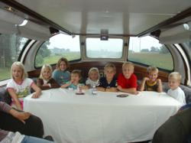

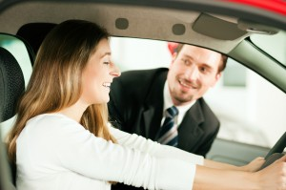

Steps
Consider Needs
Research
Not First!
Sample
Sign Up
Car http://www.prweb.com/releases/2012/8/prweb9815542.htm
Research http://www.uic.edu/uic/research/
Test drive http://www.familyhyundai.com/family-hyundai-customer-reviews/
Contract http://www.icts.uiowa.edu/content/contract-negotiation
Notes:
Place the steps for purchasing a car in the right order – at each step – what are people afraid of? Why did you not see the contact first? People are not the change – but the loss – you have to build the why before what and how.

Slide 84
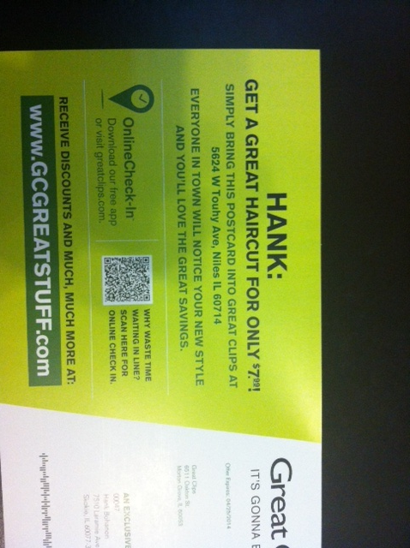
Notes:
Our solution must solve a problem the school has..

Slide 85

What Barriers Do You Face?
Not familiar/trained
Not my job
Doing too much now
Told but not asked
Agree/disagree/other
Core practices will improve problems staff
are already trying to address
Image from Flickr Creative Commons https://flic.kr/p/92ME2
Notes:
Before we begin, we would love to hear about some of the issues you face when trying to support secondary schools to change their core practices. We are focusing on behavior today, but other ideas are welcome!
For me, some of the issues that I come across include
Not familiar/trained
Not my job
Doing too much now
Told but not asked
In the chat box, could you type if you agree these are barriers in secondary schools, disagree, or have other barriers you have come across. We will give you about 2 minutes.

Slide 86
Differentiating Content
Improvement Area
Workflow
Procedures
Organization
Systems Improvement Role
Implementor
Influencer
Decision Maker
Expert
Improvement Timeline
Today
Tomorrow
Next week
Next Month
Next semester
Next year and
beyond
Teach one
expectation
to my students
Ask grade level/colleague
to teach expectation
an expectation
Share results, draft teaching
matrix with staff and students

Slide 87

Step 1 in Sales – Qualify the Customer Your last experience buying a mattress?
Buy-in implies selling
Believe in your product/approach
Questions to ask
Can they benefit?
Can they commit?
Image from https://flic.kr/p/7YKQEH
Notes:
Just looking?
What was your last experience the last time you went in to a store looking for a specific product? Computer, mattress, car
Don’t tell people about your safe, ask them what they don’t like about their current situation.

Slide 88
Implementation Phases
Exploration and adoption – buy in, urgency, awareness
Program installation – team, roles, resources, goals, data
Initial implementation – piloting, examples, sharing
Full operation – changing staff roles (some/all)
(Kotter, 1995; Blasé, Fixsen, Sims, & Ward, 2015)
Notes:
1 introduction and universals 2 setting up your team, 3 is data, 4th is best practices (MT Approach)

Slide 89
(Bohanon & Wu, 2014)

Slide 90
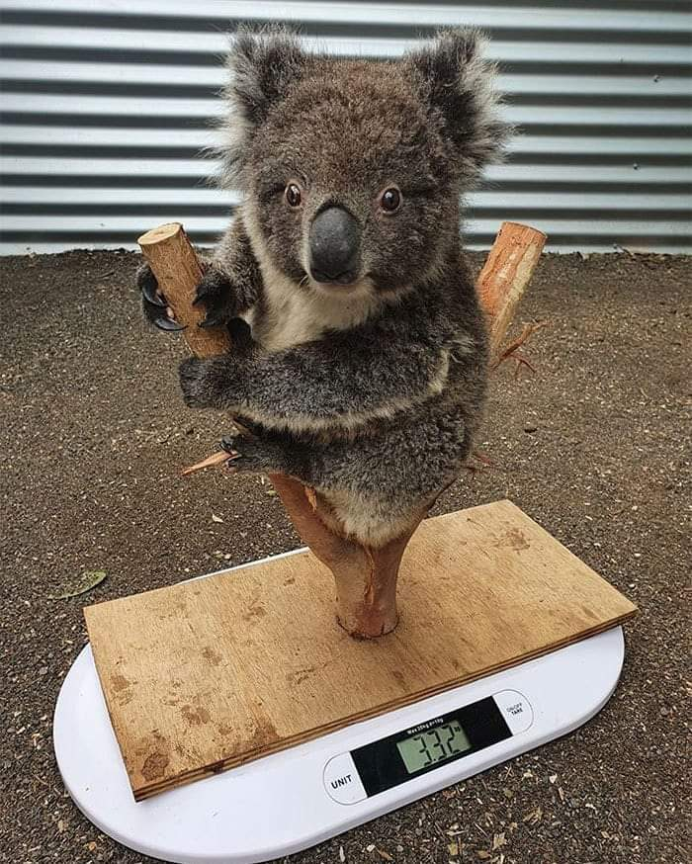
Assessing Needs
Tools
Interviews
Observations
Surveys
Focus Group
Existing documents and data (e.g., school plans, reports)
Goals
Identify Strengths
Identify Needs

Slide 91
Interviews and Surveys

Slide 92
What Are Current Needs?
Communication
High staff turnover
Inconsistent practices, polices, and procedures
Negative perception of school
School climate
Lack of data-based decision making
Lack of buy-in to address concerns
Image from https://flic.kr/p/25UMFK4
Notes:
Stake holders need to see a need – look at existing practices p. 51
I (Hank) was working with four high schools as a part of a project to implement
schoolwide academic and behavior support within their settings. We
had conducted a needs assessment. We identified several themes that we
could perhaps address. These included:
•• The need for effective communication with staff
•• High staff turnover
•• Inconsistency in defined practices, polices, and procedures
•• Negative outside community perception of school
•• School climate concerns
•• Lack of use of data for decision making
•• Lack of buy-in for staff to address concerns

Slide 93
Connection to Needs 連結的需求
Priorities/Next Steps | Connections with Schoolwide Initiative
Improve communication | Develop a leadership team that can effectively communicate with the school community
Define responses for students who struggle academically and behaviorally | Develop a continuum of supports for all students
Improve school climate | Develop, teach, acknowledge and redirect students to expected behaviors
Use data for decision making | Identify problems and needed data sets for decision making using MTSS framework
Notes:
Example from one school – p. 51 – see table 5.1

Slide 94
See Sample Tools for Interview
Needs Assessments – p. 17
Summary Table – p. 19
Summary from MT MTSS coaches as an example p. 18
Do any of these needs/strengths connect with your school(s)?
Have you used any other approaches (PLC’s)?

Slide 95
Self-Assessment
Purpose
Identify priorities based on a model
Develop action plans
Make decision based on evidence
Methods
Team completes
Proportion of school
Random sample

Slide 96
Self-Assess
For creating the PBIS System - complete the Team Implementation Checklist (link) and action plan. Page 20-27
For supporting a classroom level pilot - Positive Behavior Support Planning Checklist And Teacher Self-Assessment (link). Page 28-30

Slide 97
Organizing Existing Data
Career Builder video 1

Slide 98
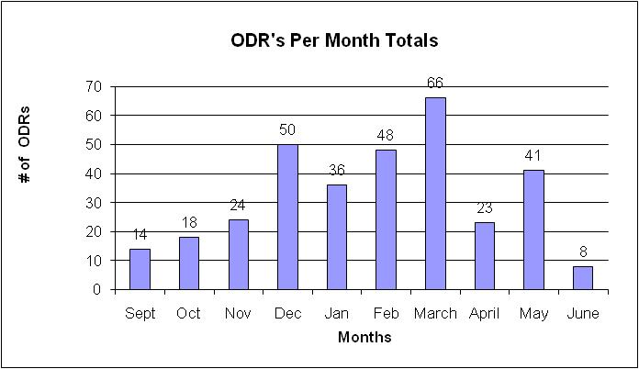
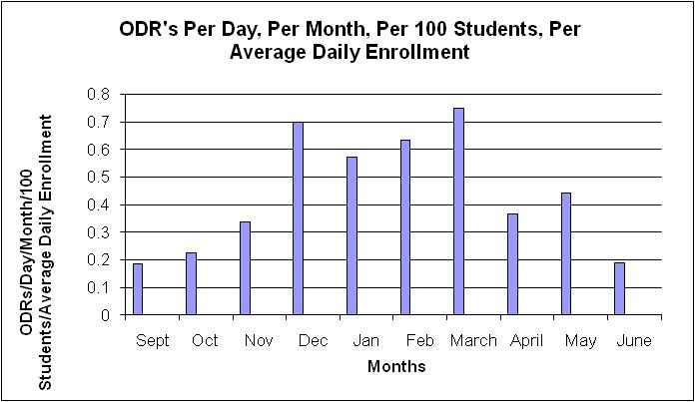
What are our priority months for support?
See page 14 for more examples

Slide 99
Build Case with Data: Create Urgency (Kotter, 1995)
Writing a referral is not a bad thing, it is necessary!
Use Circuit Training
We hope you have fewer reasons
20 Minutes per referral – Teachers
77,400 Minutes = 1,290 Instructional Hours
40 minutes per referral – Administrators
114,800 Minutes = 2,870 Administrative Hours
Scott, T. M., & Barrett, S. B. (2004).
Notes:
Present graphically – avoid data snow blindness

Slide 100
What Data already Exists in Each of the 4 Domains of School Climate 在學校氛圍的四個領域中，各有哪些學校既有的資料呢?
See Table 5.6, Page 15

Slide 101
Implementation Stages
Stage Two: Installation – Systems (Chapter 4)
See the Team Implementation Checklist (link). Pages 21-22, items 1-8
See steps 1-5
Blog on systems (link)
Blog on gaining admin support (link)
Developing local coaches – content knowledge
Add next steps to action plan
Notes:
Stage Two: Instalation
Identify the features of the system you will need to be successful. See systems slides - add common training to slide
Go back to TIC and review key steps – what tools do you need to address this step, or think you might need, or have you used?

Slide 102
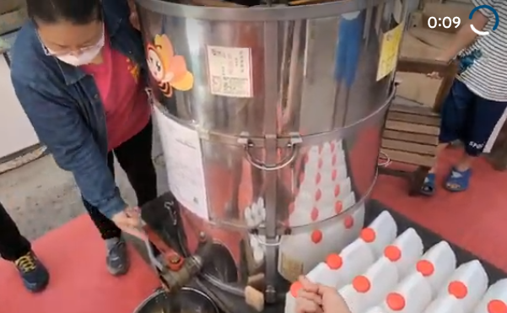
Implementation Stages
Stage Three: Initial Implementation
Consider small pilots (link)
Are there groups, or individuals in your school who are already implementing components of MTSS?
Who are they, how can you connect with them (see classroom self-assessment)?
How did you carry out initial implementation steps?
Share results with community/school
Add next steps to action plan
Notes:
Stage 3: Initial Implementation
Consider implementation cohort through pilots (p. 34) Fixsen
CBT - Think, Feel, Behave - you address thinking through behaviour
Group can provide feedback
Collecting data
Communicate results to the community
Are there groups, or individuals in your school who are already implementing components of MTSS? Who are they and how can you connect with them? How did you carry out initial implementation steps?

Slide 104
Implementation Stages
Stage Four: Full Operation
Connection to school improvement/character education plan
How does your school measure how well school improvement strategies are being implemented?
How can you connect with a top three priority?
Are you connecting with other schools?
Add next steps to action plan
Notes:
Very similar to school improvement - iterative process
Tracking fidelity of the intervention
Leadership roles are filled by staff
PLCs guided by staff members who are experts
Students and parents continue to be involved
Clear connection with school improvement plan
How does your school measure how well school improvement strategies are being implemented? How are you doing with these steps.

Slide 105

Prepare for Resistance
Think of possible questions people will ask prior to the meeting
Prepare a response
Always be respectful
See p. 32 for practice
For more information (link)

Slide 106
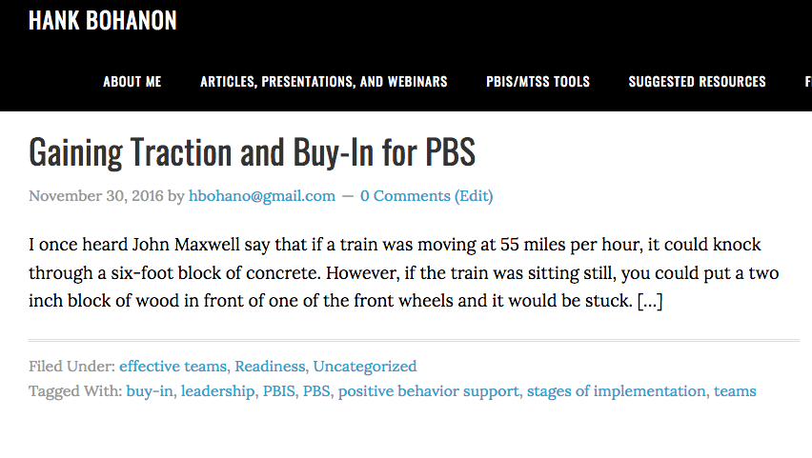
Additional Tools
Link to tools for buy-in http://www.hankbohanon.net/tag/buy-in/
Notes:
We provided some additional tools for you that specific to buy in secondary school. Just click on the link in the slide

Slide 107

Attendance Reflection
Think of a time when you missed an outing with friends and family – how did you feel?

Slide 108
Attendanceworks.org
Tier three第三層級 – specialized support 特定的支持– 20% < days
缺席>20%的上課日
Tier two 第二層級– early intervention早期介入
10 – 20% of school days 缺席10-20%的上課日(2-3 per month 每月2-3天)
Tier one 第一層級– > 10% of school days
缺席10%的上課日 (about 1 per month 每月約1天)
What are you doing for each level? 每個層級你會做什麼?

Slide 109
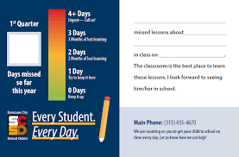
Responses 回應
Engage students and parents 讓學生和家長共同參與
Recognize good and improved attendance 認可良好和進步的出席率
Provide personalized early outreach 提供個人化的早期外展服務
Monitor data 監測數據
Nudge Intervention 推動介入 – Sending a postcard to parents to encourage students’ attendance將出缺席卡寄給家長以鼓勵學生出席 (Rogers et al., 2017)
https://provingground.cepr.harvard.edu/files/provingground/files/proving_ground_postcard_guide_march2020.pd f

Slide 110
Sample Response Tables
See Tables 12.3 and 12.4 to help you plan your responses – p. 19
How useful might these tools be to your class or school?

Slide 111
準時的定義: 學生要在第二次鐘聲響前100%跨過教室門檻
不適當的進教室行為
Be at post 待命
Escort students 護送學生
Brief interactions 簡短互動
(Johnson-Gros et al., 2008)
適當的進教室行為
See article about hallways @
http://hankbohanon.net
on publications page
Tardy Policy Office
Notes:
111
111
Mr. Irvin – tardy policy
being at post, escorting, and interacting with students

Slide 112
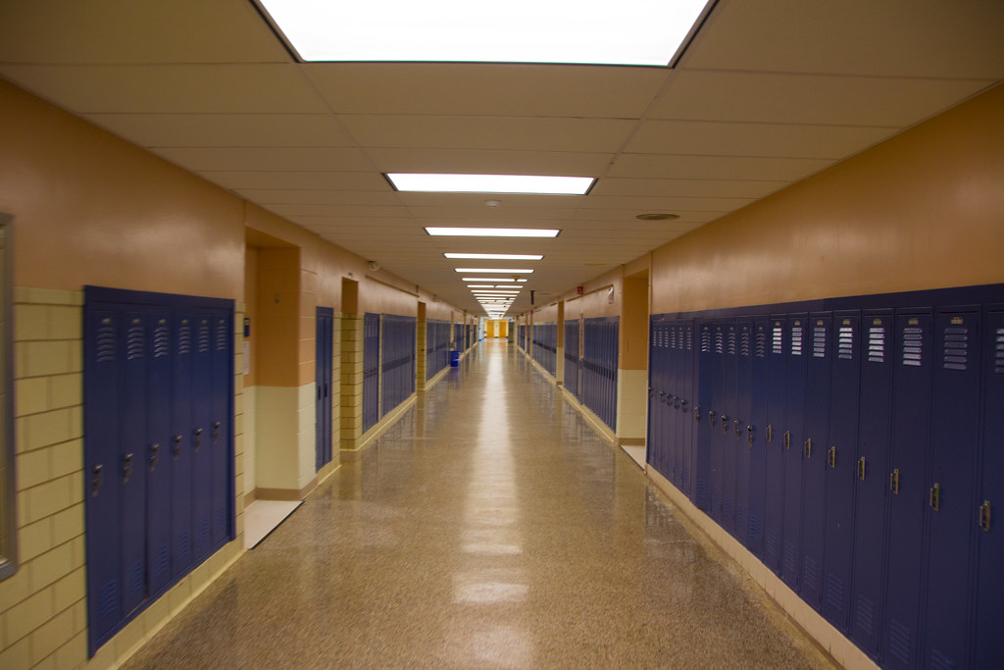
Tardy Data
Who is tardy? – time of day, locations, grade levels
ODR data for hallways – non-classroom
Mall Walking– count how many students are in the fall after passing – 10 minutes in 20/20 box
This Photo by Unknown Author is licensed under CC BY

Slide 113
Preventing Tardies預防遲到
Staff posted at doors 教職員在門口張貼標語
Brief interactions with students during passing 學生經過時簡短互動
Staff in the hallway to encourage being on time
教職員在走廊讚美學生準時到
See example範例 (link)
(Kristian Johnson-Gros et al., 2008)

Slide 114
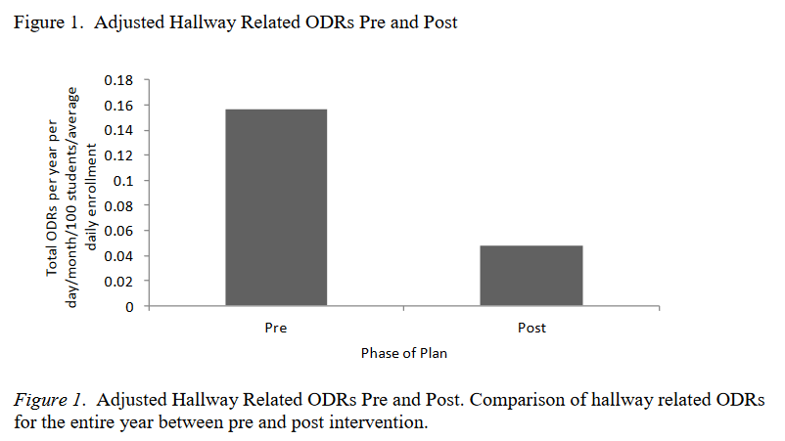
High School Example 高中範例
(Bohanon, 2015)

Slide 115

Addressing Tardies
Start on Time!
Randy Sprick
http://www.safeandcivilschools.com/products/program_previews.php

Slide 116
Reflection 反思
What data do you have, can you use these to address tardies to class? 你有什麼數據，以及如何用這些數據解決上課遲到的問題?
What approaches are you taking now to tardies, how might these suggestions help you work? 你現在採取什麼方法解決上課遲到的問題? 以上這些建議如何幫助你?

Slide 117
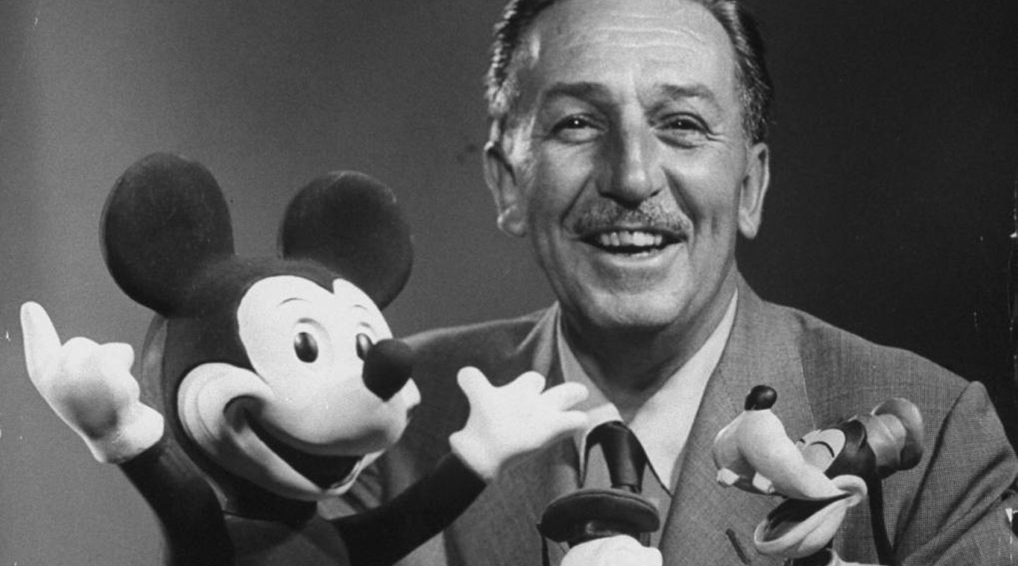
Preparing Your Syllabus 準備你的教學大綱
Walt Disney 華特迪士尼– “unarticulated expectations are premeditated disappointments” 未清楚表達的期望是可預期的失望
This Photo by Unknown Author is licensed under CC BY-NC-ND

Slide 118
The Syllabus 教學大綱
Goals 目標
Contact information 聯繫方式
Success Traits 成功特質
Rules/expectations 規則/期待
Activities 活動
Grades/Status 成績
Procedures 流程
Entering 進教室
Tardy/Absence 遲到/缺課
Materials 教材
Assignments (returns) 作業(歸還)
Due dates 截止日期
Late, missing work 作業遲交或未交
Communication 溝通
Ending class 結束課堂
Consequences 學習結果
Model projects 模範作品
Checklists 檢核表
Sprick (2006)/Shinn http://markshinn.org
See examples – http://www.hankbohanon.net (Resources page under “Teaching”
Sample first days of school for high school teacher)
Notes:
Show handout, look at student expectations

Slide 119
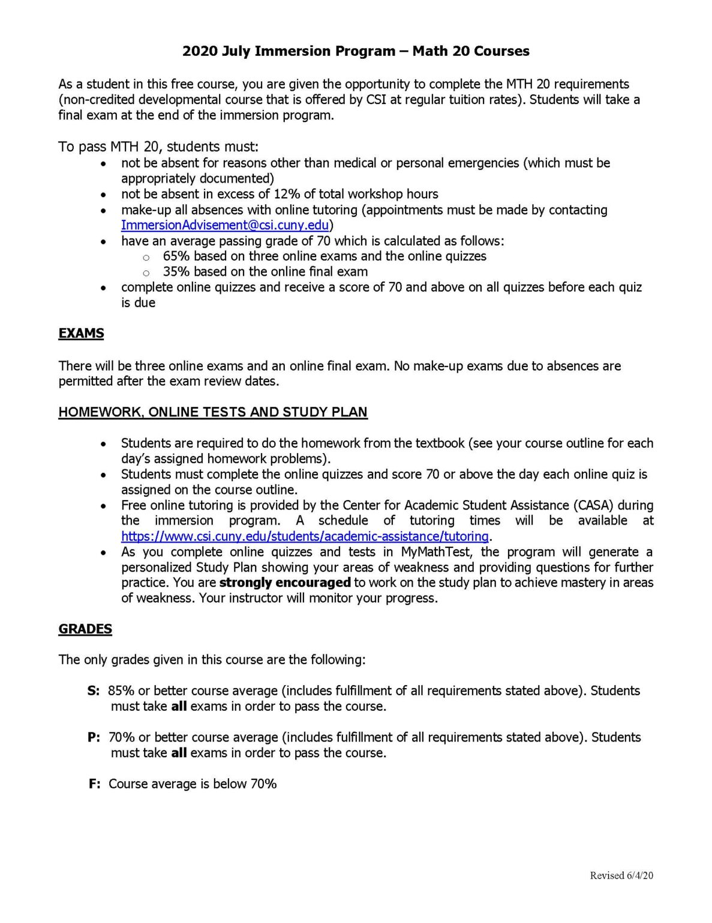
Reflection on Syllabus 教學大綱的反思
What are the things you, or your teachers, repeat daily for students? 你或你的老師每天為學生重複進行的事是什麼?
See Table 12.5 and example, p. 18 見表12.5及18頁範例– how much agreement does your school have on these key ideas? 你的學校對這些重點有多認同?
This Photo by Unknown Author is licensed under CC BY-SA-NC

Slide 120
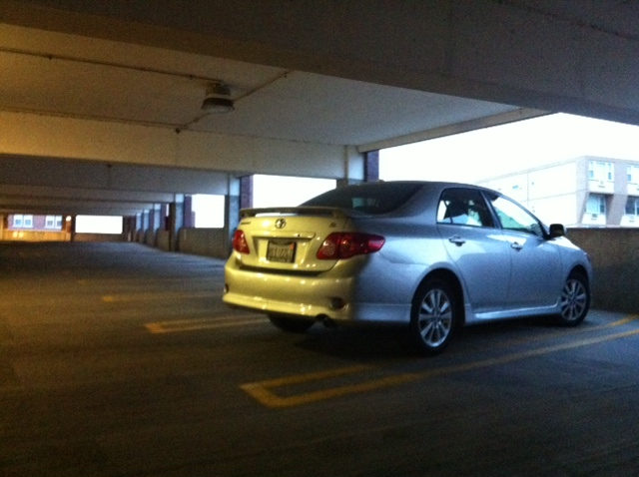
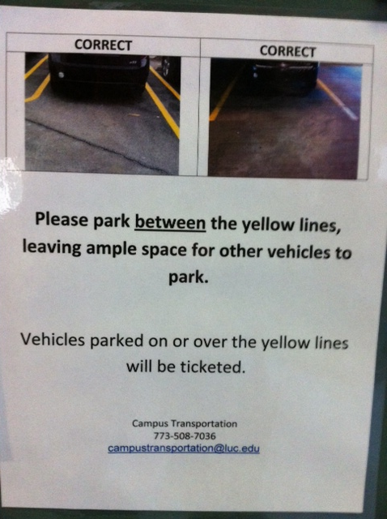
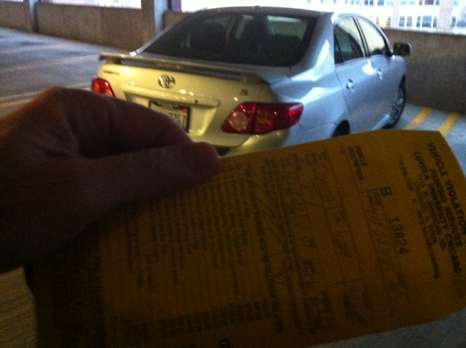
Learning through punishment - Zappos
Notes:
Working on holiday break on university related tasks
Came up and apparently my car was parked over the line and clearly I was hindering the parking of others - $40 ticket..Are you kidding me? Complained – they said this time we will let you go, but next time it will be enforced..Then..the poster…many of our students learn the rules this way – at home, they say, pass the fn sugar – they are learning a new skill.. Do not assume.. Or you will get “are you kidding me?”

Slide 121

Benefits of Teaching Expectations 教導期待的好處
Includes behavioral, social, academic skills 包括行為、社會與學業技能
Fewer defiance and drug-related discipline problems 減少反抗和與毒品有關的紀律問題(Molloy et al., 2013)
Improved development and course grades 提高發展與課業成績
(Farrington et al., 2012)
This Photo by Unknown Author is licensed under CC BY-NC-ND
Notes:
Can include non-academic skills such as mindsets, metacognition, and self-regulation – helps with development and course grades – see Farrington p. 184
Belonging to the community
Effort
Success is possible
Finding value in my work
Social and emotional skills – self-awareness, self-management, social awareness, relationship skills, and responsible decision making – CASEL
Self-determined – self-evaluation, set goals, problem-solve, express wants and needs – Wehmeyer p. 184

Slide 122
Teaching Expectations
Examples
Staff orientation meetings
Handbooks
Lesson plans
Videos
Examples
Syllabus
Posters
Booster sessions
Pre-correct/remind
See lesson- Blank!! Possible Example Teaching Story 1 or Pre-Teaching
Student example from football
Fruita Monument Example
Notes:
122
Say silk 3 times, then ask what do cows drink
Practice expectations with group

Slide 123

Developing Expectations 建立期待
3-5
General 一般性的
Positively stated 正向描述的
Use an acronym if possible 可以的話使用縮寫詞
Respectful, Appropriate, Determined (RAD) 尊重、適當、堅定
Connect to school mascot if possible 可以的話連結到學校的吉祥物
Academic and whole child standards 學業和全體兒童的標準
Align with school mission and vision 與學校任務與願景一致

Slide 124

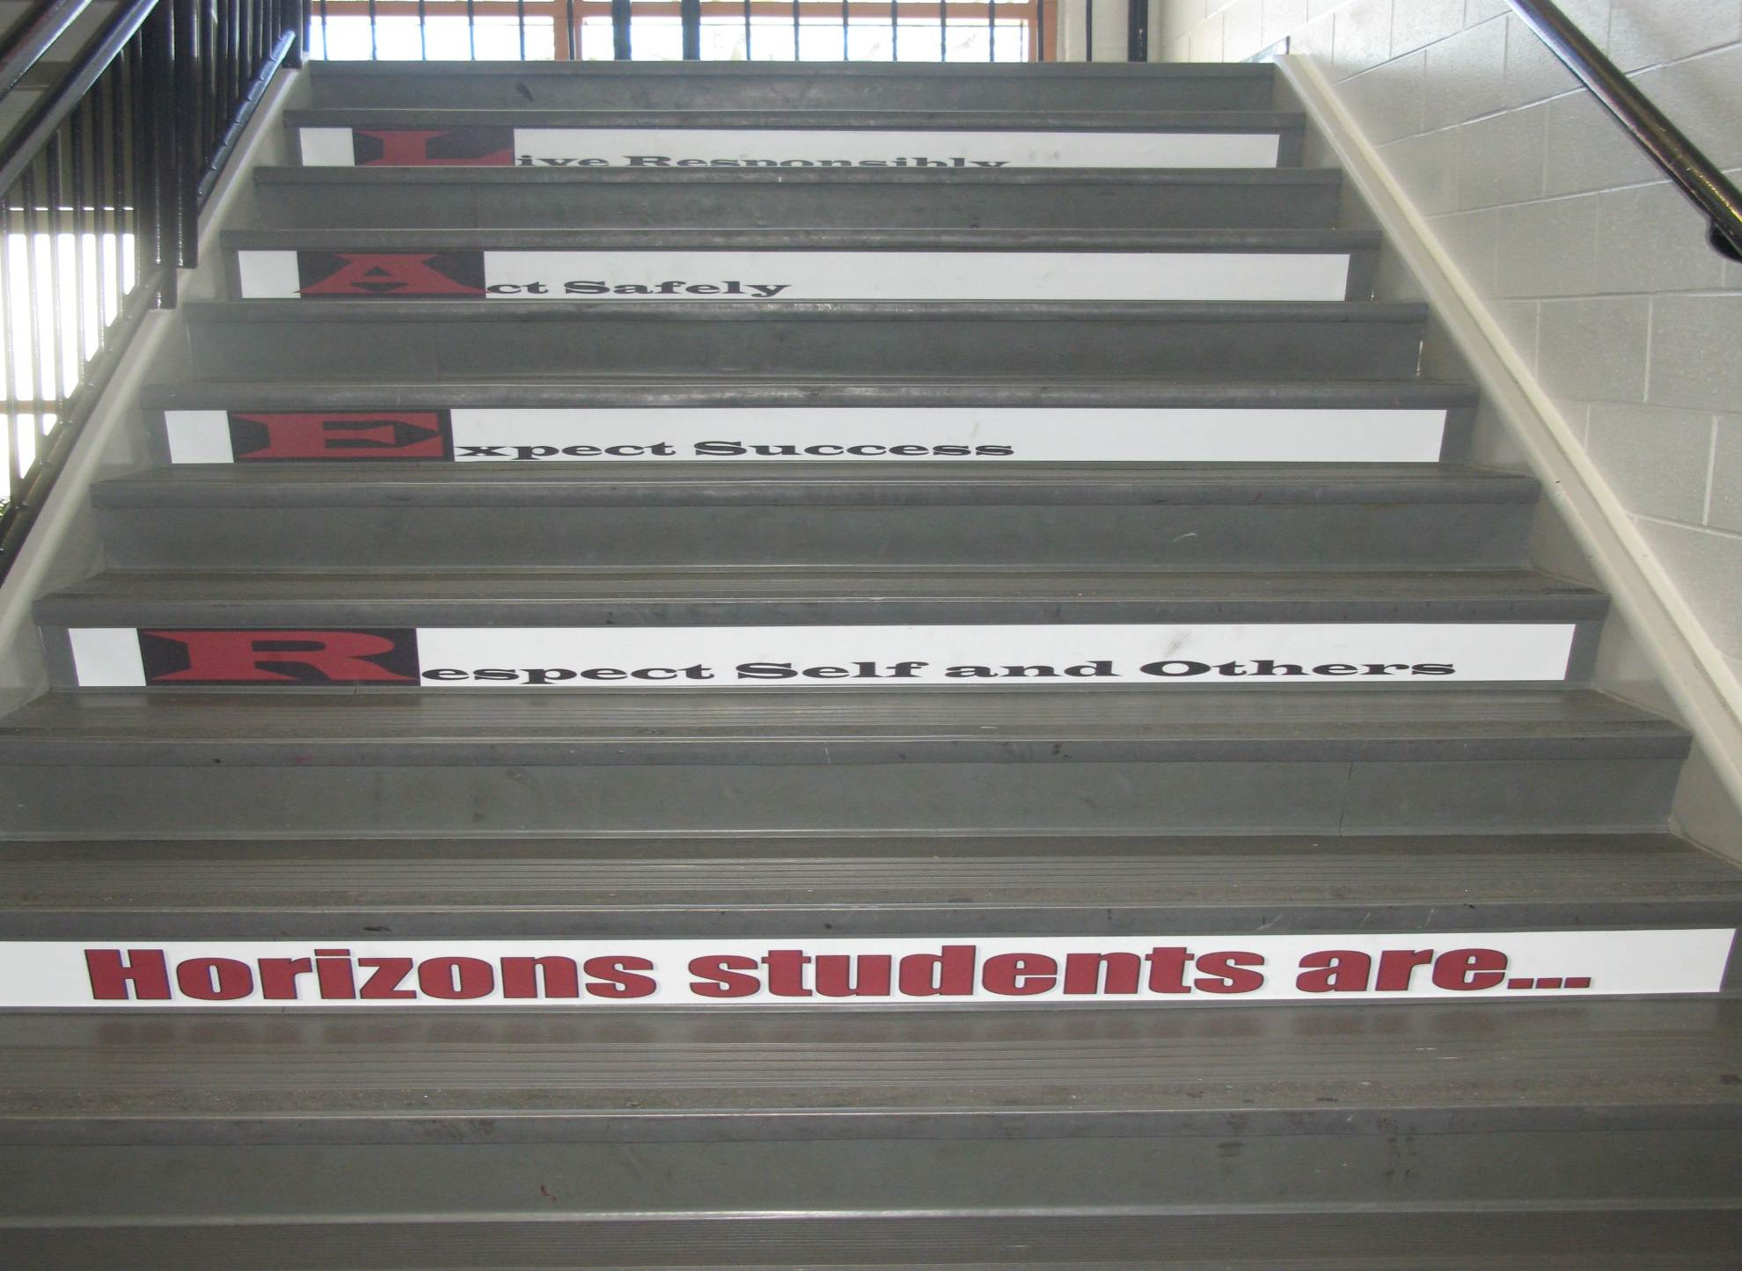
Shawnee Mission Schools, KS

Slide 125

Developing Expectations建立期待
Include your whole community 包括整個社區
Schoolwide Expectations Survey for Specific Settings針對特定環境的全校性期待調查 https://ci3t.org/pdf/SESSS.pdf
60% = respect, responsibility, and safety 尊重、負責與安全(Lynass, et al., 2012)
See the example from p. 38-40, why were these included? 見p. 38-40範例，為何包括這些?
This Photo by Unknown Author is licensed under CC BY-SA

Slide 126

Standards and Lynchpin Skills – See P. 28
Skills
NE ELA: Comprehension and Collaboration (link)
How to work cooperatively with peers
How to be respectful of people from various backgrounds
LA.12.SL.1 Communicate effectively and appropriately in collaborative activities for a variety of tasks, purposes, and audiences to express ideas, share knowledge, and generate new understandings.
Link to Oklahoma State Learning Standards: https://sde.ok.gov/sites/ok.gov.sde/files/documents/files/OAS-ELA-Final%20Version_0.pdf
Image from: https://commons.wikimedia.org/wiki/File:Lynch-pin.jpg
Notes:
If students engage in these skills, they are more likely to be successful in other areas

Slide 127
p. 30
How could you align your standards?
你要如何調整你的標準?
CPS Matrix Aligned with Common Core Standards – See http://www.hankbohanon.net
Notes:
See standards lists or reference in handout
Use your data
Select an evidence-based program – See CASEL
Develop an expectations matrix
What is the problem, what you do want to see instead
Remember academic and non-academic skills (e.g., mindsets)
See PBIS.org schoolwide matrix p. 188
Align with standards – see my example – how could you align with Australian standards

Slide 129

Sample Classroom Matrix 課堂矩陣範例
小團體活動
個別作業
轉換
不亂碰別人
安靜移動
排隊時和別人保持距離
要尊重
要說話前舉手
安靜工作
傾聽他人 接受別人的答案和想法
要負責
把物品放好 需要的物品準備好 服從指令
遵守指令 專心 待在小組中 善用時間
專心 善用時間 坐在座位上除非得到允許起身
要合作
做自己負責的工作 每個人都要參與
老師在幫其他同學時安靜等待
工作區維持整潔 幫助你的隔壁同學
Newcomer (2009)
Which of these behaviors would you like to address?你希望處理以下哪些行為?

Slide 130
Activity – Page 49
Develop one cell in the teaching matrix together
List out the settings/situations in your school where you need to address character
Using your list of character/moral traits, or the ones I listed, complete at least one cell of the teaching matrix (e.g., what you want to teach)

Slide 131
Developing Expectations
Schoolwide Expectations Survey for Specific Settings (link)
60% = respect, responsibility, and safety (Lynass, et al., 2012)
Share expectations (link) or complete Table 13.2 in Handbook, P. 28
Add next steps to action plan
This Photo by Unknown Author is licensed under CC BY-SA

Slide 132

Posting Expectations 將期待公告
From https://www.denver7.com/traffic/driving-you-crazy/whats-driving-you-crazy-speed-limit-signs-with-fractions-really

Slide 133


MRT – Be Safe

Slide 134

MRT – Be Safe 捷運—注意安全

Slide 135
Posting Big Ideas 公告重點
Large font 大字體
Focus on behaviors you want to see 強調你希望看到的行為
“Employees must wash hands“ 員工一定要洗手
Keep the verbiage to a minimum 最少量的贅詞
Consider height 考慮高度
Images and language culturally relevant 使用文化相關的圖片和語言
Must be taught 需直接教導

Slide 136


SULPHUR 9th GRADE - PBIS
Posting
CHUCK HANSEN, Principal
AMY PALMER, Teacher
SULPHUR HIGH SCHOOL, LA
Notes:
Ideas
Large font
Focus on behavior you want to see think “Employees must wash hands”
Keep the verbiage to a minimum
Consider height
Images and language culturally relevant
Content needs to be taught

Slide 137

Notes:
137
Mr. Irvin
Defining expectations by location

Slide 138




Shawnee Mission North Football Jerseys
Notes:
Teaching expectations football?

Slide 139


Shawnee Mission Schools, KS

Slide 140

(Luh, Ni, Chen, & Feng, 2024)

Slide 141
Posting Reflection Question 公告反思問題
What expectations do you consistently need to prompt? 你需要一致性地提醒哪些期待?
How could/do visual examples help? 這些視覺範例如何提供說明?

Slide 142

Teaching Expectations 教導期待
Key Elements 關鍵要素
Rationale 理由
Negative examples
負向範例
Positive examples
正向範例
Practice/Feedback
練習/回饋
Evaluate 評估
This Photo by Unknown Author is licensed under CC BY

Slide 143

Non-Examples

Slide 144

(Luh, Ni, Chen, & Feng, 2024)

Slide 145

(Luh, Ni, Chen, & Feng, 2024)

Slide 146

Prepare your staff 讓教職員準備好
See the example lesson plan p. 51 見p.51的教案範例
High School example (at two minutes)
Elementary Example
What elements of teaching did you see? 你看到了哪些教學的要素?
How long does it take to teach an expectation? 教導一個期待行為需要多長時間?
What is one routine you could teach?

Slide 147

Finding more plans 更多教案
Sample Lesson plans
http://www.hankbohanon.net
More Video Examples
http://vimeo.com/groups/pbisvideos

Slide 148
Acknowledgement 認同
Cheerleading Video
Notes:
Cheerleading video

Slide 149

Earned this bag on SW…

Slide 150
Acknowledgement 認同…
As part of schoolwide approach, can lead to improved performance 全校性作法可以提高效能
Improved attendance 出席率改善 (de Baca, Rinaldi, Billig, & Kinnison, 1991).
Reductions in discipline problems 減少送懲處問題 (Bohanon et al., 2012)
Functional outcomes are important 功能性結果很重要
Relevant curriculum 相關課程
Social connection 社會連結 (Dunlap, Foster-Johnson, Clarke, Kern, & Childs, 1995).

Slide 151

Other Advantages of Specific Praise 具體讚美的其他優點
Decreases in emotional
Exhaustion 減少情緒耗竭
Higher efficacy
提高效能
Reinke, W. M., Herman, K. C., & Stormont, M. (2013).
Photo by Josh Thompson

Slide 152
Video 影片
See examples of why this is important 參見範例了解為什麼重要
One-page document “Acknowledging Students for Good Behaviors” p. 55 一頁文件檔—認同學生的好行為
Page 56 – How could the principles from Japanese businesses apply to your school? 日本企業的原則如何用在你的學校? (link)
Notes:
Zappos video only if time
Tell them page number -

Slide 153
High Frequency 高頻率的

Slide 154

Buzzy Buck
Notes:
154
154
Brigit

Slide 155

Teacher Rewards Program
2 – Soft Drink
3 – Candy Bar
5 – Preferred Parking
8 – Free Lunch
10 – No Bus Duty
15 – No Morning or
Lunch Duty
20 – Extra Planning
Period
Tonya Ryder, Assistant Principal
Selena Gomes, Graduation Coach / Teacher
Oberlin High School, LA

Slide 156

CHUCK HANSEN, Principal
AMY PALMER, Teacher
SULPHUR HIGH SCHOOL, LA

Slide 157

Notes:
157
157
Brigit

Slide 158

Notes:
158
158
Brigit

Slide 159
Intermediate 中級的

Slide 160

Woodridge Example (link)
Timber Creek High School, FL, JOHN WRIGHT, PRINCIPAL

Slide 161
Notes:
161
161
Brigit

Slide 162

Gold and Silver ID Cards
Notes:
162
162
Brigit

Slide 163

Ron our Liaison
Jody Mimmack, PhD Fruita Monument High School, CO

Slide 164
Large Scale 大型的

Slide 165

1st Six Weeks Party –
CHUCK HANSEN, Principal
AMY PALMER, Teacher
SULPHUR HIGH SCHOOL, LA

Slide 166

A Night in Paradise…
Tonya Ryder, Assistant Principal
Selena Gomes, Graduation Coach / Teacher
Oberlin High School, LA
Notes:
With these procedures in place, it became important to recognize our students’ social, academic and behavioral successes. We no longer have a traditional academic awards presentation, but instead have a school-wide academic pep rally that recognizes all of our students’ successes in various areas. This year’s theme will be “Academic Academy Awards…A Night in Paradise.”

Slide 167

Teacher earns vacation 教師獲得放假
Timber Creek High School, FL, JOHN WRIGHT, PRINCIPAL

Slide 168
Freebies
http://www.kipbs.org/new_kipbs/familyInfo/freebies/

Slide 169

Certificate of Appreciation
Teaching Spartan of the Month
In recognition of excellence in teaching, __________ is awarded this certificate for devotion to the students, commitment to learning, and dedication to the core values of R High School.
Date
R324A070157
, Principal

Slide 170
Reflective Question 反思問題
See sample and blank reinforcement matrix, p. 34 見範例以及空白的增強物矩陣
What is one high-frequency acknowledgment that might work for your students or teachers? 什麼樣高頻率的增強物對你的學生或教師可能有用?
What is one unpredictable/intermittent “BOOSTERS” acknowledgment that might work for your students or teachers? 什麼樣無法預測/間歇性的增強物對你的學生或教師可能有用?
What is Attention-Grabbing “Celebrations” acknowledgment that might work for your students or teachers? See matrix 什麼樣的引起注意的慶祝活動對你的學生或教師有用? 見矩陣

Slide 171
Engagement and Opportunities to Respond 參與和回應機會
Non-example – Ferris
Jeff Bliss Video Example
Notes:
Jeff Bliss Video Example

Slide 172

Quiz 小測驗
What percentage of workers worldwide
consider themselves engaged at their jobs? 全世界的工作人口中
認為自己很投入工作的百分比有多少?
21 %
(Gallup, 2025)
Photo from Flicker Creative Commons https://www.flickr.com/photos/pennwic/8142281815/in/photolist-dpvjHe-dpvjNz-dpvths-pQoPx7-aMi2SZ-8vEXtU-8vBWcM-5C6oVt-pEQiQm-97vCko-rKn1F-h7BuWg-h7ybkV-h7wXts-h7y2AF-h7y1NP-8vBVJ2-8vBW8g-8vBVL8-8vBVZr-8vEXGf-8vBWgB-8vBWdB-8vBVTe-8vBW8X-8vBW4Z-h7wVwR-h7x7bs-aMi6nD-5pYDTp-aMiarZ-aMi2xk-aMhLrn-aMhSLR-aMhUsa-aMhK7i-aMhJQz-aMhUbT-aMhJxr-aMhYfc-aMhURP-aMhTt2-aMhV48-aMhKk8-aMhKyV-aMhKRR-aMhLHT-aMhTFt-aMhTXz-aMhUEp

Slide 173


To Engage Students, Save the Cat為了讓學生參與, 拯救貓咪
Why is this scene in Moana 為何在海洋奇緣中有這個場景? (link)?

Slide 174


Engagement
Image from http://2015.oimf.jp/en/news/detail/104
Image from http://bit.ly/1ZIfcPF
Good merchandise alone will not appeal to the customer, it …[stores]…must attract the five senses (ANA Innovations)
Goichi Itokazu, President of Ryubo Holdings, and former president of Family Mart
Notes:
Talk about unicycle

Slide 175





Instructional/Emotional Support 教學/情緒支持
Failure rates
from 17% to 11%
Choice of responding
Laughing with students
回應的選擇
和學生一起笑
失敗率從17降到11%
Out of desk greeting
辦公外的問候
Allen, Gregory, Mikami, Lun, Hamre, & Pinata (2013)
Ask about events
Ask “why”?
問有什麼活動
問為什麼
http://mzteachuh.blogspot.com/2012/05/that-kid-drives-me-nuts-tweets-of-day.html
http://ignitebrownsville.blogspot.com/p/picture-gallery.html
http://english.vietnamnet.vn/fms/sports/57762/hanoi-to-host-5th-asean-student-sports-games.html
http://www.phy.bris.ac.uk/news_archive1.html
http://www.hillel.org/jewish/ask-big-questions
Notes:
See Blog in handout and onwebsite

Slide 176

Reflection on Universal Design for Learning – Providing Flexible Means of Engagement
Think about the worst class you ever attended, why was it so bad/frustrating?
This Photo by Unknown Author is licensed under CC BY-NC

Slide 177

Universal Design Slide
Get from old UDL presentation
This Photo by Unknown Author is licensed under CC BY-NC

Slide 178

Flexible Means of Engagement
Explicit teaching, modeling, guided practice
www.cast.org
Make choices
Content
Who to work with
Where to work
Explore content of interest
Using technology (e.g., Kahoot)
Instructional Routines (The Core Six )
Notes:
Instructional routine – using EBP classroom strategy, as designed, frequently and regularly until students become familiar enough with the strategy that it becomes a habit
Reduce cognitive load for students with emotional or executive functioning challenges
The Core Six – Harey Silver’s book
Include writing processes, graphic organizers, academic vocabulary instruction, problem-solving steps, and self-monitoring

Slide 179
Instructional routines reduce cognitive load and allow students to be more independent learners
Examples
Reading for Meaning graphic organizer (Silver) - example below
Cornell style notes (Pauk)
Collaborative Strategic Reading (Klingner and Vaughn)
Claim-Evidence-Reasoning writing graphic organizer (many to choose from)
Evidence to prove | Claim | Evidence to refute
Table 1 shows that people with PhDs make an average income of $80,000 versus those with BAs make an average of $40,000 | People with more advanced degrees make more money
 | Most people work in the field the study for in college | Paragraph 5 stated that "75% of college graduates work in a different field than their BA was geared toward"
https://www.flickr.com/photos/docsearls/5500118475/in/photolist-cXMNUQ-bC1HTo-9o2xAT-9o5AEY-69MYfV-bubVYL-fu5X2f-E9aS-8DnR9y-bxgyP7-5qSgwP-dSA9Bi-5shMyD-8usn4k-5kZNd-89XiCo-2BGoqb-79hKaP-6wBTN-d7tNeN-7Sp5BB-9gfYVD-bA5evD-7i8Yvi-7WuQSP-4pTi29-cFS2Bs-9bk1ib-vxLgw-CJ6Cg-8GYAwP-5y9gAy-9PykmB-s4Zdf-gtS4jP-5gF5YM-6wBUr-57aEQb-6ALHfs-auR8jn-h8TtVm-3FHzm8-nTvUk-xKH84-4Vc2E6-3pSKw-5W5NMW-ma4TR-29BGFW-7Sp6Wg

Slide 180
Example for Reading for Meaning
See p. 26-27 for practice example
Evidence to prove | Claim | Evidence to refute
Table 1 shows that people with PhDs make an average income of $80,000 versus those with BAs make an average of $40,000 | People with more advanced degrees make more money
 | Most people work in the field the study for in college | Paragraph 5 stated that "75% of college graduates work in a different field than their BA was geared toward"

Slide 181

Reflective Question 反思問題
See Table 14.2, Rank order the strategies by personal preference, p. 37 見表14.2, 根據個人喜好對策略進行排序

Slide 182
Student Engagement
Webinar on using data to improve student engagement http://fb.me/4vHawmKtz
Webinar for increasing student engagement through real world projects http://bit.ly/1K5ZplN
Assessing school climate webinar http://bit.ly/1IRJgBH
Online survey: student hope, engagement, belonging, and classroom management.... http://fb.me/2bX9tbQh4
Teaching algebra in middle and high school http://buff.ly/1CqNf2c

Slide 183
Example
What connections do you make with behavior and your instructional model?
Schoolwide examples https://www.youtube.com/watch?v=y0H5XsZ1gzA
See example, how is this teacher preventing problem behavior through engagement?
See steps in handout (see video up to 2:43)
https://www.youtube.com/watch?v=zxTuPVtayOI

Slide 184
Redirection and Active Supervision重新定向與主動監督
JC Penny’s does this very well
How do you redirect your students?
How some mom’s handle the pressure video – Whitney Young

Slide 185


Redirection 重新定向
Images from Flickr Creative Commons
If you need to correct someone, speak to the person personally – do not embarrass them in front of others. Treat the person with dignity如果您需要糾正某人，請親自與此人交談——不要在他人面前讓他們難堪。有尊嚴地對待這個人
(Ng & Foo, 2016) Stephen Raidy, president and CEO of the LIPPO Group
Notes:
(US $20 Billion Dollar Conglomerate and Executive Chairmen of OUE Singapore

Slide 186
What do people like about Starbucks? Is it just the coffee?人們喜歡星巴克的什麼？只是咖啡嗎？

Slide 187


Redirection, Starbucks Style 重新定向星巴克風格
Problem=
Listen 傾聽 Acknowledge the problem 承認問題 Take action 採取行動 Thank the customer 感謝顧客 Encourage their return 鼓勵他們再次光臨
https://www.flickr.com/photos/jack79_mi/295241529/in/photolist-s6c2c-snPcA-cBe9L5-4MCv86-deQWpH-5Hrfq8-deQWmG-bs8WbE-8QwTKz-54v7jN-deQWkH-4LQZDz-pTk24-5Hrew-7zYn6p-jhtJ2-3PrS4-93M6u-5ZRgv-7iCBqP-7zXPki-cfkpQ1-cAWgMq-o3Essy-4bX7QK-jhB4Qw-oi8bk3-HPLbR-d11jb-cv4v-69dDt-5Zqe12-3KZ51j-7CSQRL-4BUac-deQWaJ-733Hyf-27bFgT-63CyTY-4JMpRY-4E56j9-dWAY9h-hHxqqw-bkD5C-5u4KaH-2ND7vr-dF4Szc-uigrX-5pETae-4V632M
https://www.flickr.com/photos/sfj/5460895004/in/photolist-9jyvQ9-4EDQCx-ciq9gq-acTCLV-or6MBF-opyZQr-7HD4bD-2VTQV-ecdhtd-oc3FqA-7uuFQf-2vECfM-5HQQga-EZgJA-7eVbg-a95T3-jGwNrD-atfY75-MaAHM-5T63vU-8Nx9W-c51DLd-4D98Gt-2WbnRa-cdr3WN-dvcKjv-7iGxjN-3jVKDf-dsbnCL-5iSejM-ci7Qe-cUGZfN-4pH6PT-8xfZ1S-9oTxv4-u8Rr6-5HXUFU-6jkHSR-cBaiHL-h6VisX-ctjB7u-dHpzzL-69sPWA-5nXi3n-s2Qe-478wUK-neMFoz-dGVCiR-jJgKTt-8MnN24

Slide 188


處理問題行為的一般程序
觀察問題行為
這個行為是學務/輔導處可以處理的嗎?
找個地方與學生談
Is the behavior office- managed?
確認安全
否
是
問題解決
通報並護送學生到處室
決定後果
問題解決
決定後果
遵循規定的程序
遵循規定的程序
堅持後果的執行
通報學務/輔導處
提交必要的文件紀錄
提交必要的文件記錄
一周內追蹤學生

Slide 189
教師 vs. 院長 vs 學務處理的行為.
教師處理的行為
課堂出缺席
學務處: 中斷課堂 過遲到課或到校 學校出缺席 安全問題
上課遲到
教師紀錄: 多話 違抗命令 不專心 傳紙條 飲食 使用耳機 使用手機 缺交作業 沒有準備好上課 不適當語言 不誠實 違反服儀 作弊/抄襲
院長辦公室:
重複記錄違規 打架 破壞 口語或肢體威脅 幫派代表 藥物濫用 縱火 走廊干擾行為 騷擾(性或霸凌) 攻擊 攜帶武器
McClatchy Students Video, Dean?
Notes:
189
Alissa present (1 minute max)
189

Slide 190

Support Staff: Preventing and Responding 支持人員:預防和應對
Teach skills for prevention
教導預防性技能
Good classroom instruction
好的課堂教學
Non-classroom settings 教室外
環境
Teach skills for redirection
教導重新導向的技能
Classroom課堂上
Non-classroom settings 教室外環境
See Handout “Professional Development on Redirection” p. 60 見講義p.60 重新導向的專業發展
This Photo by Unknown Author is licensed under CC BY-NC

Slide 191

Videos
What does PBIS Look Like? – Active Supervision and
Redirection examples 6.12 mins PBIS是什麼樣的? 積極監督與重新導向的
範例
http://vimeo.com/14818677
Notes:
Tell story from NC when your said slurs about my family - how I handled – how I did not react…

Slide 192
Reflective Question反思問題
Create a T-Chart of expectations for handling problem behavior創建處理問題行為的T型圖表
Identify who handles behaviors in your school 確認校內誰來處理問題行為
List out behaviors that should be handled on each side. P. 61-62 列出應由每一方處理的行為

Slide 193


For more on MTSS in Secondary Schools (link)
Amazon Link

Slide 194

Link

Slide 195

See Woodridge High School Prezi (link)

Slide 196

Case Stories (link)

Slide 197
Resources 資源
Year-at-a-glance
http://www.hankbohanon.net/Resources_1.html
Professional development outline, p 25 (link)
Training script for booster for staff
http://www.hankbohanon.net/Resources_1.html

Slide 198

Strategies策略
Mendler, A. N. & Mendler B. D. (2011) Power struggles: Successful techniques for teachers. Bloomington, IN: Solution Tree.

Slide 199

Classroom Management 班級經營
Knoster, T. (2013). The Teacher’s pocket guide effective classroom management (2nd Ed.), Baltimore, MD: Paul H Brookes

Slide 200
PowerPoint's
Tier 1 MTSS/PBIS includes key components to guide implementation
Taiwan secondary schools already implement strategies related to MTSS/PBIS
Taiwan schools implement MTSS/PBIS through implementation science and creating local implementation pilots

Slide 201
Student Engagement學生參與
Webinar on using data to improve student engagement關於使用數據提高學生參與度的網路研習
http://fb.me/4vHawmKtz
Webinar for increasing student engagement through real world projects透過 real word 方案提高學生參與度的網路研習
http://bit.ly/1K5ZplN
Assessing school climate webinar 評估學校氛圍的網路研習http://bit.ly/1IRJgBH
Online survey: student hope, engagement, belonging, and classroom management.... 線上調查: 學生希望、參與度、歸屬感和班級經營 http://fb.me/2bX9tbQh4
Teaching algebra in middle and high school 教國高中代數http://buff.ly/1CqNf2c

Slide 202
Preparing Your Teams
How will you prepare your staff?
See examples and action plan
Notes:
Tell page number

Slide 203
Where are you? 你在哪裡?
Complete完成
Classroom management self-assessment 班級經營自評表
http://www.pbis.org/pbis_resource_detail_page.aspx?Type=4&PBIS_ResourceID=164
Free training on active supervision (limited time only) 主動監督的免費培訓( 限時)
https://www.irised.com/freecourse&?utm_source=IRIS+Educational+Media+Mailing+List&utm_campaign=9d73acd430-FREEprog_SysSupEvElem_8_5_2014&utm_medium=email&utm_term=0_cb7ab95a8b-9d73acd430-291122974#.U-U6UPldWSq

Slide 204
Resources 資源
State Implementation & Scaling-up of Evidence-based Practices Center 各州實施擴大實證本位實務中心
http://sisep.fpg.unc.edu/
Kotter, J. (1995). Leading change: Why transformation efforts fail. Harvard Business Review, 73(2), 59–67. Retrieved from http://hbr.org/
http://www.hankbohanon.net/Resources_1.html

Slide 205
Videos影片
Michael Kennedy http://vimeo.com/channels/129830
Fruita Monument
Consistent
Scott’s Pride https://sites.google.com/a/ddouglas.k12.or.us/scotspride/

Slide 206
Other Supports 其他支持
Defusing Disruptive Behavior in the Classroom化解課堂上的破壞性行為
Geoff Colvin http://www.lookiris.com/store/K-12_Professional_Development/Defusing_Disruptive_Behavior_in_the_Classroom/
Classroom management training 班級經營培訓
http://pbismissouri.org/class.html
The FAST Method
http://www.lookiris.com/store/K-12_Professional_Development/The_FAST_Method_ONLINE/
Notes:
See website

Slide 207
Other Supports 其他支持
IRIS Online Modules
http://iris.peabody.vanderbilt.edu/resources.html
Rti Action Network Article Behavior and Academics
http://www.rtinetwork.org/Learn/Behavior/ar/Integrating-Behavior-and-Academic-Supports-Within-an-RtI-Framework-General-Overview
National Center on PBIS
http://www.pbis.org
Association of Positive Behavior Support
http://www.apbs.org
Direct behavior rating
http://www.directbehaviorratings.com/cms/

Slide 208
References 參考書目
Allen, J., Gregory, A., Mikami, A., Lun, J., Hamre, B., & Pianta, R. (2013). Observations of effective teacher–student interactions in secondary school classrooms: Predicting student achievement with the classroom assessment scoring system—secondary. School Psychology Review, 42(1), 76–98.
Benbenishty, R., Astor, R. A., Roziner, I., & Wrabel, S. L. (2016). Testing the Causal Links Between School Climate, School Violence, and School Academic Performance: A Cross-Lagged Panel Autoregressive Model. Educational Researcher, 45(3), 197-206. doi:10.3102/0013189X16644603
Bohanon, H. (2015). Changes in adult behavior to decrease disruption from students in non-classroom settings. Intervention in School and Clinic, 15 (1), 12-18. http://ecommons.luc.edu/education_facpubs/39
Bohanon, H. & Wu, M. (2014). Developing buy-in for positive behavior support in secondary settings. Preventing School Failure, 58 (4), 1–7. doi: 10.1080/1045988X.2013.798774 http://ecommons.luc.edu/education_facpubs/17/
Bohanon, H., Castillo, J., & Afton, M. (2015). Embedding self-determination and futures planning within a schoolwide framework. Intervention in School and Clinic. 50 (4), 203-209. http://ecommons.luc.edu/education_facpubs/16/
Bohanon, H. (2015). Changes in adult behavior to decrease disruption from students in non-classroom settings. Intervention in School and Clinic, 15 (1), 12-18. http://ecommons.luc.edu/education_facpubs/39
Bohanon, H., Fenning, P., Hicks, K., Weber, S., Their, K., Akins. B., Morrissey, K., Briggs, A., Bartucci, G., Hoeper, L., Irvin, L., & McArdle, L. (2012). Case example of the implementation of schoolwide positive behavior support in a high school setting. Preventing School Failure, 56 (2), 92-103. http://ecommons.luc.edu/education_facpubs/7

Slide 209
References
Bohanon, H., Gilman, C., Parker, B., Amell, C., & Sortino, G. (2016 online first). Using school improvement and implementation science to integrate multi-tiered systems of support in secondary schools. Australasia Journal of Special Education. pp. 1–18. DOE: 10.1017/jse.2016.8. http://ecommons.luc.edu/ education_facpubs/80/
Blase, K. A., Fixsen, D.L., Sims, B.J., Ward, C.S. (2015). Implementation science – changing hearts, minds, behavior, and systems to improve educational outcomes. Paper presented at the Wing Institute’s Ninth Annual Summit on Evidence-Based Education, Berkeley, CA. http:// nirn.fpg.unc.edu/resources/implementation-science-changing-hearts-minds-behavior-and-systems-to-improve
Brawley, S. (accessed March 22, 2011). PBS in the classroom. M.Ed. Heart of Missouri RPDC. http://www.cesa7.org/pbis/Classroom_Management.asp
Burke, A. (2015). Early Identification of High School Graduation Outcomes in Oregon Leadership Network Schools. REL 2015-079. Regional Educational Laboratory Northwest.
de Baca, M. R. C., Rinaldi, C., Billig, S., & Kinnison, B. M. (1991). Santo Domingo School: A rural schoolwide project success. Educational Evaluation and Policy Analysis, 13(4), 363-368. doi: 10.3102/01623737013004363
Eber, L., Phillips, D., Upreti, G., Hyde, K., Lewandowski, H., & Rose, J. (2009). Illinois positive behavioral interventions & supports (PBIS) network 2008-09 progress report (pp. 245). La Grange Park, IL.
Flannery, B. K., Guest, E., & Horner, R. (2010). SWPBS: Schoolwide positive behavior supports. Principal Leadership, 11(1), 38-43. doi: 2123461661
Illinois Positive Behavior Intervention and Support Network (2011). FY11 end of the year summary report. La Grange, IL: Illinois Positive Behavior Intervention Network.

Slide 210
References
Johnson-Gros, K. N., Lyons, E. A., & Griffin, J. R. (2008). Active supervision: An intervention to reduce high school tardiness. Education & Treatment of Children, 31(1), 39-53.
Koon, S., & Petscher, Y. (2016). Can scores on an interim high school reading assessment accurately predict low performance on college readiness exams? (REL 2016–124). Washington, DC: U.S. Department of Education, Institute of Education Sciences, National Center for Education Evaluation and Regional Assistance, Regional Educational Laboratory Southeast. Retrieved from http://ies.ed.gov/ncee/edlabs.
Kotter, J. (1995). Leading change: Why transformation efforts fail. Harvard Business Review, 73(2), 59–67.
Lynass, L., Tsai, S.-F., Richman, T. D., & Cheney, D. (2012). Social Expectations and Behavioral Indicators in School-Wide Positive Behavior Supports. Journal of Positive Behavior Interventions, 14(3), 153-161. doi:10.1177/1098300711412076
Luh, H-J, Ni, H., Chen, C., & Feng, Y. (2024). SW-PBIS in China: A case study on implementation and cultural adaptations. Presentation at 2024 Association of Positive Behavior Support International Conference, Chicago, IL.
McKeon, G. (2014). Essentialism: The disciplined pursuit of less. Crown Business
McNeely, C. A., J. M. Nonnemaker, J.M., & Blum, R. W. (2002). Promoting School Connectedness: Evidence from the National Longitudinal Study of Adolescent Health. The Journal of School Health 72(4): 138-146.
McIntosh, K., Filter, K. J., Bennett, J. L., Ryan, C., & Sugai, G. (2009). Principles of sustainable prevention: Designing scale-up of School-wide Positive Behavior Support to promote durable systems. Psychology in the schools, 47(1), n-a-n/a. doi:10.1002/pits.20448
McIntosh, K., Flannery, K. B., Sugai, G., Braun, D., & Cochrane, K. L. (2008). Relationships between academics and problem behavior in the transition from middle school to high school. Journal of Positive Behavior Interventions, 10(4), 243–255. doi:10.1177/1098300708318961
Morrissey, K. L., Bohanon, H., & Fenning, P. (2010). Positive behavior support: Teaching and acknowledging behaviors in an urban high schools. Teaching Exceptional Children, 42(5), 26-35.

Slide 211
References
National High School Center, National Center on Response to Intervention, and Center on Instruction. (2010). Tiered interventions in high schools: Using preliminary “lessons learned” to guide ongoing discussion. Washington, DC: American Institutes for Research. http://bit.ly/2r0SaeE
Newcomer, L. (2009). Universal positive behavior support for the classroom. PBIS Newsletter, 4(4). Retrieved September 24, 2009 from http://www.pbis.org/pbis_newsletter/volume_4/issue4.aspx
Ng, J. & Foo, A. (2016). Heart to heart with Asian leaders: Exclusive interviews on crisis, comebacks, and character. Singapore: World Science Publishing.
Rogers, T., Duncan, T., Wolford, T., Ternovski, J., Subramanyam, S., & Reitano, A. (2017). A randomized experiment using absenteeism information to "nudge" attendance (REL 2017– 252). Retrieved from Washington, DC: https://ies.ed.gov/ncee/edlabs/regions/midatlantic/pdf/REL_2017252.pdf
Rowan, B., Correnti, R., Miller, R. J., & Camburn, E. M. (2009). School improvement by design: Lessons from a study of comprehensive school reform programs. Consortium for Policy Research in Education. Retrieved from http://www.cpre.org/school-improvement-design-lessons-study-comprehensive-school-reform-programs
Sherif, M., Harvey, O. J., White, B. J., Hood, W. R., & Sherif, C. W. (1961). Intergroup conflict and cooperation: The Robbers Cave experiment (Vol. 10): University Book Exchange Norman, OK.
Simonsen, B., Fairbanks, S., Briesch, A., Myers, D., & Sugai, G. (2008). Evidence-based practices in classroom management: Considerations for research to practice. Education & Treatment of Children, 31(3), 351-380. doi:10.1353/etc.0.0007
Therriault, S. B., Heppen, J., O’Cummings, M., Fryer, L., & Johnson, A. (2010). Early warning system implementation guide. Retrieved from http://www.betterhighschools.org/documents/NHSCEWSImplementationGuide.pdf
Vermont Agency of Education (Accessed July 28, 2016). The 13 dimensions of school climate. Vermont Agency of Education, Retrieved from: http://education.vermont.gov/documents/edu-school- climate-13%20Dimensions.pdf

